Slide 1
Top Flight league comparison and season modeling for European soccer
Howard Mckeon

Slide 2



Goals of the project
Find comparable differences in competitiveness between leagues
Determine advertisement pricing based on results
Predict a team’s season performance through modeling in each league

Slide 3
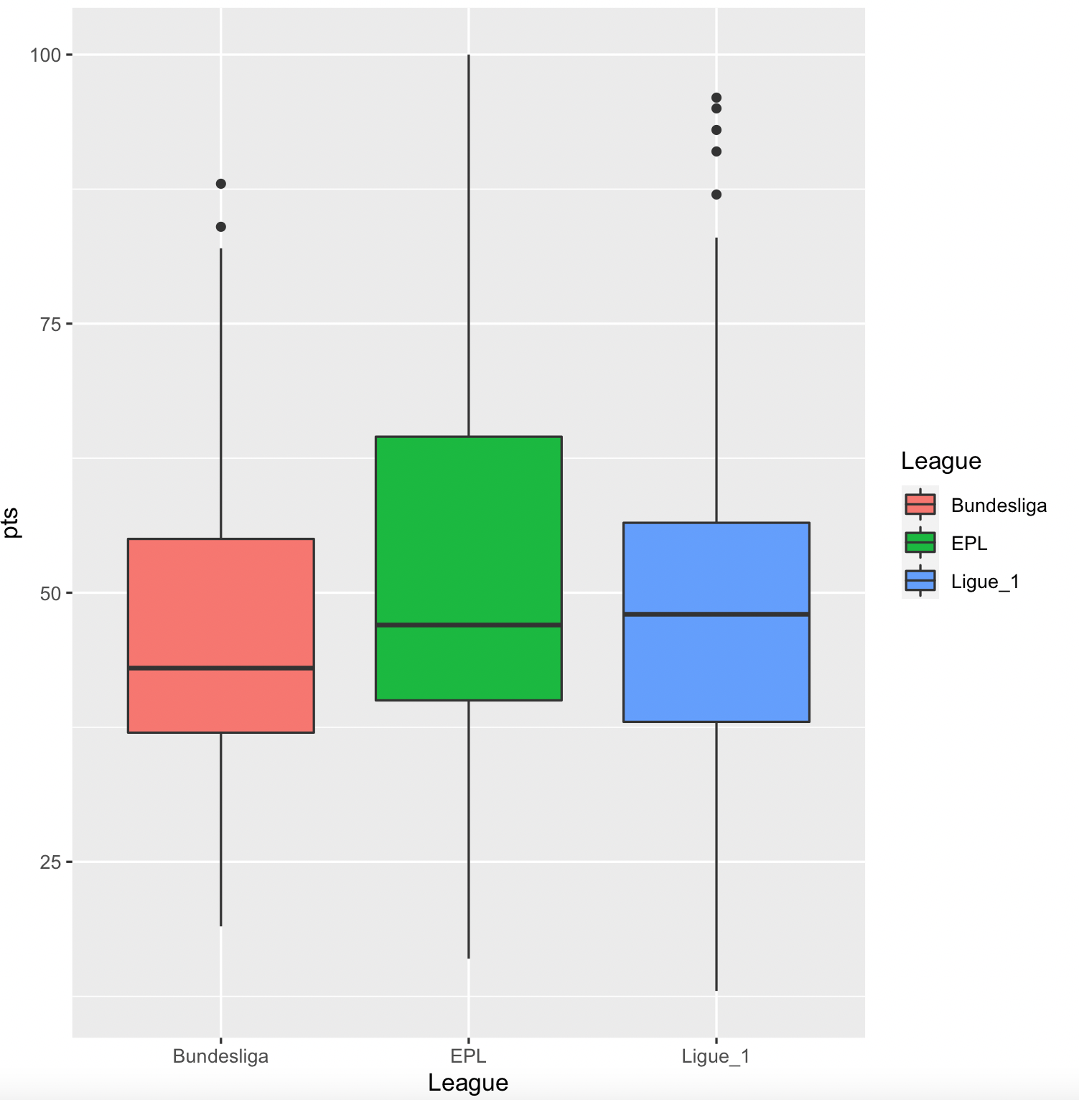
We were able see league competitive differences through comparison
Downloaded csv file that included season data for top flight leagues from understat.com
Any team in top flight league over last 6 years included
Full league data over the inspected years indicate a slight competitive advantage towards the Premier League

Slide 4
We were able to effectively model teams’ expected season outcomes
Built a model for one team in each league that placed in the top 5 of each year in the data we looked to predict wins
Found the most important variables were goals scored, expected points, expected goals, and expected points difference in every league
Then built a model for expected points in a season that output a team’s results with 83% accuracy.

Slide 5
Champions League data did not help with any findings
Scraped Champions league data from RBref.com
Looked at all statistics for a team in a champions league season over last 7 seasons
Champions league data was not extensive enough. It did not contribute any significant impact to our modeling
Champions league variables had no impact and were eventually pulled from models
Not enough data points due to the team revolving aspect of the competition

Slide 6
Ways to further improve the model going forward
Currently not enough data with top league teams in champions league
Would need to go further back in history to build up data
Try to predict champions league performance based on variables such as league, expected goals, and expected goals against
Explore correlation and interaction between variables for season statistics to build a more accurate model
Would like to look at an individual player’s statistics and integrate all the individuals on one team into the model’s predictions

Slide 7
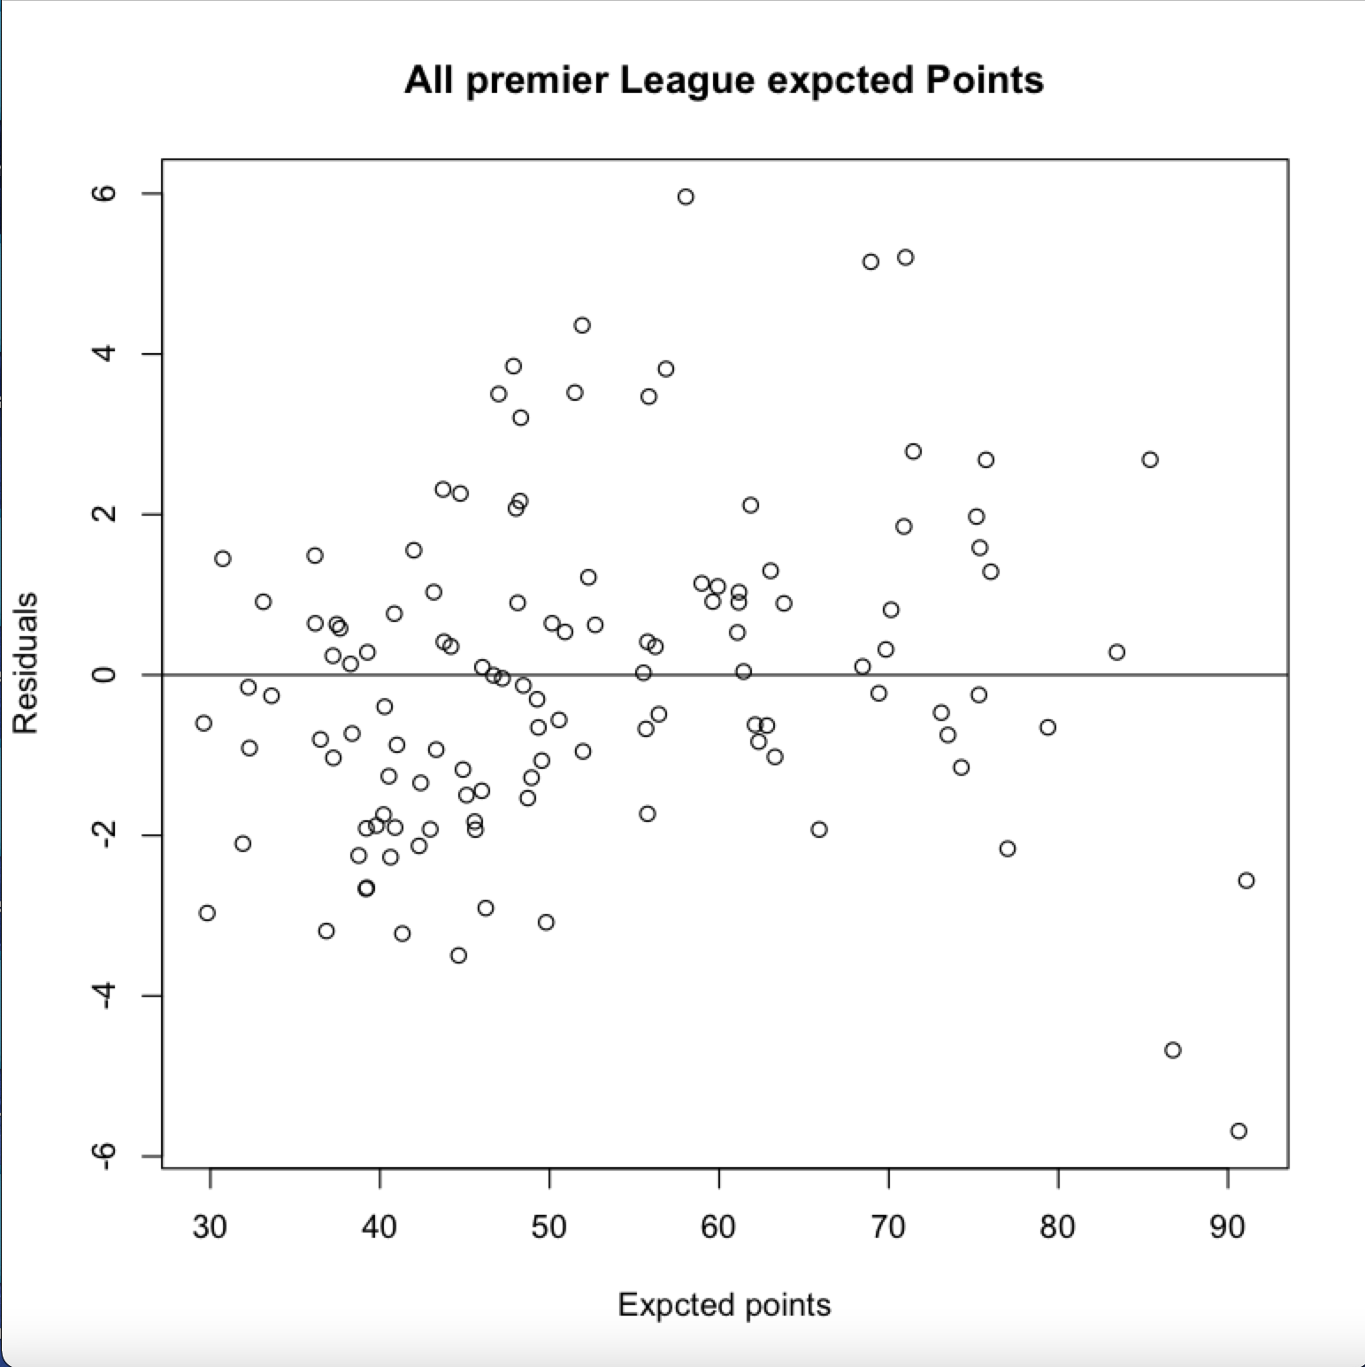
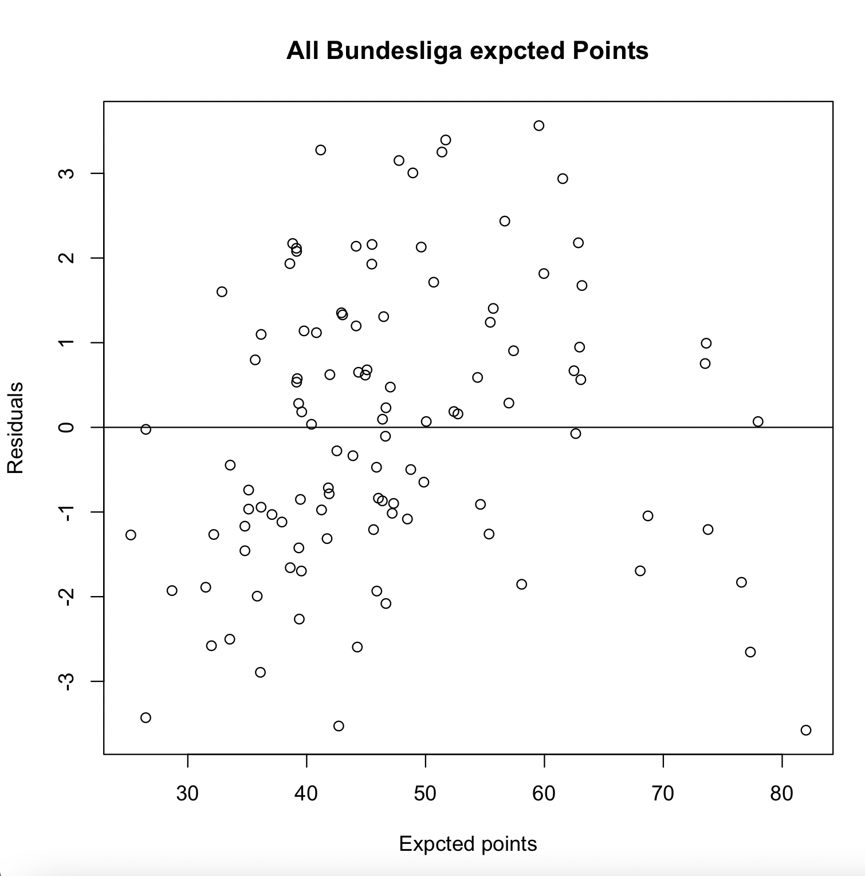
Appendix - full league expected point plots

Slide 8
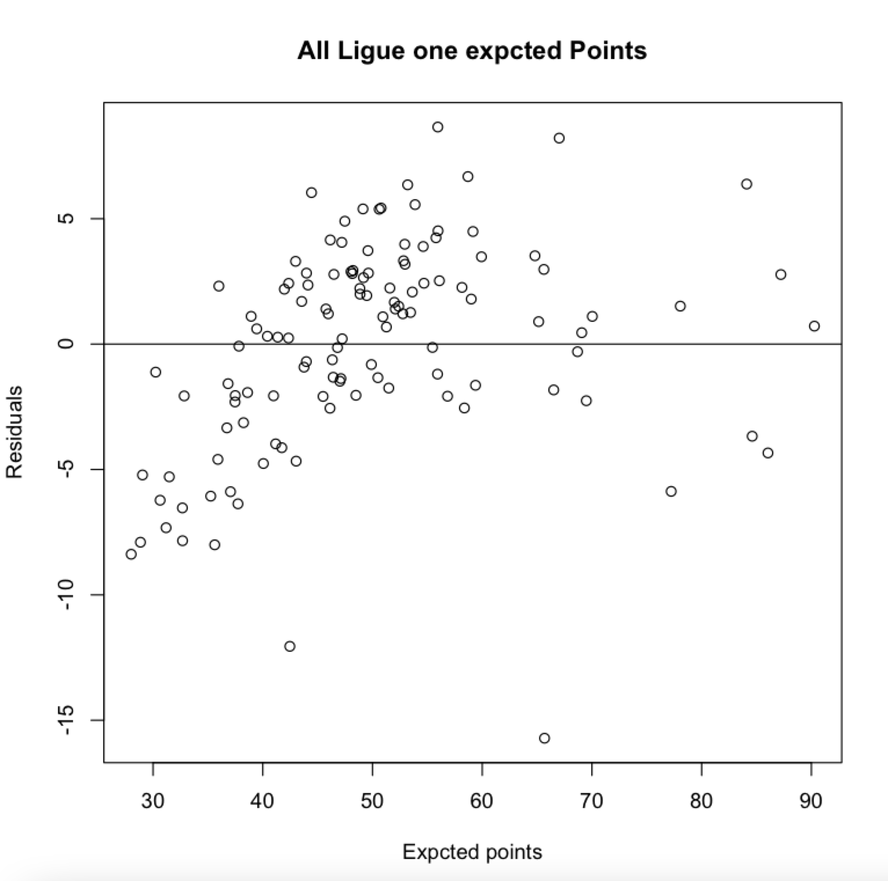
Full league Expected points continued

Slide 9
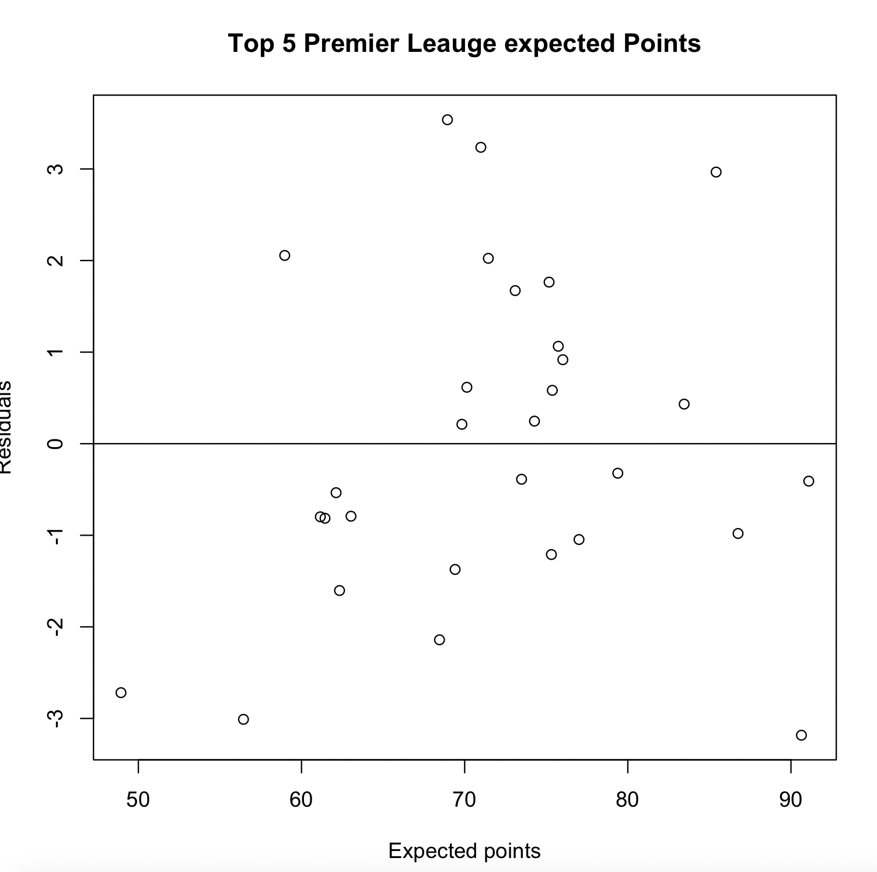
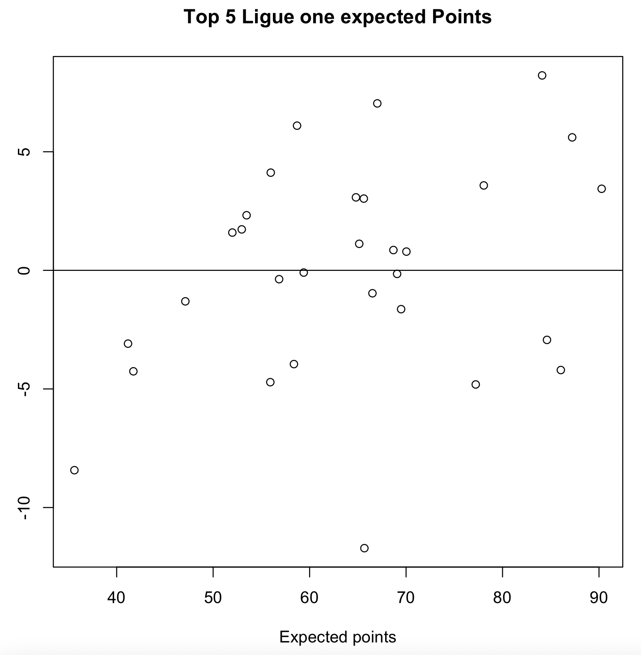
League top 5 expected points

Slide 10
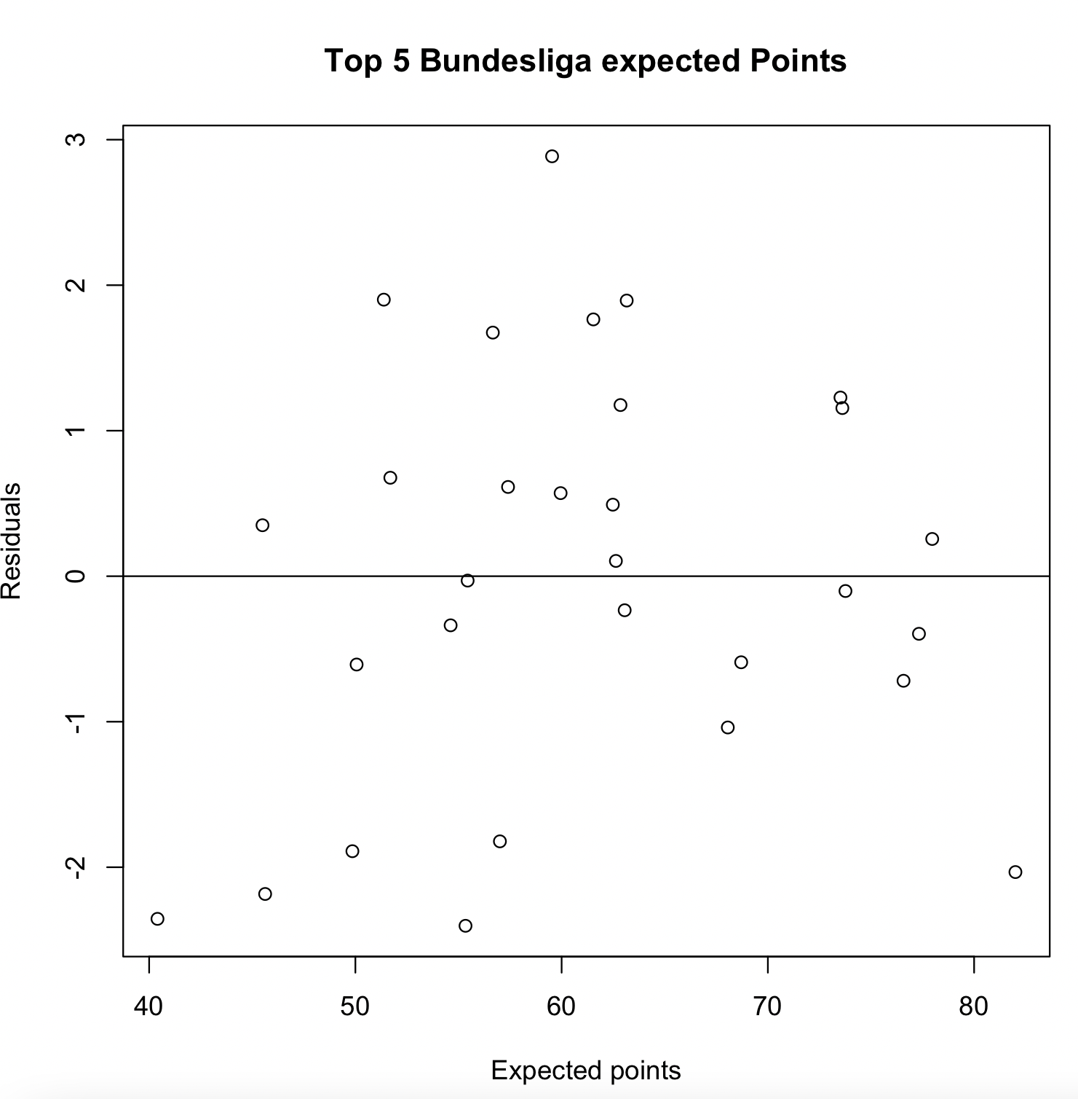
League top 5 continued

Slide 11
League comparison points

