Slide 1
Database System Concepts Overview

Slide 2
考试覆盖内容
Ch1 Introduction
Ch2 Introduction to the Relational Model
Ch3 Introduction to SQL
Ch4 Intermediate SQL
Ch5 Advanced SQL
Ch7 Entity-Relationship Model
Ch8 Relational Database Design
Ch11 Indexing and Hashing
Ch14 Transactions
Ch15 Concurrency Control
Ch16 Recovery System

Slide 3
Ch1: Key Points
Data models and databases
Database Design
Database Engine
Storage Manager
Query Processing
Transaction Manager
Database Architecture
考察基本概念

Slide 4
Data Models
Levels of Abstraction
Physical level: describes how a record (e.g., instructor) is stored.
Logical level: describes data stored in database, and the relationships among the data.
type instructor = record
ID : string; name : string; dept_name : string; salary : integer;
end;
View level: application programs hide details of data types. Views can also hide information (such as an employee’s salary) for security purposes.

Slide 5
DBMS Architecture
成绩单
学号：xxxxx | 姓名：xxx | 性别：x
离散数据 |  | 75
数据库系统 |  | 81
…… |  | ……
外模式（External Schema，也称子模式或用户模式）
——数据库用户使用的局部数据的逻辑结构和特征的描述
模式（Logical Schema, Schema，也称逻辑模式）
——数据库中全体数据的逻辑结构和特征（型）的描述
Sno | Sname | Ssex | Sage | Sdept
Cno | Cname | Cpno | Ccredit
Sno | Cno | Grade
内模式（Physical Schema，也称存储模式）
——数据物理结构和存储方式的描述

Slide 6
Data Models
Data Model
A collection of tools for describing
Data
Data relationships
Data semantics
Data constraints
Relational model
Entity-Relationship data model (mainly for database design)
Object-based data models (Object-oriented and Object-relational)
……

Slide 7
Ch2: Key Points
Fundamental Relational-Algebra Operations
select(选择): σ
project(投影): π
union(并): ∪
set difference(集合差): –
Cartesian product(笛卡尔积): ×
rename: ρ
Additional Relational-Algebra Operations
Set intersection(集合交)
Natural join(自然连接)
Division(除法)

Slide 8
Structure of Relational Database
Keys(键/码)
Let K ⊆ R
K is a superkey of R if values for K are sufficient to identify a unique tuple of each possible relation r(R)
Example: {ID} and {ID,name} are both superkeys of instructor.
Superkey K is a candidate key if K is minimal Example: {ID} is a candidate key for Instructor
One of the candidate keys is selected to be the primary key.
which one?
Foreign key constraint: Value in one relation must appear in another
Referencing relation
Referenced relation
Example – dept_name in instructor is a foreign key from instructor referencing department

Slide 9
Relational-Algebra Operations
Select Operation
Notation: σ _{p}(r)
p is called the selection predicate
Defined as: σ_{p}(r) = {t | t ∈ r and p(t)}
Where p is a formula in propositional calculus consisting of terms connected by : ∧ (and), ∨ (or), ¬ (not) Each term is one of:
<attribute> op <attribute> or <constant>
where op is one of: =, ≠, >, ≥. <. ≤
Example of selection: σ _{dept_name=“Physics”}(instructor)

Slide 10
Relational-Algebra Operations
Project Operation
Notation:
where A₁, A₂ are attribute names and r is a relation name.
The result is defined as the relation of k columns obtained by erasing the columns that are not listed
Duplicate rows removed from result, since relations are sets
Example: To eliminate the dept_name attribute of instructor ∏_{ID, name, salary} (instructor)

Slide 11
Relational-Algebra Operations
Union Operation
Notation: r ∪ s
Defined as:
r ∪ s = {t | t ∈ r or t ∈ s}
For r ∪ s to be valid.
1. r, s must have the same arity (same number of attributes)
2. The attribute domains must be compatible (example: 2nd column of r deals with the same type of values as does the 2nd column of s)
Example: to find all courses taught in the Fall 2009 semester, or in the Spring 2010 semester, or in both ∏_{course_id} (σ _{semester=“Fall” Λ year=2009} (section)) ∪ ∏_{course_id} (σ _{semester=“Spring” Λ year=2010} (section))

Slide 12
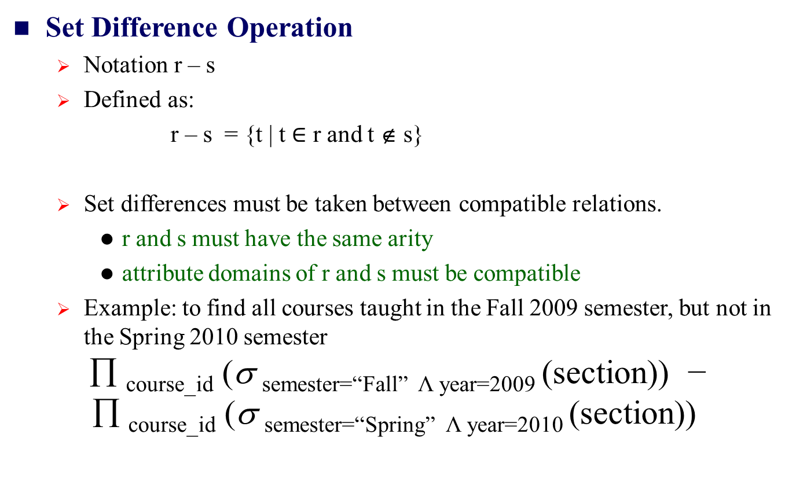
Relational-Algebra Operations
Set Difference Operation
Notation r – s
Defined as:
r – s = {t | t $∈$ r and t ∉ s}
Set differences must be taken between compatible relations.
r and s must have the same arity
attribute domains of r and s must be compatible
Example: to find all courses taught in the Fall 2009 semester, but not in the Spring 2010 semester ∏ _{course_id} (σ _{semester=“Fall” Λ year=2009} (section)) − ∏ _{course_id} (σ _{semester=“Spring” Λ year=2010} (section))

Slide 13
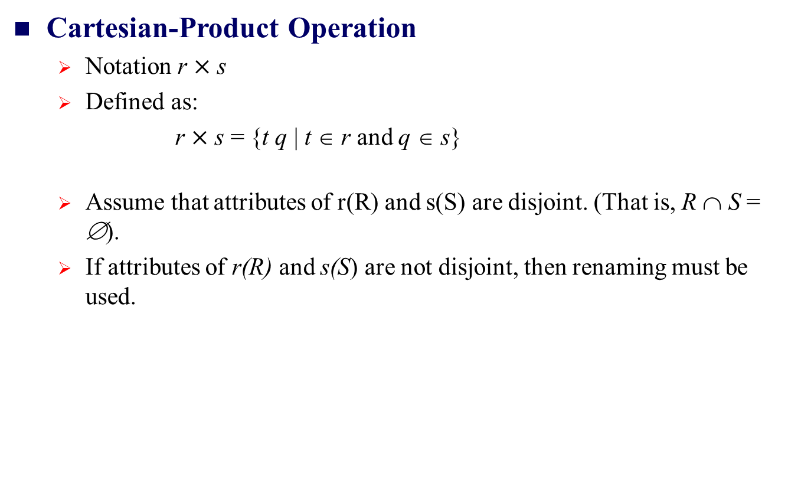
Relational-Algebra Operations
Cartesian-Product Operation
Notation r $×$ s
Defined as:
r $×$ s = {t q | t ∈ r and q ∈ s}
Assume that attributes of r(R) and s(S) are disjoint. (That is, R ∩ S = ∅).
If attributes of r(R) and s(S) are not disjoint, then renaming must be used.

Slide 14
Relational-Algebra Operations
Rename Operation
Allows us to name, and therefore to refer to, the results of relational-algebra expressions.
Allows us to refer to a relation by more than one name.
Example:
ρ _{x} (E)
returns the expression E under the name X
If a relational-algebra expression E has arity n, then
returns the result of expression E under the name X, and with the
attributes renamed to A₁ , A₂ , …., A_{n} .

Slide 15
Additional Operations
Intersection Operation(交操作)
Notation: r ∩ s
Assume:
r, s have the same degree
attributes of r and s are compatible
Defined as:
r ∩ s ={ t | t ∈ r ∧ t ∈ s }
Note: r ∩ s = r - (r - s)
Find the names of all customers who have a loan and an account at bank.
π_{customer_name} (borrower ) ∩ π_{customer_name} (depositor )

Slide 16
Additional Operations
Join operations take two relations and return as a result another relation.
A join operation is a Cartesian product which requires that tuples in the two relations match (under some condition). It also specifies the attributes that are present in the result of the join
The join operations are typically used as subquery expressions in the from clause

Slide 17
Additional Operations
Outer Join
An extension of the join operation that avoids loss of information.
Computes the join and then adds tuples form one relation that does not match tuples in the other relation to the result of the join.
Uses null values.

Slide 18
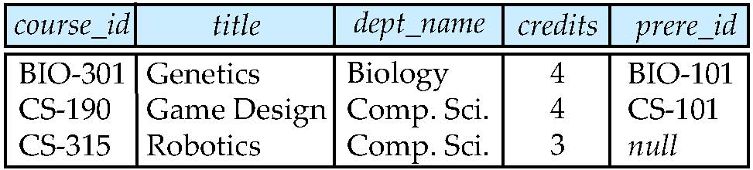
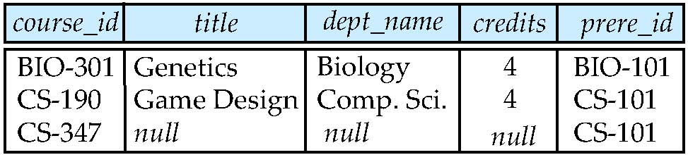
Additional Operations
Left Outer Join
course natural left outer join prereq
course natural right outer join prereq

Slide 19
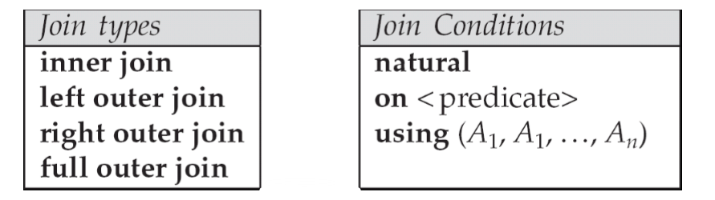
Additional Operations
Joined Relations
Join operations take two relations and return as a result another relation.
These additional operations are typically used as subquery expressions in the from clause
Join condition – defines which tuples in the two relations match, and what attributes are present in the result of the join.
Join type – defines how tuples in each relation that do not match any tuple in the other relation (based on the join condition) are treated.

Slide 20
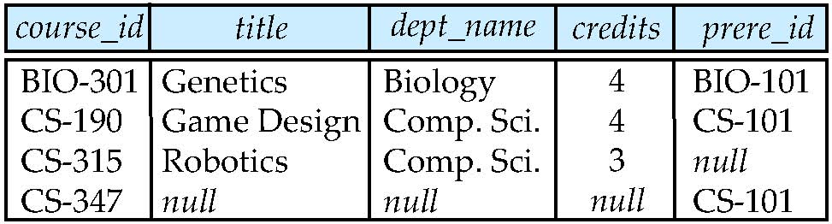
Additional Operations
Full Outer Join
course natural full outer join prereq

Slide 21
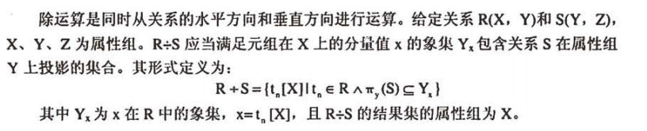
Additional Operations
Division Operation(除)
Suited to queries that include the phrase “for all”.
Let r and s be relations on schemas R and S respectively where
R = (A₁, …, A_{m}, B₁, …, B_{n})
S = (B₁, …, B_{n})
The result of r ÷ s is a relation on schema
R ÷ S = (A₁, …, A_{m})
Defined as:
r ÷ s = { t | t ∈ π _{R-S}(r) ∧ ∀ u ∈ s → tu ∈ r ) }

Slide 22
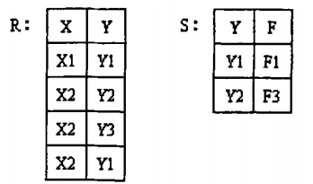
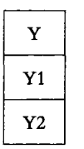
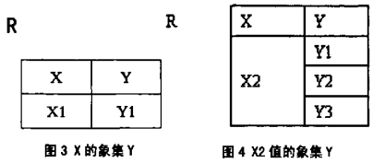
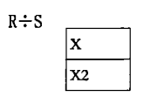
Additional Operations
Division Operation(除)
1：找出关系R和关系S中相同的属性，即Y属性。在关系S中对Y做投影（即将Y列取出）
2：被除关系R中与S中不相同的属性列是X ，关系R在属性（X）上做取消重复值的投影为{X1，X2}；
3：求关系R中X属性对应的像集Y
4：判断包含关系 。
R÷S其实就是判断关系R中X各个值的像集Y是否包含关系S中属性Y的所有值。对比即可发现： X1的像集只有Y1，不能包含关系S中属性Y的所有值，所以排除掉X1； 而X2的像集包含了关系S中属性Y的所有值，所以R÷S的最终结果就是X2

Slide 23
Ch3: Key Points
Basic Query Structure
Null Values
Aggregate Functions
Nested Subqueries

Slide 24
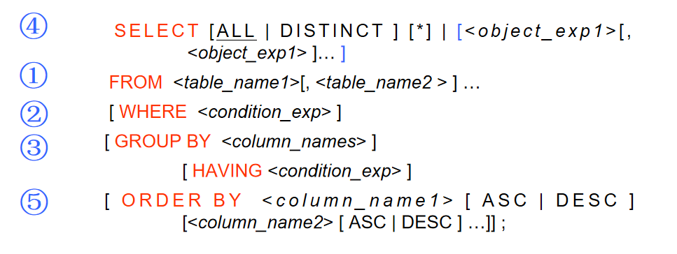
Basic Query Structure
Executing Orders of Query Clauses

Slide 25
NULL Values
Null Values and Three Valued Logic
Three values – true, false, unknown
Any comparison with null returns unknown
Example: 5 < null or null <> null or null = null
Three-valued logic using the value unknown:
OR: (unknown or true) = true, (unknown or false) = unknown (unknown or unknown) = unknown
AND: (true and unknown) = unknown, (false and unknown) = false, (unknown and unknown) = unknown
NOT: (not unknown) = unknown
“P is unknown” evaluates to true if predicate P evaluates to unknown
Result of where clause predicate is treated as false if it evaluates to unknown

Slide 26
Aggregate Functions
These functions operate on the multiset of values of a column of a relation, and return a value
avg: average value
min: minimum value
max: maximum value
sum: sum of values
count: number of values

Slide 27
Nested Subqueries
SQL provides a mechanism for the nesting of subqueries. A subquery is a select-from-where expression that is nested within another query.
The nesting can be done in the following SQL query select A₁, A₂, ..., A_{n} from r₁, r₂, ..., r_{m} where P as follows:
A_{i} can be replaced be a subquery that generates a single value.
r_{i} can be replaced by any valid subquery
P can be replaced with an expression of the form:
B <operation> (subquery)
Where B is an attribute and <operation> to be defined later.

Slide 28
Nested Subqueries
Subqueries in the Where Clause
A common use of subqueries is to perform tests:
For set membership
For set comparisons
For set cardinality.

Slide 29
Ch4: Key Points
Views
Integrity Constraints

Slide 30
Views
A view is defined using the create view statement which has the form
create view v as < query expression >
where <query expression> is any legal SQL expression. The view name is represented by v.
Once a view is defined, the view name can be used to refer to the virtual relation that the view generates.
View definition is not the same as creating a new relation by evaluating the query expression
Rather, a view definition causes the saving of an expression; the expression is substituted into queries using the view.

Slide 31
Integrity Constraints
Integrity Constraints on a Single Relation
not null
primary key
unique
check (P), where P is a predicate

Slide 32
Ch5: Key Points
Accessing SQL From a Programming Language
Functions and Procedural Constructs
Triggers

Slide 33
Functions and Procedural Constructs
Define a function that, given the name of a department, returns the count of the number of instructors in that department.
create function dept_count (dept_name varchar(20)) returns integer begin declare d_count integer; select count (* ) into d_count from instructor where instructor.dept_name = dept_name return d_count; end
The function dept_count can be used to find the department names and budget of all departments with more that 12 instructors.
select dept_name, budget from department where dept_count (dept_name ) > 12

Slide 34
Triggers
Triggering event can be insert, delete or update
Triggers on update can be restricted to specific attributes
For example, after update of takes on grade
Values of attributes before and after an update can be referenced
referencing old row as : for deletes and updates
referencing new row as : for inserts and updates
Triggers can be activated before an event, which can serve as extra constraints. For example, convert blank grades to null.
create trigger setnull_trigger before update of takes referencing new row as nrow for each row when (nrow.grade = ‘ ‘) begin atomic set nrow.grade = null; end;

Slide 35
Triggers
When Not To Use Triggers
Triggers were used earlier for tasks such as
Maintaining summary data (e.g., total salary of each department)
Replicating databases by recording changes to special relations (called change or delta relations) and having a separate process that applies the changes over to a replica
There are better ways of doing these now:
Databases today provide built in materialized view facilities to maintain summary data
Databases provide built-in support for replication
Encapsulation facilities can be used instead of triggers in many cases
Define methods to update fields
Carry out actions as part of the update methods instead of through a trigger

Slide 36
Triggers
When Not To Use Triggers
Risk of unintended execution of triggers, for example, when
Loading data from a backup copy
Replicating updates at a remote site
Trigger execution can be disabled before such actions.
Other risks with triggers:
Error leading to failure of critical transactions that set off the trigger
Cascading execution

Slide 37
Ch7: Key Points
Design Process
Modeling - E-R Diagram

Slide 38
Design Process
Design Approaches
Entity Relationship Model (covered in this chapter)
Models an enterprise as a collection of entities and relationships
Entity: a “thing” or “object” in the enterprise that is distinguishable from other objects
Described by a set of attributes
Relationship: an association among several entities
Represented diagrammatically by an entity-relationship diagram:
Normalization Theory (Chapter 8)
Formalize what designs are bad, and test for them

Slide 39
Modeling
The ER data mode was developed to facilitate database design by allowing specification of an enterprise schema that represents the overall logical structure of a database.
The ER model is very useful in mapping the meanings and interactions of real-world enterprises onto a conceptual schema. Because of this usefulness, many database-design tools draw on concepts from the ER model.
The ER data model employs three basic concepts:
entity sets,
relationship sets,
attributes.
The ER model also has an associated diagrammatic representation, the ER diagram, which can express the overall logical structure of a database graphically.

Slide 40
Modeling
Entity Sets
An entity is an object that exists and is distinguishable from other objects.
Example: specific person, company, event, plant
An entity set is a set of entities of the same type that share the same properties.
Example: set of all persons, companies, trees, holidays
An entity is represented by a set of attributes; i.e., descriptive properties possessed by all members of an entity set.
Example:
instructor = (ID, name, street, city, salary ) course= (course_id, title, credits)
A subset of the attributes form a primary key of the entity set; i.e., uniquely identifiying each member of the set.

Slide 41
Modeling
Relationship Sets
A relationship is an association among several entities
Example: 44553 (Peltier) advisor 22222 (Einstein) student entity relationship set instructor entity
A relationship set is a mathematical relation among n ≥ 2 entities, each taken from entity sets
{(e₁, e₂, … e_{n}) | e₁ ∈ E₁, e₂ ∈ E₂, …, e_{n} ∈ E_{n}} where (e₁, e₂, …, e_{n}) is a relationship
Example:
(44553,22222) ∈ advisor

Slide 42
Modeling
Degree of a Relationship Set
binary relationship
involve two entity sets (or degree two).
most relationship sets in a database system are binary.
Relationships between more than two entity sets are rare. Most relationships are binary. (More on this later.)
Example: students work on research projects under the guidance of an instructor.
relationship proj_guide is a ternary relationship between instructor, student, and project

Slide 43
Modeling
Mapping Cardinality Constraints
Express the number of entities to which another entity can be associated via a relationship set.
Most useful in describing binary relationship sets.
For a binary relationship set the mapping cardinality must be one of the following types:
One to one
One to many
Many to one
Many to many

Slide 44
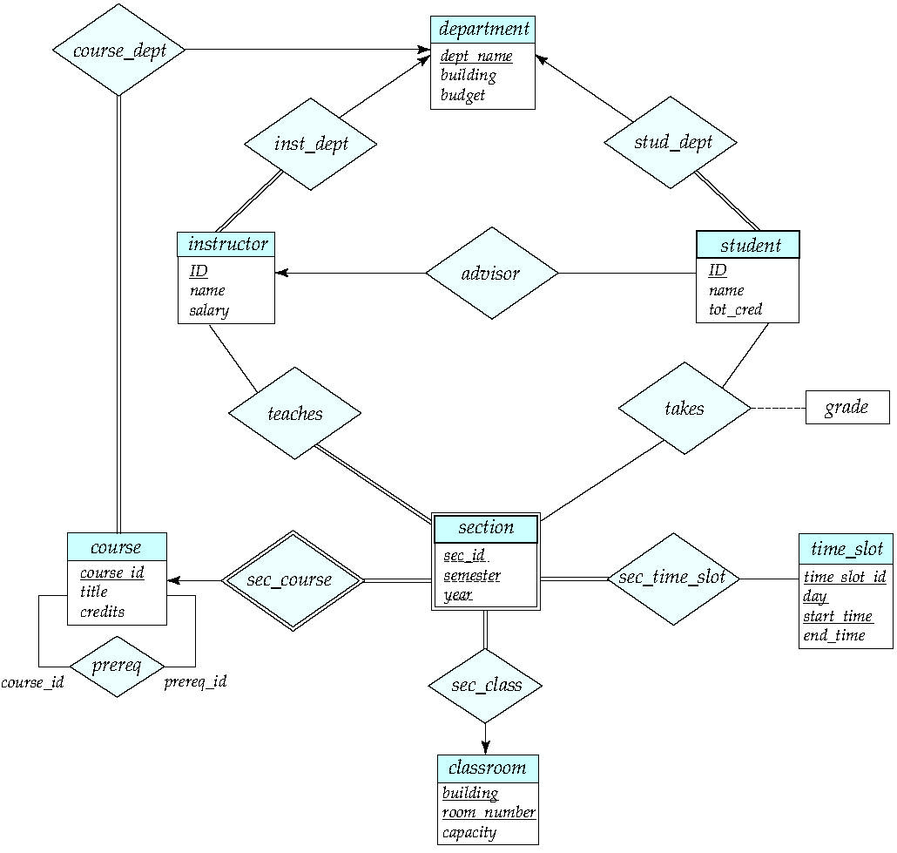
E-R Diagram
E-R Diagram for a University Enterprise

Slide 45
Ch8: Key Points
Normal Form：1NF、2NF、3NF、BCNF
Functional Dependency Theory

Slide 46
Features of Good Relational Design
What About Smaller Schemas?
Suppose we had started with inst_dept. How would we know to split up (decompose) it into instructor and department?
Write a rule “if there were a schema (dept_name, building, budget), then dept_name would be a candidate key”
Denote as a functional dependency:
dept_name → building, budget
In inst_dept, because dept_name is not a candidate key, the building and budget of a department may have to be repeated.
This indicates the need to decompose inst_dept
Not all decompositions are good. Suppose we decompose employee(ID, name, street, city, salary) into
employee1 (ID, name)
employee2 (name, street, city, salary)
The next slide shows how we lose information -- we cannot reconstruct the original employee relation -- and so, this is a lossy decomposition.

Slide 47
Atomic Domains and First Normal Form
Domain is atomic if its elements are considered to be indivisible units
Examples of non-atomic domains:
Set of names, composite attributes
Identification numbers like CS101 that can be broken up into parts.
A relational schema R is in first normal form if the domains of all attributes of R are atomic
Non-atomic values complicate storage and encourage redundant (repeated) storage of data
Example: Set of accounts stored with each customer, and set of owners stored with each account
We assume all relations are in first normal form.

Slide 48
Atomic Domains and First Normal Form
Goal — Devise a Theory for the Following.
Decide whether a particular relation R is in “good” form.
In the case that a relation R is not in “good” form, decompose it into a set of relations {R₁, R₂, ..., R_{n}} such that
each relation is in good form
the decomposition is a lossless-join decomposition
Our theory is based on:
functional dependencies
multivalued dependencies

Slide 49
Functional Dependency Theory
Let R be a relation schema
α ⊆ R and β ⊆ R
The functional dependency
α → β holds on R if and only if for any legal relations r(R), whenever any two tuples t₁ and t₂ of r agree on the attributes α, they also agree on the attributes β. That is,
t₁[α] = t₂ [α] ⇒ t₁[β ] = t₂ [β ]
Example: Consider r(A,B ) with the following instance of r.
On this instance, A → B does NOT hold, but B → A does hold.
4
1 5
3 7

Slide 50
Functional Dependency Theory
A functional dependency is trivial（平凡） if it is satisfied by all instances of a relation
Example:
ID, name → ID
name → name
In general, α → β is trivial if β ⊆ α

Slide 51
Functional Dependency Theory
Closure of a Set of Functional Dependencies
Given a set F of functional dependencies, there are certain other functional dependencies that are logically implied by F.
For example: If A → B and B → C, then we can infer that A → C
The set of all functional dependencies logically implied by F is the closure of F.
We denote the closure of F by F⁺.
F⁺ is a superset（超集） of F.

Slide 52
Functional Dependency Theory
Boyce-Codd Normal Form
A relation schema R is in BCNF with respect to a set F of functional dependencies if for all functional dependencies in F⁺ of the form
α → β
where α ⊆ R and β ⊆ R, at least one of the following holds:
α→β is trivial (i.e., β ⊆ α)
α is a superkey for R
Example schema not in BCNF:
instr_dept (ID, name, salary, dept_name, building, budget )
because dept_name→ building, budget
holds on instr_dept, but dept_name is not a superkey

Slide 53
Functional Dependency Theory
Decomposing a Schema into BCNF
Suppose we have a schema R and a non-trivial dependency α →β causes a violation of BCNF.
We decompose R into:
(α U β )
( R - ( β - α ) )
In our example,
α = dept_name
β = building, budget
and inst_dept is replaced by
(α U β ) = ( dept_name, building, budget )
( R - ( β - α ) ) = ( ID, name, salary, dept_name )

Slide 54
Functional Dependency Theory
A relation schema R is in third normal form (3NF) if for all:
α → β in F⁺ at least one of the following holds:
α → β is trivial (i.e., β ∈ α)
α is a superkey for R
Each attribute A in β – α is contained in a candidate key for R.
(NOTE: each attribute may be in a different candidate key)
If a relation is in BCNF it is in 3NF (since in BCNF one of the first two conditions above must hold).
Third condition is a minimal relaxation of BCNF to ensure dependency preservation (will see why later).

Slide 55
Functional Dependency Theory
Closure of Attribute Sets
Given a set of attributes α, define the closure of α under F (denoted by α⁺) as the set of attributes that are functionally determined by α under F
Algorithm to compute α⁺, the closure of α under F
result := α; while (changes to result) do for each β → γ in F do begin if β ⊆ result then result := result ∪ γ end

Slide 56
Functional Dependency Theory
Example of Attribute Set Closure
R = (A, B, C, G, H, I)
F = {A → B, A → C, CG → H, CG → I, B → H}
(AG)⁺
1. result = AG
2. result = ABCG (A → C and A → B)
3. result = ABCGH (CG → H and CG ⊆ AGBC)
4. result = ABCGHI (CG → I and CG ⊆ AGBCH)
Is AG a candidate key?
Is AG a super key?
Does AG → R? == Is (AG)⁺ ⊇ R
Is any subset of AG a superkey?
Does A → R? == Is (A)⁺ ⊇ R
Does G → R? == Is (G)⁺ ⊇ R

Slide 57
Functional Dependency Theory
Uses of Attribute Closure
There are several uses of the attribute closure algorithm:
Testing for superkey:
To test if α is a superkey, we compute α^{+,} and check if α⁺ contains all attributes of R.
Testing functional dependencies
To check if a functional dependency α → β holds (or, in other words, is in F⁺), just check if β ⊆ α⁺.
That is, we compute α⁺ by using attribute closure, and then check if it contains β.
Is a simple and cheap test, and very useful
Computing closure of F
For each γ ⊆ R, we find the closure γ⁺, and for each S ⊆ γ⁺, we output a functional dependency γ → S.

Slide 58
Functional Dependency Theory
Canonical Cover （正则覆盖）
Sets of functional dependencies may have redundant dependencies that can be inferred from the others
For example: A → C is redundant in: {A → B, B → C, A→ C}
Parts of a functional dependency may be redundant
E.g.: on RHS: {A → B, B → C, A → CD} can be simplified to {A → B, B → C, A → D}
E.g.: on LHS: {A → B, B → C, AC → D} can be simplified to {A → B, B → C, A → D}
Intuitively, a canonical cover of F is a “minimal” set of functional dependencies equivalent to F, having no redundant dependencies or redundant parts of dependencies

Slide 59
Functional Dependency Theory
R = (A, B, C) F = {A → BC, B → C, A → B, AB → C}
Combine A → BC and A → B into A → BC
Set is now {A → BC, B → C, AB → C}
A is extraneous in AB → C
Check if the result of deleting A from AB → C is implied by the other dependencies
Yes: in fact, B → C is already present!
Set is now {A → BC, B → C}
C is extraneous in A → BC
Check if A → C is logically implied by A → B and the other dependencies
Yes: using transitivity on A → B and B → C.
Can use attribute closure of A in more complex cases
The canonical cover is: A → B B → C

Slide 60
Functional Dependency Theory
Lossless-join Decomposition
For the case of R = (R₁, R₂), we require that for all possible relations r on schema R
r = ∏_{R1} (r ) ∏_{R2} (r )
A decomposition of R into R₁ and R₂ is lossless join if at least one of the following dependencies is in F⁺:
R₁ ∩ R₂ → R₁
R₁ ∩ R₂ → R₂
The above functional dependencies are a sufficient condition for lossless join decomposition; the dependencies are a necessary condition only if all constraints are functional dependencies

Slide 61
Functional Dependency Theory
Lossless-join Decomposition – Example
R = (A, B, C) F = {A → B, B → C)
Can be decomposed in two different ways
R₁ = (A, B), R₂ = (B, C)
Lossless-join decomposition:
R₁ ∩ R₂ = {B} and B → BC
Dependency preserving
R₁ = (A, B), R₂ = (A, C)
Lossless-join decomposition:
R₁ ∩ R₂ = {A} and A → AB
Not dependency preserving (cannot check B → C without computing R₁ R₂)

Slide 62
Functional Dependency Theory
Third Normal Form: Motivation
There are some situations where
BCNF is not dependency preserving, and
efficient checking for FD violation on updates is important
Solution: define a weaker normal form, called Third Normal Form (3NF)
Allows some redundancy (with resultant problems; we will see examples later)
But functional dependencies can be checked on individual relations without computing a join.
There is always a lossless-join, dependency-preserving decomposition into 3NF.

Slide 63
Functional Dependency Theory
Comparison of BCNF and 3NF
It is always possible to decompose a relation into a set of relations that are in 3NF such that:
the decomposition is lossless
the dependencies are preserved
It is always possible to decompose a relation into a set of relations that are in BCNF such that:
the decomposition is lossless
it may not be possible to preserve dependencies.

Slide 64
Functional Dependency Theory
Design Goals
Goal for a relational database design is:
BCNF.
Lossless join.
Dependency preservation.
If we cannot achieve this, we accept one of
Lack of dependency preservation
Redundancy due to use of 3NF
Interestingly, SQL does not provide a direct way of specifying functional dependencies other than superkeys.
Can specify FDs using assertions, but they are expensive to test, (and currently not supported by any of the widely used databases!)
Even if we had a dependency preserving decomposition, using SQL we would not be able to efficiently test a functional dependency whose left hand side is not a key.

Slide 65
Ch11: Key Points
Basic Concepts
B+-Tree Index Files

Slide 66

Basic Concepts
Indexing mechanisms used to speed up access to desired data.
E.g., author catalog in library
Search Key - attribute to set of attributes used to look up records in a file.
An index file consists of records (called index entries) of the form
Index files are typically much smaller than the original file
Two basic kinds of indices:
Ordered indices: search keys are stored in sorted order
Hash indices: search keys are distributed uniformly across “buckets” using a “hash function”.

Slide 67
Basic Concepts
Index Evaluation Metrics
Access types supported efficiently. E.g.,
records with a specified value in the attribute
or records with an attribute value falling in a specified range of values.
Access time
Insertion time
Deletion time
Space overhead

Slide 68
Ordered Indices
In an ordered index, index entries are stored sorted on the search key value. E.g., author catalog in library.
Primary index: in a sequentially ordered file, the index whose search key specifies the sequential order of the file.
Also called clustering index
The search key of a primary index is usually but not necessarily the primary key.
Secondary index: an index whose search key specifies an order different from the sequential order of the file. Also called non-clustering index.
Index-sequential file: ordered sequential file with a primary index.

Slide 69
B+-Tree Index Files
B+-tree indices are an alternative to indexed-sequential files.
Disadvantage of indexed-sequential files
performance degrades as file grows, since many overflow blocks get created.
Periodic reorganization of entire file is required.
Advantage of B⁺-tree index files:
automatically reorganizes itself with small, local, changes, in the face of insertions and deletions.
Reorganization of entire file is not required to maintain performance.
(Minor) disadvantage of B⁺-trees:
extra insertion and deletion overhead, space overhead.
Advantages of B⁺-trees outweigh disadvantages
B⁺-trees are used extensively

Slide 70
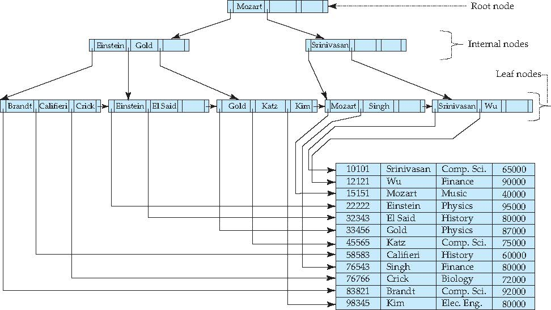
B+-Tree Index Files
Example of B⁺-Tree

Slide 71
B+-Tree Index Files
A B+-tree is a rooted tree satisfying the following properties:
All paths from root to leaf are of the same length
Each node that is not a root or a leaf has between ⎡n/2⎤ and n children.
A leaf node has between ⎡(n–1)/2⎤ and n–1 values
Special cases:
If the root is not a leaf, it has at least 2 children.
If the root is a leaf (that is, there are no other nodes in the tree), it can have between 0 and (n–1) values.

Slide 72
B+-Tree Index Files
A B+-tree is a rooted tree satisfying the following properties:
Typical node
K_{i} are the search-key values
P_{i} are pointers to children (for non-leaf nodes) or pointers to records or buckets of records (for leaf nodes).
The search-keys in a node are ordered
K₁ < K₂ < K₃ < . . . < K_{n–1}
(Initially assume no duplicate keys, address duplicates later)

Slide 73
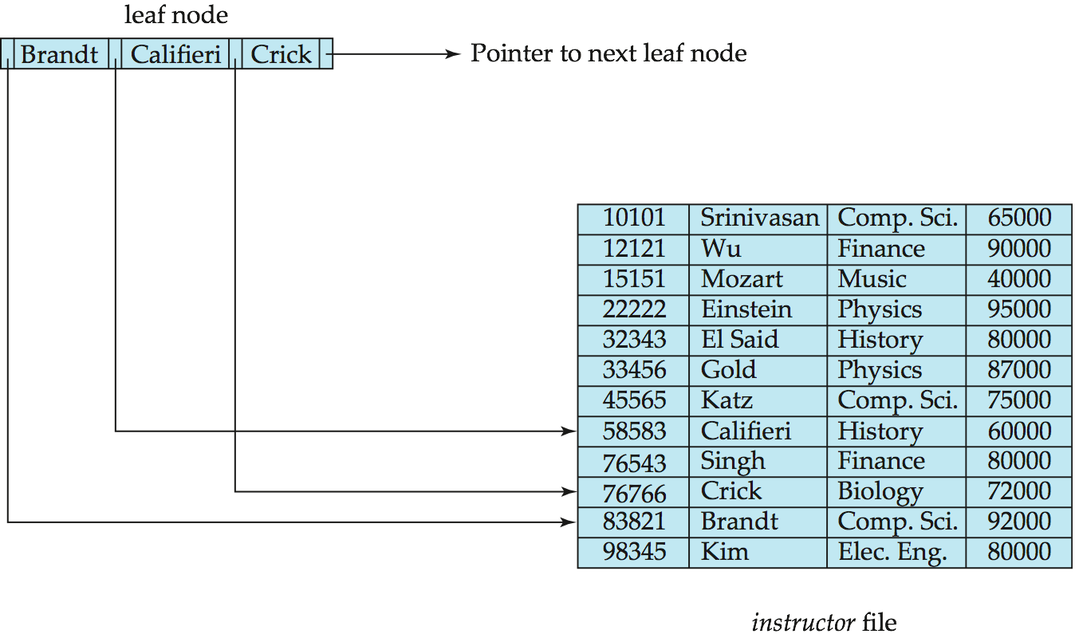
B+-Tree Index Files
Properties of a leaf node:
For i = 1, 2, . . ., n–1, pointer P_{i} points to a file record with search-key value K_{i},
If L_{i}, L_{j} are leaf nodes and i < j, L_{i}’s search-key values are less than or equal to L_{j}’s search-key values
P_{n} points to next leaf node in search-key order

Slide 74
B+-Tree Index Files
Non leaf nodes form a multi-level sparse index on the leaf nodes. For a non-leaf node with m pointers:
All the search-keys in the subtree to which P₁ points are less than K₁
For 2 ≤ i ≤ n – 1, all the search-keys in the subtree to which P_{i} points have values greater than or equal to K_{i–1} and less than K_{i}
All the search-keys in the subtree to which P_{n} points have values greater than or equal to K_{n–1}

Slide 75
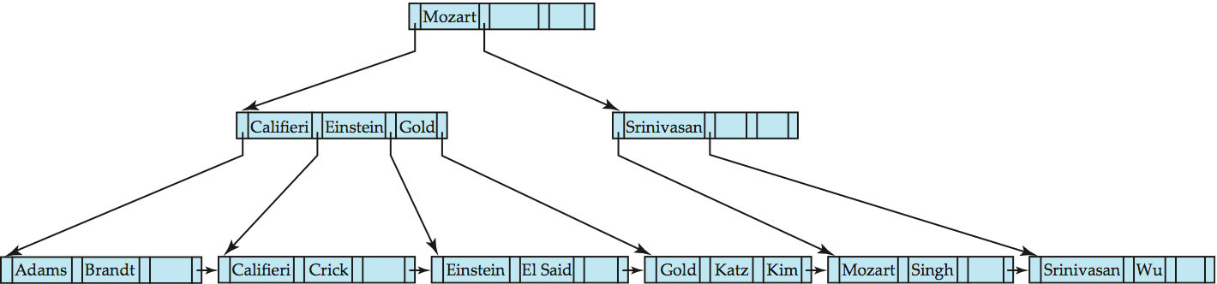
B+-Tree Index Files
Queries on B+-Trees
Find record with search-key value V.
C=root
While C is not a leaf node {
Let i be least value s.t. V ≤ K_{i}.
If no such exists, set C = last non-null pointer in C
Else { if (V= K_{i} ) Set C = P_{i +1} else set C = P_{i}}
}
Let i be least value s.t. K_{i} = V
If there is such a value i, follow pointer P_{i} to the desired record.
Else no record with search-key value k exists.

Slide 76
B+-Tree Index Files
Updates on B+-Trees: Insertion
Find the leaf node in which the search-key value would appear
If the search-key value is already present in the leaf node
Add record to the file
If necessary add a pointer to the bucket.
If the search-key value is not present, then
add the record to the main file (and create a bucket if necessary)
If there is room in the leaf node, insert (key-value, pointer) pair in the leaf node
Otherwise, split the node (along with the new (key-value, pointer) entry) as discussed in the next slide.

Slide 77
Ch4: Key Points
Transaction Concept
Concurrent Executions
Serializability
Recoverability
Implementation of Isolation

Slide 78
Transaction Concept
A transaction is a unit of program execution that accesses and possibly updates various data items.
Can be defined as
A set of SQL statements
Stored procedures
Initiated by high level programming languages (Java, C++ etc.)
Delimited by begin transaction & end transaction
Example:
Begin transaction
x = select salary from person where name = “Gao H…”
update person set salary = x * 10 where name = “Gao H…”
End transaction

Slide 79
ACID Properties
A transaction is a unit of program execution that accesses and possibly updates various data items. To preserve the integrity of data the database system must ensure:
Atomicity. Either all operations of the transaction are properly reflected in the database or none are.
Consistency. Execution of a transaction in isolation preserves the consistency of the database.
Isolation. Although multiple transactions may execute concurrently, each transaction must be unaware of other concurrently executing transactions. Intermediate transaction results must be hidden from other concurrently executed transactions.
That is, for every pair of transactions T_{i} and T_{j}, it appears to T_{i} that either T_{j}, finished execution before T_{i} started, or T_{j} started execution after T_{i} finished.
Durability. After a transaction completes successfully, the changes it has made to the database persist, even if there are system failures.

Slide 80
Concurrent Executions
Multiple transactions are allowed to run concurrently in the system. Advantages are:
Increased processor and disk utilization, leading to better transaction throughput
E.g. one transaction can be using the CPU while another is reading from or writing to the disk
Reduced average response time for transactions: short transactions need not wait behind long ones.
Concurrency control schemes – mechanisms to achieve isolation
That is, to control the interaction among the concurrent transactions in order to prevent them from destroying the consistency of the database
Will study in Chapter 15, after studying notion of correctness of concurrent executions.

Slide 81
Schedules
Schedule – a sequences of instructions that specify the chronological order in which instructions of concurrent transactions are executed
A schedule for a set of transactions must consist of all instructions of those transactions
Must preserve the order in which the instructions appear in each individual transaction.
A transaction that successfully completes its execution will have a commit instructions as the last statement
By default transaction assumed to execute commit instruction as its last step
A transaction that fails to successfully complete its execution will have an abort instruction as the last statement

Slide 82
Serializable schedule – example
Suppose x has $100, y has $200
Consider two operations
x transfer $50 to y
Dividend
For serial schedules
If transfer comes before dividend
X : 100 -> 50 -> 50.5
Y : 200 -> 250 -> 252.5
If dividend comes before transfer
X : 100 -> 101 -> 51
Y : 200 -> 202 -> 252
In both case, X + Y = 303

Slide 83
Serializable schedule – example
What’s going on here?
Interleaving can be very bad.
However, some interleaving does not cause problems.
How can we determine what kind of interleaving is “nice”?

Slide 84
Conflicting Instructions
Let l_{i} and l_{j} be two Instructions of transactions T_{i} and T_{j} respectively. Instructions l_{i} and l_{j} conflict if and only if there exists some item Q accessed by both l_{i} and l_{j}, and at least one of these instructions wrote Q.
1. l_{i} = read(Q), l_{j} = read(Q). l_{i} and l_{j} don’t conflict. 2. l_{i} = read(Q), l_{j} = write(Q). They conflict. 3. l_{i} = write(Q), l_{j} = read(Q). They conflict 4. l_{i} = write(Q), l_{j} = write(Q). They conflict
Intuitively, a conflict between l_{i} and l_{j} forces a (logical) temporal order between them.
If l_{i} and l_{j} are consecutive in a schedule and they do not conflict, their results would remain the same even if they had been interchanged in the schedule.

Slide 85
Conflicting Serializability
If a schedule S can be transformed into a schedule S´ by a series of swaps of non-conflicting instructions, we say that S and S´ are conflict equivalent.
We say that a schedule S is conflict serializable if it is conflict equivalent to a serial schedule

Slide 86
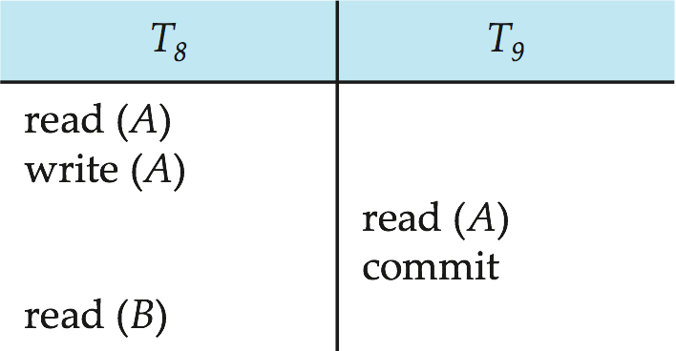
Recoverable Schedules
Recoverable schedule — if a transaction Tj reads a data item previously written by a transaction Ti , then the commit operation of Ti must appear before the commit operation of Tj.
The following schedule is not recoverable if T9 commits immediately after the read(A) operation.
If T8 should abort, T9 would have read (and possibly shown to the user) an inconsistent database state. Hence, database must ensure that schedules are recoverable.

Slide 87
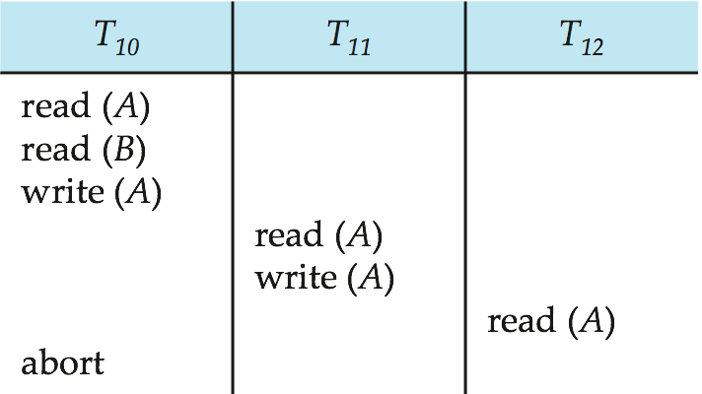
Cascading Rollbacks
Cascading rollback – a single transaction failure leads to a series of transaction rollbacks. Consider the following schedule where none of the transactions has yet committed (so the schedule is recoverable) If T₁₀ fails, T₁₁ and T₁₂ must also be rolled back.
Can lead to the undoing of a significant amount of work

Slide 88
Cascadeless Schedules
Cascadeless schedules — for each pair of transactions T_{i} and T_{j} such that T_{j} reads a data item previously written by T_{i}, the commit operation of T_{i} appears before the read operation of T_{j}.
Every cascadeless schedule is also recoverable
It is desirable to restrict the schedules to those that are cascadeless
Example of a schedule that is NOT cascadeless

Slide 89
Concurrency Control
A database must provide a mechanism that will ensure that all possible schedules are both:
Conflict serializable.
Recoverable and preferably cascadeless
A policy in which only one transaction can execute at a time generates serial schedules, but provides a poor degree of concurrency
Concurrency-control schemes tradeoff between the amount of concurrency they allow and the amount of overhead that they incur
Testing a schedule for serializability after it has executed is a little too late!
Tests for serializability help us understand why a concurrency control protocol is correct
Goal – to develop concurrency control protocols that will assure serializability.

Slide 90
Levels of Consistency in SQL-92
Serializable — default
Repeatable read — only committed records to be read, repeated reads of same record must return same value. However, a transaction may not be serializable – it may find some records inserted by a transaction but not find others.
Read committed — only committed records can be read, but successive reads of record may return different (but committed) values.
Read uncommitted — even uncommitted records may be read.
Lower degrees of consistency useful for gathering approximate information about the database
Warning: some database systems do not ensure serializable schedules by default
E.g., Oracle and PostgreSQL by default support a level of consistency called snapshot isolation (not part of the SQL standard)

Slide 91
Ch15: Key Points
Lock-Based Protocols
Multiversion Schemes

Slide 92
Lock-Based Protocols
A lock is a mechanism to control concurrent access to a data item
Data items can be locked in two modes :
1. exclusive (X) mode. Data item can be both read as well as
written. X-lock is requested using lock-X instruction.
2. shared (S) mode. Data item can only be read. S-lock is
requested using lock-S instruction.
Lock requests are made to the concurrency-control manager by the programmer. Transaction can proceed only after request is granted.

Slide 93
Lock-Based Protocols
Lock-compatibility matrix
A transaction may be granted a lock on an item if the requested lock is compatible with locks already held on the item by other transactions
Any number of transactions can hold shared locks on an item,
But if any transaction holds an exclusive on the item no other transaction may hold any lock on the item.
If a lock cannot be granted, the requesting transaction is made to wait till all incompatible locks held by other transactions have been released. The lock is then granted.

Slide 94
The Two-Phase Locking Protocol
This protocol ensures conflict-serializable schedules.
Phase 1: Growing Phase
Transaction may obtain locks
Transaction may not release locks
Phase 2: Shrinking Phase
Transaction may release locks
Transaction may not obtain locks
The protocol assures serializability. It can be proved that the transactions can be serialized in the order of their lock points (i.e., the point where a transaction acquired its final lock).

Slide 95
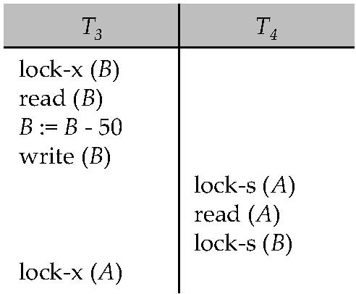
Deadlocks
Consider the partial schedule
Neither T₃ nor T₄ can make progress — executing lock-S(B) causes T₄ to wait for T₃ to release its lock on B, while executing lock-X(A) causes T₃ to wait for T₄ to release its lock on A.
Such a situation is called a deadlock.
To handle a deadlock one of T₃ or T₄ must be rolled back and its locks released.

Slide 96
Deadlocks
The potential for deadlock exists in most locking protocols. Deadlocks are a necessary evil.
When a deadlock occurs there is a possibility of cascading roll-backs.
Cascading roll-back is possible under two-phase locking. To avoid this, follow a modified protocol called strict two-phase locking -- a transaction must hold all its exclusive locks till it commits/aborts.
Rigorous two-phase locking is even stricter. Here, all locks are held till commit/abort. In this protocol transactions can be serialized in the order in which they commit.

Slide 97
Multiversion Schemes
Multiversion schemes keep old versions of data item to increase concurrency.
Multiversion Timestamp Ordering
Multiversion Two-Phase Locking
Each successful write results in the creation of a new version of the data item written.
Use timestamps to label versions.
When a read(Q) operation is issued, select an appropriate version of Q based on the timestamp of the transaction, and return the value of the selected version.
reads never have to wait as an appropriate version is returned immediately.

Slide 98
Multiversion Timestamp Ordering
Each data item Q has a sequence of versions <Q₁, Q₂,...., Q_{m}>. Each version Q_{k} contains three data fields:
Content -- the value of version Q_{k}.
W-timestamp(Q_{k}) -- timestamp of the transaction that created (wrote) version Q_{k}
R-timestamp(Q_{k}) -- largest timestamp of a transaction that successfully read version Q_{k}
When a transaction T_{i} creates a new version Q_{k} of Q, Q_{k}'s W-timestamp and R-timestamp are initialized to TS(T_{i}).
R-timestamp of Q_{k} is updated whenever a transaction T_{j} reads Q_{k}, and TS(T_{j}) > R-timestamp(Q_{k}).

Slide 99
Multiversion Timestamp Ordering
Suppose that transaction T_{i} issues a read(Q) or write(Q) operation. Let Q_{k} denote the version of Q whose write timestamp is the largest write timestamp less than or equal to TS(T_{i}).
If transaction T_{i} issues a read(Q), then the value returned is the content of version Q_{k}.
If transaction T_{i} issues a write(Q)
if TS(T_{i}) < R-timestamp(Q_{k}), then transaction T_{i} is rolled back.
if TS(T_{i}) = W-timestamp(Q_{k}), the contents of Q_{k} are overwritten
else a new version of Q is created.
Observe that
Reads always succeed
A write by T_{i} is rejected if some other transaction T_{j} that (in the serialization order defined by the timestamp values) should read T_{i}'s write, has already read a version created by a transaction older than T_{i}.
Protocol guarantees serializability

Slide 100
Multiversion Two-Phase Locking
When an update transaction wants to read a data item:
it obtains a shared lock on it, and reads the latest version.
When it wants to write an item
it obtains X lock on; it then creates a new version of the item and sets this version's timestamp to ∞.
When update transaction T_{i} completes, commit processing occurs:
T_{i} sets timestamp on the versions it has created to ts-counter + 1
T_{i} increments ts-counter by 1
Read-only transactions that start after T_{i} increments ts-counter will see the values updated by T_{i}.
Read-only transactions that start before T_{i} increments the ts-counter will see the value before the updates by T_{i}.
Only serializable schedules are produced.

Slide 101
MVCC: Implementation Issues
Creation of multiple versions increases storage overhead
Extra tuples
Extra space in each tuple for storing version information
Versions can, however, be garbage collected
E.g. if Q has two versions Q5 and Q9, and the oldest active transaction has timestamp > 9, than Q5 will never be required again

Slide 102
Ch16: Key Points
Log-Based Recovery

Slide 103
Recovery Algorithm
Logging (during normal operation):
<T_{i} start> at transaction start
<T_{i}, X_{j}, V₁, V₂> for each update, and
<T_{i} commit> at transaction end
Transaction rollback (during normal operation)
Let T_{i} be the transaction to be rolled back
Scan log backwards from the end, and for each log record of T_{i} of the form <T_{i}, X_{j}, V₁, V₂>
perform the undo by writing V₁ to X_{j},
write a log record <T_{i} , X_{j}, V₁>
such log records are called compensation log records
Once the record <T_{i} start> is found stop the scan and write the log record <T_{i} abort>

Slide 104
Recovery Algorithm
Recovery from failure: Two phases
Redo phase: replay updates of all transactions, whether they committed, aborted, or are incomplete
Undo phase: undo all incomplete transactions
Redo phase:
Find last <checkpoint L> record, and set undo-list to L.
Scan forward from above <checkpoint L> record
Whenever a record <T_{i}, X_{j}, V₁, V₂> or <T_{i}, X_{j}, V₂> is found, redo it by writing V₂ to X_{j}
Whenever a log record <T_{i} start> is found, add T_{i} to undo-list
Whenever a log record <T_{i} commit> or <T_{i} abort> is found, remove T_{i} from undo-list

Slide 105
Recovery Algorithm
Undo phase:
Scan log backwards from end
Whenever a log record <T_{i}, X_{j}, V₁, V₂> is found where T_{i} is in undo-list perform same actions as for transaction rollback:
perform undo by writing V₁ to X_{j}.
write a log record <T_{i} , X_{j}, V₁>
Whenever a log record <T_{i} start> is found where T_{i} is in undo-list,
Write a log record <T_{i} abort>
Remove T_{i} from undo-list
Stop when undo-list is empty
i.e. <T_{i} start> has been found for every transaction in undo-list
After undo phase completes, normal transaction processing can commence

Slide 106
Example of Recovery

Slide 107
试题说明
全英文试卷
题型：
单选题10个（20分）
关系代数计算题（关系代数表达式和SQL）（30分）
事务计算题（事务、调度）（20分）
关系数据库理论题（15分）
数据库设计（15分）

