Slide 1
BarCo Corporation
Supply Chain Optimisation
Under Natural Gas Curtailment
VCES 2026
A Linear Programming Approach to Production and Distribution Planning
49680 Value Chain Engineering Systems · Autumn 2026 · UTS FEIT
Group Z · Botao Huo (25104579) · Shah Misbabun Nur Rupom (26042287)

Slide 2
Presentation Overview
4 key sections — aligned with assessment criteria
Business Problem
Analysis Approach
01
Natural gas curtailment context, federal priority rules & financial risk
02
Linear Programming formulation, model assumptions & methodology
Key Results
Recommendations
03
Production plan, distribution plan, sensitivity analysis & CO₂ scenario
04
Three evidence-based strategic recommendations for management
2 / 15

Slide 3
The Business Problem
BarCo Corporation — Natural Gas Curtailment Crisis
Company Profile
The Crisis
▸ 8 chemical product lines
▸ 3 manufacturing complexes (A, B, C)
▸ Gas supplier: MaxEnergy (nodes I, J, K)
▸ Current gas usage: 85,680 × 10³ cu.ft/day
▸ Ammonia uses gas as raw material (2nd Priority)
▸ All other products use gas as boiler fuel (3rd Priority)
! MaxEnergy warns of natural gas shortages
! Cause: extreme heat wave — power plants at capacity
! Rolling brownouts: 20–40% curtailment expected
! Curtailment based on actual usage (85,680), NOT contract max (90,000)
! MaxEnergy will NOT specify which products to cut
! BarCo has flexibility to absorb cuts strategically
Federal Commission Priority Rules
1st Priority
Residential & commercial heating/cooling
2nd Priority
Industrial raw material users ← BarCo Ammonia
3rd Priority
Industrial boiler fuel users ← BarCo (all other products)
3 / 15

Slide 4
Financial Risk at a Glance
What is the potential daily profit impact without management action?
$611,062
$513,023
$411,623
$358,650
Baseline Daily Profit
Profit at 20% Curtailment (−16.0%)
Profit at 40% Curtailment (−32.6%)
Profit at 50% Curtailment (−41.3%)
⚡ Key Insight: Profit drops LESS than proportionally to gas — a 50% gas cut causes only a 41.3% profit drop. This is the value of smart prioritisation via LP.
Value of LP-Driven Prioritisation vs. Naive Proportional Cut
✓ At 50% curtailment: LP saves ~$44,000/day vs. proportional cut
✓ Annualised value: ~$16 million per year
✓ The LP identifies exactly which products to protect and which to cut — the optimal answer, not a guess
4 / 15

Slide 5
Analysis Approach: Linear Programming
Why LP? — The natural mathematical formalism for this problem
Why Linear Programming?
Model 1: Production LP
▸ Linear objective: maximize profit (sum of profit × volume)
▸ Linear constraints: gas budget, capacity limits
▸ Continuous decision variables: production in tons/day
▸ Proven global optimal guarantee via Simplex algorithm
▸ Transparent, auditable, repeatable decisions
▸ Sensitivity analysis built in — shows impact of uncertainty
Maximise Z = Σⱼ pⱼ · xⱼ Subject to: Σⱼ gⱼ · xⱼ ≤ G (gas budget) 0 ≤ xⱼ ≤ capⱼ (capacity)
Model 2: Distribution (Transportation) LP
Minimise T = ΣᵢΣⱼ cᵢⱼ · yᵢⱼ Subject to: Σⱼ yᵢⱼ ≤ sᵢ (supply) Σᵢ yᵢⱼ = dⱼ (demand) yᵢⱼ ≥ 0
5 / 15

Slide 6
Key Model Assumptions
Conditions under which the LP solution is valid
Linearity
Divisibility
Profit per ton, gas per ton, and transport cost per 10³ cu.ft are constant throughout the planning period — no economies of scale or diminishing returns.
Production volumes are continuous real numbers. Rounding to integer tons is operationally trivial at BarCo's scale of output.
Certainty
Independent Capacities
All profit, gas, and cost coefficients are known with certainty. Sensitivity analysis (Slide 11) relaxes this assumption for profit coefficients.
Each product line operates independently up to its effective capacity. No cross-product machine-sharing or interlocks within a plant.
Uniform Curtailment
Single-Period
Gas reduction applies equally and proportionally to all three supply nodes (I, J, K), per MaxEnergy notification.
The LP optimises a representative single day. Multi-period inventory dynamics are noted as a limitation.
6 / 15

Slide 7
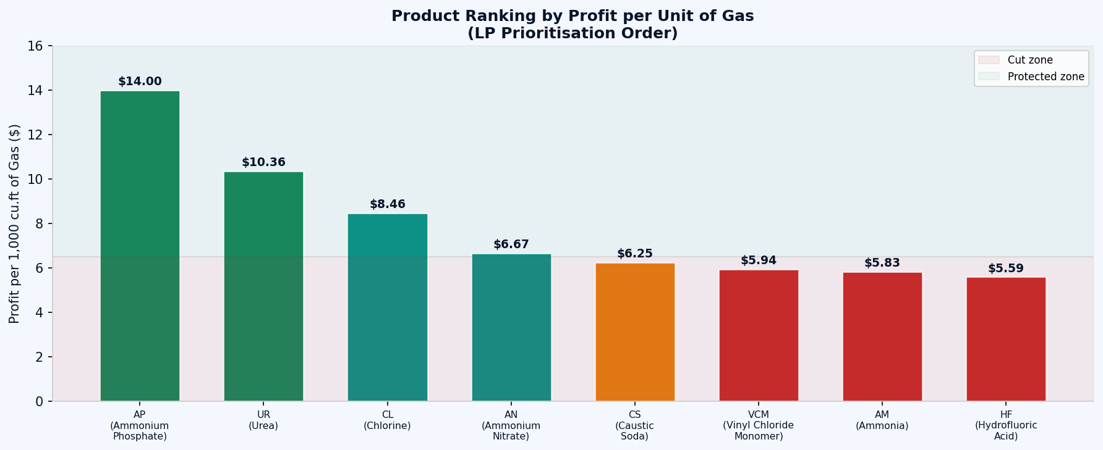
Product Economics: The LP's Prioritisation Logic
Profit per unit of gas consumed — this ranking determines the optimal cut sequence
The Key Insight
Under a gas constraint, the LP ranks products by $/1,000 cu.ft
Top 4 protected products (always run at full capacity):
① Ammonium Phosphate $14.00
② Urea $10.36
③ Chlorine $8.46
④ Ammonium Nitrate $6.67
Products cut first (from lowest):
⑧ Hydrofluoric Acid $5.59
⑦ Ammonia $5.83
Note: This is not a heuristic — it is the exact LP solution. The Simplex algorithm discovers this ranking automatically.
⑥ Vinyl Chloride Monomer $5.94
⑤ Caustic Soda $6.25
7 / 15

Slide 8
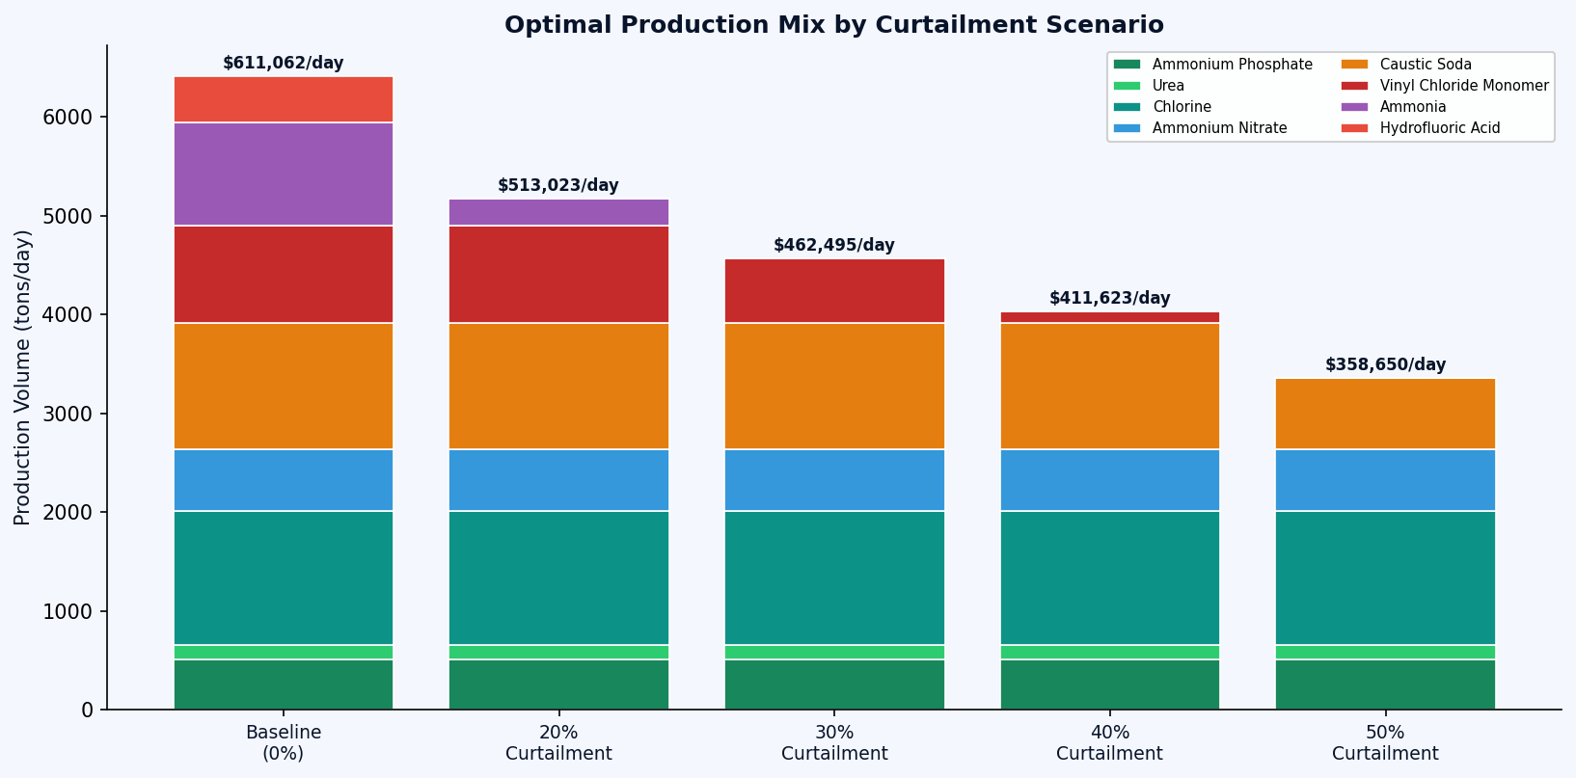
Production Plan Results
Optimal product mix under each curtailment scenario (LP-derived)
Product
Baseline
20% Cut
30% Cut
40% Cut
50% Cut
Ammonium Phosphate
510
510
510
510
510
Urea
150
150
150
150
150
Chlorine
1,350
1,350
1,350
1,350
1,350
Ammonium Nitrate
630
630
630
630
630
Caustic Soda
1,280
1,280
1,280
1,280
720
Vinyl Chloride Mon.
980
980
651
116
0
Ammonia
1,050
275
0
0
0
Hydrofluoric Acid
461
0
0
0
0
Daily Profit ($)
$611,062
$513,023
$462,495
$411,623
$358,650
vs. Baseline (%)
—
−16.0%
−24.3%
−32.6%
−41.3%
✓ The LP protects the 4 highest-margin products at full capacity even under 50% curtailment. Cut sequence: HF → Ammonia → VCM → Caustic Soda.
8 / 15

Slide 9
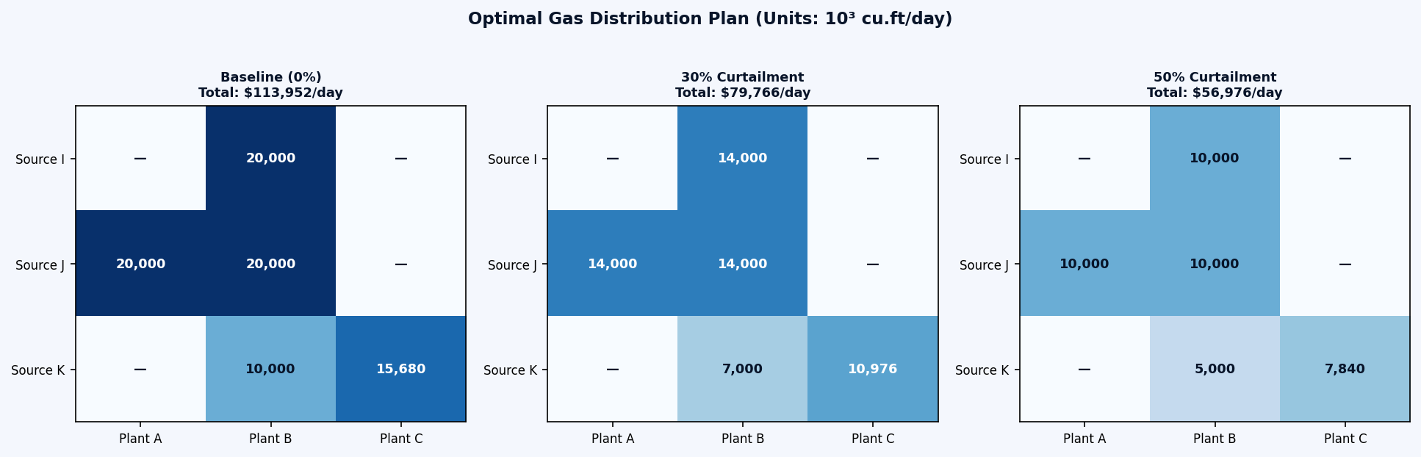
Distribution Plan Results
Optimal gas allocation from MaxEnergy nodes (I, J, K) to BarCo plants (A, B, C)
Distribution Costs ($ per 1,000 cu.ft)
Plant A
Plant B
Plant C
Source I
$1.30
$1.20 ✓
$1.60
Source J
$1.20 ✓
$1.40
$1.50
✓ = cheapest lane per source
Source K
$1.80
$1.60
$1.40 ✓
▸ Five active lanes: I→B, J→A, J→B, K→B, K→C | Baseline total cost: $113,952/day
▸ Structure is INVARIANT under curtailment — only volumes shrink proportionally
▸ Average unit cost remains constant at $1.33 per 1,000 cu.ft regardless of curtailment level
▸ Unused lanes I→C ($1.60) and K→A ($1.80) — candidates for renegotiation
9 / 15

Slide 10
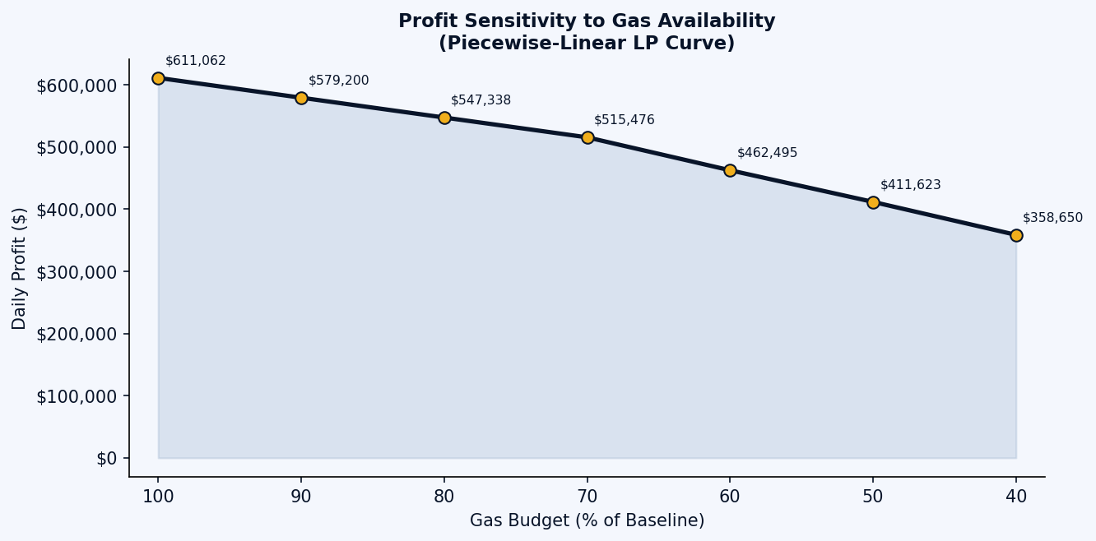
Sensitivity Analysis
Shadow price of gas & profit robustness under coefficient changes
Shadow Price of Gas Constraint
Scenario
Gas Budget
Marginal Product
Shadow Price
Baseline
85,680
Hydrofluoric Acid
$5.59/10³
20% Cut
68,544
Ammonia
$5.83/10³
30% Cut
59,976
Vinyl Chloride Mon.
$5.94/10³
40% Cut
51,408
Vinyl Chloride Mon.
$5.94/10³
50% Cut
42,840
Caustic Soda
$6.25/10³
Managerial Implication
Every 1,000 cu.ft of spot gas BarCo secures above the curtailed budget is worth $5.59–$6.25 to daily profit. This defines the maximum price BarCo should pay for emergency gas procurement.
Profit Coefficient Stability
• Protected 4 products: stable within ±20% margin movement — no change to optimal mix
• Marginal products (Ammonia, VCM, Caustic Soda, HF): a −20% price drop removes them from the optimal mix
• Rule: small change (<10%) → no action; medium (10–20%) → re-run LP monthly; large (>20%) → re-optimise immediately
10 / 15

Slide 11
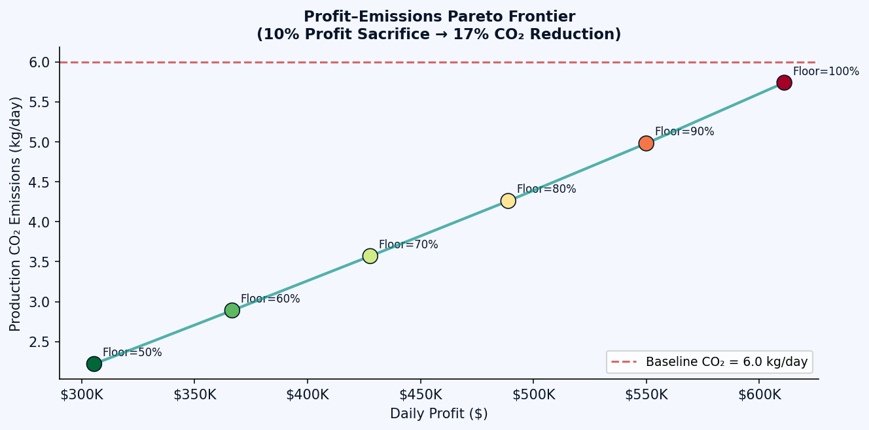
Environmental Scenario: Minimising CO₂ Emissions
What if BarCo pursues sustainability alongside profit?
Profit–Emissions Trade-off
Profit Floor
Daily Profit
CO₂ (kg)
CO₂ Cut
100%
$611,062
5.74 kg
4.4% ↓
90%
$549,956
4.98 kg
17.0% ↓
80%
$488,849
4.26 kg
29.0% ↓
70%
$427,743
3.57 kg
40.5% ↓
Key Findings
▸ At profit-max baseline, BarCo's production CO₂ is already 4.4% below the stated 6.0 kg baseline — because ammonia runs at full capacity (lower emission use)
▸ A 10% profit sacrifice achieves 17% CO₂ reduction
▸ Break-even carbon price ≈ $80,000/tonne
Ammonia deserves protection: it is BarCo's lowest-emission gas use AND qualifies for 2nd-Priority regulatory protection. Cutting ammonia for short-term profit is both financially and reputationally risky.
▸ Australia's Safeguard Mechanism: ~$30/tonne today — profit-max remains optimal
▸ The CO₂-aware LP is ready to activate when carbon prices rise meaningfully
11 / 15

Slide 12
Strategic Recommendations
Three evidence-based actions for BarCo management — each with quantified value
Implement the LP-Derived Production Priority Rule
R1
Written policy: always run AP, Urea, Chlorine, AN at full capacity · Cutback sequence: HF → Ammonia → VCM → Caustic Soda Value: ~$16M/year over naive proportional cut at 50% scenario · Shadow price defines max price for emergency spot gas: $5.59–$6.25/10³ cu.ft
Commit to 5-Lane Distribution Structure
R2
Pre-negotiate volume-flexible contracts on lanes: I→B, J→A, J→B, K→B, K→C · No need to re-tender each curtailment cycle — structure is invariant Renegotiate unused lanes I→C ($1.60) and K→A ($1.80) for cost optionality · Average unit cost locked at $1.33/10³ cu.ft regardless of curtailment level
Run CO₂-Aware LP in Parallel
R3
Report Pareto trade-off to the board each planning cycle · Baseline production CO₂ already 4.4% below stated target — document this Activate CO₂-aware variant when AUS carbon prices clear ~$80/tonne · Positions BarCo ahead of tightening carbon regulation
12 / 15

Slide 13
Conclusion
LP transforms curtailment decisions
from high-pressure judgment calls into transparent, pre-committed policy
Profit drops sub-proportionally to gas
a 50% gas cut → only 41.3% profit drop ≈ $16M/year in LP value
Shadow price quantifies gas value
$5.59–$6.25 per 1,000 cu.ft — the ceiling for emergency procurement
Same model supports CO₂ planning
ready to activate as carbon pricing enters Australian industrial policy
With these three recommendations implemented, BarCo will not only weather the 2026 brownouts — it will build a planning capability fit for the more constrained, more carbon-aware operating environment of the years ahead.
Thank you · Questions welcome
13 / 15

