Slide 1
The Adapter Pattern

Slide 2
An Adapter is… an Adapter!
Just like a power adapter you might take with you when travelling abroad, the Adapter Pattern let’s us fit two existing systems together.
My Existing System
Adapter!
Vendor’s Class
Notes:
which I really, really, really don’t want to refactor

Slide 3
An Adapter is… an Adapter!
Just like a power adapter you might take with you when travelling abroad, the Adapter Pattern let’s us fit two existing systems together.
The Adapter class is the only new code.
No code changes to the existing system or the vendor’s class
My Existing System
Adapter!
Vendor’s Class

Slide 4
Lab 6 Acceptance Tests and the Bazaar
The completeness of the project is also measured by the test requirements.
I’ll randomize the testing order. Will let you know as a D2L announcement on Tuesday.
ALL members must present during the tests for the acceptance tests points. Unless excused by other members and the instructor
If you plan to sell your project, by 8p WEDNESDAY by email with your sales rep availability.
If you want to ”buy” one, please let me know by Wednesday 8p with your buying rep availability.
I’ll arrange time and location for the bazaar based on the information. I encourage the buyers make the decisions AFTER you see every selling project, not just getting from acquaints.

Slide 5
Lab 7
You can form a new team ONLY IF you leave details on the team evaluation form or have emailed/talked to me. Or you are part of these details
2-4 people in lab 7
Please let me know by 8p WEDNESDAY by email. I’ll approve that only when I believe there are severe issues.

Slide 6
Adaptor Pattern
Want an A but only has a B
Good news is that B is “similar” to A
We want to build an adapter to use a B as an A

Slide 7
Using a B as an A
An Adaptor should
“Deceive” the compiler
The adapter needs to be an A
Make the Adapter a subclass of A
Behave like an A
Implement the A methods
Note that it is just an adapter. So it simply use a B to simulate an A
Contain a B as a field
Use the B as needed

Slide 8
Book’s Example: Ducks
public interface Duck {
public void quack();
public void fly();
}
public class MallardDuck implements Duck {
public void quack() {
System.out.println("Quack");
}
public void fly() {
System.out.println("I'm flying");
}
}

Slide 9
public interface Turkey {
public void gobble();
public void fly();
}
public class WildTurkey implements Turkey {
public void gobble() {
System.out.println("Gobble gobble");
}
public void fly() {
System.out.println("I'm flying a short distance");
}
}

Slide 10
And then, there was this one time when we needed more Ducks…
public class TurkeyAdapter implements Duck {
Turkey turkey;
public TurkeyAdapter(Turkey turkey) {
this.turkey = turkey;
}
public void quack() {
turkey.gobble();
}
public void fly() {
for(int i=0; i < 5; i++) {
turkey.fly();
}
}
}
Turkeys can fly, but only over short distances.

Slide 11
Adaptor Pattern Defined
The Adaptor Pattern converts the interface of a class into another interface the clients expect. Adapter lets classes work together that couldn’t otherwise because of incompatible interfaces.

Slide 12
Adapter Pattern
Most patterns we covered this semester have a family of classes with the name of the pattern
E.g. Observer, visitor, etc
Adaptor pattern does not have such a family. It consists of one class only

Slide 13
Adaptor Pattern (Book’s Diagram)

Slide 14
A Better Version

Slide 15
Scene
The Client
The Adapter
The Adaptee
My Newer System
Adapter!
Existing System
request()
translatedRequest()
Note this is the only new code to write.
Notes:
My Newer System is said to be the client because it uses the existing system.

Slide 16
Scene
Newer
The Adapter
Older
Expects
Iterator
Adapter!
Returns
Enumeration
request()
translatedRequest()
Notes:
Client is written against the “target interface”
Adapter implements the target interface and holds an instance of the Adaptee. WRAPPING IT.

Slide 17
Scene
Early Java had Enumeration that let you walk through the elements of a collection
Enumeration Interface
hasMoreElements()
nextElement()
Later, Java created Iterators that are like Enumerations
Iterator Interface
hasNext()
next()
remove()

Slide 18
Scene
Newer
The Adapter
Older
Expects
Iterator
Adapter!
Returns
Enumeration
request()
translatedRequest()
hasNext()
hasMoreElements()
Notes:
Client is written against the “target interface”
Adapter implements the target interface and holds an instance of the Adaptee. WRAPPING IT.

Slide 19
Legacy Code
There is code that exposes that Enumeration interface, but, for consistency, we’d like to only use Iterators.
Notes:
draw the next one

Slide 20
Using Adapter to make Enumerations look like Iterators
Iterator
Enumeration

Slide 21
Using Adapter to make Enumerations look like Iterators

Slide 22
Using Adapter to make Enumerations look like Iterators
public class ???? implements ???? {
???? adaptee;
}

Slide 23
Using Adapter to make Enumerations look like Iterators
public class EnumerationIterator implements ???? {
???? adaptee;
}

Slide 24
Using Adapter to make Enumerations look like Iterators
public class EnumerationIterator implements Iterator {
???? adaptee;
}

Slide 25
Using Adapter to make Enumerations look like Iterators
public class EnumerationIterator implements Iterator {
Enumeration adaptee;
}

Slide 26
Using Adapter to make Enumerations look like Iterators
public class EnumerationIterator implements Iterator {
Enumeration adaptee;
boolean hasNext() {
return adaptee.hasMoreElements();
}
}

Slide 27
How about remove()?
public class EnumerationIterator implements Iterator {
Enumeration adaptee;
boolean hasNext() {
return adaptee.hasMoreElements();
}
void remove() { ??? }
}

Slide 28
Does Not Have to Be Perfect
public class EnumerationIterator implements Iterator {
Enumeration adaptee;
boolean hasNext() {
return adaptee.hasMoreElements();
}
void remove() {
throw new UnsupportedOpertaionException();
}
}

Slide 29
Last Bonus Opportunity
Finish course evaluation by the end of Wednesday’s class
1%
Stop by to tell me that you finished it
Do it in class on Wednesday

Slide 30
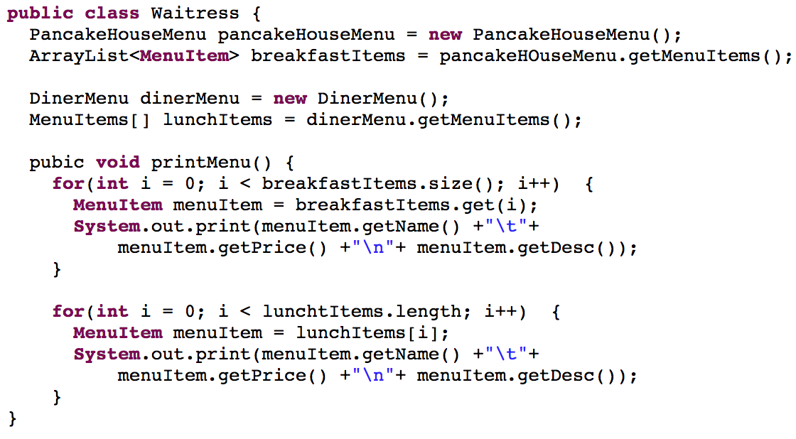
Review: Iterator

Slide 31
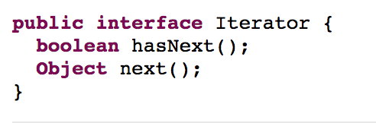
Review: Iterator

Slide 32
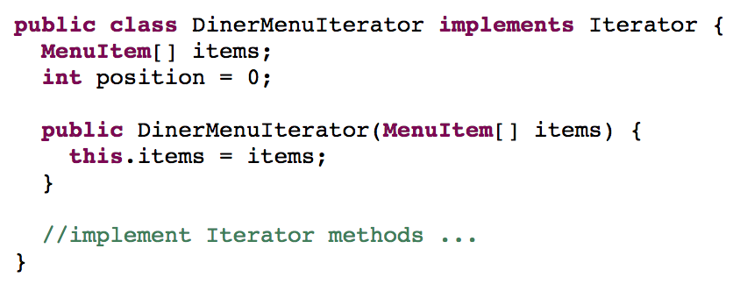
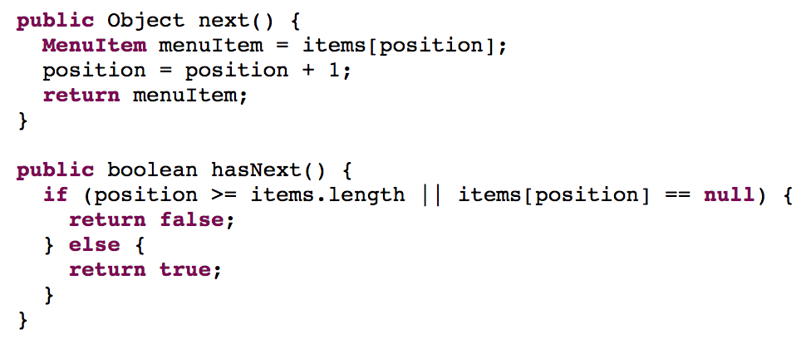
Review: Iterator

Slide 33
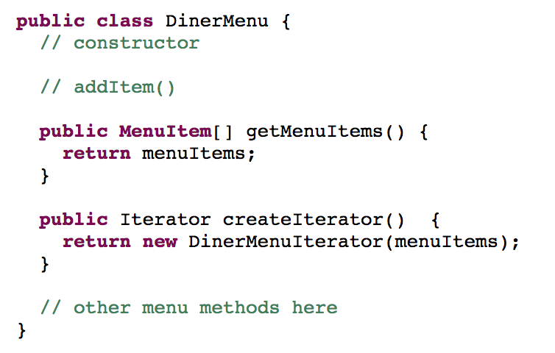
Review: Iterator

Slide 34
Review: Iterator

Slide 35
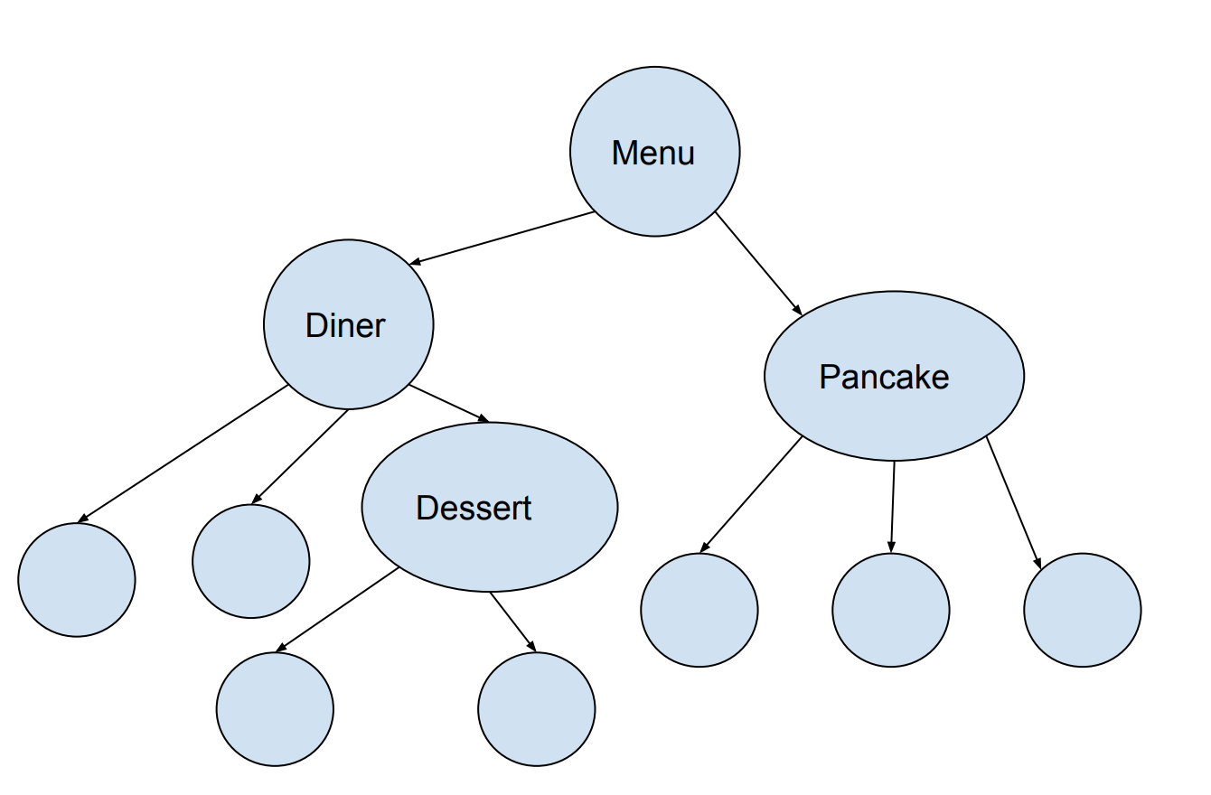
Review: Composite

Slide 36
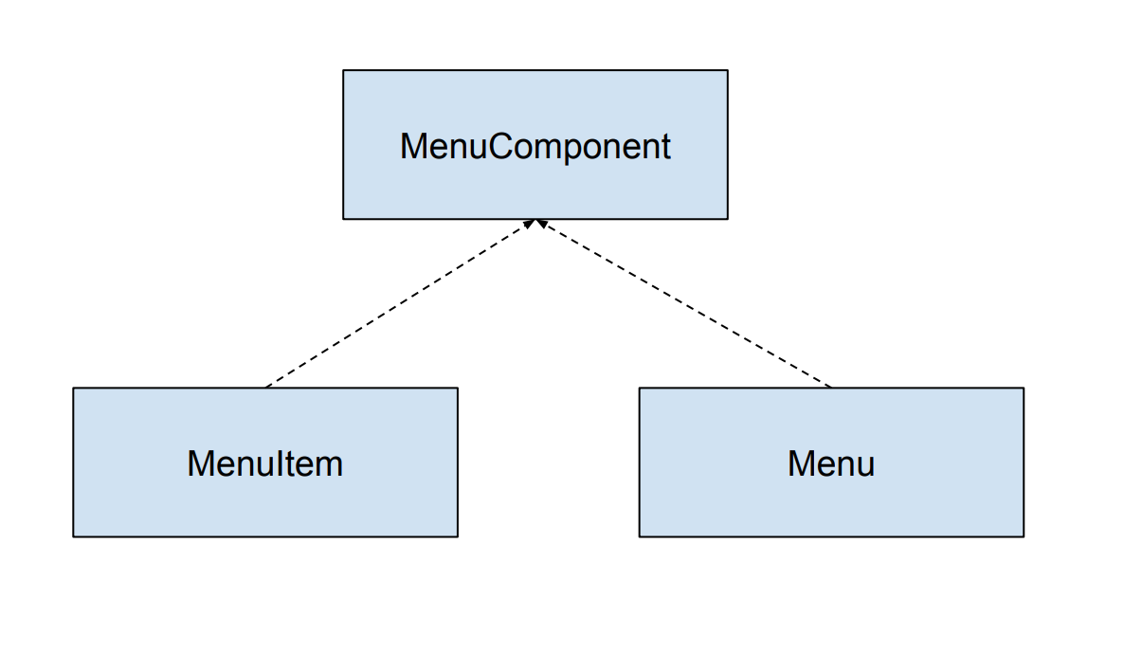
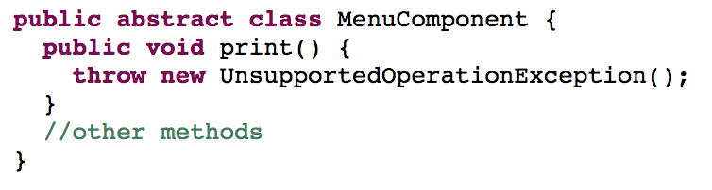
Review: Composite

Slide 37
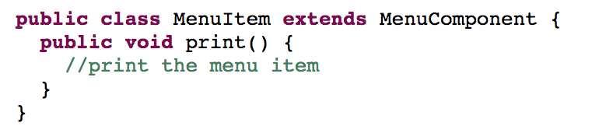
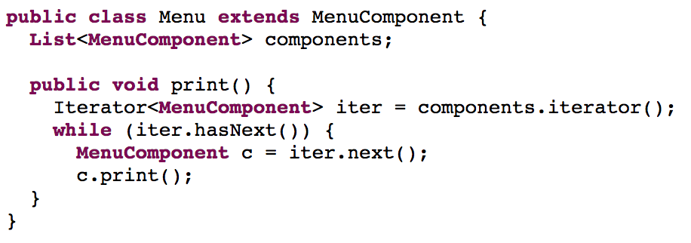
Review: Composite

Slide 38
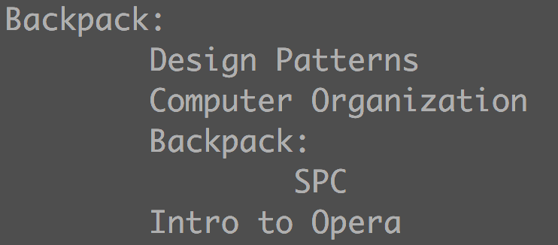
Review: Composite
You can put textbooks or smaller backpacks in a backpack
Given a backpack, print what it contains.
A textbook prints the title, e.g. “Design Patterns”
A backpack just prints “Backpack: “
Textbooks/backpack in a smaller backpack indented by one more tab

Slide 39
Adapter vs. Decorator
We are “wrapping” objects similarly to how we did in Decorator
How is Adapter different from decorator?
Notes:
Adapter makes an instance of class A act as an instance of class B
Decorator returns an object of same type.

Slide 40
Façade Pattern
Situation
A complex subsystem of classes that work together to perform higher level operations
Solution
Create a class whose methods are those higher level operations and whose responsibility is making all of the classes work together
Another example of Wrapping, but this time we are “wrapping” a set of classes

Slide 41
Façade Pattern Defined
The façade pattern provides a unified interface to a set of interfaces in a subsystem. Façade defines a higher-level interface that makes the subsystem easier to use

Slide 42
Adapter vs. Façade
Both patterns may wrap more than one class.
The main difference is in the intent of the pattern.
Adapter provides a one-to-one translation of methods.
Façade provides an interface that simplifies complex operations into single method calls.

Slide 43
Have you been good?
Do you want to see a bewildering video about turkeys?

