Slide 1
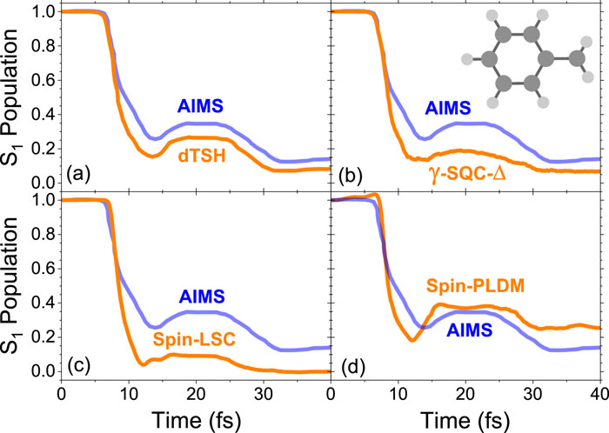
From: Ab initio spin-mapping non-adiabatic dynamics simulations of photochemistry
J. Chem. Phys.. 2025;162(8). doi:10.1063/5.0248950
^{Date of Download: 2/25/2025}
Copyright © 2025 . All rights reserved.
Notes:
Figure Legend: S<sub>1</sub> population dynamics of the fulvene molecule for a variety of semi-classical methods: (a) dTSH, (b) γ-SQC-Δ, (c) spin-LSC, and (d) spin-PLDM. All methods are compared to the ab initio multiple spawning (AIMS) results, which are taken to be more exact compared to these semi-classical approaches. The AIMS and dTSH results were taken from Ref. 73.

