Slide 1

TECHNICAL . SOLUTIONS
ECONOMIC
EVALUATION
PLASTICS WASTE MANAGEMENT
From Collection & Sorting to Waste-to-Energy & Remeditation Technologies
DATE / ORGANIZATION PRESENTER: XXX

Slide 2
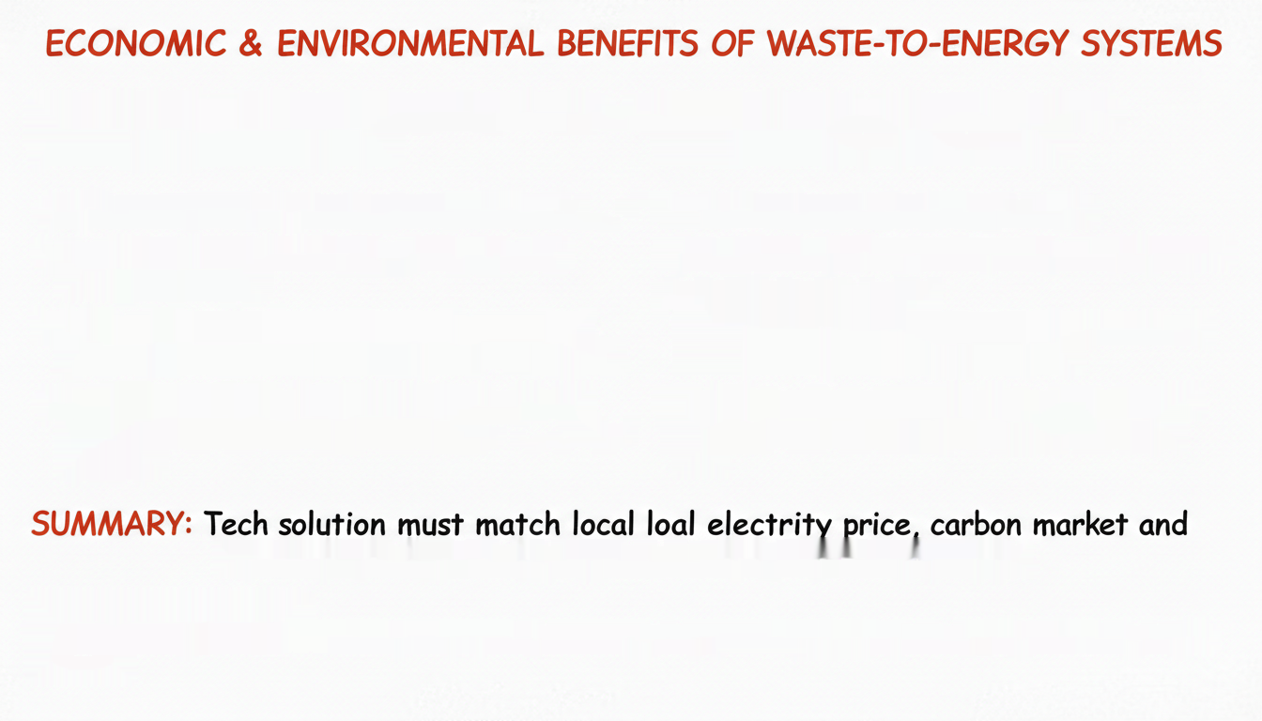
CASE 2: Clement (2012) Fort Bliss CASE 1: Khwamana & Chaiyata (2025)
WtE-Zero Emission System
WtE/CSP Hybrid Cost-Benefit
- Model: EPA WARM, 1M tons/year input - Input: 17.85 tons/day MSW, 31.63% combutible.
- System: Trigenration for power, heat, cooling.
- CO2 Reduction: ~264.025 MTCO2e avoided/year via
22.38% efficiency.
- Carbon Rev. Sensitivity:
- Economics: LCOE ~0.15 USD/kWH, NV = 1.63M USD,
0.4-36.2M USD 0.4 - 36.2M USD (2-year env. benefit)
Pl = 7.72, IRR, 81.9% = 7.97%, Payback = 9.63 years.
based carbon price (0.10-10 USTCO2e).
- Insight: Viable economic return & high resource
- Key Factor: Project NVV highly sensitive to diff.
between local electricity price & WTE power sales recovery within reasinable project
lifecycle.
rate.
steam for dual optimal environmental & economic benefits.
ACKNOLEJUEMENTS:
ACKIONOLEUEMENTS: Thank to all experts, and collegues for listening & guidance. Questions & sugestions
welcome!

