Slide 1

Basic know how
???

Slide 2

Basic Requirement and Design
Basic Coding and Unit Test
Feedbacks

Slide 3

Basic Requirement and Design
What is Requirement and Design?
Why is requirement and Design so important?
Requirement is money.
Design is our effort.
Request from senior customer.
Measure twice and cut one

Slide 4
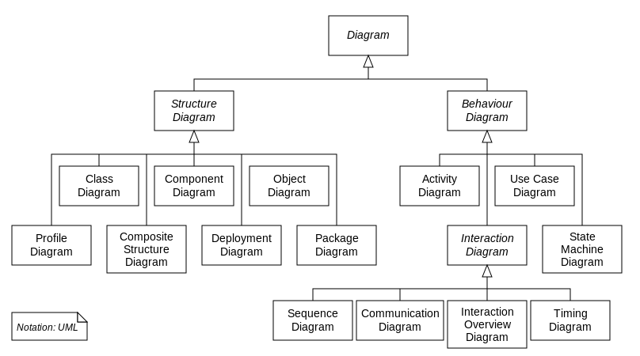
Basic Requirement and Design
How to modeling requirement

Slide 5
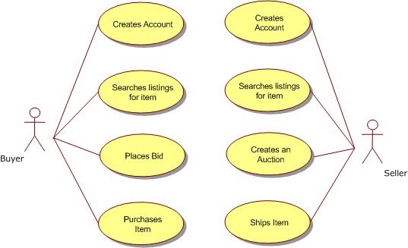
Basic Requirement and Design
Use case
What is use case?
A use case is a graphic depiction used in system analysis to identify, clarify and organize system requirement.

Slide 6
Basic Requirement and Design
Use case (cont)
How to create use case:
Define actor
Define action for actor.
Divide the general action by <<include>> and <<extends>>
Describe the purpose and flow of use case

Slide 7
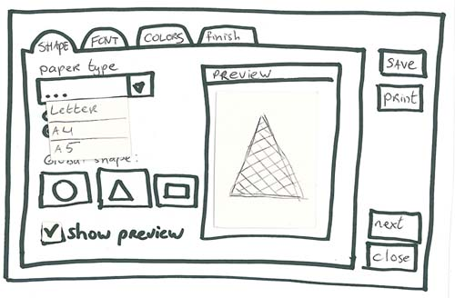
Basic Requirement and Design
Screen Design
What is Screen Design?
Help user see how the function is displayed and handled on screen.

Slide 8
Basic Requirement and Design
Screen Design (cont)
How to create Screen Design:
Draw GUI of function based on requirement and other same kind of project.
Describe about the purpose, kind, default value and special requirement for each element on GUI.

Slide 9
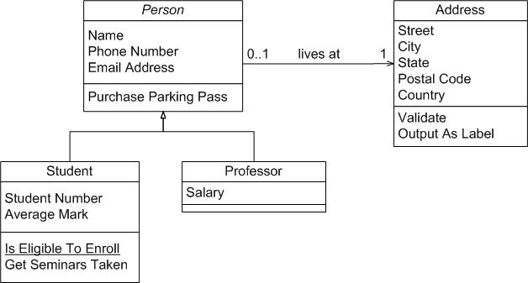
Basic Requirement and Design
Class Diagram
What is Class Diagram?
Help user see how the function is displayed and handled on screen.

Slide 10
Basic Requirement and Design
Class Diagram(cont)
How to create Class Diagram:
Determine class object (properties and method)
Determine relationship of classes.

Slide 11
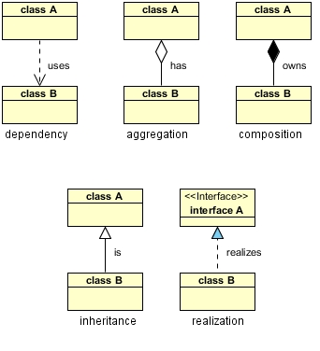
Basic Requirement and Design
Class Diagram(cont)
Relationship in Class Diagram:
Notes:
Dependency: When a class used one instance of another class as a parameter
Association: is a broad term that encompasses just about any logical connection or relationship between classes. For example, passenger and airline may be linked
Aggregation: refers to the formation of a particular class as a result of one class being aggregated or built as a collection. For example, the class “library” is made up of one or more books
Composition: is very similar to the aggregation relationship, with the only difference being its key purpose of emphasizing the dependence of the contained class to the life cycle of the container class
Inheritance: refers to a type of relationship wherein one associated class is a child of another by virtue of assuming the same functionalities of the parent class. In other words, the child class is a specific type of the parent class. To depict inheritance in a UML diagram, a solid line from the child class to the parent class is drawn using an unfilled arrowhead
Realization: denotes the implementation of the functionality defined in one class by another class. To show the relationship in UML, a broken line with an unfilled solid arrowhead is drawn from the class that defines the functionality to the class that implements the function. In the example, the printing preferences that are set using the printer setup interface are being implemented by the printer

Slide 12
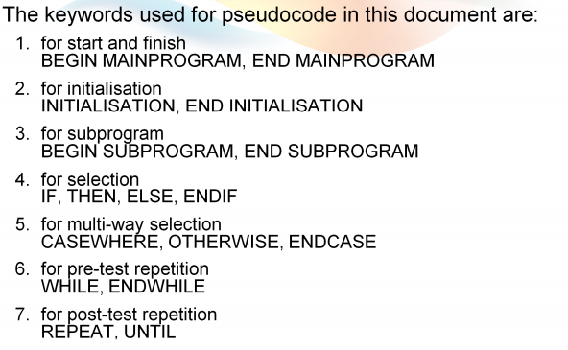
Basic Coding and Unit Test
Pseudo Code
Must define the rules for pseudo code.
You able to define another rule for pseudo code in your team

Slide 13
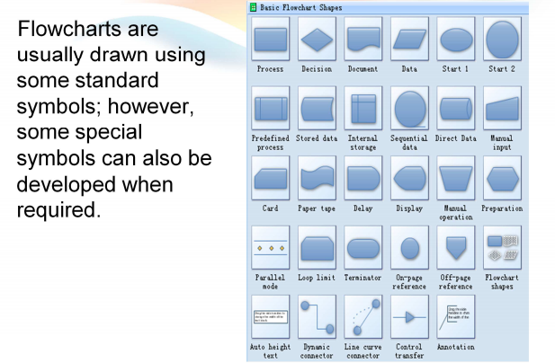
Basic Coding and Unit Test
Flow chart
Describe process of requirement by defined shape set.

Slide 14
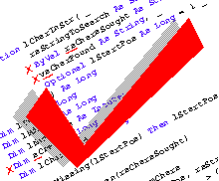
Basic Coding and Unit Test
Coding convention
The important action must do before coding.
Must train to team and make a checklist.
After coding, each of member must check the checklist again to make sure that coding is following rules closely.

Slide 15
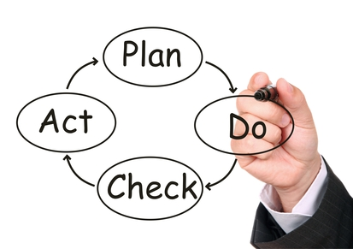
Basic Coding and Unit Test
Coding process in real project.
Based on Detail Design or Program Design, leader and member define a plan to release code.
If member has any question, they will log Q&A on online project management, TL and BA will have responsibility to answer this.

Slide 16
Basic Coding and Unit Test
Coding process in real project (cont)
After finish coding, member checking coding convention and business logic. Member request code review on leader by email.
If has any issues, leader will reply mail to ask member to fix. This step maybe loops some times.
If review result is passed. Member will execute Unit Test.

Slide 17
Basic Coding and Unit Test
Unit Test
What is Unit Test?
Testing done by developer.
Testing for one or some block of code to make sure that it runs correctly.
What is process of Unit Test?
Create test cases to cover all functions in application.
Make plan to finish testing.
Training checklist for unit test.
Review test result by team leader.
Release UT.

Slide 18


