Slide 1
Info Slides

Slide 2
APRS
Stands for “Automatic Packet Reporting System”
APRS is a worldwide AX.25 Packet network
In the states, the VHF frequency is 144.390 Mhz in the 2m band
Used for:
Amateur-to-amateur messaging
Position Reporting
Sensor Telemetry Data
Weather stations / weather data

Slide 3
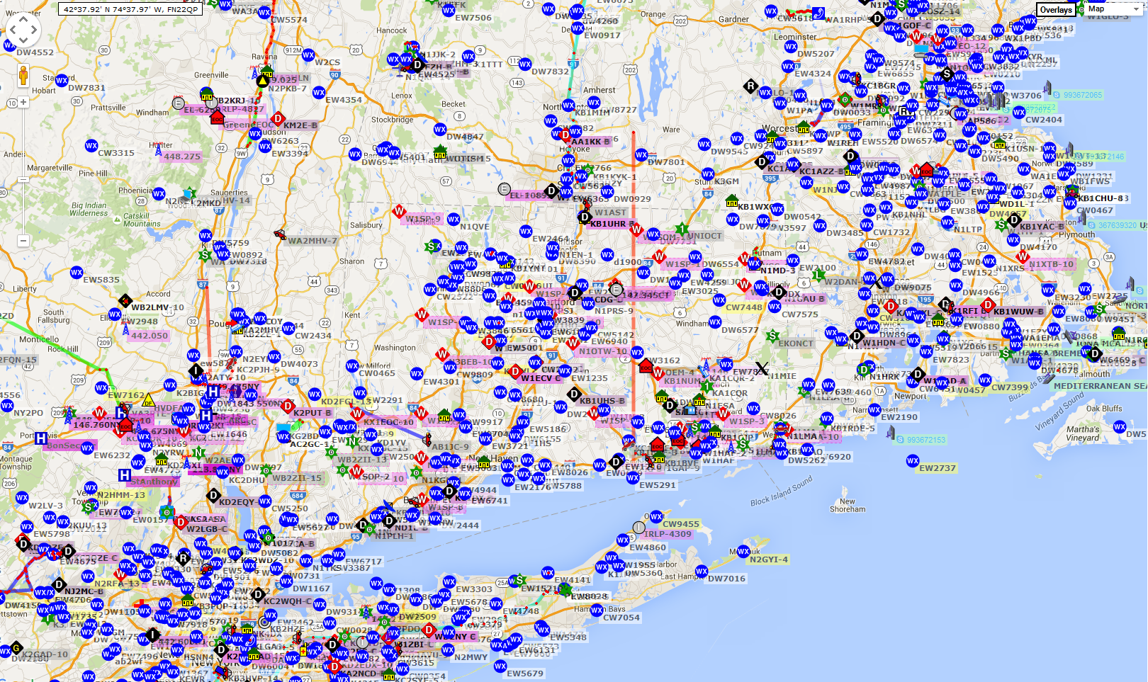
APRS Local users in CT Area

Slide 4
APRS Position Report Format
Data Formats
Position Message: Will be sent by the balloon ONCE PER MINUTE
AB1JC-11>APTT4,WIDE1-1,WIDE2-1:@211229h4114.24N/07301.08WO000/000/Discovery Balloon/A=000141!W75! ---------======================-=======--------=---------=---/===/-----------------/========----- A B C D E F G H I J K L M
Where:
A = Larry Reed’s Amateur Callsign. I use -11 for the balloon, and -9 for my car. Dash number can be 1-15. The > is a field separator
B = If fiel starts with “AP”, the APRS network will forward it. WIDE1-1 will probably NOT be present. WIDE 2-1 is a digipeating instruction. This can all be ignored up thru the colon.
C = Can be ignored. Indicates message-capable APRS. Could be another character in this position (say, a “/”)
D = Time 21 hours, 12 minutes 29 seconds. “h” indicates this is Zulu Time (Greenwich Mean Time = EDT + 4 hours)
E = Latitude (DDMM.MM) in hundredths of minutes (that is, 41 degrees, and 14.24 minutes North)
F = a “/” here indicates the PRIMARY symbol table is used (see table of symbols). A “\” means ALTERNATE Table
G = Longitude (DDDMM.MM) in hundredths of minutes (that is, 073 degrees, and 01.08 minutes West)
H = In the PRIMARY symbol table See F above) the capital letter “O” indicates a “balloon” symbol. The site “APRS.fi” will show this symbol on top of a google map if the user searches for “AB1JC-11”
I = COURSE (That is, HEADING of balloon in degrees clockwise from TRUE North.)
J = SPEED of the balloon in KNOTS. Multiply by 6076 and divide by 5280 to display speed in Miles Per Hour
K = optional TEXT field that we have set up to be sent with EVERY TENTH Position Report Message
L = ALTITUDE in FEET. Six Numeric Digits.
M = Optional field “!” and “!” mark start and end. The “W” indicates ONE extra digit of precision for Latitude “7”, and ONE extra digit of precision for Longitude “5”. Gives a precision of 6 feet latitude and 4 feet longitude.
MESSAGE TERMINATED BY cr/lf

