Slide 1
Application - TS Team
Q4 - QUATERLY REPORT
IT DIVISION
Present by: Mr. Huong
Agenda
1. Overview
2. Review Result
3. Next Plan
21 Jan. 2025

Slide 2

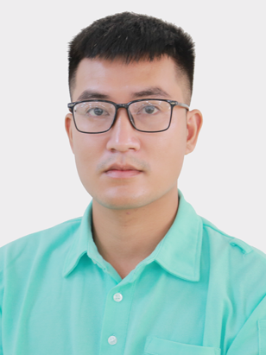
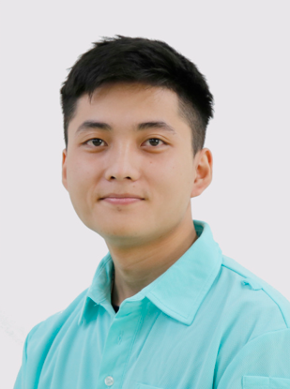
1. Overview
Main Jobs:
Completion: 2/4 projects
Typically:
Finished: 2
In-Process: 2
Main Activities:
Cost-down 1 license MSSQL by Migrate IDMS to PostgreSQL
PSI System get Bronze Prize of CVN Award
Open 1 class training API for 12 IT Div. members on Sep.2024
Integrated ELK monitoring system for TS Programs
Built 1 monitoring system Grafana

Slide 3
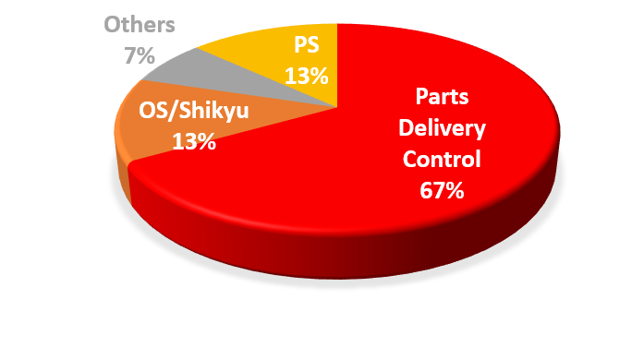
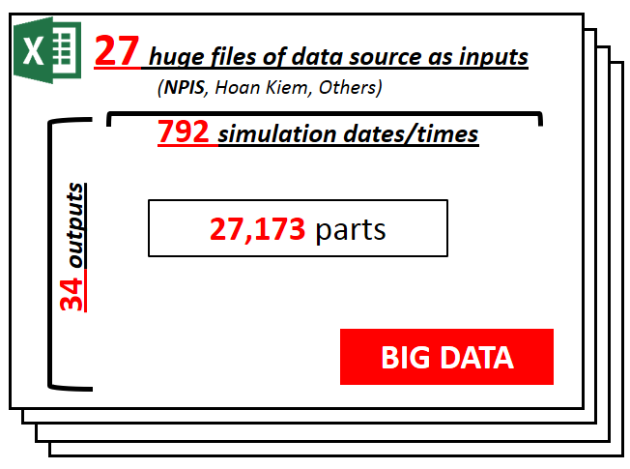
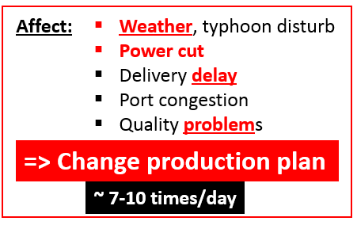
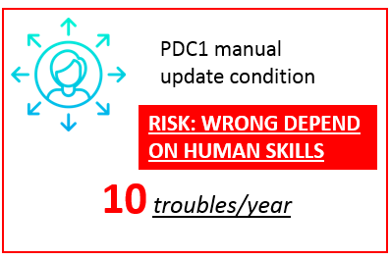

2. Review Result
Production Shipment Inventory
BACKGROUND:
Main Jobs:
PREPARE ENOUGH parts for production
MINIMUM inventory parts
Difficulty:
1
Very slow, can not to take action before TROUBLE HAPPEN
2
High RISK OF QUALITY belong to human skills
3
Stress due to very HIGH WORKLOAD
IT & PDC1
INNOVATION PDC1 OPERATION BY PSI SYSTEM
* TOP Instruction:
Promote SMART factories
Inventory Turn Over Day of KPI Policy

Slide 4

2. Review Result
Production Shipment Inventory
PROGRESS:
Applied
Plan
Expand
Additional
PIC
PRIORITY
Theme | 2023 | 2024 | 2025 | 2026
1. Master Structure
2. Forecast Delivery
3. PO Part Control
4. Turn Over Day
5. Lead Time control
6. Part Adjustment
7. Digital Simulation
8. Manpower
9. Recruitment
10. Inventory
11. BOL/EOL
12. Plan & Model control
13. Human Cultivation
14. ECN Control
15. SOTO Cell
EXPAND
1
None FC
Truck
2
Auto Workload
Rec demand
3
APPLIED FACTORY:
Step 1
Stock point
Step 1
Visualization
TS
10/11
4
TL
4/11
Optimize plan
Training & Standardize
QV
4/11
Auto ratio FC
4
SOTO part control & inventory

Slide 5
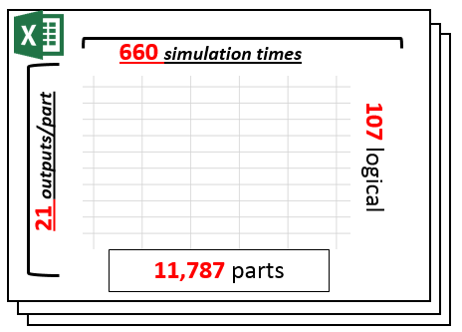
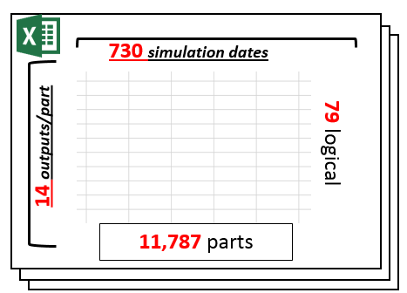
2. Review Result
Production Shipment Inventory
CHALLENGE:
Part Simulation – Long Term of TL
Part Simulation – Short Term of TL
SOLUTION:
Data Source | Number of rows
1. EUC B101 - IJ | 29.1 M
2. EUC B101 - LBP | 9.8 M
3. EUC J4500 – IJ | 1.2 M
4. EUC J4500 – LBP | 1.3 M
5. EUC E700 – LBP | 0.984M
6. Others source | < 0.1M
Data Source | Number of rows
1. Live production plan | 381.1K
2. Receiving data | 35.1K
3. Stock Inventory data | 30.1K
6. Others source | < 10K
Database:
Indexing for tables
Suitable data type (kind of array)
INPUT
INPUT
Codebase:
Parallel processing
Asynchronous thread
Concurrent data collections
Optimize process by key-value method
OUTPUT
OUTPUT
Logical:
= 11,787 part * 730 day * 14 kind of output
= 120,463,140 ~ 120.4 M output value
BIG DATA
= 11,787 part * 660 times * 21 kind of output
= 163,367,820 ~ 163.3 M output value
Improve PDC1 logical
Contribute new idea logical
= 11,787 part * 730 day * 79 logical
= 679,756,290 ~ 679.7 M calc operators
= 11,787 part * 660 times * 107 logical
= 832,397,940 ~ 832.4 M calc operators
BIG PROCESS

Slide 6
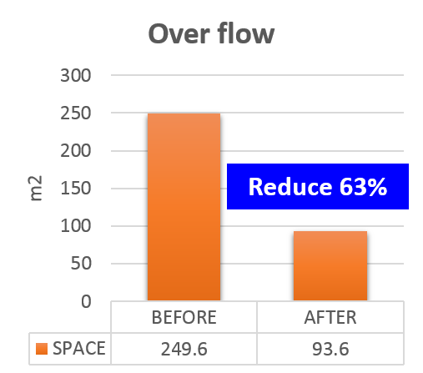
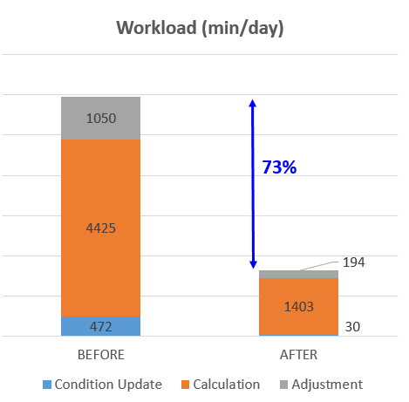
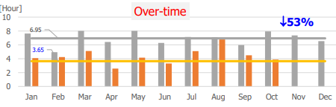
2. Review Result
Production Shipment Inventory
ACTUAL RESULT:
2
SPACE benefit
benefit
5
SPEED UP
1
COST benefit
improvement
Calculation
Before: 0.0029 min (78min)
After: 0.0001 min (2.7min)
Reduce ~97%
4,320 min/d ~ 9 person
Save 57,240 USD
Predict + Control
Before: 1,050 min/day
After: 194 min/day
Reduce ~82%
6
IMPROVEMENT operation
3
QUALITY up
Remove : 2items (15%)
Transform Auto : 7items(54%)
Transform Semi-Auto : 4items(31%)
* ZERO trouble
(~10 trouble/year before)
* Ensure 100% accurate
Remove Risk of wrong condition use
4
OVERTIME reduce
7
STORAGE files
Remove heavy file 1,160 MB
Target:
24 per
26 per
Remove PO paper ~55Kgs
~ 38,500 sheets/year
16 per
2025
2026
2027

Slide 7








2. Review Result
MONITORING
BACKGROUND:
Very hard to understand user situation
Delay support
Quickly support user
Support Flow
Kaizen Flow
user
user
3
feedback
1
2
1. KAIZEN FLOW
1
2
request
problem
request
problem
IT
problem
IT
Fixed & release
WHAT is the problem user facing ?
HOW to QUICKLY support ?
Is that problem STILL CONTINUE ?
Timely detect trouble & fixed
2
Fixed & release
4
3
TROUBLE HAPPENDED
system
system
IT Monitoring Systems
CHANCE:
Mr. Hung SMF built ELK Stack on Apr.2024
???
2. USING SYSTEM
Integrated all Tien Son application logging to ELK
NETWORK
INFRASTRUCTURE
DATABASE
APPLICATION

Slide 8
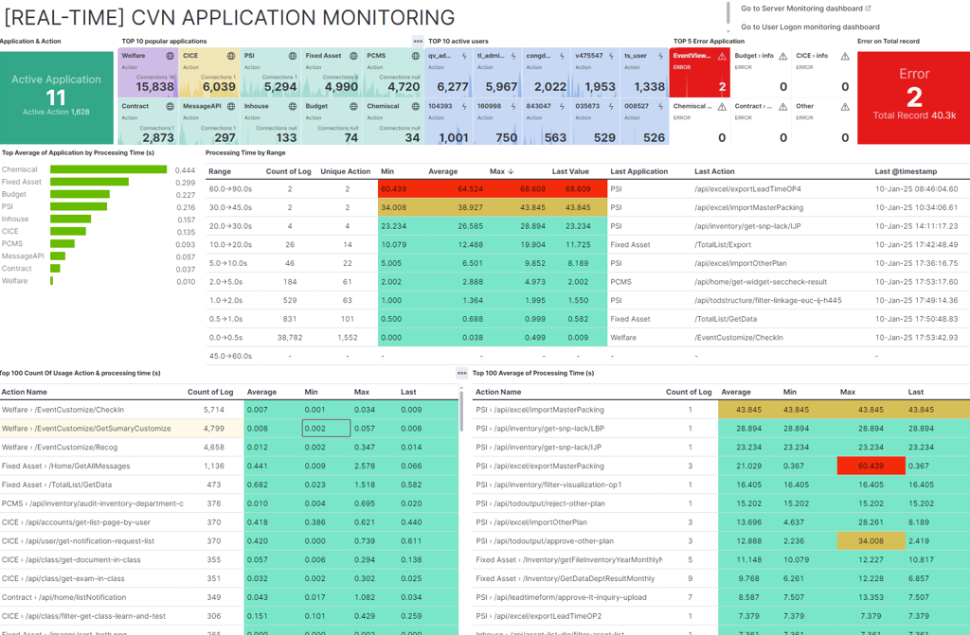
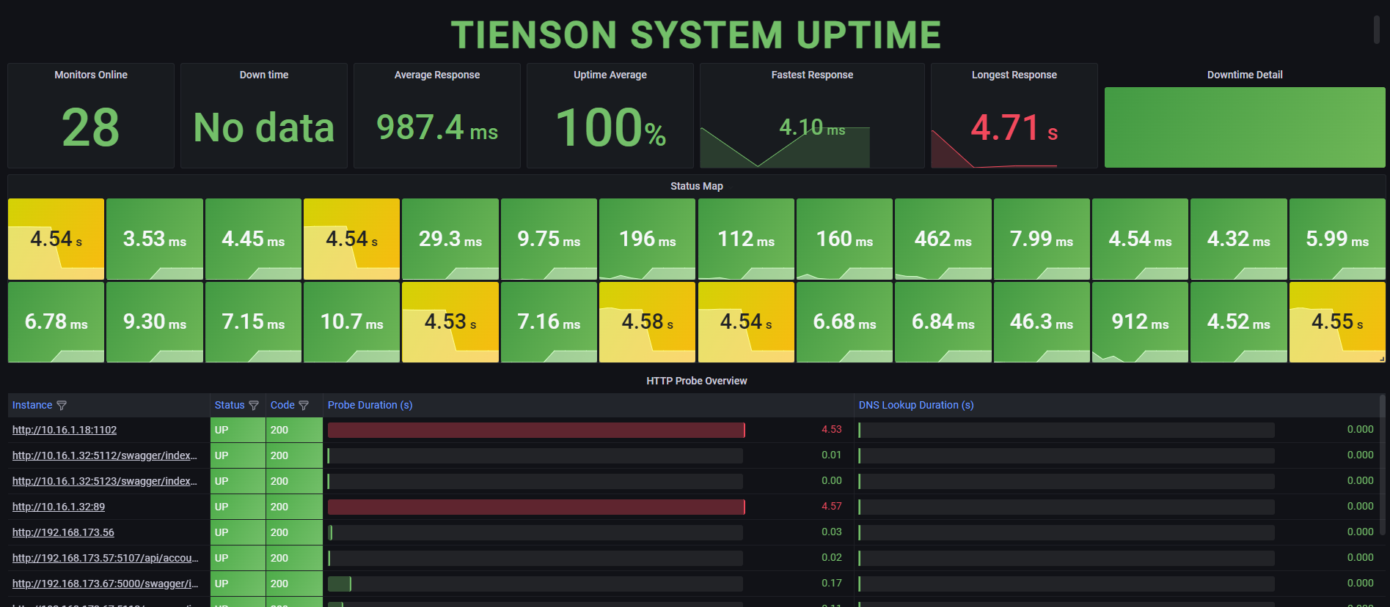



2. Review Result
MONITORING
OUR AIMING:
ZERO TROUBLE, ZERO DOWNTIME
ABILITIES:
TARGET:
PROGRESS:
Warning DOWN TIME
Detect errors and problem quickly
System performance evaluation
Understanding user behavior to make decision (which points need to improve)
Detect unusual activities
Detect slow point, bad request
Early trouble detected
Quickly support user
Improve response time, user experience
Optimize database
Enhanced security
10/11
TS Systems
integrated

Slide 9






2. Review Result
MONITORING
ACTUAL RESULT
1. SECURITY: detected 2 cases UNAUTHORIZED ACCESS
2. EVIDENCE: to investigate 2 cases USER LOST/CHANGED DATA
3. MAINTAINANCE: fixed 7 kind of errors
Transaction deadlock
SQL Syntax Error
Exception of programming
Event Viewer
Null able object
IIS Hosting Disconnected
Others
CICE: User TS Mold use Dev account to view course not owned by them
PCMS: User TS Mold use IT account to view PC account infor
Welfare: TL GA & QV GA disabled data during of event Fresh Summer Jun/Jul 2024
PCMS: User TL CIS user modify data, but she doesn’t remember
4. SUPPORT: quickly support
5. SPEED UP: improve user experience
6. DISADVANTAGE:
this version of ELK is free, not yet have Alert/Trigger warning to PIC (example: send email,..)
Estimated reduce ~70% time of support cases
No need support 8/9 systems (PSI, CICE, Contract, Welfare, ..)
Reduce 26% up to 82% response time
(This result based on the most action of Welfare (Gift Delivery), typically action, unaffected by external condition (PC slow, user input heavy file…) between Apr-Jul and Aug-Nov.24)
=> Research to improve
NEXT ACTION
Target only
0 -> 0.5 system support
2. Improvement the disadvantage
Option 1: Mr. Hung SMF research to integrate trigger in ELK
Option 2: Combine with Grafana dashboard (already installed and trigger)

Slide 10
3. Next Plan

Slide 11
Thanks for your listening !

