Slide 1
Subject of presentation
1-For the future of CVN, what is the biggest issue (problem) in your job?
2-And, what is your actual and original solution to overcome the issue.
3-What is the policy of your management
N.T.T.Trang-TS STG/PIA
Planning Div
Oct.24
Notes:
XIN CHAO!!!
I am Trang, from TS STG-Belong to Planning Div.
Thank you so much for giving me the chance to present today.
There are 3 part in presentation.

Slide 2











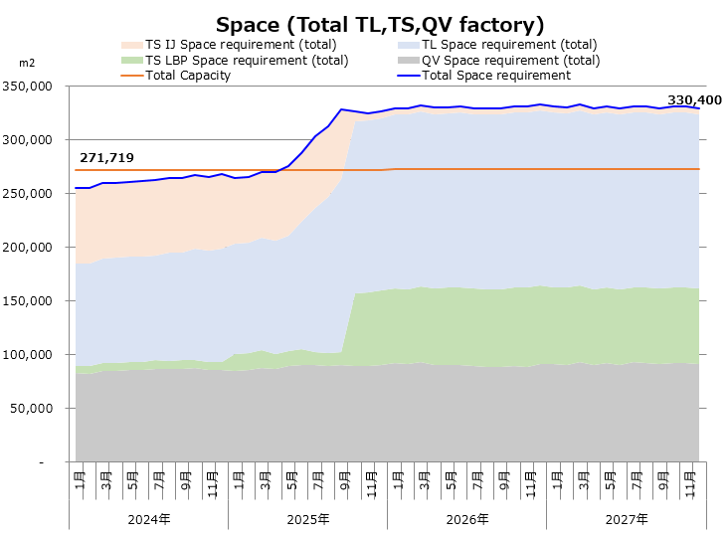
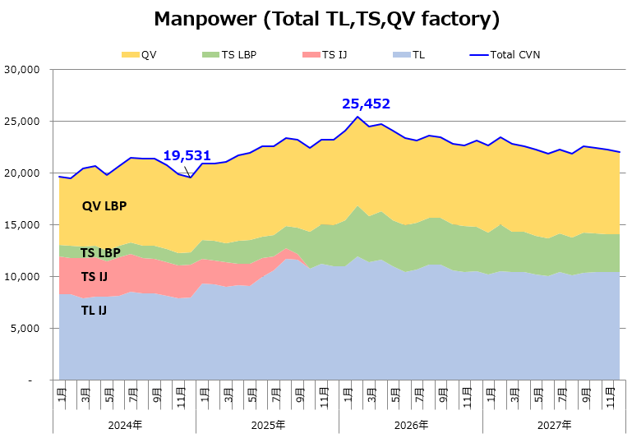
I- For CVN future, what is the biggest issue in my job?
Demand
3rd invest wave to VN
Technology
Resource
CN
Indian
Virtual/Augmented reality
Paper/Ink
2,352 per
ASEAN
+12%
VN
Iot
2100 per
Recycle
Increase competitor
=>Difficult recruitment
Energy
=>
.Automation
.SHOUJIN
Printer Business volume reduce
=>Small lot (many variety)+ new Business
24Y
27Y
New Technical more invested
F
C
Technical human resources increasing
=>?Qty MPW keep & output increase
D
Q
(SPACE-Monozukuri)
CVN Future
-58,000 m2
TS IJ
Lack space,
Big Environment change in next 3 years
TL IJ
Capacity up
TS LBP
・ Current Kaizen system can not follow rapid
environment changing -> competitiveness down!
・ Each dept promote activity by their view
QV LBP
2024 2025 2026 2027
-5,900 MPW
Biggest issue:
Lack Manpower,
How to accelerate QCDF kaizen activity
with same direction following TOP policy
2024 2025 2026 2027
Notes:
How CVN future in next 3Y,5Y,10Y?.
From my view, we will deal with flexible space for Monozukuri due to Demand printer change, human resources how to adapt rapid development technology & competive from 3rd party. If look at G1-MPW kaizen, u can see the MP reduction only 30% after 10Y, low speed, low efficiency, what’s the route cause?
I already used 5 why analyze sheet with 4 M to find out. I realize that each dept promote activity by their view, current kaizen system is difficult to adapt quick changing.
My biggest issued is “How to accelerate QCDF kaizen activity with same direction following TOP policy”.
So what’s my action to cover it, I will explain in next slide.
Target:1.5 m

Slide 3
II- Actual and original solution to overcome
1- What’s the KMS?
Kaizen Management System (KMS)
Mission:
Establish a simple & effectiveness system to promote kaizen chain
～Linkage all kaizen activity from top policy ～
[Planning Div]
Link all activity
PIA job
Target
Promote Kaizen
CIMS cultivate
Plan job
MHD job
(PDCA cycle)
Kaizen promotion
CIMS cultivation cycle for each dept
Top policy
Kaizen with Dept
PE/MFE
Kaizen
practice
[PDC dept]
QA
Actual Kaizen
MO
MSD
Planning Div.
PCB
LOG
Draw aiming figure
Assy
PDC
Build up training
Make case study
Apply CIMS tool
-Mono-jo
-3 C-BOM
…
Set Target & KPI
Direction/progress check
Top Genba
FM/KPI check
Organize
Top check
CIMS
CIMS
Training
ASSY
PDC
Div…
KPI control
-------
-------
-------
PIBC
13 Div
25 Depts
CVN
-------
-------
-------
Reward
E-learning
-------
-------
-------
FM/Center
---------------
Theme up
MDB
Systemize training
Notes:
KMS is short for Kaizen Management system, with mission establish a simple & effectiveness system to promote kaizen chain. Base on STG’s charactic, mix 3 function, I want to promote kaizen linkage with target and CIMS cultivate.
1-Set up Target/KPI by drawing aiming figure with CIMS tool,
2-Do kaizen with all dept., this kaizen will be reflect to case study in CIMS CULTIVATION cycle for each dept.
3-Check progress via KPI/Top genba ck.
4-Encourge Kaizen with Awarding structure.
So to do KMS, How many step? I will report in next page.
Target:1.5 m

Slide 4
III- Actual and original solution to overcome
2- Step to build KMS
Adapt big environment change
-> up competitiveness !
Step4
2027
Maintain & Development KMS by conduct Audit
Step3
2026
KMS Monitor evaluation & adjust
P
D
Real One CVN
Step2
2025
Step1
2024
A
C
Operate KMS for each dept
P
D
A
C
Conduct Internal & External audit
Prepare Build up KMS structure
P
D
Evaluation
+ 2 times/year
A
C
P
D
Draw aiming figure
A
C
Do kaizen with dept
Implement CIMS training
Setting method
Sharing & get approval
Systemize CIMS training
Issue operation Procedure
Report in next page
Notes:
Have 4 Steps to build KMS, each step will be follow PDCA cycle and aim to “Adapt big environment change, up competitiveness. And become real one CVN
Due to limited time, I will report u Step 1-Prepare build up KMS structure.
Target:0.25 m

Slide 5



III- Actual and original solution to overcome
Step 1:Build up KMS structure
Structure
What’s to do?
Detail
Image
1-Setting method: Draw aiming figure by CIMS tools
2-Sharing & get approval:
+KPI Dept&Top
+Common understanding between depts
3-Linkage factory Target /KPI
Slim cell-Uxmal
Dec.2024
SILK
メインセル
受入
内製
(14%)
4.4
サブセル
❶ Target setting
(14%)
4.3
(2%)
0.5
⑩
②
⑦
+Target MP/Cell:
37.2->31.78 per
ストア
kit
(2%)
0.5
(30%)
9.5
(0%)
0
(0%)
0
(11%)
3.5
(6%)
2.0
⑨
③
⑬
⑭
⑪
⑫
単組
(13%)
4.1
Shoujin index:
92 per/255 (occupy 36%)
⑥
(0%)
0.1
(6%)
2.0
⑧
①
(1%)
0.5
④
(1%)
0.5
Done-Trial for TS-Uxmal
⑤
TOTAL:31.76人
1-Decide operation procedure for kaizen activity
+Dept kaizen (Do by each dept)
->Control by KPI dept
+Factory Kaizen (Related from 2 dept up)
->Factory promotion kaizen mtg
->Control by Factory KPI
2-Choose typical theme
->Report in top Genba check
->Factory/Company KPI management
Uxmal F52.71
(Assy-Butsuryu-Inhouse)
Individual theme:
Balance line & 3MU remove
❷ Promote kaizen
Common theme:
+TTL cell layout-Process-Butsuryu concept simply
+Outsource units
+Checker less
+Jig/Automation making
Top Genba check on 25.Apr
→ Ideal Goal Target 2025:
Shojin Accumulate.: 110⼈
Double Productivity by 2 cells in 1
1-CIMS cultivation cycle
+Make case study
+Build up training
+Practice kaizen
2-Systemize CIMS training
-Shortern & keep efficiency CIMS training
-Create more trainer by hold & train CIMS trainer course
+Man machine chart
Waiting time
Plan in
June ~Dec.24
❸ CIMS cultivate
+Modify CIMS textbook
CIMS
(34 Hr)
-4Hr
PIBC
(48 Hr)
-0.5Hr
+Restructure CIMS LD/PIBC/E-learning
E-learning
(0.5Hr)
Notes:
There are 3 structure in KMS, we already trial 2 this structure for Uxmal model, Remain this structure, I will trial in 2nd half of this year.
I’ve already list up what’s to do, detail & image for each structure. After become Manager, I will make KMS more strengthen with other IJ&LBP model, together TL/QV And bring it apply for supplier.
Target:0.25 m

