Slide 1

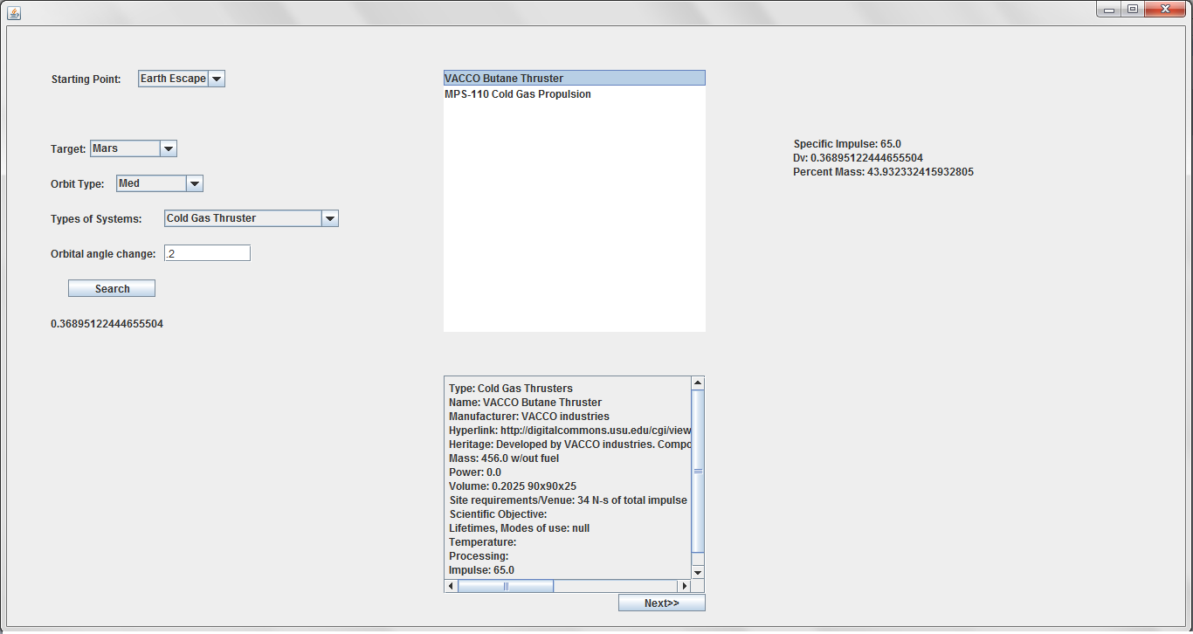
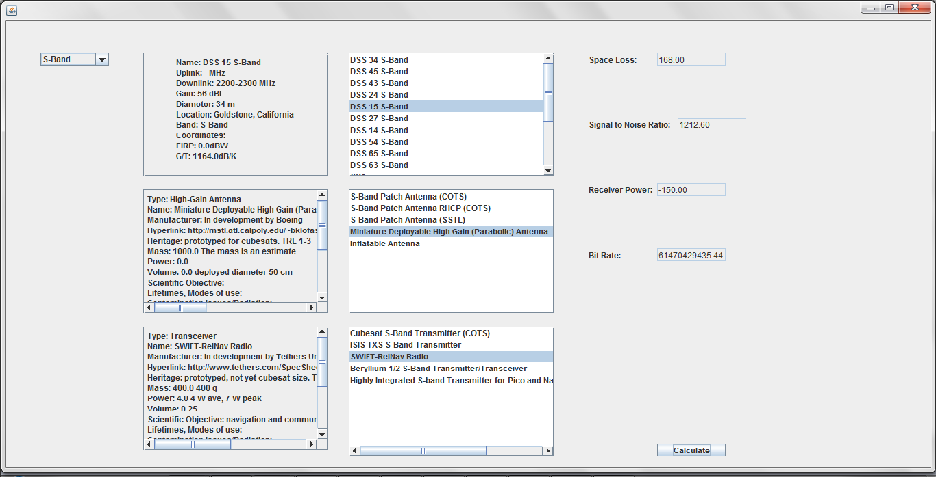
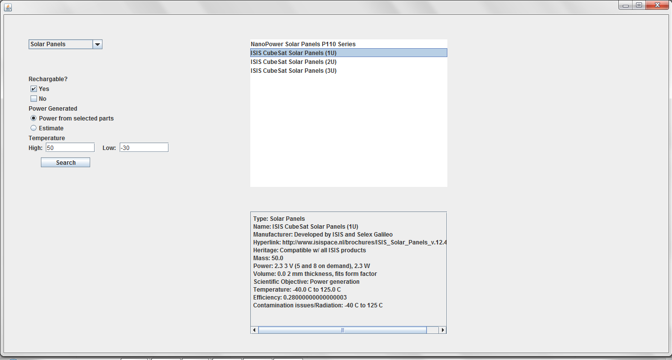
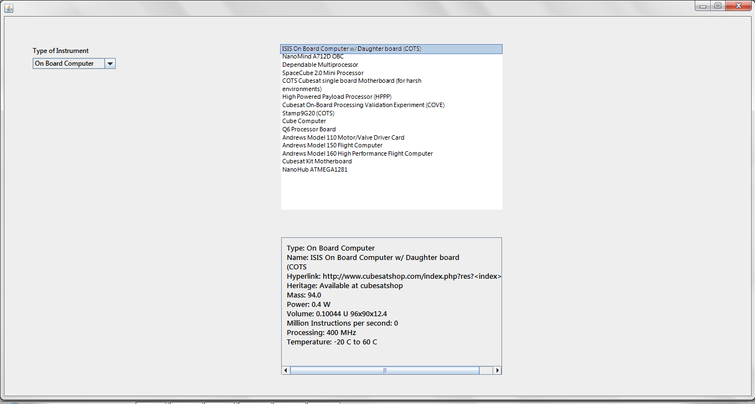
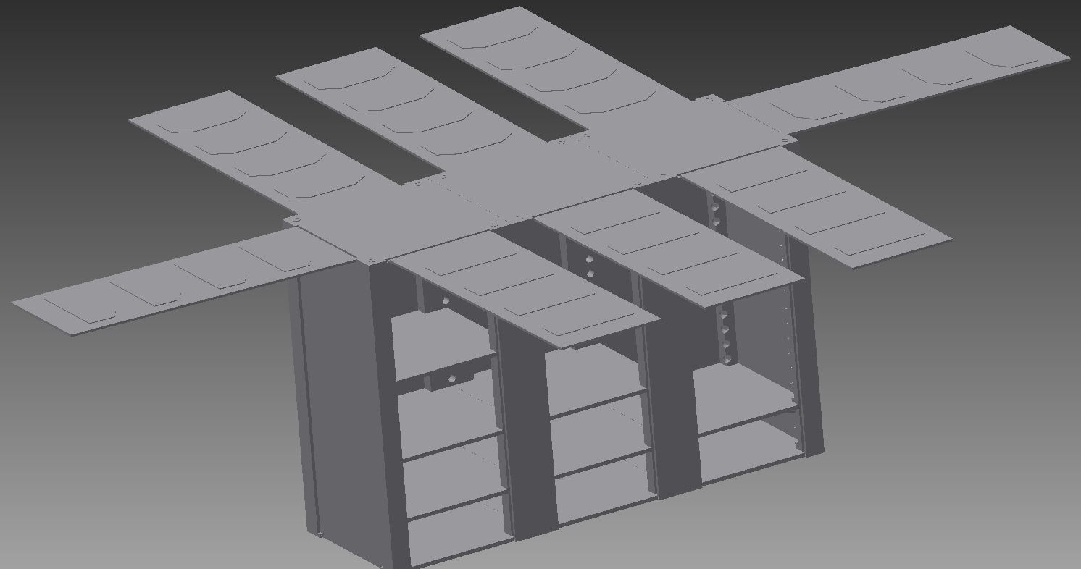
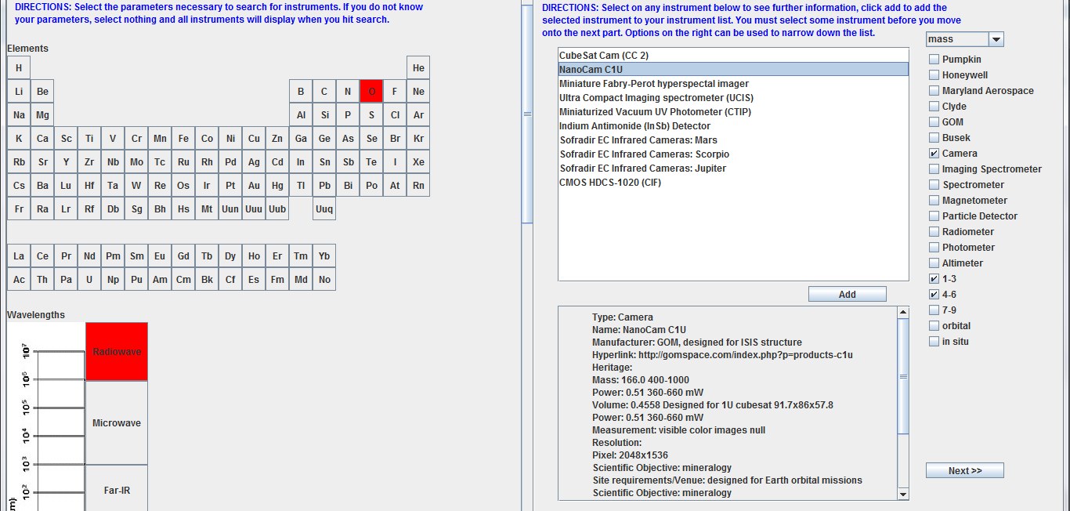
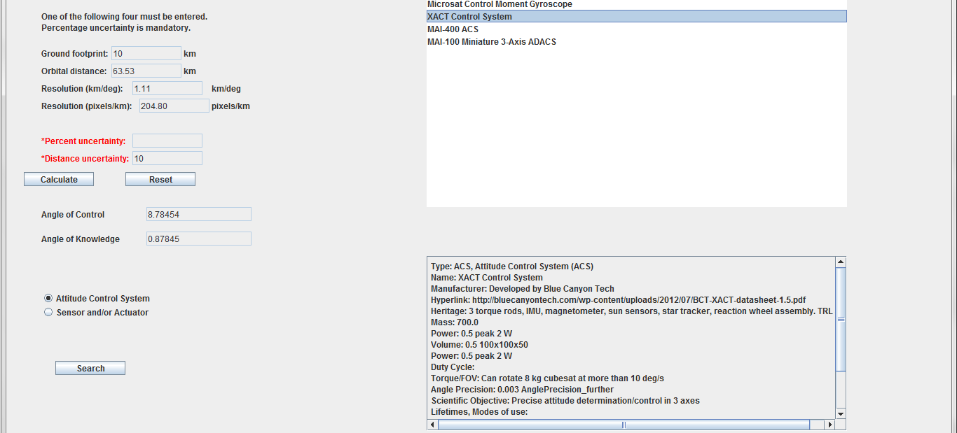
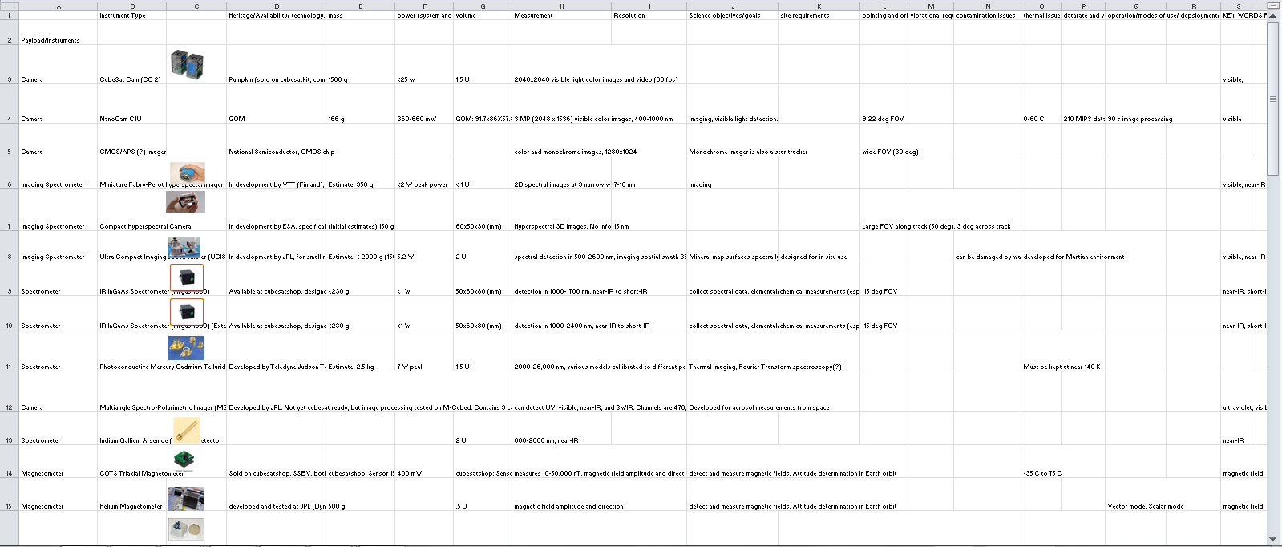

Science Payloads and Advanced Concepts for Exploration (SPACE) Interactive Tool
Pamela E. Clark¹, Zoe M. Himwich, Robin M. Leiter, Aparna M. Natarajan, and Jacob Rosenthal
¹Catholic University of America , Contact: Pamela.E.Clark@NASA.gov
Purpose
The project aims to make CubeSat construction accessible to scientists who do not have subsystem experts available for early design stages. To accomplish the goal necessitated a database of existing CubeSat parts and a program to search through the database.
Concluding Notes
What the program accomplishes:
Provides a basic system for a deep space CubeSat based off of user specifications for a mission
Limitations:
The user will need to hold some mission development knowledge and a scientific background.
The user must use their own knowledge to organize the parts once selected. The tool is meant for concept development rather than a final solution.
Challenges:
The visual element originally planned included space optimization software to simulate the construction of the CubeSat. This was too time-consuming for our project.
Solution: We instead decided to make 3D printing files for each part, allowing the user to assemble their CubeSat by hand.
The formula to calculate dV in the propulsion system included variables which depended on the percentage of CubeSat mass allotted to fuel and the specific impulse of the propulsion system. There was no way to know which parts would be sufficient based on one variable.
Solution: We decided not to search by a criteria of minimum dV provided but instead had the program calculate a low estimate of the dV required on the trip and display for each propulsion search result the percentage of CubeSat mass devoted to fuel it would require.
The communication system on the CubeSat could not, on its own, provide a guarantee of sufficient communication on a given trip without knowledge of the ground station used.
Solution: The user must select a ground station as well as a transmitter or receiver in order to ensure that communication needs are met.
As long as the user is informed of the limitations and functionality of the program, they should be able to use it to effectively draft a CubeSat system.
Method
Our approach splits the CubeSat elements into subsystems of Instruments, Attitude Control, Communication, Propulsion, Command and Data Handling, and Power. Each subsystem needs its own spreadsheet of existing parts and its own search page. The graphic user interface (GUI) allows the user of the tool to progress through each subsystem search page in a set order. As the user searches each subsystem, parts that meet the criteria appear in the results box and may be selected for addition to the CubeSat in development.
Once selected, parts appear on the final Parts List, an excel sheet that the user receives after selecting a part for each subsystem, which will display specifications such as mass, volume, and power requirements for each of the parts individually and for the systems combined. It is then possible to return to subsystems to edit selections after seeing the combination.
In addition to specifications, there are 3D models attached to each part which the user can print at will. The aim of the 3D models is to enable drafting of a CubeSat layout with the selected parts.
The Propulsion Page aims to give the user a low estimate of the dV required to make any given trip to a target body in space. From this low estimate and an added calculation for any anticipated change in the angle of orbit, the search function returns a list of possible parts and information about how much fuel the CubeSat would need to carry in order to reach a destination with that part.
The Communication Page allows the user to select several different factors that influence their ability to communicate with a CubeSat in space. This is extremely important because the quality of signal that a CubeSat or ground station receives is dependent on the equipment at both sites. This page will also display the full information on each selected piece (ground station and part). The user can choose from a set of results for each.
The program Autodesk Inventor allowed creation of 3 dimensional models of each of the parts in the spreadsheet. These parts are accessible to users of the program and the user can print chosen parts. This should make visualization of the product relatively simple and will enable the designer to modify part placement within the structure. The image to the left is a model of a 6 U (1U = 10cm³) CubeSat frame.
The Power Subsystem Page again gives a list of possible search parameters and allows the user to enter the known information. From this the search will return several possible choices and show more information for each below the results box.
The Command and Data Handling Page similarly allows selection by certain parameters. The most important option is that of the type of part. The image above displays a search for On-Board Computers. Full part specifications are provided.
Formulas
$dV=g_{0}I_{sp}\ln{\frac{m_{i}}{m_{f}}}$ ^{[2]}
$P_{r}=EIRP+G_{r}−\sum{L}$ ^{[1]}
$\frac{P_{r}}{N_{0}}=EIRP+\frac{G}{T}−k−\sum{L}$ ^{[1]}
$R=\frac{P_{r}}{N_{0}}−\frac{E_{B}}{N_{0}}$ ^{[1]}
Program Acknowledgments
Microsoft Office Excel. Vers. 2007. Redmond, WA: Microsoft Corporation, 2007. Computer software.
Eclipse Kepler. Computer software. Eclipse. Vers. 3.9.2. The Eclipse Foundation, 2014. Web. <https://www.eclipse.org/>.
The Instrument Selection Page helps the user select a payload for their CubeSat. The instruments are sorted by several parameters that ask the user which elements, compounds, or measurements they want to detect. The search then suggests the best options and offers detailed information about the instruments.
The Attitude Control Page helps a user determine the appropriate system for attitude control using parameters such as instrument resolution and orbital requirements, which tie into the already selected instrument parts and the mission goals. A series of options appear in the result box and offer specific information.
Sources
Stocklin, Frank J. UMD ENAE 691 RF Communications. PPT.
Spence, Douglas, Eric Ehrbar, Nate Rosenblad, Nate Demmons, Tom Roy, Samuel Hoffman, Dan Williams, Vlad Hruby, and Chris Tocci. "Electrospray Propulsion Systems for Small Satellites." 27th Annual AIAA/USU Conference on Small Satellites
Cohen, Barbara. "Lunar Flashlight: Mapping Lunar Surface Volatiles Using a Cubesat." Servi Exploration Science Forum. NASA, n.d. Web. <http://nesf2014.arc.nasa.gov/content/cohen-barbara-lunar-flashlight-mapping-lunar-surface-volatiles-using-cubesat>
Clark, Pamela E., and Michael L. Rilee. Remote Sensing Tools for Exploration: Observing and Interpreting the Electromagnetic Spectrum. N.p.: Springer, 2010. Print.
Staehle, Robert L., Joseph Lazio, Martin Wen-Yu Lo, Pantazis Mouroulis, Neil Murphy, Paula J. Pingree, Thor Wilson, Diana Blaney, Hamid Hemmati, Dayton Jones, Andrew Klesh, Paulett Liewer, Jordi Puig-Suari, Austin Williams, Tomas Svitek, Bruce Betts, and Louis Friedman. "Interplanetary CubeSat Architecture and Missions." AIAA SPACE (2012): n. pag. Web.
Background image of Earth Moon’s Tycho Crater courtesy of NASA (Hubble Space Telescope)
Quick Information
Purpose: To construct a software tool that helps CubeSat designers find parts
Method: Standardize the subsystem requirements of a CubeSat and create parameter searches resulting in a list of possible parts
Design: A series of search pages with a final printout of all selected parts. See images and demonstration.
Conclusion: A successful tool with a list of parts currently in production for each subsystem and search options that narrow down results.
The spreadsheet database includes information such as the parts’ mass, volume, power requirements, temperature limitations, and a published source where a user can find more information. The display on each of the search pages shows these facts in an additional information box when the user selects the part.
Future Efforts
As technology for CubeSat instruments and parts improves we hope to keep the SPACE tool up to date by adding new parts to the searchable database and eliminating those no longer in production. The program searching through the database will also receive updates as more information becomes available about important parameters. There are some upcoming CubeSat launches planned, including the EM1 Mission, which will launch CubeSats including Lunar Flashlight^{[3]}. Information from this mission and others will make clear when new important factors come to light that the program must consider.

