Slide 1
Order Fulfillment Automation & Exception Monitoring
BUSINESS ANALYSIS CASE STUDY · PROJECT SUMMARY
AugBridge Commerce: a small cross-border e-commerce business selling on Etsy
10
7
16
16
34
10,685
pain points
business requirements
functional requirements
user stories
UAT test cases
simulated orders
2 out of scope
not run
12 weeks
A portfolio case study based on hands-on experience in cross-border e-commerce. The company and the dataset are simulated, and the solution has not been built.
Notes:
This deck is the short version of my BA case study. The story goes from the current process and its pain points, to requirements, a proposed To-Be design in Lark, and how the requirements trace to user stories and test cases. The company and data are simulated; nothing was built, so I do not claim results.

Slide 2




Business Context and Problem
Every order is handled by hand, so the workload grows with order volume.
Each order needs four manual steps
6
3
1. Select the supplier
PD&CS choose a supplier by hand for every order.
Etsy shops
external suppliers
2. Enter the order
selling mainly to North America and Europe
2 primary, 1 backup; all have an API that is not used today
Order and artwork details are typed into the supplier's system.
3. Check status again and again
Staff open each supplier system to see production and shipping status.
9
~7×
4. Copy tracking back to Etsy
Tracking numbers are copied from the supplier system to Etsy.
team members
volume in peak season
The problem Information is spread across Etsy, supplier systems, spreadsheets, notebooks and chat. There is no shared view of order status, so late or stuck orders are hard to spot early in peak season.
4 PD&CS, 4 Designers, 1 Team Lead
about 400 orders a week, up to about 2,800
Notes:
AugBridge is a small Etsy business: 6 shops, 3 suppliers, 9 people. Four PD&CS staff handle product work and every order. Each order needs four manual steps, so the work grows with volume. In peak season volume is about 7 times a normal week. These figures are scenario figures I set for the case study, based on the kind of team I worked in.

Slide 3
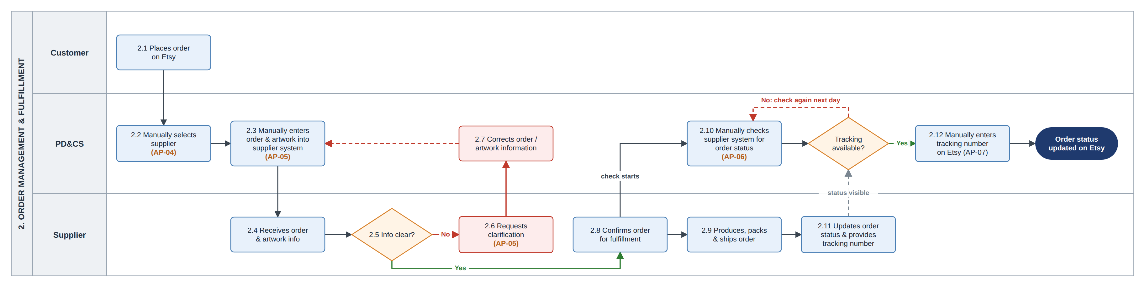
As-Is Process and Pain Points
The current order flow has four manual steps and eight pain points in scope.
AP-03
Information spread across many tools
AP-04
Supplier chosen by hand for every order
AP-05
Order and artwork details retyped
AP-06
Status checked repeatedly in supplier systems
AP-07
Tracking numbers copied to Etsy by hand
AP-08
Late or stuck orders found too late in peak
AP-09
Weekly report prepared by hand (6–8 hours)
AP-10
Customer issues handled in chat, no shared record
8 pain points are in scope. Out of scope: AP-01 (combined PD&CS role) and AP-02 (manual product research).
Notes:
This is the current order process. The orange labels on the diagram are the pain points. I documented 10 pain points; 8 are in scope. AP-01, the combined PD and CS role, and AP-02, manual product research, are out of scope because they would not remove the repetitive order work this project targets.

Slide 4
Evidence and Root Cause Analysis
Simulated order data shows the size of the peak. Problem orders are found late because there is no shared view and no rule to flag them.
Root cause analysis: AP-08
Problem Stuck or late order lines are identified late, often only after a customer complains.
1
Staff check orders one by one across supplier systems.
2
Status information is spread across Etsy, supplier systems and spreadsheets.
3
There is no shared order-status view and no exception mechanism.
10,685
7,150
5.2–7.1%
81.0–83.7%
Main process gap No shared view and no rule that flags lines needing action.
Addressed by BR-01 and BR-04.
orders in 12 weeks
in peak weeks 8–11
overdue, normal weeks
overdue, peak weeks
Working hypothesis Manual work per order may make peak workload hard to manage. Tested in the pilot.
Overdue = order-to-delivery time above 10 business days. Volume and cycle time were set as simulation inputs, so this is operational context, not causal proof.
Notes:
There is no central order database, so I built a simulated 12-week dataset and analyzed it with SQL. Peak weeks 8 to 11 have much higher volume and an overdue rate above 80 percent. But volume and cycle time were inputs of the simulation, so I use this as context only, not as proof of the cause. For the root cause of late detection, the main gap is that there is no shared order-status view and no rule to flag lines that need action. Manual work per order is a working hypothesis that the pilot would test.

Slide 5
Business Objectives and Requirements
Each pain point in scope is covered by a business requirement.
ID | Business requirement | Pain point | Priority
BR-01 | One shared workspace for order, supplier and issue information | AP-03 | Must
BR-02 | A shared Product Type-to-supplier mapping, so no supplier is chosen by hand | AP-04 | Must
BR-03 | Complete orders sent to suppliers without retyping, with validation | AP-05 | Must
BR-04 | Order lines monitored through an exception queue based on status, expected time, ship-by date and events | AP-06, AP-08 | Must
BR-05 | Tracking numbers sent to Etsy without manual copying | AP-07 | Must
BR-06 | Current operational figures without a manual weekly report | AP-09 | Should
BR-07 | Every customer issue recorded as a case with cause, owner, status and result | AP-10 | Should
Direct objectives
1
Reduce repetitive internal order work
2
Detect and handle order exceptions earlier
3
Improve operational visibility
Intended outcome: fewer avoidable late orders. Tracked as an outcome, not proven yet.
If only two things can be built first
BR-01 + BR-04: one shared place for information, and one queue of the order lines that need action.
Out of scope Product research and listing, separating the PD&CS role, automatic re-routing between suppliers, carrier delays.
Must = minimum useful scope (releases R0–R2). Should = delivered in R3 or R4.
Notes:
Each in-scope pain point leads to a business requirement. AP-06 and AP-08 lead to one requirement, BR-04, because the same exception queue addresses both. Five are Must and form the minimum useful scope. BR-06, the dashboard, and BR-07, issue cases, are Should, because the core order flow works without them. If I could build only two things first, they would be BR-01 and BR-04.

Slide 6

Solution Evaluation and Selection
Five options were scored against eight criteria. Lark scored highest.
Why Lark
Fits the problem
Information is spread across many tools today. A stack of three separate tools could repeat that.
Fits the constraints
The cost suits about 10 users; one Developer can maintain it.
One workspace
Orders, supplier mapping, exceptions, issue cases and reporting in one place.
Trade-offs accepted
API support is Adequate, not Strong
→ integration layer and failure alerts
One platform, one dependency
→ the current process stays available
8 weighted criteria taken from the business requirements and constraints: linked tables, automation, API support, dashboard, chat and tasks, cost for about 10 users, one Developer can maintain it, ease of use. The ratings are my own assessment, not a full market comparison.
Plan limits and personal data
→ checked in R0 and before go-live
Notes:
I compared five options against eight weighted criteria that come from the business requirements and constraints. Lark scored 50 of 54. The main reason is fit with the problem: information is already spread across many tools, and a stack of three tools could repeat that. The ratings are my own assessment. Plan limits and pricing would be checked in R0. Lark is proposed for order fulfillment only; the internal task website stays as it is.

Slide 7
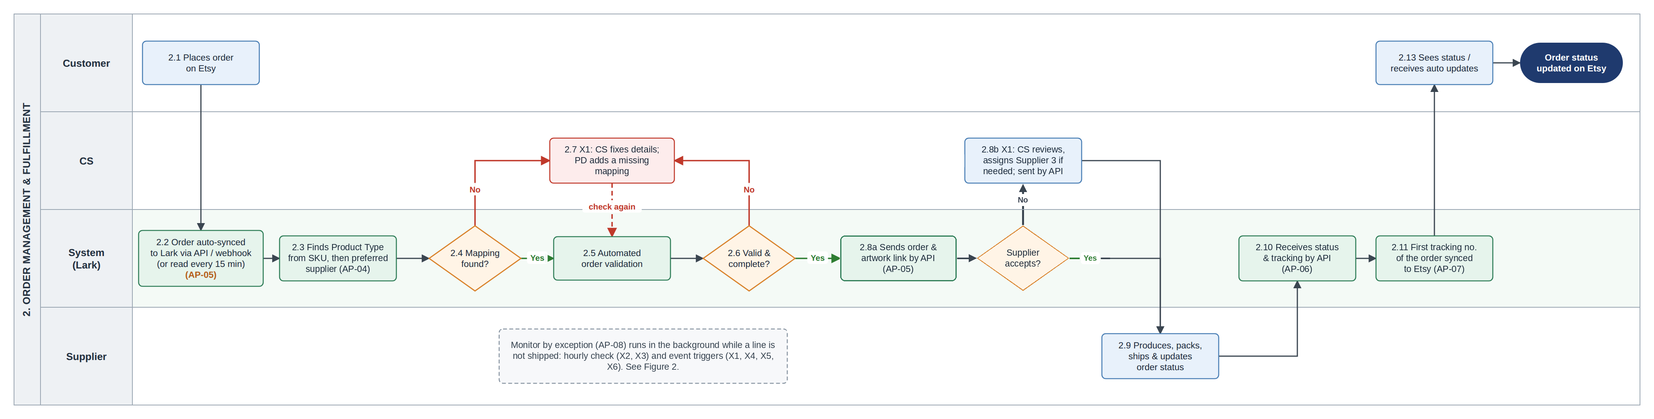
To-Be Process
The system handles the routine steps. CS steps in only when an order line needs action.
Choose the supplier
Send the order
Follow status
Update tracking
As-Is For every order, by hand
To-Be From the Product Type mapping. CS assigns the backup supplier only when needed.
As-Is Typed into the supplier system
To-Be Checked, then sent by API. CS fixes only the lines that fail the check.
As-Is Supplier systems checked repeatedly
To-Be Status comes back by API. CS works the exception queue.
As-Is Tracking numbers copied by hand
To-Be First tracking number synced to Etsy. By hand only if the sync fails.
Team: the 9 current people stay in their roles and 1 Developer is added. PD and CS are not split into separate roles.
Notes:
This is the proposed order flow. Green boxes are done by the system. Orders come into Lark from Etsy. The system finds the Product Type of the SKU, assigns the preferred supplier from the mapping, checks the line and sends it to the supplier by API. Status and tracking come back by API, and the first tracking number of an order is synced to Etsy. If the preferred supplier cannot fulfill a line, CS assigns Supplier 3 for that line only. There is no automatic re-routing, because the business has no supplier stock data.

Slide 8
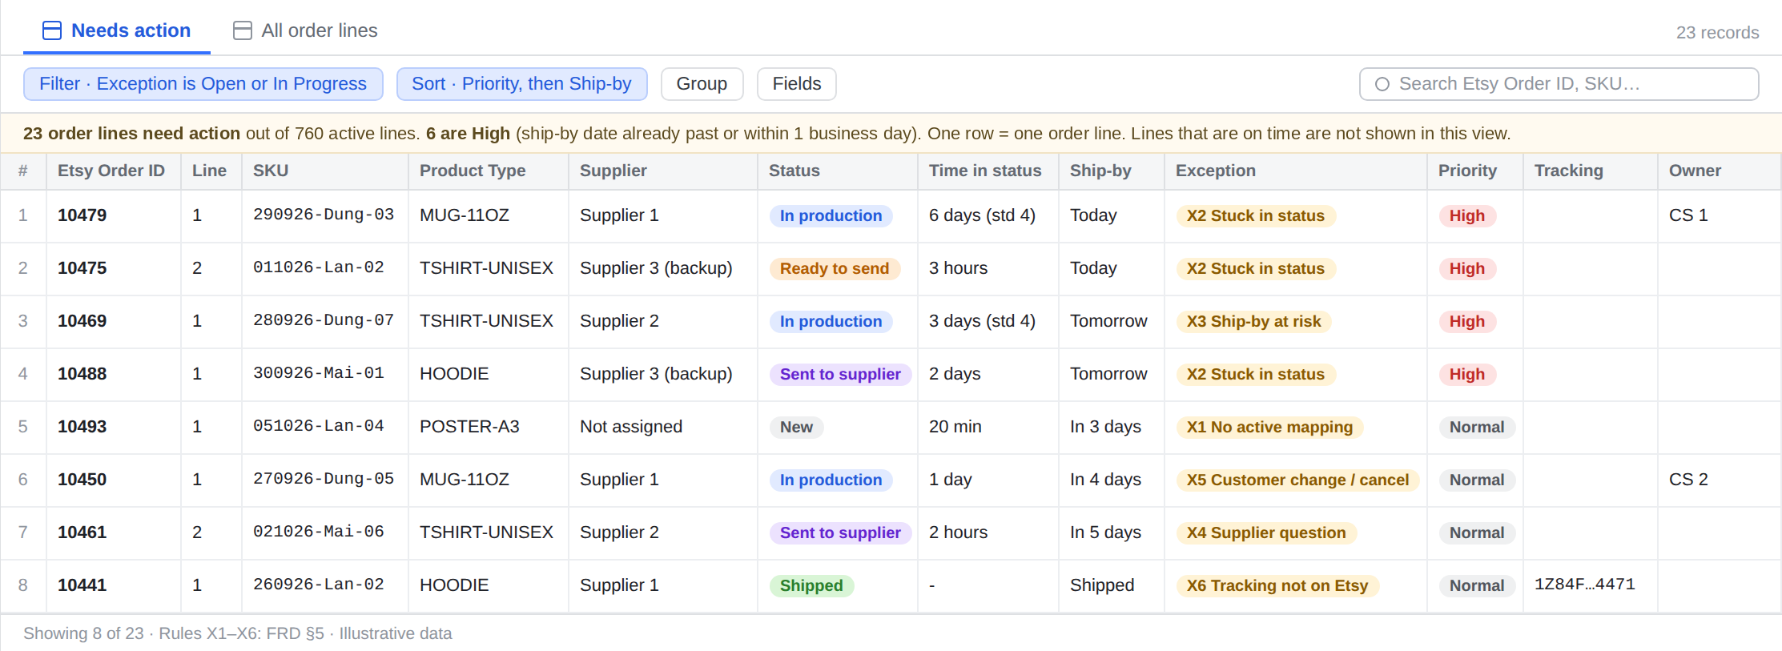
Exception Handling
CS works from one queue that shows only the order lines that need action.
Cannot send Event
X1
The order check fails, there is no active mapping, or the supplier rejects the line.
Stuck in status Hourly check
X2
The line stays in a status longer than expected.
Ship-by date at risk Hourly check
X3
The expected ship date is after the ship-by date.
Supplier question Event
Wireframe: the Needs action view in Lark Base (illustrative data)
X4
CS logs a question from a supplier.
Priority
Escalation
No duplicates
Customer change or cancel Event
High when the ship-by date has passed or is 1 business day away or less.
A High exception with no owner for over 2 working hours goes to the Team Lead.
A line shows once per active problem. No second X2 or X3 is added.
X5
Accepted only before production starts.
Tracking not on Etsy Event
X6
The tracking number could not be synced to Etsy.
Main decision Checking every order by hand does not scale in peak season.
X1, X2, X3 and X6 are in the core release (R1); X4 and X5 are in R3.
Notes:
This is the main design decision. Checking every order by hand does not scale in peak season, so CS works only on the order lines that need action. There are six exception reasons. X2 and X3 come from an hourly check; the others are raised when an event happens. Each exception has a priority and an owner. The time values, like the 2 working hours for escalation, are assumed and would be confirmed in the pilot. The rules help CS find problem lines earlier; they do not make suppliers faster.

Slide 9

Requirements Traceability and UAT
Each pain point in scope links to a requirement, user stories and test cases.
8
in-scope pain points
BRD
7
business requirements
BRD
16
functional requirements
FRD
16
user stories
User Stories
34
UAT test cases
UAT pack
BR | Pain point | Functional req. | User stories | Test cases | Release
BR-01 | AP-03 | FR-01, 02 | US-01, 02 | TC-01a, 02a | R1
BR-02 | AP-04 | FR-03, 04 | US-03, 04 | TC-03a, 04a–c | R1
BR-03 | AP-05 | FR-05 to 08 | US-05 to 08 | TC-05a–c, 06a–b, 07a–d, 08a | R1, R3
BR-04 | AP-06, AP-08 | FR-09 to 12 | US-09 to 11 | TC-09a–c, 10a–e, 11a–b | R1, R3
BR-05 | AP-07 | FR-13 | US-12 | TC-12a–b | R1
BR-06 | AP-09 | FR-14 | US-13 | TC-13a | R3
BR-07 | AP-10 | FR-15, 16 | US-14 to 16 | TC-14a–b, 15a–b, 16a | R4
UAT pack
33
P1: must pass before the release goes live (1 is P2)
13
negative test cases
5
technical checks run by the Developer
Not run: the solution is not built
Summary of 06 RTM. Each test case is counted once, under the user story it mainly checks.
Notes:
The RTM links every in-scope pain point to a business requirement, functional requirements, user stories and test cases, with the release and the reason for each link. For example, AP-04, choosing the supplier by hand, leads to BR-02, then FR-03 and FR-04, user stories US-03 and US-04, and test cases TC-03a and TC-04a to c. The UAT pack has 34 test cases. They are written with steps, test data and expected results, but they are not run because the solution is not built.

Slide 10
Release Plan and Pilot
Six releases in order of dependency. Management decides after R0 and after the R2 pilot.
R0
R1
R2
R3
R4
R5
Discovery and baseline
Core order fulfillment
Pilot and measure
Queue additions and dashboard
Issue cases
Peak season review
Confirm APIs and mapping; measure the baseline.
Build and test the core flow and the queue.
Live orders in 1 or 2 shops, compared with R0.
X4, X5 and the dashboard; other shops added.
Cases, refunds and replacements.
One full peak season; KPI targets are set.
R0 to R2 = minimum useful scope (Must requirements). Management decides at the R0 and R2 gates: continue, adjust or stop. The order follows dependencies, not dates.
Pilot (R2)
How success is measured
Management decisions
1 or 2 of the 6 shops, in normal weeks
Suppliers 1 and 2, with Supplier 3 as backup
Core flow and exceptions X1, X2, X3, X6
Manual process stays available
Manual time per order (R0 vs R2)
Tracking delay to Etsy
Needs-action lines per day
Late lines flagged early
After R0: continue, adjust scope or stop
After R2: continue or adjust
After R5: keep or change the rules and the supplier setup
If the pilot is stopped, the pilot shops go back to the current process.
No targets before the pilot. Targets are set in R5.
The full Developer capacity starts only after the R0 gate.
Notes:
The plan has six releases, ordered by dependency, not by date. R0 confirms the assumptions and measures the baseline before the build is committed. R1 builds and tests the core flow. R2 runs it as a pilot on one or two shops in normal weeks, and the results are compared with the R0 baseline. R0 to R2 is the minimum useful scope. Management decides at each gate. No targets are set before the pilot because these measures have never been measured.

Slide 11
Business Case, Risks and Limitations
What the project needs, what could go wrong, and what this case study does not prove.
Added resources
Planning benchmark
1 Developer, planned at about 40 hours a week
A paid Lark plan for about 10 users (cost to confirm in R0)
A small hosting cost for the integration layer
6.0 minutes per order
40 Developer hours × 60 ÷ 400 orders a week
This is the time saving per order that would match the planned Developer hours. It is not an expected result, ROI or a cost saving. The real saving is measured as R0 minus R2.
The team stays at 9 people. No headcount reduction is assumed.
Main risks
Limitations
R-01
A supplier API may be limited or unreliable
Confirm access in R0. Failed calls are logged and the lines stay visible in the queue.
Solution not built; UAT not run
Order data is simulated
Supplier API access: to confirm in R0
Manual effort per order is a working hypothesis
R-03
A wrong mapping may send orders to the wrong supplier
PD checks Product Types and the mapping against recent orders before auto-assignment.
R-04
There is only one Developer
Document the workflows and setup. The manual process is the contingency.
R-06
In peak season the queue may grow too large
Measured in the pilot and R5. Management decides if the rules need to change.
No results or targets are claimed.
Notes:
The project adds one Developer, a paid Lark plan and a small hosting cost. The team stays at 9 people. I do not have real cost data, so I did not calculate ROI. The 6.0 minutes per order is only a planning benchmark: it is the saving per order that would match the planned Developer hours. The real saving would be measured as R0 minus R2. The main risks are supplier API access, a wrong mapping, having only one Developer, and the queue growing too large in peak season. Each has a mitigation and an owner in the BRD. The limits are clear: the solution is not built, the data is simulated, and no results are claimed.

