Slide 1

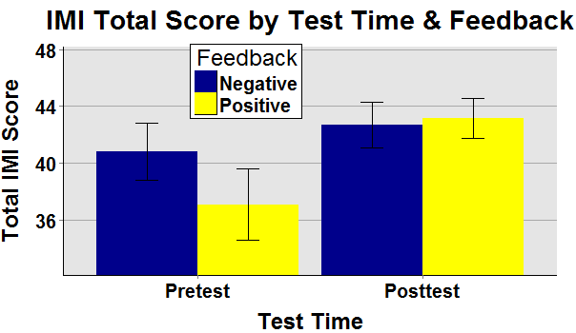
“You did better than most people!”
The Influence of Positive and Negative Verbal Feedback on Motivation
in a Timed and Repeated Task
Huong Nguyen and Jane’t Morrison
Eastern Oregon University, La Grande, OR 97850-2807 USA
OPTIONAL
LOGO HERE
OPTIONAL
LOGO HERE
Abstract
Method
Results
Discussion
We investigated whether positive and negative verbal feedback, when perceived as genuine, can increase or decrease motivation. We measured motivation with modified versions of the Intrinsic Motivation Inventory questionnaire (IMI I and IMI II). Results indicated statistic significance for positive feedback on motivation.
Participants
24 male and female participants from local communities who were at least 18 years old and fluent in English.
Results indicated that positive feedback correlated with an increase in Posttest Total IMI scores, which measured motivation. All other variables did not have significant relations. Deci (1971) speculated that verbal reinforcement, as a form of social approval, does not seem to decrease intrinsic motivation because it is not perceived as a control mechanism. Our study was limited to a cohort who enjoyed tangrams; findings cannot be generalized. Some feedback phrases may be more or less positive or negative. Researchers were rated favorably as genuine; there was no information for disingenuous feedback.
Stimuli (Counterbalanced and Randomly Assigned)
Positive Verbal Feedback:
“You did better than most people!” “Wow, that was fast!”
Introduction
Negative Verbal Feedback:
The study investigated the effect of feedback on motivation. Some researchers have argued that tangible extrinsic rewards can undermine existing intrinsic motivation (e.g., Deci, 1971; Kruglanski, Friedman, & Zeevi, 1971; Lepper, Greene & Nisbett, 1973). However, others have found that intangible extrinsic rewards, such as verbal praise, can be effective (Breckler, Olson, & Wiggins, 2006), if perceived as genuine (Akin-Little, Lovett, and Little 2004).We were interested whether: a) motivation will slightly increase with positive feedback, b) motivation will increase even more with negative feedback. Results can pinpoint the specific conditions in which feedback is most effective and can be a tool for improved performance.
“This must be difficult for you.”
“You should recheck your strategy.”
Procedure
Participants filled out IMI I Questionnaire (measured motivation).
Participants completed as many tangrams as possible for 5 minutes.
Participants received positive or negative verbal feedback,.
Participants were given the option to repeat the task again.
If participants agreed to repeat the task, they filled out IMI II (measured motivation after independent variable.
Participants filled out Genuine Verbal Feedback questionnaire to rate researchers’ genuineness.
Summary
Positive verbal feedback appeared to correlate with significant increase in motivation. When total pretest scores were compared to total posttest scores after manipulation, there was no significant difference.
Anova showed Test Time as a function of Feedback at F(1,21)=27.97, p<0.001.
Welch Two Sample t-test showed df = 21.05, p-value = 0.25, for Pretest scores.
Welch Two Sample t-test showed df = 21.67, p-value = 0.81, for Posttest scores.
Paired t-test showed df = 11, p-value = 0.51, for Pretest and Posttest scores for Negative Feedback.
Paired t-test showed df = 11, p-value = 0.04 (p<0.05), for Pretest and Posttest scores for Positive Feedback.
References
References
Akin-Little, K. A., Eckert, T. Lovett, B. J., & Little, S. G. (2004). Extrinsic reinforcement in the classroom: Bribery or best practice. School Psychology Review, 33, 344-362.
Breckler, S. J., Olson, J. M., & Wiggins, E. C. (2006). Social Psychology Alive. Belmont, CA:Thomson Wadsworth.
Deci, E. L. (1971). Effects of externally mediated rewards on intrinsic motivation. Journal of Personality and Social Psychology, 18, 105-115.
Deci‚ E. L.‚ Eghrari‚ H.‚ Patrick‚ B. C.‚ & Leone‚ D. (1994). Facilitating internalization: The self-determination theory perspective. Journal of Personality‚ 62‚ 119-142.
Kruglanski, A. W., Friedman, I. & Zeevi, G. (1971). The effects of extrinsic incentive on some qualitative aspects of task performance. Journal of Personality, 39, 606-617.
Lepper, M. R., Greene, D., & Nisbett, R. E. (1973). Undermining children’s intrinsic interest with extrinsic rewards: A test of the “overjustification” hypothesis. Journal of Personality and Social Psychology, 28, 129-137.
Plant‚ R. W.‚ & Ryan‚ R. M. (1985). Intrinsic motivation and the effects of self-consciousness‚ self-awareness‚ and ego-involvement: An investigation of internally-controlling styles. Journal of Personality‚ 53‚435-449.
Ryan‚ R. M. (1982). Control and information in the intrapersonal sphere: An extension of cognitive evaluation theory. Journal of Personality and Social Psychology‚ 43‚ 450-461.
Ryan‚ R. M.‚ Connell‚ J. P.‚ & Plant‚ R. W. (1990). Emotions in non-directed text learning. Learning and Individual Differences‚ 2‚ 1-17.
Ryan‚ R. M.‚ Koestner‚ R.‚ & Deci‚ E. L. (1991). Varied forms of persistence: When free-choice behavior is not intrinsically motivated. Motivation and Emotion‚ 15‚ 185-205.
Statistical Design
Within-Subjects Mixed design Anova for Total IMI scores as a function of Test Time and Feedback, accounting for variance.
2 Welch Two Sample t-tests
2 Paired t-tests

