Slide 1
Istio Enablement
huoqif@cn.ibm.com

Slide 2
Agenda
Service Mesh in Kubernetes
Istio Architecture
Istio typical usage
Istio main functions
Managed Istio in IKS
Istio in CC and Peer Pod?

Slide 3
Service Mesh in Kubernetes – What is
Micro Services communicating is complex
Service Mesh -- Manage traffic in more scalable and graceful manner
Connect
Secure
Monitor

Slide 4
Service Mesh in Kubernetes – Options
Istio (1st popular, Google, IBM, Microsoft…)
Linkerd (2nd popular, CNCF)
Consul (HashiCorp suite)
K8s built-in (growing…)
…
Istio-Consul-Linkerd Comparing

Slide 5
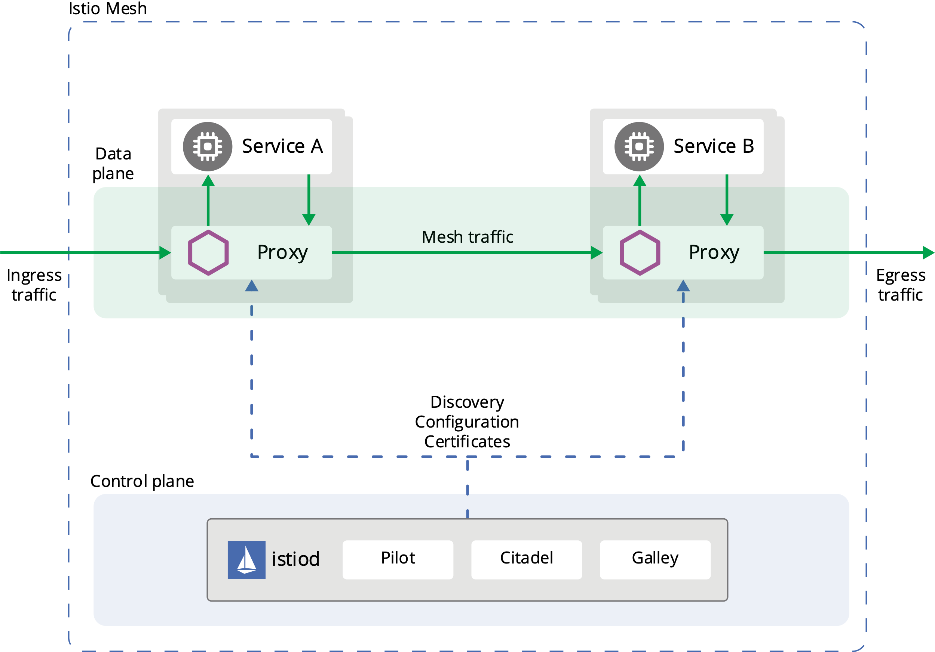
Istio Architecture

Slide 6
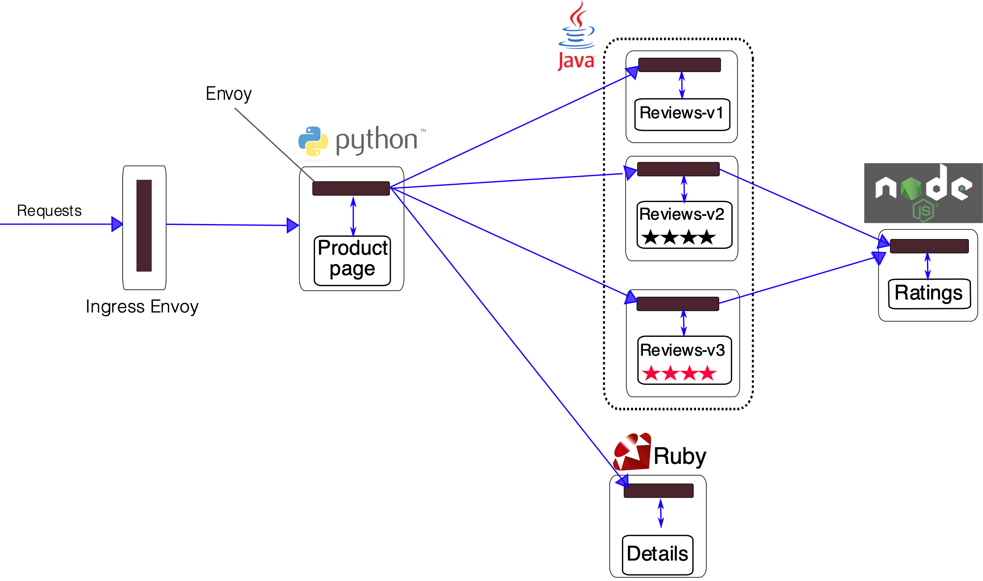
Istio typical usage

Slide 7
Istio main functions
Traffic management
Security
Obervability (Telemetry)

Slide 8
Istio main functions – Inject sidecar
Automatic injection
Manual injection
Customizing injection

Slide 9
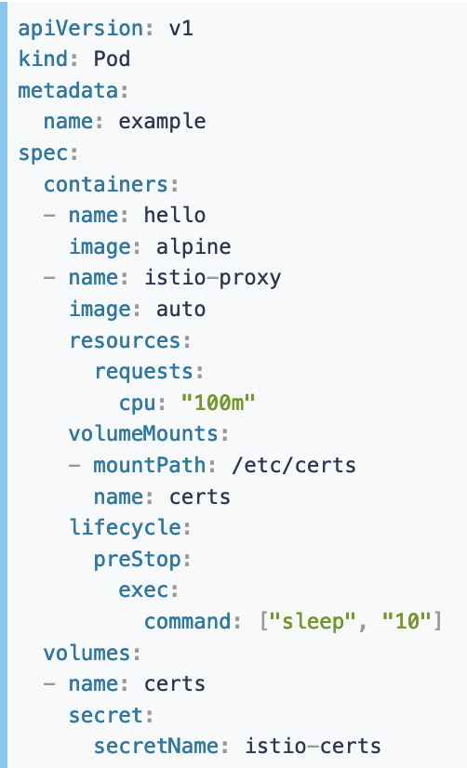
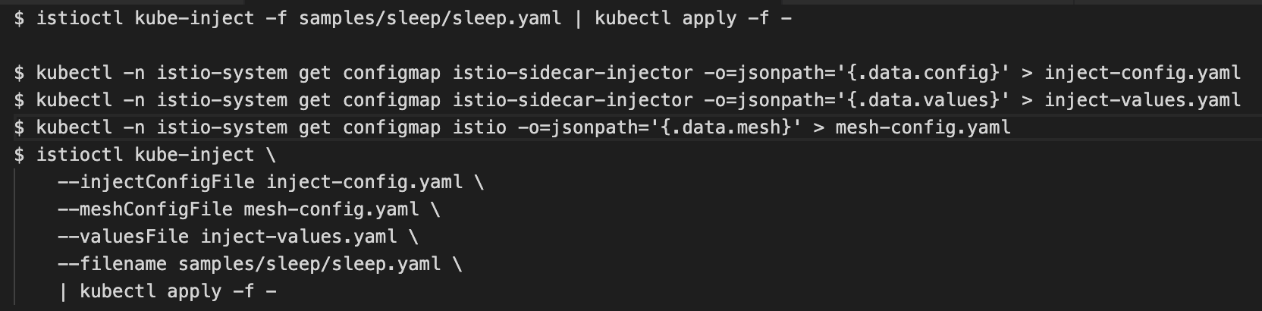
Istio main functions – Inject sidecar example

Slide 10
Istio main functions – Traffic management
Basic
Ingress
Egress
Policy Enforcement

Slide 11
Istio main functions – CRDs
VirtualServices
Destination Rules
Gateways
Service Entries
Sidecars
…

Slide 12
Istio main functions – Basic traffic management
Routing
Networking resilence and test
Timeouts
Retries
Circuit breakers
Fault injection

Slide 13
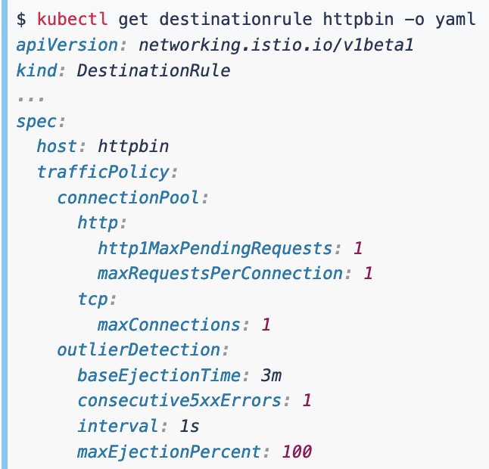
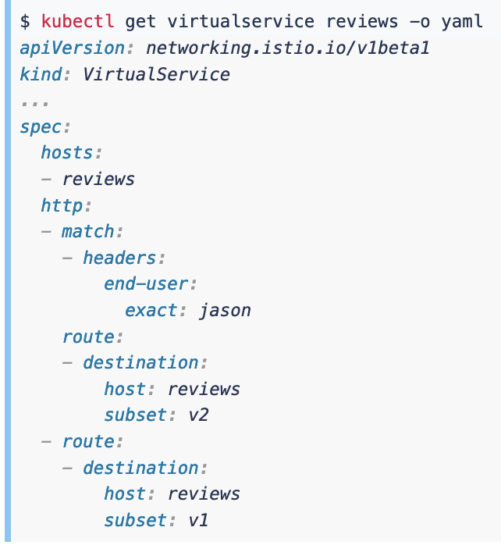
Istio main functions – Basic traffic example

Slide 14
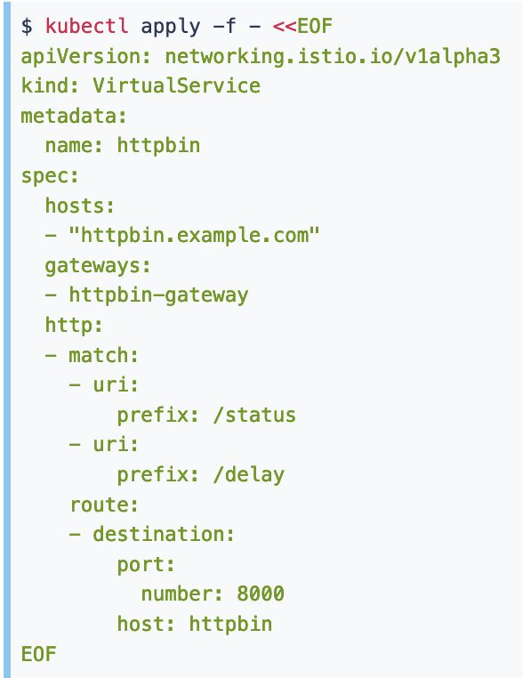
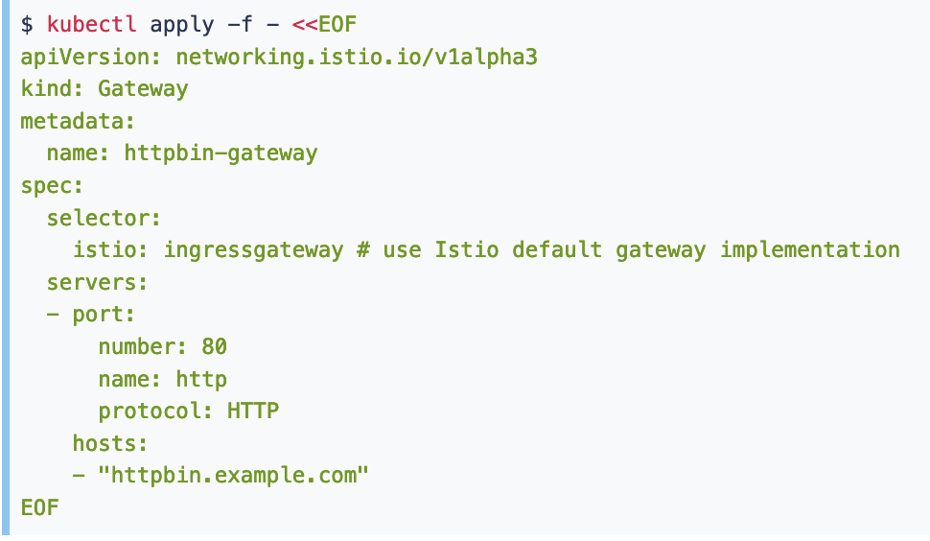
Istio main functions – Ingress

Slide 15
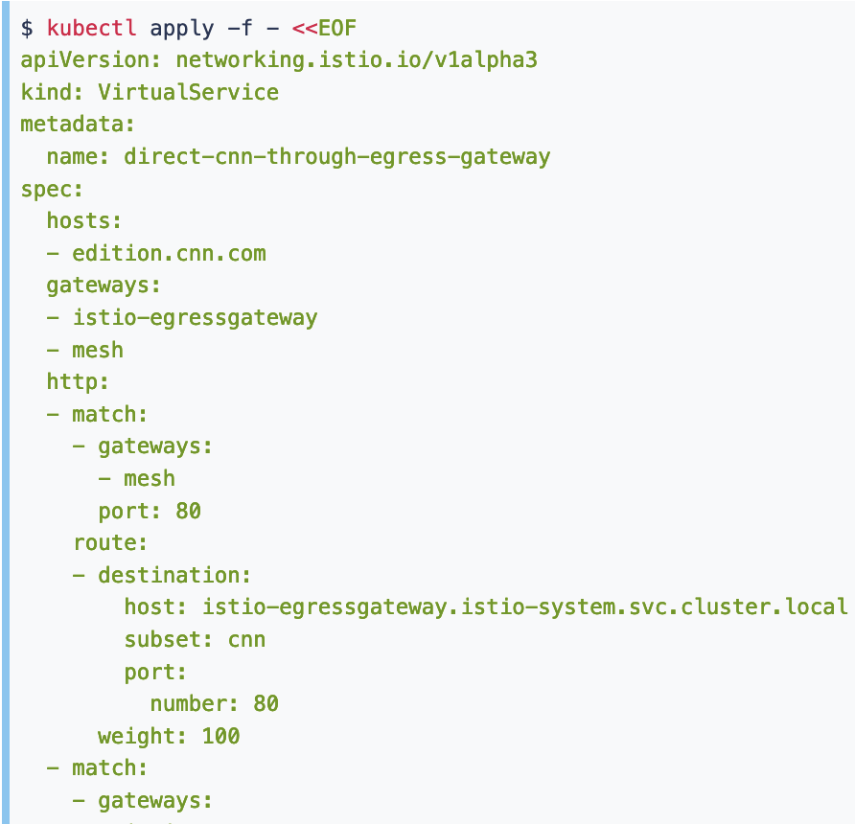
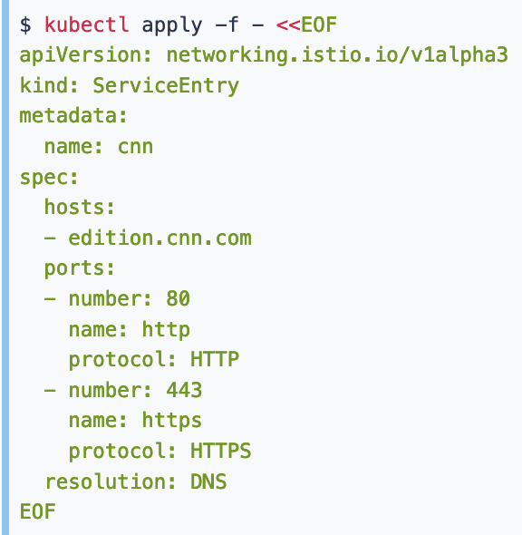
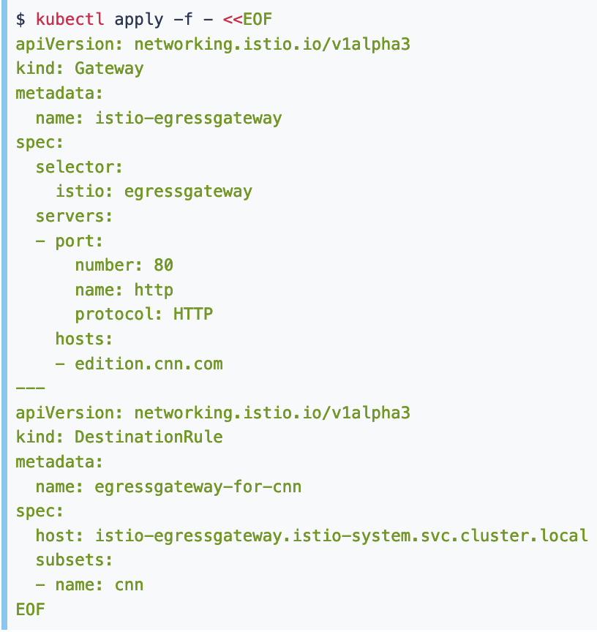
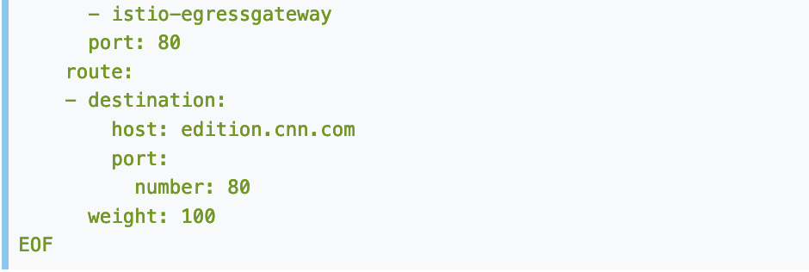
Istio main functions – Egress

Slide 16
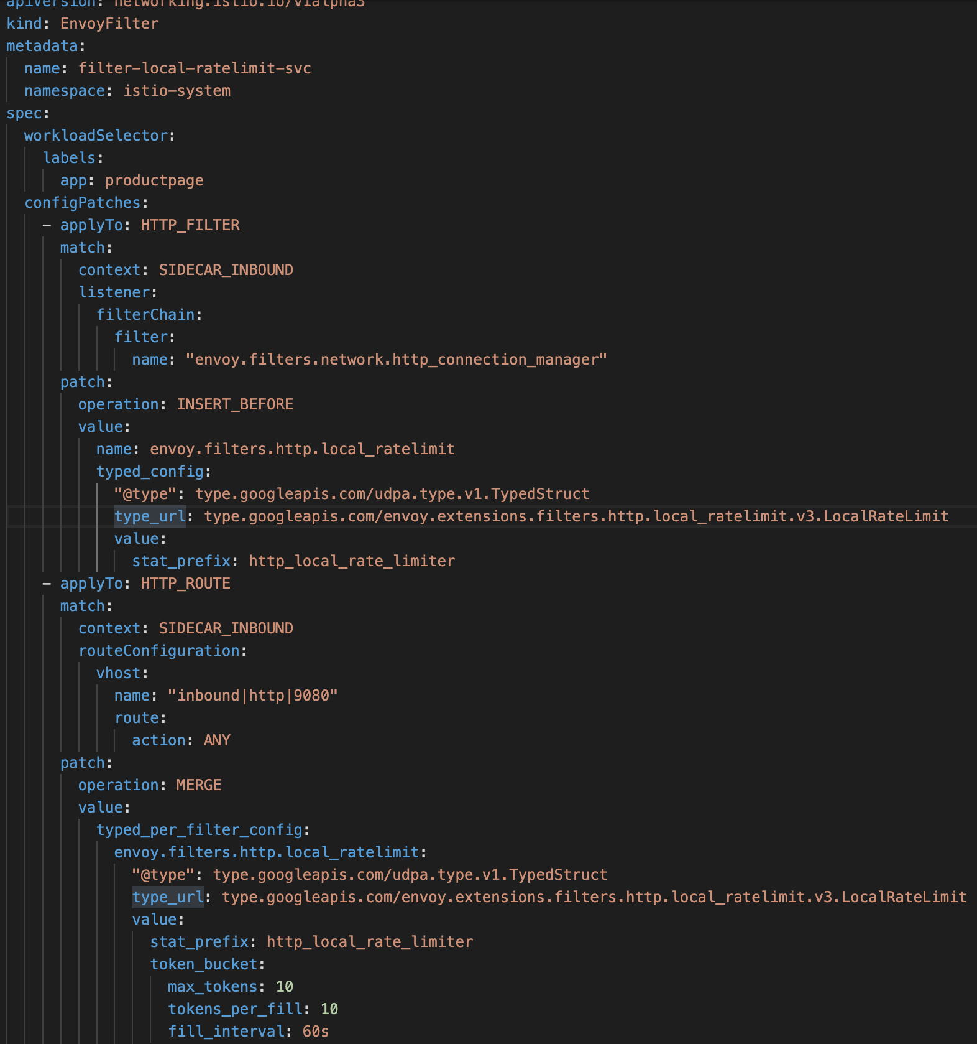
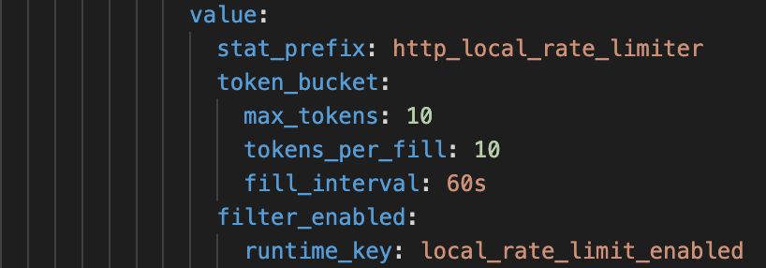
Istio main functions – Policy Enforcement

Slide 17
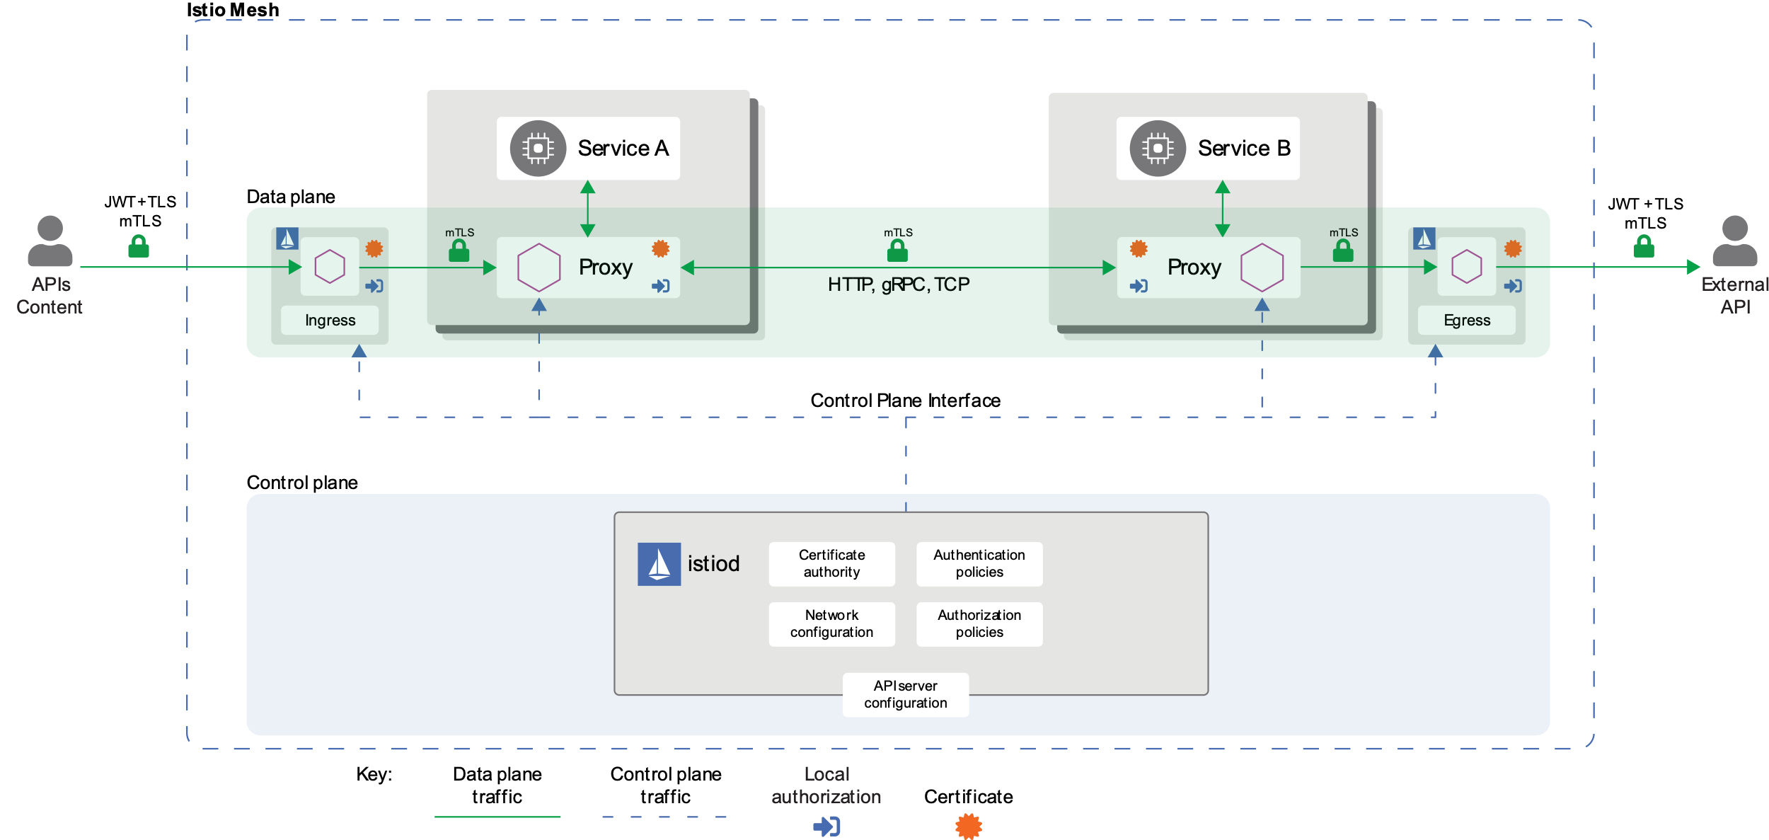
Istio main functions – Security

Slide 18
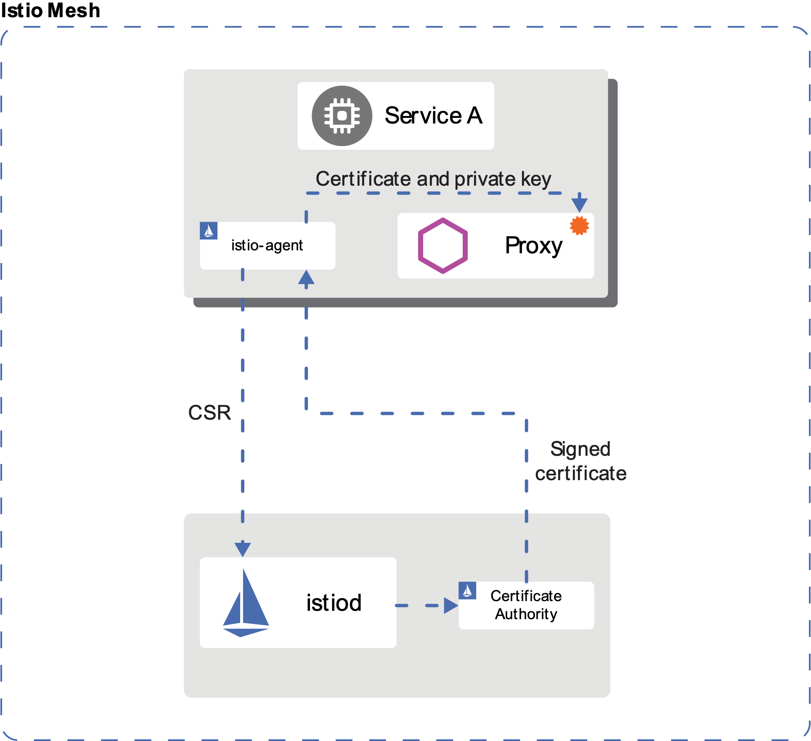
Istio main functions – ID and Certs
Identity
ID and Certs mgmt
Secure Naming
Authentication
Aothorization

Slide 19
Istio main functions – Observability
Open Telemetry
Spans
Traces
Logs
Metrics
Baggage
Observability
Metrics (Service, Proxy, Control Plane)
Distributed traces
Logs
Visibility (Integration)

Slide 20
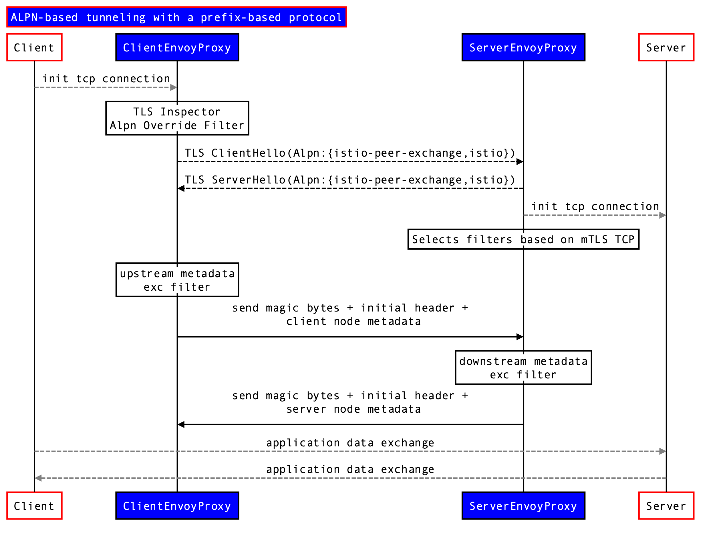
Istio main functions – Istio-peer-exchange Protocol

Slide 21
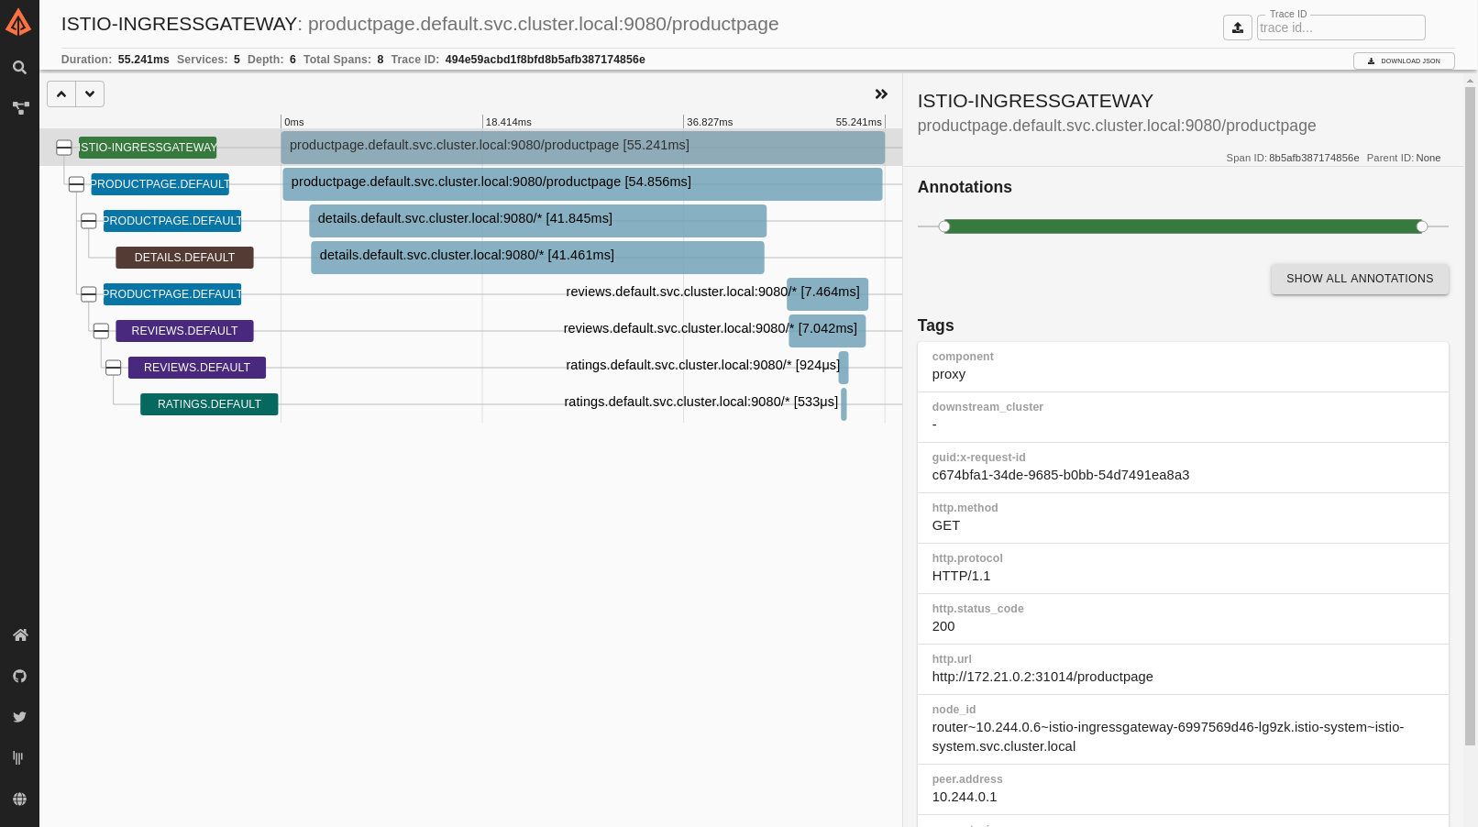
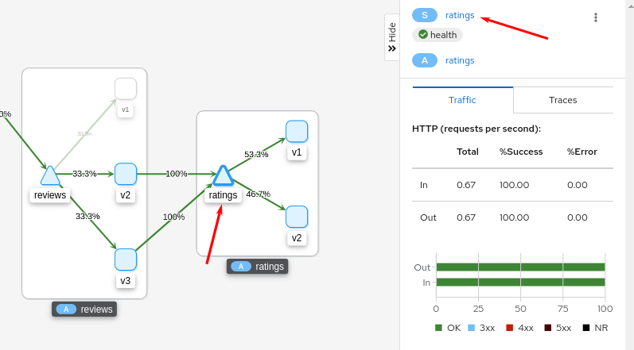
Istio main functions – Visibility

Slide 22
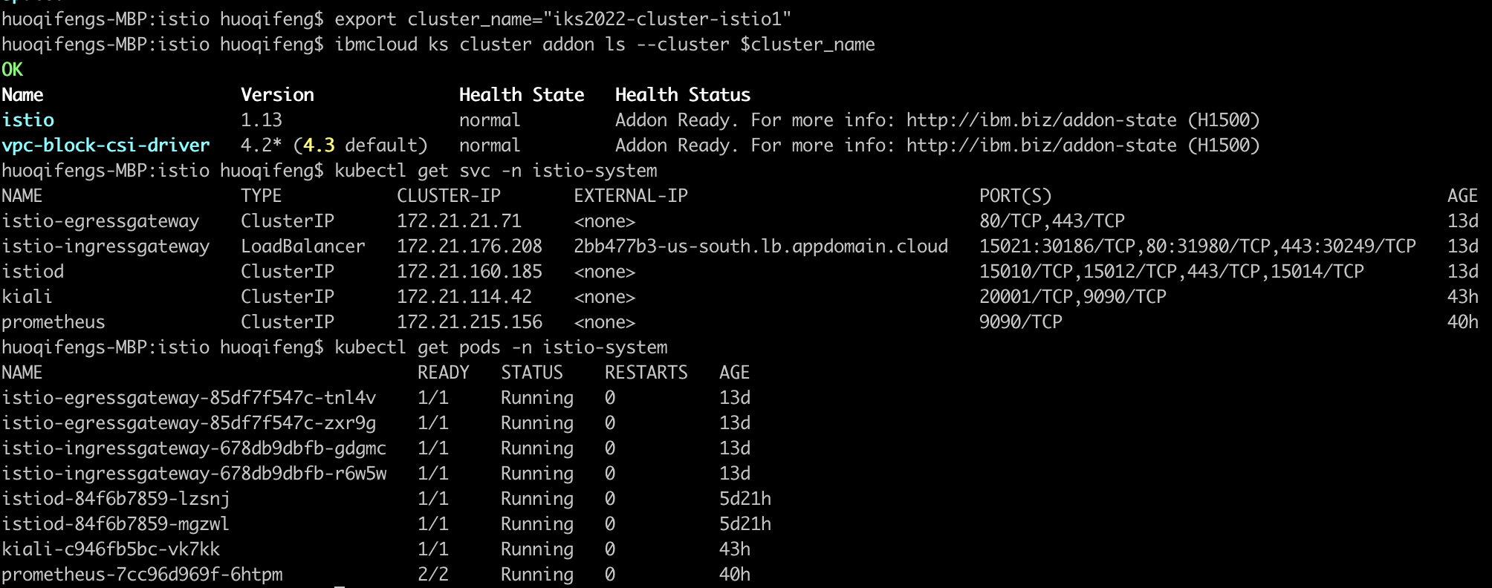
Managed Istio in IKS
Install Istio
IBM Cloud Console
IBM Cloud CLI
Operator
Integratation
IBM Log and Monitoring
ControlZ dashboard
Envoy dashboard
Setup managed Istio in IBM Cloud
IBM Cloud Dashboard Integration

Slide 23
Istio in CC and Peer Pod?
Requirements
Istio multi-arch images
Ability to inject sidecar to Peer Pod
Customize Envoy Proxy image URL
TEE Contract
Push the configure to Envoy proxy in Peer Pod
Micro service and DNS support in Peer Pod
CC considerations
How to inject sidecar in Peer Pod securely
Security, CA/TLS keys management in Istio control plane

Slide 24


