Slide 1
CoCo Tech Talk Sessions Cloud API Adaptor Deep Dive and History Yohei Ueda

Slide 2
Peer Pod VM architecture
Pod isolation design that uses IaaS VM instances to run sandbox VMs
No bare metal server to run sandbox VMs
No nested virtualization
Original Kata architecture
Peer pod VM architecture
Worker node (bare metal)
Worker node VM
Pod VM
Pod VM
QEMU VM
QEMU VM
kubelet
Pod
Pod
Pod
Pod
kubelet
cri-o / containred
container
container
container
container
cri-o / containred
container
container
container
container

Slide 3
Peer Pod VM - History
[2020] MVP1 – https://github.ibm.com/ZaaS/hyperpcons-securepod
Internal project for PoC of the Peer Pod VM architecture
Implemented from scratch
[2021] MVP2 – https://github.ibm.com/ZaaS/hyperpcons-securepod-kata/
Second internal project for the Peer Pod VM architecture
Implemented based on CoCo / Kata Containers
Reused some MVP1 components
[2022] Cloud API Adaptor – https://github.com/confidential-containers/cloud-api-adaptor
Sanitized version of MVP2 was published as a repository of the Confidential Containers project

Slide 4
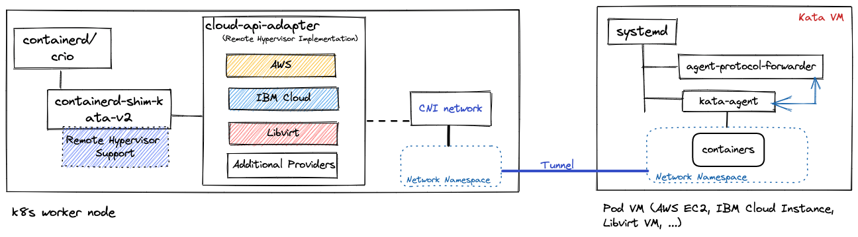
High-level architecture of Cloud API adaptor
Accept requests from Kata shim to create/delete Kata VM instances without requiring nested virtualization support
Manage VM instances in the cloud to run PODs using cloud (virtualization) provider APIs
Forward communication between kata shim on a worker node VM and kata agent on a pod VM
Provide a mechanism to establish a network tunnel between a worker and pod VMs to Kubernetes pod network

Slide 5
Necessary enhancements in Kata shim to support peer pod VMs
Support a new “remote” hypervisor type in kata shim
In addition to the current built-in hypervisor supports like QEMU, Firecracker…
Support Unix Domain Socket as kata agent socket type for communication between Cloud API adaptor and kata shim
In addition to the current VSock and HybridVSock
Initial PR for Kata: https://github.com/kata-containers/kata-containers/pull/3697

Slide 6
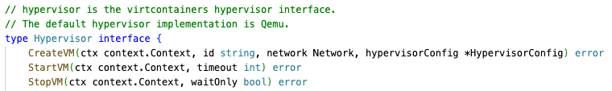
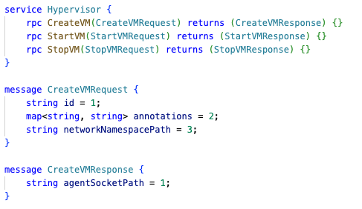
Remote hypervisor driver in kata shim
Another implementation of the Hypervisor interface in the virtcontainers package
Kata shim communicates with a Cloud API adaptor via a Unix Domain Socket to send hypervisor API calls
Cloud API adaptor manages pod VM and network
Create a network tunnel in the network namespace created by CNI plugin
Creates a pod VM using cloud API
Worker node VM
containred
kata-shim
CreateVM ttrpc request
/run/peerpod/hypervisor.sock
Listen
Cloud API adaptor
Request a VM instance
Pod VM
Cloud API Endpoint
Create
Kata agent

Slide 7
Unix Domain Socket as an agent socket type in kata shim
Worker node VM
Cloud API adaptor creates a Unix domain socket per shim for agent protocol communication, and tells its path to kata shim in CreateVMResponse
Kata shim communicates with kata agent using the Unix Domain Socket to send agent API calls
containred
kata-shim
Agent API calls
/run/peerpod/hypervisor.sock
/run/peerpod/12345/agent.ttrpc
Create Unix domain socket per shim
Cloud API adaptor
Agent API calls forwarded by Cloud API adaptor
Pod VM
Cloud Endpoint
Kata agent

Slide 8
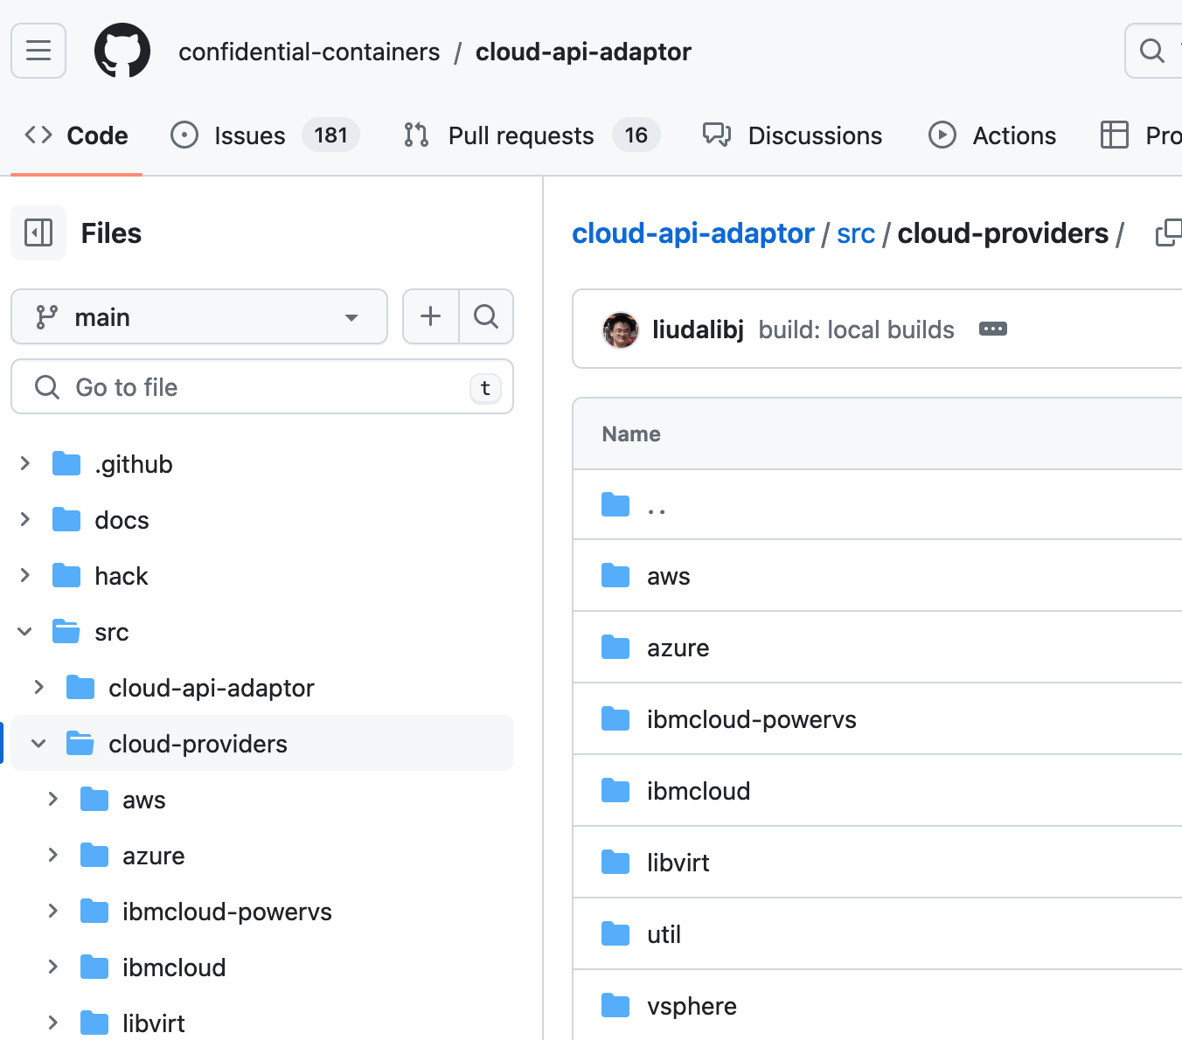
Cloud providers
Cloud API Adaptor can support multiple cloud providers
Using the remote hypervisor support
No need to change kata shim to support new cloud providers
Each cloud provider driver needs to implement the Provider interface

Slide 9
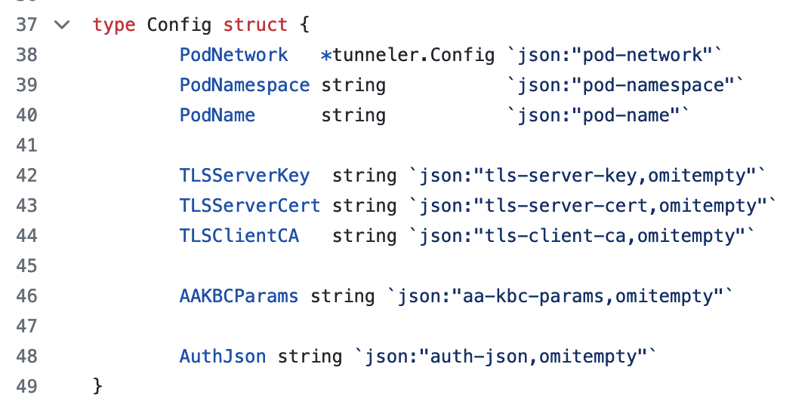
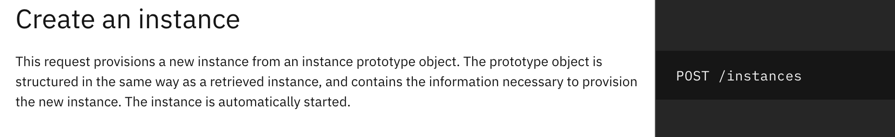
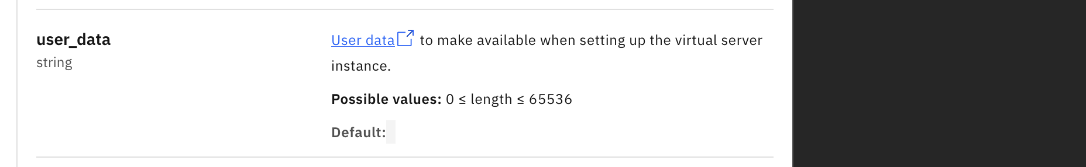
Pod VM initialization config data are passed via cloud-init userdata
Each cloud provider driver passes the config data to cloud API as userdata
Userdata is available via a config drive or instance metadata service (IMDS) in a created pod VM
Cloud-init retrieves the userdata and generates a config file for agent-protocol-forwarder
IBM Cloud VPC API

Slide 10
Two types of tunnels between a worker node VM and a peer pod VM
Worker node VM
kubelet
IaaS cloud
API endpoint
CRI
Tunnel for agent protocol
Agent API requests and responses between kata-shim and kata-agent are transferred via a tunnel established between Cloud API Adaptor and Agent Protocol Forwarder
Tunnel for pod network
Incoming and outgoing packets of a pod running in a peer pod VM are transferred via a network tunnel between a worker node VM and peer pod VM
containerd
Shim API
kata-shim
Create
Request
Request
Agent protocol
Pod VM
Cloud API adaptor
Tunnel for agent protocol
Agent protocol forwarder
CNI
Configure
Kata agent
Create
Tunnel for pod network
Pod
Network namespace
container
CNI plugin
container
Configure
Pod network

Slide 11
Agent protocol forwarder for kata agent
Worker node VM instance
containred
kata-shim
Original kata container uses VSock for communication between shim and agent
VSock is a host-guest communication channel
Peer Pod VM needs Agent Protocol Forwarder to connects kata-shim and kata-agent via TLS connection instead of Vsock
Unix Domain Socket
Cloud API adaptor
Pod VM instance
TLS
systemd
Agent protocol forwarder
Kata agent
Unix Domain Socket
Network
namespace
container
container

Slide 12
Agent API request manipulation by cloud-api-adaptor and agent-protocol-forwarder
Current implementation manipulates original agent API requests from kata-shim to work around some incompatibility due to peer pod VMs
cloud-api-adaptor and agent-protocol-forwarder need to recognize the latest agent API protobuf spec
Kata-shim should not encrypt agent protocol using TLS https://github.com/kata-containers/kata-containers/pull/9159
This limitation will be removed when kata-shim and kata-agent fully support peer pod VMs
cloud-api-adaptor
https://github.com/confidential-containers/cloud-api-adaptor/blob/main/src/cloud-api-adaptor/pkg/adaptor/proxy/service.go
PullImageRequest is issued before CreateContainerRequest (unless remote-snapshotter is available)
An annotation for CSI wrapper is added when a persistent volume is used
agent-protocol-forwarder
https://github.com/confidential-containers/cloud-api-adaptor/blob/main/src/cloud-api-adaptor/pkg/forwarder/interceptor/interceptor.go
Network namespace path is replaced with one in the pod VM
Updating DNS setting in a sandbox VM is disabled

Slide 13
[Original Kubernetes] Pod network configuration for runc pods
A CNI plugin configures a virtual NIC in the network namespace of a pod
Host operating system
Pod
Network namespace
CNI network
runc container
veth0
eth0
runc container
eth0
Virtual Ethernet

Slide 14
[Original Kata] Pod network configuration for Kata container pods
Host operating system
QEMU
Guest operating system
Pod
Kata shim set up a tap device to connect the virtual NIC in the network name space to the virtual NIC of the VM
Network namespace
container
CNI mechanism is compatible with Kata containers
container
eth0
CNI network
Network namespace
veth0
eth0
tap0
eth0
Virtual Ethernet
Redirect
macvtap

Slide 15
[Our approach] Pod network configuration for Peer-Pod VM
Container runtime establishes a network tunnel between network namespaces in worker and sandbox VMs
We can utilize various tunnel technologies such as VXLAN, IPIP, Routing, etc
Pod VM instance
Pod
Network namespace
Worker node VM instance
container
Network tunnel is established to transfer packets between worker and pod VMs
container
Existing CNI plugins are compatible with Peer Pod VM architecture
eth0
CNI network
Network namespace
veth0
eth0
Network tunnel
eth0
Virtual Ethernet
eth0

Slide 16
Encapsulation options for pod network tunnels
VXLAN
Currently most used
Network performance overheads or incompatibility may occur due to a smaller MTU compared to IPIP
When Calico is used as CNI plugin, we need to change the VXLAN port from the default one to another one due to Calico’s bug
https://github.com/confidential-containers/cloud-api-adaptor/issues/244
Routing
Initially implemented, but not well tested
No packet header overhead for encapsulation
A worker node and a pod VM need to reside in a single subnet
Unstable in IBM Cloud VPC for unknown reasons
IPIP (IP-in-IP)
Not yet implemented
https://github.com/confidential-containers/cloud-api-adaptor/issues/74
Does not support IPv6
No additional packet header overhead for encapsulation when CNI plugin uses IPIP as encapsulation for pod networking
IBM Cloud VPC requires a special permission to enable IPIP packets
WireGuard
Not yet implemented
https://github.com/confidential-containers/cloud-api-adaptor/issues/688
Traffics between a worker node and pod VM can be encrypted
VXLAN
Routing
Ethernet header
20 bytes
Ethernet header
IP header
50 bytes
IP header
UDP heder
IP payload
VXLAN heder
MTU
1,500 bytes
IP header
MTU
1,450 bytes
IP payload
IPIP
WireGuard
Ethernet header
20 bytes
Ethernet header
IP header
IP header
40 bytes
IP header
UDP heder
MTU
1,480 bytes
IP payload
WireGuard
IP header
MTU
1,460 bytes
IP payload

Slide 17
Volumes
ConfigMap and Secrets are supported
Kata has a mechanism to copy volume contents from worker to pod VM
Dynamic updates of ConfigMap and Secrets are detected using fsnotify, and eventually copied
https://github.com/kata-containers/kata-containers/pull/6342
Supporting persistent volumes such as NFS requires a CSI wapper driver
See: Red Hat Blog: Persistent volume support with peer-pods: A technical deep dive by Qi Feng Huo, Da Li Liu, Yohei Ueda, Lei LI
https://www.redhat.com/en/blog/persistent-volume-support-peer-pods-technical-deep-dive
Worker node VM
kubelet
CRI
containerd
Shim API
kata-shim
Request
Agent protocol
Pod VM
Cloud API adaptor
Tunnel for agent protocol
Agent protocol forwarder
CopyFile
Kata agent
Create
Pod
container
Volume
Volume

Slide 18
Questions?

