Slide 1
LPARaaS and LPAR-Manager
huoqif@cn.ibm.com

Slide 2
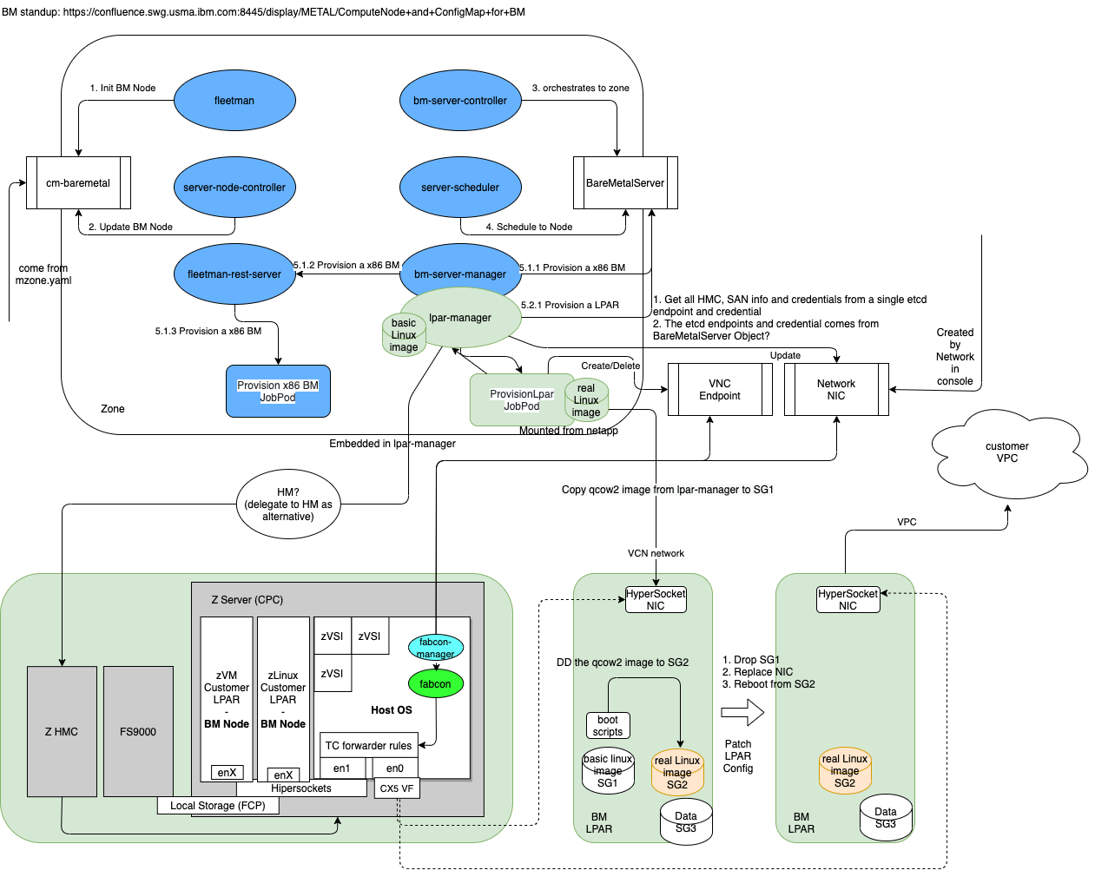
LPAR Manager overview

Slide 3
Thanks! 谢谢！

