Slide 1
Istio certs management
huoqif@cn.ibm.com

Slide 2
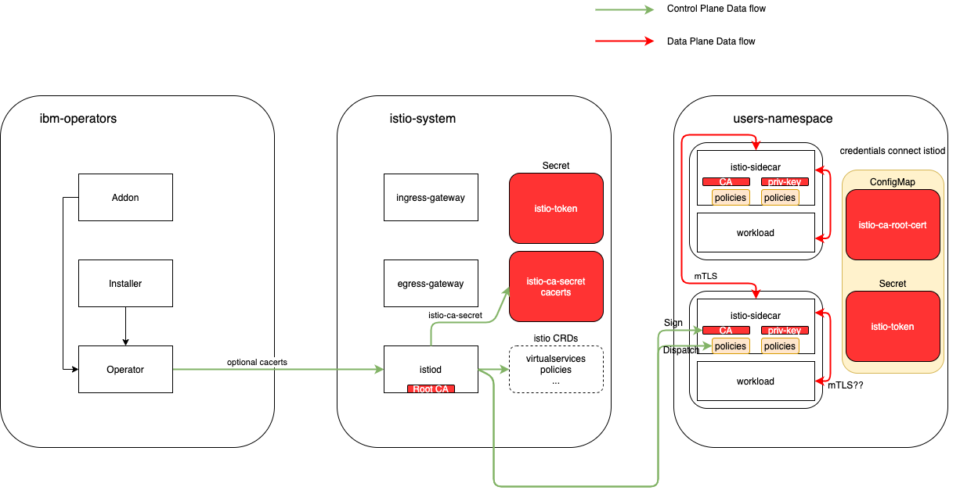

Slide 3
Backup

Slide 4
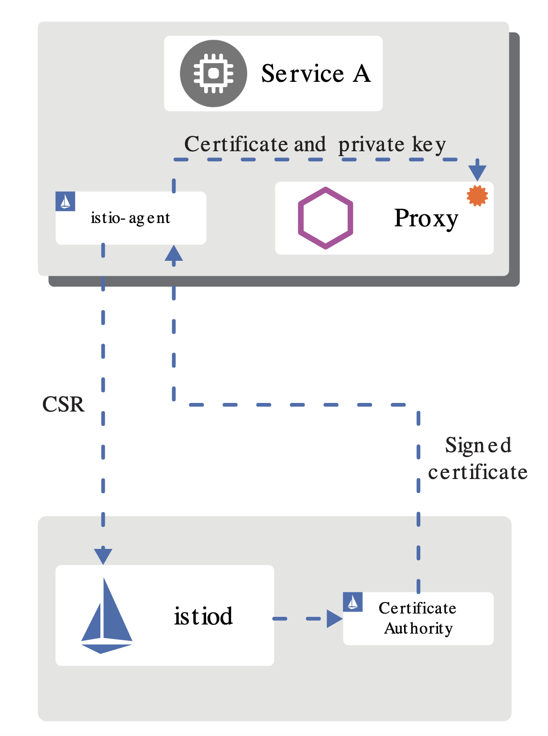
Overview
istiod offers a gRPC service to take certificate signing requests (CSRs).
When started, the Istio agent creates the private key and CSR, and then sends the CSR with its credentials to istiod for signing.
The CA in istiod validates the credentials carried in the CSR. Upon successful validation, it signs the CSR to generate the certificate.
When a workload is started, Envoy requests the certificate and key from the Istio agent in the same container via the Envoy secret discovery service (SDS) API.
The Istio agent sends the certificates received from istiod and the private key to Envoy via the Envoy SDS API.
Istio agent monitors the expiration of the workload certificate. The above process repeats periodically for certificate and key rotation.

Slide 5
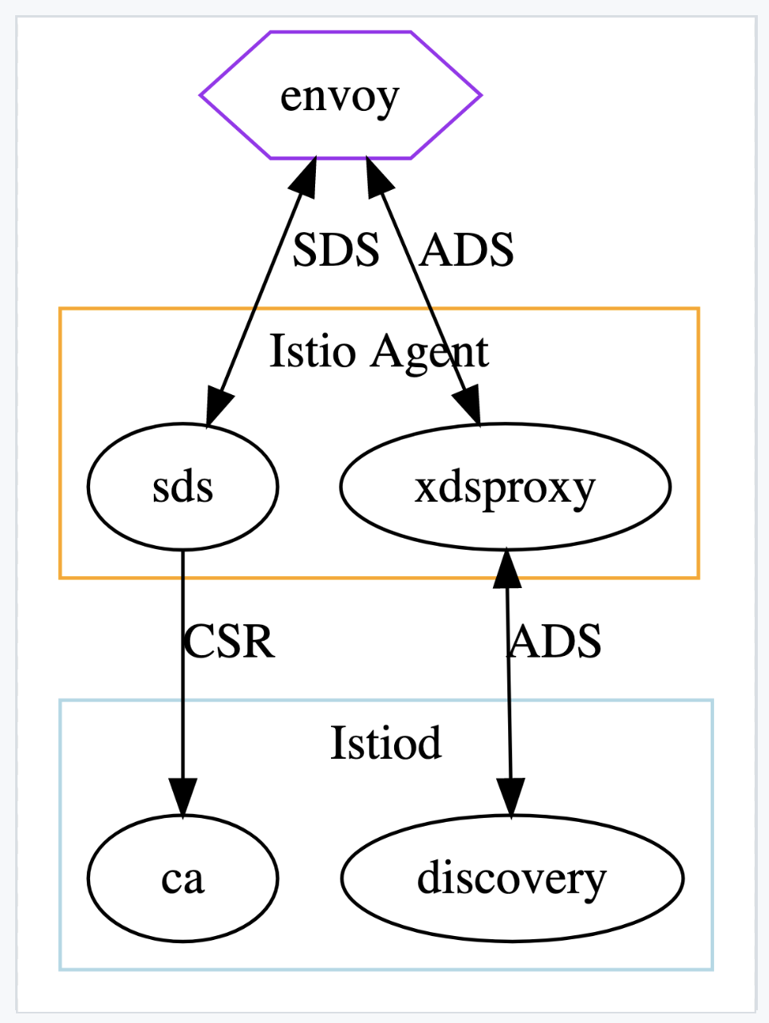
Istio agent
Istio agent acts as an intermediate proxy between Istiod and Envoy.
For distributing workload certificates, Envoy will send SDS requests to the agent, causing the agent to submit a CSR to the configured CA (Istiod).
For other configuration, Envoy will send ADS requests to the agent, which will be forwarded to the configured discovery server (Istiod).

Slide 6
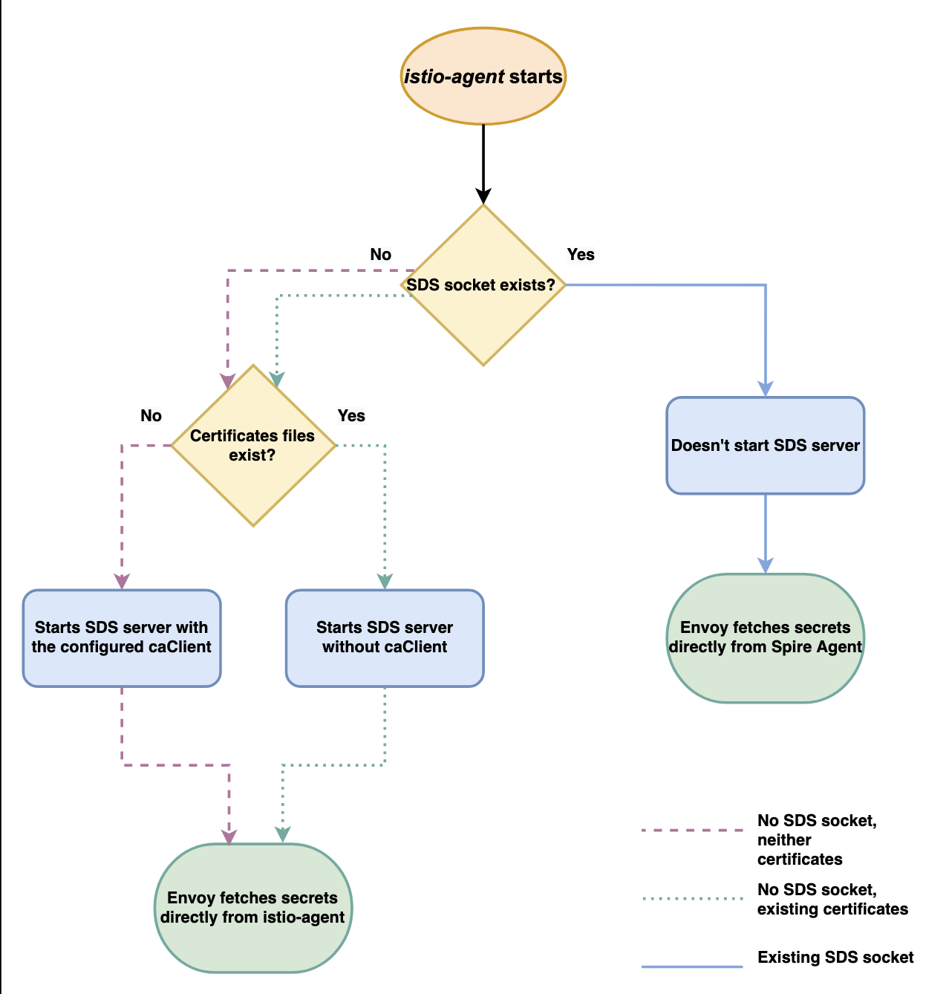
CA
istio-agent checks socket path /var/run/secrets/workload-spiffe-uds/socket. If a socket is found, istio-agent will not start its own SDS Server and Envoy will be configured to use that socket as its source of cryptographic material.
If a socket is not found, istio-agent then checks certificate files on the certificate path /var/run/secrets/workload-spiffe-credentials. If certificate files are found, istio-agent will start its own SDS Server, listening and serving these certificates on the defined socket path /var/run/secrets/workload-spiffe-uds/socket, while also keeping file watchers on them. Envoy proxy then connects to istio-agent's SDS Server through the defined socket path and gets the cryptographic materials of the certificate files served by the SDS API.
If istio-agent does not find either the socket, or the certificate files in their respective paths it will start its own SDS Server using a caClient to connect to istiod or an external CA, to fetch cryptographic materials (Default CA Flow).

Slide 7
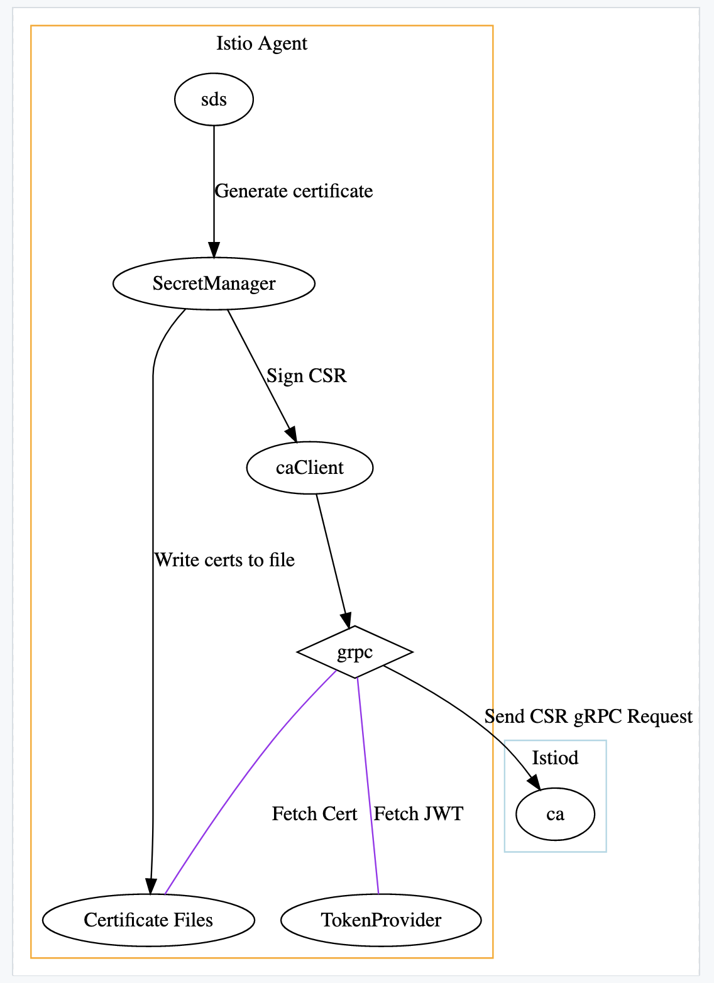
Default CA
First, the request is handled by the SDS server. This is an intermediate translation layer exposing the SecretManager to Envoy, for each resource requested by Envoy, the SDS server will call SecretManager.GenerateSecret(resourceName)
When GenerateSecret is called, the SecretManager is expected to return a new certificate. This can occur in a few ways.
The default method is to sign a new certificate by calling the configured CA (Istiod).
If the certificate is not yet expired, the SecretManager also can return a cache response.
SecretManager can also read certificates from files. When this is configured, no CA client is used.
The caClient will be configured to use either JWT or mTLS authentication. In k8s, which is k8s root ca: /var/run/secrets/kubernetes.io/serviceaccount/ca.crt and serviceAccountToken: /var/run/secrets/tokens/istio-token
GenerateSecret may additionally write any signed certificates to disk, with OUTPUT_CERTS configured (don’t see it in k8s cfg)

Slide 8
XDS
Xds using CA root defined by PROV_CERT, which is configMap: istio-ca-root-cert and mounted to var/run/secrets/istio/root-cert.pem in istio-proxy container to talk withistiod
It will be rotated and updated by istiod

Slide 9
Credentials
Server/Client | Token(s) | Usage | Source | Destination
Client | K8s Root CA | Connect to Istiod XDS | ConfigMap: istio-ca-root-cert | /run/secrets/istio/root-cert.pem
Client | K8s Root CA | Connect to Istiod SDS | ConfigMap: istio-ca-root-cert | /var/run/secrets/kubernetes.io/serviceaccount/ca.crt
 | K8s serviceAccountToken | Connect to Istiod SDS | Secret: istio-token/istio-ca | /var/run/secrets/tokens/istio-token
 | CSR | DataPlane mTLS communication | Generated via pki tool in istio-agent | In memory signed by istiod
 | Private Key | DataPlane mTLS communication | Generated via pki tool in istio-agent | In memory
Server | Signing Cert, Key | Root certs signing key/cert used to sign workload CA | Secret istio-ca-secret/ca-cert.pem, ca-key.pem | Appended to self-signed certs as root certs
 | K8s serviceAccountToken | Connet other k8s services | Secret: istio-token/istio-ca | /var/run/secrets/tokens/istio-token

Slide 10
Generation
ibm-operators
istio-systems
users-namespace
Secret
Pod (sidecar)
creds to connect istiod
Addon
ingress-gateway
Private key
CA
ConfigMap
istio-token
Self-generated
egress-gateway
istio-ca-root-cert
Installer
Secret
Secret
Pod (sidecar)
istiod(pilot)
istio-ca-secret
istio-token
Operator
Private key
CA
Self-generated
Optional cacerts
Root ca
Create if no cacerts
Sign

Slide 11
Threats
Istio sidecar steal secret in workload?
Are the CA/token generated by istioctl/installer/operator vulnerable?
Could te K8s Root CA (istio-ca-root-cert ConfigMap) and serviceAccoutToken be used by kube admin to communicate with istiod and make forge CSR?
Could the root Signing key (istio-ca-secret secret) be hacked by kube admin in istiod?
Could the Service Mesh objects be hacked by kube admin?

Slide 12
Levels
Level 1 – no istio
Level 2 – no secure istio
We don’t rely istio mTLS, but service mesh only
Encryption twice
Level 3 – secure istio
Secure Policy and CA etc

