Slide 1
CoCo remote attestation for IBM Secure Execution (SE)
Qi Feng Huo (IBM)

Slide 2
Thanks
Steffen Eiden
provided the ibmse rust crate
Hyounggyu Choi
provided the CoCo CI
Da Li Liu, LEI LI(genjuro214)
provided the rvps, policy guide and verified the function
Ding(Xynnn007), Tobin Feldman-Fitzthum, Magnus Kulke
Reviewed the PRs
James MAGOWAN, Steven Horsman
Coordinating IBM Z stuff

Slide 3
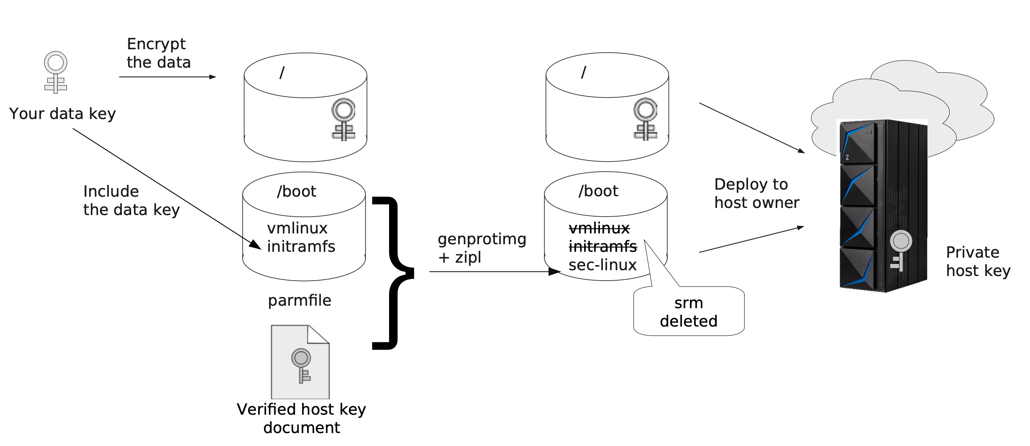
IBM Secure Execution - Image

Slide 4
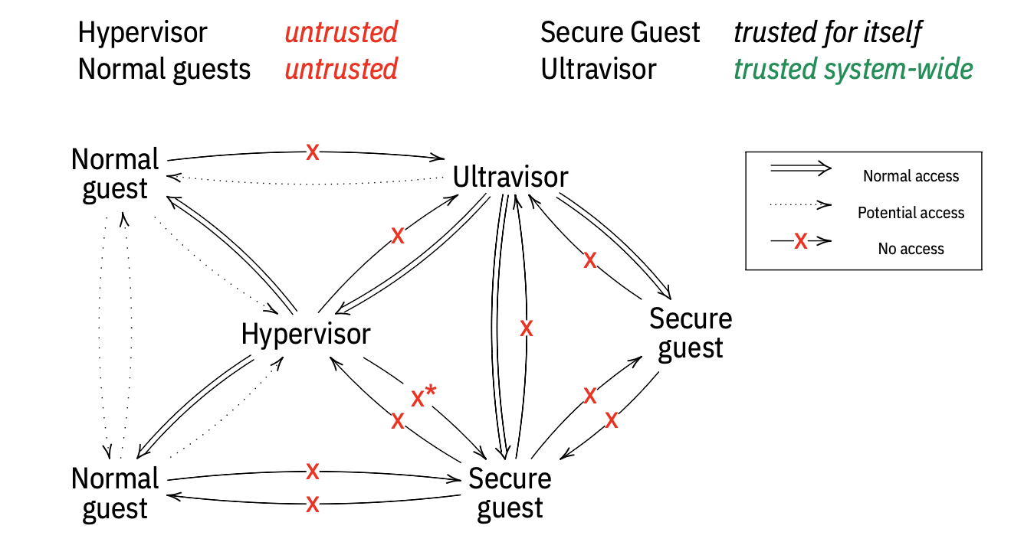
IBM Secure Execution -- TEE

Slide 5
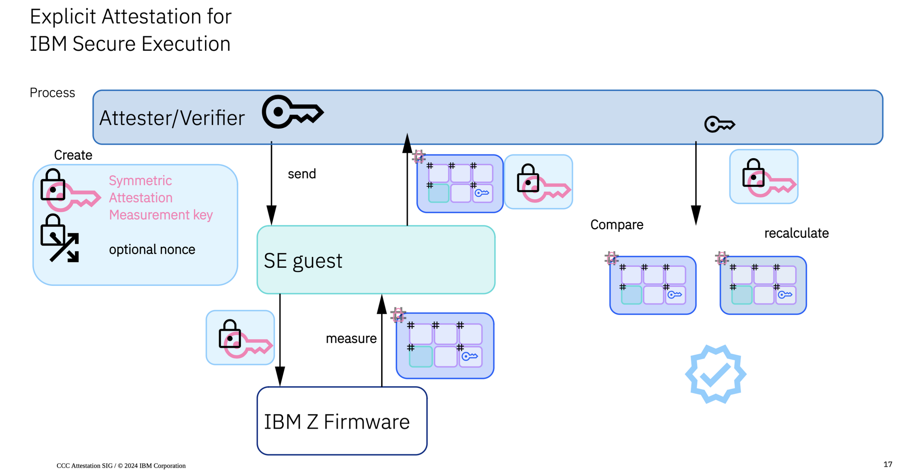
IBM Secure Execution -- Attestation
Notes:
The verifier generates the encrypted attestation-request based on Host Key Document(HKD), Root CA, signing_key, a measurement key and a nonce, the encrypted data is protected by the symmetric attestation request protection key measurement key, which is encrypted using the HKD. Refer code in Create attestation request on verifier and sample request in Sample attestation request. https://docs.rs/s390_pv/0.10.0/s390_pv/attest/struct.AttestationRequest.html
Verifier sends the request to attester.
Firmware on the Attester's system decrypts the request via private HKD and calculates the evidence based on the encrpted part of the request (measurement key + nonce). Refer code in Calculate measurement on attesrer and the sample evidence in Sample attestation evidence. Which includes:
MACed measurement.
Additional data generated based on Firmware, include Configuration UID and HKD hash.
Optional inject 256 bytes user-data which comes from user.
Attester send the evidence to verifier.
Verifier recalculates the evidence based on the Configuration UID, Additional data, user-data, HKD hash, measurement key and nonce. (its a HMAC-SHA512 with the measurement key as secret). Refer code in Verify measurement on verifier.
If both HMACs, the one from the Firmware and the calculated one from the verifier match, then attestation success.
Optionally check the user_data and additional_data fields. Refer sample claims.

Slide 6
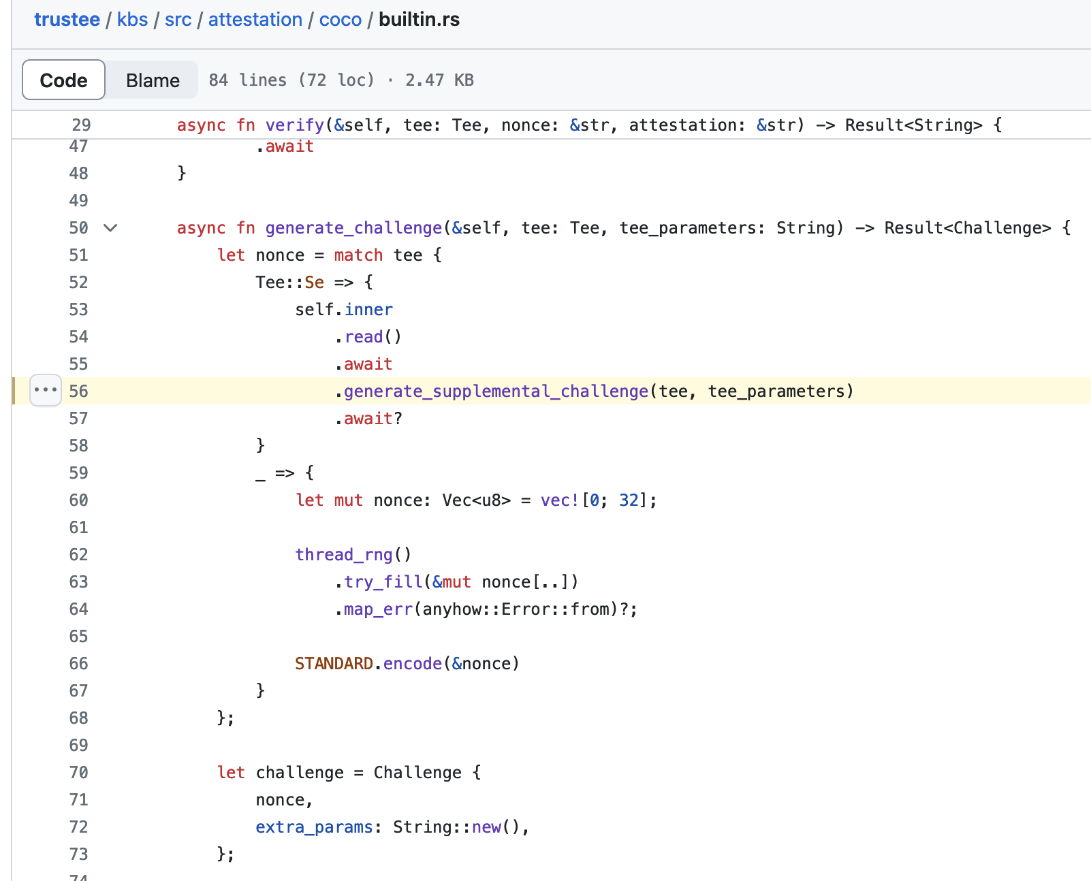
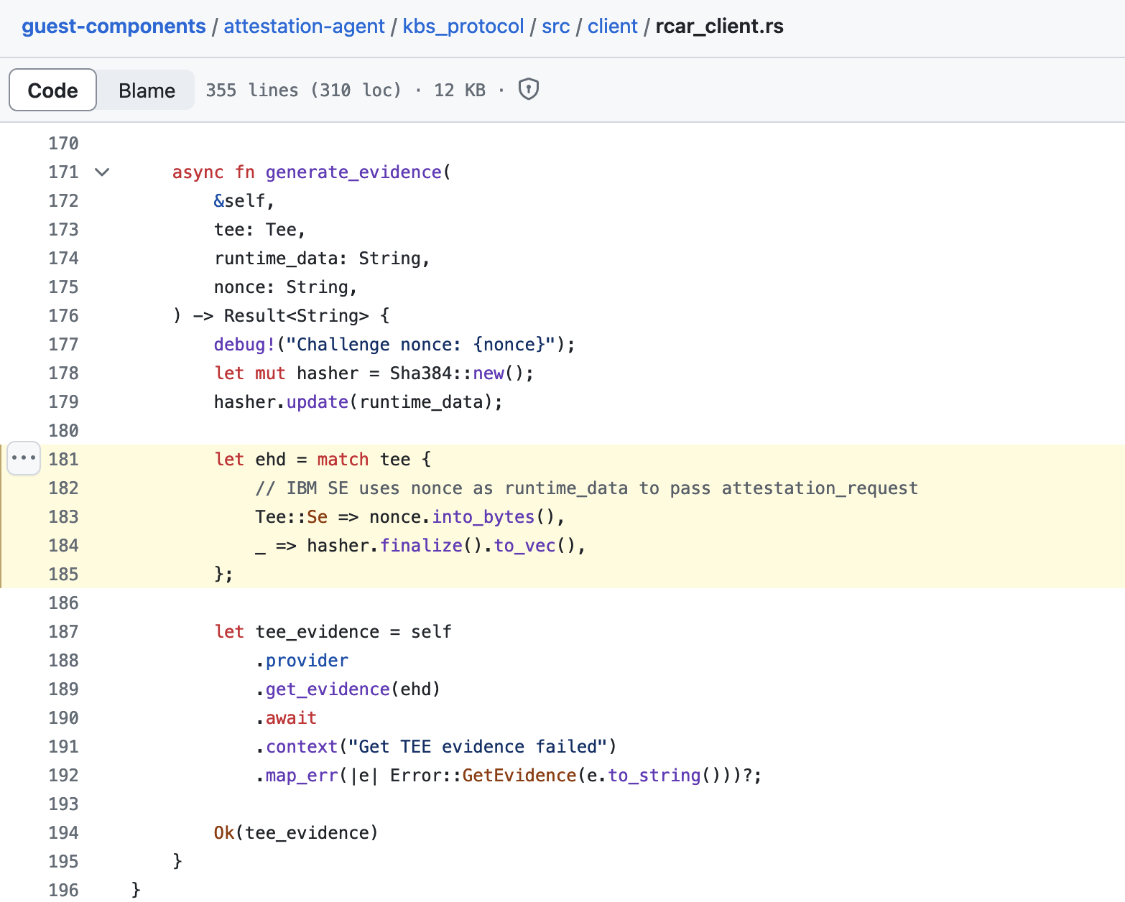
API changes
https://github.com/confidential-containers/trustee/blob/main/kbs/src/attestation/coco/builtin.rs#L56
https://github.com/confidential-containers/guest-components/blob/main/attestation-agent/kbs_protocol/src/client/rcar_client.rs#L181-L185

Slide 7
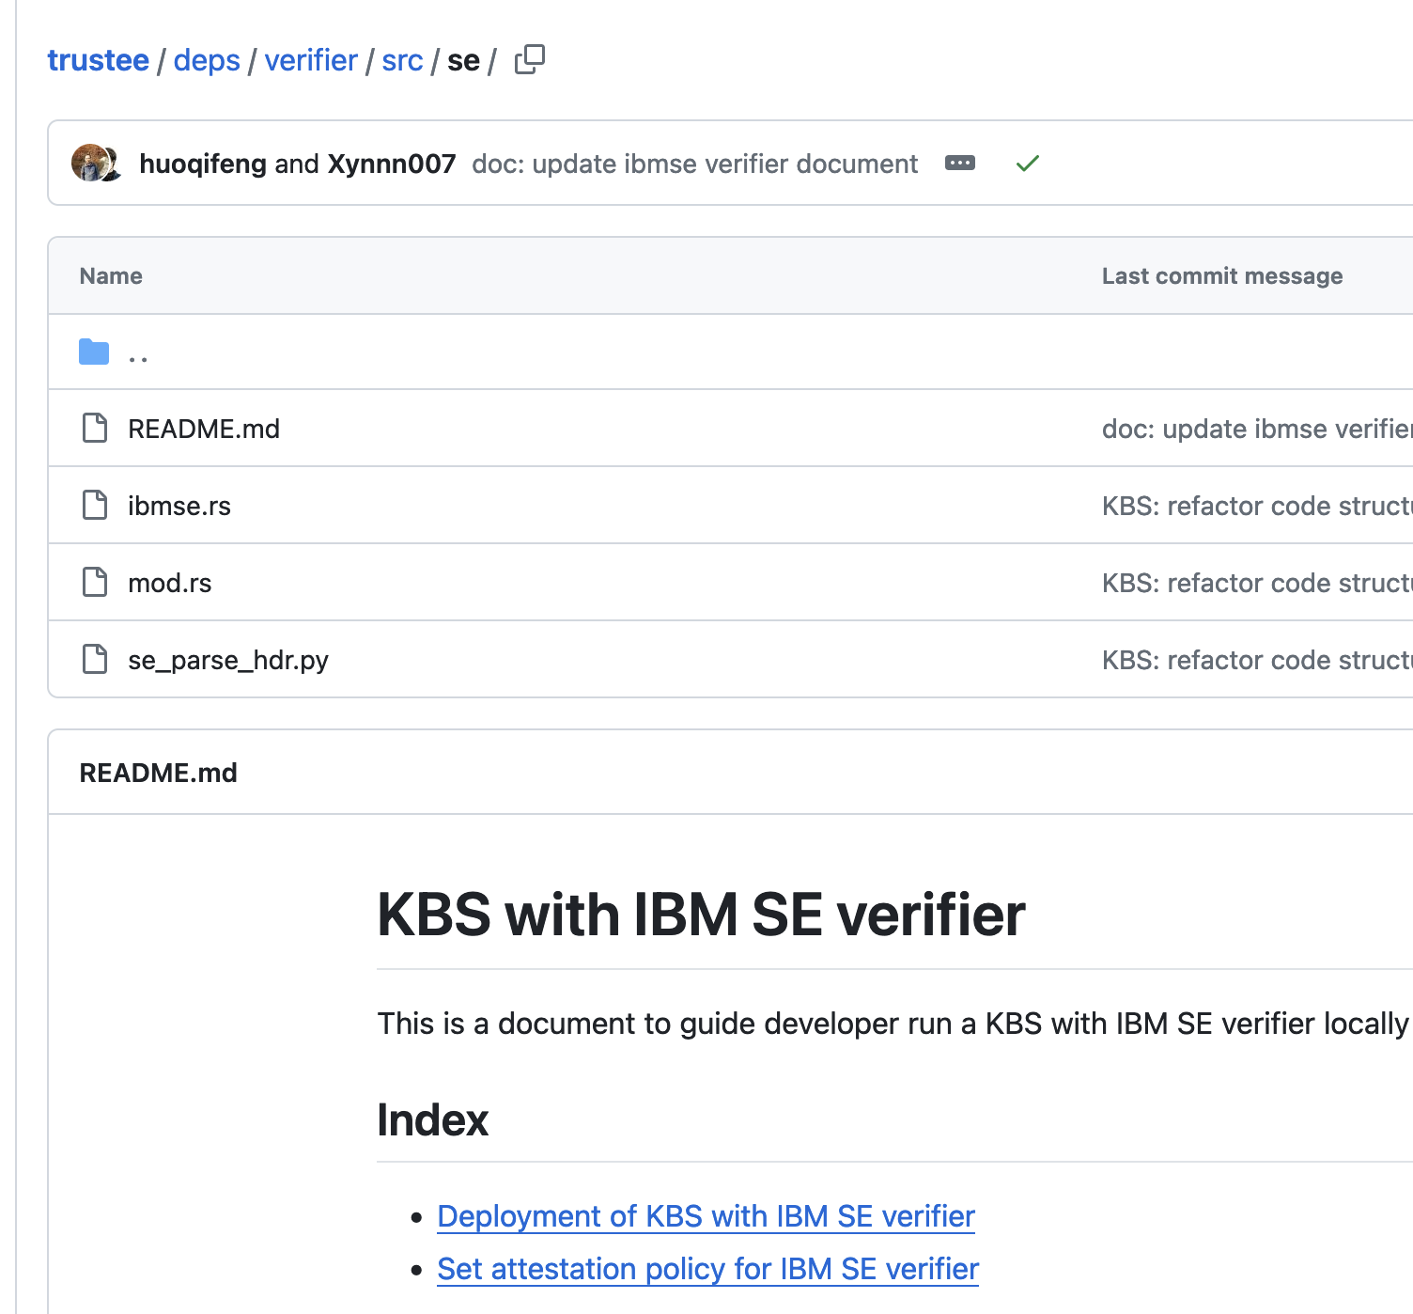
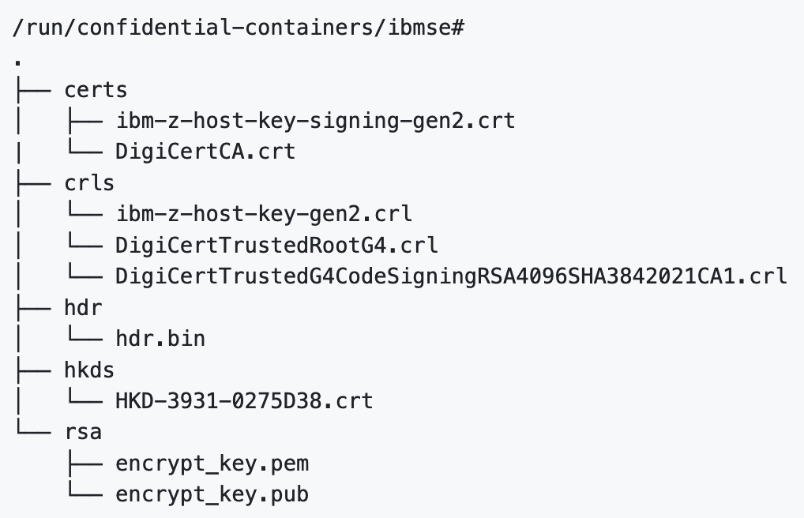
IBM SE verifier
https://github.com/confidential-containers/trustee/tree/main/deps/verifier/src/se

Slide 8
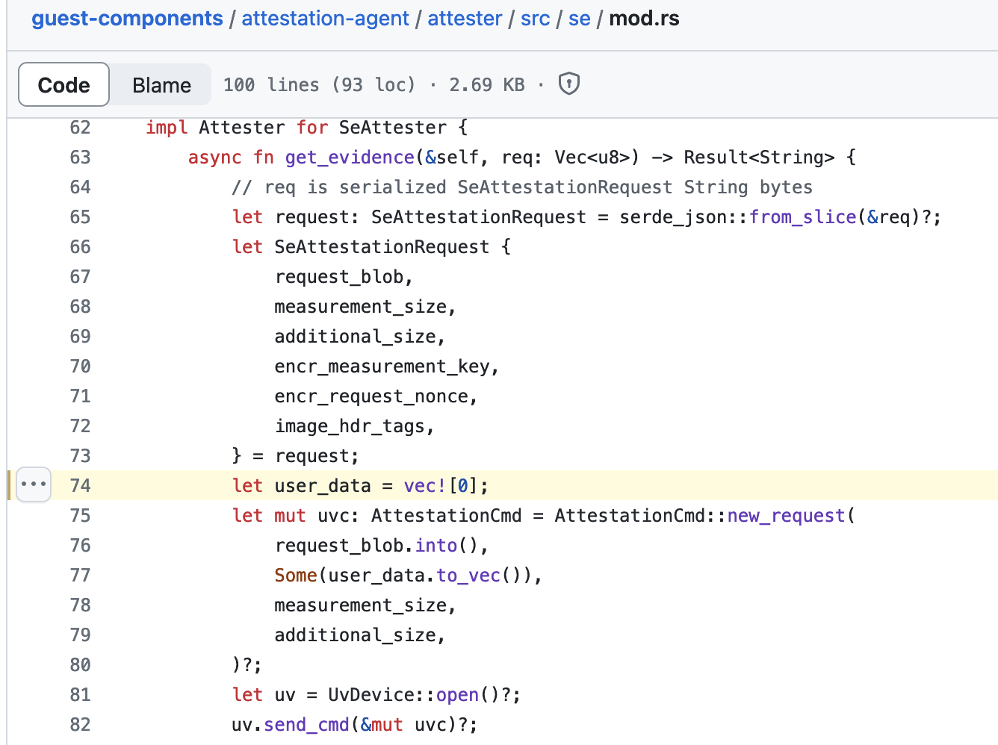
Initdata & Future

Slide 9
Demo

