Slide 1
DATA ANALYTICS 1 — ASSIGNMENT, STAGE 2
Retail Credit Risk Scoring
Workflow, database & scoring results
Notes:
Stage 1 covered the business model and requirements. Stage 2 shows how we built it: the data workflow, the database, the scoring logic, and the results.

Slide 2
RECAP
Business problem & goal
Problem
Goal
Loans that default cost the bank money
Manual review by loan officers is slow and inconsistent — two officers can decide differently on the same customer
Score every customer consistently
A score of 300–850 and a risk grade A–E
Use internal data only
Accounts, transactions, income, repayment history — no credit bureau
Score in two ways
Reactive: when a loan application arrives · Proactive: a batch scan of existing customers to make loan offers
Keep it explainable
Every criteria and weight is visible, not a black box
Notes:
Quick recap from stage 1. The key point: the score must use internal data only and must be explainable — every criteria and weight is traceable.

Slide 3
STAGE 2
What we built
1
Workflow
From raw data to a stored score
2
Database
13 tables in PostgreSQL
3
Analytical questions
12 metrics, each answering one business question — with real-data evidence
4
Scoring
Weights, points, score range & grades, worked examples
5
Results
Grade distribution for 800 customers
6
Dashboard
Interactive report of the results
7
Data quality & limitations
What to watch out for
Notes:
Stage 2 walk-through, in the order the data flows.

Slide 4
1 · WORKFLOW
End-to-end workflow
1
2
3
4
5
6
Generate data
Store in database
Compute metrics
Calculate score
Check results
Dashboard
Real UCI German Credit loans + Faker → consistent data for 800 customers
PostgreSQL, 13 tables linked by customer
One script per criteria: raw data → metric points for every customer
Weight the 5 criteria → score 300–850 → grade A–E, saved per customer
Grade distribution and a 20-customer spot check
Streamlit report on the results
generate_data.js
01_schema.sql
scripts 01–05
script 06
script 07
Data & database
Scoring (SQL)
Reporting
The scoring is split into numbered SQL scripts (01–07), run in order, so each step can be checked on its own. Every script is safe to re-run.
Notes:
Read left to right. Steps 3–5 are SQL script files in the scripts/ folder, run in order 01 to 07. Scripts 01–05 each compute one criteria, so each one's logic can be reviewed on its own; 06 combines them and saves the result; 07 checks it.

Slide 5
2 · DATABASE
Database: 13 tables in 4 groups
Customer
Banking behaviour
Loan lifecycle
Scoring
Data volume
customer
account
loan_product
risk_score
800 customers
income_source
transaction
loan_offer
calculated_risk_score (our output)
1,063 accounts
account_balance_history
loan_application
21,260 transactions
loan_account
341 loan applications
payment_history
240 loan accounts
delinquency_event
1,440 scheduled payments
Every table links back to customer, so one customer's income, accounts, transactions and loans can be joined into one picture
calculated_risk_score holds the output of our SQL scorecard: one row per customer with each criteria's points, the score and the grade
Notes:
Every table traces back to customer. The scorecard reads the raw tables and writes its result into calculated_risk_score.

Slide 6
2 · DATABASE
Where the data comes from
Real data: UCI German Credit (1,000 loans)
Generated (Faker + rules)
Use 1 — make the mock data realistic
Real ages, loan amounts and loan terms; the real good / bad outcome decides which mock loans are approved and which fall behind on payments
Use 2 — evidence for our metrics
Default rates in the real loans show each metric points the right way (section 3)
Names, dates, transaction amounts & categories
Balance trends and account tenure
Rules keep each customer's accounts, transactions and loans consistent with one risk level
Note: the scorecard itself (SQL scripts 01–07) never reads the UCI file — it only scores the 13 tables in our PostgreSQL database.
Notes:
The data is synthetic but grounded in a real dataset where one exists. We also use the same real dataset later as evidence that our metrics relate to default.

Slide 7
2 · DATABASE
What the real data looks like
RAW FILE — one line per applicant, mostly codes
A11 6 A34 A43 1169 A65 A75 4 A93 A101 4 A121 67 A143 A152 2 A173 1 A192 A201 1
DECODED — 5 real applicants, only the columns we use
Applicant | Checking balance | Loan amount | Duration | Installment burden | Years in job | Age | Outcome
1 | < 0 DM | 1,169 DM | 6 months | 4 (high) | 7+ | 67 | Good
2 | 0–200 DM | 5,951 DM | 48 months | 2 | 1–4 | 22 | Bad
3 | No account | 2,096 DM | 12 months | 2 | 4–7 | 49 | Good
4 | < 0 DM | 7,882 DM | 42 months | 2 | 4–7 | 45 | Good
5 | < 0 DM | 4,870 DM | 24 months | 3 | 1–4 | 53 | Bad
1,000 real loans, 20 attributes each, outcome = good or bad
No credit score in the data — only whether the loan was repaid
No transactions, balances over time or payment history
That is why our accounts, transactions and payments are generated
Notes:
First 5 rows of bootstrap/german_credit.data, decoded with the UCI code list. Point out: each row is one loan, the only outcome is good/bad (no score), and there are no transactions or balances over time — that is why the rest of our data is generated.

Slide 8
3 · ANALYTICAL QUESTIONS
Every metric answers one analytical question
Criteria | Metric | Analytical question | Score goes up with…
Payment Behaviour | % on-time payments | Does the customer pay their installments on time? | ▲ more on-time payments
 | Worst delinquency | Has the customer ever fallen seriously behind? | ▲ no or only mild delinquency
Income & Capacity | Monthly income level | Does the customer earn enough to repay? | ▲ higher income
 | Income diversification | Would income continue if one source stopped? | ▲ 2+ income sources
 | Debt-to-income | Is the loan reasonable for this income? | ▲ smaller loan vs income
Transaction Behaviour | Transaction volume | Is account activity normal, or dormant / erratic? | ▲ activity close to typical
 | Spend-to-income | Does the customer spend more than they earn? | ▲ lower spending vs income
 | Balance trend | Is the customer's balance growing or shrinking? | ▲ rising balance
Account Relationship | Account tenure | How long has the customer banked with us? | ▲ longer relationship
 | Account status | Are the customer's accounts still in use? | ▲ all accounts active
Demographics & Loan | Age | Is the customer in the lowest-default age range? | ▲ age near 42
 | Amount vs product range | Is the customer asking for the top of what the product allows? | ▲ smaller share of the range
Notes:
This is the bridge from business question to score. Each of the 12 metrics is a question a loan officer would ask; the SQL answers it the same way for every customer and turns the answer into points.

Slide 9
3 · ANALYTICAL QUESTIONS
Evidence: these factors predict default in real loans
INCOME & CAPACITY
TRANSACTION BEHAVIOUR
ACCOUNT RELATIONSHIP (PROXY)
Installment as % of disposable income
Checking account balance (DM)
Years in current job
Bigger repayment burden → more defaults
Higher balance → fewer defaults
More stability → fewer defaults
DEMOGRAPHICS — AGE
DEMOGRAPHICS — LOAN
Years away from age 42
Loan amount (DM)
Further from 42 → more defaults
Largest loans → most defaults
Bars = share of applicants who defaulted, in 1,000 real loans (UCI Statlog German Credit Data; average 30%). Balance chart leaves out applicants with no checking account.
Notes:
Each chart uses the real UCI German Credit data (1,000 loans, 30% defaulted). Each bar is the % of loans in that group that went bad. It is not our mock data, so it is independent evidence that the direction of each metric is right. Employment length is a proxy for account tenure (both measure stability over time).

Slide 10
4 · SCORING
How the score is built: a weighted scorecard
1
2
3
4
5
Metric → points
Average per criteria
Weighted sum
Scale
Grade
Each metric is put into a band and gets 0–100 points
Criteria points = average of its metric points
Composite (0–100) = Σ weight × criteria points
Score = 300 + composite × 5.5 (range 300–850)
Score → grade A–E → approve / reject
Composite = 0.35×Payment + 0.25×Income + 0.20×Transaction + 0.10×Account + 0.10×Demographics
Score = ROUND(300 + Composite × 5.5)
Why 5.5? It maps the 0–100 composite onto the 300–850 score range: (850 − 300) ÷ 100 = 5.5.
Notes:
Same structure as FICO-style scorecards. Every metric becomes points from 0 to 100, so different units (money, counts, ratios) can be combined.

Slide 11
4 · SCORING
Why 300–850, and what makes an A or an E
Why 300–850?
Grade | Score | Risk | Decision
A | 750–850 | Very low | Approve
B | 680–749 | Low | Approve
C | 600–679 | Moderate | Approve
D | 500–599 | High | Reject
E | 300–499 | Very high | Reject
Same range as FICO, the best-known credit score
Anyone who has seen a credit score can read ours
Simple conversion from the composite
Score = 300 + composite × 5.5 → composite 0 = 300, composite 100 = 850
The scale doesn't change who ranks higher
It only makes the result easier to read and compare
Where the grade cut-offs come from
A bank policy choice (risk appetite), not a calculation
We set them close to FICO's bands: Good 670+, Fair 580–669, Poor below 580
Approve from 600 (grade C and above)
A real bank might send grade C to manual review instead
Notes:
The 300–850 range is only the display scale; the ranking of customers comes from the 0–100 composite. The grade cut-offs are a policy choice by the bank, not a calculation — a bank with more appetite for risk would set them lower.

Slide 12
4 · SCORING
5 criteria and their weights
Payment Behaviour
35%
Past repayment is the strongest predictor (repeat borrowers only)
Income & Capacity
25%
Direct measure of ability to repay
Transaction Behaviour
20%
Cash-flow discipline — useful for first-time borrowers
Account Relationship
10%
Tenure and account status as a stability signal
Demographics & Loan Context
10%
Kept low on purpose — a light adjustment only
First-time applicants (no loan yet, so no payment history — 560 of 800 customers): the 35% is shared out proportionally, each other weight ÷ 0.65 → Income 38.5% · Transaction 30.8% · Account 15.4% · Demographics 15.4%. They are not punished with zero points for missing history.
Notes:
Weights were set by judgment, based on what usually matters most in retail scorecards. A real bank would fit them statistically on historical defaults.

Slide 13
4 · SCORING
How a metric turns into points
A. Fixed limits
B. Ranked against all customers
Used when the number means the same for everyone
Used when there is no universal “good” value
Example: % of payments made on time
Example: monthly income — sort all 800 customers, cut into 4 groups of 200
≥ 95%
100 pts
85–94%
70 pts
70–84%
40 pts
< 70%
10 pts
Top 25%
100 pts
2nd 25%
70 pts
3rd 25%
40 pts
Bottom 25%
10 pts
Paying 95% on time is good in any bank, so the limit doesn't need the other customers.
Whether 1,500 a month is “high” depends on the customer base, so we compare customers with each other. This also spreads customers across all grades.
Fixed (4 metrics): on-time %, worst delinquency, income diversification, account status · Ranked (8 metrics): all other ratios and trends
SQL: CASE WHEN for fixed limits, NTILE(4) for ranking
Missing data → 55 points, the middle of 10 and 100
e.g. no loan application yet, so no debt-to-income — the customer is neither rewarded nor punished
Notes:
Every metric ends up as 100, 70, 40 or 10 points. The only question is how we decide which band a customer lands in. Payment uses fixed limits; everything else is ranked against the other customers.

Slide 14
4 · SCORING
Criteria 1 — Payment Behaviour (35%)
% on-time payments
Worst delinquency
“Does the customer pay their installments on time?”
“Has the customer ever fallen seriously behind?”
WHY IT SIGNALS RISK
WHY IT SIGNALS RISK
Past repayment is the best guide to future repayment — people who paid on time usually keep doing so.
Being 90 days late or written off shows serious financial distress. How far behind matters more than one late day.
HOW WE MEASURE IT
HOW WE MEASURE IT
On-time installments ÷ all installments, from payment_history
Most severe event in delinquency_event across the customer's loans
Fixed: ≥ 95% → 100 · 85–94% → 70 · 70–84% → 40 · < 70% → 10
Fixed: none → 100 · 30 days → 60 · 60 days → 30 · 90 days / write-off → 0
Criteria points = average of these 2 metrics · scripts/01_metric_payment_behavior.sql
Notes:
Only the 240 customers who already have a loan with us have payment history. For the other 560 the 35% is shared across the other criteria. Fixed limits, because repayment means the same in any population.

Slide 15
4 · SCORING
Criteria 2 — Income & Capacity (25%)
Monthly income level
Income diversification
Debt-to-income
“Does the customer earn enough to repay?”
“Would income continue if one source stopped?”
“Is the loan reasonable for this income?”
WHY IT SIGNALS RISK
WHY IT SIGNALS RISK
WHY IT SIGNALS RISK
More income leaves more room to pay installments after living costs.
A second income (e.g. salary + rental) cushions the customer if one is lost.
The bigger the loan compared with income, the heavier each installment and the easier it is to fall behind.
HOW WE MEASURE IT
HOW WE MEASURE IT
HOW WE MEASURE IT
Sum of the latest monthly_income for each income type
Number of different income types the customer declares
Latest requested amount ÷ total monthly income
Ranked: highest 25% → 100 · 70 · 40 · lowest 25% → 10
Fixed: 2 or more → 100 · 1 → 60
Ranked: lowest ratio → 100 · 70 · 40 · highest → 10 · no application → 55
Criteria points = average of these 3 metrics · scripts/02_metric_income_capacity.sql
Notes:
Ability to repay. Income is the latest declared amount for each income type, added up. Debt-to-income uses the customer's latest application.

Slide 16
4 · SCORING
Criteria 3 — Transaction Behaviour (20%)
Transaction volume
Spend-to-income
Balance trend
“Is account activity normal, or dormant / erratic?”
“Does the customer spend more than they earn?”
“Is the customer's balance growing or shrinking?”
WHY IT SIGNALS RISK
WHY IT SIGNALS RISK
WHY IT SIGNALS RISK
Almost no activity means we know little about the customer; very heavy, erratic activity can mean cash-flow stress.
Spending more than comes in drains savings and leaves nothing spare for loan repayments.
A growing balance builds a safety buffer; a shrinking one shows savings being used up.
HOW WE MEASURE IT
HOW WE MEASURE IT
HOW WE MEASURE IT
Average transactions per active month, compared with the median customer
Total spending ÷ total income transactions
Slope of closing balance over 26 weekly snapshots (REGR_SLOPE)
Ranked: closest to median → 100 · 70 · 40 · furthest → 10
Ranked: lowest ratio → 100 · 70 · 40 · highest → 10
Ranked: most rising → 100 · 70 · 40 · most falling → 10
Criteria points = average of these 3 metrics · scripts/03_metric_transaction_behavior.sql
Notes:
How the customer manages money day to day. Especially useful for first-time borrowers, who have no payment history yet.

Slide 17
4 · SCORING
Criteria 4 — Account Relationship (10%)
Account tenure
Account status
“How long has the customer banked with us?”
“Are the customer's accounts still in use?”
WHY IT SIGNALS RISK
WHY IT SIGNALS RISK
A long relationship gives the bank more history to judge, and long-standing customers tend to be more stable.
Dormant or closed accounts give less recent data and can mean the customer is drifting away or banking elsewhere.
HOW WE MEASURE IT
HOW WE MEASURE IT
Time since the customer's first account was opened
Active accounts compared with all the customer's accounts
Ranked: longest 25% → 100 · 70 · 40 · newest 25% → 10
Fixed: all active → 100 · some active → 40 · none active → 0
Criteria points = average of these 2 metrics · scripts/04_metric_account_relationship.sql
Notes:
A stability signal. Low weight because it says less about ability to repay than income or payment history.

Slide 18
4 · SCORING
Criteria 5 — Demographics & Loan Context (10%)
Age
Amount vs product range
“Is the customer in the lowest-default age range?”
“Is the customer asking for the top of what the product allows?”
WHY IT SIGNALS RISK
WHY IT SIGNALS RISK
Very young borrowers often have less stable income; in real loan data, defaults are lowest within about 10 years of age 42.
Asking for the maximum means more money at risk and can mean the customer is stretching.
HOW WE MEASURE IT
HOW WE MEASURE IT
Distance between the customer's age and 42
Where the requested amount sits between the product's minimum and maximum
Ranked: closest to 42 → 100 · 70 · 40 · furthest → 10
Ranked: lowest share → 100 · 70 · 40 · highest → 10 · no application → 55
Criteria points = average of these 2 metrics · scripts/05_metric_demographics.sql
Notes:
Deliberately the lowest weight, so non-behavioural factors like age can only nudge the score, not decide it.

Slide 19
4 · SCORING
Worked example 1 — repeat borrower (customer 13)
Criteria | Metric points | Criteria points | Weight | Contribution
Payment Behaviour | On-time 100 · Delinquency 100 | 100.00 | 0.35 | 35.00
Income & Capacity | Income level 40 · Diversification 60 · DTI 100 | 66.67 | 0.25 | 16.67
Transaction Behaviour | Volume 10 · Spend ratio 70 · Balance trend 70 | 50.00 | 0.20 | 10.00
Account Relationship | Tenure 40 · Status 100 | 70.00 | 0.10 | 7.00
Demographics | Age 70 · Amount vs range 40 | 55.00 | 0.10 | 5.50
Composite |  |  | 1.00 | 74.17
Score = 300 + 74.17 × 5.5 = 707.9 → 708
708 is in 680–749 → grade B
708 · Grade B
Approve
Notes:
Real row from calculated_risk_score. Metric points come from scripts 01–05 for customer 13. Walk through one row, e.g. Income: 40 + 60 + 100, divided by 3, is 66.67; times 0.25 is 16.67.

Slide 20
4 · SCORING
Worked example 2 — first-time applicant (customer 2)
Criteria | Metric points | Criteria points | Weight | Contribution
Payment Behaviour | No loan history | — | 0 | 0
Income & Capacity | Income level 70 · Diversification 100 · DTI 55 (neutral) | 75.00 | 0.385 | 28.85
Transaction Behaviour | Volume 70 · Spend ratio 10 · Balance trend 40 | 40.00 | 0.308 | 12.31
Account Relationship | Tenure 70 · Status 100 | 85.00 | 0.154 | 13.08
Demographics | Age 10 · Amount vs range 55 (neutral) | 32.50 | 0.154 | 5.00
Composite |  |  | 1.00 | 59.23
Score = 300 + 59.23 × 5.5 = 625.8 → 626
626 is in 600–679 → grade C
626 · Grade C
Approve
Notes:
Same customer has no loan account, so Payment Behaviour is empty and its 35% is redistributed: each other weight divided by 0.65. Debt-to-income and amount-vs-range get the neutral 55 because there is no application on file.

Slide 21
5 · RESULTS
Results: 800 customers scored
652
average score (median 653)
479–790
lowest to highest score
240 / 560
repeat / first-time borrowers
681 (85%)
approved — grades A–C
119 (15%)
rejected — grades D–E
Notes:
Shape is a realistic skew: most customers in the middle (C), a small top tier (A), and a thin tail of D/E. Under the approval policy, 681 customers (85%) would be approved.

Slide 22
5 · RESULTS
What separates the grades
How to read: each cell is the average points (0–100) that customers in that grade scored on that criteria. Darker = higher. E.g. A-grade customers averaged 81.9 on Income, E-grade only 26.7.
Grade | Payment (35%) | Income (25%) | Transaction (20%) | Account (10%) | Demographics (10%)
A | 100.0 | 81.9 | 63.0 | 85.6 | 78.3
B | 100.0 | 65.8 | 58.5 | 80.3 | 56.5
C | 91.5 | 57.8 | 56.6 | 77.4 | 55.3
D | 25.0 | 52.1 | 41.1 | 71.0 | 46.3
E | 20.0 | 26.7 | 40.0 | 62.5 | 25.0
What it tells us
Payment Behaviour is the big divider
A–C average 91–100, D/E only 20–25: a bad repayment record pushes a borrower to rejection
Income and Demographics fall steadily A → E
They decide where a customer lands across the range
Account Relationship barely moves
A light adjustment, as its 10% weight intends
Payment averages cover the 240 repeat borrowers only. Grades are calculated from these points, so this shows what drives a grade — not proof the model is right (see the evidence slide for that).
Notes:
Average criteria points per grade. Read across a row to compare grades. Payment Behaviour is averaged only over repeat borrowers in each grade.

Slide 23
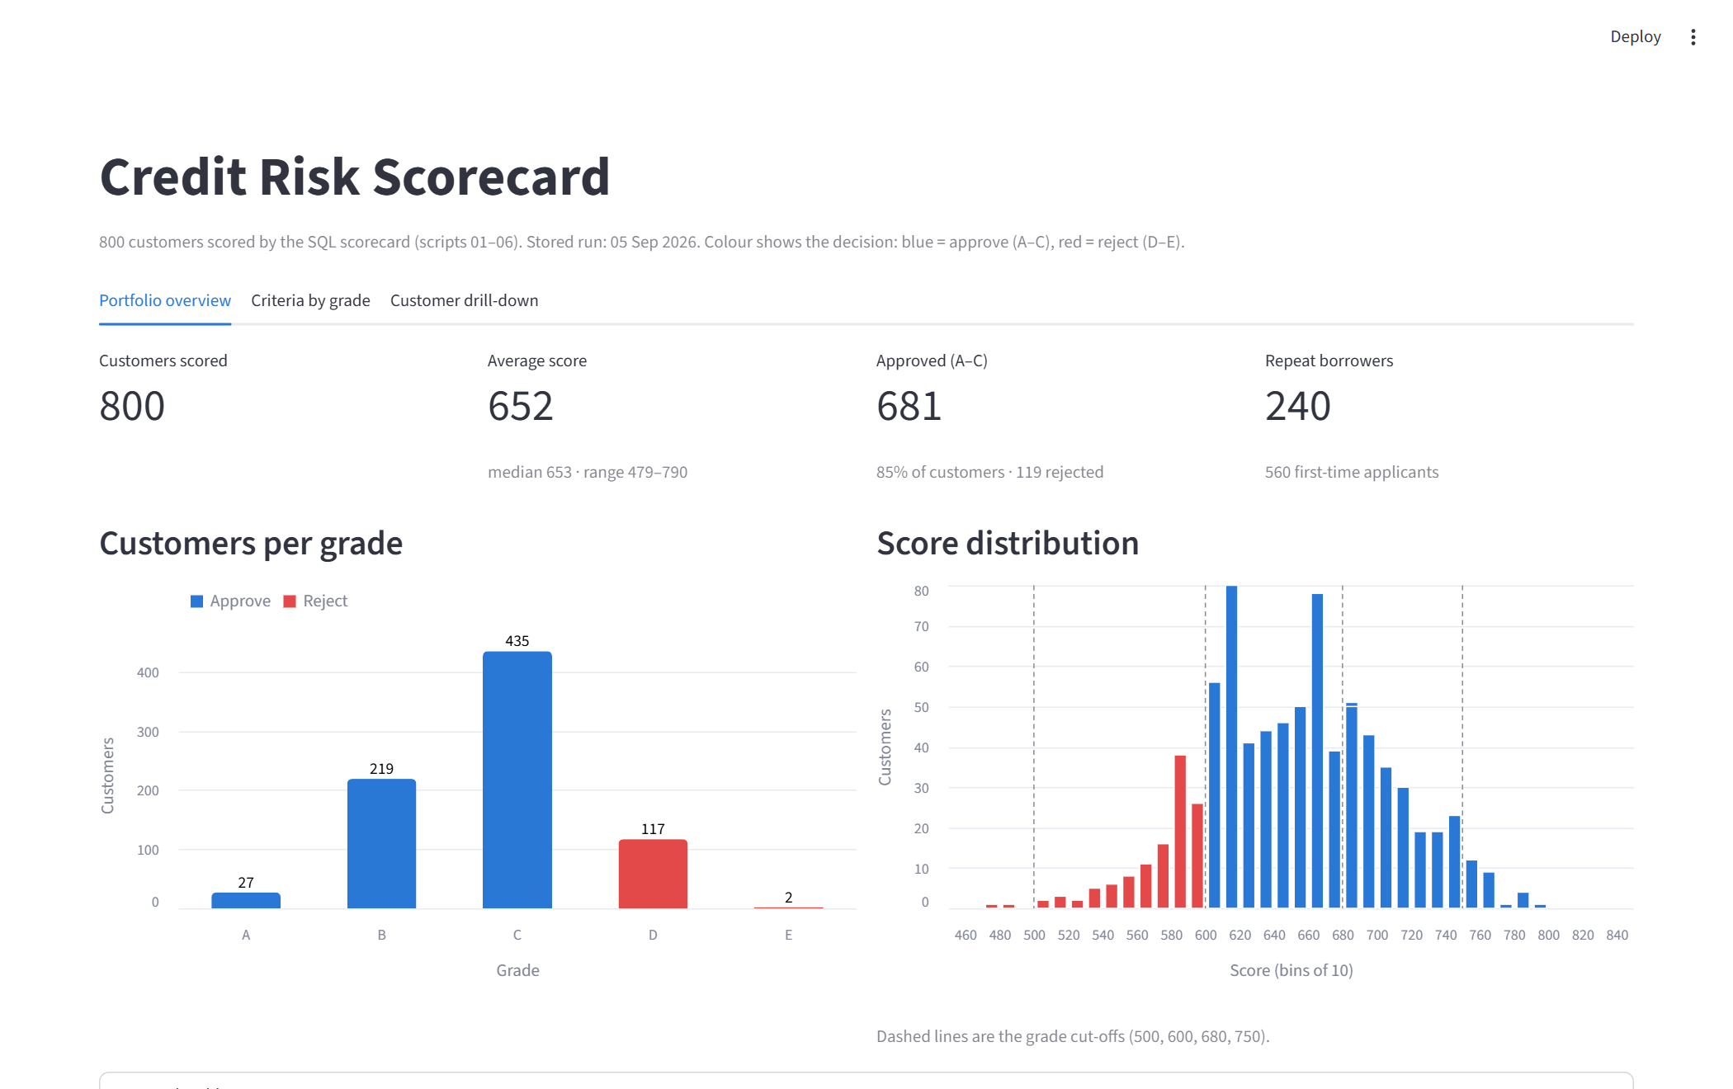
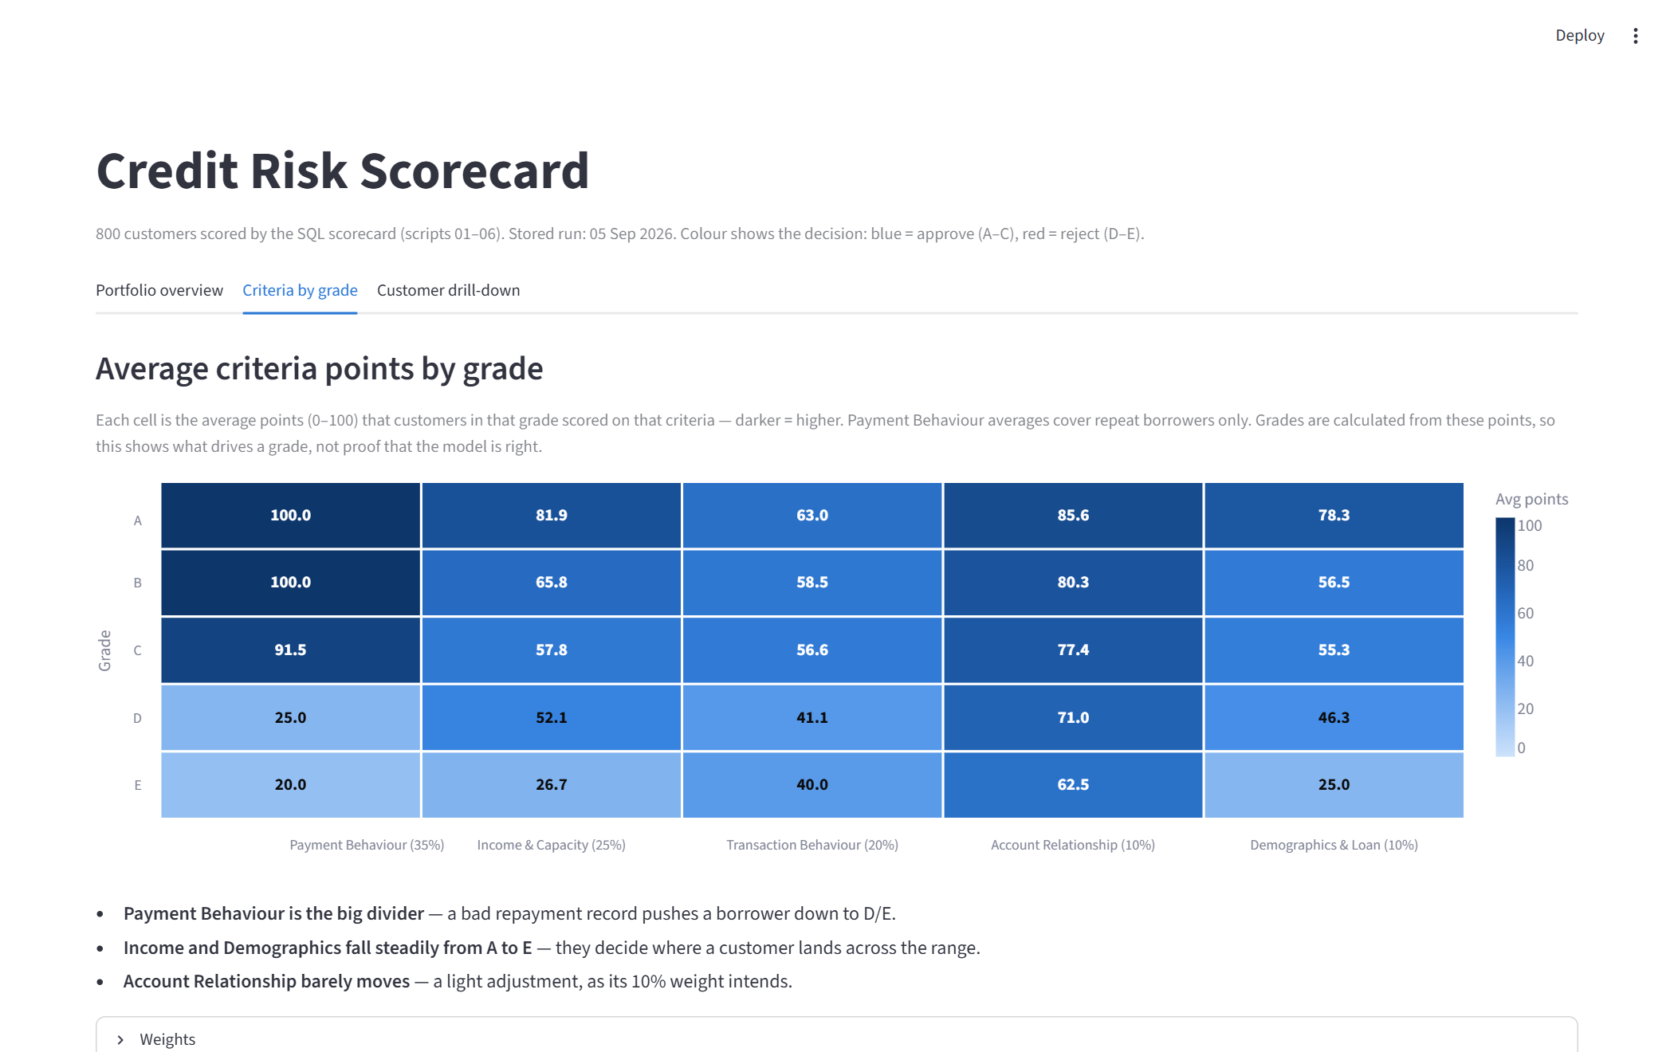
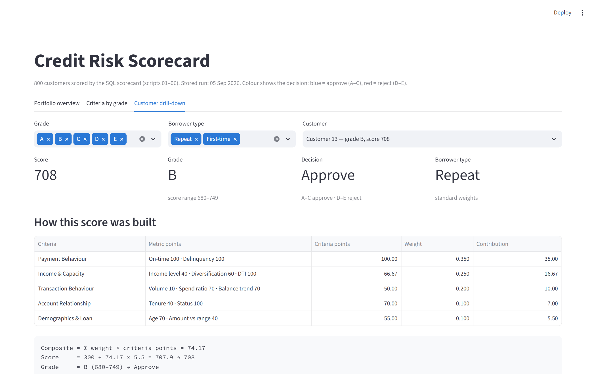
6 · DASHBOARD
Dashboard
Criteria by grade — average points heatmap
Portfolio overview — KPIs, customers per grade, score distribution with the grade cut-offs
Streamlit app (dashboard/app.py) reading live from PostgreSQL · runs in Docker on port 8502
Customer drill-down — metric points → weights → score
Notes:
Live demo if possible: open the app on port 8502. Show the overview, then pick customer 13 in the drill-down — it matches worked example 1.

Slide 24
7 · DATA QUALITY
Sensitive data & data quality risks
Sensitive data
Data element | Risk | Effect on score
monthly_income | Self-declared, not verified | Can inflate Income & Capacity (25%)
balance snapshots | Missed batch run leaves gaps | Balance-trend slope can change sign
PII
full_name, date_of_birth
CFI
income, transactions, balances, loan amounts, payment & delinquency history
CFI (derived)
risk scores — they decide approve / reject
Control
Mask or restrict at the view / query layer, since every table joins back to customer
Notes:
Only PII and CFI apply — no telecom (CPNI) or health (PHI) data in this model.

Slide 25
7 · LIMITATIONS
Limitations & next steps
Limitations
Next steps
Synthetic data — only partly grounded in the UCI dataset
Weights set by judgment, not fitted to real default outcomes
Binary approve / reject — no manual review step for borderline grade C
Quartile bands are relative: a customer's points depend on the rest of the population
Fit weights and bands on real historical defaults (e.g. Weight of Evidence / Information Value)
Add a 'pending' manual review route for grade C (the schema already allows it)
Run script 06 as a scheduled batch and keep each run's history
Use the batch scores to generate proactive loan offers
Notes:
Be upfront: the model logic is sound and traceable, but the weights and data are not validated against real defaults.

Slide 26
Thank you
Questions?

