Slide 1
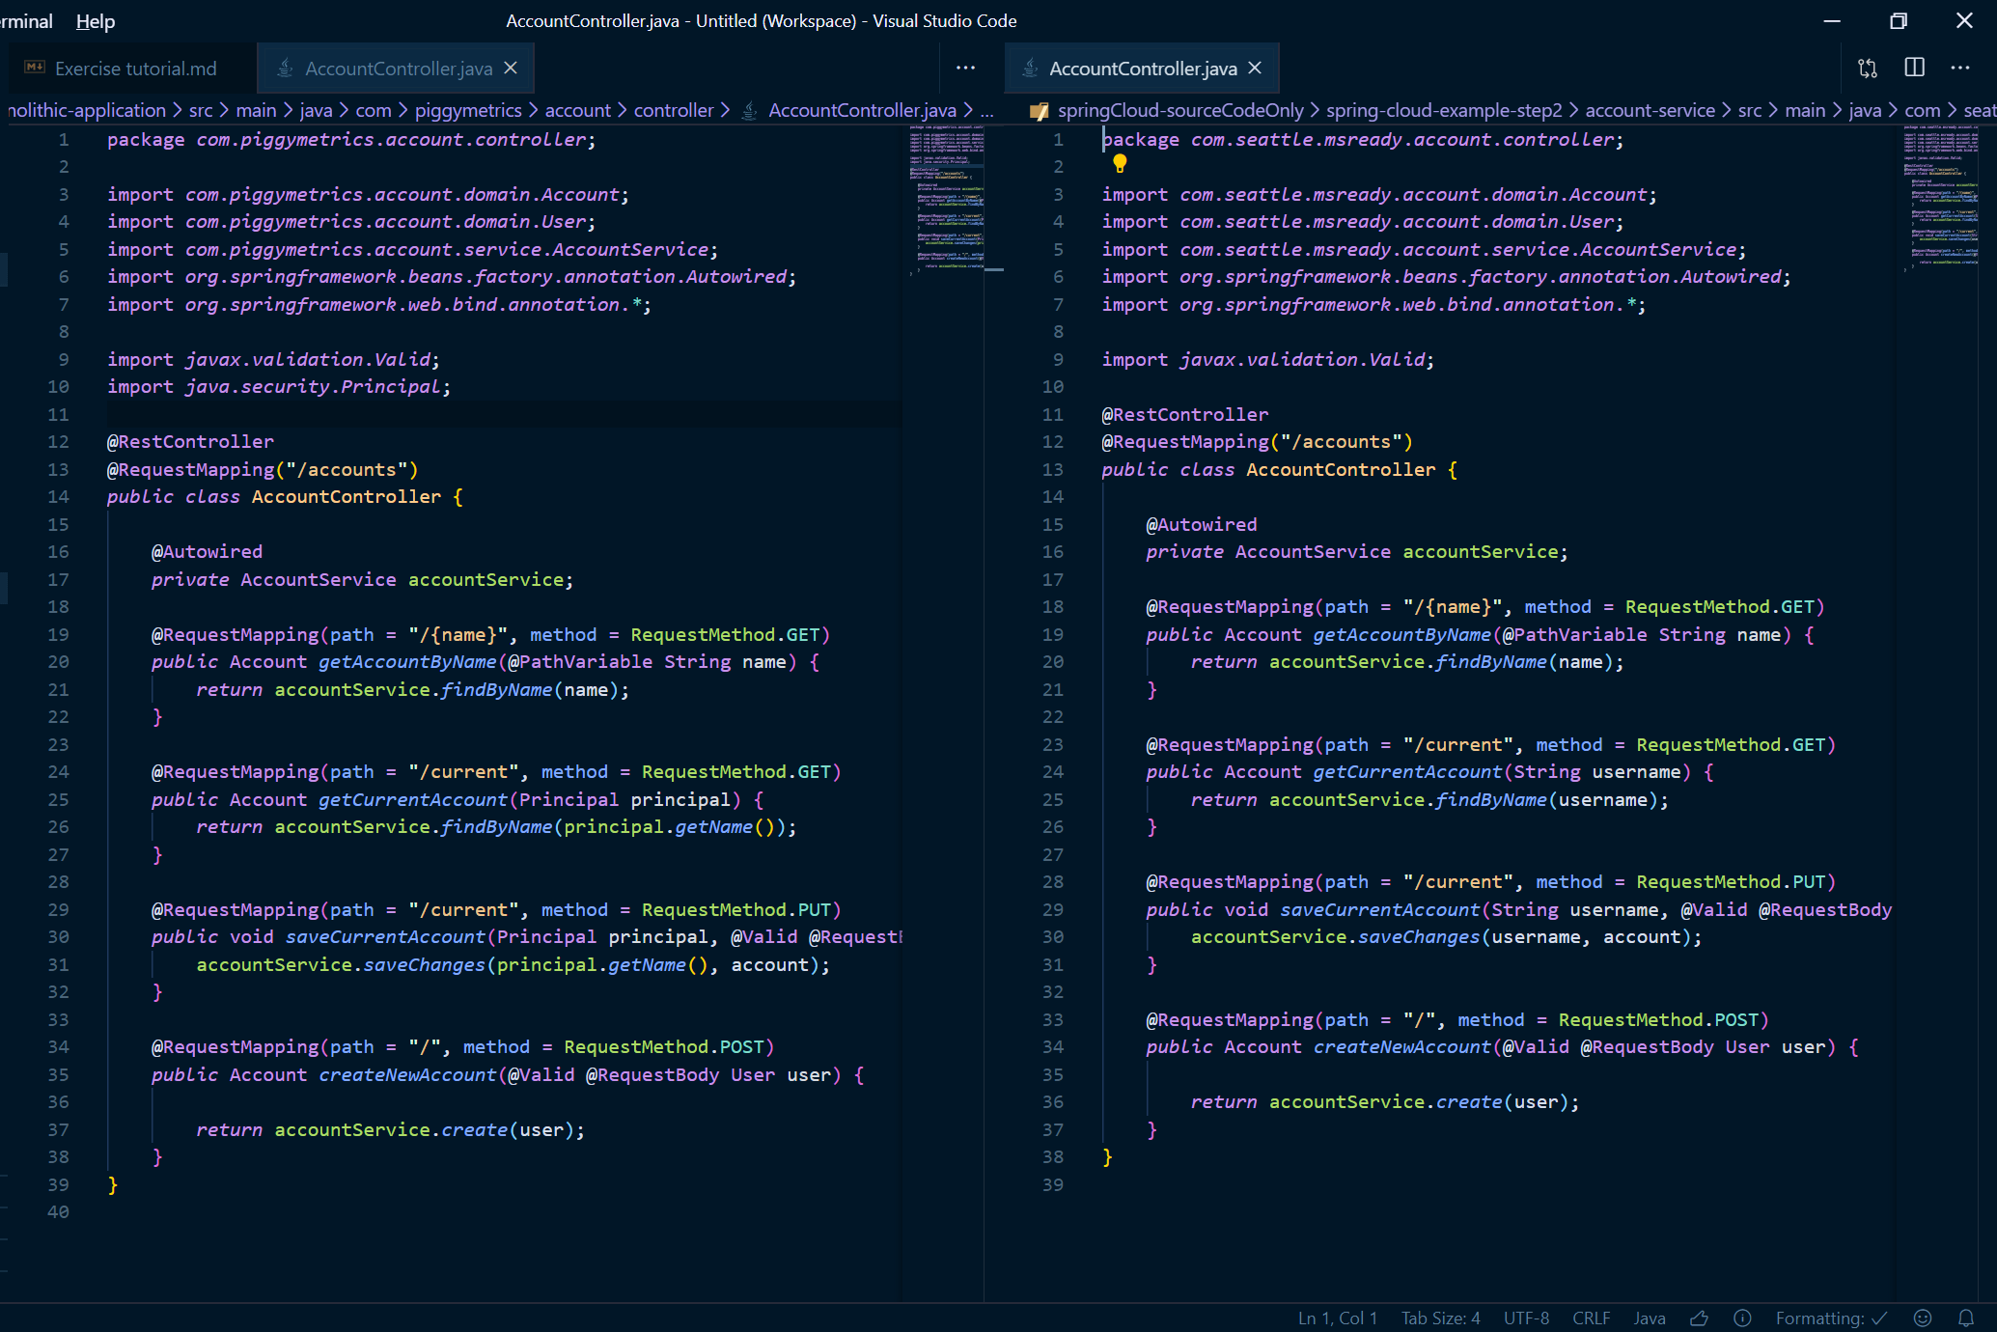
Change Namespace
Modify security method
Old Monolithic Java
New Microservices Java
Modify security method

