Slide 1


User applications
Presented by Igor Sfiligoi, UCSD/SDSC
Kubernetes for Science Compute Tutorial

Slide 2


Outline
It is all about containers
Picking the right image
Amending the container at runtime
Customizing the image

Slide 3

Kubernetes container based
Containers are the basic building block
Historically Docker based
Standard images for many applications exist
Creating custom ones almost trivial

Slide 4
Container image
How do you decide what to run in a pod?
What “image” should you use?
Actually, where is the image coming from?
By default, from DockerHub
But you can provide an arbitrary URL, too

Slide 5

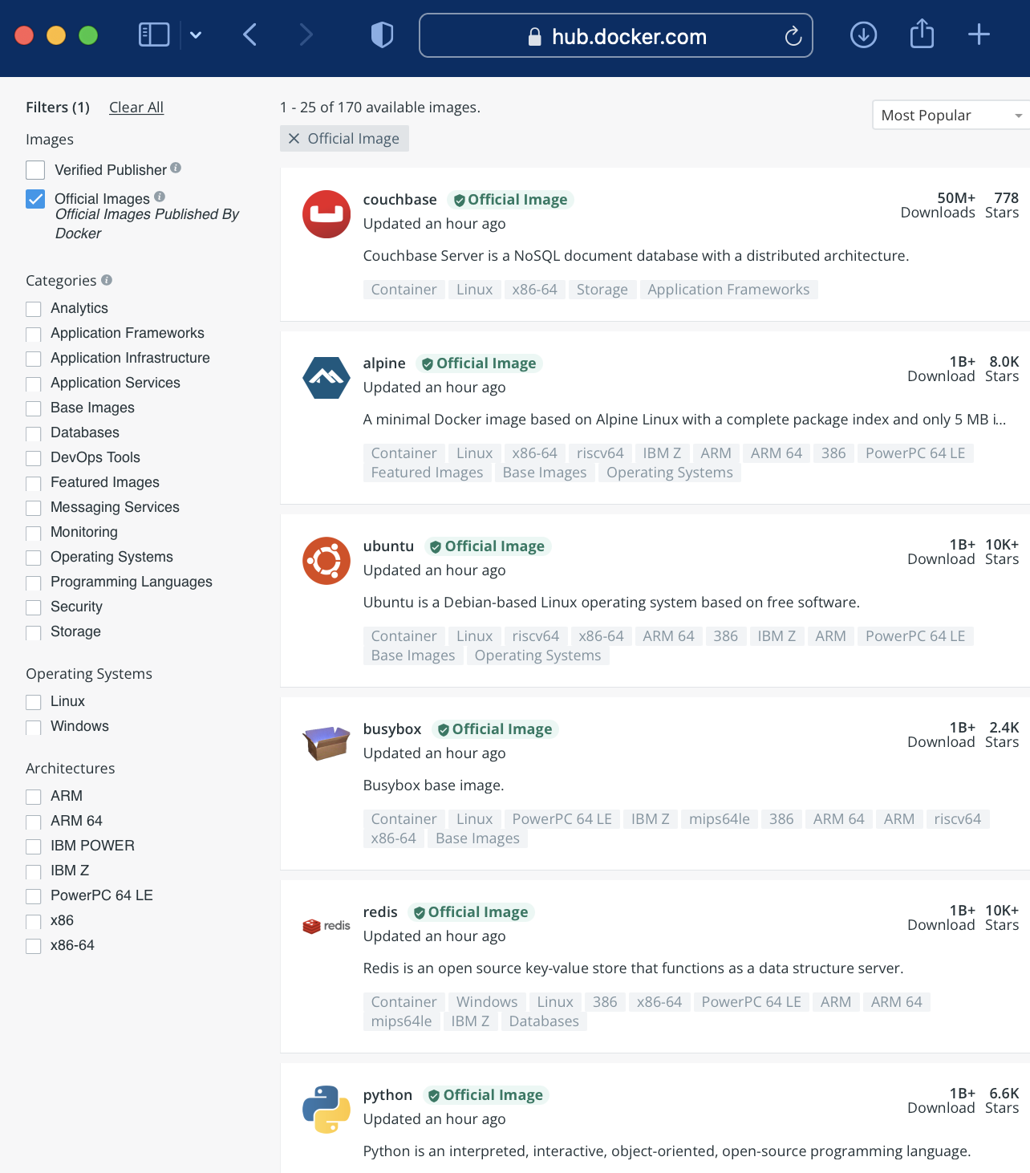
https://hub.docker.com/search?type=image&image_filter=official
Docker Image hosting site
Most important software projects have a ready-to-use image there

Slide 6
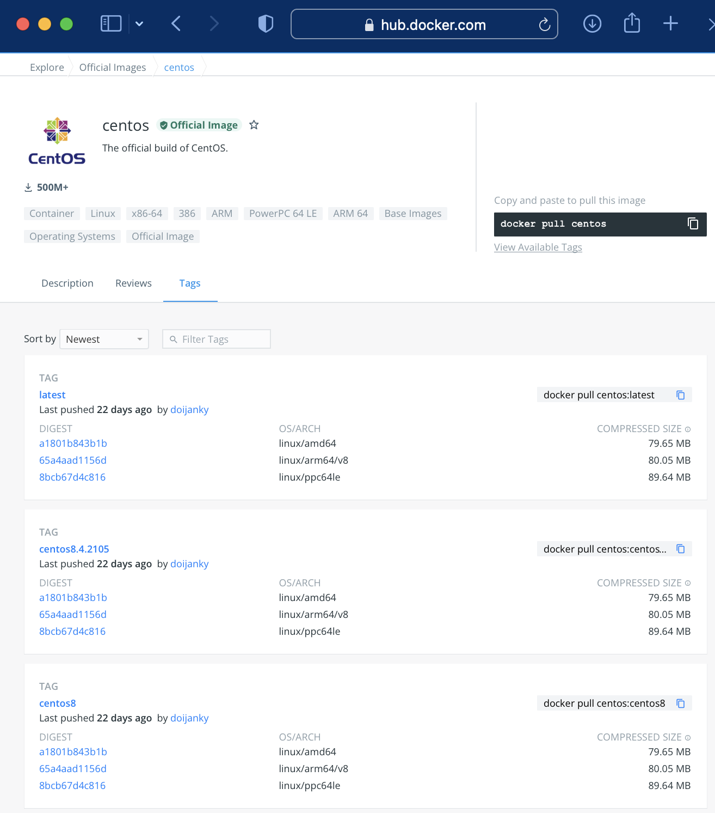
Docker Image hosting site
After you pick a project, you need to also pick a tag
You get ”latest”, if you don’t

Slide 7

From the hands-on
apiVersion: v1
kind: Pod
metadata:
name: pod-<username>
spec:
containers:
- name: mypod
image: centos:centos8
resources:
limits:
memory: 100Mi
cpu: 100m
requests:
memory: 100Mi
cpu: 100m
command: ["sh", "-c", "sleep infinity"]

Slide 8
Custom run environments
What if no image is a perfect match?
For example, you created your own software.
Customizing the images quite common:
Inject files into the pod at runtime
Build custom images
Or need a special mix of existing software libraries

Slide 9
Configuration management
Most applications need to be configured
Kubernetes provides an easy mechanism to inject information into the Container images at runtime
Three mechanisms
Environment variables
ConfigMaps
Secrets
https://kubernetes.io/docs/tasks/configure-pod-container/configure-pod-configmap/ https://kubernetes.io/docs/concepts/configuration/secret/

Slide 10
Configmaps
Configmaps are collections of files.
Pods can mount any file from any configmap
At any arbitrary location
Can also map a whole configmap as a directory
Defined ahead of time
Can be used by multiple pods
Not limited to "config files"
Main executable and libraries can be injected, too

Slide 11
Custom code example
apiVersion: v1
kind: Pod
metadata:
name: mypod
spec:
volumes:
- name: pi
configMap:
name: myconfig
items:
- key: pi.py
path: pi.py
containers:
- name: mypod
image: centos:centos8
command: ["sh", "-c", "python3 /opt/code/pi.py"]
volumeMounts:
- name: pi
mountPath: /opt/code/pi.py
subPath: pi.py
Python script in configmap.
Python script in configmap.

Slide 12
Environment variables
Environment variables are easier to use
No new objects needed
Often used in conjunction with configmaps
Just stick the value in the pod YAML
Many applications use file-based configs
But those configs can reference the environment

Slide 13
Environment input example
apiVersion: v1
kind: Pod
metadata:
name: mypod
spec:
volumes:
- name: pi
configMap:
name: myconfig
items:
- key: pi.py
path: pi.py
containers:
- name: mypod
image: centos:centos8
command: ["sh", "-c", "python3 /opt/code/pi.py"]
env:
- name: PI_STEPS
value: "100000”
volumeMounts:
- name: pi
mountPath: /opt/code/pi.py
subPath: pi.py
Environment used by the python script.

Slide 14
Secrets
Some information is more senistive
Secrets provide some additional protection
The content of a secret cannot be directly viewed
But no additional protection once mounted in the pod
Passwords
Tokens
Else, very similar to configmaps

Slide 15
Custom images
Sometimes the amount of change is just too big
Or may have complex packaging
Creating a new image becomes necessary
e.g. external RPM packages

Slide 16
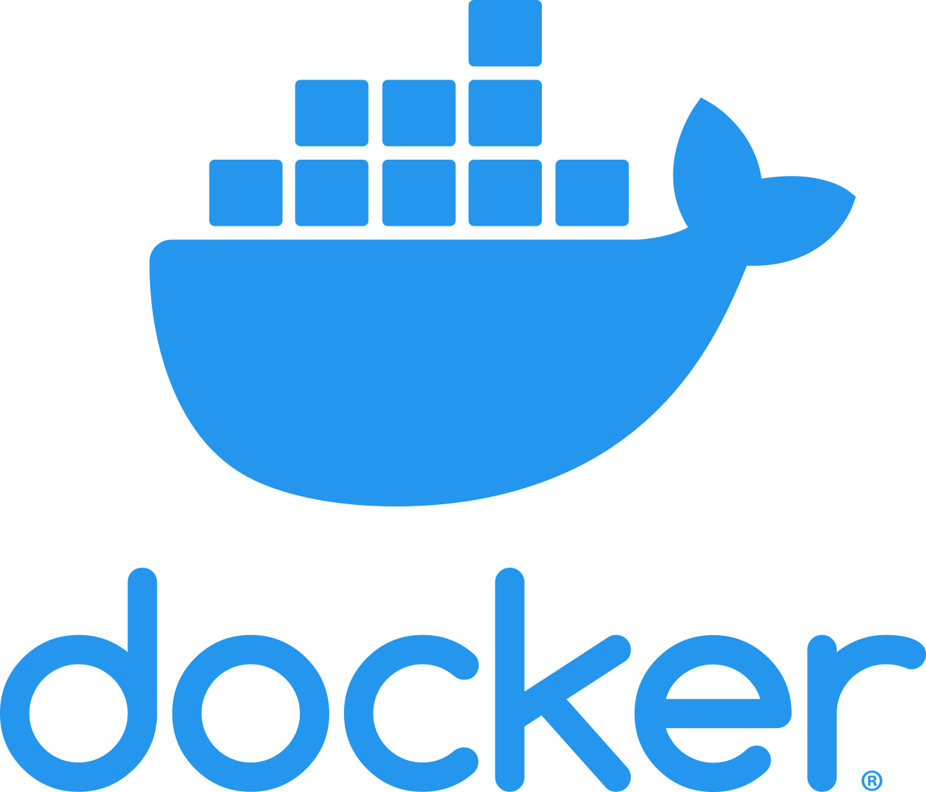
Start with an existing image, then add your needed software
FROM nvidia/cuda:11.2-runtime-centos7
RUN yum -y install \
https://repo.opensciencegrid.org/\
osg/3.6/osg-3.6-el7-release-latest.rpm
RUN yum -y install osg-wn-client
RUN yum -y groupinstall \
"Compatibility Libraries" \
"Development Tools" \
"Scientific Support"
Use the standard Docker image building procedure
First, create a Dockerfile

Slide 17
You can also inject your own files, and define environment variables.
FROM nvidia/cuda:11.2-runtime-centos7
RUN yum -y install \
https://repo.opensciencegrid.org/\
osg/3.6/osg-3.6-el7-release-latest.rpm
RUN yum -y install osg-wn-client
RUN yum -y groupinstall \
"Compatibility Libraries" \
"Development Tools" \
"Scientific Support”
ADD config/default.cfg /etc/myapp/
ADD bin/* /opt/myapp/bin/
ENV PATH ${PATH}:/opt/myapp/bin/
Use the standard Docker image building procedure
First, create a Dockerfile

Slide 18
Building your image
You have your Dockerfile. Now what?
K8s cannot directly use the Dockerfile as-is.
You need to build it into an actual image.
And the put it in a place k8s can fetch it from.
Many options available to build the image
You can even do it on your laptop using docker.

Slide 19
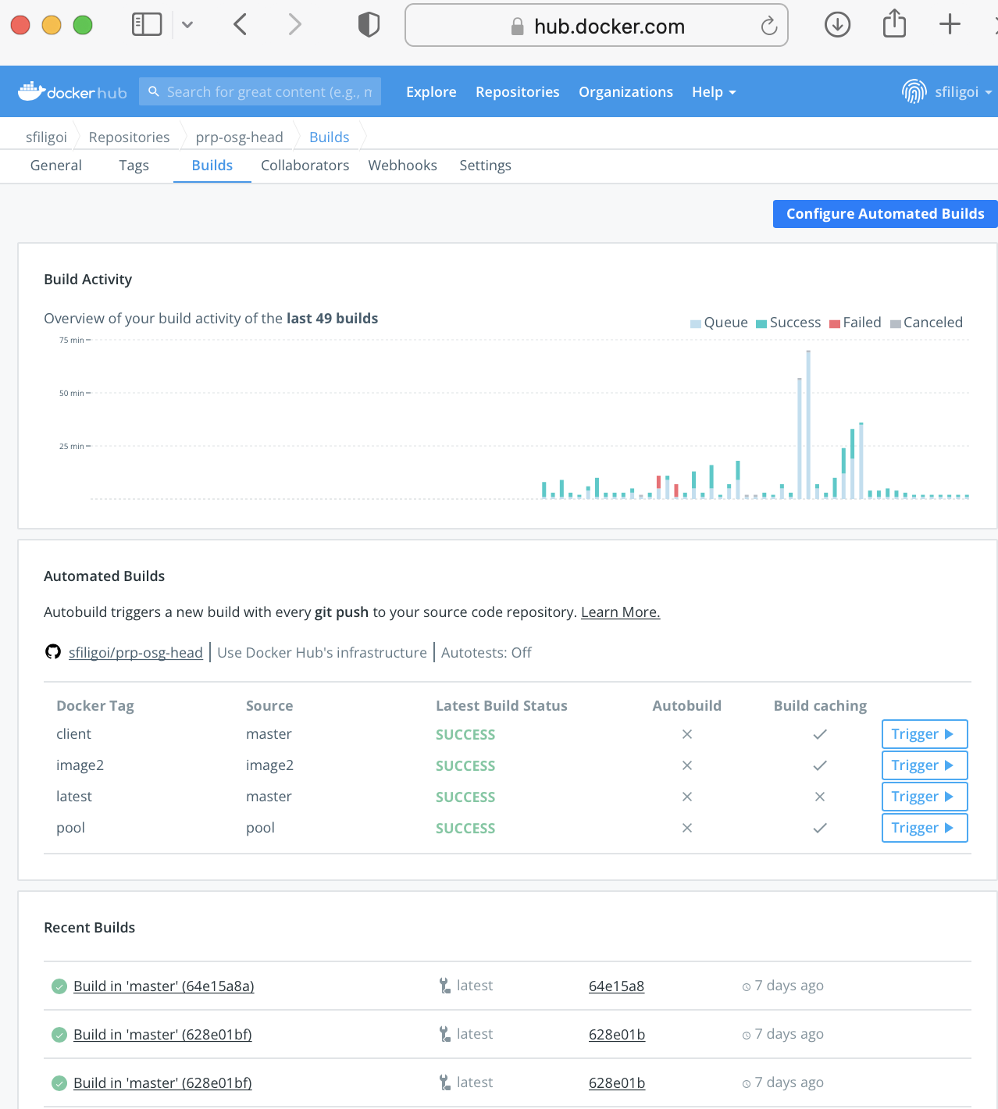
Just be aware that it is a premium feature.
I.e., you have to pay for it.
Dockerhub also offers a service to build your Dockerfiles into images
By fetching them from github

Slide 20

The end

Slide 21

Acknowledgents
This work was partially funded by US National Science Foundation (NSF) awards CNS-1456638, CNS-1730158, ACI-1540112, ACI-1541349, OAC-1826967, OAC 1450871, OAC-1659169 OAC-2030508 and OAC-1841530.

