Slide 1


Taking advantage of network services
Presented by Igor Sfiligoi, UCSD/SDSC
Kubernetes for Science Compute Tutorial

Slide 2

Kubernetes networking
Batch users often don’t think about networking
At best, they rely on outgoing TCP connections
Kubernetes has a rich set of networking options
Stems from the fact that it was designed with service applications in mind
Can come handy for science users, too
Especially for interactive applications
But science compute can make good use of service applications, too!
User Portals
Task queues
Databases

Slide 3

Pod Networking
Each container get its own private IP address
No incoming networking from WAN
Allows for easy communication between Pods
Outgoing TCP networking (typically) allowed
Tunnel can be created to any Pod from your laptop (like with ssh) kubectl port-forward
But new (non-deterministic) IP given every time a Pod starts
https://kubernetes.io/docs/tasks/access-application-cluster/port-forward-access-application-cluster/

Slide 4
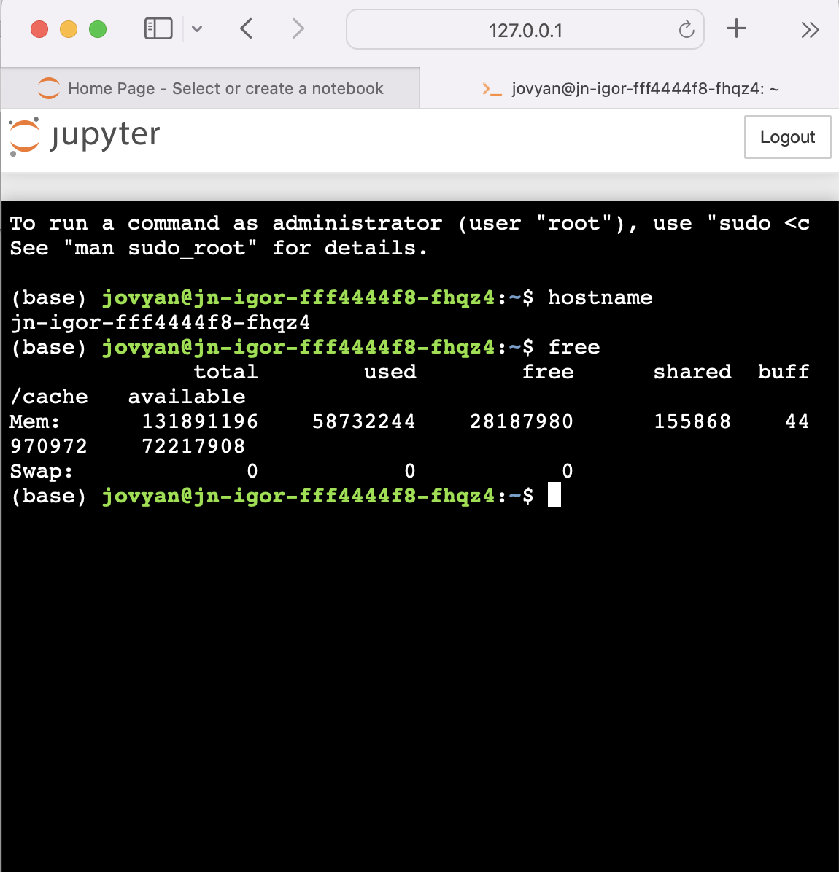
Port forwarding handy for interactive use
$ kubectl port-forward jn-igor-fff4444f8-fhqz4 8888:8888
Forwarding from 127.0.0.1:8888 -> 8888
Forwarding from [::1]:8888 -> 8888

Slide 5
Service network objects
A service object can be created to have a permanent network address
Service typically load-balances a set of pods
Traffic routed to the Pods in the set (e.g. Deployment)
Gets its own IP address and (cluster-local) DNS entry at creation
Several routing policies supported (defaults to Round-Robin)
https://kubernetes.io/docs/concepts/services-networking/dns-pod-service/

Slide 6


An example service
apiVersion: v1
kind: Service
metadata:
labels:
k8s-app: mysvc name: mysvc
spec:
ports:
- port: 80
protocol: TCP
targetPort: 80
selector:
k8s-app: http
Will route to all pods that match the selector

Slide 7
Incoming network traffic
A service object can also be used to route incoming WAN traffic
Ingress popular for HTTP(S) traffic
It operates at the application layer (HTTP)
Arbitrary IP protocol routing also possible
The tutorial Kubernetes clusters uses MetalLB
In addition to routing in-cluster traffic
But needs additional configuration
Very flexible architecture, rule based
https://kubernetes.io/docs/concepts/services-networking/ingress/

Slide 8
An example ingress
apiVersion: networking.k8s.io/v1
kind: Ingress
metadata:
annotations:
kubernetes.io/ingress.class: haproxy
name: ingress-mysvc
spec:
rules:
- host: test-svc.nrp-nautilus.io
http:
paths:
- path: /
pathType: Prefix
backend:
service:
name: mysvc
port:
number: 80

Slide 9

The end

Slide 10

Acknowledgents
This work was partially funded by US National Science Foundation (NSF) awards CNS-1456638, CNS-1730158, ACI-1540112, ACI-1541349, OAC-1826967, OAC 1450871, OAC-1659169 OAC-2030508 and OAC-1841530.

