Slide 1


Additional tools
Presented by Igor Sfiligoi, UCSD/SDSC
Kubernetes for Science Compute Tutorial

Slide 2

Rich ecosystem
Kubernetes is quite powerful by itself
But it is the surrounding ecosystem that makes it so valuable!
Kubernetes has become an industry standard
Many projects build on top of it to deliver additional capabilities
Will mention just a couple in the next few slides

Slide 3
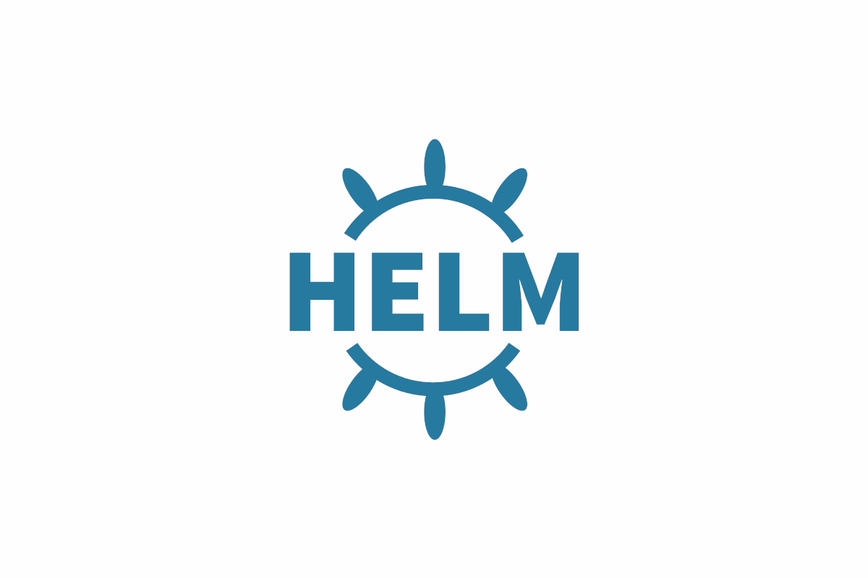
Helm package manager
Many larger applications require several pods and services to be fully functional
Having a package manager highly desirable
Helm has become the de-facto standard https://helm.sh/docs/
No special privileges needed to use it
Builds on top of standard Kubernetes objects

Slide 4

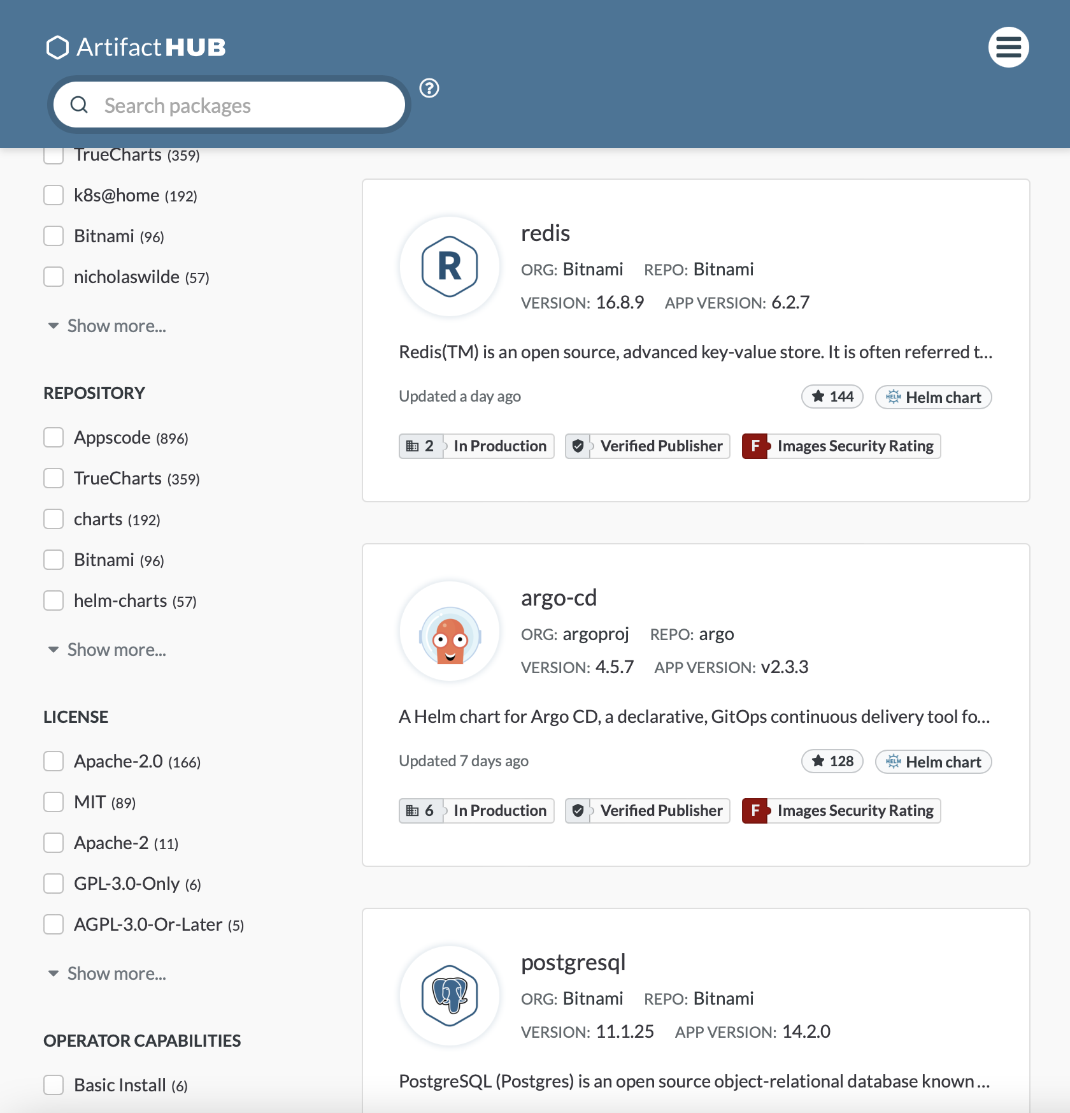

Helm comes with ArtifactHub
https://artifacthub.io/packages/search?verified_publisher=true

Slide 5

Jupyter Hub
Creating Jupyter notebook pods by hand may be a fun exercise
But not very user friendly
Jupyter Hub can automate all the steps
Hides underlying resource provisioning behind a Web portal
Ready-to-use Kubernetes recipe available (but not for “plain” users) https://zero-to-jupyterhub.readthedocs.io/en/latest/

Slide 6
MPI jobs
Kubernetes does not natively support MPI jobs
Or gang-scheduling in general
Several external projects help getting a cluster to support them
kube-openmpi: Automates MPI setup https://github.com/everpeace/kube-openmpi
Volcano pod scheduler: Adds support for gand-scheduling https://www.kubeflow.org/docs/components/training/job-scheduling/

Slide 7
True batch on Kubernetes
If you do not like YAML and Pods, it is easy to create an overlay batch system on top of Kubernetes
Kubernetes capabilities are really a superset of most batch systems (if we ignore scheduling capabilities)
We have plenty of experience using HTCondor as an overlay batch system for Kubernetes
Users never see Kubernetes, just HTCondor
Resources provisioned by Kubernetes given to HTCondor for management (the pilot concept)
https://doi.org/10.48550/arXiv.2205.01004

Slide 8

The end

