Slide 1


Monitoring your compute
Presented by Igor Sfiligoi, UCSD/SDSC
Kubernetes for Science Compute Tutorial

Slide 2


Outline
Understanding your compute
Monitoring utilization
Additional options

Slide 3

Understanding your compute
List your requests
Listing the pods the most useful kubectl get pods
But be aware of the controllers, too, as they may spawn more pods on your behalf
Deployments
Jobs
And let’s not forget about storage kubectl get pvc
Using the –o wide option provides good balance between detail and readability

Slide 4
Understanding your compute
List your requests
Check progress
Sometimes things don’t go as expected
Namespace events provide good overview of what is happening kubectl get events
You will likely want to order them in chronological order with --sort-by=.metadata.creationTimestamp

Slide 5
Understanding your compute
List your requests
Check progress
Log into running pods
Useful both for true interactive pods as well as for debugging kubectl exec
By default just runs a command, but can be made interactive with -it -- /bin/bash

Slide 6
Understanding your compute
List your requests
Check progress
Fetch stdout
Can provide useful debugging information, if your applications prints out progress kubectl logs
Log into running pods

Slide 7
Monitoring utilization
Kubernetes provides basic performance metrics
Typically CPU and memory utilization
You can easily get a snapshot for all your pods kubectl top pods

Slide 8
Monitoring utilization
Kubernetes provides basic performance metrics
System metrics available, too
Similar syntax kubectl top nodes

Slide 9

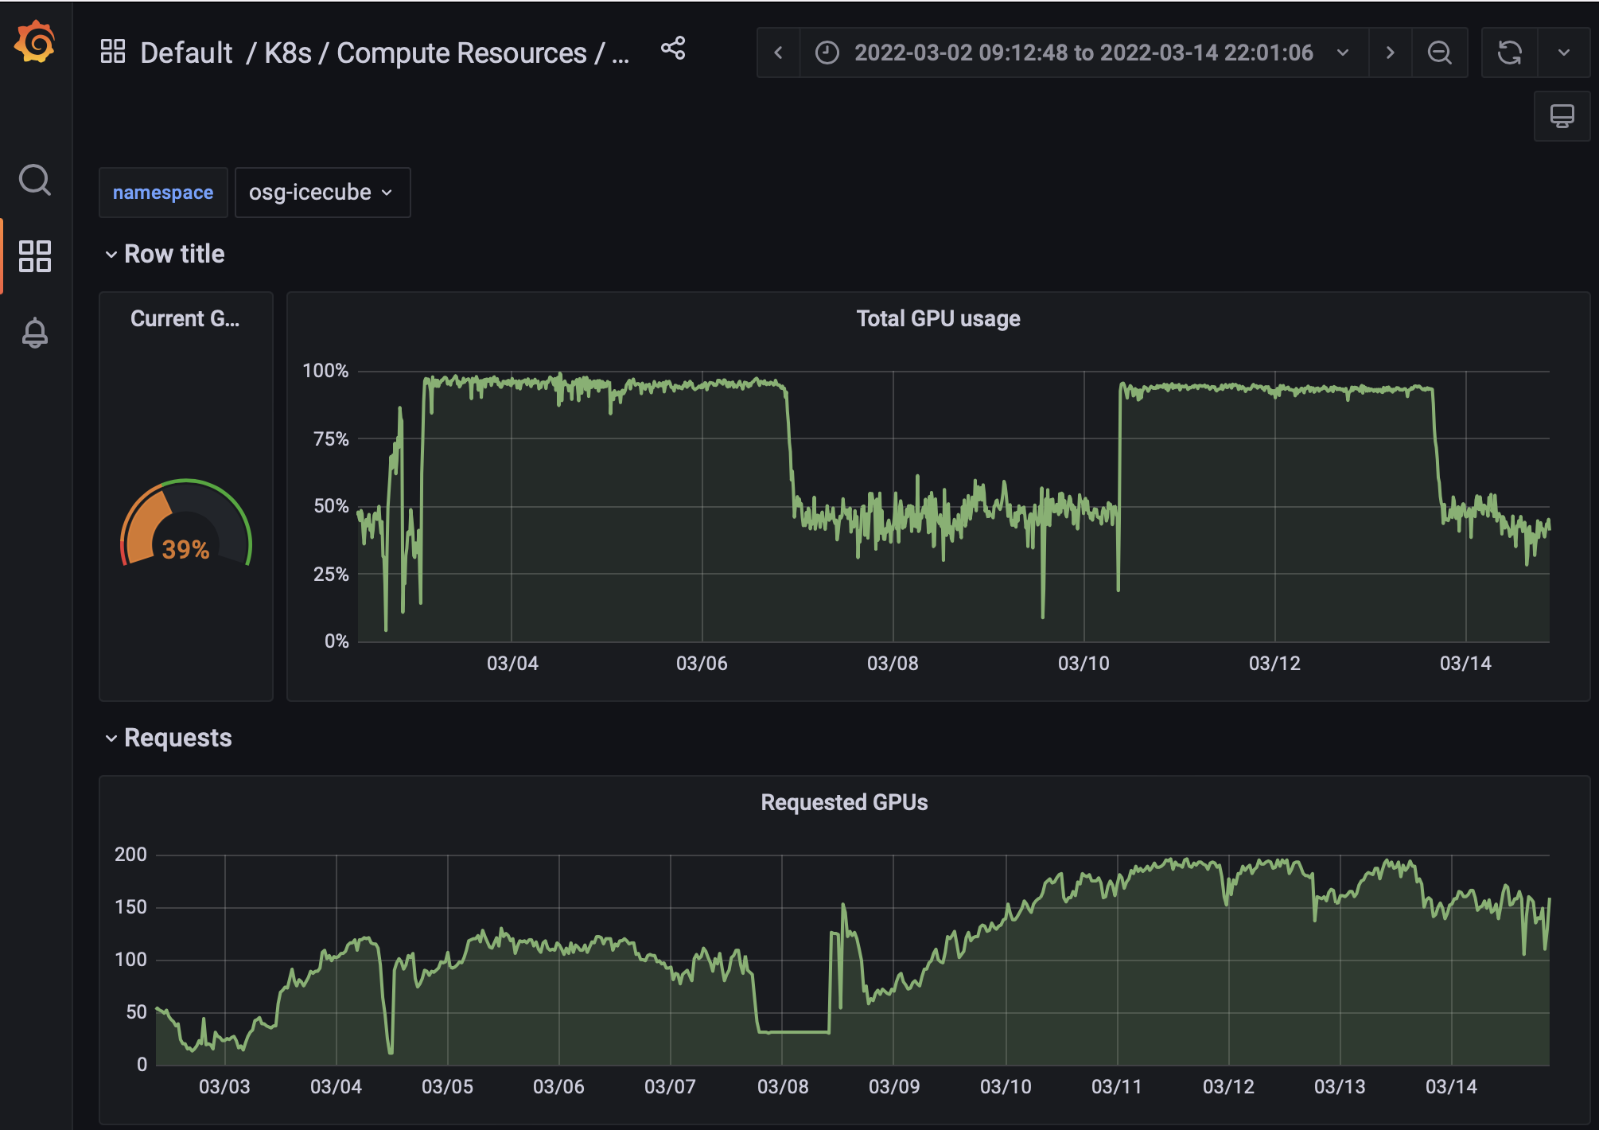

Cluster specific tools
Tutorial cluster has GUI monitoring through grafana

Slide 10

The end

Slide 11

Acknowledgents
This work was partially funded by US National Science Foundation (NSF) awards CNS-1456638, CNS-1730158, ACI-1540112, ACI-1541349, OAC-1826967, OAC 1450871, OAC-1659169 OAC-2030508 and OAC-1841530.

