Slide 1
AUDITVERSE.AI
AuditVerse.AI
Live
The audit
platform that
actually ships
findings.
Open Findings
Engagements
47
23
Closure Rate
Overdue
82%
8
One workspace for the audit lifecycle — universe to engagement, workpaper to finding, escalation to closure.
Coverage
Cycle Time
91%
18d
Client Briefing · May 2026

Slide 2
THE PROBLEM
Internal audit runs on email, spreadsheets, and stale memory.
Three groups feel the pain — and they don't see the same version of the truth.
EXECUTIVES
AUDIT TEAM
BUSINESS / IT
No real-time view of audit coverage, open risks or remediation status.
Spend 60% of cycle time copy-pasting between Word, Excel and email.
Repeated requests for the same evidence, no visibility into status.
Last quarter's deck is the only artifact
Workpaper review threads buried in inbox
Same control re-audited from 3 angles
Audit committee learns of issues 60+ days late
No standard CCCE structure across findings
Action owners chase audit for due dates
Assurance gaps invisible until something breaks
Skill-to-engagement matching done in heads
No self-service to attest or push back

Slide 3
THE SOLUTION
Seventeen modules. One workspace. The full audit lifecycle.
Each module is on the next slide. Here is the map.
01
02
03
04
05
06
Universe
Plans
Engagements
Workpapers
Findings
Issues
07
08
09
10
11
12
Surveys
Documents
Analytics
Portal
Charter
CCM
13
14
15
16
17
Reporting
QAIP
Test Scripts
Skill Matrix
Capacity

Slide 4
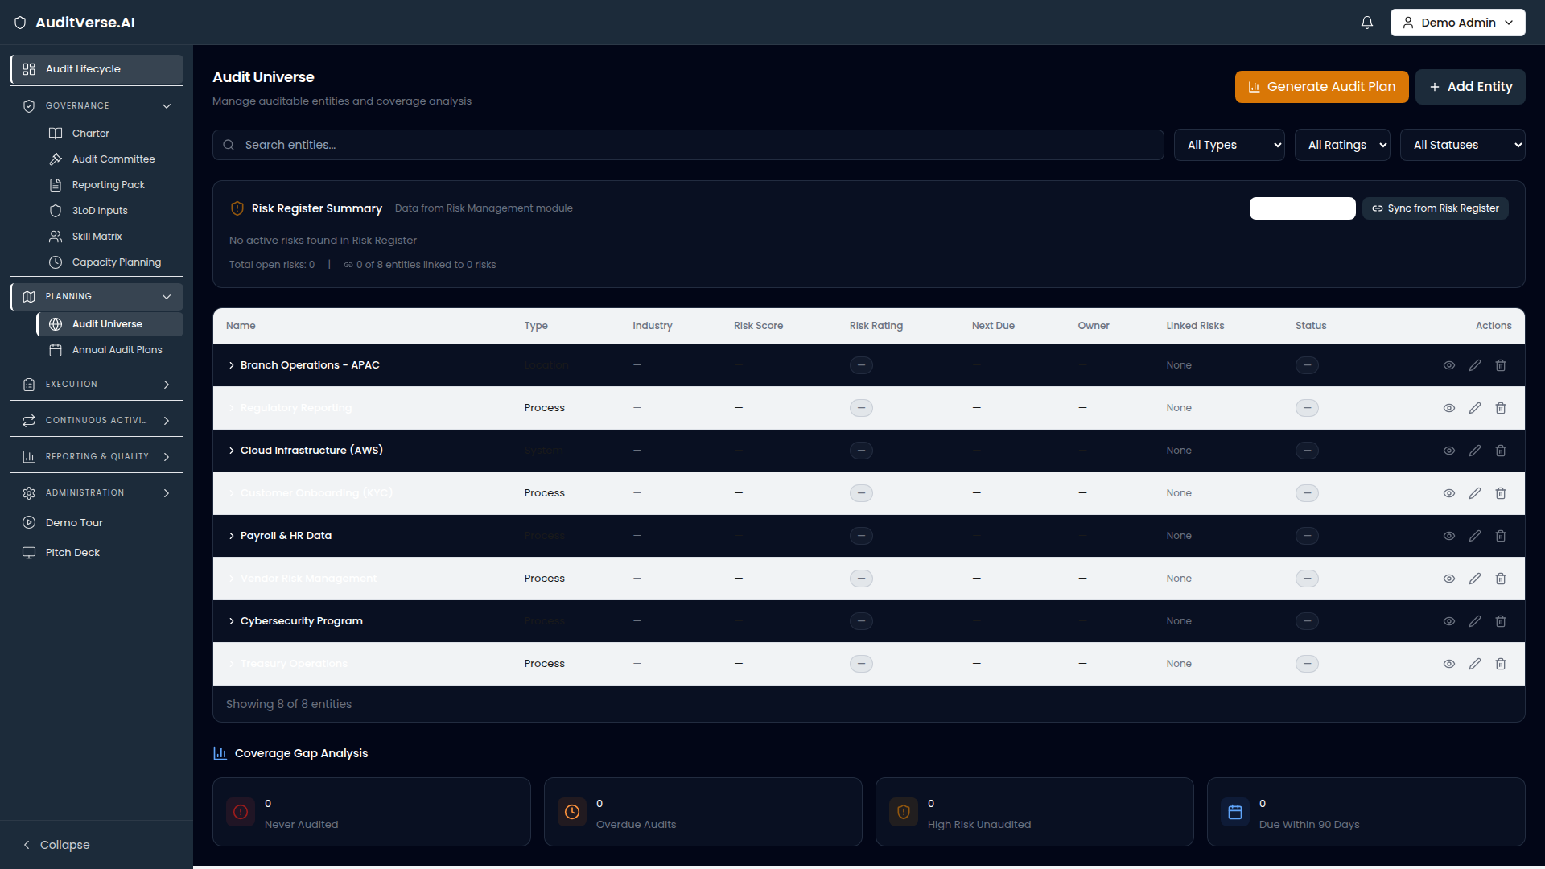
UNIVERSE
Audit Universe
Risk-rated map of every auditable entity, refreshed continuously.
TODAY
auditverse.ai · /audit/universe
Auditable entities live in spreadsheets that are out of date the moment they're shared. Coverage gaps are invisible until the audit committee asks.
WITH AUDITVERSE.AI
Universe gives executives a live heat map across business units, scored for inherent risk and last-audited recency. Assurance gaps surface automatically.
Tag entities by BU, geography, regulation
Inherent + residual risk scoring
Coverage delta vs. last 12/24/36 months
Drill from heatmap to engagement
AuditVerse.AI · Audit Management Platform
4 / 22

Slide 5
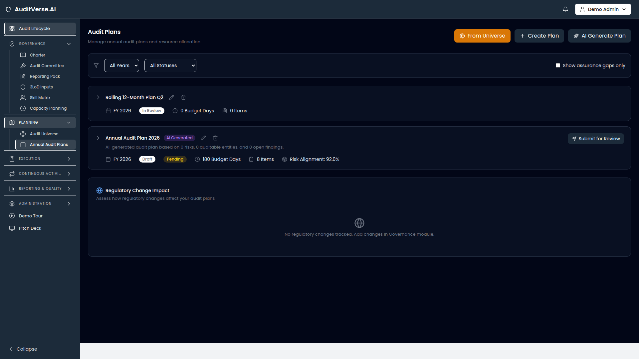
PLANS
Audit Plans
Risk-based annual planning, not a calendar exercise.
TODAY
auditverse.ai · /audit/plans
Annual plans get built in Excel, then drift the moment Q1 starts. There's no traceability from a plan slot back to the risk that justified it.
WITH AUDITVERSE.AI
Plans turns the universe into a multi-year, risk-weighted schedule with budgeted hours, dependencies, and live status for every engagement slot.
Multi-year and rolling-12 views
Auto-suggest from universe risk score
Hours budgeted vs. capacity available
Approval workflow with audit committee
AuditVerse.AI · Audit Management Platform
5 / 22

Slide 6
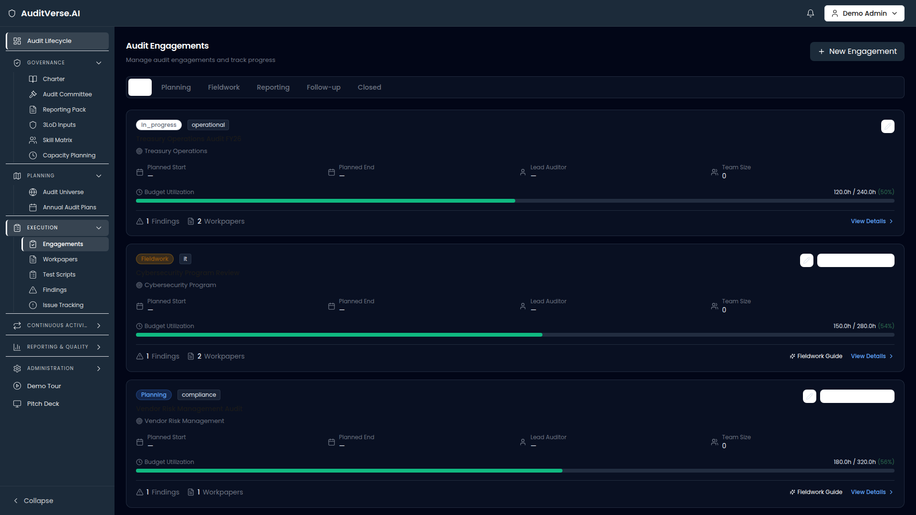
ENGAGEMENTS
Engagements
Run every engagement to one consistent shape.
TODAY
auditverse.ai · /audit/engagements
Each lead auditor structures engagements differently. Reviewers can't tell, slot-to-slot, where time is being burned or where scope quietly grew.
WITH AUDITVERSE.AI
Engagements gives every audit a standard scope, objectives, milestones, hours and team — with AI scope-drafting from the universe entry.
AI-drafted scope from entity context
Budget vs. actual hours, live
Standard milestones + workpaper structure
Assurance gap badges from universe
AuditVerse.AI · Audit Management Platform
6 / 22

Slide 7
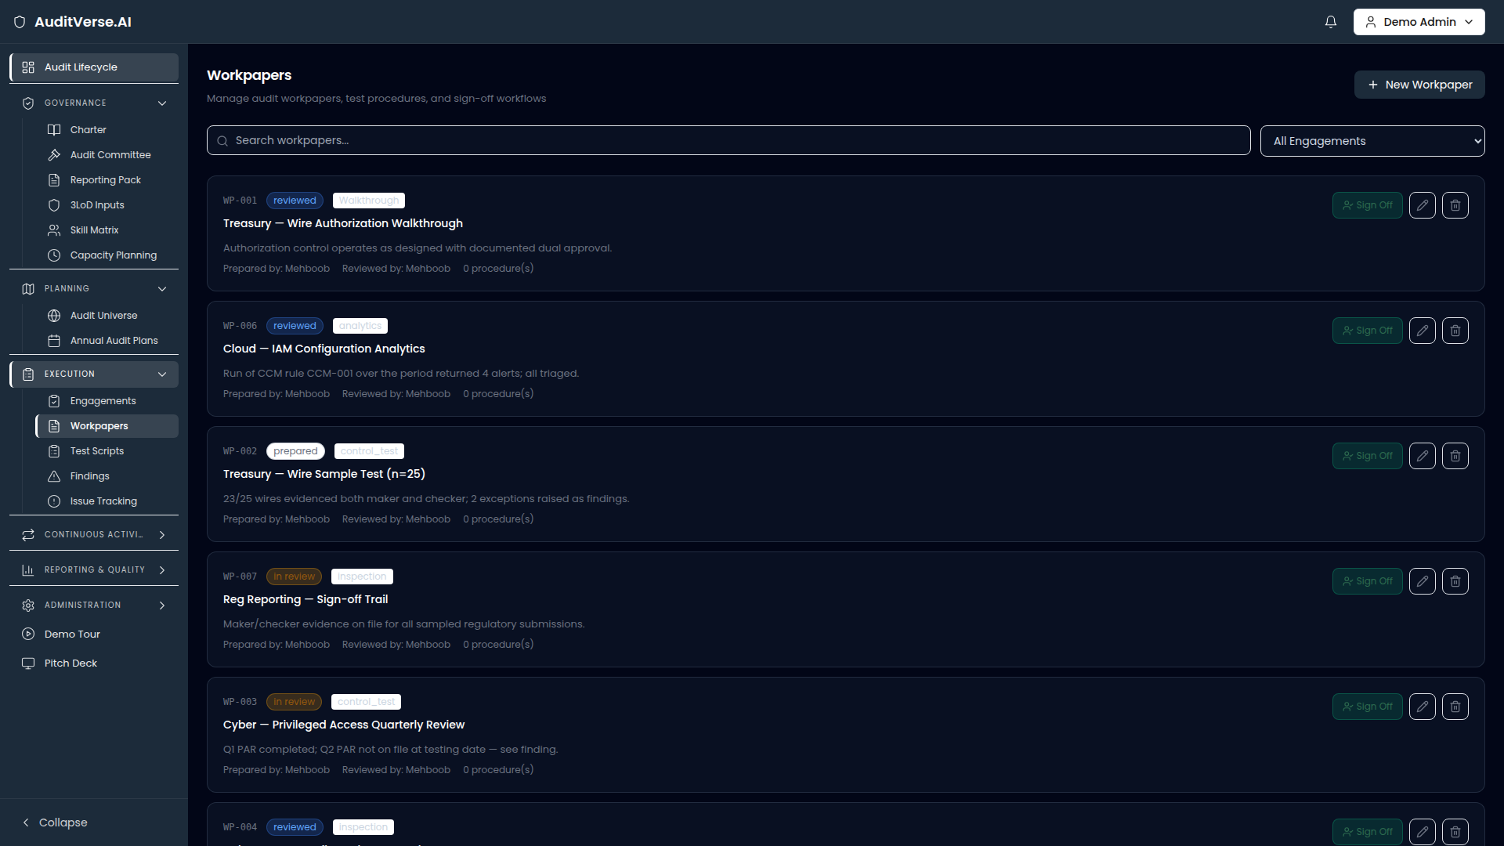
WORKPAPERS
Workpapers & Sign-Off
Test procedures, evidence and review trail in one place.
TODAY
auditverse.ai · /audit/workpapers
Workpapers live in Word, evidence in shared drives, review notes in email. Reconstructing what happened months later is forensic work.
WITH AUDITVERSE.AI
Workpapers structures every test (planning, walkthrough, analytical, interview) with a 4-stage sign-off chain: prepare → review → lead sign-off → close.
Standard procedure templates
Inline evidence + cross-reference
Preparer / reviewer / lead signatures
Reject-and-return with notes
AuditVerse.AI · Audit Management Platform
7 / 22

Slide 8
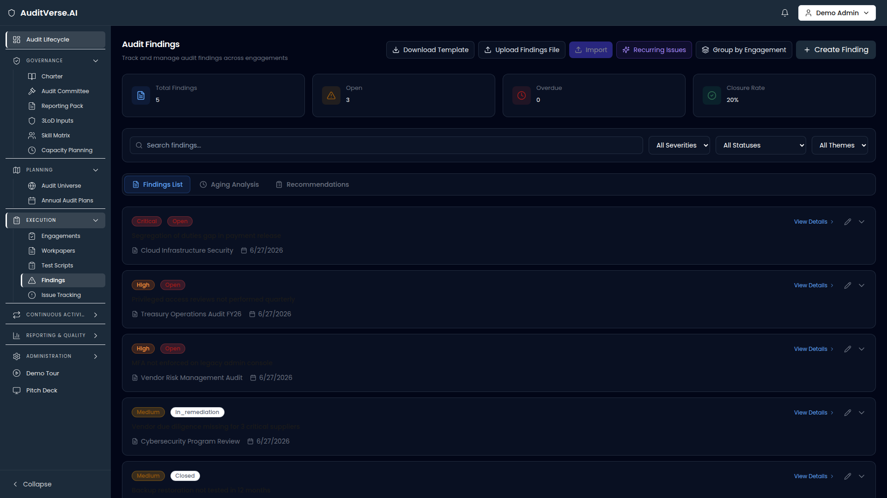
FINDINGS
Findings
Every finding written to the same CCCE structure.
TODAY
auditverse.ai · /audit/findings
Findings get rewritten by every reviewer because there's no shared template. Severity ratings drift between auditors. Recurring issues go undetected.
WITH AUDITVERSE.AI
Findings enforces the IIA-aligned CCCE structure (Condition, Criteria, Cause, Effect), with AI-drafted condition statements and severity calibration.
AI-drafted CCCE from anomaly description
Severity calibration across the team
Similar / recurring detection across years
Bulk import + Excel template
AuditVerse.AI · Audit Management Platform
8 / 22

Slide 9
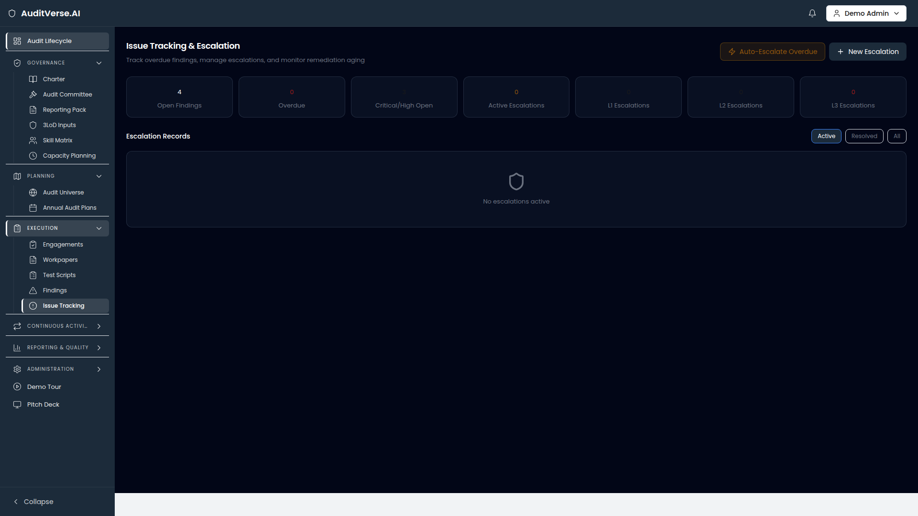
ISSUES
Issue Tracking & Escalation
No more 'we'll chase that one next month'.
TODAY
auditverse.ai · /audit/issues
Once a finding has a due date, ownership tracking ends. Overdue issues sit unresolved because no one knows whose desk they're on.
WITH AUDITVERSE.AI
Issues runs aging buckets, automatic 3-level escalation (reminder → manager → executive), and a single dashboard for everything overdue.
Aging buckets: 0-30, 30-60, 60-90, 90+ days
Auto-escalate from L1 → L2 → L3
Daily digest to action owners
Resolved-with-notes audit trail
AuditVerse.AI · Audit Management Platform
9 / 22

Slide 10
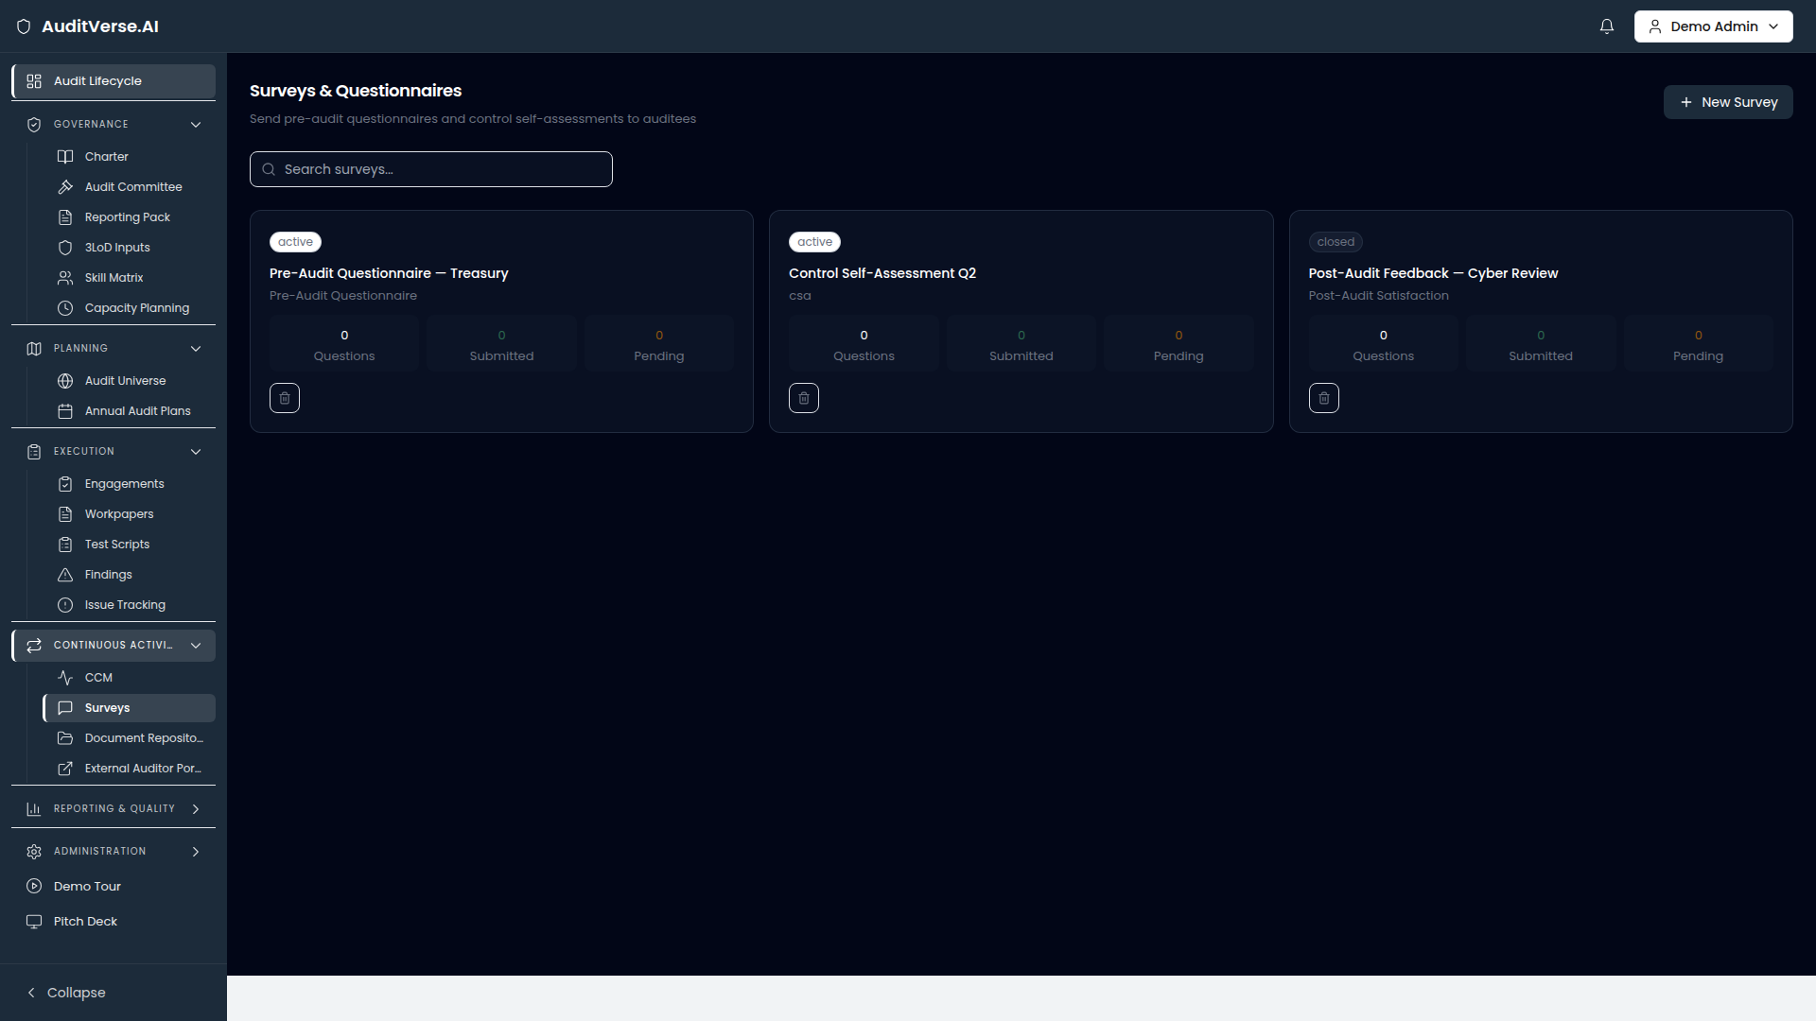
SURVEYS
Surveys & Self-Assessments
Pre-audit, post-audit, and CSA without SurveyMonkey.
TODAY
auditverse.ai · /audit/surveys
Pre-audit questionnaires get sent in Outlook with a Word attachment. Responses arrive scattered, half complete, and need to be hand-tallied.
WITH AUDITVERSE.AI
Surveys lets the team build pre-audit, post-audit, and control self-assessment surveys — with AI question generation tied to the engagement scope.
AI-generated questions from scope
Pre/post-audit + CSA templates
Email distribution + reminders
Response dashboard + export
AuditVerse.AI · Audit Management Platform
10 / 22

Slide 11
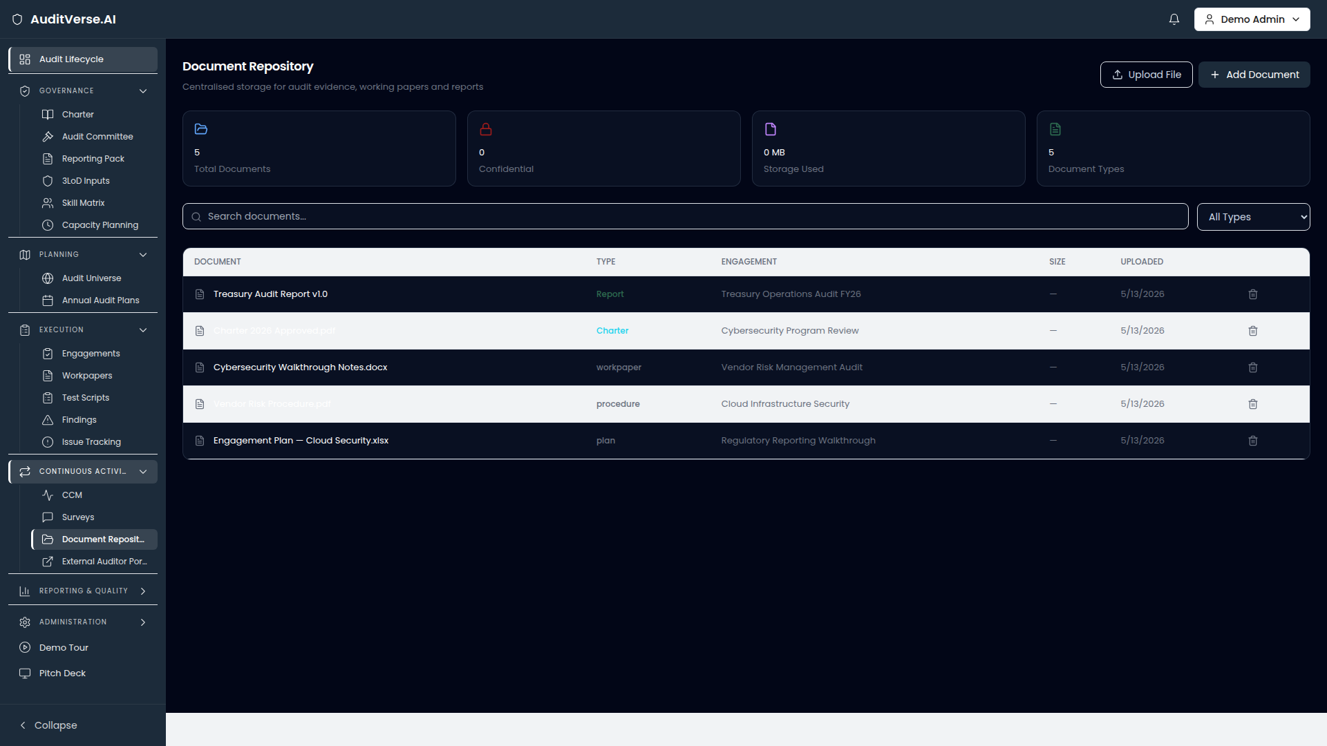
DOCUMENTS
Document Repository
One place for evidence, working papers, reports, charters.
TODAY
auditverse.ai · /audit/documents
Audit evidence lives in OneDrive, SharePoint, email and personal laptops. Confidentiality is enforced by hope. Retention is whatever default the drive has.
WITH AUDITVERSE.AI
Documents centralises every artefact with type, engagement linkage, confidentiality flag and full-text search — backed by the same access model as the rest of the platform.
Tag by type, engagement, BU
Confidentiality flag with access scope
Full-text search across the corpus
Linked to workpapers + findings
AuditVerse.AI · Audit Management Platform
11 / 22

Slide 12
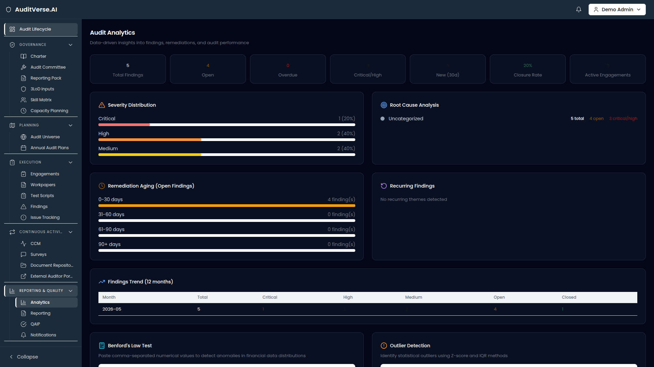
ANALYTICS
Audit Analytics
The numbers behind the assurance — not a quarterly slide.
TODAY
auditverse.ai · /audit/analytics
Analytics today means rebuilding the same Excel pivot at the end of every quarter. Trends are guessed at; hard numbers arrive too late to act on.
WITH AUDITVERSE.AI
Analytics ships a live coverage / velocity / closure / aging dashboard, sliced by BU, engagement type and severity — with drill-through to underlying records.
Coverage % by BU and risk tier
Mean cycle time + closure rate
Findings opened vs. closed by quarter
Slice by severity, owner, theme
AuditVerse.AI · Audit Management Platform
12 / 22

Slide 13
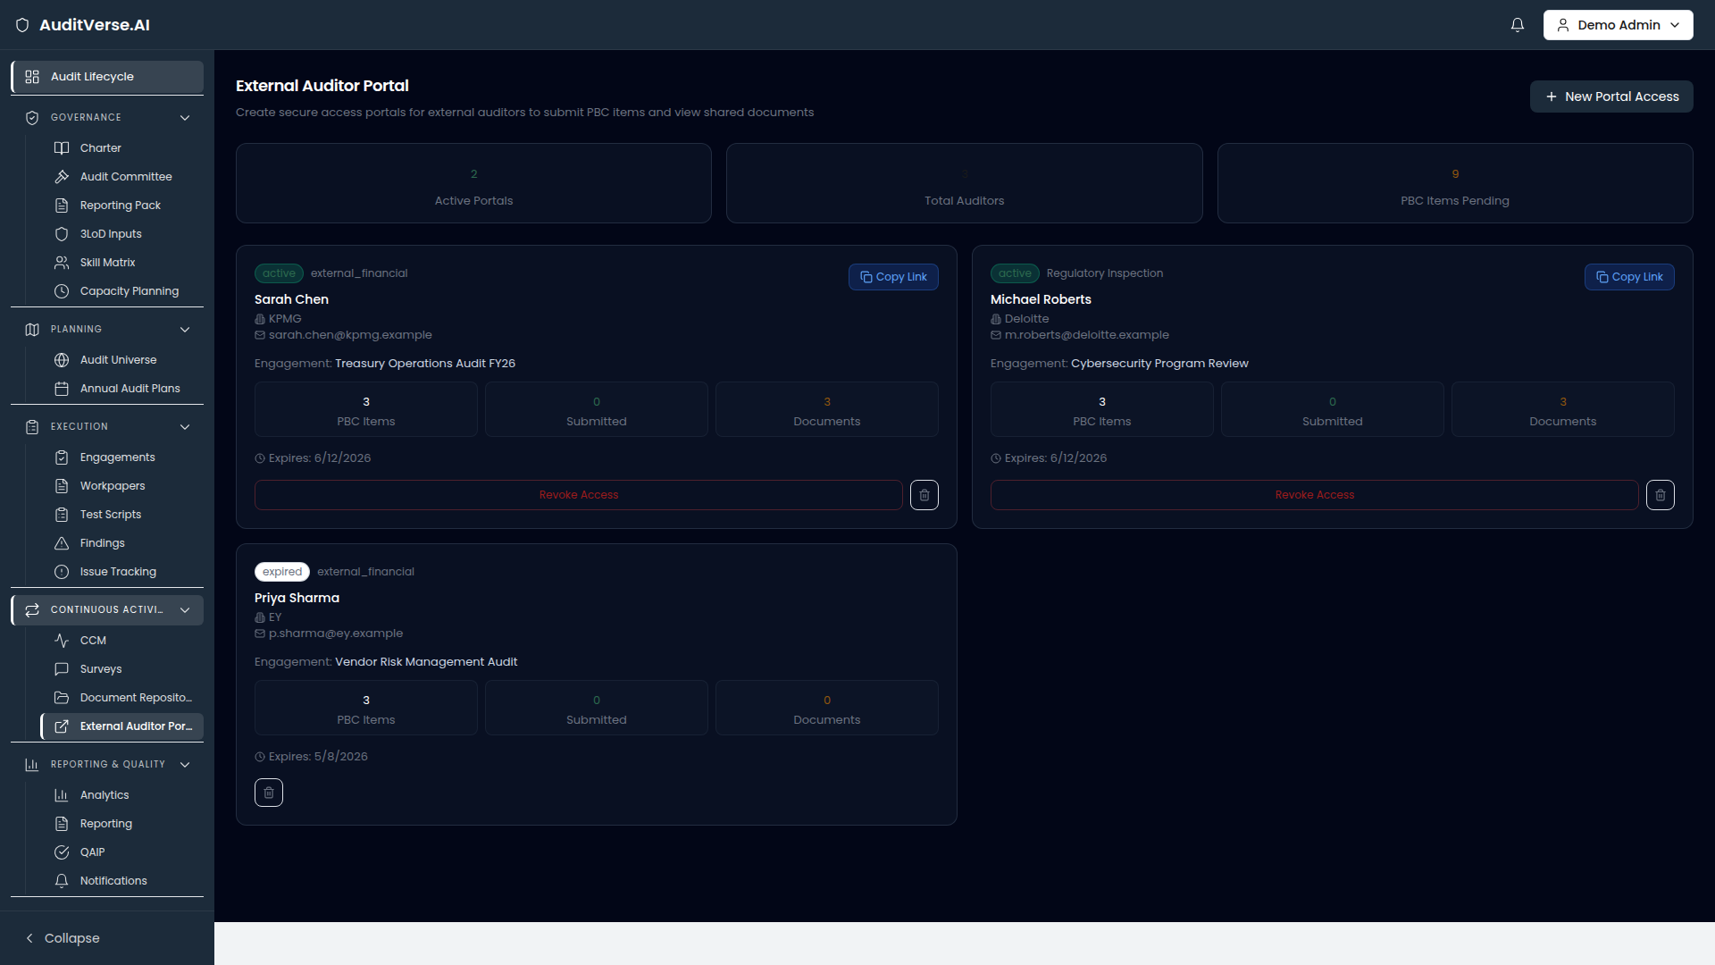
PORTAL
External Auditor Portal
Give Big-4 a workspace, not a Dropbox link.
TODAY
auditverse.ai · /audit/portal
External auditors get a shared folder and a user account that's hard to revoke. Read-only is enforced by access groups that nobody audits.
WITH AUDITVERSE.AI
Portal gives external teams scoped, expiring, read-only access to exactly the engagements / workpapers / findings they need — with full activity logging.
Scoped to specific engagements
Expiry date + auto-revoke
Read-only with comment threads
Full activity log per external user
AuditVerse.AI · Audit Management Platform
13 / 22

Slide 14
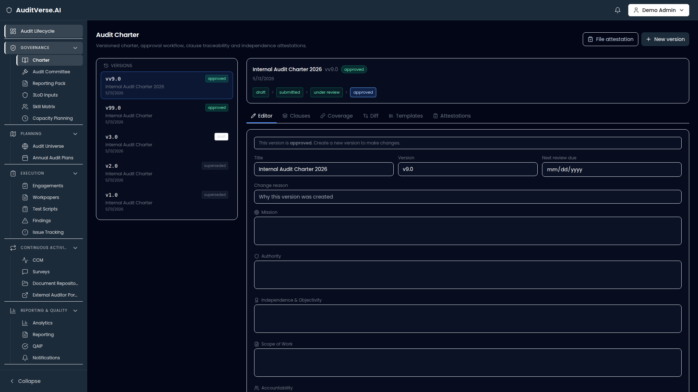
CHARTER
Audit Charter
Living charter, versioned, approved.
TODAY
auditverse.ai · /audit/charter
The audit charter lives as a Word doc on the head of audit's laptop. Nobody knows which version is current. Committee approval is hunted in old minutes.
WITH AUDITVERSE.AI
Charter holds the current and historical charter documents, with AI-assisted drafting, version comparison, and committee approval workflow.
AI drafting from IIA template
Side-by-side version diff
Committee approval workflow
Linked from every engagement
AuditVerse.AI · Audit Management Platform
14 / 22

Slide 15
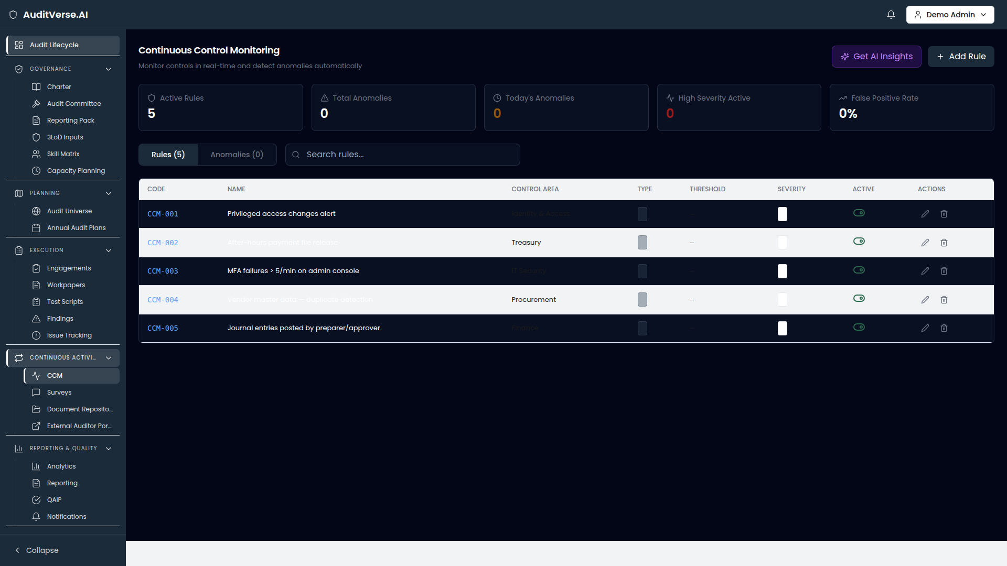
CCM
Continuous Controls Monitoring
Daily controls testing, not annual snapshots.
TODAY
auditverse.ai · /audit/ccm
Most controls get tested once a year on a sample. Failures between tests go undetected for months. Internal audit and SecOps don't share data.
WITH AUDITVERSE.AI
CCM runs scripted controls daily against source systems, surfaces exceptions, and feeds them into the audit findings backlog automatically.
Scripted controls per framework
Daily execution + alerting
Exception → finding workflow
Time-series view per control
AuditVerse.AI · Audit Management Platform
15 / 22

Slide 16
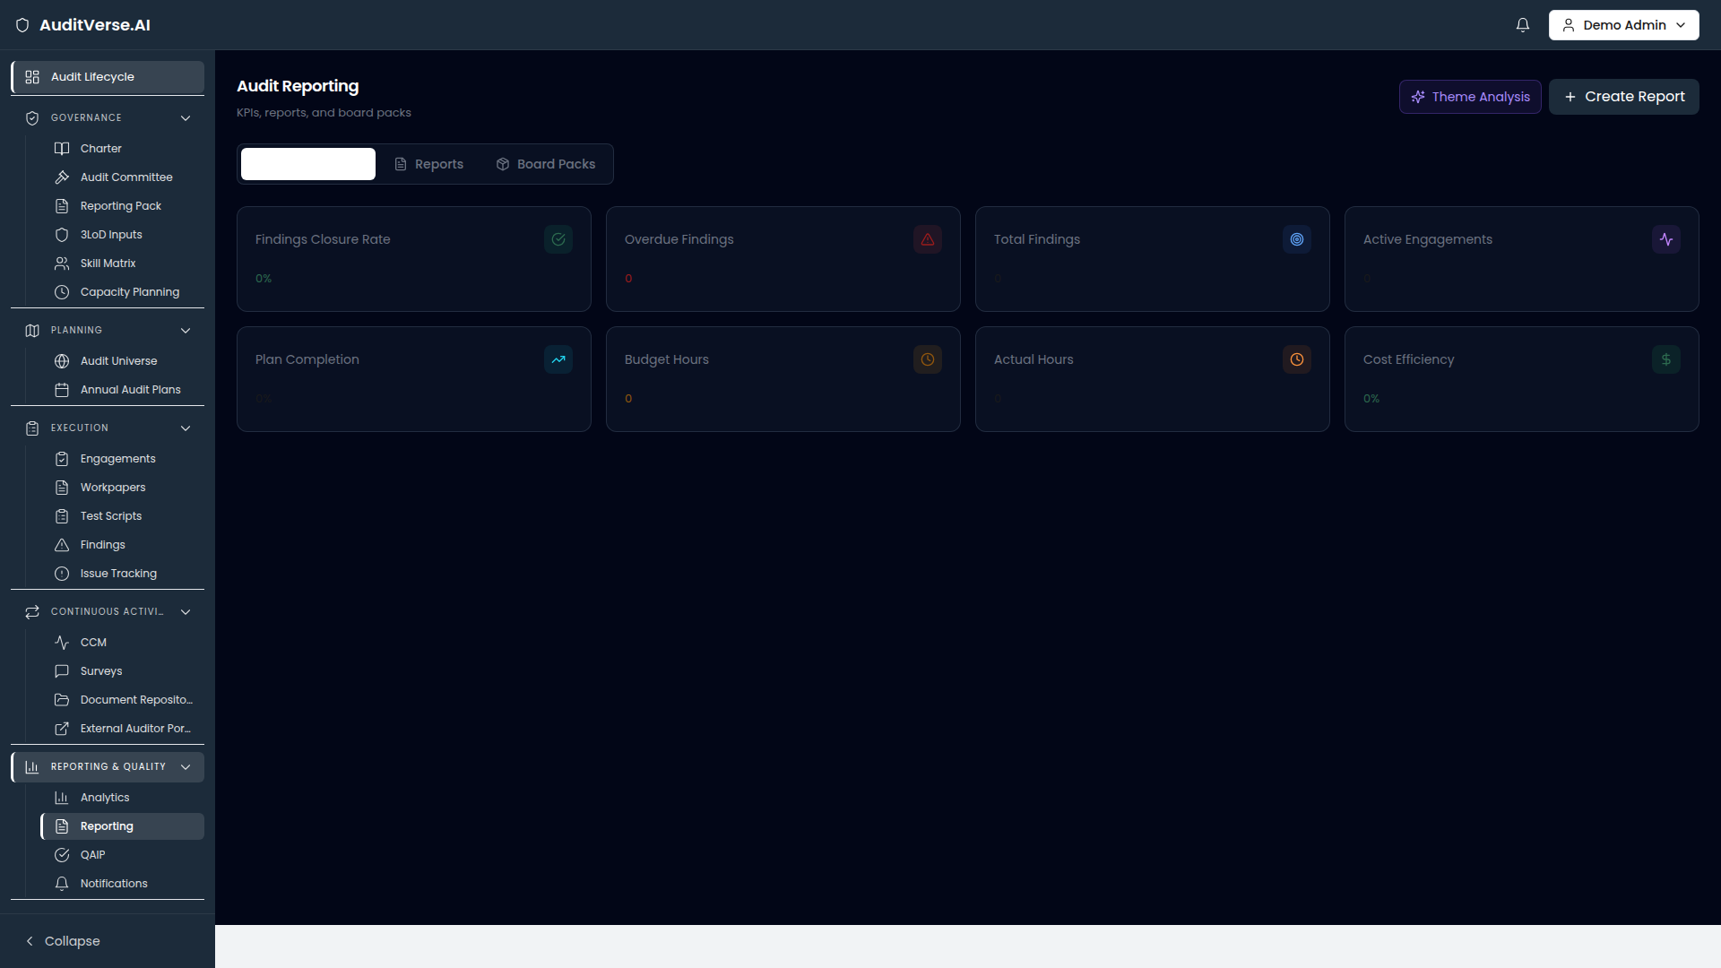
REPORTING
Reporting
The committee pack writes itself.
TODAY
auditverse.ai · /audit/reporting
Quarterly reporting is two analysts and a week of PowerPoint. By the time it's done, half the numbers are stale and the layout has drifted from last quarter.
WITH AUDITVERSE.AI
Reporting generates the committee pack from live data — heatmap, top findings, aging, coverage delta — in a branded template, in one click.
Branded PDF, one-click export
Auto-refreshed snapshots
Drill-through to workpapers
Historical pack archive
AuditVerse.AI · Audit Management Platform
16 / 22

Slide 17
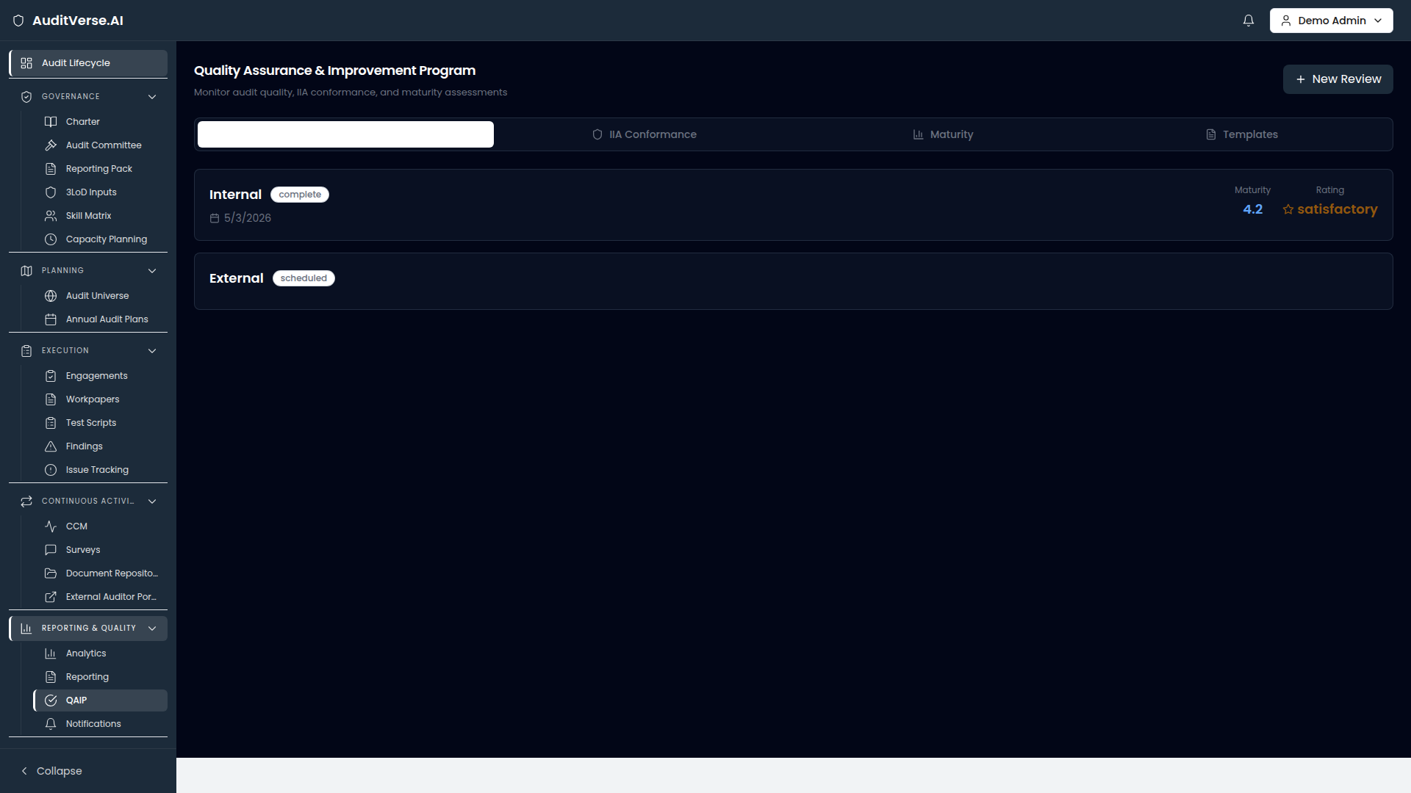
QAIP
Quality Assurance & Improvement
IIA-aligned QAIP that runs itself.
TODAY
auditverse.ai · /audit/qaip
QAIP is the program everyone agrees they need and nobody runs. Internal assessments are sporadic; external EQAs surface preventable findings.
WITH AUDITVERSE.AI
QAIP holds internal/external assessment cycles, KPI tracking against IIA standards, and the conformance evidence the committee needs.
Internal assessment scheduling
KPIs vs. target with targets visible
External EQA history + actions
Conformance statement export
AuditVerse.AI · Audit Management Platform
17 / 22

Slide 18
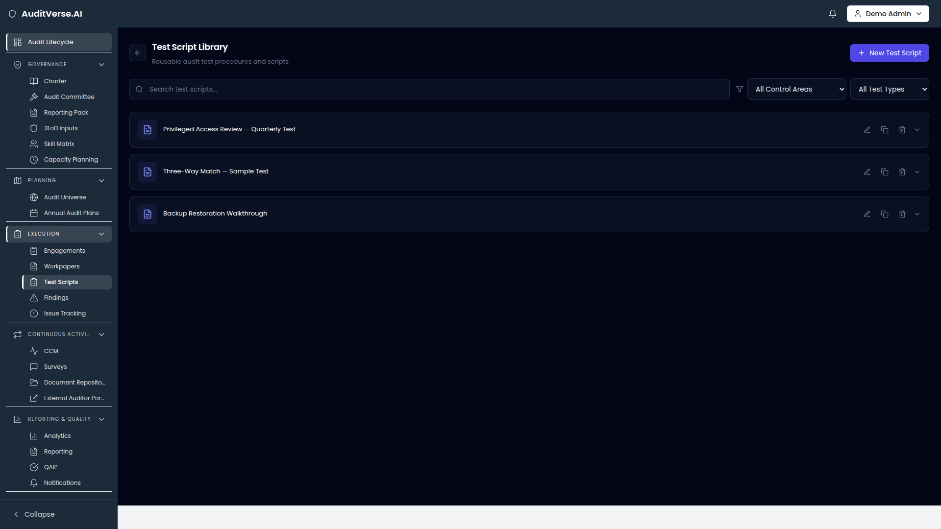
TEST SCRIPTS
Test Script Library
184 reusable scripts. Cloned, not retyped.
TODAY
auditverse.ai · /audit/test-scripts
Every engagement re-writes the same MFA test, vendor SOC2 check, and access recertification procedure from memory. Quality varies wildly.
WITH AUDITVERSE.AI
Test Scripts is a versioned library of reusable procedures, mapped to frameworks and categories, that auditors clone into a workpaper in two clicks.
Versioned, peer-reviewed library
Mapped to ISO, NIST, SOX, FATF
Clone-to-workpaper in two clicks
Category + framework filters
AuditVerse.AI · Audit Management Platform
18 / 22

Slide 19
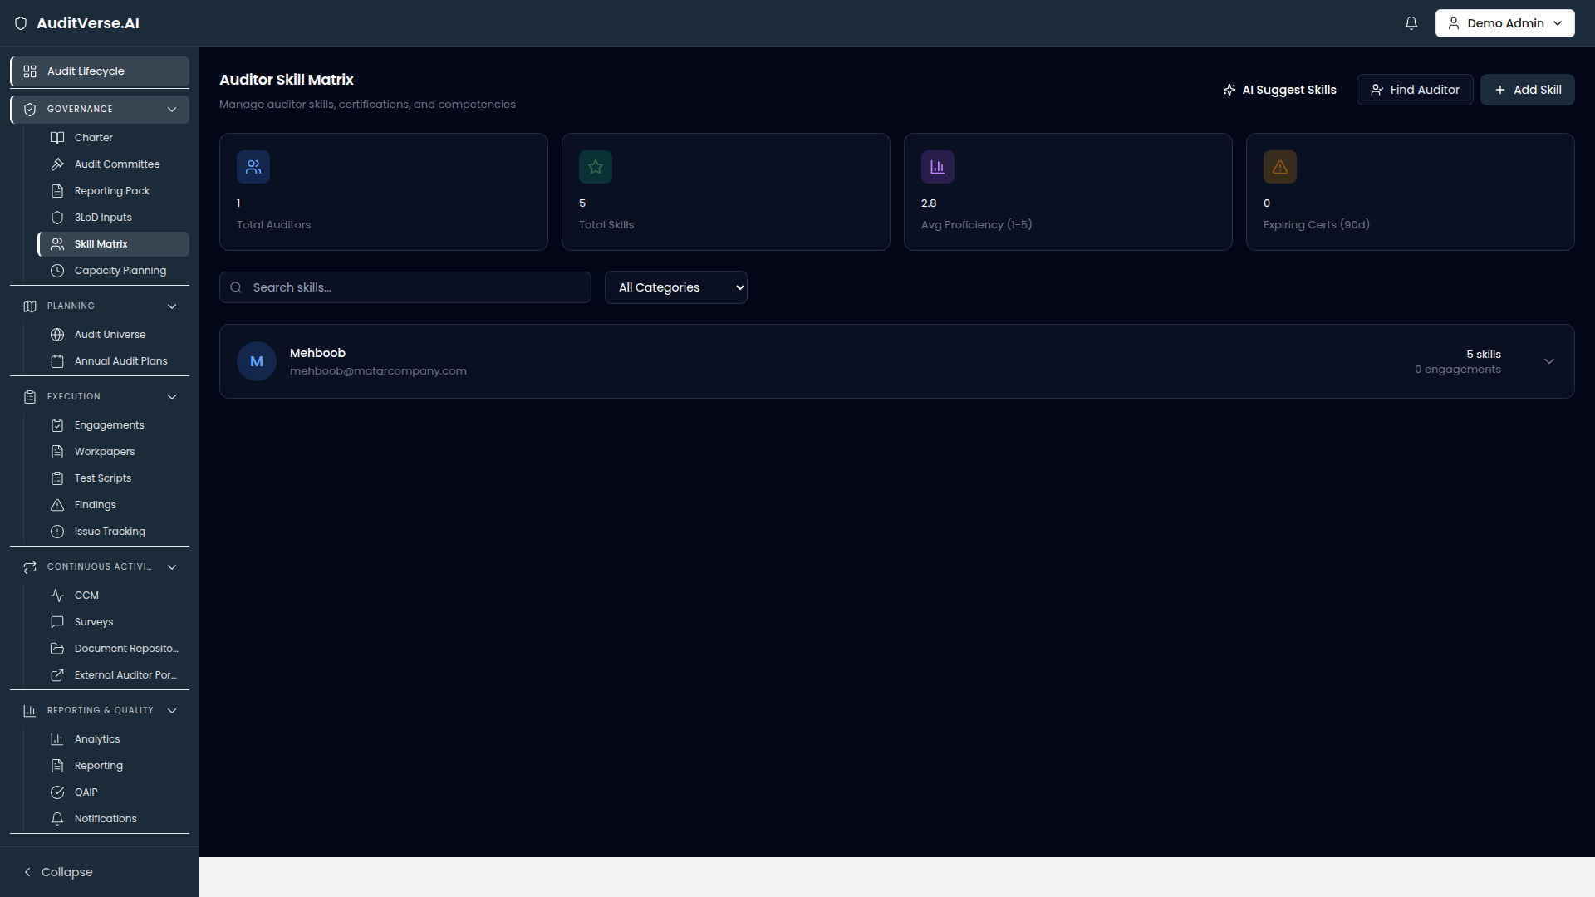
SKILL MATRIX
Skill Matrix
Match the right auditor to the right engagement.
TODAY
auditverse.ai · /audit/skill-matrix
Engagement staffing is done from memory. Junior auditors get put on cyber engagements they aren't ready for. Skills gaps surface only when work slips.
WITH AUDITVERSE.AI
Skill Matrix tracks every auditor's competency × seniority, surfaces team-wide gaps, and suggests staffing for incoming engagements.
Competency × seniority heatmap
Gap detection at team level
Staffing suggestions per engagement
Training-plan input
AuditVerse.AI · Audit Management Platform
19 / 22

Slide 20
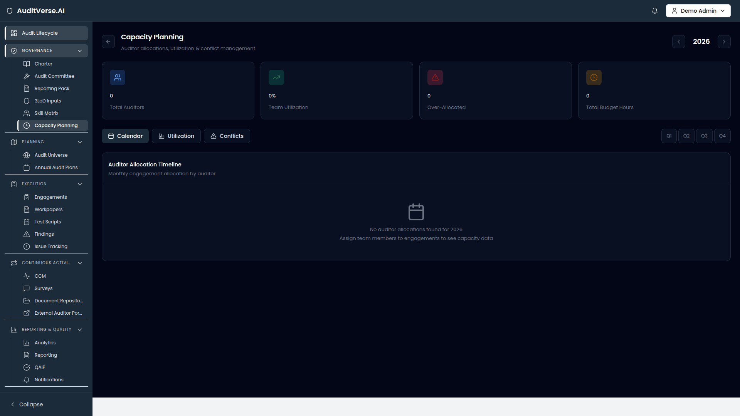
CAPACITY
Capacity Planning
See over-allocation before it ships.
TODAY
auditverse.ai · /audit/capacity
Audit teams routinely commit to more hours than they have. The over-allocation surfaces in Q3 when something has to be deferred or descoped.
WITH AUDITVERSE.AI
Capacity reconciles planned engagement hours against auditor availability — daily, monthly, quarterly — and flags over-allocation before it bites.
Hours planned vs. available
Per-auditor utilisation
Forecast 1-2 quarters ahead
Replan or hire signal
AuditVerse.AI · Audit Management Platform
20 / 22

Slide 21
BUSINESS CASE
What AuditVerse.AI means in numbers.
Indicative impact for a 12-person internal audit function.
40%
60%
3x
100%
less cycle time
less admin
audit-committee freshness
evidence retrievability
per engagement, planning to report
writing/formatting, not auditing
live numbers vs. quarterly pack
every workpaper indexed and signed off
WHAT MAKES THE NUMBERS HOLD
AI scope drafting
CCCE structuring
Auto-escalation
Live committee pack
2-4 hrs / engagement back to the auditor
30 min / finding back to the lead
Issues never sit > 30 days in silence
0 prep weeks per quarter
AuditVerse.AI · Audit Management Platform
21 / 22

Slide 22
NEXT STEPS
Let's run
your next audit
on AuditVerse.AI.
AUDITVERSE.AI
Audit Management Platform
PILOT CONTACT
pilot@auditverse.ai
SOLUTIONS
solutions@auditverse.ai
WEB
90-minute pilot scoping. We bring 2 reference engagements; you bring your real universe and a recent finding.
auditverse.ai
PHONE
+1 (555) 014-0210
01
Scoping call
02
Pilot
03
Decision
60 min · your team + ours
30 days · 2 engagements
Roll out or walk away
AuditVerse.AI · Audit Management Platform
22 / 22

