Slide 1
Clustering
(Hierarchical, K-means, Gaussian mixture-EM)
18.05.08

Slide 2
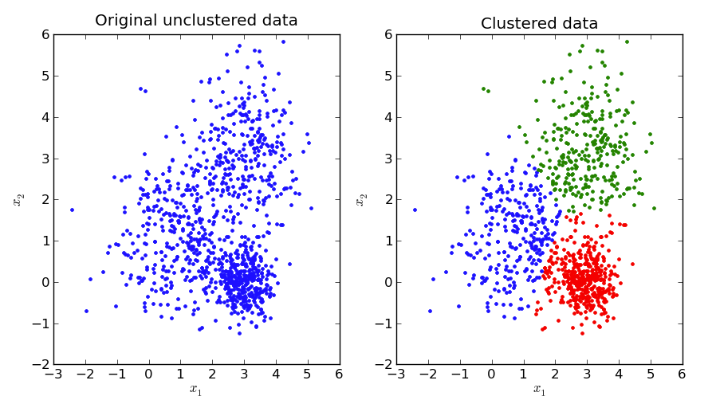
Clustering
Grouping sets of objects
Mostly, unsupervised learning.
A lot of methods to solve a lot of issues
http://pypr.sourceforge.net/kmeans.html#k-means-example

Slide 3
What we hope the data look like...
The data we face in life
cluster 1
cluster 4
Variable 1
cluster 3
Variable 1
cluster 2
X
Variable 2
Variable 2
2

Slide 4

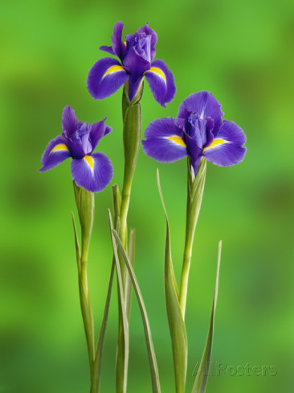
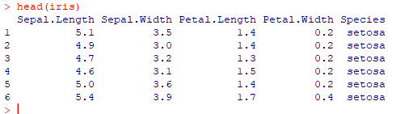
https://www.r-project.org/
Iris dataset : 150 samples, 4 attributes, 3 labels
3

Slide 5
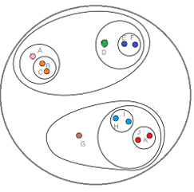
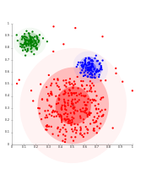
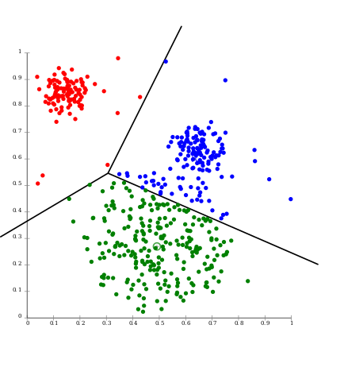
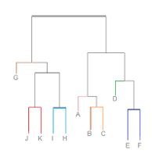
We will cover these...
K-means
EM
(for Gaussian-distributed)
Hierarchical
4

Slide 6
K-means
Need to define K
Placing, moving centroids
by euclidian distance of data points
repeat until convergence
explained well at : https://www.youtube.com/watch?v=_aWzGGNrcic
5

Slide 7
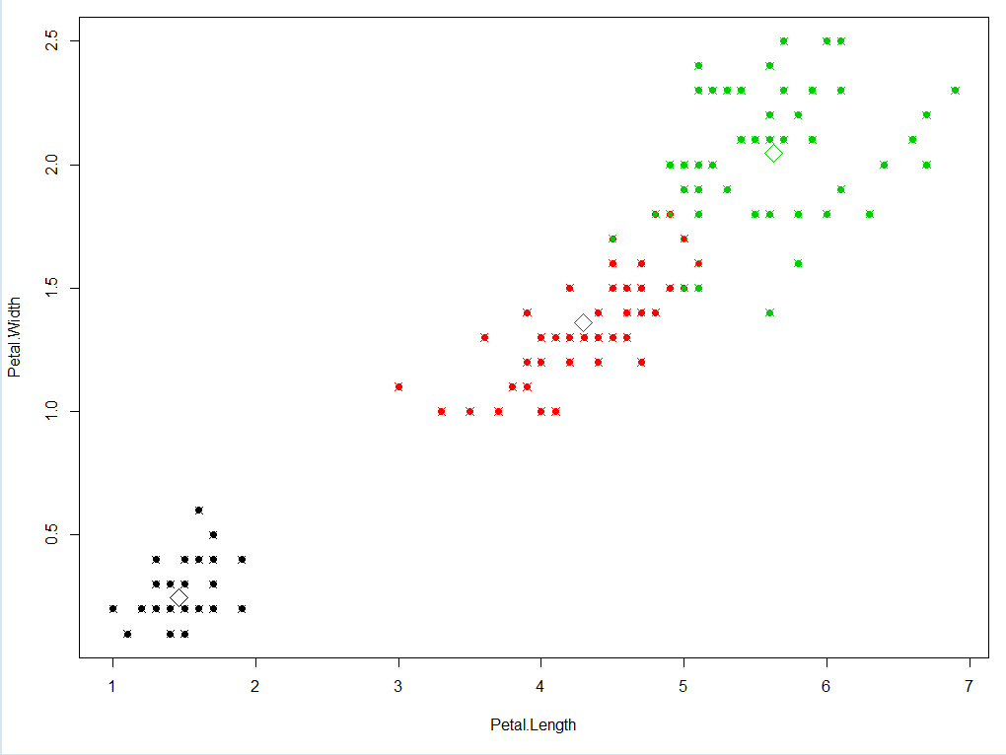
K-means simple example
library(datasets)
#making matrix of Petal.length, Petal.Width from iris data
data_matrix = iris[,3:4]
#Checkout how the data_matrix looks like. (col = colored by labels, cex = size of data point, pch = plot symbols)
#plot(data_matrix, cex=1 ,pch=20)
#plot(data_matrix, col=iris[,5], cex=1 ,pch=20)
#Run K-means clustering. K = 3
kc <- kmeans(data_matrix, 3)
kc
plot(data_matrix, col=kc$cluster, cex=1, pch=20)
points(kc$centers[,c("Petal.Length", "Petal.Width")], col=1:3, pch=23, cex=2)
points(data_matrix, col=iris[,5], pch=21, cex=1.4)
6

Slide 8
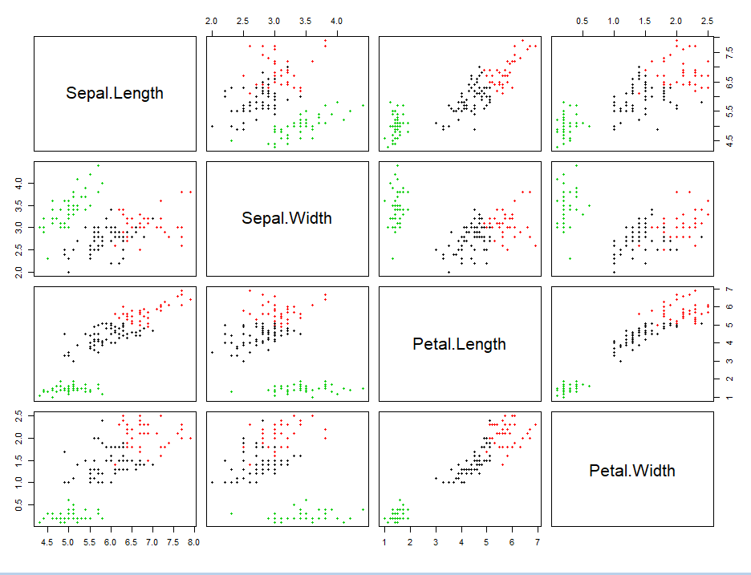
K-means simple example
data_matrix = iris[,-5]
kc <- kmeans(data_matrix, 3)
kc
plot(data_matrix, col=kc$cluster, cex=1, pch=20)
7

Slide 9
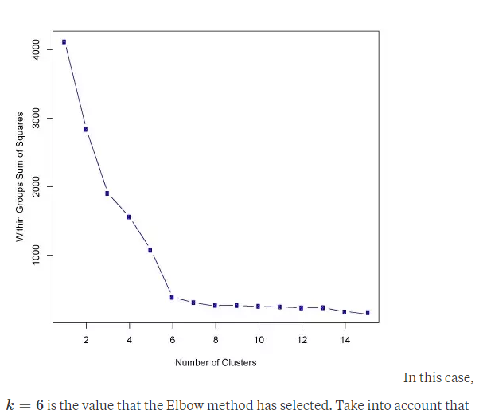
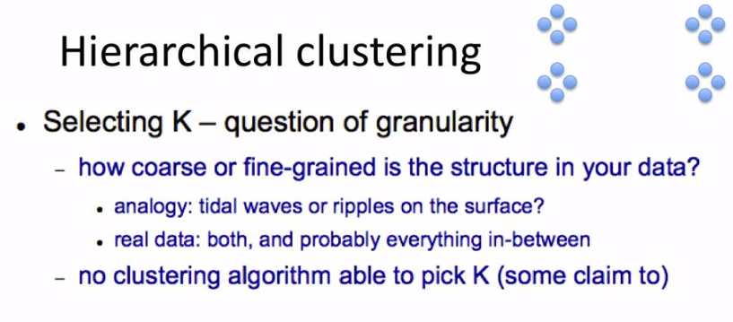
What if we do not know K ?

Slide 10
Hierarchical Clustering
Difficult to pick K
So, why not see the hierarchy of the data point rather than K?
Mainly buttom-up approach.
A.K.A : agglomerative
Theoretical assistance :
https://www.youtube.com/watch?v=XJ3194AmH40 https://www.youtube.com/watch?v=GVz6Y8r5AkY&list=PLBv09BD7ez_7qIbBhyQDr-LAKWUeycZtx
8

Slide 11
Hierarchical Clustering (Agglomerative)
Each data point starts as an cluster
Nearby points end up in the same cluster
Repeat until only one cluster is left
9

Slide 12
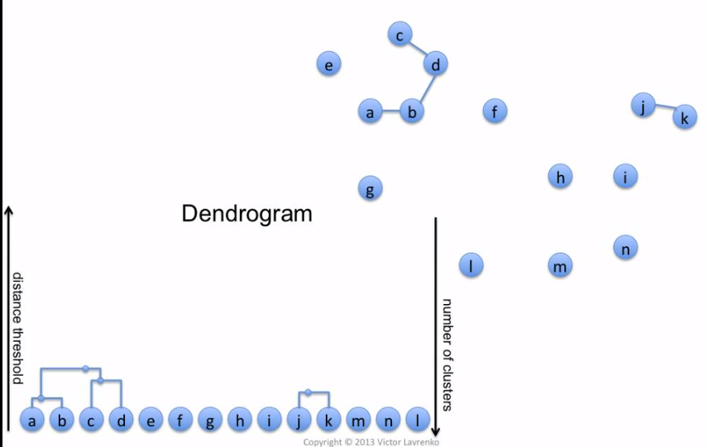
Hierarchical Clustering (Agglomerative)
Buttom-up
Height of the dendrogram represents the distance between data points
10

Slide 13
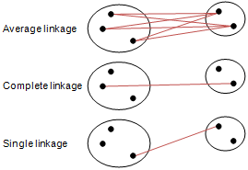
Hierarchical Clustering (Agglomerative)
Linkage Methods : Calculation of the distance between two clusters
11
Notes:
.

Slide 14
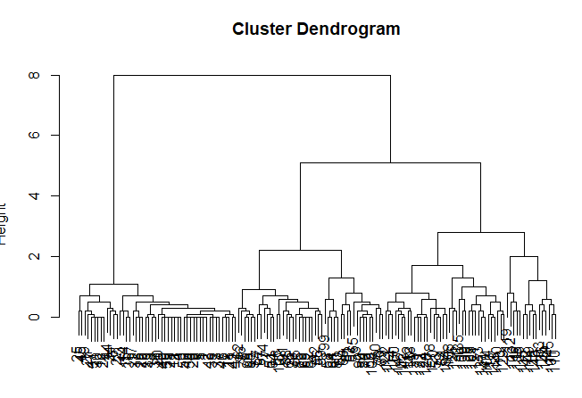
Hierarchical Clustering
#Calculate Distance of Petal's Length, Width
#distance measure depends on your method
x = dist(iris[,3:4])
x = dist(iris[,3:4], method ="manhattan")
#hclust has several methods
clustering <- hclust(x, method=“complete”)
#Plot results
plot(clustering)
#cut
clusterCut <- cutree(clustering, 3)
#see cut results
table(clusterCut, iris[,5])
cutree
12

Slide 15
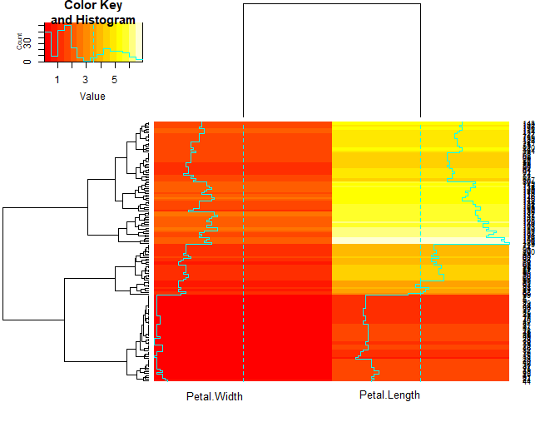
Hierarchical Clustering (Heatmap)
library("gplots")
data_matrix <- as.matrix(iris[,3:4])
heatmap.2(data_matrix, cexCol=1, srtCol=0)
#as default it uses hclust default
#Option tuning
hclust2 <- function(data_matrix, method="average")
hclust(data_matrix, method=method)
dist2 <- function(data_matrix)
dist(data_matrix, method ="manhattan")
heatmap.2(data_matrix, distfun=dist2, hclustfun =hclust2, srtCol=0, cexCol=1)
13

Slide 16
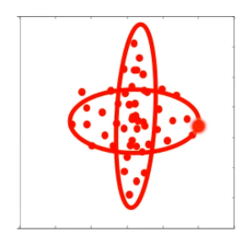
EM-Clustering
What if clusters are overlapped ?
Theoretical assistance : https://www.youtube.com/watch?v=qMTuMa86NzU
14

Slide 17
EM-Clustering
Assumes that the data points is generated from Gaussian distribution
Clusters modeled as Gaussians
EM algorithm
Assign data to cluster with some probability
15

Slide 18
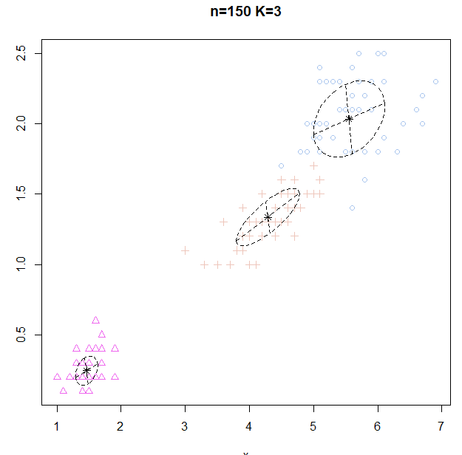
EM-Clustering
library("EMCluster")
set.seeds(1234)
data_matrix <- iris[,3:4]
#Initialize
emobj <- simple.init(data_matrix, nclass=3)
#Run EM
ret <- emcluster(data_matrix, emobj, assign.class = TRUE, EMC )
summary(ret)
plotem(ret, data_matrix)
#SVD. simple
ret_iris <- starts.via.svd(data_matrix, nclass = 3, method = "em")
summary(ret_iris)
plotem(ret_iris, data_matrix)
16

Slide 19
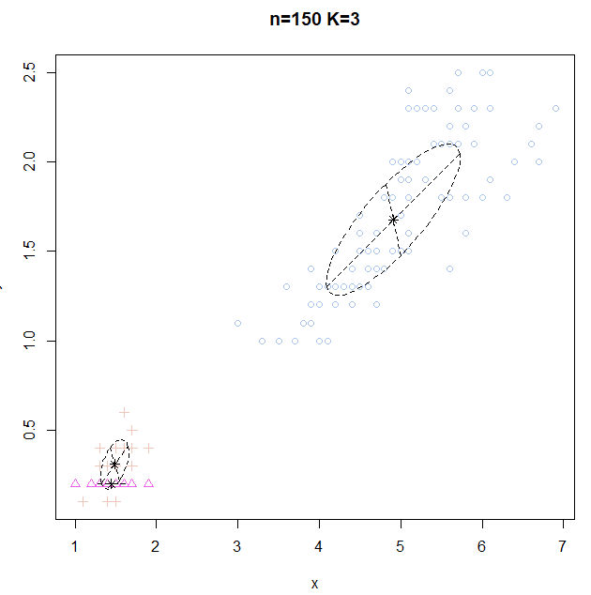
EM-Clustering (trouble shoot)
Reason why appropriate cluster method is important for appropriate data
For this kind of data,
if the initialization point is skewed somewhere
it is impossible to make other clusters
17

Slide 20
HW1 (Abalone Data)
Assume that you don’t know the label of dataset.
Try to find clusters of Female/Male by WholeWeight and ShellWeight
Perform K-means, Hierarchical clustering, EM-clustering
Attach Plot & Code
Now you know the label of the dataset
Which clustering method performed well?
Describe why it performed than others.

Slide 21
HW2 (Animal Data)
animals <- cluster::animals
colnames(animals) <- c("warm-blooded",
"can fly",
"vertebrate",
"endangered",
"live in groups",
"have hair")
Dataset : Animals (copy paste the red box)
According to the dataset, consider all 6 attributes.
1. What are the 3 animals that is closest to the ant.
2. Attach Plot & Code

Slide 22
HW (Submission)
Deadline : 18.05.22 23:59
Submit your code & plot & explanation to a single document file.
Filename: [CCC2018HW] ID-Name
Email submission title : [CCC2018HW] ID-Name
E-mail : hurben.bioinfo@gmail.com
If you have any questions, ask me with the subject title [CCC2018HW]

