Slide 1
CN3D
( Practice )
Benjamin Hur
November 15th 2015
Bio & Health Informatics Lab., Seoul National University

Slide 2
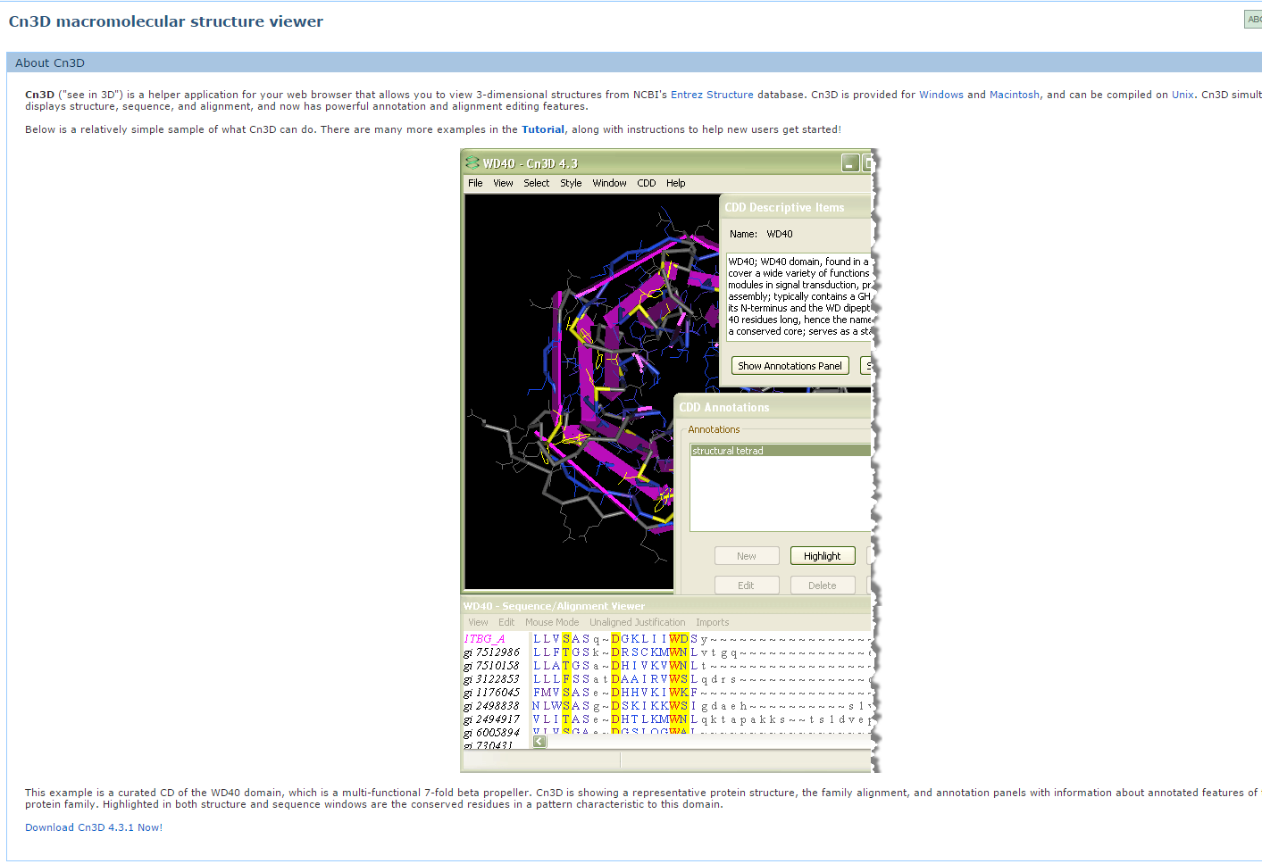
Cn3D ( Download & install )
See in 3D = Cn3D

Slide 3
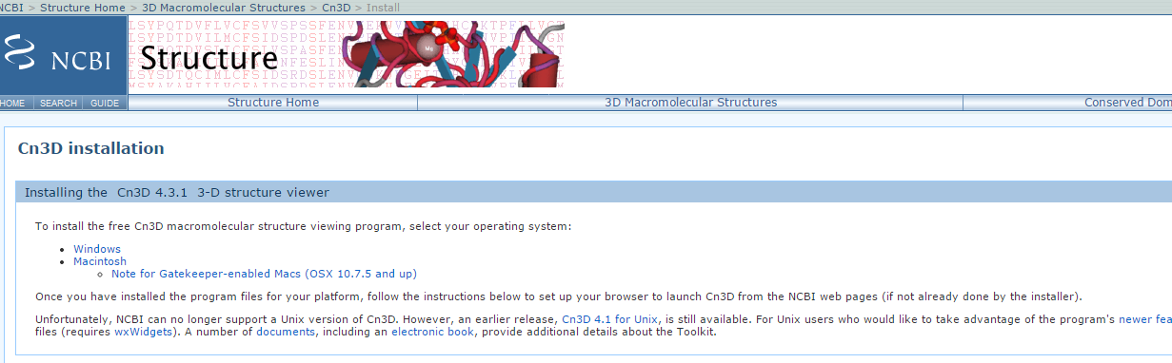
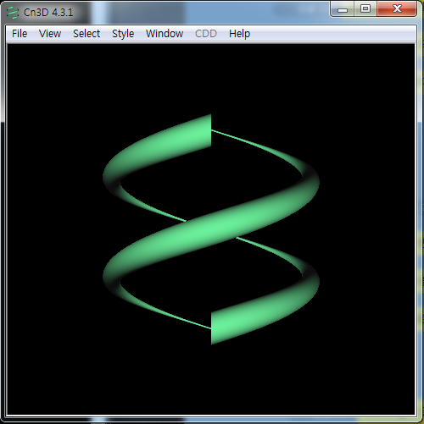
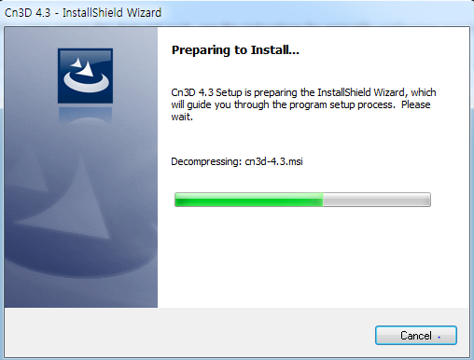
Cn3D ( Download & install )

Slide 4
Cn3D
You need to Use…
MMDB or PDB
BLAST
Scheme :
From unknown protein sequence. BLAST it.
Find out which known protein is similar to that unknown protein.
Find the known protein structure by using PDB or MMDB
Then, it is time to use Cn3D

Slide 5
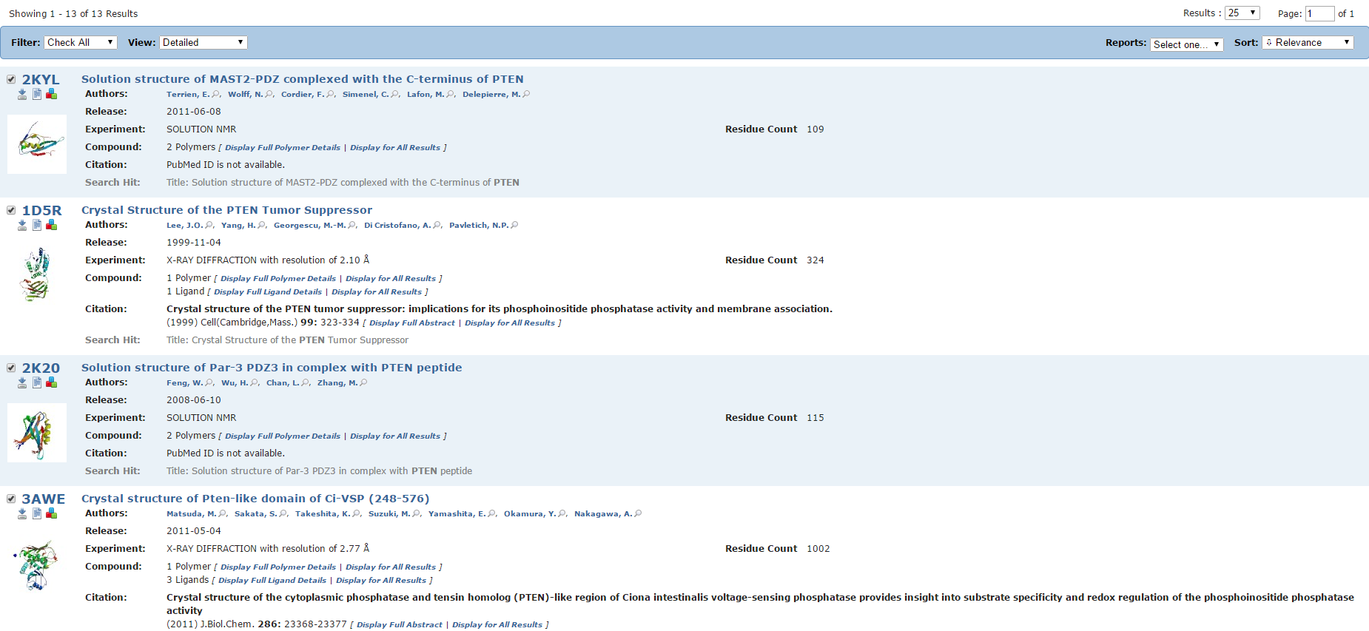
Lets say that BLAST gave us a result that the unknown sequence is similar to PTEN
Then we found the crystal structure of PTEN using PDB

Slide 6
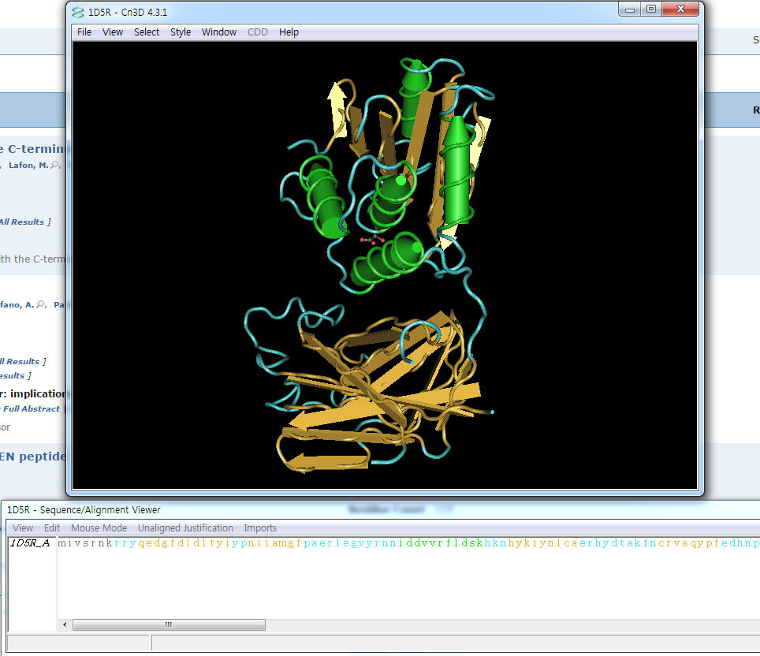
2. File -> Load Network -> 1D5R
->single model
ID Gained when we find PDB
:look previous slide
1. Execute Cn3D
Structure of the protein
Sequence of the protein

Slide 7
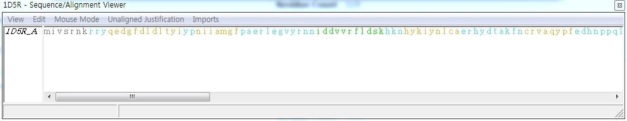
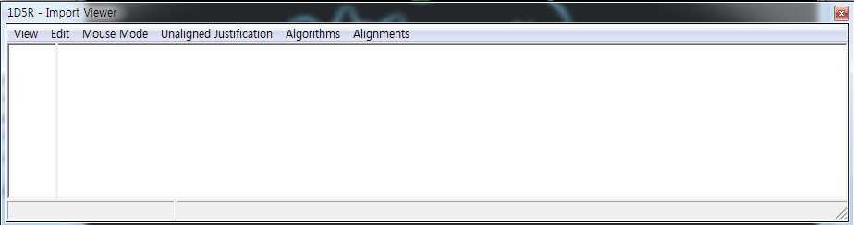
1. Imports -> Show imports
Gives you a new window
2. Edit -> import sequences
In this practice, click network and type P60484

Slide 8
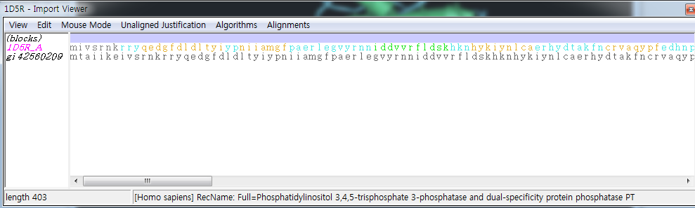
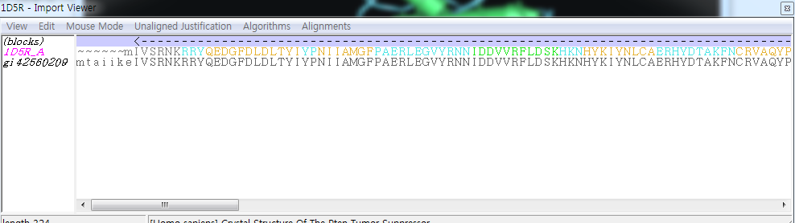
3. Algorithms -> BLAST single -> mouse click
4. Mouse click here
5. Alignments -> Merge all

Slide 9
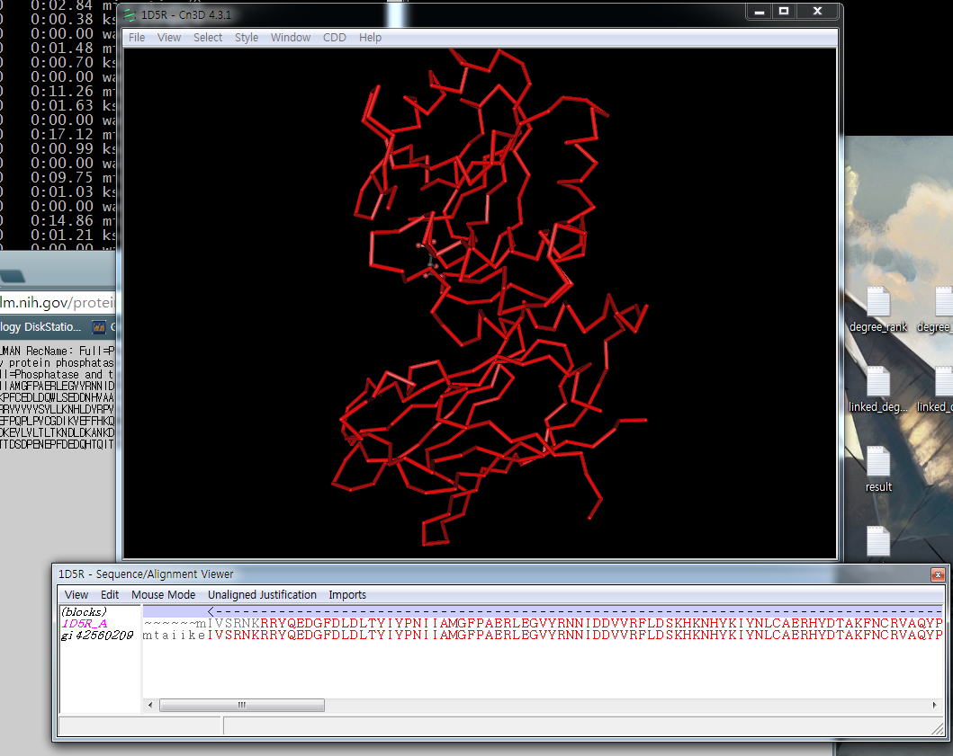
Cn3D
DONE ! Red indicates same(or similar) protein structure

Slide 10
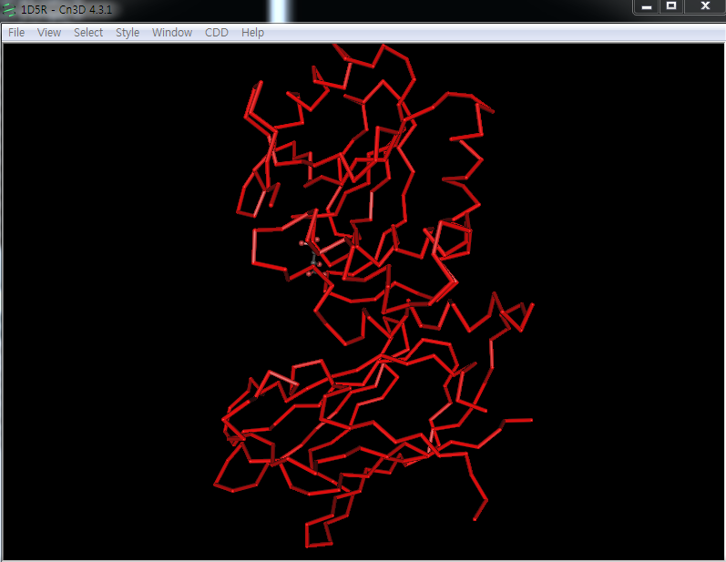
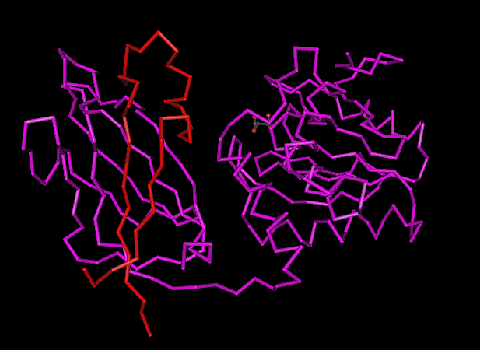
Cn3D
In this practice, we used PTEN structure, and unknown sequence as “PTEN”.
So, the protein structure matched perfectly.
If sequence are less similar. Unmatched region will colored as purple.
PTEN structure, with PTEN sequence
PTEN structure, with P53 sequence

Slide 11
Cn3D ( Finding enzyme catalytic site )
Cn3D can be used for finding enzyme catalytic site.
From unknown enzyme sequence.
( In this practice retrieve sequence of lysozyme from NCBI. )
BLAST the unknown enzyme sequence
Retrieve the the most similar protein structure from PDB
( In this practice 1lyz )
Use Cn3D to align & merge sequences to known protein structure
Mark known catalytic site from the merged results.
Gallus gallus (GI : 220899129)

Slide 12
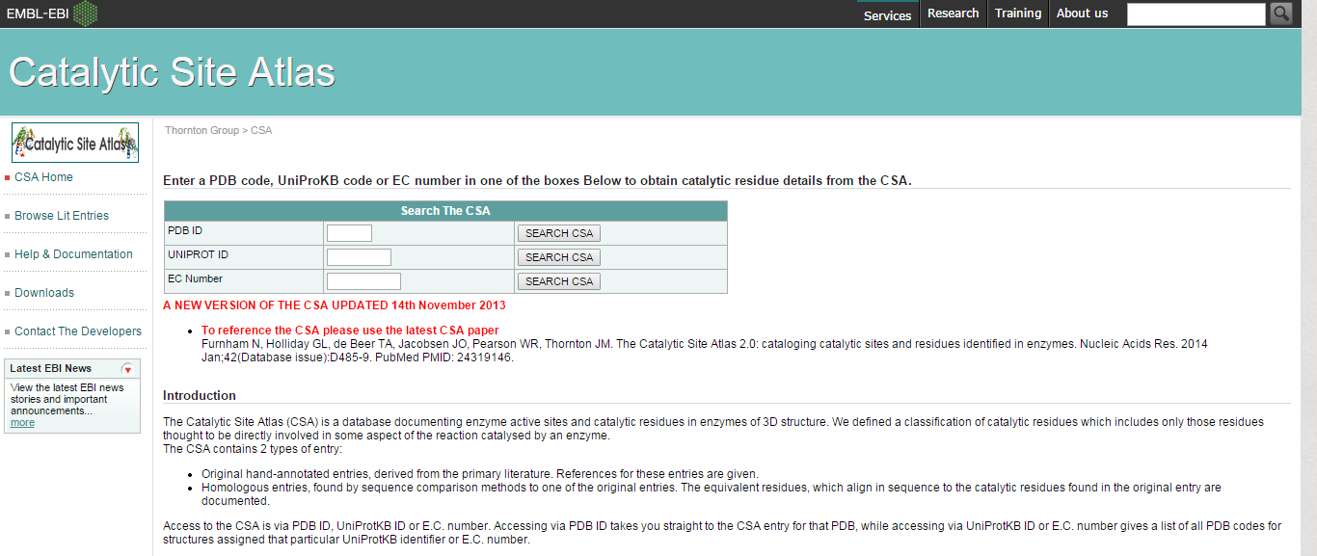
Cn3D ( Finding enzyme catalytic site )
Q : How do I find enzyme’s catalytic site?
A : Use Catalytic Site Atlas ! ( http://www.ebi.ac.uk/ )

Slide 13
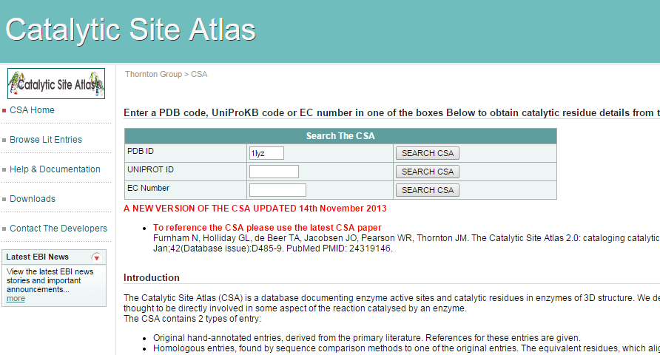
Type the enzyme PDB structure ID

Slide 14
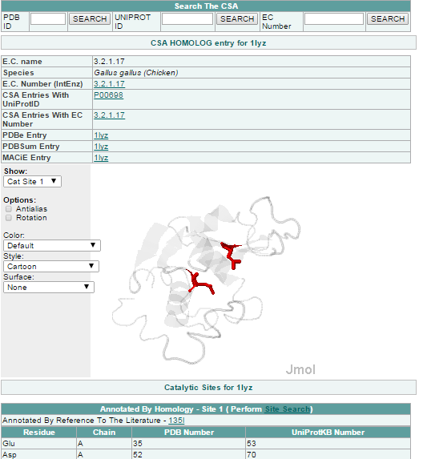
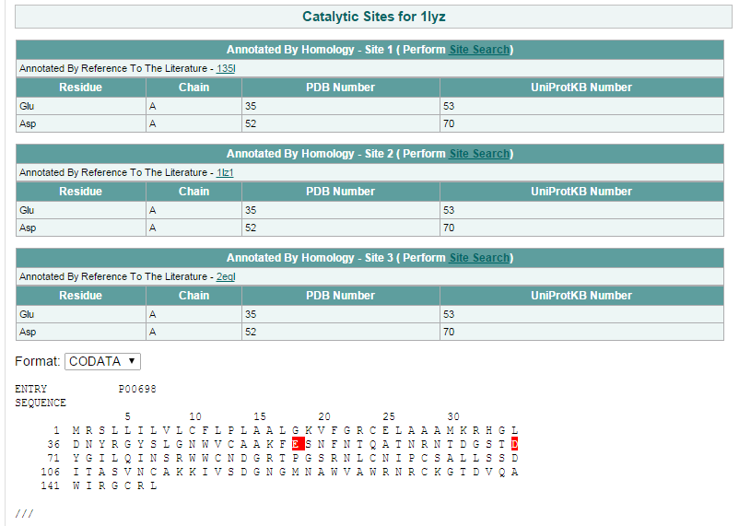
Catalytic Sites position in 3D structure
Red colors are the position of Catalytic Sites

Slide 15
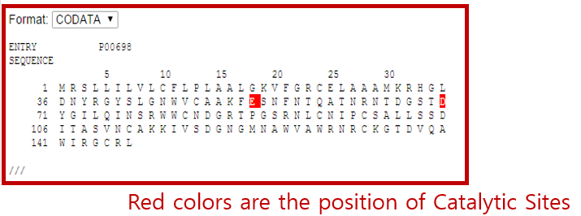
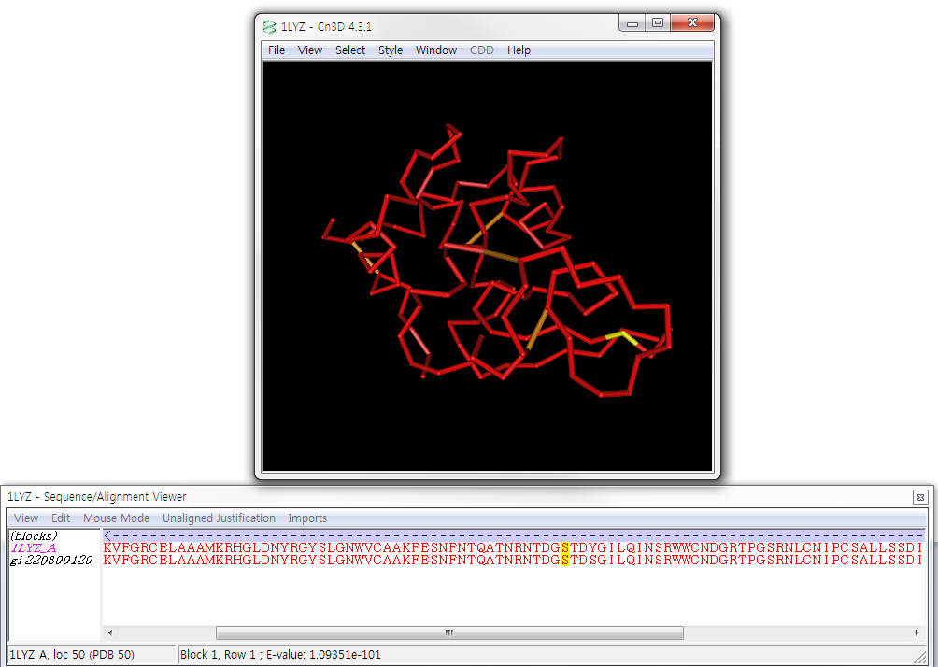
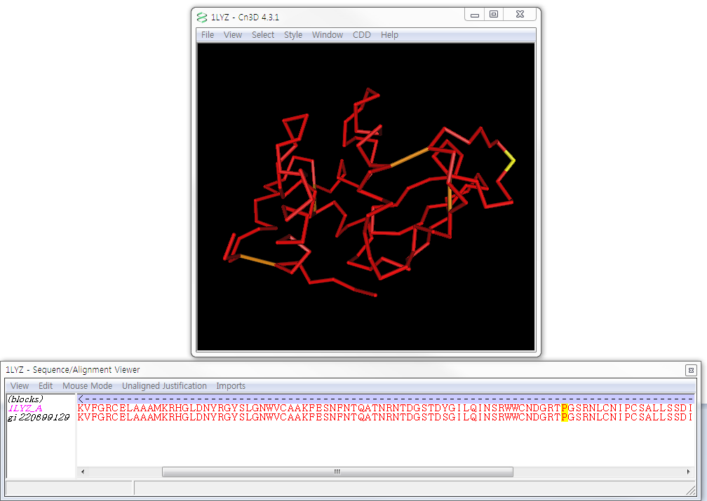
Cn3D ( Marking catalytic sites in Cn3D )
Position 53 & 70 are catalytic sites.
Mark them at here!

Slide 16

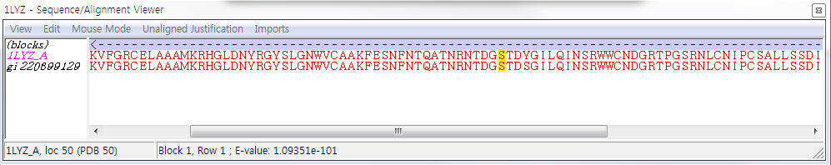
Cn3D ( Details for marking catalytic sites )
53th
70th
From Sequence alignment viewer : Mouse Mode -> select columns -> mouse click
53th Position of 1LYZ_A
68th Position of Unknown Sequence
Note : Must click the PDB structure sequence’s Position.
Because the Catalytic Site Atlas gave us the position of the PDB structure

Slide 17
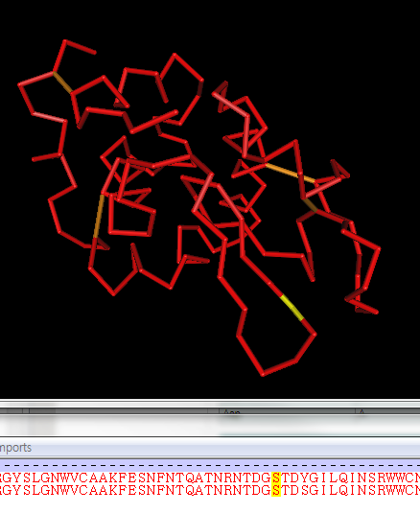
Cn3D ( Details for marking catalytic sites )
When Marked.
The marked position will be colored yellow.

Slide 18
THANK YOU

Slide 19
HOME WORK

Slide 20
HW
Select Enzyme sequences.
Find the most similar 3D structure of the enzyme and use Cn3D to visualize.
Align & Match the Enzyme’s sequence to the 3D structure.
Show the Catalytic site of the enzyme.

Slide 21
HW ( Details )
You can select any enzyme.
Reference sequence or your own unknown sequences
Using mutated enzyme sequence is acceptable.
If your enzyme structure is not in PDB, call the most similar structure.
ex ) Homologous protein structure
If the called 3D structure’s information are not in Catalytic Site Atlas( unable to determine the catalytic site), try literature finding or apply other 3D structure. If still do not exists, describe the details and opinion of this case.
It is acceptable even if the called 3D structure does not match well to the unknown sequences.

Slide 22
HW ( Requirements )
Name (Symbol), Species of the Enzyme or unknown sequences.
Copy & paste the sequence to the document.
Screenshot of protein BLAST results.
Must show which protein matched best.
Name & ID (PDB or other ) of the used 3D structure
Screenshot of Cn3D
Loaded 3D structure
Matched & Merged results (State which algorithm was used from Import viewer.)
Mark the catalytic site of the sequences.
Show marked region form the Sequences from the Sequence/Alignment Viewer
Show marked region from the 3D structure

Slide 23

Please send MS Document file to Jotunnheim@snu.ac.kr
Greatly appreciated sending an email with a header [실습2]
Recommended E-mail title : [실습2]_학번_한글이름
Recommended file name : [실습2]_학번_한글이름
For other cases, [Practice2]_STUDENTNUMBER_NAME
DEADLINE : December 1st , 0:00 AM

