Slide 1
PSIPRED
( Practice )
Benjamin Hur
November 17th 2015
Bio & Health Informatics Lab., Seoul National University

Slide 2
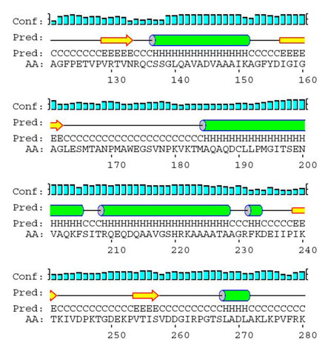
PSIPRED INTRO
PSIPRED for
Protein secondary structure prediction

Slide 3
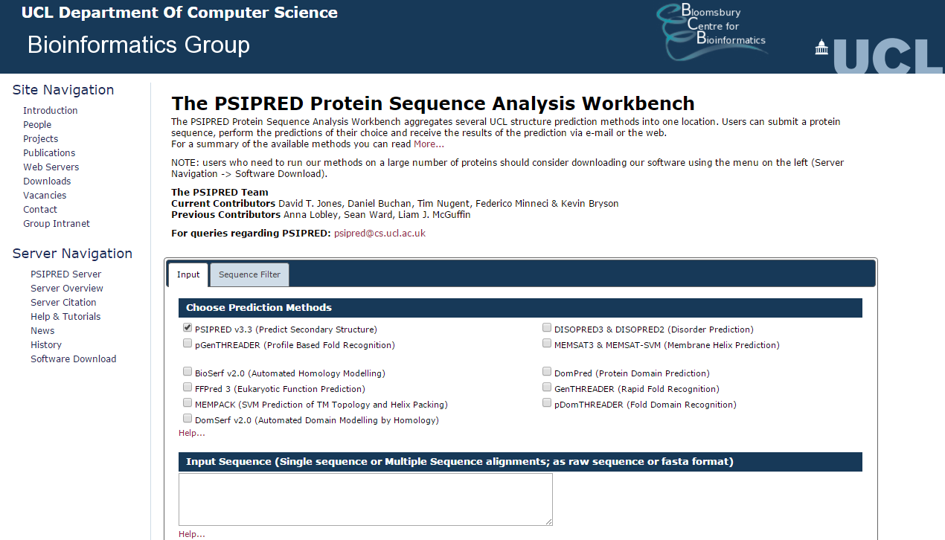
PSIPRED INTRO
http://bioinf.cs.ucl.ac.uk/psipred/

Slide 4
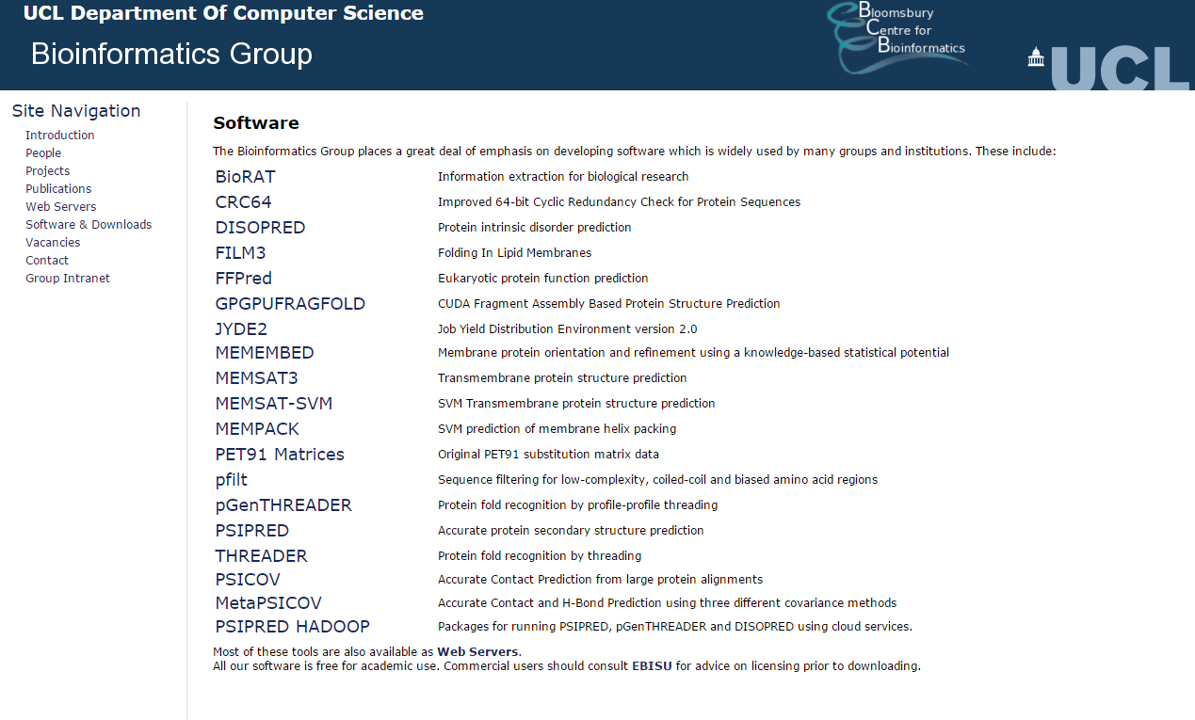
PSIPRED ( Download & install )

Slide 5
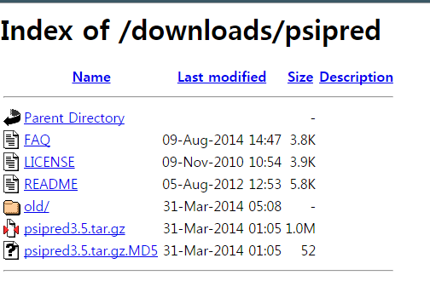
PSIPRED ( Download & install )
Download the data file with wget
$ wget [download link]
Copy the link address

Slide 6
PSIPRED ( Download & install )
Unzip the file using tar
$ tar –xvf psipred3.5.tar.gz

Slide 7
PSIPRED ( Preparing data )
//data/bioinfo2/human_faa_db
human.protein.faa
p53_human.fasta
Will be used for construction of protein data base.
Will be used for unknown sequence.

Slide 8
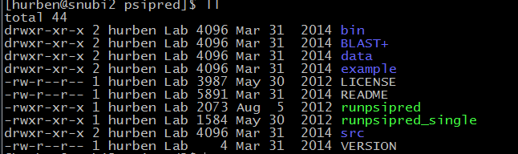
PSIPRED ( Download & install )
Details of installation & Usage are in README file
Installation
STEP 1: go to src folder ( $ cd src )
STEP 2: $ make
STEP 3: $ make install

Slide 9
PSIPRED ( Create Sequence data bank )
Process of PSIPRED :
Create Sequence data bank
Run PSIPRED with unknown protein sequence.
Make Sequence data bank
STEP 1 : pfilt human.protein.faa > human.protein.filt
STEP 2 : makeblastdb –dbtype prot –in human.protein.filt –out human.protein.filt
*pfilt is in src folder
Sequence data bank construction complete

Slide 10
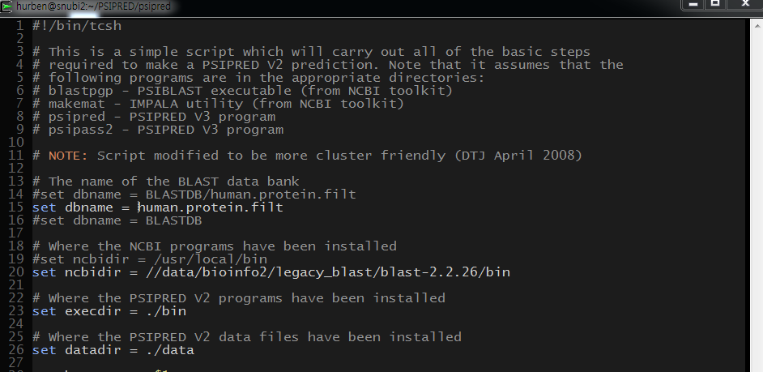
PSIPRED ( minor preparation )
Need several modification…
open runpsipred file ( $ vim runpsipred )

Slide 11

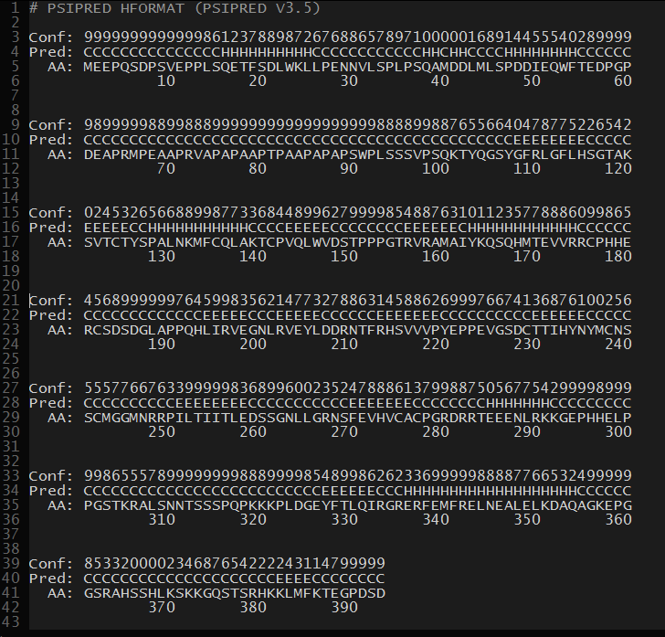
PSIPRED ( Run PSIPRED )
$ runpsipred unknown_seq_fasta.file

Slide 12
PSIPRED ( result representation )
.horiz

Slide 13
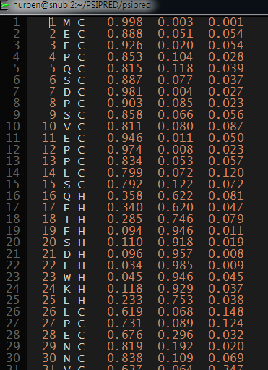
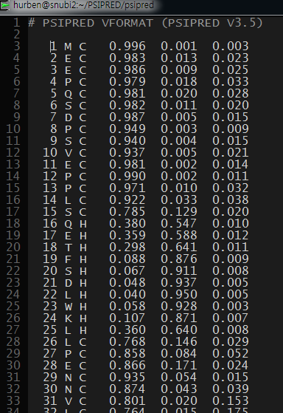
PSIPRED (result representation )
.ss
.ss2

