Slide 1
PSI-BLAST & PSI-PRED
2016 November
Bioinformatics Lab.
Benjamin Hur

Slide 2
Server : snubi2.snu.ac.kr
ID : user1 ~ 5
PW:

Slide 3
PSI-BLAST

Slide 4
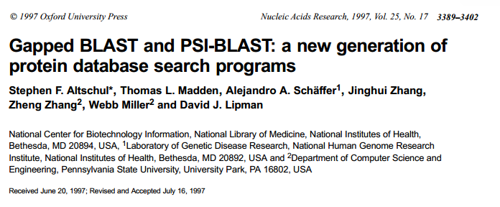
PSI-BLAST
Position specific iterative – Basic Local Alignment Search

Slide 5
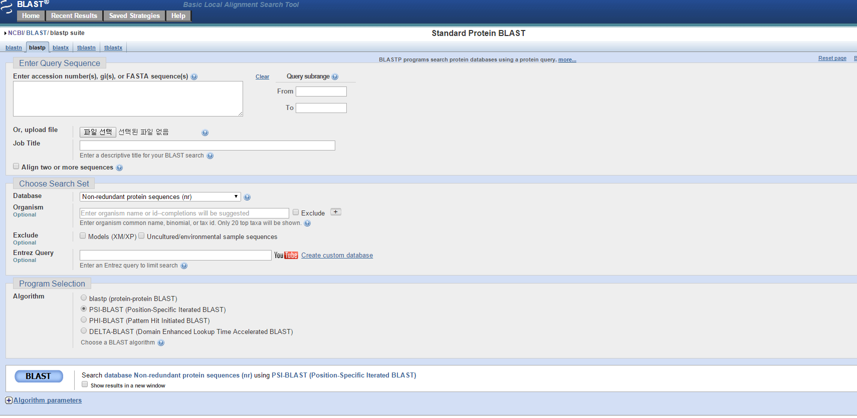
PSI-BLAST (WEB)

Slide 6
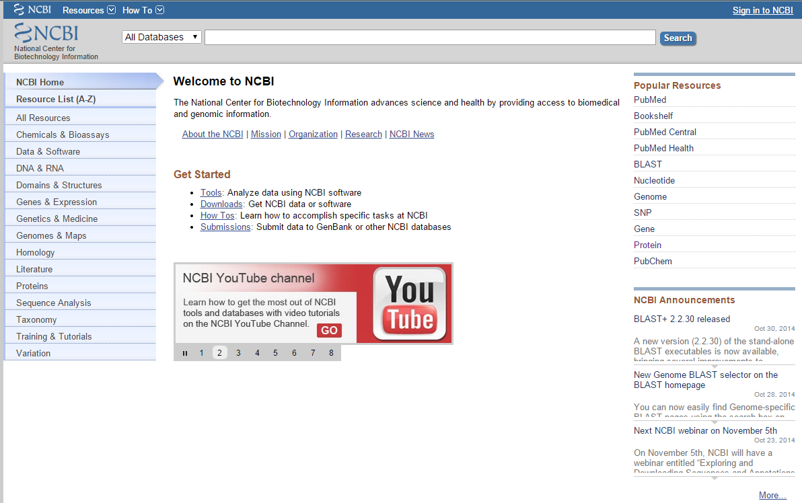
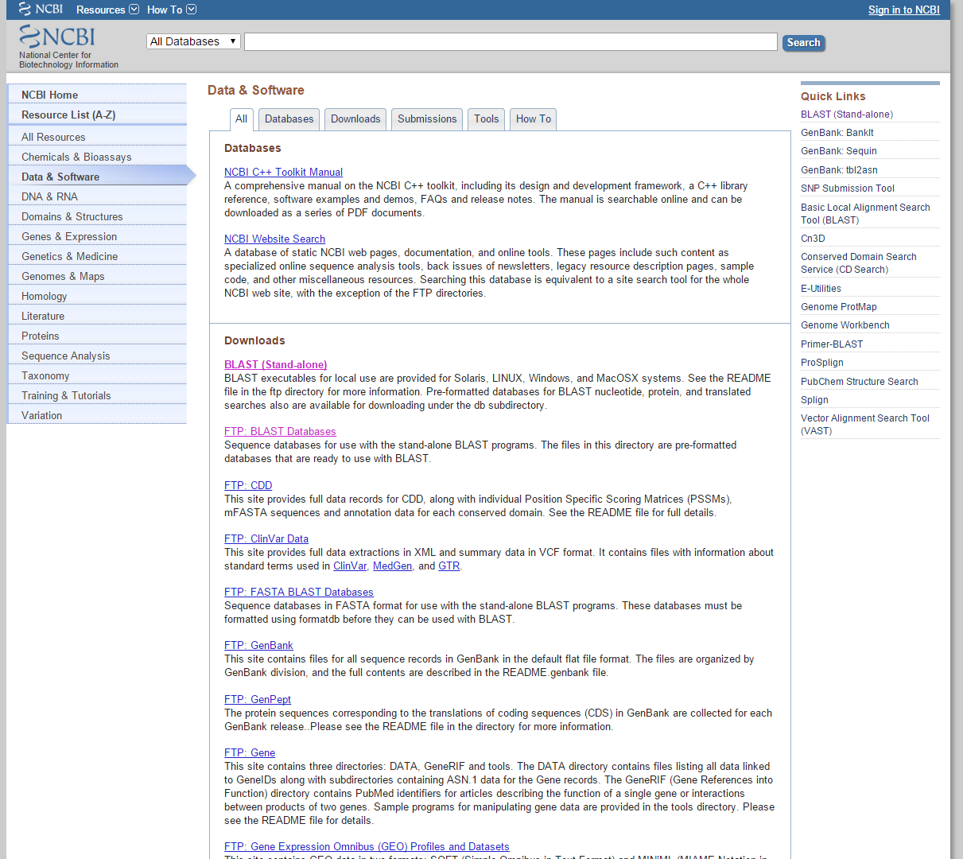
BLAST+ (download)

Slide 7
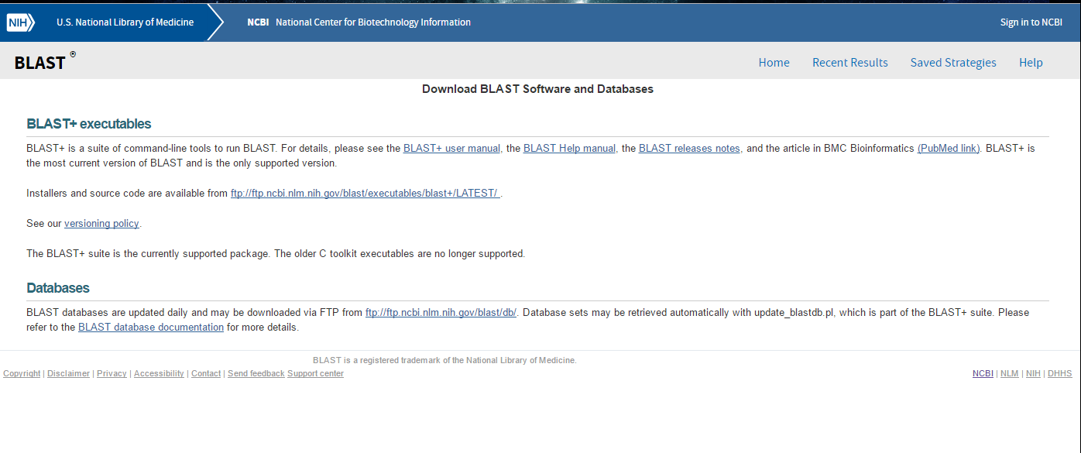
BLAST+ (download)

Slide 8
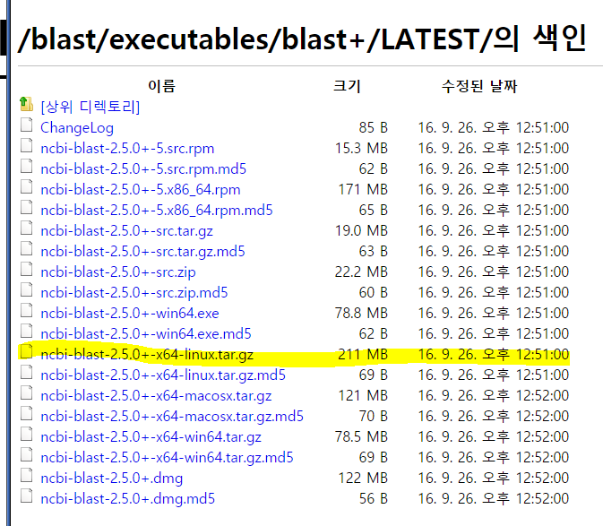
BLAST+ (download)
Download : ftp://ftp.ncbi.nlm.nih.gov/blast/executables/LATEST/
wget ftp://ftp.ncbi.nlm.nih.gov/blast/executables/blast+/LATEST/ncbi-blast-2.5.0+-x64-linux.tar.gz

Slide 9
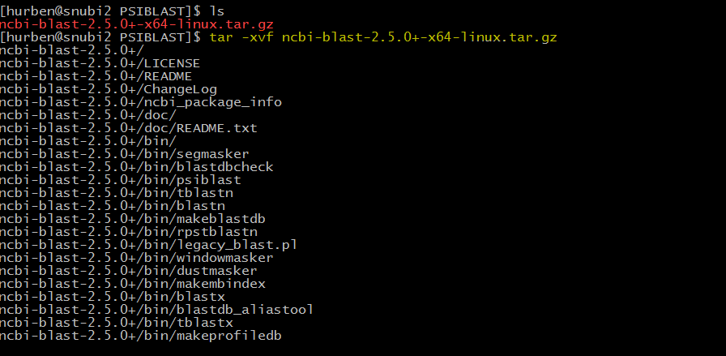
BLAST+ (Install)
Downloaded file
unzip file
tar –xvf [file name]

Slide 10
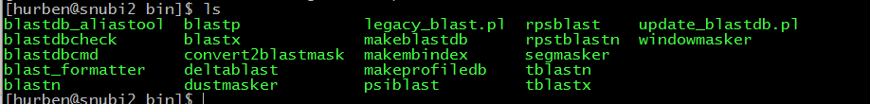
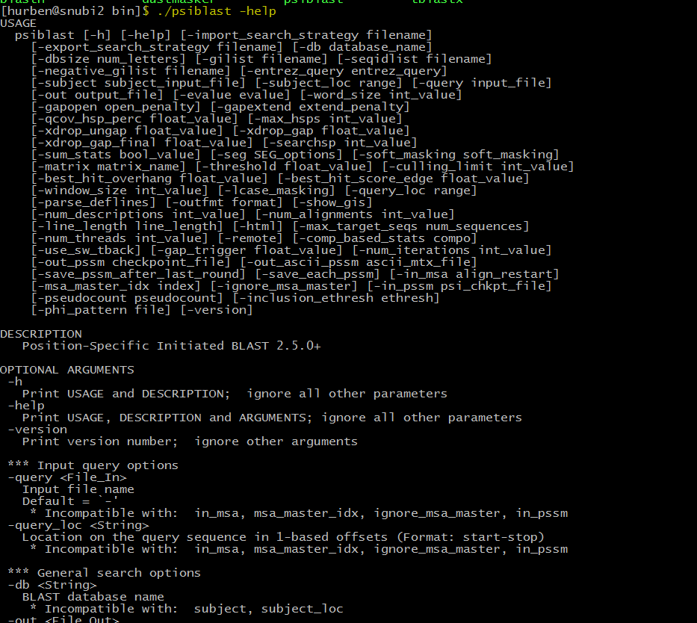
PSI-BLAST
./psiblast –help
Requirements
BLAST DB
INPUT (=Query sequence)

Slide 11
PSI-BLAST (making BLASTDB)

Slide 12
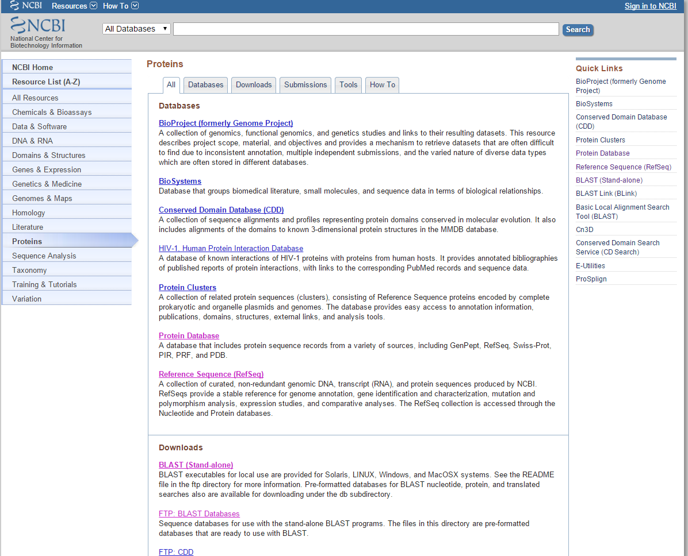

Slide 13
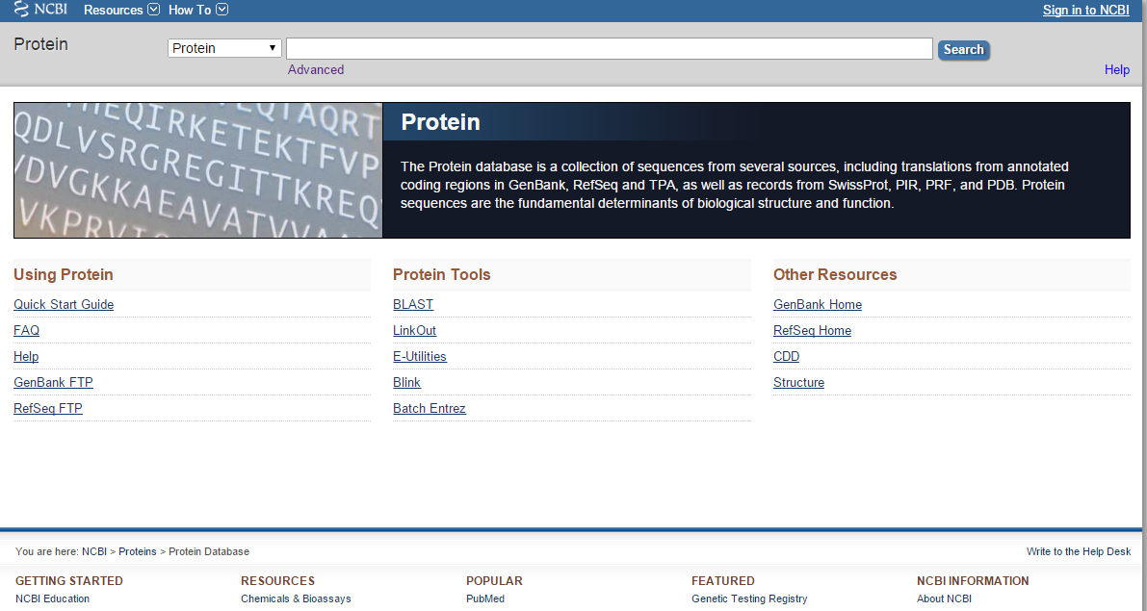

Slide 14
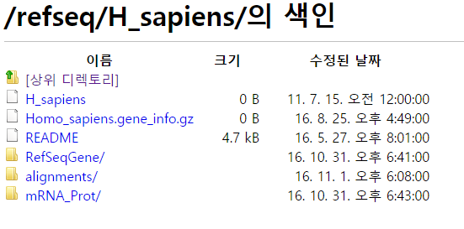
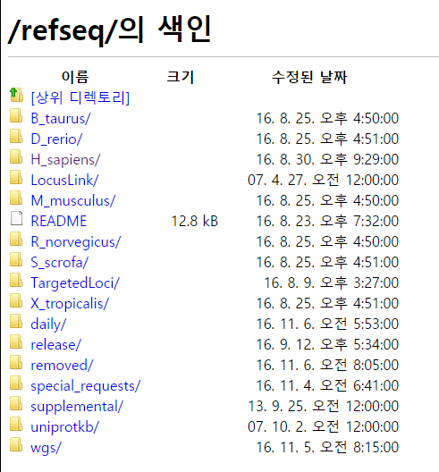
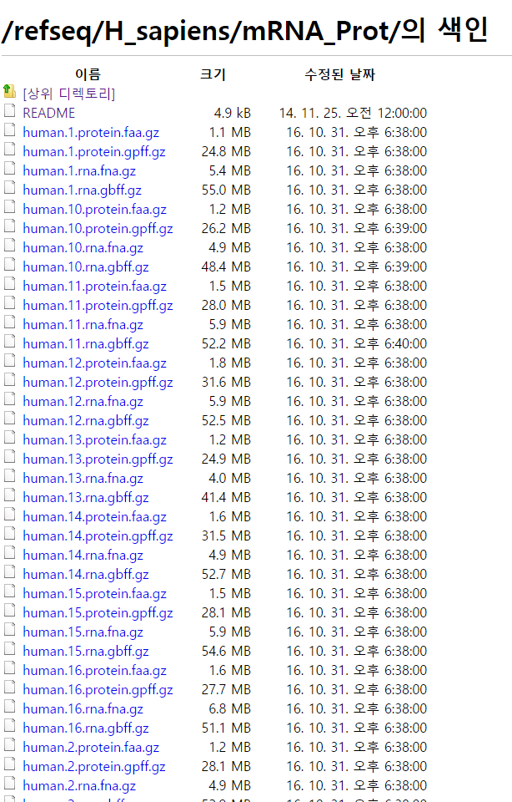

Slide 15
You need to Download files of
human.1.protein.faa.gz
human.2.protein.faa.gz
human.3.protein.faa.gz
…
human.15.protein.faa.gz
human.16.protein.faa.gz
For convenience, make a small shell script.
for i in {1..16..1}
do
wget ftp://ftp.ncbi.nih.gov/refseq/H_sapiens/mRNA_Prot/human.$i.protein.faa.gz
done
Save it as [file_name].sh
Run script sh [file_name].sh

Slide 16
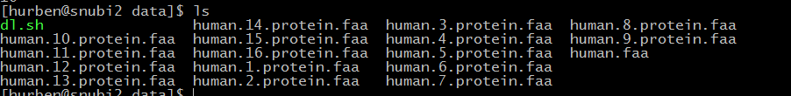
We need to integrate every .faa files into a single file
cat human.*.protein.faa >> human.faa
However… I stored integrated file in this directory
//data/bioinfo2/human_faa_db/human.protein.faa

Slide 17
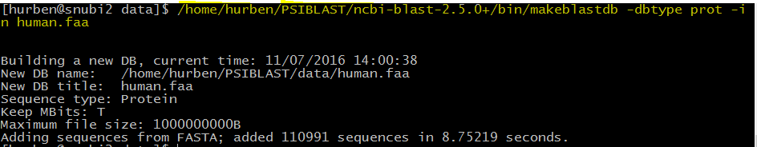
PSI-BLAST (making BLASTDB)
./makeblastdb –help
Essential options
-dbtype
-in ( input )
Defining DB type : protein
Make DB from given input
Command line : ./makeblastdb –dbtype prot –in human.faa
You will find multiple files on your directory [ human.faa.phr , human.faa.pin, human.faa.psq ]

Slide 18
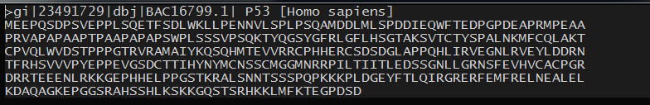
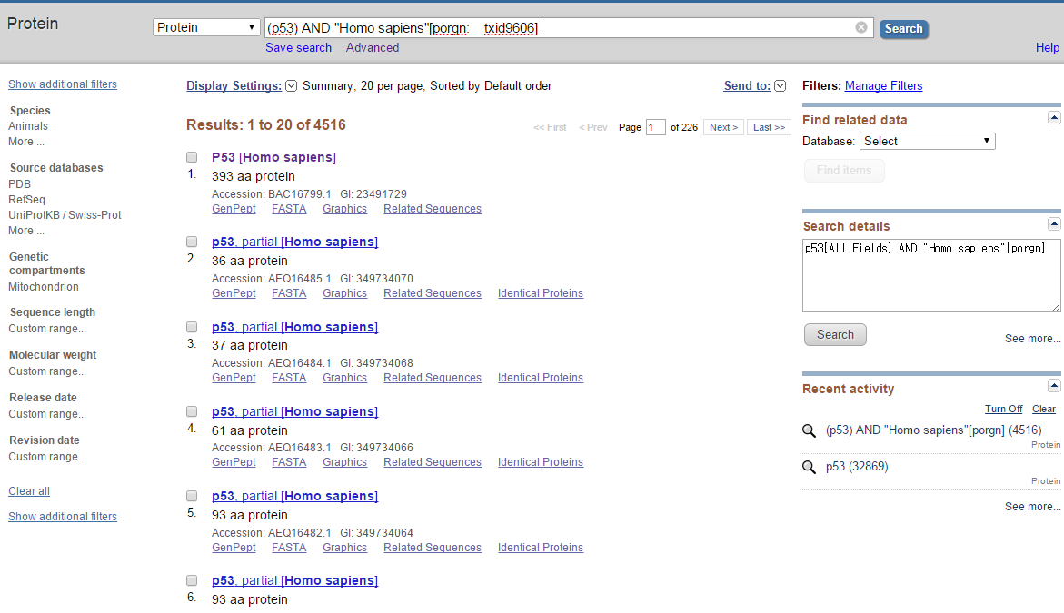
PSI-BLAST (Gaining query sequence)
PSI-BLAST can read fasta file as query sequence OR your own sequence.
Protein sequence are available from public database

Slide 19
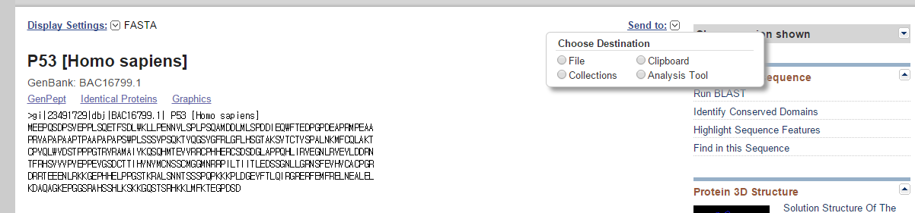
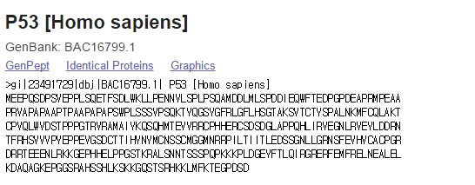
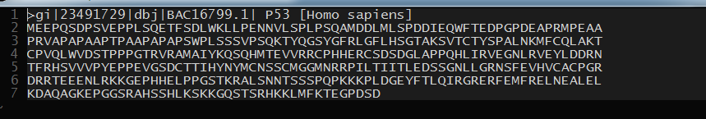
Saving as text file
OR.. Just Copy & Paste
Shift + Insert

Slide 20
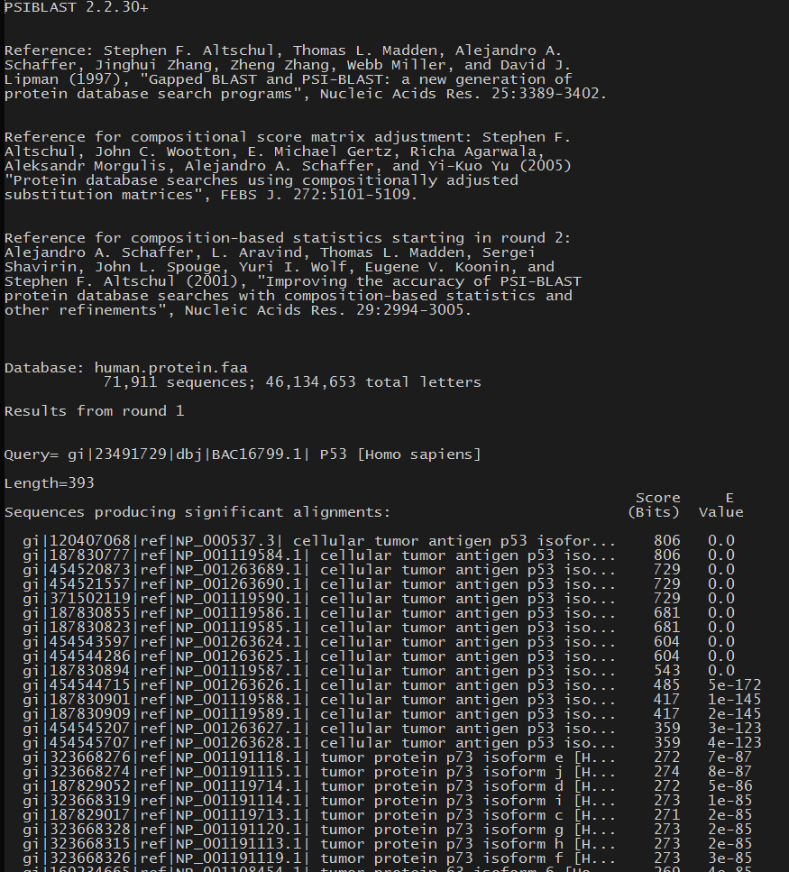
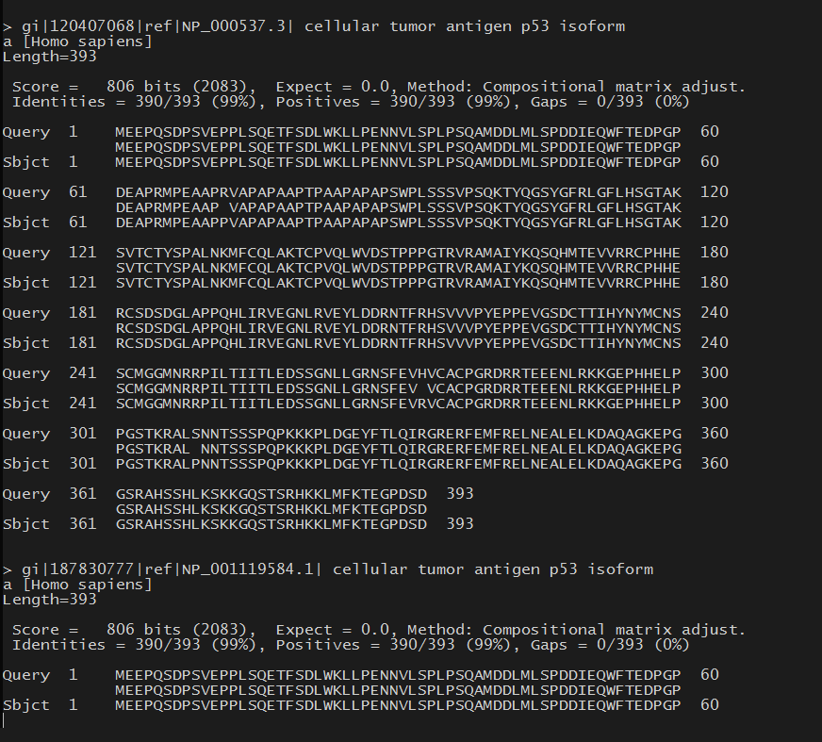
PSI-BLAST (RUN)
Command line : ./psiblast -db human.faa -query p53_human.fasta > result
Defining DB to use
Defining query to use
Save results to “result”

Slide 21
PSI-PRED

Slide 22
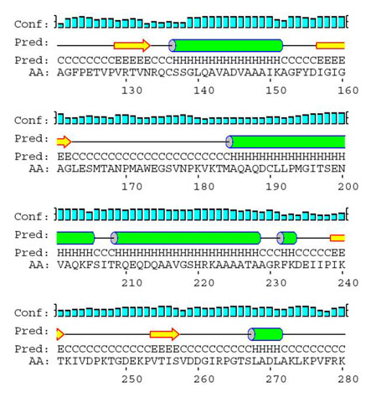
PSIPRED?
Protein secondary structure prediction tool

Slide 23
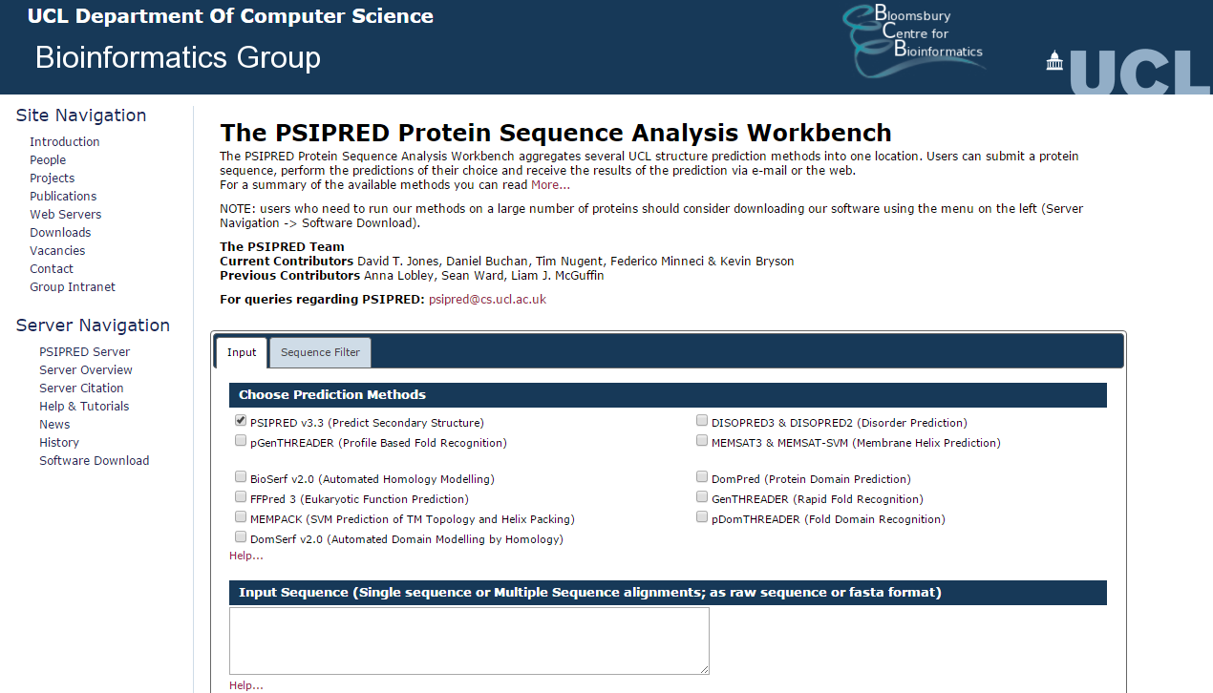
PSIPRED (WEB)
http://bioinf.cs.ucl.ac.uk/psipred/

Slide 24
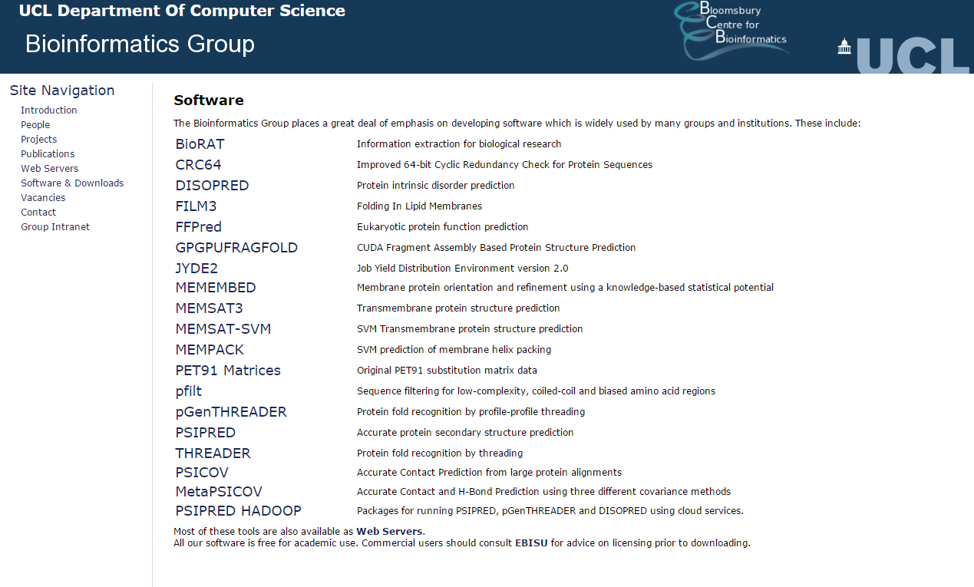
PSIPRED (Download & install)

Slide 25
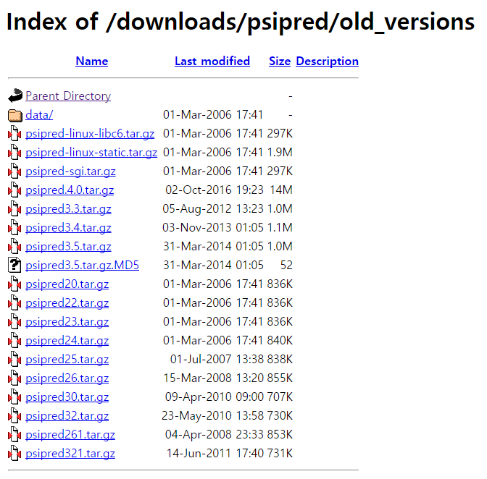
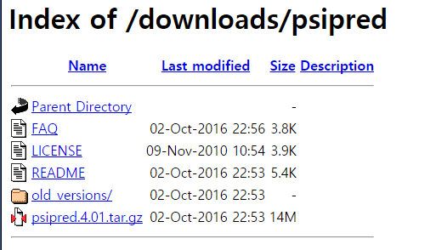
PSIPRED (Download & install)
Psipred.3.5.tar.gz
Download & unzip

Slide 26
PSIPRED (Download & install)
//data/bioinfo2/human_faa_db
human.protein.faa
p53_human.fasta
Will be used for construction of protein data base.
Will be used for unknown sequence.

Slide 27
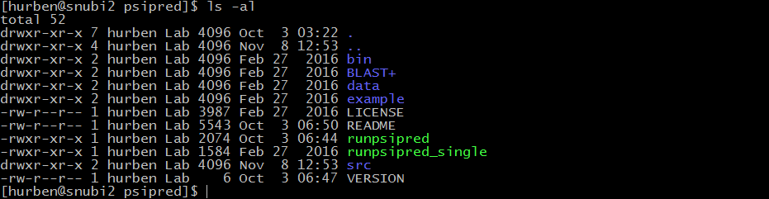
PSIPRED (Download & install)
Details of installation & Usage are in README file
Installation
STEP 1: go to src folder ( cd src )
STEP 2: make
STEP 3: make install

Slide 28
PSIPRED (Create sequence data bank)
Process of PSIPRED :
Create Sequence data bank
Run PSIPRED with unknown protein sequence.
Make Sequence data bank
STEP 1 : pfilt human.faa > human.protein.filt
STEP 2 : makeblastdb –dbtype prot –in human.protein.filt –out human.protein.filt
This file is in your PSIBLAST folder.
Sequence data bank construction complete

Slide 29
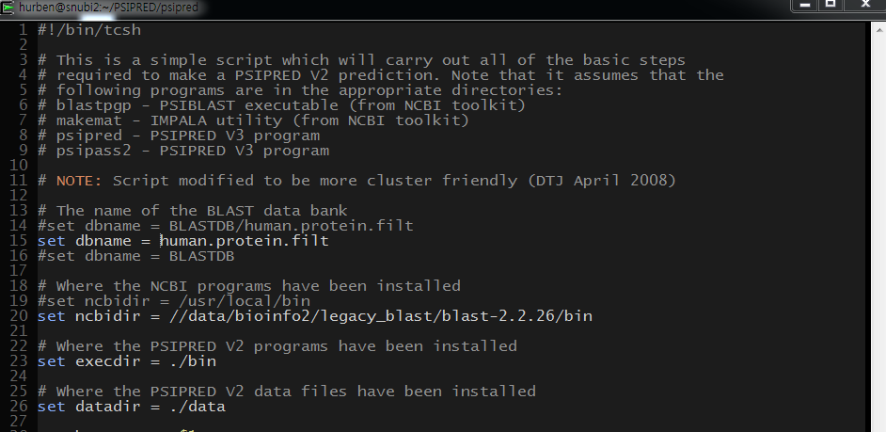
PSIPRED (Create sequence data bank)
Important note:
PSIPRED needs blastpgp. But this program is not available from recent BLAST+. Therefore, you need old version of BLAST+
Need several modification…
open runpsipred file ( vim runpsipred )
We have old version of BLAST+ in this directory

Slide 30

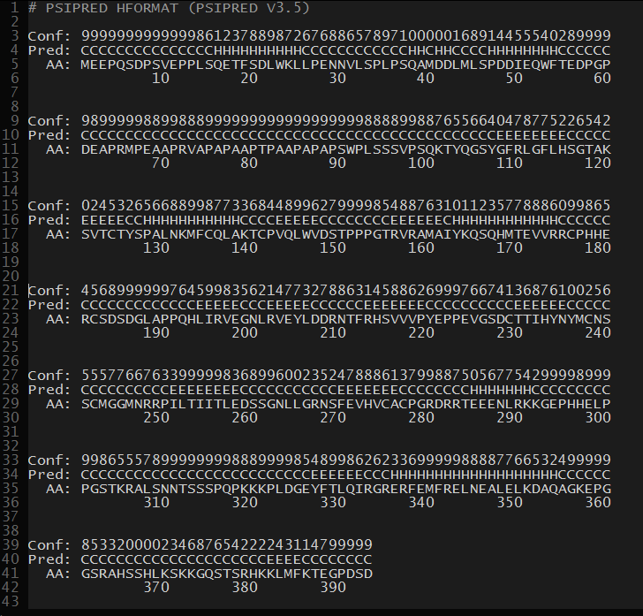
runpsipred unknown_seq_fasta.file

Slide 31
.horiz

Slide 32
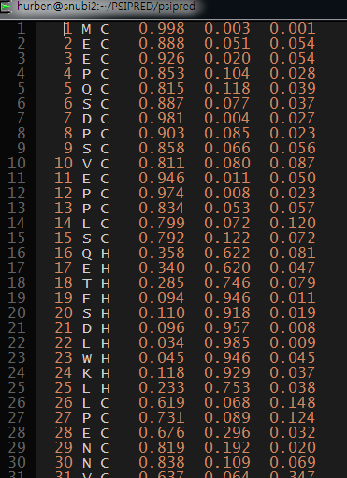
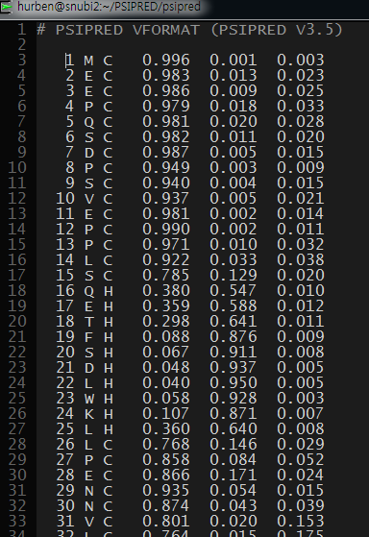
.ss
.ss2

Slide 33
H.W.
PSIBLAST & PSIPRED your own protein sequence
(or protein sequence that is not used in this practice)
Submit these files & process to the following E-mail
Outputs of PSIBLAST and PSIPRED
Screenshot of your process & command line
Jotunnheim@snu.ac.kr Deadline : 2016.11.27 23:59
Please include the header [실습2] as well as your student number
Ex) [실습2]_2012_211111_고길동

