Slide 1
Clustering
(K-means, Hierarchical, Gaussian mixture-EM)
TA : Benjamin Hur
18.05.08
Notes:
Hey guys. Today we will have a simple practice with those 3 major clustering methods.
K-means, Hierarchical , and EM clustering.
Todays main purpose is to have a practice, so I will not cover the details of each clustering methods.
But, I will introduce simple concept of these methods, as well as how and when to use those clustering methods to the right data.

Slide 2
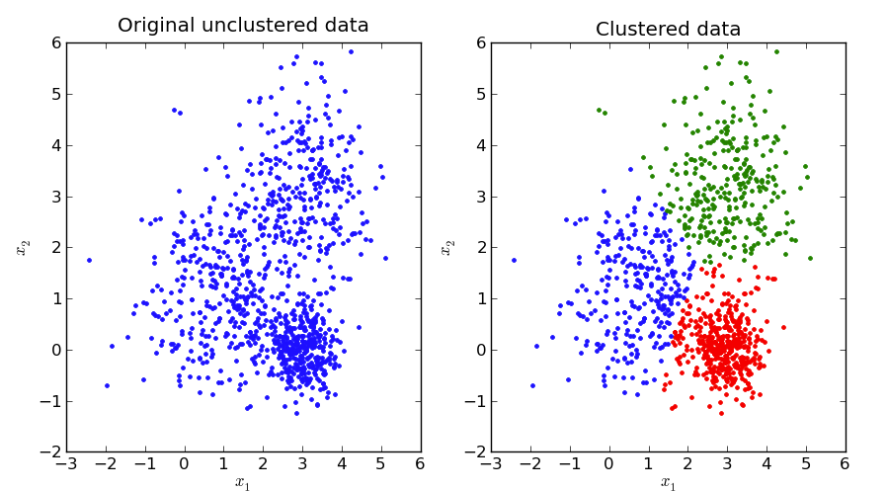
Clustering
Grouping sets of objects
Mostly, unsupervised learning.
A lot of methods to solve a lot of issues
http://pypr.sourceforge.net/kmeans.html#k-means-example
Notes:
In terms of datamining, when we want to learn something from a data.
we try to group the data in order to start understand what the data represents.
unlike classification, Clustering is often used to find structure in unlabeled data. AKA unsupervised learning.
Clustering can discover groups that have similar patterns, which might make sense.
A cluster is therefore a collection of objects which are “similar” between them and are “dissimilar” to the objects belonging to other clusters.
After clustering is done, you need to have background knowledge to interpret the clustered results.

Slide 3
What we hope the data look like...
The data we face in life
cluster 1
cluster 4
Variable 1
cluster 3
Variable 1
cluster 2
X
Variable 2
Variable 2
2
Notes:
So when we try to find a cluster from the data, we probably hope that the data looks nice and easy.
wishing to find the clusters with our bare eyes.
However, life is hard. Doesn’t let you analyze things simple.
Well, obviously, we can easily find 4 clusters from the left plot.
but when we have a data light the this kind of plot, we definitely need a clustering algorithm.

Slide 4


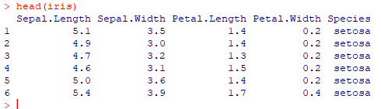
https://www.r-project.org/
Iris dataset : 150 samples, 5 attributes, 3 labels
3
Notes:
For today’s practice, we will use iris data.
I’m pretty sure that you guys are familiar to this dataset. The dataset has been introduced several times by other TAs.
Just to remind,
The dataset contains 150 samples, 4 attributes, and 3 species.
Just note that in real life, there are more than 3 species for Iris

Slide 5
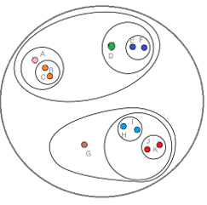
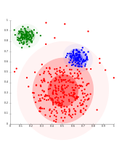
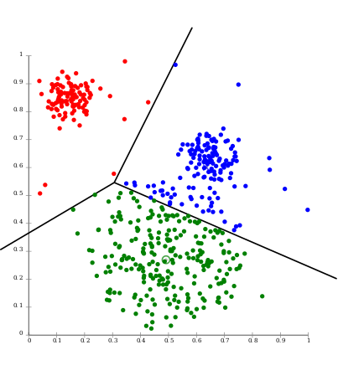
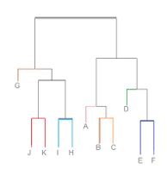
We will cover these...
K-means
EM
(for Gaussian-distributed)
Hierarchical
4
Notes:
As I said, today we will cover 3 major clustering methods.
K-means, hierarchical, and EM clustering.
I am not sure the professor have explained these methods in details.
Whether or not, I will not cover the details of them.
But, I will point out the catch of these methods with a very scrappy explanation.

Slide 6
K-means
Need to define K
Placing, moving centroids
by Euclidian distance of data points
repeat until convergence
explained well at : https://www.youtube.com/watch?v=_aWzGGNrcic
5
Notes:
Starting with K-means,
The Key idea of K-means clustering is to define the number of clusters, meaning that how many centroids should be located.
The method is quite simple.
If K is 3, place 3 centroids at random location.
We initially get 3 clusters.
Move the centroids to the means of each cluster. then we have updated clusters.
repeat this until the cluster is not being updated.
If you want to know the details, I thoroughly recommend to watch the youtube below.

Slide 7
X
X
Notes:
To explain with a little bit more details,
Lets assume that we have a data point like this.
First, we defined the K as 2. meaning 2 centroids will be located.
Locate those 2 centroids in a random location. we then calculate the distance between those 2 centroids.
Now we have a boundary for two initial clusters.

Slide 8
X
X
Notes:
which will colored like this.

Slide 9
X
X
Notes:
Then, we calculate the mean of the initial clusters.
The centroid is then relocated. as well as the distance between the centroids.

Slide 10
X
X
Notes:
We now have a updated clusters.

Slide 11
X
X
Notes:
re-calculate the centroid location.
but this time , the cluster is doesn’t need to be updated. therefore it is converged.
Again I did not explained the detail of the this algorithm. So, I thoroughly recommend to watch the youtube if you are more interested.

Slide 12
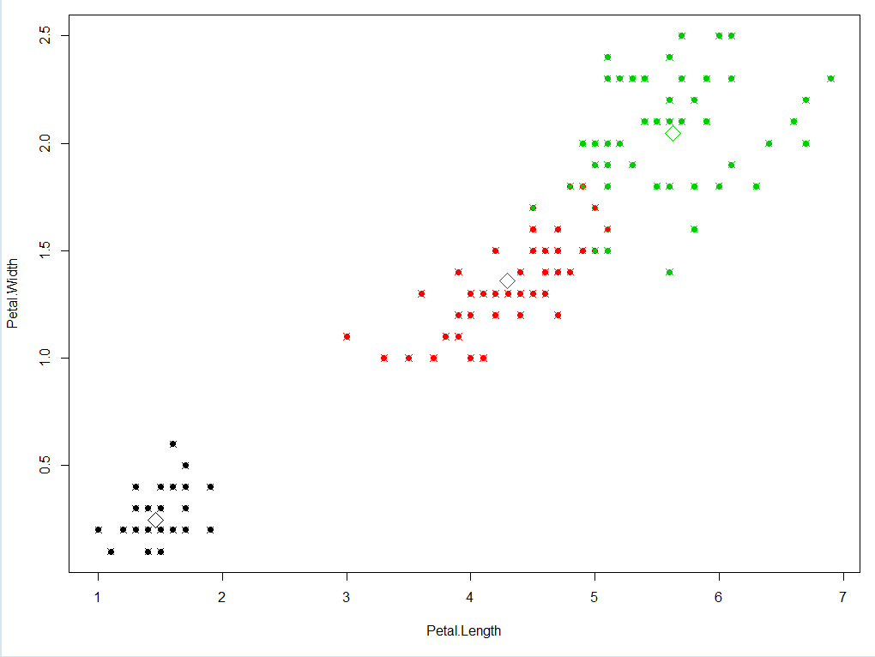
K-means simple example
library(datasets)
#making matrix of Petal.length, Petal.Width from iris data
data_matrix = iris[,3:4]
#Checkout how the data_matrix looks like. (col = colored by labels, cex = size of data point, pch = plot symbols)
plot(data_matrix, cex=1 ,pch=20)
#plot(data_matrix, col=iris[,5], cex=1 ,pch=20)
#Run K-means clustering. K = 3
kc <- kmeans(data_matrix, 3)
kc
plot(data_matrix, col=kc$cluster, cex=1, pch=20)
points(kc$centers[,c("Petal.Length", "Petal.Width")], col=1:3, pch=23, cex=2)
points(data_matrix, col=iris[,5], pch=21, cex=1.4)
6
Notes:
Kmeans is implemented in R so we do not need to download any library for it.
For simplicity we will only consider two attributes of iris. the length and width of the petal.
pretend that we only know that iris have 3 species, but we dont know about the data.
First, lets check out how the dataset looks like. This should be your very first step in order to choose any analysis method during datamining.
OK... so we can see that there might be two clusters of this data.
But as we know that iris have 3 species, we will set the K to 3.
we can see the statistics, and which sample is assigned to which cluster.
So, lets investigate how it looks like.

Slide 13
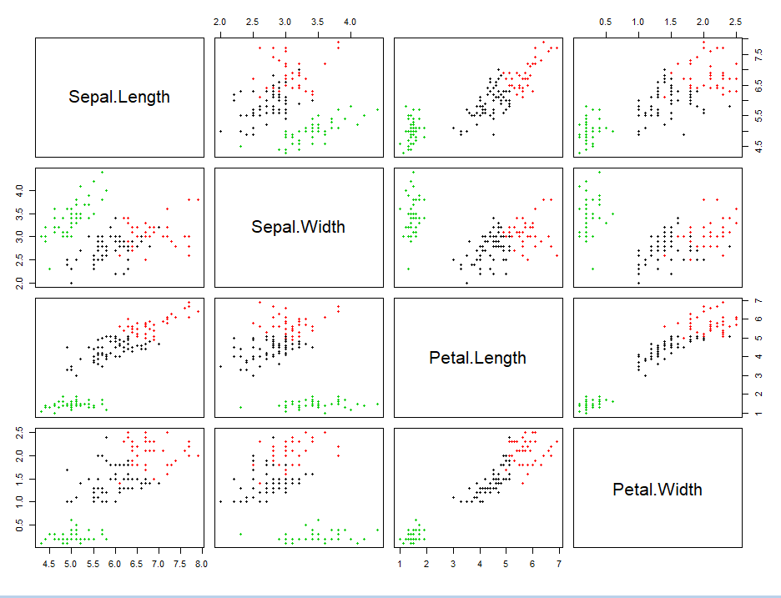
K-means simple example
data_matrix = iris[,-5]
kc <- kmeans(data_matrix, 3)
kc
plot(data_matrix, col=kc$cluster, cex=1, pch=20)

Slide 14
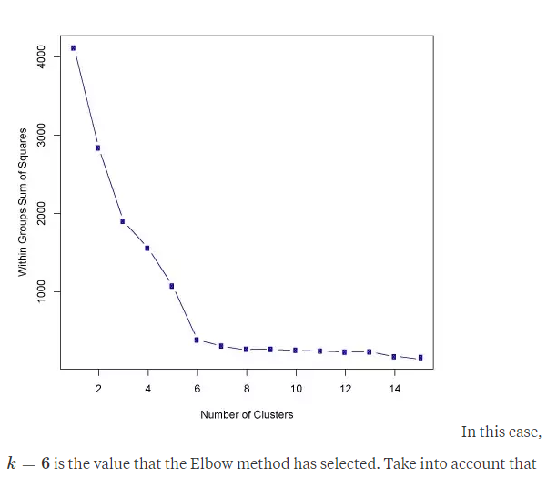
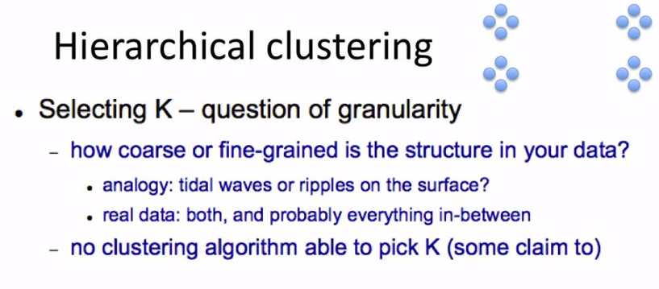
What if we do not know K ?
7
Notes:
With the Iris data, we know that the iris have 3 species so we set the number of K as 3.
But what if we do not know? what if we don’t have prior knowledge about if?
Some says that change the K until to plot looks pretty.
Some says use the Elbow method.

Slide 15
Hierarchical Clustering
Difficult to pick K
So, why not see the hierarchy of the data point rather than K?
Mainly buttom-up approach.
A.K.A : agglomerative
Theoretical assistance :
https://www.youtube.com/watch?v=XJ3194AmH40 https://www.youtube.com/watch?v=GVz6Y8r5AkY&list=PLBv09BD7ez_7qIbBhyQDr-LAKWUeycZtx
8
Notes:
At that point, hierarchical clustering comes in handy.
Again, If you want to know the details, I recommend to watch the youtube below.
The mechanism of the hierarchical clustering is summarized in a gif file. which you can see in slide.
In short, the top hierarchy will contain all data point.
And the data points will be splitted by going down the hierarchy.
There are two different approach. Top-down and buttom-up.
Top-down refers by making a hierarchy tree starting from the top. while buttom-up makes a tree from the bottom.
Mainly buttom-up is used often.

Slide 16
Hierarchical Clustering (Agglomerative)
Each data point starts as an cluster
Nearby points end up in the same cluster
Repeat until only one cluster is left
9
Notes:
A litter bit more details for the hierarchical clustering for the buttom up, agglomerative.
We assign each data point as each clusters.
So, when we have 150 samples, we have initial 150 clusters.
then each clusters are integrated to the nearest cluster. and so on.

Slide 17
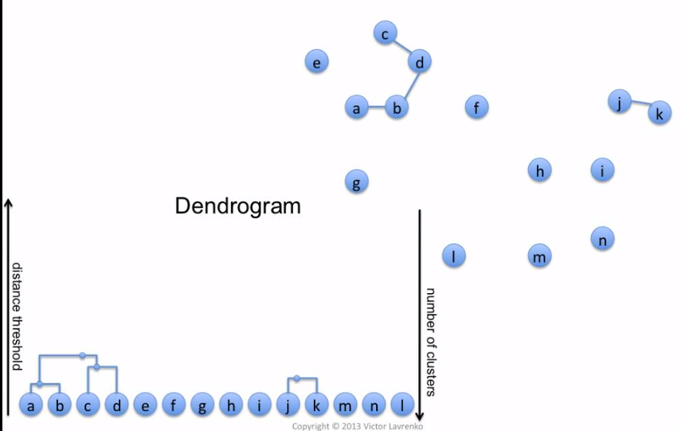

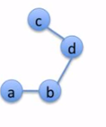
Hierarchical Clustering (Agglomerative)
Buttom-up
Height of the dendrogram represents the distance between data points
10
Notes:
So the initial clusters, data points will locate the buttom of the tree.
and these clusters will paired by their distance.
Note the height of pair AB and Pair CD are different
because the distance between A and B are shorter than the distance between C and D.

Slide 18
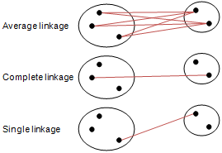
Hierarchical Clustering (Agglomerative)
Linkage Methods : Calculation of the distance between two clusters
Notes:
Also note that there are several methods that considers the distance between two clusters.
complete/single linkage calculates the maximum/minimum distance between two data points. from different clusters.
while average linkage calculates the average distance between every possible calculate able distances

Slide 19
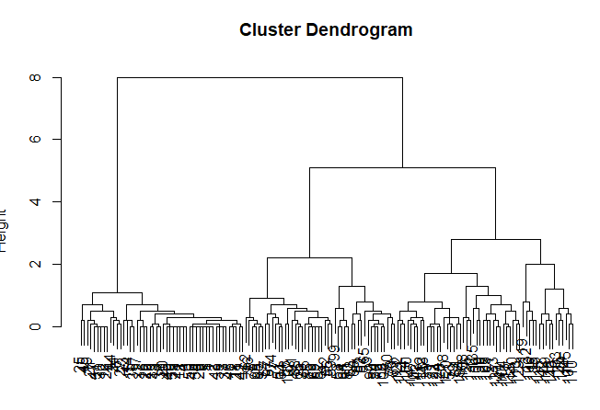
Hierarchical Clustering
#Calculate Distance of Petal's Length, Width
#distance measure depends on your method
x = dist(iris[,3:4])
x = dist(iris[,3:4], method ="manhattan")
#hclust has several methods
clustering <- hclust(x, method=“complete”)
#Plot results
plot(clustering)
#cut
clusterCut <- cutree(clustering, 3)
#see cut results
table(clusterCut, iris[,5])
cutree
Notes:
the cut purely depends on you

Slide 20
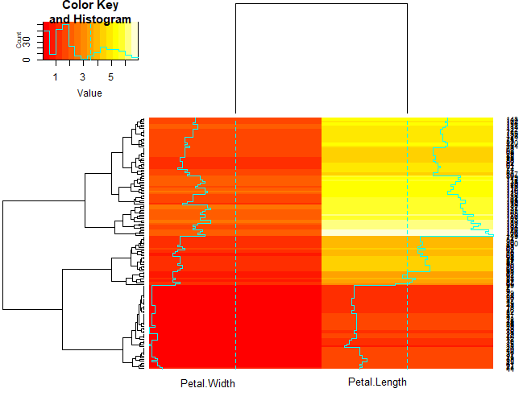
Hierarchical Clustering (Heatmap)
library("gplots")
data_matrix <- as.matrix(iris[,3:4])
heatmap.2(data_matrix, cexCol=1, srtCol=0)
#as default it uses hclust default
#Option tuning
hclust2 <- function(data_matrix, method="average")
hclust(data_matrix, method=method)
dist2 <- function(data_matrix)
dist(data_matrix, method ="manhattan")
heatmap.2(data_matrix, distfun=dist2, hclustfun =hclust2, srtCol=0, cexCol=1)
11
Notes:
Hierarchical clustering,
however, is used more commonly as heatmap.
heatmap is a powerful plot to show the data trend as well as clusters.
heatmap.2 contains the library of hclust, which we just practiced.

Slide 21
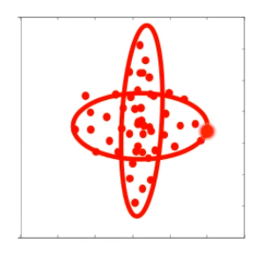
EM-Clustering
What if clusters are overlapped ?
12
Notes:
Now to the final method.
It seems that K-means and hierarchical clustering methods is effective to all dataset.
however, what if the clusters are overlapped?
normally, typically, the fore-mentioned clustering methods make a clusters like a lego block. which will meet difficulties.
At this point , EM clustering is useful.

Slide 22
EM-Clustering
Assumes that the data points is generated from Gaussian distribution
Clusters modeled as Gaussians
EM algorithm
Assign data to cluster with some probability
Theoretical assistance : https://www.youtube.com/watch?v=qMTuMa86NzU
13
Notes:
EM clustering assumes that the data point is generated from a Gaussian distribution.
Therefore, the cluster results shows as Gaussians.
As the name is EM-clustering. The clustering method is all about Expectation Maximization.
The method is extremely complicated than the K-means and Hierarchical clustering.
Its beyond my limit to explain the method Cleary.
If you are interested. again, their is a youtube link.

Slide 23
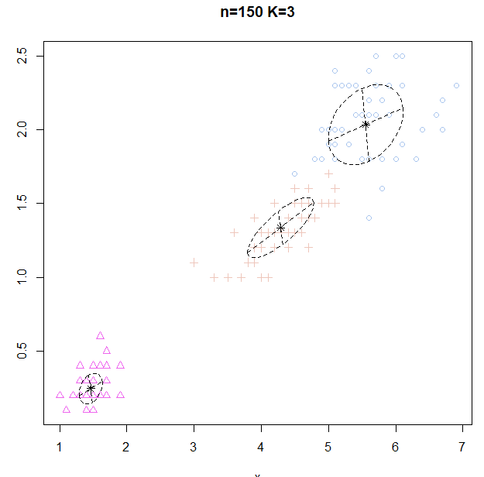
EM-Clustering
library("EMCluster")
set.seeds(1234)
data_matrix <- iris[,3:4]
#Initialize
emobj <- simple.init(data_matrix, nclass=3)
#Run EM
ret <- emcluster(data_matrix, emobj, assign.class = TRUE, EMC )
summary(ret)
plotem(ret, data_matrix)
#SVD. simple
ret_iris <- starts.via.svd(data_matrix, nclass = 3, method = "em")
summary(ret_iris)
plotem(ret_iris, data_matrix)
14
Notes:
However, we can try and use the EM clustering without understanding the details.
nice and easy.

Slide 24
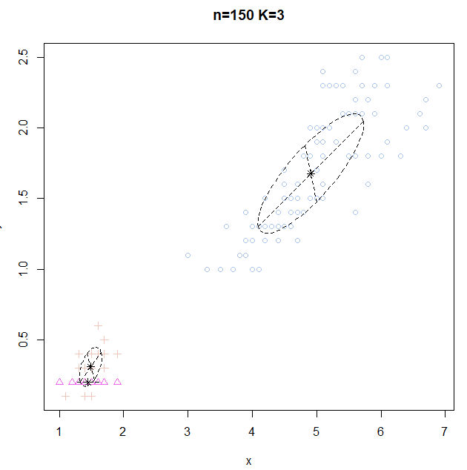
EM-Clustering (trouble shoot)
Reason why appropriate cluster method is important for appropriate data
For this kind of data,
if the initialization point is skewed somewhere
it is impossible to make other clusters
15

Slide 25
HW (Abalone Data)
Assume that you don’t know the label of dataset. Try to find clusters of Female/Male by shell weights (WholeWeight, ShellWeight)
Perform K-means, Hierarchical clustering, EM-clustering
Attach Plot & Code
Now you know the label of the dataset.
Which clustering method performed well?
Describe why it performed better than others.

Slide 26
HW2 (Animal Data)
animals <- cluster::animals
colnames(animals) <- c("warm-blooded",
"can fly",
"vertebrate",
"endangered",
"live in groups",
"have hair")
Dataset : Animals (copy paste the red box)
According to the dataset, consider all 6 attributes.
1. What are the 3 animals that is closest to the ant.
2. Attach Plot & Code

Slide 27
HW (Submission)
Deadline : 18.05.22 23:59
Submit your code & plot & explanation to a single document file.
Filename: [CCA2018HW] ID-Name
Email submission title : [CCA2018HW] ID-Name
E-mail : hurben.bioinfo@gmail.com
If you have any questions, ask me via E-mail including [CCA2018HW] to the title

