Slide 1


VIRTUAL APPLIED DATA SCIENCE TRAINING INSTITUTE
Module 3: Statistical Distributions, Sampling, & Hypotheses Testing
Bayesian Analysis : Alternative to Frequentists
03/05/2021
Paul Kolm, PhD

Slide 2
Outline
Frequentist (classical) review.
Bayesian perspective.
Examples:
Diagnostic tests: positive predictive values. Randomized trial of medications for epilepsy. Probabilistic sensitivity analysis (PSA).

Slide 3






Populations and samples
Population – everyone in the universe (of interest)
Sample – subset of the population of interest (random or not)
Research sample
Population
Is the sample representative of the population?

Slide 4

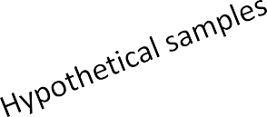
A frequentist view of hypothesis testing: population parameter (e.g., mean) is fixed, samples (data) are random – random sampling variability.
Population
μ_{p}
X_{s}
X_{s}
Research sample
X_{s}
X_{s}
X_{s}
X_{s}
The mean of the means of an infinite number of random samples with size n will equal the population mean.
X_{s}
X
s
X_{s}
X_{s}
X_{s}
X_{s}

Slide 5


Population of diastolic BP values (mean = 76)
73 | 42 | 73 |  | 67 | 84 | 75 | 80 | 78 | 64 | 73 | 70 | 92
59 | 77 | 65 |  | 69 | 91 | 71 | 69 | 62 | 76 | 89 | 91 | 79
67 | 76 | 66 |  | 80 | 98 | 70 | 74 | 71 | 74 | 59 | 84 | 73
68 | 74 | 70 |  | 72 | 84 | 65 | 81 | 54 | 67 | 83 | 87 | 63
68 | 93 | 92 |  | 71 | 95 | 69 | 98 | 74 | 90 | 100 | 60 | 82
75 | 91 | 72 |  | 82 | 67 | 71 | 61 | 94 | 75 | 76 | 66 | 76
97 | 58 | 72 |  | 57 | 74 | 65 | 79 | 73 | 91 | 79 | 63 | 80
73 | 92 | 62 |  | 82 | 73 | 90 | 73 | 83 | 64 | 70 | 60 | 79
94 | 73 | 78 |  | 99 | 71 | 90 | 82 | 74 | 82 | 77 | 71 | 64
68 | 73 | 86 |  | 89 | 100 | 77 | 88 | 72 | 56 | 85 | 90 | 88
55 | 68 | 73 |  | 85 | 80 | 69 | 62 | 73 | 78 | 73 | 84 | 70
65 | 81 | 85 |  | 90 | 89 | 64 | 81 | 77 | 91 | 95 | 86 | 73

Slide 6
Sampling distribution of diastolic BP
Sample(n = 5) Mean
63 | 73 | 61 | 73 | 66 | 67
90 | 92 | 56 | 68 | 60 | 73
69 | 67 | 85 | 72 | 73 | 73
90 | 80 | 55 | 73 | 77 | 75
69 | 74 | 91 | 73 | 66 | 75
64 | 71 | 80 | 76 | 94 | 77
62 | 91 | 79 | 89 | 62 | 77
81 | 76 | 91 | 77 | 63 | 78
95 | 91 | 73 | 65 | 72 | 79
72 | 82 | 73 | 90 | 81 | 80
83 | 75 | 69 | 92 | 79 | 80
89 | 90 | 77 | 80 | 82 | 84
Sampling distribution

Slide 7
95% confidence intervals for dBP from hypothetical samples (n = 5) Population mean dBP = 76
Sample
Mean SEM
LB UB
5666666666677777777778888888888999999
9012345678901234567890123456789012345
72 | 82 | 73 | 90 | 81 | 80 | 3 | 70 | 89 | (-----x------------)
89 | 90 | 77 | 80 | 82 | 84 | 3 | 77 | 91 | x(-------------)
95 | 91 | 73 | 65 | 72 | 79 | 6 | 63 | 95 | (------------x------------------)
83 | 75 | 69 | 92 | 79 | 80 | 4 | 69 | 90 | (------x-------------)
64 | 71 | 80 | 76 | 94 | 77 | 5 | 63 | 91 | (------------x--------------)
63 | 73 | 61 | 73 | 66 | 67 | 2 | 60 | 74 | (-------------) x
69 | 67 | 85 | 72 | 73 | 73 | 3 | 64 | 82 | (-----------x-----)
62 | 91 | 79 | 89 | 62 | 77 | 6 | 59 | 94 | (----------------x-----------------)
81 | 76 | 91 | 77 | 63 | 78 | 5 | 65 | 90 | (----------x-------------)
69 | 74 | 91 | 73 | 66 | 75 | 4 | 63 | 87 | (------------x----------)
95% confidence interval: over repeated sampling, the CI will include the true population mean 95% of the time.

Slide 8
Hypothesis testing
Treatment: 80 88 76 77 84 Mean = 81
Control: 84 90 86 77 93 Mean = 86
Null hypothesis: Whatever difference there is between the means of the Treatment and
Control groups occurred by random sampling variability – or chance.
Alternative hypothesis: There is a difference between means of the Treatment and Control groups that was unlikely to have occurred just by chance.
Assume the null hypothesis is true.
Based on our statistical test, we will reject the null hypothesis or fail to reject the null hypothesis .

Slide 9
Statistical decisions
α and β are arbitrary.
p < 0.05 is an entrenched tradition.
If p < 0.01 is set as the error rate, then p= 0.05 is not “significant” (fail to reject the null hypothesis).
If p is < 0.01, reject the null hypothesis, but would be wrong 1 time out of every 100 random samples.

Slide 10
p values
What p values are:
Preset level for rejecting the null hypothesis. Scaled as a probability (0,1).
What p values are not:
probability that the null hypothesis is false. probability that the alternative hypothesis is true. an index of importance or meaningfulness.

Slide 11
Interpretation of p values
If p < 0.05 (or 0.01, 0.001 or 0.06), we reject the null hypothesis (having assumed it was true) and conclude that the observed sampling statistic (z, t, χ²) was unlikely (5/100; 1/1000) to have occurred by random sampling variability (chance).
If p > 0.05, we fail to reject the null hypothesis and conclude –
“Found no evidence for a difference.”

Slide 12
Bayesian and frequentist perspectives
Frequentist: Probability is the long-run frequency of random events over repeated sampling.
Frequentist: Data are random; population parameter is fixed.
Bayesian: Probability is an index of confidence an investigator has about the occurrence of an event.
Bayesian: Data are fixed; population parameter (e.g., mean) is random.

Slide 13
Bayesian analysis
Prior belief (event, condition, diagnosis).
Get new information (data).
Revise prior belief with posterior (new) belief.
Example: Physician updates initial medications based on current lab results.

Slide 14
Bayes’ Theorem (conditional probability)
Probability of A given B:
P(A|B) = P(A) P(B|A)
P(B)
Thomas Bayes (1701 – 1761) was an English statistician, philosopher and Presbyterian minister.

Slide 15
Diagnostic test
Disease
 |  | + | -
Test | + | TP | FP
 | - | FN | TN
Sensitivity = TP/(TP+FN) PPV = TP/(TP+FP) FP rate = FP/(FP+TN)
Specificity = TN/(TN+FP) NPV = TN/(TN+FN) FN rate = FN/(FN+TP)

Slide 16
Test statistics
Sensitivity: proportion of TP correctly identified
by test
Specificity: proportion of TN correctly identified
by test
Positive Predictive Value (PPV): proportion of patients with + test that have the disease
Negative Predictive Value (NPV): proportion of
patients with – test that don’t have the disease

Slide 17
Prevalence: proportion of disease in a given population.
Sensitivity and specificity of a test are independent of prevalence.
PPV and NPV dependent on prevalence.

Slide 18

Bayes' Theorem
estimating predictive values for specific prevalence.
P(+|D) x P(D) P(D|+) = ------------------
P(+)
Prior probability - prevalence
Posterior probabilities: PPV and 1 - NPV are revised estimates of the prior for patients
positive and negative to the test.
P(+|D) x P(D)
P(D|+) = P(+|D) x P(D) + P(+|ND) x P(ND)
P(D) = Prevalence P(D|+) = PPV
P(+|D) = Sensitivity P(+|ND) = 1 - Specificity
sensitivity x prevalence
PPV =
sensitivity x prevalence + (1 - specificity) x (1 - prevalence)
By a similar argument:
specificity x (1 - prevalence)
NPV =
(1 - sensitivity) x prevalence + specificity x (1 - prevalence)

Slide 19
Pathology
 |  | Abnormal | Normal | Total
 |  | (+) | (-)
 | Abnormal(+) | 231 | 32 | 263
Test
 | Normal(-) | 27 | 54 | 81
 | Total | 258 | 86 | 344
Sensitivity | = | 231/258 | = | 0.895
Specificity | = | 54/86 | = | 0.628
PPV | = | 231/263 | = | 0.878
NPV | = | 54/81 | = | 0.667
Prevalence | = | 258/344 | = | 0.750

Slide 20
Solve for Prevalence = 0.50
0.895*.50
PPV = 0.895*.50 + (1 – 0.628)*(1 – 0.50)
= 0.706
Solve for Prevalence = 0.25
0.895*.25
PPV = 0.895*.25 + (1 – 0.628)*(1 – 0.25)
= 0.445

Slide 21
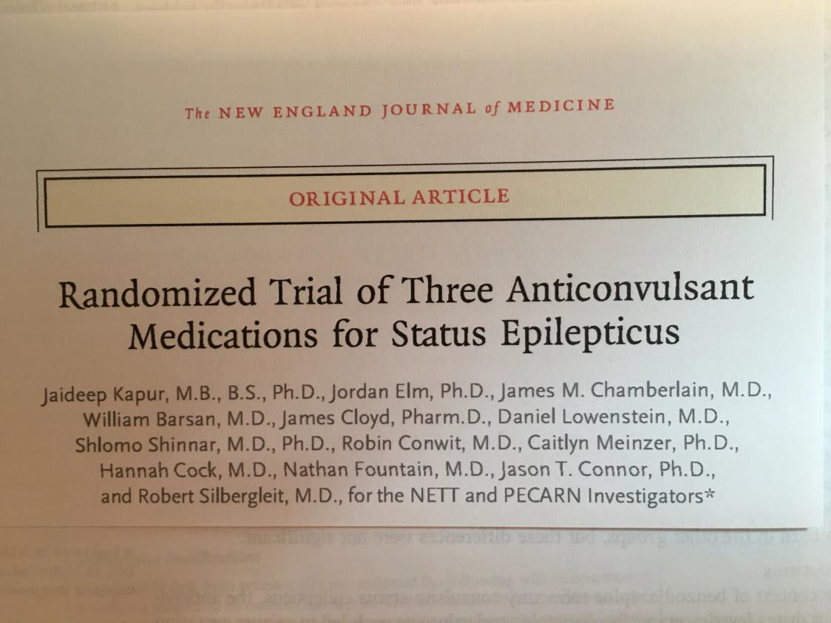

Slide 22
METHODS
In a randomized, blinded, adaptive trial, we compared the efficacy and safety of three intravenous anticonvulsive agents — levetiracetam, fosphenytoin, and valproate — in children and adults with convulsive status epilepticus that was unresponsive to treatment with benzodiazepines. The primary outcome was absence of clinically evident seizures and improvement in the level of consciousness by 60 minutes after the start of drug infusion, without additional anticonvulsant medication. The posterior probabilities that each drug was the most or least effective were calculated. Safety outcomes included life-threatening hypotension or cardiac arrhythmia, endotracheal intubation, seizure recurrence, and death.

Slide 23
Outcomes
The primary outcome was an absence of clinically apparent seizures and improving responsiveness at 60 minutes after the start of trial drug infusion, without additional anticonvulsant medication, including medication used for endotracheal intubation.
The primary safety outcome was the composite of life-threatening hypotension or cardiac arrhythmia within 60 minutes after the start of trial drug infusion. Data on serious adverse events were collected through the end of participation in the trial (hospital discharge or 30 days, whichever came first) for every patient. Data on adverse events were collected through the first 24 hours after enrollment.

Slide 24
We used a response-adaptive comparative-effectiveness design. Patients were randomly assigned to receive one of the three trial drugs, initially in a 1:1:1 ratio. After 300 patients were assigned to a treatment group, response-adaptive randomization was initiated on the basis of previously defined decision rules, with the goal of maximizing the likelihood of identifying the most effective treatment. Interim analyses were planned after the enrollment of 400, 500, 600, and 700 patients, at which times the trial could be stopped early for success or futility, the rules for which are contained in the protocol.

Slide 25
At each interim analysis, the randomization assignment probabilities were updated. The maximum sample was 795 patients. Randomization was stratified according to age category (2 to 17 years, 18 to 65 years, and >65 years) at the targeted assignment probabilities. Before assessment of the trial results, all three drugs were considered to be equally likely to be the most effective or least effective treatment.

Slide 26

Response rates in each of the treatment groups were modeled independently with the use of Bayesian analysis. The percentage of patients with treatment success in each group was calculated starting with a uniform(0,1) prior probability distribution (which allows the treatment success to take any value between 0 and 100%) and was updated on the basis of the observed binomial data with the use of a conjugate beta-binomial model. From these three posterior distributions, the probability that each treatment was the most or least effective treatment was calculated as described previously.
Uniform distribution is a non-informative prior.

Slide 27
We randomly and repeatedly (10⁶ iterations) drew from these three posterior probabilities to calculate the probability that a given treatment was better than the other two. The same approach was taken for the potentially worst treatment. The criterion for declaring a most or least effective treatment was a probability greater than 0.975. The threshold of 0.975 was chosen by convention (analogous to an alpha of 0.025 in a one-sided comparison) and because a simulation study showed that with this threshold and trial design, the type I error rate was controlled. Unlike a trial in which success can be achieved in a number of different ways (e.g., multiple treatments vs. a control), only one treatment could be identified as best.

Slide 28
A maximum sample of 720 unique patients from 795 enrollments provided 90% power to identify the most effective treatment when one treatment group had a true response rate of 65% and the true response rate was 50% in the other two groups (an absolute difference of 15 percentage points). We report the percentage response in each treatment group with 95% credible intervals. The primary analysis was based on the intention-to-treat population and included all unique patients who underwent randomization, regardless of the amount of treatment that was actually received.

Slide 29
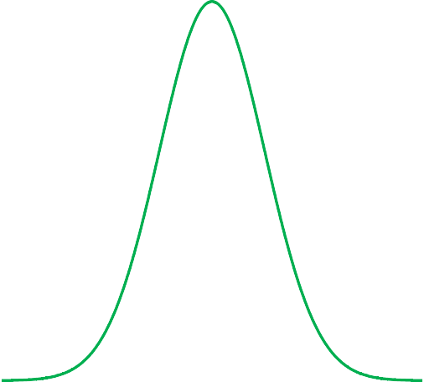
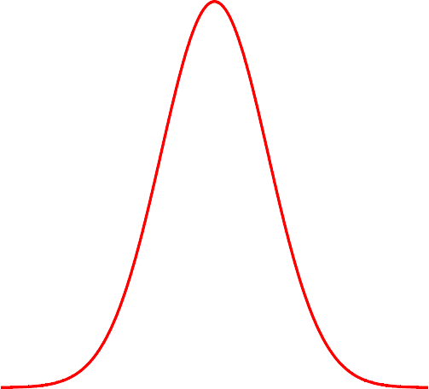

20
25
30 35 40 45 50
Patients with treatment success (%)
55
60
65
70
75
80
2.5%

Slide 30
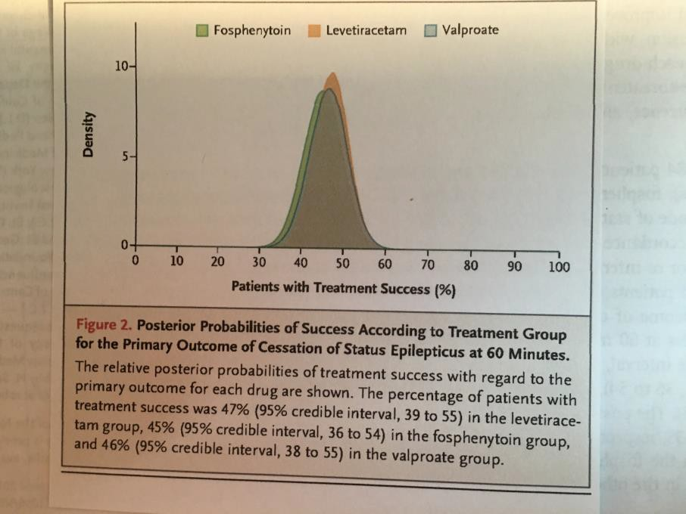
In this prospective, randomized, double-blind, adaptive comparative-effectiveness trial involving patients with benzodiazepine-refractory status epilepticus, we found no significant difference in the percentage of patients with seizure cessation among the levetiracetam group, fosphenytoin group, and valproate group.
Treatment success and 95% Credible Interval
Levetiracetam: | 47% (39% - 55%)
Fosphenytoin: | 45% (36% - 54%)
Valproate: | 46% (38% - 55%)

Slide 31
Bayesian CI:
95% credible interval: 95% probability that the interval includes the
population parameter.
Frequentist CI:
95% confidence interval: over repeated sampling, the interval will include
the population parameter 95% of the time.

Slide 32
Probabilistic (Bayesian) sensitivity analysis
Multiple input variables to estimate multiple parameters.
Parameter estimation sensitive to changes in input variables.
Prior and posterior distributions (e.g., normal, gamma, beta) the same for a given variable.
Different distributions for other variables.

Slide 33
Patient Level Cost-effectiveness Analysis (CEA)
Compare cost and effectiveness of two (or more) treatments.
Patient level costs and measure of effectiveness.

Slide 34
Cost-effectiveness analysis
Outcome from study -
Survival, life years gained, quality-adjusted life years (QALYs)
QALYs calculated by multiplying life years gained by utility, a measure of health status scaled from zero (death) to one (perfect health).
Cost of treatment – procedures, physician, medications,
hospitalizations, office visits, lab tests.

Slide 35

Table 2. Acute CVD Event Costs (Per Episode)
Costs (2018 USD) by age group | Mean | Standard Deviation | Minimum | Maximum | Distribution | Reference
Fatal CVD event
45-64 | $18,940 | $5,175 | $11,921 | $32,205 | Gamma | (4,5)
65-84 | $17,473 | $4,567 | $11,518 | $29,420 | Gamma
≥85 | $11,970 | $3,394 | $7,620 | $20,926 | Gamma
Myocardial infarction
45-64 | $22,542 | $3,908 | $14,353 | $29,672 | Gamma | (4,5)
65-84 | $22,410 | $4,176 | $14,241 | $30,612 | Gamma
≥85 | $14,159 | $3,822 | $8,288 | $23,270 | Gamma

Slide 36
2.0e-05
Density
1.0e-05 1.5e-05
5.0e-06
0
0
50000 100000 150000 200000 250000 300000
Cost ($)

Slide 37
Supplemental Table 4. Cost-effectiveness analysis utility values.
Description | Value | Distribution | SD | Reference
Chronic Utility
No history of CVD | 1.0000 | Beta | ---- | 18,19
History of angina | 0.9064 | Beta | 0.0223 | 18,19
History of MI | 0.9648 | Beta | 0.0287 | 18,19
History of stroke | 0.8835 | Beta | 0.0241 | 18,19
History of MI & stroke | 0.8524 | Beta | 0.0359 | 18,19
Acute Disutility*
Angina | -0.0078 | Beta | 0.0021 | 18,19
PCI | -0.0096 | Beta | 0.0028 | 18,19
CABG | -0.0192 | Beta | 0.0046 | 18,19
MI | -0.0079 | Beta | 0.0022 | 18,19
Stroke | -0.0113 | Beta | 0.0031 | 18,19
* Disutilities applied if patient experienced event or revascularization during the trial. SD = standard deviation; CVD = cardiovascular disease; MI = myocardial infarction; PCI = percutaneous coronary intervention; CABG = coronary artery bypass grafting.

Slide 38
Incremental Cost-Effectiveness Ratio (ICER)
µCostA – µCostB
ICER =
µEffA – µEffB
µΔ C
=
µΔ E
Spend $50,000 for every QALY gained.

Slide 39
Cost-effectiveness plane
Incremental Cost
+
IV
I
Cost Increasing/ Effectiveness Reducing
(Dominated)
Cost Increasing/ Effectiveness Increasing
Δ Cost
More Costly
-
Δ QALYs
+
Incremental Effectiveness
Cost Reducing/ Effectiveness Reducing
Cost Reducing/ Effectiveness Increasing
(Dominant)
III
II
-
More Effective

Slide 40
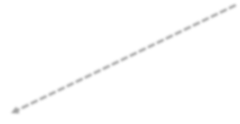


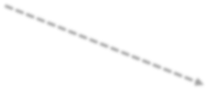









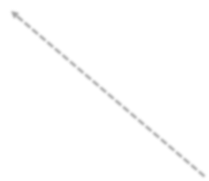

Probabilistic (Bayesian) sensitivity analysis
No Hx CVD (1.00)
$Fatal CVD
Γ₁
β₁
Hx MI
$MI
Γ₂
β₂
nth random draw n = 1:100,000
Hx Stroke
$Stroke
Γ₃
β₃
Hx Stroke + MI
$Atorvastatin
Γ₄
Δ Cost / Δ QALY (100,000)
β
4
Hx Angina
Death (0.00)

Slide 41
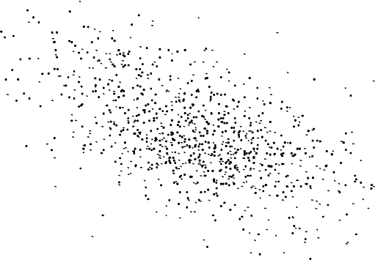
Joint Distribution of Cost & Effectiveness
Differences
1.6
Mean Cost Difference (PCI-Medial Therapy) ($10000s)
1.4
1.2
1.0
0.8
0.6
0.4
-0.5 0.0
0.5
Mean Effective Difference in QALYs (PCI-Medical Therapy)

Slide 42
Summary
Frequentist: based on repeated sampling of data from population.
Confidence interval: over repeated sampling, interval will
include population parameter X% of the time (95%, 99%).
Bayesian: prior distribution data posterior distribution.
Credible interval: X probability (e.g., .95) that interval includes population parameter.

Slide 43
Summary
Frequentist methods used for simple or straightforward analyses.
Bayesian methods can handle complex, multiparameter analyses difficult for frequentist methods.
Bayesian simulation: first 10,000-50,000 iterations are “burn-in”.

Slide 44
References:
Kapur J, Elm J, Chamberlain, JM, et. al. Randomized Trial of Three Anticonvulsant Medications for Status Epilepticus. New England Journal of Medicine
2019;381:2103-2113.
Gelman A, Carlin JB, Stern HS, Dunson DB, Vehtari A, Rubin DB. Bayesian Data Analysis, 3rd edition, CRC Press, Boca Raton, FL, 2014.
Gray K, Hampton B, Silveti-Falls T, McConnell A, Bausell C. Comparison of Bayesian Credible Intervals and Frequentist Confidence Intervals. Journal of Modern Applied Statistical Methods 2015;14:43-52.

Slide 45
Thank you
paul.kolm@medstar.net

