Slide 1
Opening GitBash & Navigating Between Folders

Slide 2
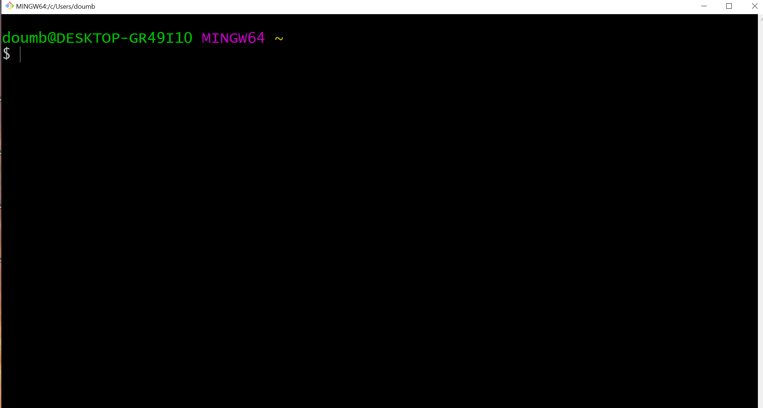
Step 1: Open GitBash

Slide 3
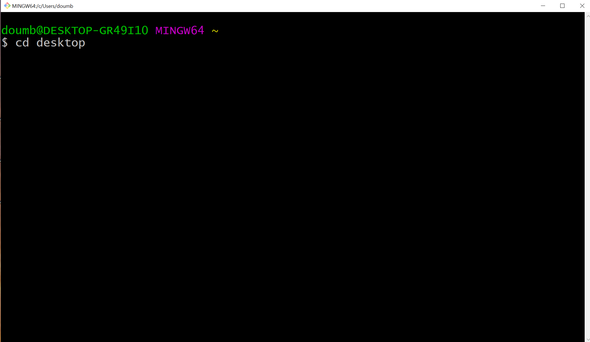
Step 2: Change Directory to Desktop (cd Desktop)

Slide 4
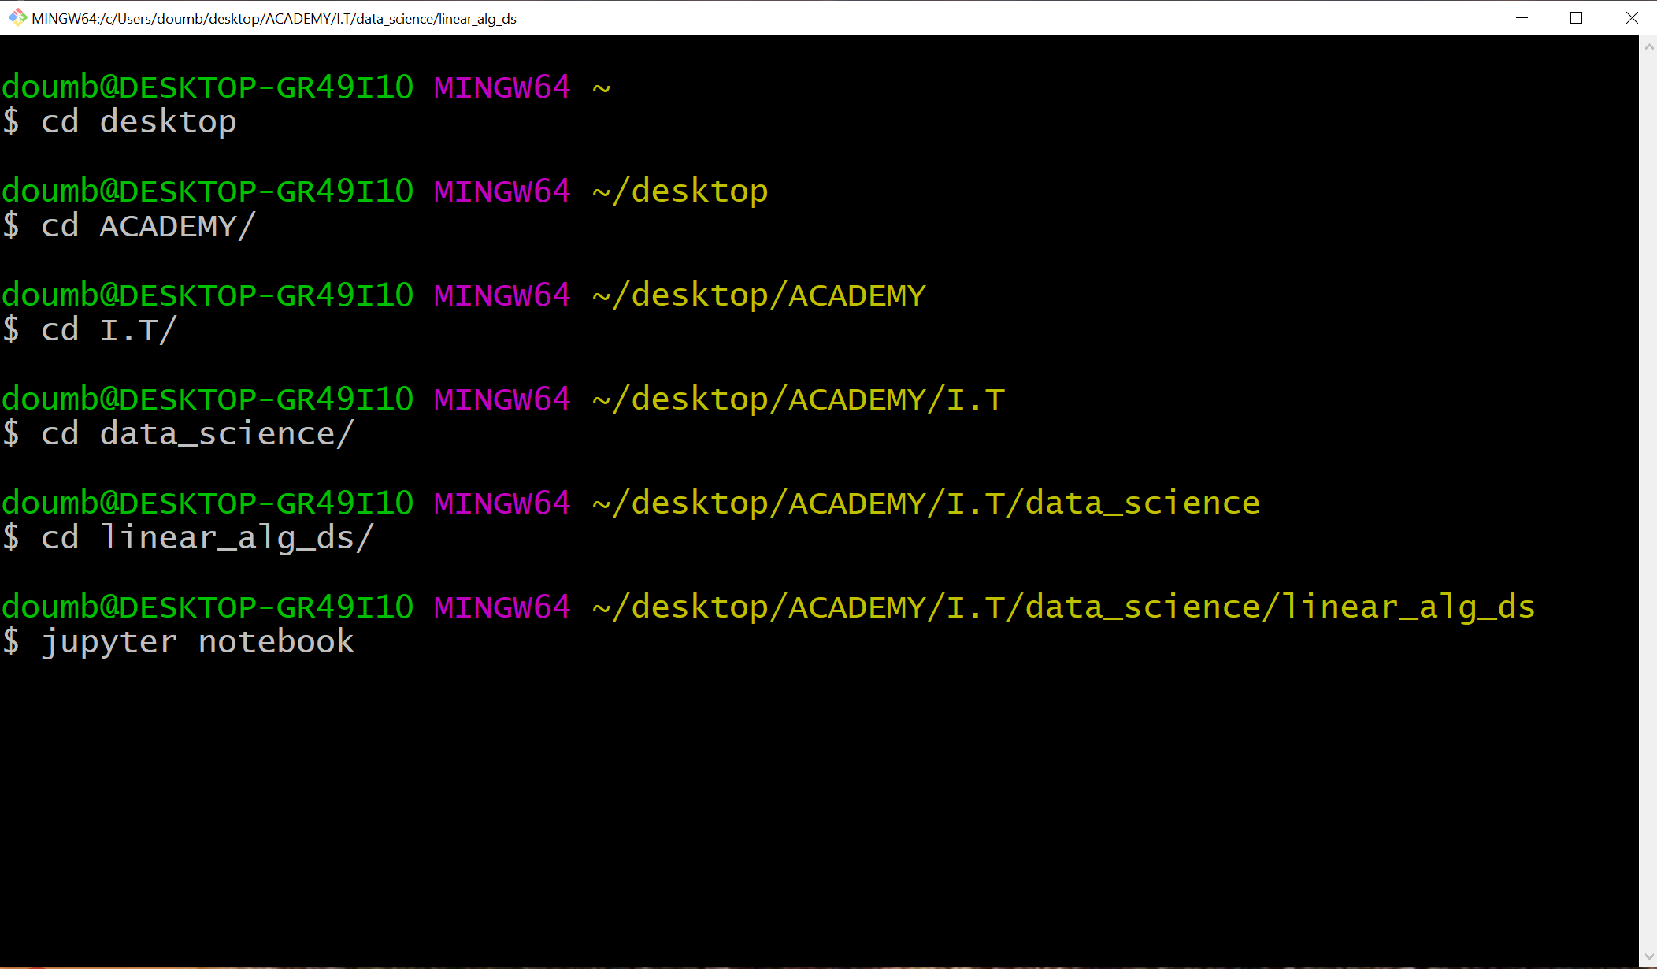
Step 3: change directory to linear algebra ds folder& open Jupyter notebook

Slide 5
Thank you!

