Slide 1
Max Flow
Fang Chen,Yaqun Yu, Xinhe Wang, Jinglun Li

Slide 2
Preflow Push Algorithm
By Yaqun Yu & Fang Chen

Slide 3
Difference with Ford-Fulkerson
Our goal : push from source AS MUCH AS POSSIBLE
What if there is a small cut further down the graph?
Push the “excess” flow back to the source

Slide 4
Preflow
When this happen?
When We can not maintain a flow at each point in time.
Notation:
In a preflow, the flow entering the node is allowed to be more than the flow leaving it
&

Slide 5
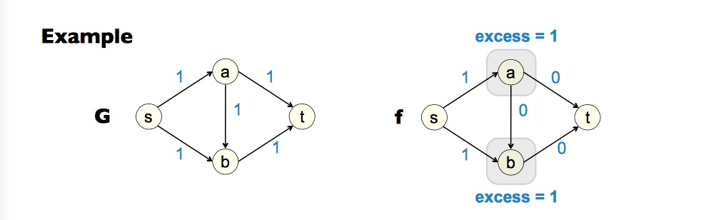
Preflow Example
Notation:
In a preflow, the flow entering the node is allowed to be more than the flow leaving it
&

Slide 6
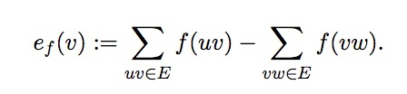

Preflow
Notation:
In a preflow, the flow entering the node is allowed to be more than the flow leaving it
“Excess” :
“Active” : a node is consider to be active if
&

Slide 7
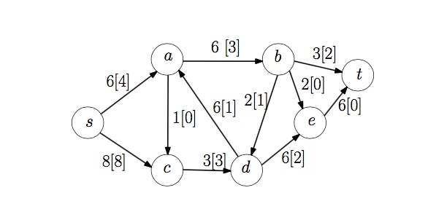
Active Example
Notation:
“Active” : a node is consider to be active if
Active nodes: a, c, d, e

Slide 8

Push and Label
Label h : Each node v is given a label h(v) ∈
valid for preflow f if for all edges (v, w) in Ef ,
h(v) <= h(w)+1
v w
arc uv admissible : h(v) >= h(w)+1
Relabeling: if e_{f}(v) >0, h(w)>=h(v), (v, w) in Ef ,then we stocked. Can not push, need Relabeling
Push f : from high label to low label
Preflow f and labeling h are compatible if
h(t)=0, h(s)=n
For all edges (v,w) in G_{f}, we have h(v) <= h(w) + 1
Notes:
The initial preflow f and labeling h are compatible.

Slide 9
How the algorithm works
Maintain a preflow f and a labeling h compatible with f
Modify f and h as to move f toward being a flow
When e_{f}(v) = 0, f becomes a flow and we know it has maximum flow value
Because this time,there is no s-t path in residual graph G_{f}, same as Ford-Fulkerson.

Slide 10
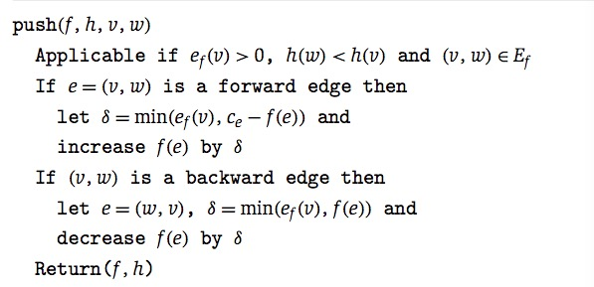
Push Algorithm
Notes:
Consider any node v that has excess—that is, ef (v) > 0. If there is any edge e in the residual graph Gf that leaves v and goes to a node w at a lower height, then we can modify f by pushing some of the excess flow from v to w. We will call this a push operation.

Slide 11
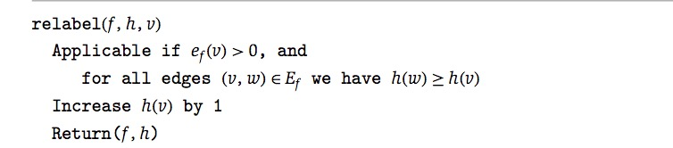
Relabel Algorithm
If we cannot push the excess of v along any edge leaving v, then we will need to raise v’s height

Slide 12
Preflow-Push Algorithm
Preflow-Push
Initially:h(v)=0, h(s) = n, f(e)=C_{e} for e=(s,v) other f(e)=0
While there is a node v (not t) with e_{f}(v)>0
choose v
if there is w can be applied push
push(f,h,v,w)
Else
relabel(f,h,v)
Endwhile
Return (f)
Running time: The general running time when select the node at
maximum height is O(n³)

Slide 13
Preflow-Push Implement
Preflow-Push
1. maintain a residual graph, it is updated after each time we push a (v,w).
it is very useful in this algorithm because we need to find h(w)<h(v) to push (v,w) by looking for an edge
(v,w) in residual graph
2. maintain an array for the height value

Slide 14
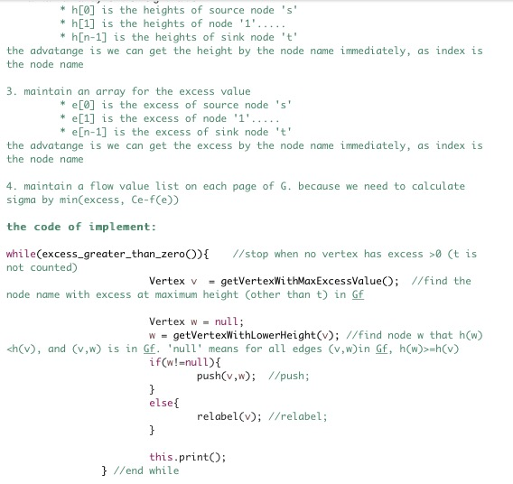

Slide 15
Preflow-Push Implement Demo
Preflow-Push

Slide 16
Future Work
Preflow-Push:
The worst-case running time of this algorithm is O(n³)
Which can be improve to O(mn) by using the structure below:
After the current(v) pointer is advanced from an edge (v, w), we cannot apply push to this edge until v gets relabeled.
When the current(v) pointer reaches the end of the edge list for v, the relabel operation can be applied to node v.
This part will need further research

Slide 17
Q & A
By Yaqun Yu & Fang Chen

Slide 18
The End
By Yaqun Yu & Fang Chen

