Slide 1

FAQ about Islam
(Frequently Asked Questions)
Who is Allah?
Allah means God. It is a personal name, which Allah calls Himself in the Koran.
That is where we get it. It can also be found in an Aramaic copy of the Bible,
and even Christian Arabs say Allah.

Slide 2

Who is Jesus to us?
Jesus peace be upon Him is a true prophet.
Sent by Allah like Moses, Abraham, Lot, Noah, Jonah, Joseph …etc.

Slide 3
Who were Jesus's parents?
Jesus is the son of Virgin Mary, and he had no father.
Allah created Jesus
Can Jesus, or Mohammed peace be upon them be worshipped?
No, Allah does not accept that a cow, a person, an angel,
a prophet, a stone, or anything be worshipped in place of him,
or even along with Him. Worship must be to Allah the creator of them

Slide 4
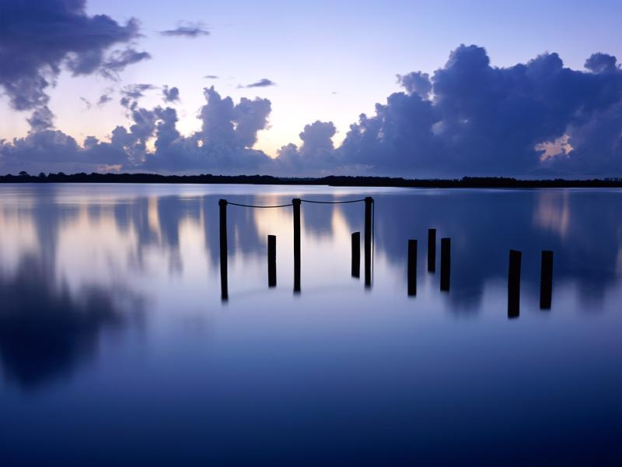
Is Allah the same as what Christians call the father?
Allah is the creator who Jesus worshipped.
He is the Creator who spoke to Moses,
and split the sea for Moses, and his followers.
That is Allah. But Allah tells us:
"Say Allah is one, He is Perfect, He has never begotten
, nor was He begott, and there is no one equal to Him".

Slide 5
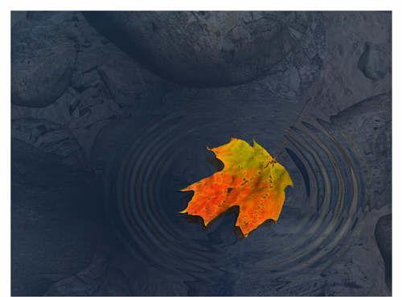
Is there a trinity in Islam?
No. Allah is perfect.
Do we believe that Allah created the heavens and earth in 6 days?
Yes, but He did not rest on the seventh day,
because He did not get tired.
Allah is perfect He does not get tired,
nor does He sleep, eat, go to the bathroom,
feel pain, or die for that matter.

Slide 6
Can we see Allah?
Allah is not like the sun. Anyone can see the Sun.
But Allah is the most beautiful. Nothing is as beautiful as Allah.
Actually looking at Allah is the greatest pleasure of the people in Pradise.
This pleasure Allah does not give anyone but the believers.
So no one will see Allah before he dies.
Does Allah see us?
Allah sees us, and knows everything about us.
He knows us better than we know ourselves.
There is not a leaf on a tree that blows away,
or stays in its place except that He knows it.
There is not a dry spot, nor a wet spot,
nor a grain in the depths of the earth except that Allah knows it.

Slide 7
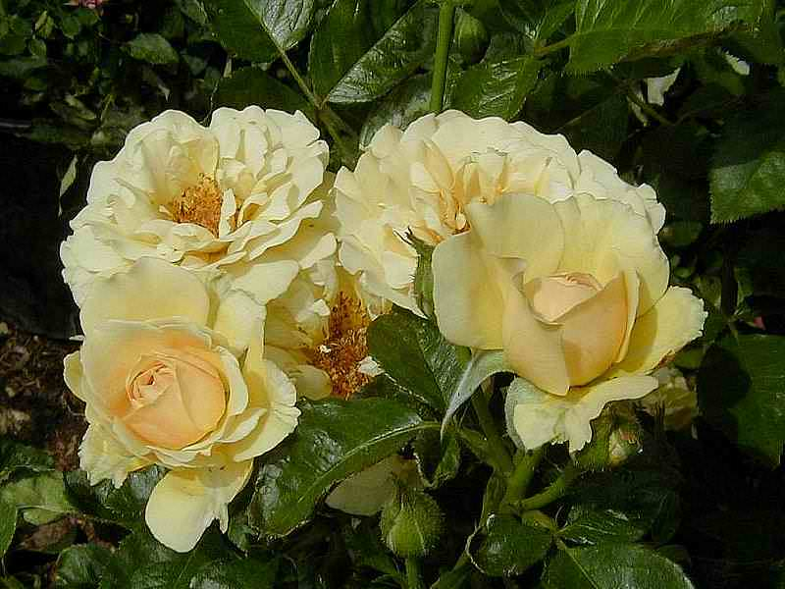
Do we have free will?
Yes, of course. Allah does not punish us for something we did not do on our own.
But at the same time, our will is not inspire of Allah's will.
We cannot do anything if Allah will not allow it.
In other words nothing goes on in Allah's kingdom without His will.

Slide 8
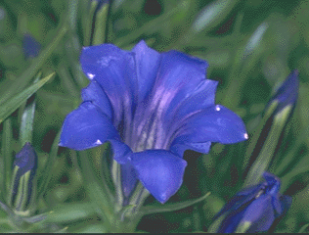
Did Allah create Evil?
Yes, Allah created the good, and the bad.
Whatever bad happens to us is due to our sins.
We sin and Allah pardons much of what we do; however,
when something bad happens to us it is our fault
, and we are to blame.
Bad things that happen to a person are a chance for that person to reflect,
and ask: ”Why is this happening to me?”
A chance for a person to return from his sin, and obey, and worship Allah.

Slide 9
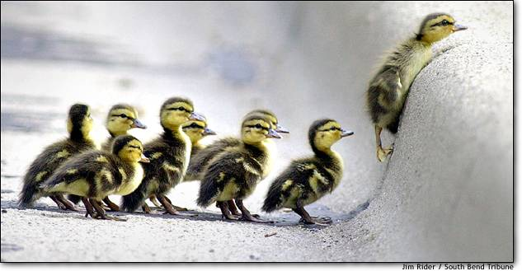
Do bad things happen to the believers (good people)?
Yes, they do. But they appear bad to the believers cause they are
things people don't like. Who likes breaking a leg? However,
when a bad thing happens to a believer this believer is patient.
He praises Allah in all circumstances.
He knows Allah does not decree something unless it is for his own good.

Slide 10
But how can breaking a leg are good for a beleiver?
Because it is a chance for the believer to think about what he did wrong.
Also because Allah forgives much of what we do, tbu
t those things we are not for
given, they are forgiven due to our patience when we are struck by a calamity
. Allah gives us better reward when a problem strikes us on earth if we are patient
. This reward can be on earth, and it can be in Heaven.
Does Allah hear my prayers?
Yes.

Slide 11
Does Allah answer my prayers?
We know that Allah answers all the prayers of the believers.
This can be in 4 ways:
1- Get what we are asking for!
2- Get something as good or better!
3- We get spared something bad that would have happened otherwise.
4- We get rewarded on the day of Judgment with a much greater
reward than what we were asking for on earth.

Slide 12

When does Allah not answer our prayers?
* When it is bad for us!
* When we ask, but not from our heart!
* When we say: I asked and asked and He did not answer.
When we eat, drink, and wear unlawful, food, and clothes, and property that
wa earned either through interest from the bank, or that was stolen,
or if the food was pork, or the like.

Slide 13
What can I ask of Allah?
Any thing but don't ask Him to do things like make you a prophet.
Cause He has already said that there will be no more prophets.
You can ask Allah for guidance.
Meaning you can ask Him to show you the correct religion.
Who are my best friends?
Your best friends are the ones that care where you go after you are dead.
This is like the prophets. They cared that we go to heaven,
even if it meant some hardship on earth.

Slide 14
Who is my worst enemy?
That would be the devils, whether they are human devils (evil people),
or Jinn devils (like Iblis) The Arabic word for a devil is Shaytan (similar to Satan).
Satan wants us all to go to hell. He wants us to be bad on earth,
even if we get rich, or do lots of wrong things that we appear to enjoy,
he does not mind that. But he wants to make sure we don't go to heaven.
What is it that keeps us from entering Heaven?
Worship of anyone other than Allah is the greatest sin. It is called shirk,
and this is not forgiven except through repentance.
Where is Allah?
Allah is the highest. He is high above ALL of His creation.
He is ascended upon a Throne, which is greater than the heavens, and the Earth.
Much much much greater than the heavens and the earth.
So much greater that the heavens
and the earth could fit in the footstool of the throne,
and they would be like a ring thrown into an open desert.
Allah is certainly the greatest.

Slide 15
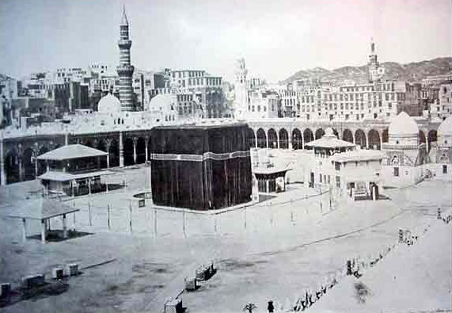
Does Allah look like us?
No Allah is perfect. He is not like any of His creation.
He has told us that He has Hands, Eyes, a Face, and Foot.
But all of these attributes are befitting to His might and Glory.
A Muslim does not say a sin
gle thing about Allah other than what Allah says about Himself
. We don't say He is like a clover, He got tired, He is Jealous!
Allah is Perfect, and Unique.

Slide 16
What does it mean to believe in Allah?
It means to believe in Allah in total perfection, and uniqueness.
It means to believe in His prophets cause they are His, and He sent them.
We cannot pick and choose. A Muslim must believe in all the prophets of Allah.
It means to believe in the Angles! We must love them all,
for example, to hate Michael who is charged with rain,
and the vegetation of the Earth, or Gabriel who is charged with revelation
(brings down the scriptures to the prophets).
It means to believe in Allah's predestination of good, and bad
(relative to us, but to Allah everything Allah does is good).
It means to believe in the last day: The day of Judgment.

Slide 17
When is the Day of Judgment?
Only Allah knows.
Are there signs for the day of Judgment?
Plenty, plenty, plenty. Many have already occurred.
To name a few,
Objects will begin to talk
There will be much killing. The killer won't know why he killed,
and the guy that was killed won't know why he was killed.
The Antichrist will come.
Prophet Jesus son of Mary will return.
Gog and Magog will be set free.
The sun will rise from the west (after this one there can be no more repentance)

Slide 18
What about non-Muslims do they go to heaven?
Allah only accepts Islam. He says in the Koran:
"Whoever seeks a religion other than Islam it won't be accepted of him,
and he will be one of the loosers in the hereafter".
I would rather loose anywhere, but not loose in the hereafter.
This is because Hellfire is eternal. It never ends,
and we never die when we go there, if we go there
What about someone who never heard of Islam?
Allah is the most just. Don't even think that we can be nicer than Allah.
Allah is the Most Just, and He said in the Koran
"We were not to punish till having sent a warner".
The "We" here is the majestic we used in Arabic.
So if a person never heard about Islam,
and was never warned clearly Allah would have a special test for that person
that He knows is equal to the chance that person would have had on earth.

Slide 19
How do we know Islam is the truth?
It is the only religion that:
1- Hold Allah as One, Unique, and Perfect.
2- A lonly worship of Allah, not Jesus, not an idol, and not an angel only Allah.
3- The Koran does not contain contradictions.
4- The Koran contains scientific facts, which are 1300 years ahead of their time.
The Koran while revealed 1400 years ago contains scientific facts,
which are only now being discovered.
It is not in contradiction to science.
5- Allah challenges the world to produce the like of the Koran.
And He says they won't be able to.
6- Prophet Mohammed was the most influential man in History.
Even a non-Muslim wrote a book called the 100 most influential men in History,
and Prophet Mohammed was #1. Prophet Jesus was #3.
Note even Prophet Jesus was a prophet sent by Allah.
Would Allah allow a false prophet to be so successful? No.
Even the Bible says this in Deuteronomy 18:19.
A false prophet would die!!!
Yet Prophet Mohammed did not die till he completely conveyed,
and taught Allah's religion.
He had many prophecies,
and all of his prophecies have come true, or are still coming true

Slide 20
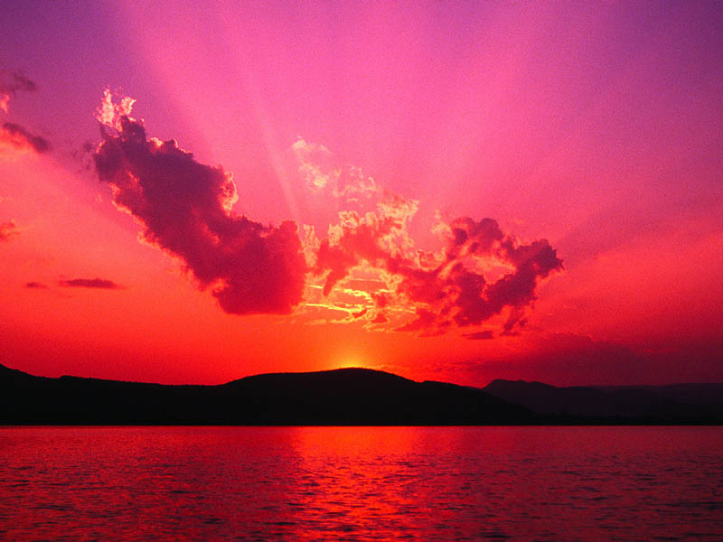
Most importantly is this:
Allah created us, and we know that we should only worship Him.
This is an instinct Allah has created us with.
He did not just leave us, rather He sent prophets for us.
These prophets had miracles as proof.
The miracle for us today is the Koran.
There is no other religion that worships only Allah,
and believes in Him as totally perfect,
and believes in all of His prophets
, and scriptures.

Slide 21
Can anyone become a Muslim?
Yes anyone can. There are two declarations, which are necessary:
1- To bear witness that no one deserves to be worship except Allah
2- To bear witness that Prophet Mohammed is the Messenger of Allah.
This makes a person Muslim. But it should be said in Arabic.
Next a person takes a shower, and He/She is a Muslim.
Then What?
After a person becomes Muslim he/she is taught about Prayers
, Fasting, the Poor due, Pilgrimage. These are pillars of Islam.
Then What?
Muslims are brothers. A Muslim should love
for his brother what he loves for himself.
Allah's wealth does not run out, and Allah can provide for us all.
We pray for each other, and love each other,
and love for our brothers and sisters what we love for ourselves.

Slide 22

for more FAQ click here :
www.islamfaq.com/islamfaq/faq_part01.html
www.islamfaq.com/islamfaq/faq_part10.html
www.islam-usa.com/25ques.html
www.sultan.org

