Slide 1
Junguk Hur juhur@umich.edu
JUMiner v2.2
Demonstration

Slide 2
Pre-requisites
A passcode for your email
Queries that you would use in PubMed
  Check how large your corpus is before running JUMiner.
  Better have specific queries
  Check ‘Details’ in the PubMed searches to make sure it’s getting what you want.

Slide 3
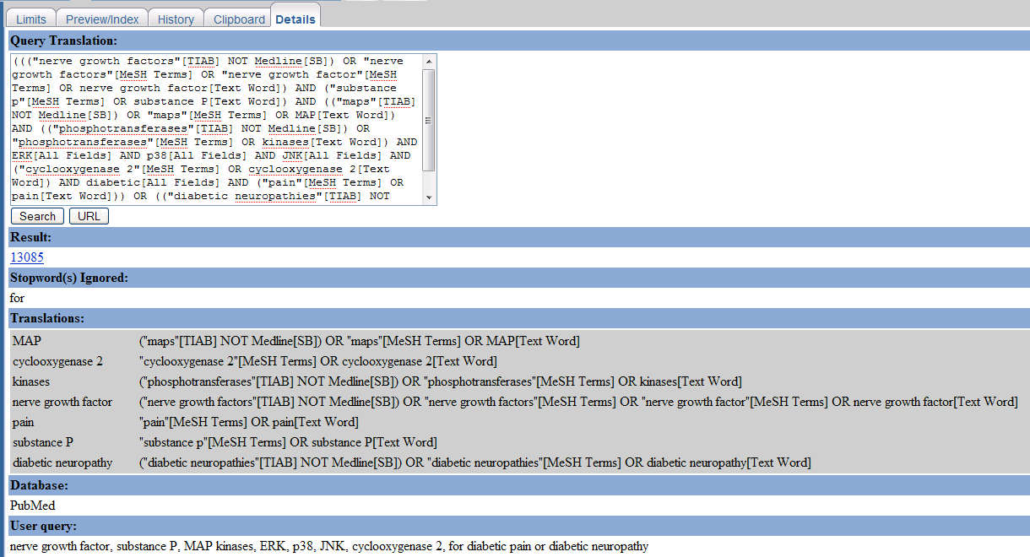
Example query
nerve growth factor, substance P, MAP kinases, ERK, p38, JNK, cyclooxygenase 2, for diabetic pain or diabetic neuropathy

Slide 4
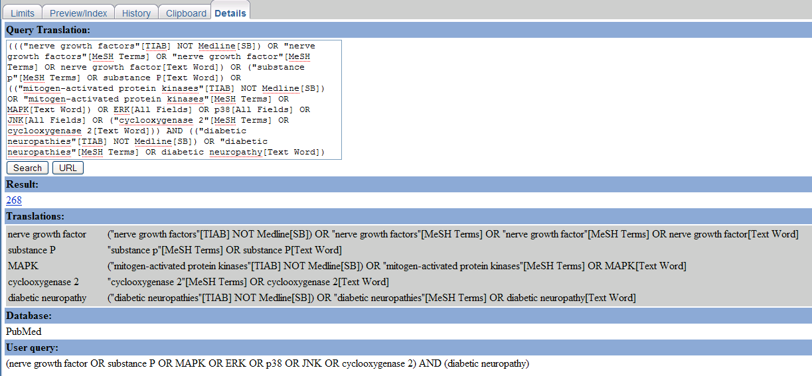
Example - improved
(nerve growth factor OR substance P OR MAPK OR ERK OR p38 OR JNK OR cyclooxygenase 2) AND (diabetic neuropathy)

Slide 5
Example – improved
“MAP kinase”
Or search MeSH database for proper term interpretation.
  MAPK[MeSH]
  “Mitogen-Activated Protein Kinases”[MeSH]

Slide 6
How to use JUMiner
Mining step
  Check and start your query
  Queued and processed.
  Go through the results and you may have to create your own filters.
    Ignore: gene names to be ignored
    Exclude: gene symbols to be excluded
    Include: gene symbols to be included
  User’s own filters have higher priority over the default filters.
  Re-run your query again with filters specified.
Post-mining analysis steps
  Check your query numbers
  Select appropriate modules and thresholds.
  Run and wait for the results

Slide 7


Formats of filters
Ignore
  One name per line
Exclude (tab-delimited)
  Symbol_to_exclude <tab> cond1 <tab> cond2
Include (tab-delimited)
  Symbol_to_include <tab> cond1 <tab> cond2

Slide 8
My expectations from you
Try to use it and let me know
  False-negatives
    Missing genes filtered by default settings
    article (full text is available but not used by JUMiner)
  False-positive (wrong identification)
  your own filters
    Ignore
    Exclude
    Include
  Any suggestions would be welcomed.

Slide 9
Result Example
-- Junguk Hur
* "Reactive Oxygen Species"[MeSH] AND Diabetes
http://192.168.159.130:8888/JUMiner/FinalResults/Query_69__juhur/result.html
-- Eva
* bax and mitochondrial fusion or bax and mitochondrial fission
http://192.168.159.130:8888/JUMiner/FinalResults/Query_70__juhur/result.html
* mitochondrial fusion and diabetes
http://192.168.159.130:8888/JUMiner/FinalResults/Query_71__juhur/result.html
* neuropathy and bax
http://192.168.159.130:8888/JUMiner/FinalResults/Query_72__juhur/result.html
-- Thomas
* (nerve growth factor OR substance P OR MAPK OR ERK OR p38 OR JNK OR cyclooxygenase 2) AND (diabetic neuropathy)
http://192.168.159.130:8888/JUMiner/FinalResults/Query_73__juhur/result.html
-- Tim
* "Amyotrophic Lateral Sclerosis"[MeSH Heading] AND VEGF
http://192.168.159.130:8888/JUMiner/FinalResults/Query_74__juhur/result.html
-- Simon
* "Amyotrophic Lateral Sclerosis" and "growth factor"
http://192.168.159.130:8888/JUMiner/FinalResults/Query_75__juhur/result.html
* "Amyotrophic Lateral Sclerosis" and IGF
http://192.168.159.130:8888/JUMiner/FinalResults/Query_76__juhur/result.html

Slide 10
(Section_2) Some examples of available JUMiner results.
Click the link for further detail. There are mostly based on query terms not using [MeSH]. Try with / wihtout [MeSH] and/or “your query terms” like
"Amyotrophic Lateral Sclerosis" and "growth factor"
Query Number | Query Name | Date | # of PMIDs | # of genes | Result
1 | GO_HUR | 2007-12-06 | 3 | 31 | Link
2 | ProstateCancerEpigenetics | 2007-12-06 | 272 | 903 | Link
3 | ProstateCancerEpigeneticsNotReview | 2007-12-06 | 230 | 857 | Link
4 | ALS_GrowthFactor | 2007-12-06 | 297 | 377 | Link
5 | ALS_IGF | 2007-12-06 | 55 | 79 | Link
6 | ALS_MeSH_VEGF | 2007-12-06 | 57 | 132 | Link
7 | DiabeticPainAll | 2007-12-06 | 262 | 254 | Link
8 | BaxMtFusionMtFission | 2007-12-06 | 120 | 356 | Link
9 | MtFusionDiabetes | 2007-12-06 | 26 | 153 | Link
10 | NeuropathyBax | 2007-12-06 | 22 | 78 | Link
11 | NGF_Pain_Diabetes | 2007-12-06 | 29 | 109 | Link
12 | NGF_Pain | 2007-12-06 | 670 | 593 | Link
13 | NGF_Cyclooxygenase2 | 2007-12-06 | 50 | 247 | Link
14 | ROSDiabetes | 2007-12-06 | 1326 | 919 | Link
15 | Pain_Diabetes | 2007-12-06 | 6463 | 831 | Link

Slide 11
DEMO
Online version
http://jdrf.neurology.med.umich.edu/JUMiner/

