Slide 1
A Comprehensive Analysis of Reaction Kinetics in Intracellular Environments with Macromolecular Crowding:
Modified Fractal-like and Phenomenological Equation
Junguk Hur
juhur@indiana.edu
December 7, 2004

Slide 2
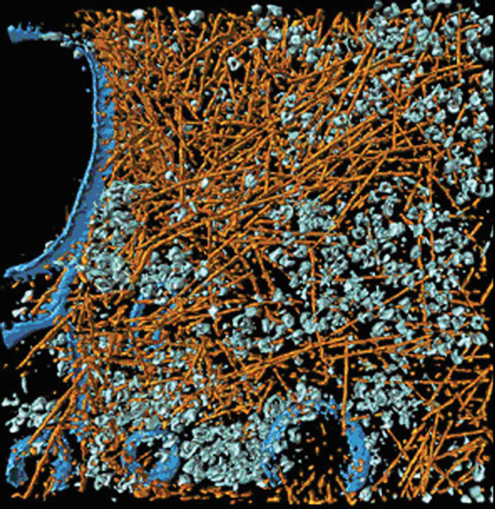
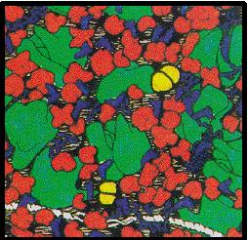
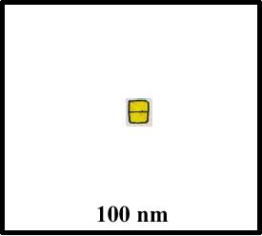
INTRODUCTION – Macromolecular Crowding
Cytoplasm of a Dictyostelium discoideum cell – Cryoelectron tomography
Medalia et al. (2002), Science 298, 1209–1213
In vivo
In vitro
Density 50-400 mg/ml
Density 1-10 mg/ml

Slide 3
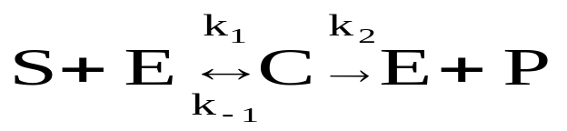



Kinetics Equations
Michalis-Menten Reaction : Reversible reaction
Modified Fractal-like Kinetics : Zipf-Mandelbrot distribution
Phenomenological Equation

Slide 4
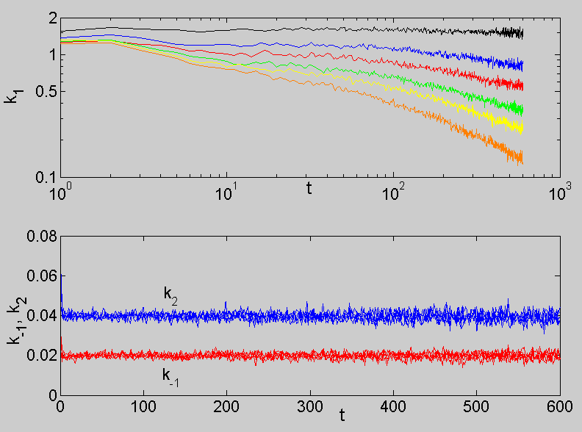
Modified Fractal-like Kinetics
Effects of θ/θ_{c} on τ, h, and k₁⁰
θ = 0.40
θ = 0.35
θ = 0.30
Increasing h
θ = 0.20
2D
θ = 0.00
3D
θ = 0.00

Slide 5
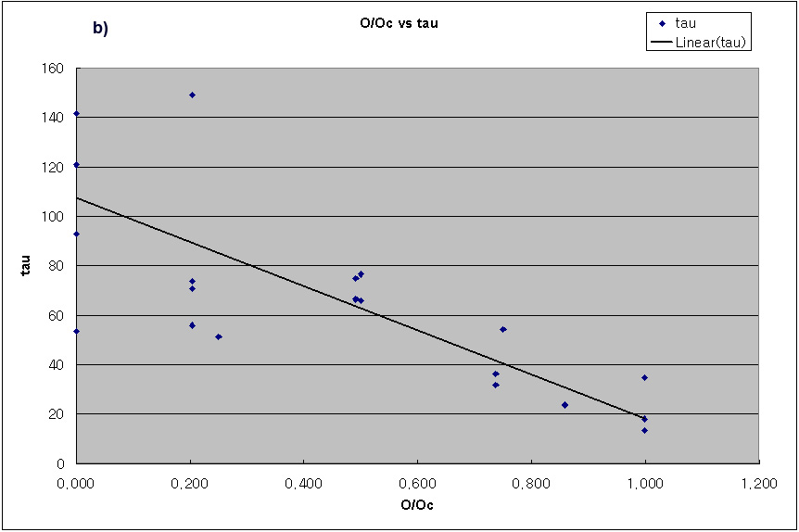
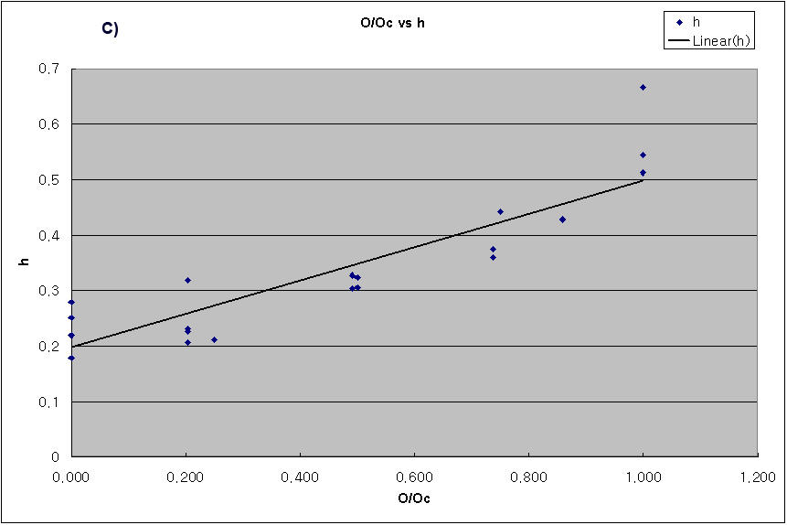
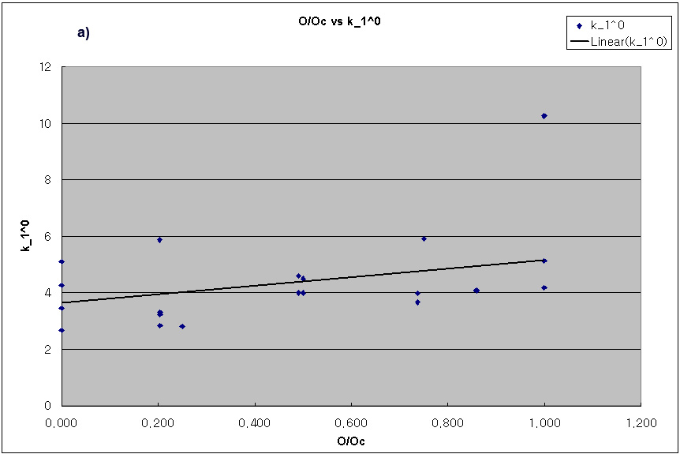
Modified Fractal-like Kinetics
Effects of θ/θ_{c} on τ, h, and k₁⁰

Slide 6
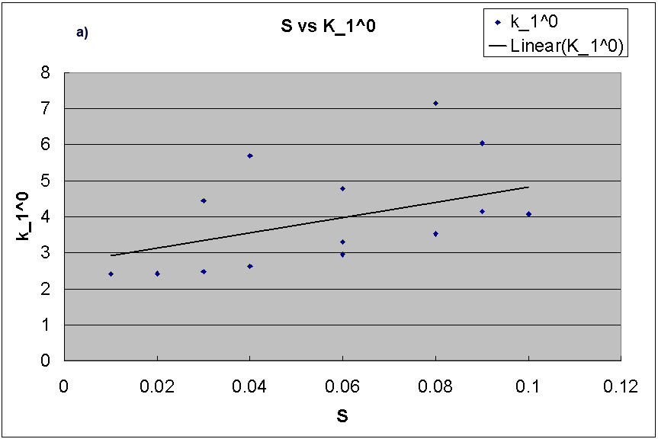
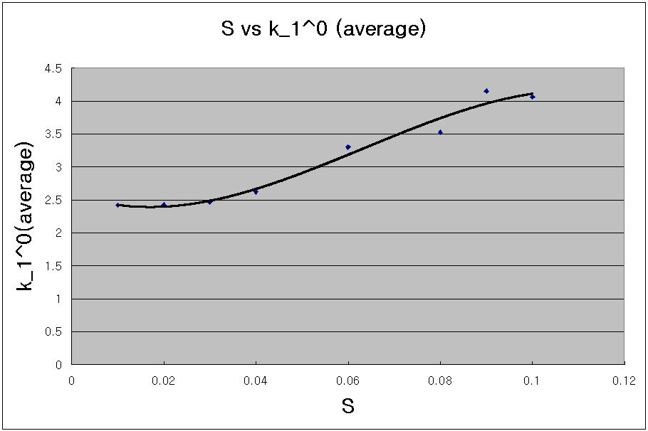
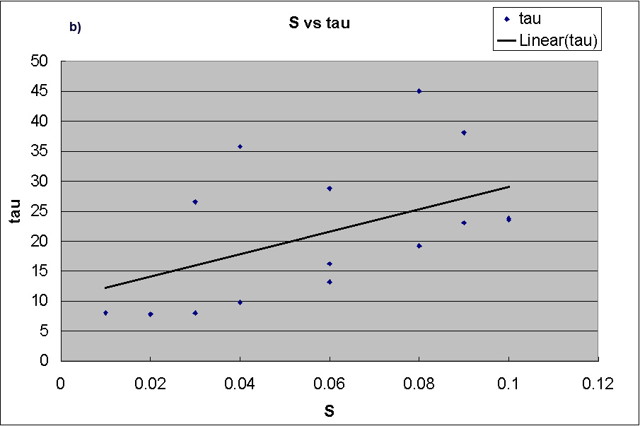
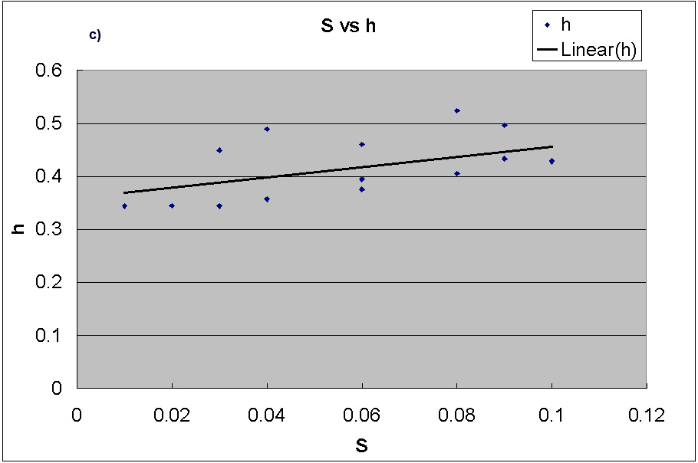
Modified Fractal-like Kinetics
Effects of substrate concentration [S] on τ, h, and k₁⁰
Satulated

Slide 7
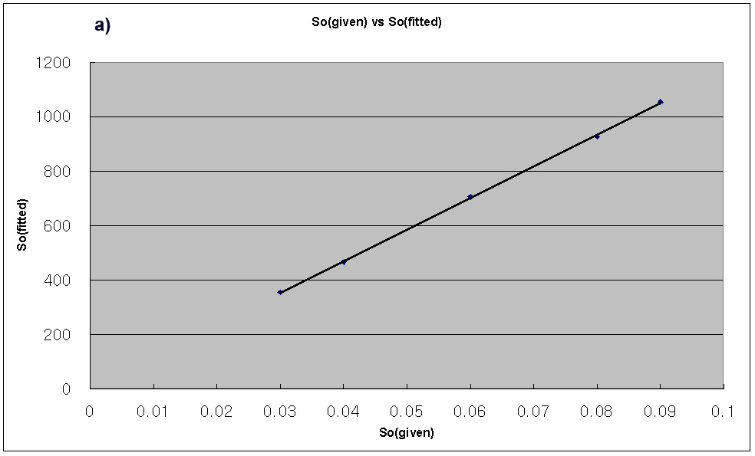
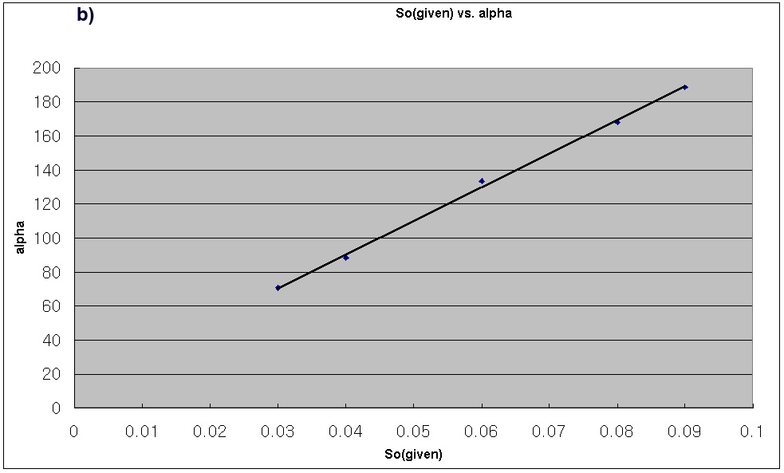
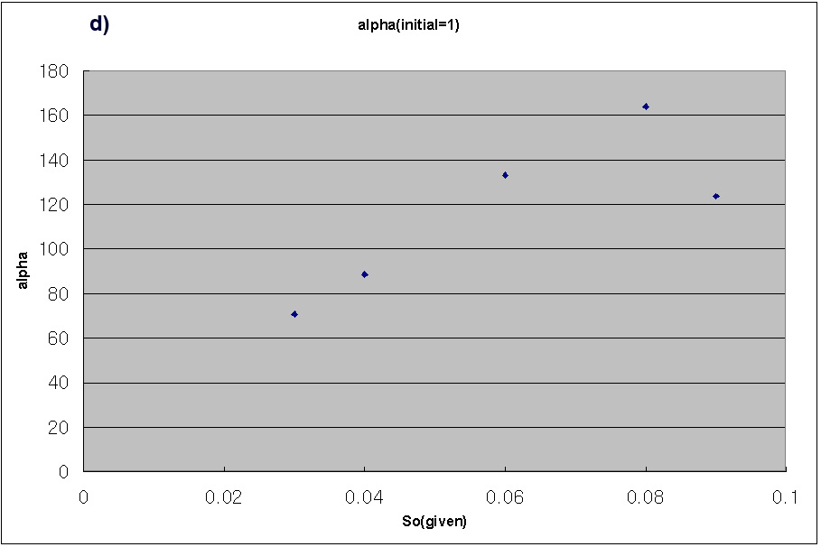
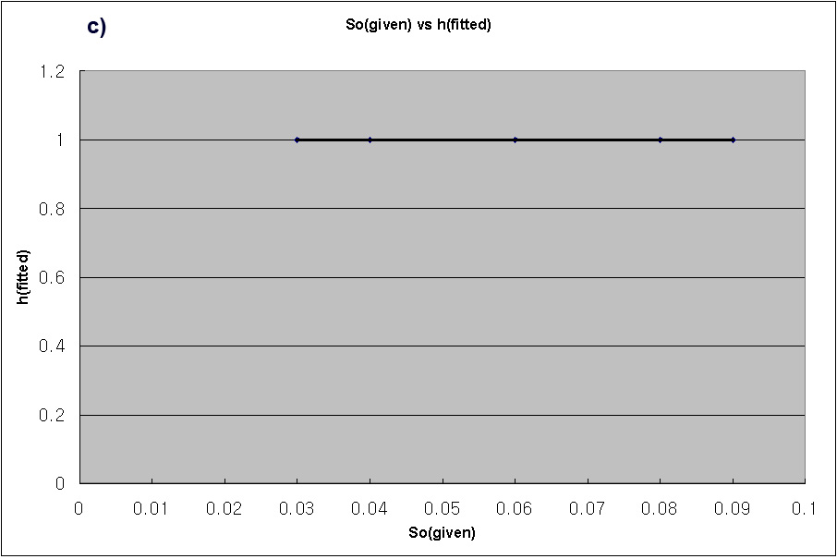
Phenomenological (Empirical) Equations
Initial Values
* Given : [α, S₀ , h] = [ 1, 1000, 0.5]
=> Only 7 out of 20 data set gave real number results
* Modified : [α, S0 , h] = [ 10, 1000, 0.5]
=> All 20 data set gave real number results
Effects of Sο on τ, h, and k₁⁰

Slide 8
Conclusion
Modified Fractal-like Kinetics works better.
  t (critical delay time point)
  h (fractal parameter – degree of heterogeniosity
New Empirical Equation needs more work.
  Heavy dependency on initial values
  Few data set

