Slide 1

Junguk Hur
Computational Omics Lab
School of Informatics
Differential location analysis
A novel approach to detecting cellular responses to environmental changes
Indiana University
Bloomington, IN

Slide 2
OVERVIEW
Overview
Background & Motivation
Location Analysis
Differential Location Analysis
Comparison of ChIP-Chip with Microarray Expression Data
Results
Summary

Slide 3
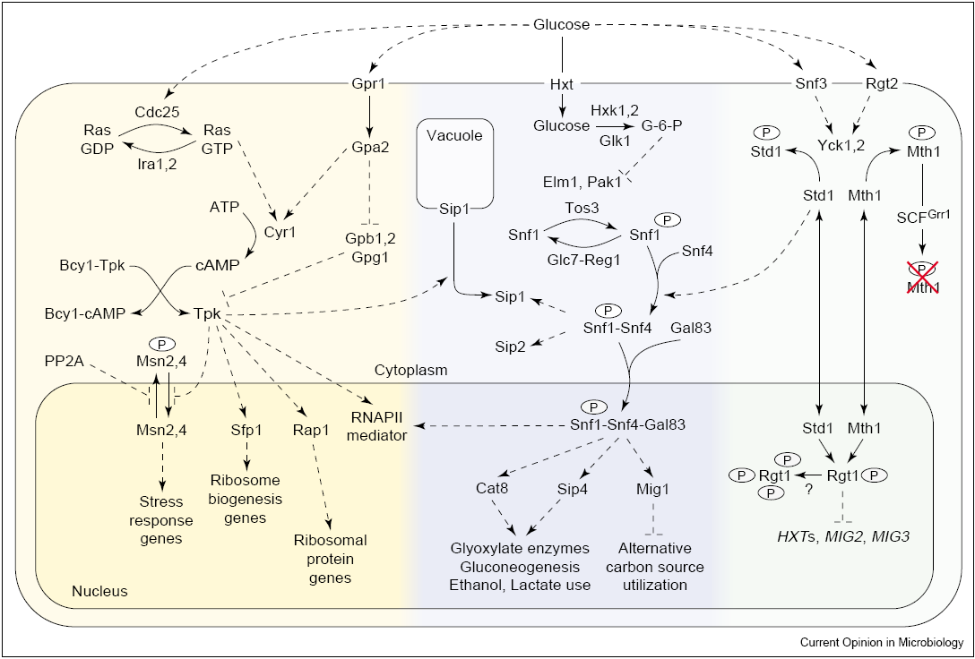
Introduction
Background & Motivation <
Signal Pathways Responding to Environment Change
Broach et al. Curr Opin Microbiol 2004

Slide 4
Introduction
Background & Motivation <
Gene Expression Changes to Environmental Changes
A component of cellular response to the environmental change
Exploring the metabolic and genetic control of gene expression on a genomic scale, DeRisi JL, et al. (1997) Science
Genomic expression programs in the response of yeast cells to environmental changes, Gasch AP, et al. (2000) Mol Biol Cell
Global and specific translational regulation in the genomic response of Saccharomyces cerevisiae to a rapid transfer from a fermentable to a nonfermentable carbon source, Kuhn KM, et al. (2001) Mol Cell Biol
Role of thioredoxin reductase in the Yap1p-dependent response to oxidative stress in Saccharomyces cerevisiae, Carmel-Harel O, et al. (2001) Mol Microbiol
Transcriptional Remodeling in Response to Iron Deprivation in Saccharomyces cerevisiae, Shakoury-Elizeh M, et al. (2004). Mol Biol Cell
Disruption of Yeast Forkhead-associated Cell Cycle Transcription by Oxidative Stress, Shapira M, et al. (2004) Mol Biol Cell
Transcriptional response of steady-state yeast cultures to transient perturbations in carbon source, Ronen M and Botstein D (2005) Proc Natl Acad Sci
And many more

Slide 5
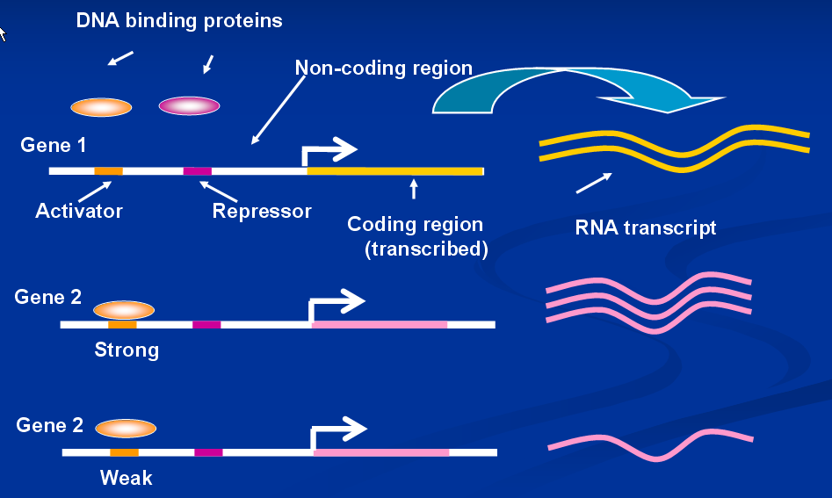
Introduction
Background & Motivation <
Transcriptional Regulation

Slide 6
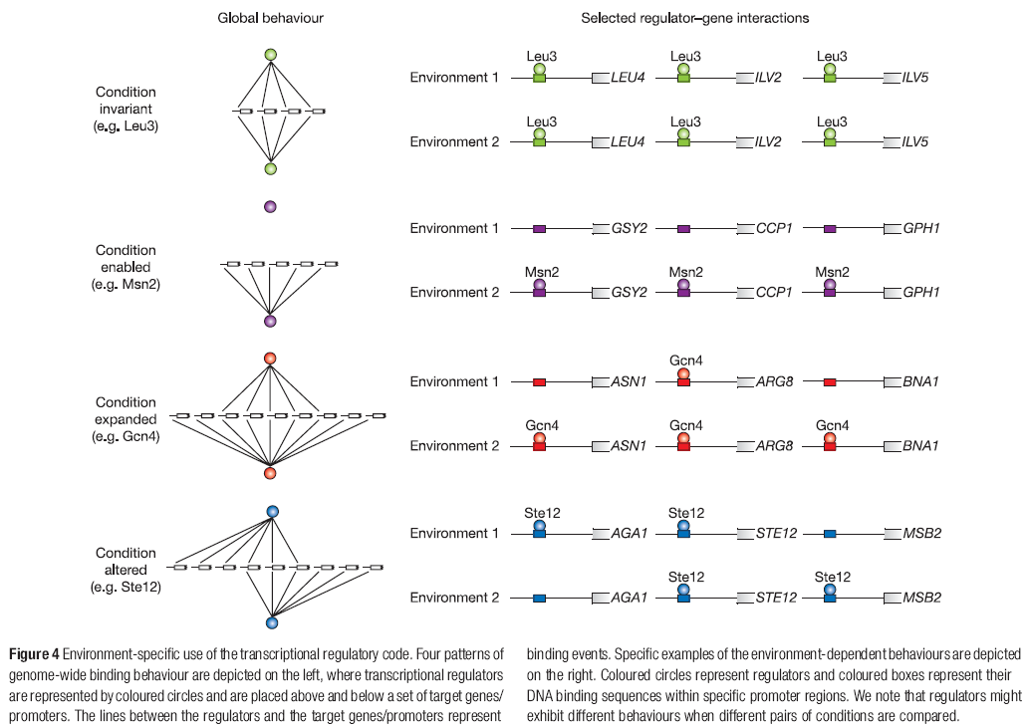
Introduction
Background & Motivation <
Changes of Gene Regulations
Environment specific use of regulatory code
(Harbison et al. Nature 2004)

Slide 7
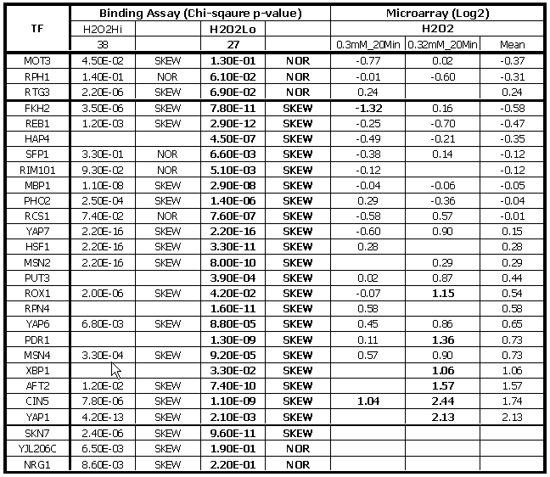
Introduction
Background & Motivation <
Changes of Gene Regulations
These changes are not captured by gene expression
analysis

Slide 8
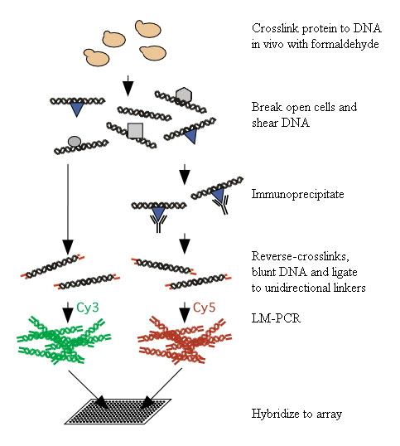
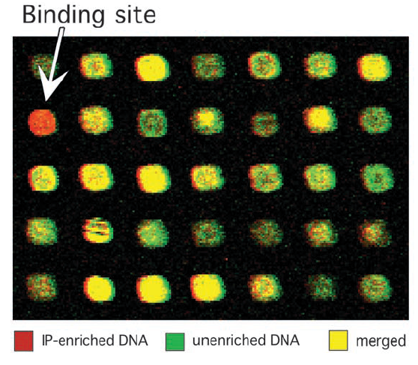
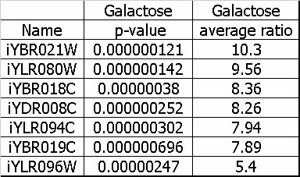
Introduction
Background & Motivation
Location Analysis <
Location Analysis : ChIP-on-Chip Exp.
In vivo assay based on
  ChIP (Chromatin Immuno-Precipitation)
  Microarray
Genome-wide location analysis
Ren et al. Science 2000

Slide 9
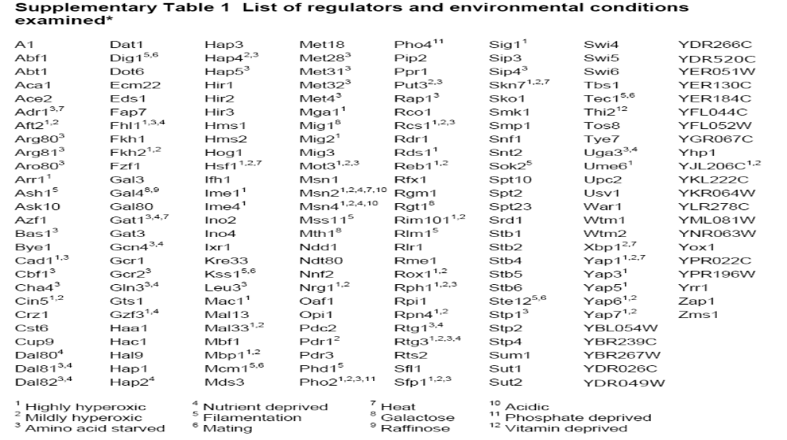
Introduction
Background & Motivation
Location Analysis <
Differential Location Analysis Under Env. Change
Harbison et al. Nature 2004
Saccharomyces cerevisiae (budding yeast)
204 TFs in 14 conditions (352 experiments)
Genome-wide location data (11,000 interactions)

Slide 10
Introduction
Background & Motivation
Location Analysis <
Changes of Gene Regulations
Environment specific use of regulatory code
(Harbison et al. Nature 2004)
Qualitative analysis not quantitative
No detailed analysis for particular environmental changes

Slide 11
Introduction
Background & Motivation
Location Analysis
Differential Location Analysis <
Our Approach : Quantitative
For better understanding of differential binding of TF and DNA under different conditions by using ChIP-on-Chip and gene expression data.
Potential causes for this differential binding to be
  Changes in the TF expression
  Changes in other TFs expression
  Modifications in TFs (protein level)
  Changes in physical structures (epigenetic
  features)
  Other unknown reasons

Slide 12
Introduction
Background & Motivation
Location Analysis
Differential Location Analysis <
Examples of Differential Binding
Condition 1
Condition 2
Condition 1
Condition 3
Condition 1
Condition 4

Slide 13
Introduction
Background & Motivation
Location Analysis
Differential Location Analysis <
ChIP-on-Chip Data
Data Files (Harbison et al. Nature 2004)
  p-value & ratio
  204 TFs in 14 different conditions
Data Preprocessing
  ‘NaN’ point removal
  Ratio below 1 ==> 1
Distribution of points
  Normal distribution

Slide 14
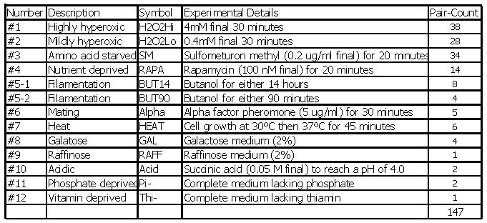
Introduction
Background & Motivation
Location Analysis
Differential Location Analysis <
ChIP-on-Chip Data
Condition 1 : Rich medium
Condition 2 : All other stress conditions
Number of pairwise comparisons

Slide 15
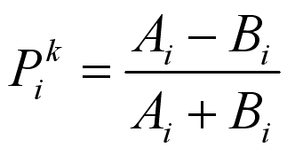
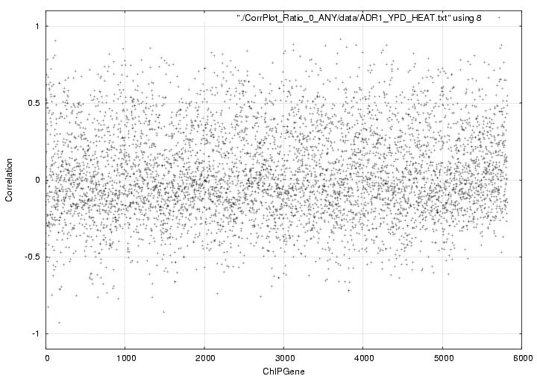
Introduction
Background & Motivation
Location Analysis
Differential Location Analysis <
Differential Binding
Simple correlation
A_{i}, B_{i}: binding ratio of TF k to regulated region i
under condition 1 and 2 respectively
Without p-value threshold applied

Slide 16
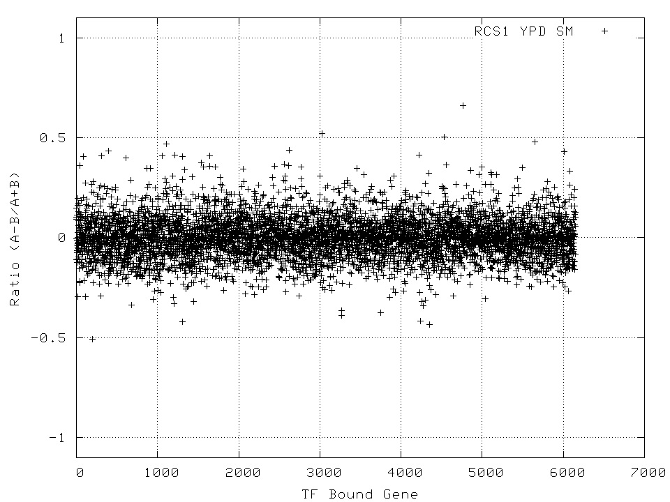
Introduction
Background & Motivation
Location Analysis
Differential Location Analysis <
Differential Binding
Simple correlation
A_{i}, B_{i}: binding ratio of TF k to regulated region i
under condition 1 and 2 respectively
Without p-value threshold applied

Slide 17
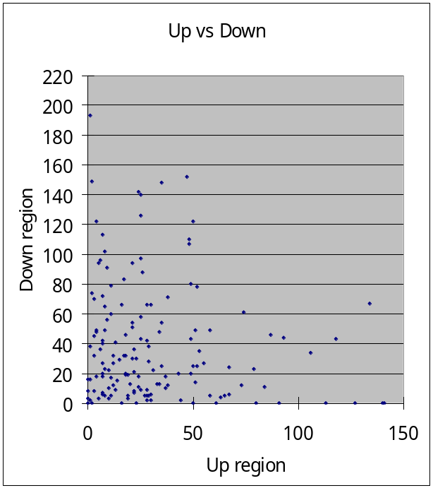
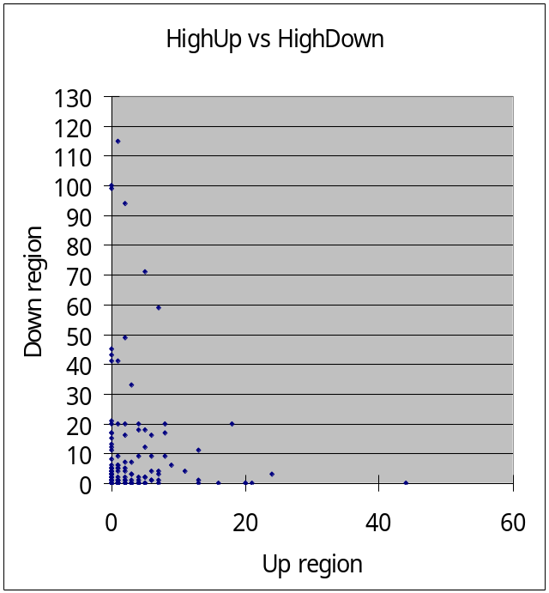
Introduction
Background & Motivation
Location Analysis
Differential Location Analysis <
Differential Binding – Up vs Down
Distribution of P^{k}_{i} with p_{i} < 0.001

Slide 18
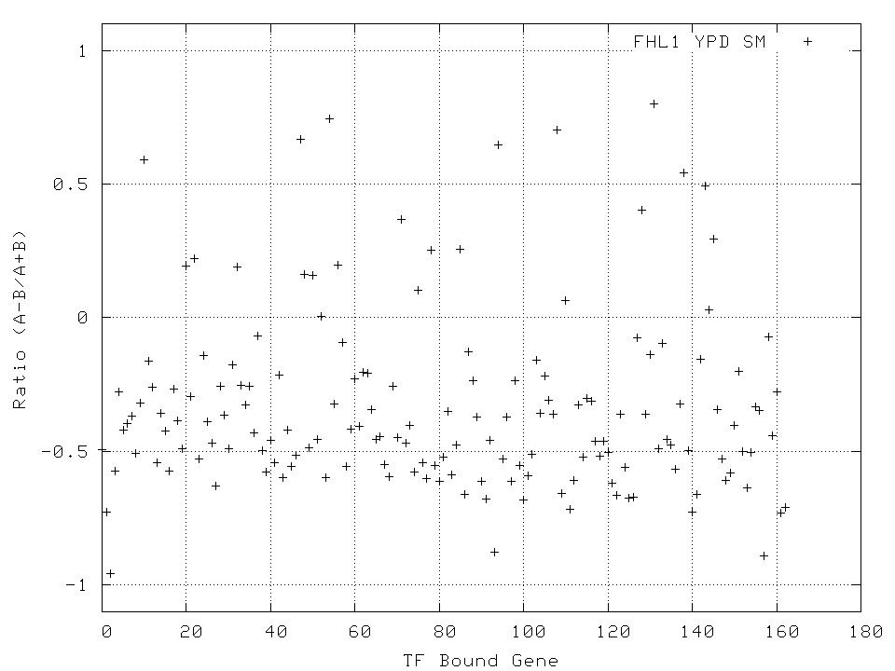
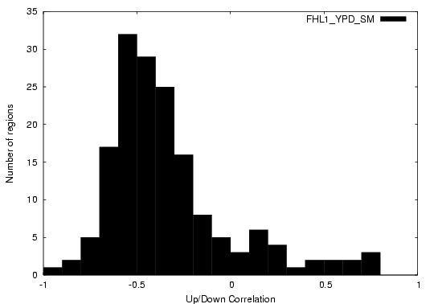
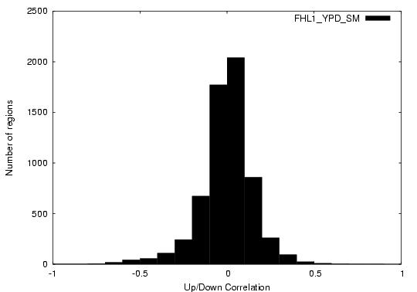
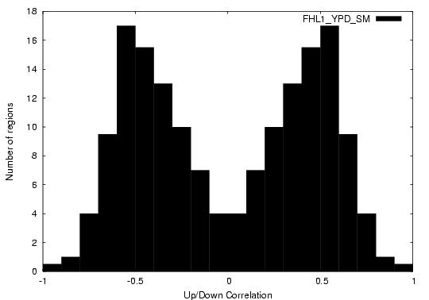
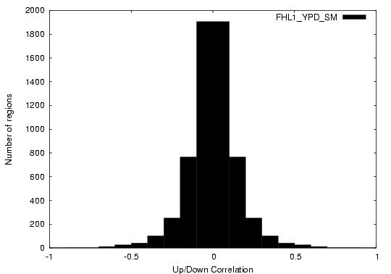
Introduction
Background & Motivation
Location Analysis
Differential Location Analysis <
Example FHL1 (SM)
P<0.001
Without p-value threshold
Original value dist.
Original value dist.
Absolute value dist.
Absolute value dist.

Slide 19
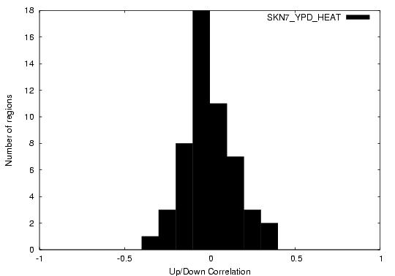
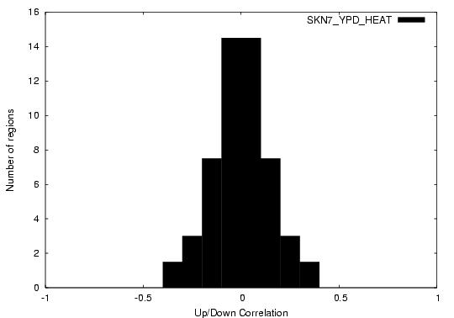
Introduction
Background & Motivation
Location Analysis
Differential Location Analysis <
Normal Distribution or Skewed
Chi-square test
  R-function and simple script
  Original vs Normal random data set
Skewed (p=0.00003)
Normal (p=0.97)
Original value dist.
Original value dist.
Absolute value dist.
Absolute value dist.

Slide 20
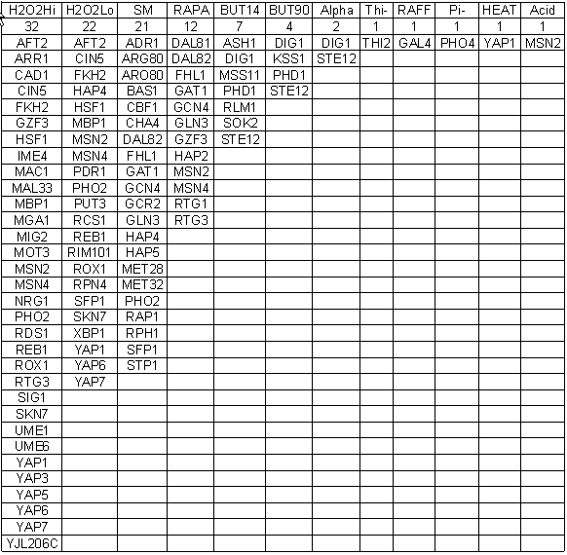
Introduction
Background & Motivation
Location Analysis
Differential Location Analysis <
Skewed TFs for Diff. Conditions
Chi-square test : p < 0.05
105 TF-Cond pairs (out of 147)

Slide 21
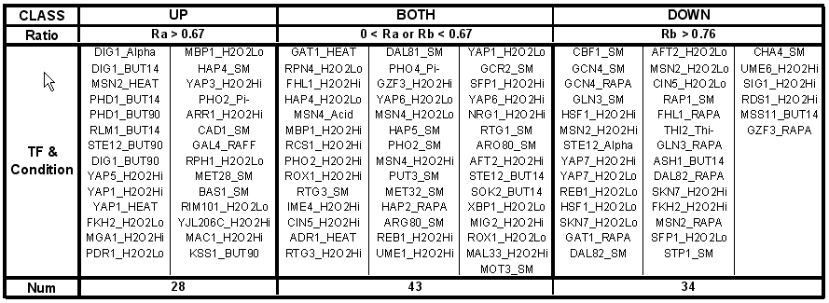
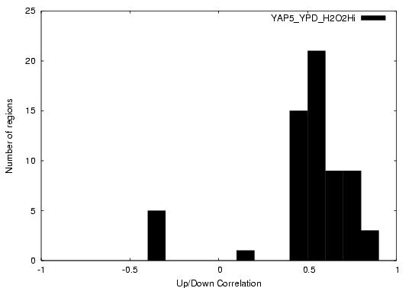
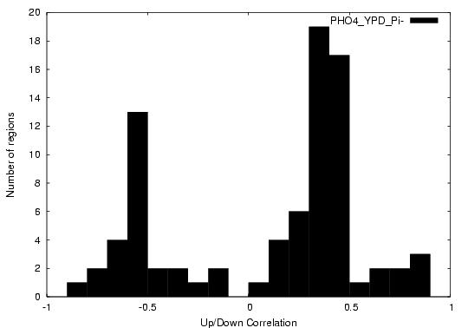
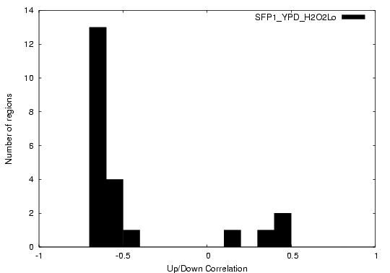
Introduction
Background & Motivation
Location Analysis
Differential Location Analysis <
Classification of TFs
Ratio = (Max(A,B) – Min (A,B)) / Max(A,B)
UP : YAP5_H₂O₂Hi
BOTH : HPO4_Pi
DOWN : SFP1_H₂O₂Lo

Slide 22
Introduction
Background & Motivation
Location Analysis
Differential Location Analysis
Comparison with Microarray <
Microarray Data
Found corresponding Microarray
Gene expression data from SGD
(http://genome-www5.stanford.edu/)
  Out of 13 conditions under study,
  2 were found to have gene expression data
    Hyperoxide & Heatshock

Slide 23
Introduction
Background & Motivation
Location Analysis
Differential Location Analysis
Comparison with Microarray <
Findings from Data Comparison (H₂O₂-Lo)
27 TFs (ChIP-Chip)
  ~ 67% of them did not show
  significant expressional change
ChIP-Chip (27 TFs)
Microarray |  | Tested | Not Tested
 |  | 24 | 3
Skewed |  | 21 | 1
Fold change | >= 2 | 7 | .
 | 0 ~ 2 | 14 | .
Normal |  | 3 | 2
Fold change | >= 2 | 0 | .
 | 0 ~ 2 | 3 | .

Slide 24
Introduction
Background & Motivation
Location Analysis
Differential Location Analysis
Comparison with Microarray <
Primary & Secondary Responses
Primary
Secondary
Broach et al., 2004, Curr Opin Microbiol

Slide 25
Introduction
Background & Motivation
Location Analysis
Differential Location Analysis
Comparison with Microarray
Summary <
SUMMARY
Microarray can not fully detect regulatory responding to environmental changes
Previous ChIP-Chip analyses focused on qualitative measures.
Integration of Location analysis data with gene expression data can reveal the differential changes of bindings of transcription factor.

Slide 26
Introduction
Background & Motivation
Location Analysis
Differential Location Analysis
Comparison with Microarray
Summary <
Future Works
Finding genes that are regulated by the responsive TFs
Investigating the biological mechanism of the differentially binding of TFs
  Changes of expression level (Microarray)
  Post-translational modification
  Protein-protein interaction
Comprehensive differential analysis
Diff. Expression
Integration
Diff. Location
Diff. Proteomics (open)
Diff. Protein-Protein Int. (open)

Slide 27
Introduction
Background & Motivation
Location Analysis
Differential Location Analysis
Comparison with Microarray
Summary <
References
1. Gasch, A.P., et al., Genomic expression programs in the response of yeast cells to environmental changes. Mol Biol Cell, 2000. 11(12): p. 4241-57.
2. Harbison, C.T., et al., Transcriptional regulatory code of a eukaryotic genome. Nature, 2004. 431(7004): p. 99-104.
3. Lee, T.I., et al., Transcriptional regulatory networks in Saccharomyces cerevisiae. Science, 2002. 298(5594): p. 799-804.
Ren, B., et al., Genome-wide location and function of DNA binding proteins. Science, 2000. 290(5500): p. 2306-9.
Schneper, L., K. Duvel, and J.R. Broach, Sense and sensibility: nutritional responses and signal integration in yeast. Curr Opin Microbiol, 2004. 7(6): p. 624-30

Slide 28
Acknowledgements
Dr. Haixu Tang
School of Informatics
Center for Genomics and Bioinformatics

