Slide 1
ChIP-on-Chip and
Differential Location Analysis
Junguk Hur
School of Informatics
October 4, 2005

Slide 2
Overview
Introduction to Transcriptional Regulation
ChIP-on-Chip (ChIP-Chip)
Current Approaches
Our Approach

Slide 3
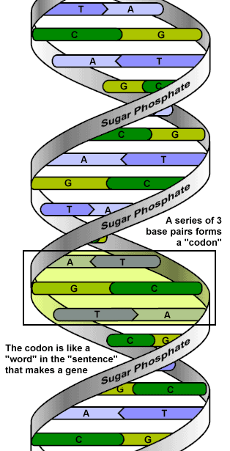
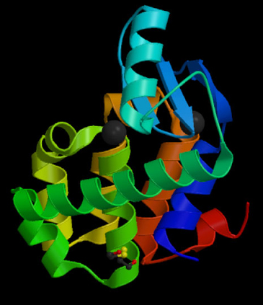
The Central Dogma
Transcription
Translation
Protein
DNA
RNA

Slide 4
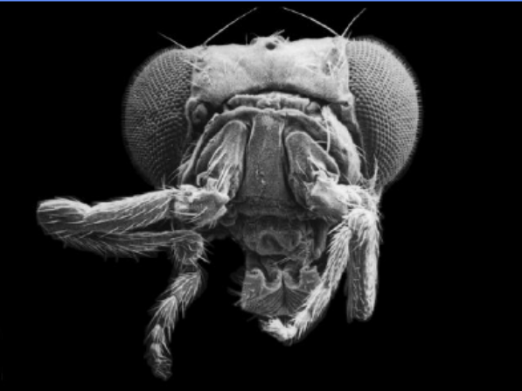
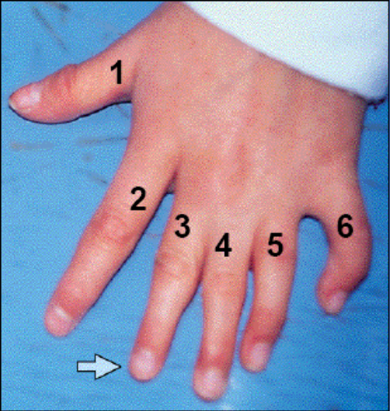
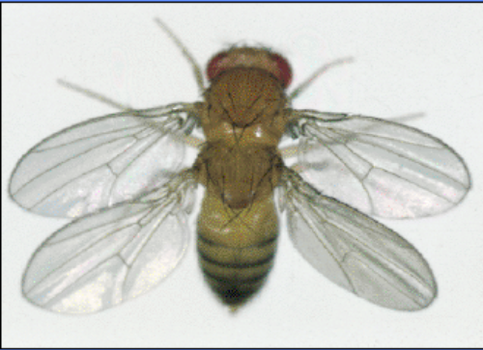
Genes need to be regulated
* If gene regulation goes awry?
=> Developmental abnormality
=> Diseases such as
Chronic myeloid leukemia
rheumatoid arthritis

Slide 5
•transcription
•post transcription (RNA stability)
•post transcription (translational control)
•post translation (not considered gene regulation)
usually, when we speak of gene regulation, we are referring to transcriptional regulationthe “transcriptome”

Slide 6
Transcriptional Regulation
DNA binding proteins
Non-coding region
Gene 1
Activator
Repressor
Coding region
(transcribed)
RNA transcript
Gene 2
Binding sites
(specific sequences)
Gene 3

Slide 7
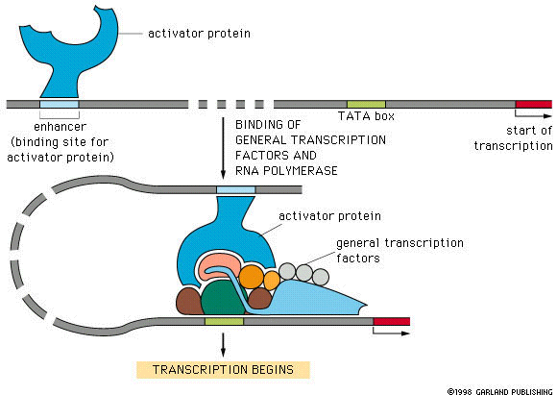
Transcriptional Regulation

Slide 8
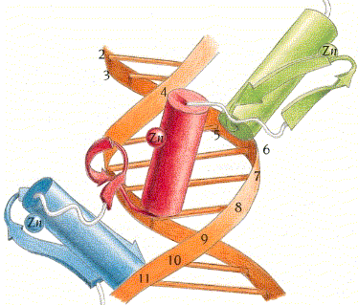
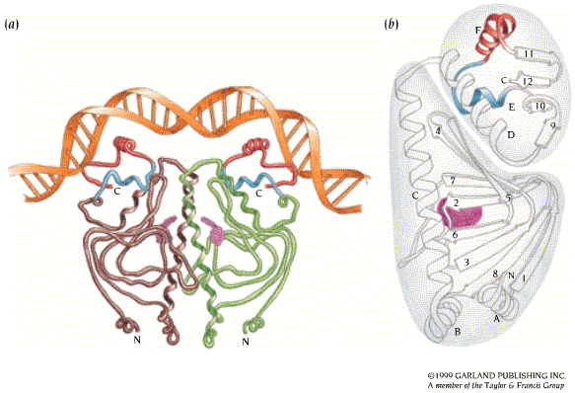
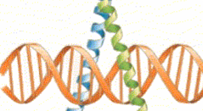
Transcription Factor Binding Sites
Gene regulatory proteins contain structural elements that can “read” DNA sequence “motifs”
The amino acid – DNA recognition is not straightforward
Experiments can pinpoint binding sites on DNA
Zinc finger
Helix-Turn-Helix
Leucine zipper

Slide 9
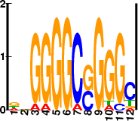
Modeling Binding Sites
Given a set of (aligned) binding sites …
Consensus sequence
Probabilistic model
(profile of a binding site)
GCGGGGCCGGGC
TGGGGGCGGGGT
AGGGGGCGGGGG
TAGGGGCCGGGC
TGGGGGCGGGGT
TGGGGGCCGGGC
ATGGGGCGGGGC
GTGGGGCGGGGC
AAAGGGCCGGGC
GGGAGGCCGGGA
GCGGGGCGGGGC
GAGGGGACGAGT
CCGGGGCGGTCC
ATGGGGCGGGGC
  NNGGGGCNGGGC
A | 4 | 3 | 1 | 1 | 0 | 0 | 1 | 0 | 0 | 1 | 0 | 1
C | 1 | 3 | 0 | 0 | 0 | 0 | 13 | 6 | 0 | 0 | 1 | 9
G | 5 | 5 | 13 | 13 | 14 | 14 | 0 | 8 | 14 | 12 | 13 | 1
T | 4 | 3 | 0 | 0 | 0 | 0 | 0 | 0 | 0 | 1 | 0 | 3

Slide 10
Overview
Introduction to Transcriptional Regulation
ChIP-on-Chip (ChIP-Chip)
Current Approaches
Our Approach

Slide 11
ChIP-on-Chip
Based on
  ChIP (Chromatin Immuno-Precipitation)
  Microarray
In vivo assay
Genome-wide location analysis

Slide 12
Chromatin Immuno Precipitation (ChIP)
Sonication or
vortexing with glass-beads
Immunoprecipitation
Using antibody of a protein of interest
DNA bound to specific protein are enriched.
Supernatant
Pellet
Notes:
Average length of fragment :
False positive rate : 6 – 10 %
False negative rate : difficult but to estimate about 24% based on the literature survey on cell cycle regulation

Slide 13
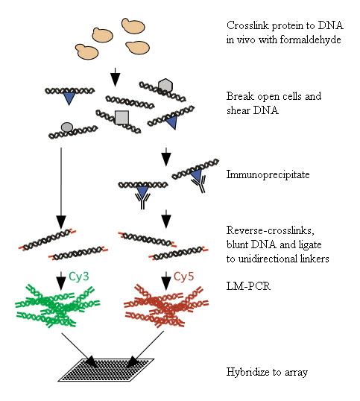
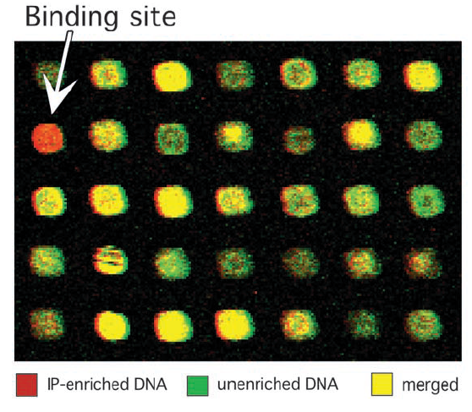
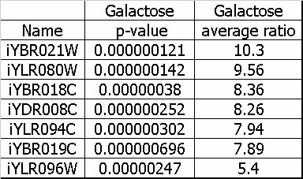
ChIP-on-Chip (Ren et al.)
Array of intergenic sequences from the whole genome

Slide 14
Protein Binding Microarray (PBM)
(Bulyk et al.)
In vitro assay
DNA-binding protein of interest is expressed with an epitope tag, purified and then bound directly to a double-strand DNA microarray
Can overcome the shortcomings of ChIP-on-Chip
  Poor enrichment
  No available antibody
  Unknown culture condition or time points

Slide 15
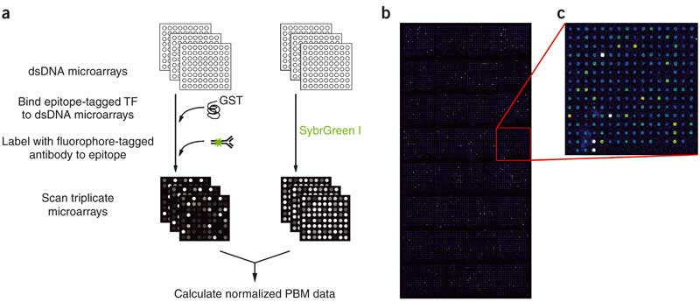
Protein Binding Microarray
Whole-genome yeast intergenic microarray bound by Rap1

Slide 16
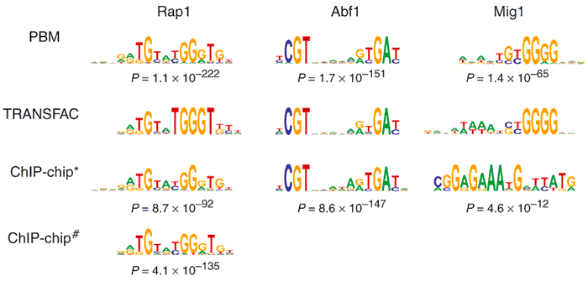
ChIP-on-Chip vs PBM
Done by Mukherjee et al.
Useful when ChIP-on-Chip does not result in enough enrichment
* Lee et al. , # Lieb et al.

Slide 17
Overview
Introduction to Transcriptional Regulation
ChIP-on-Chip (ChIP-Chip)
Current Approaches
Our Approach

Slide 18
Approaches
Representative TFBS (Motif) Discovery
Understanding Regulatory Modules

Slide 19
Motif Discovery
MEME (Expectation Maximization)
CONSENSUS (greedy multiple alignment)
WINNOWER (Clique finding in graphs)
SP-STAR (Sum of pairs scoring)
MITRA (Mismatch trees to prune exhaustive search space)
BioProspector (Gibbs Sampling Based)
MDScan (Differential weight for sequences)
Motif Regressor
EBMF (Energy Based Motif Finding)

Slide 20
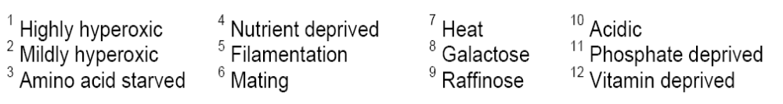
Transcriptional regulatory code by Harbison et al.
Saccharomyces cerevisiae (budding yeast) - Eukaryote
TFBS binding analysis
Simple regulatory models
203 TFs in rich media +
84 TFs in at least 1 in 12 other environmental conditions
Genome-wide location data 11,000 unique interaction (p < 0.001)

Slide 21
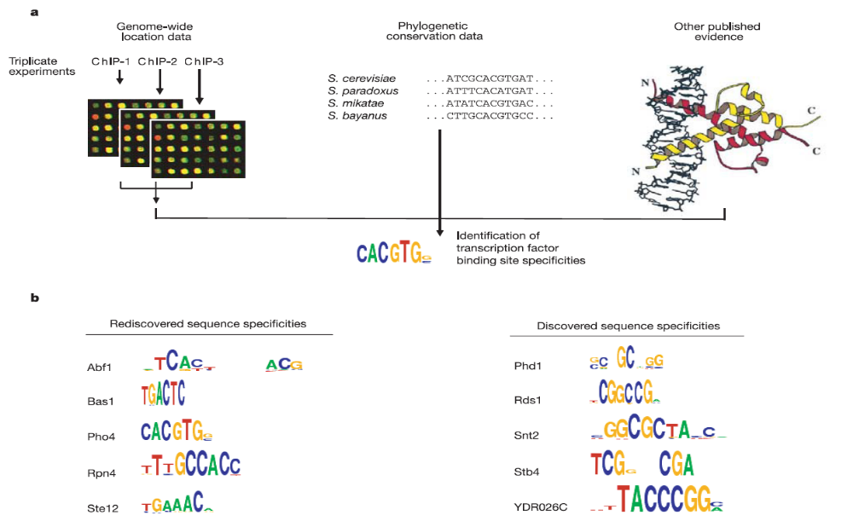
Transcriptional regulatory code by Harbison et al.
Identification of transcription factor binding site specificities
Notes:
Total 203 TF
147 TFs (More than 10 probes)
116 motifs
65 high-confidence motifs

Slide 22
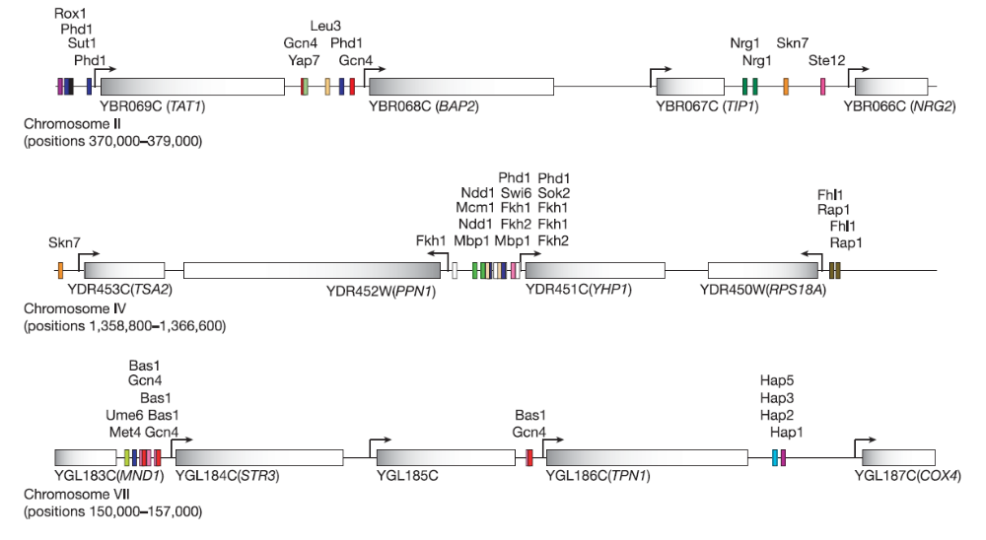
Transcriptional regulatory code by Harbison et al.
Construction of regulatory map of Yeast

Slide 23
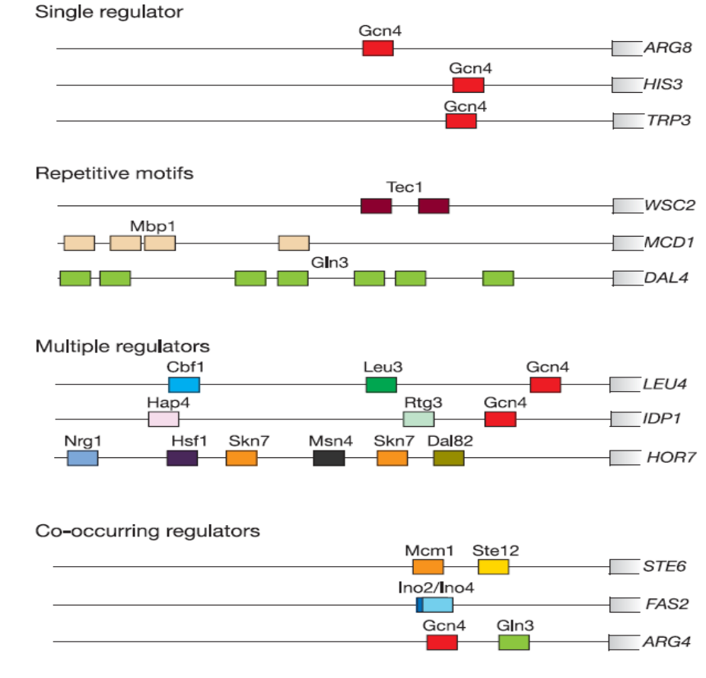
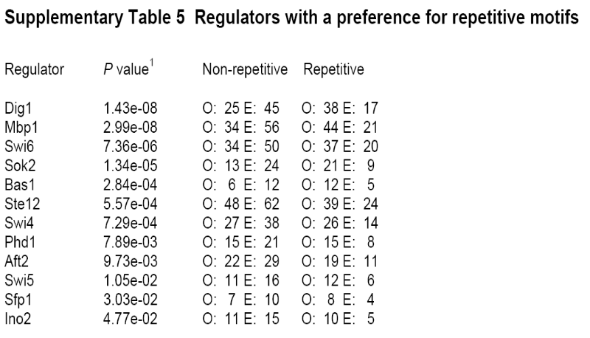
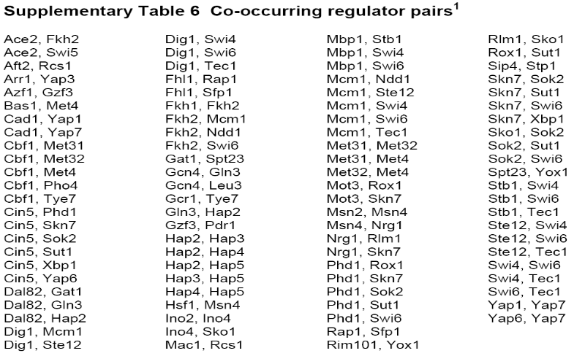
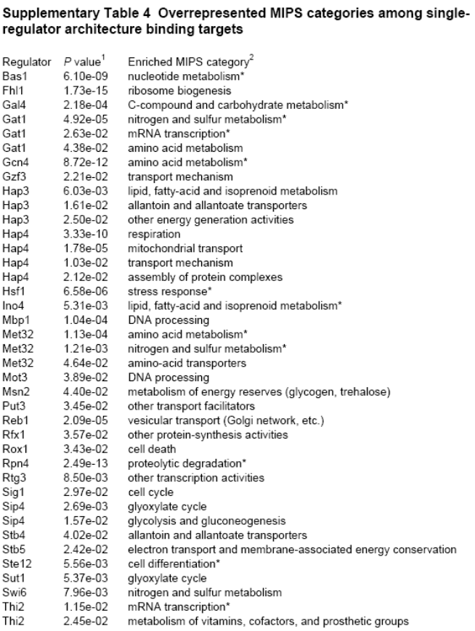
Transcriptional regulatory code by Harbison et al.
Promoter architectures
Notes:
Single : 30
Repetitive 20
Co-occuring : 100 pairs

Slide 24
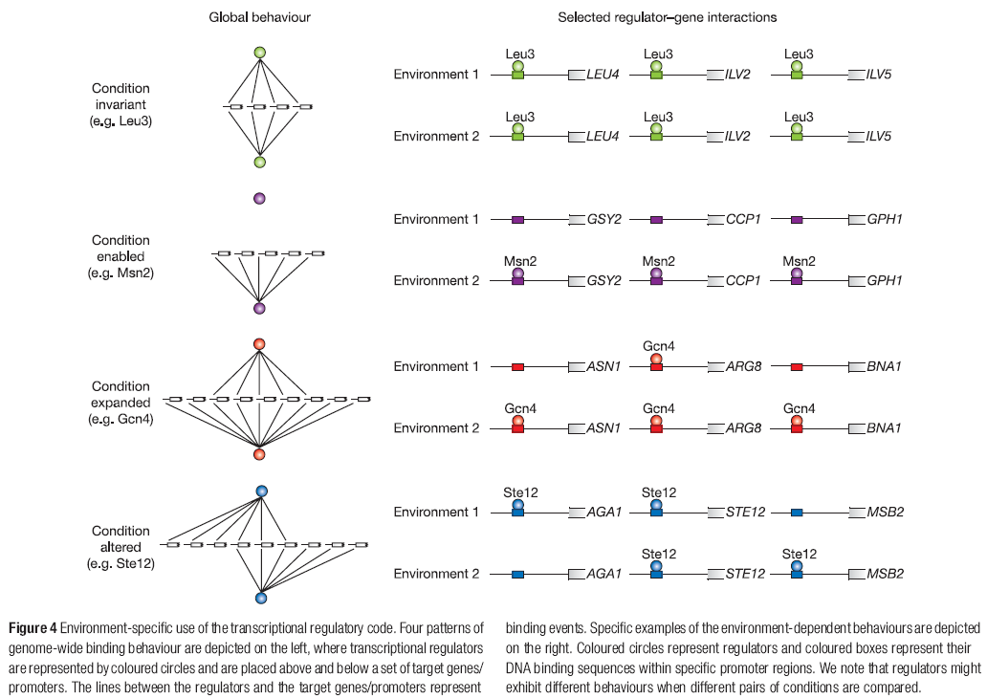
Transcriptional regulatory code by Harbison et al.
Environment-specific use of regulatory codes

Slide 25
Overview
Introduction to Transcriptional Regulation
ChIP-on-Chip (ChIP-Chip)
Current Approaches
Our Approach

Slide 26
Our Approaches
Better understanding of differential binding of TF and DNA in different conditions by using ChIP-on-Chip and gene expression data.

Slide 27
Obstacles in TFBS Analysis
Variation in binding sequences might be problematic in motif discovery process.
  But for differential binding, there is no sequence discrepancy.
For eukaryotic systems, lots of transcription factors (TFs) work together with other TFs affecting each other’s binding to DNA

Slide 28
Causes of Differential Binding
We suspect the possible causes for this differential binding to be
  Changes in the TF expression
  Changes in other TFs expression
  Modifications in TFs (protein level)
  Changes in physical structures (epigenetic features)
  Other unknown reasons

Slide 29
Cooperations in TFs
Condition 1
Condition 2
Condition 3
What has caused the difference in the binding affinity?

Slide 30
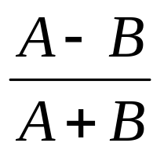
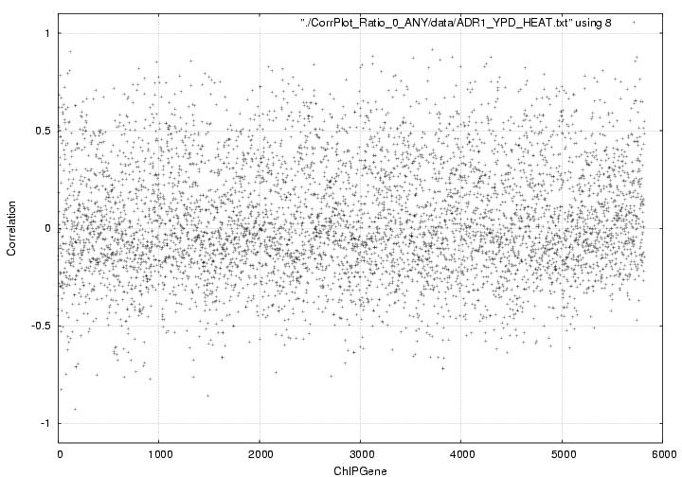
Differentially Bound Promoters
Simple correlation
  (A, B: binding ratio of TF in condition 1 and 2 respectively)

Slide 31
Differentially Bound Promoters
Con1 vs Con2
Gene_1
Gene_2
Gene_3
Gene_4
~
Gene_n
Con1 vs Con3
Gene_2
Gene_5
Gene_7
Gene_8
~
Gene_n
Con2 vs Con3
Gene_1
Gene_2
Gene_3
Gene_4
~
Gene_n
How can we confirm which other TF(s) is involved?

Slide 32
Methods
How can we confirm which other TF(s) is involved?
  Sequence analyses on the differentially bound promoters?
  Comparison of ChIP-on-Chip results?
  Protein-protein interaction between TFs?
Other possible analysis
  Gene Ontology distribution of differentially bound promoters

Slide 33
Expected Results
We may be able to use heterogeneous experimental data to reveal the underlying mechanisms of differential binding of transcription factor to cis-regulatory region.

Slide 34
Thank you
Any question and suggestion ?

