Slide 1
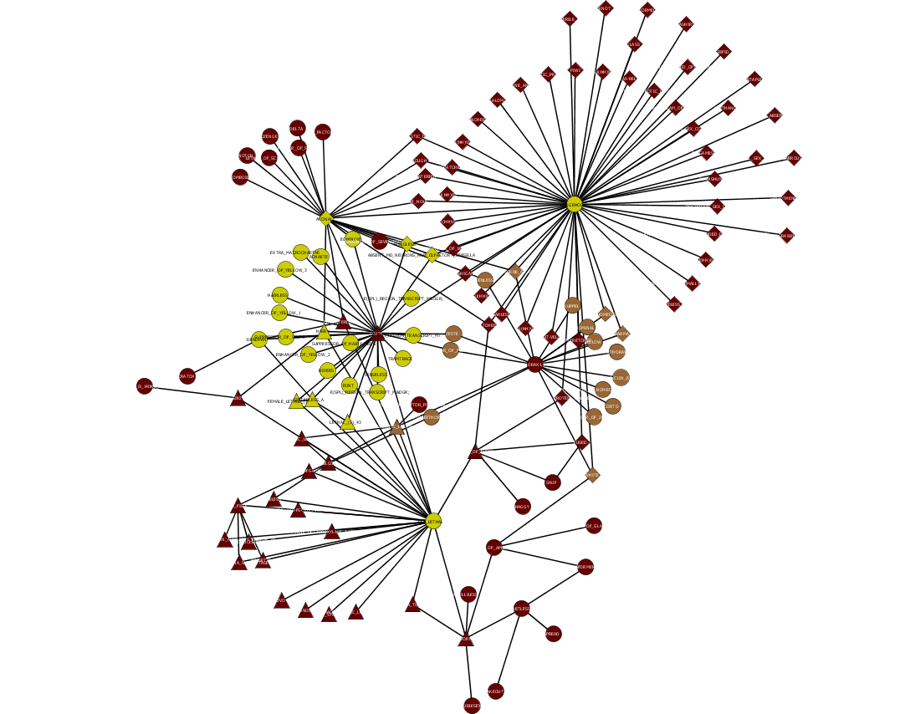
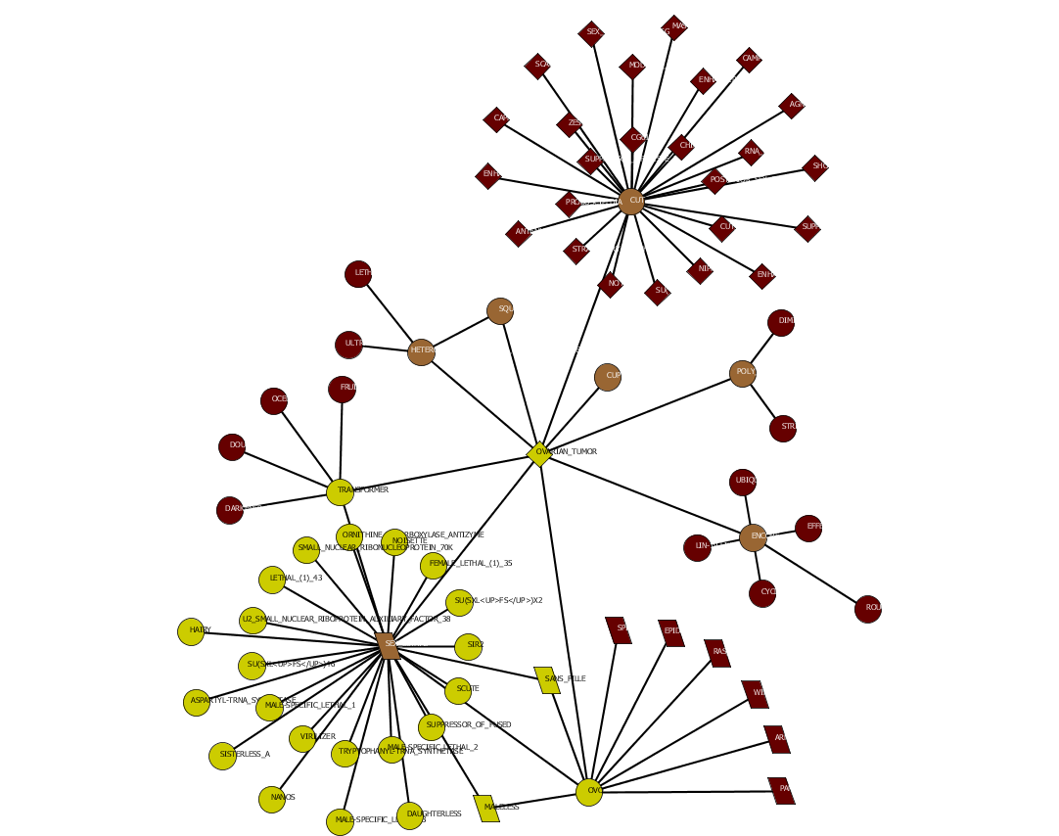
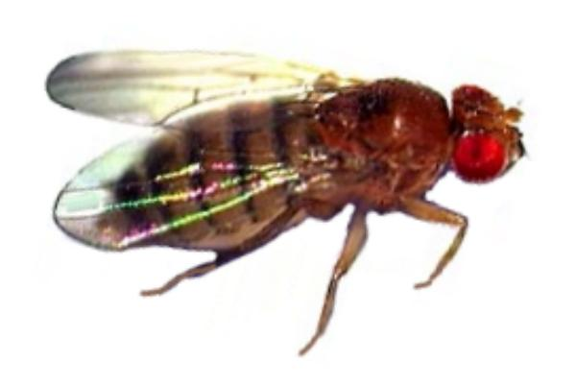
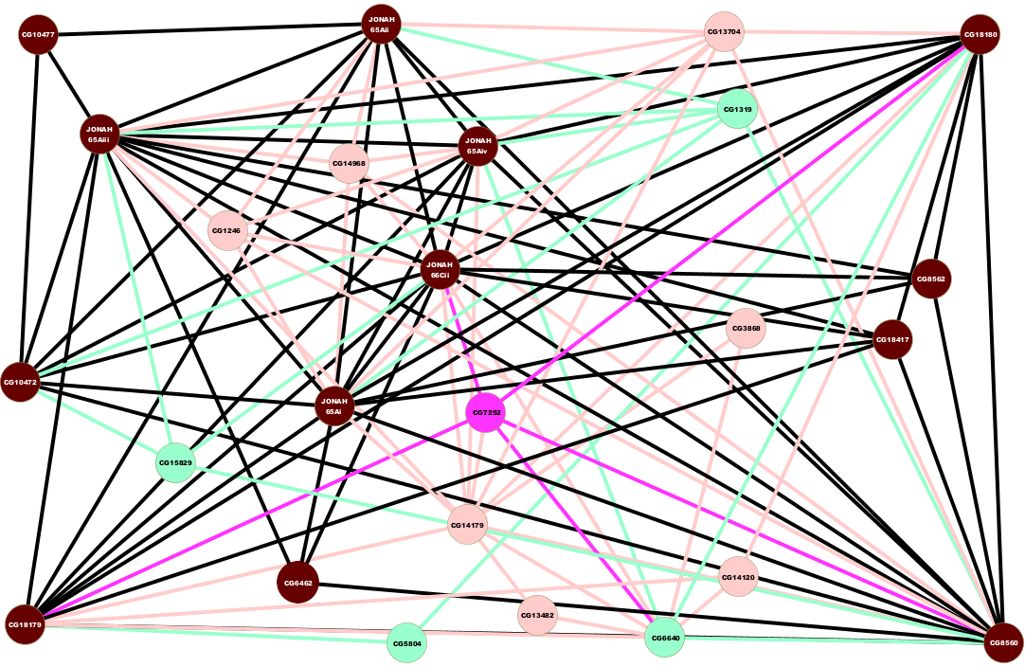
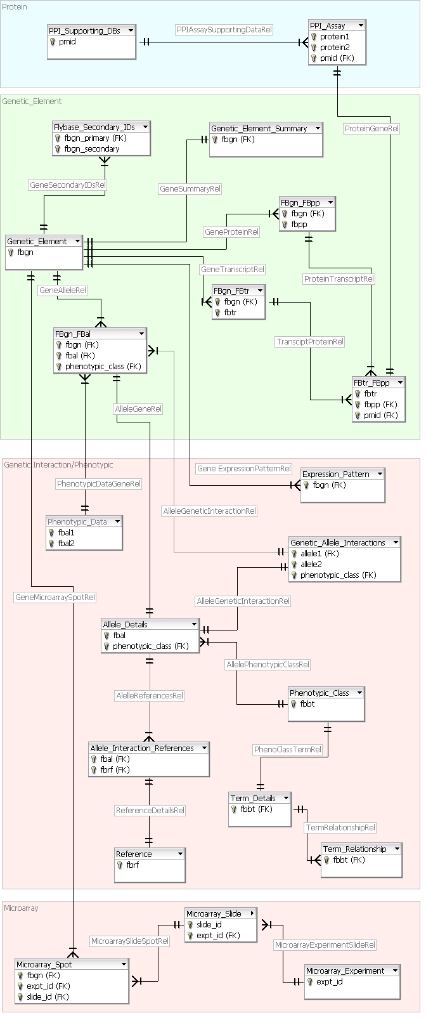
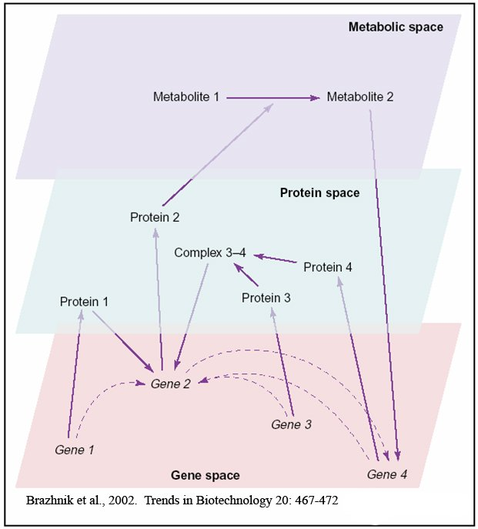



InGeNE
Integrated Gene Network Explorer
James Costello, MS PhD. Candidate Indiana University School of Informatics Center for Genomics and Bioinformatics | Mehmet Dalkilic, PhD Asst. Professor Indiana Univeristy School of Informatics Center for Genomics and Bioinformatics | Justen Andrews, PhD Asst. Professor Indiana University Biology Dept. Center for Genomics and Bioinformatics
Rupali Patwardhan, MS CGB Researcher Indiana University | Junguk Hur MS Candidate Indiana University School of Informatics | Sumit Middha, MS CGB Researcher Indiana University | Brian Eads, PhD Post-Doc Indiana University CGB | Keval Mehta MS Candidate Indiana University School of Informatics | John Colbourne, PhD Genomics Director Indiana University CGB | Amit Saple MS Candidate Indiana University School of Informatics
Why build a Gene Network?
Integrating The Data
The rise of the –omics (genomics, proteomics, metabolomics, …) and high-throughput techniques have unveiled a new perspective into the world of biology. Techniques such as Yeast 2 Hybrid Assays, Microarray Assays, and Large-Scale Genetic Screens allow us to take a genome-wide look into how organisms function, but also provide a whole new assortment of problems. Biological researchers have ever increasing sets of data with inadequate data integration, analysis, and discovery tools. Alone, integration of these large data sets is difficult because 1) each data set tends to be noisy, 2) false positive results are abundant, 3) inferences on gene function depend on the context of the experiment, and 4) validation of correctly integrated data is not straight forward. By leveraging the strengths of each data set, we can build a gene network that allows biological researchers to not only view their data more effectively, which is a significant contribution of itself, but also allow researchers to make predictions about gene function that can then be tested at the bench.
Currently, the data used to build the Gene Network has been taken from 4 distinct data sources, which include yeast 2 hybrid protein-protein interaction assays¹, large-scale microarray experiments^{2,3,4}, genetic interaction screens⁵, and human curated phenotypic information⁶. The data model has been built to take into account new sets of data, which can simply be placed into the database and consequently be integrated into the Gene Network. The edges in the network were created by applying a set of logical rules to all of the data placed in the database, where the logical rules were created by domain experts.
LEGEND
represent genes involved in proteolysis and peptidolysis
represents genes involved in some kind of transport
represents genes involved in chitin metabolism
represents genes of unknown function
Thinking about Genes
Conceptually, one can think of different data sources belonging to separate spaces of a gene, where we move from DNA to RNA to Protein to Complex Structures. Each one of these spaces has a great wealth of information, but together they allow us to see the bigger picture of how molecules from all gene spaces regulate and interact with each other.
Gene Network image created using Cytoscape⁷
An Explosion of Future Research
The integration and exploration of disparate, but related biological high-throughput datasets has immense power and can lead to an explosion of research being done in a great many areas. Here are a few:
Biology – Discovery of gene function and regulation from closely related genes through genetic and genomic techniques such as knock-outs, DNA footprinting, and immunoprecipitation.
Chemistry – Discovery of interacting genes in the protein space using chemically related methods such as mass spectrometry and chromatography.
Computation – Discovery of unknown or unpredicted gene relationships through computational analysis such as graph theory and sub-graph clustering.
Mathematics and Statistics – Building of novel models to represent further areas of interest, like predicting genetic interactions based on their statistical bias in other data sources.
Logic – Finding the IF-THEN relationships that is built into the inherent biological structure.
¹Giot, L., et al. A protein interaction map of drosophila melanogaster. Science, 302(5651):1727–1736, 2003.
²Parisi, M., et al.. Paucity of genes on the drosophila x chromosome showing male-biased expression. Science, 299(5607):697–700, 2003.
³Arbeitman, M., et al. Gene expression during the life cycle of drosophila melanogaster. Science, 297(5590):2270–2275, 2002.
⁴Li, T. and White, K. Tissue-specific gene expression and ecdysone-regulated genomic networks in drosophila. Developmental Cell, 5(1):59–72, July 2003.
⁵The Fly Consortium. The FlyBase database of the drosophila genome projects and community literature. Nucleic Acids Research, 31:172–175, 2003.
⁶Drysdale, R. Phenotypic data in flybase. Briefings in Bioinformatics, 2:68–80, 2001.
⁷Shannon, P., et al. Cytoscape: A Software Environment for Integrated Models of Biomolecular Interaction Networks. Genome Research, 13:2498-2504, 2003.

