Slide 1
A Quantitative Modeling of Protein-DNA interaction for Improved
Energy Based Motif Finding Algorithm
L529 – Term Project
Junguk Hur
School of Informatics
April 25, 2005

Slide 2
BACKGROUND
Motif Finding : Important challenge in computation biology.
Current Algorithms :
  Many stochastic or combinatorial algorithms to find motifs for a given set of sequences; MEME, Gibbs, CONSENSUS, and etc
  No quantitative data
High-throughput genome-wide quantitative data are available
  ChIP-on-Chip: Chromatin ImmunoPrecipitation on Microarray (In vivo)
  PBM: Protein-Binding Microarray (In vitro)
EMBF (Energy Based Motif Finding) Algorithm
  Ratio → Binding Affinity → Energy

Slide 3
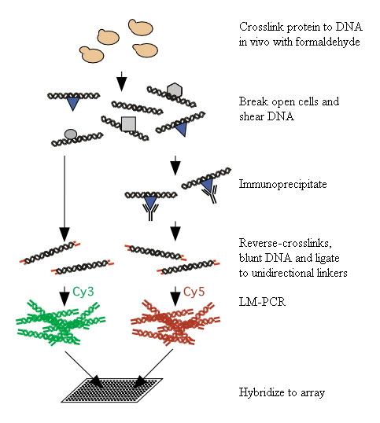
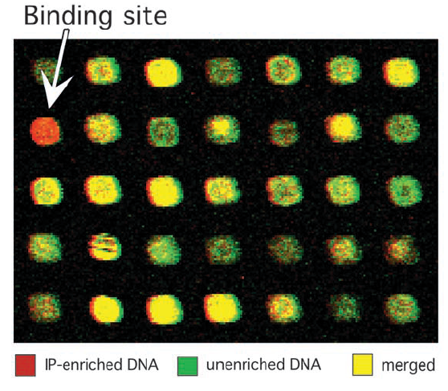
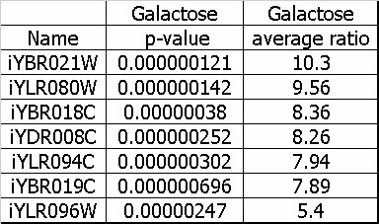
ChIP-on-Chip (Ren et al.)
Array of intergenic sequences from the whole genome

Slide 4

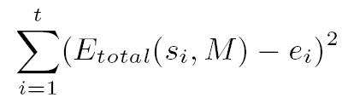
Energy-Based Motif Finding (EBMF)
Chin et al. 2004
Let e_{i} be the average binding energy between TF and sequence s_{i},
then e_{i} = -ln(K_{e})
Ke = [TF•s_{i}] / [TF][s_{i}]
Color intensity ratio represents the value of Ke
4 x l energy matrix M to represent the motif (l=motif length)
Problem Definition
  Solve A*X = B ( A: Matrix to be decomposed, B: Total Energy, X=New Energy at each Position ,To be calculated)
  Minimize the prediction error
Iteratively improve candidate matrix M

Slide 5
Goals and Methods
Ultimately to build better model representing the local and non-local correlation between nucleotides
  Based on the EBMF algorithm
  Utilizing quantitative measure for DNA-protein interaction
  Potentially more accurate than the Positional Weight Matrices (PWMs)
Implementation of EBMF first
  Solving linear equations
    Matrix Solution : QR-decomposition / LR-decomposition
    Least square method : Downhill Simplex Method
  Programming Language : Perl
  Data Set : Yeast ChIP-on-Chip data (GAL4, GCN4, RAP1)

Slide 6
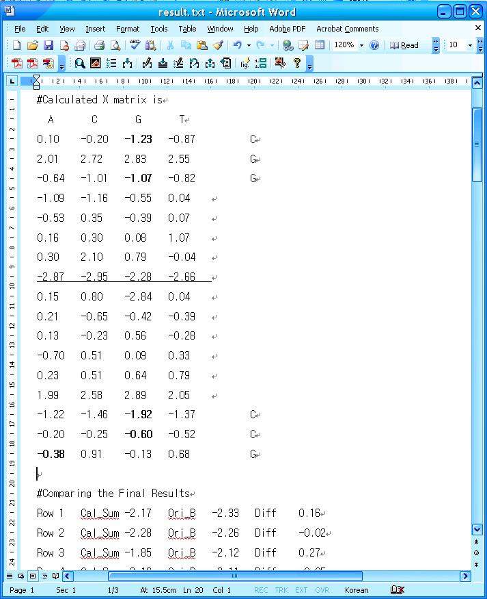
Results
Implemented EBMF failed to find the motif for each TFs even though initial matrix starting from the TRANSFAC PSSM.
  QR/LR-decomposition: Resulted in Infinity
    ➔ Due to singular-like matrix (up to the precision of the machine)
  Downhill Simplex Method: Too slow and still deviated from the TRANSFAC result
  MATLAB : Same as QR
Tried to modify the matrix
  Add small non-zero number to zero element
  Limit to only one TFBS per promoter
  Worked for short length of random sets but still did not work for the yeast TFs.

Slide 7
Discussion
Data are singular? Any other tricky way?
Try other data set.
Other direction to use quantitative protein-DNA binding data
➔ Possible correlation among TFs
Acknowledgement
I deeply thank Dr. Haixu Tang

