Slide 1
microRNA World for Diabetes
Junguk Hur (juhur)

Slide 2
Contents
mir-375
mir-506
Tools

Slide 3
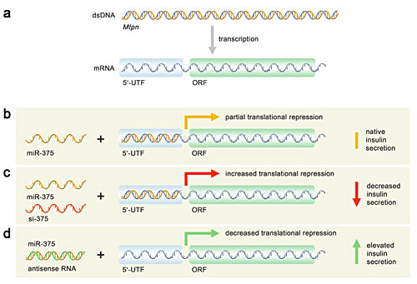
mir-375
islet specific microRNA
Regulation of insulin exocytosis by targeting Myotrophin (Mtpn)
First human microRNA functionally known (Nov. 2004)

Slide 4
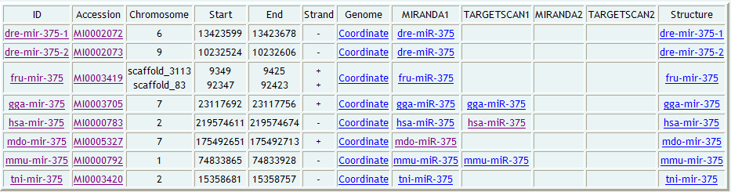
mir-375
8 members

Slide 5
mir-506
miR-506 is a human microRNA family of three members (hsa-mir506, hsa-mir-507, and hsa-mir-508). This microRNA was identified by Bentwich et al (Nature Genetics, 2005) and is known for its implication in oxidative stress response. One of its major target protein is serine/threonine-protein kinase OSR1 (EC 2.7.1.37) (Oxidative stress responsive 1 protein) [Uniprot: OXSR1_HUMAN, O95747].

Slide 6
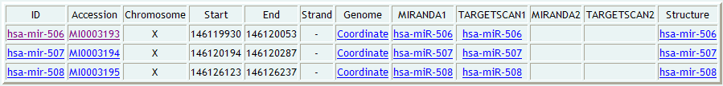
mir-506
8 members

Slide 7
Tools
Individual stem-loop structure prediction
  ViennaRNA – RNAfold
  * http://bcs1.bioinformatics.med.umich.edu/~juhur/cgi-bin/miRNA/miRNA.cgi
  * http://127.0.0.1:8080/~juhur/cgi-bin/miRNA/miRNA.cgi (SSH tunneling)
Conserved stem-loop structure prediction
  ViennaRNA – RNAalifold
  *http://bcs1.bioinformatics.med.umich.edu/~juhur/cgi-bin/miRNA/miRNAsingle.cgi
  * http://127.0.0.1:8080/~juhur/cgi-bin/miRNA/miRNAsingle.cgi (SSH tunneling)

Slide 8
Tools
BLAST search against miRNA stem-loop sequences
  * http://bcs1.bioinformatics.med.umich.edu/~juhur/cgi-bin/miRNA/blast.cgi
  * http://127.0.0.1:8080/~juhur/cgi-bin/miRNA/blast.cgi (SSH tunneling)

Slide 9
Acknowledgment
Dr. David States
Dr. Jeffrey De Wet
Dr. Tom Blackwell
All classmates

