Slide 1
Menopause proxy + SNS/lipolysis in human adipose (GTEx v10)

Slide 2
With technical + composition confounding addressed
Junguk Hur — 2026-02-01

Slide 3
Collaborator goal (Kenichi) + constraints
Goal: add human adipose transcriptomic evidence consistent with adrenergic/lipolysis differences in postmenopause.
Constraints:
GTEx is baseline/unstimulated tissue → acute SNS transcripts may be weak.
Chronic SNS can yield catecholamine resistance → directionality not straightforward.
Bulk adipose is mixed cell types → composition can dominate signals.

Slide 4
Data + cohorts
GTEx v10: Adipose Subcutaneous + Visceral (Omentum), women-only.
Menopause proxy (age-bin midpoint): pre <45, peri 45–55, post >55.
Key outputs summarized in: docs/master_summary_menopause_sns_gtex_2026-02-01.md

Slide 5
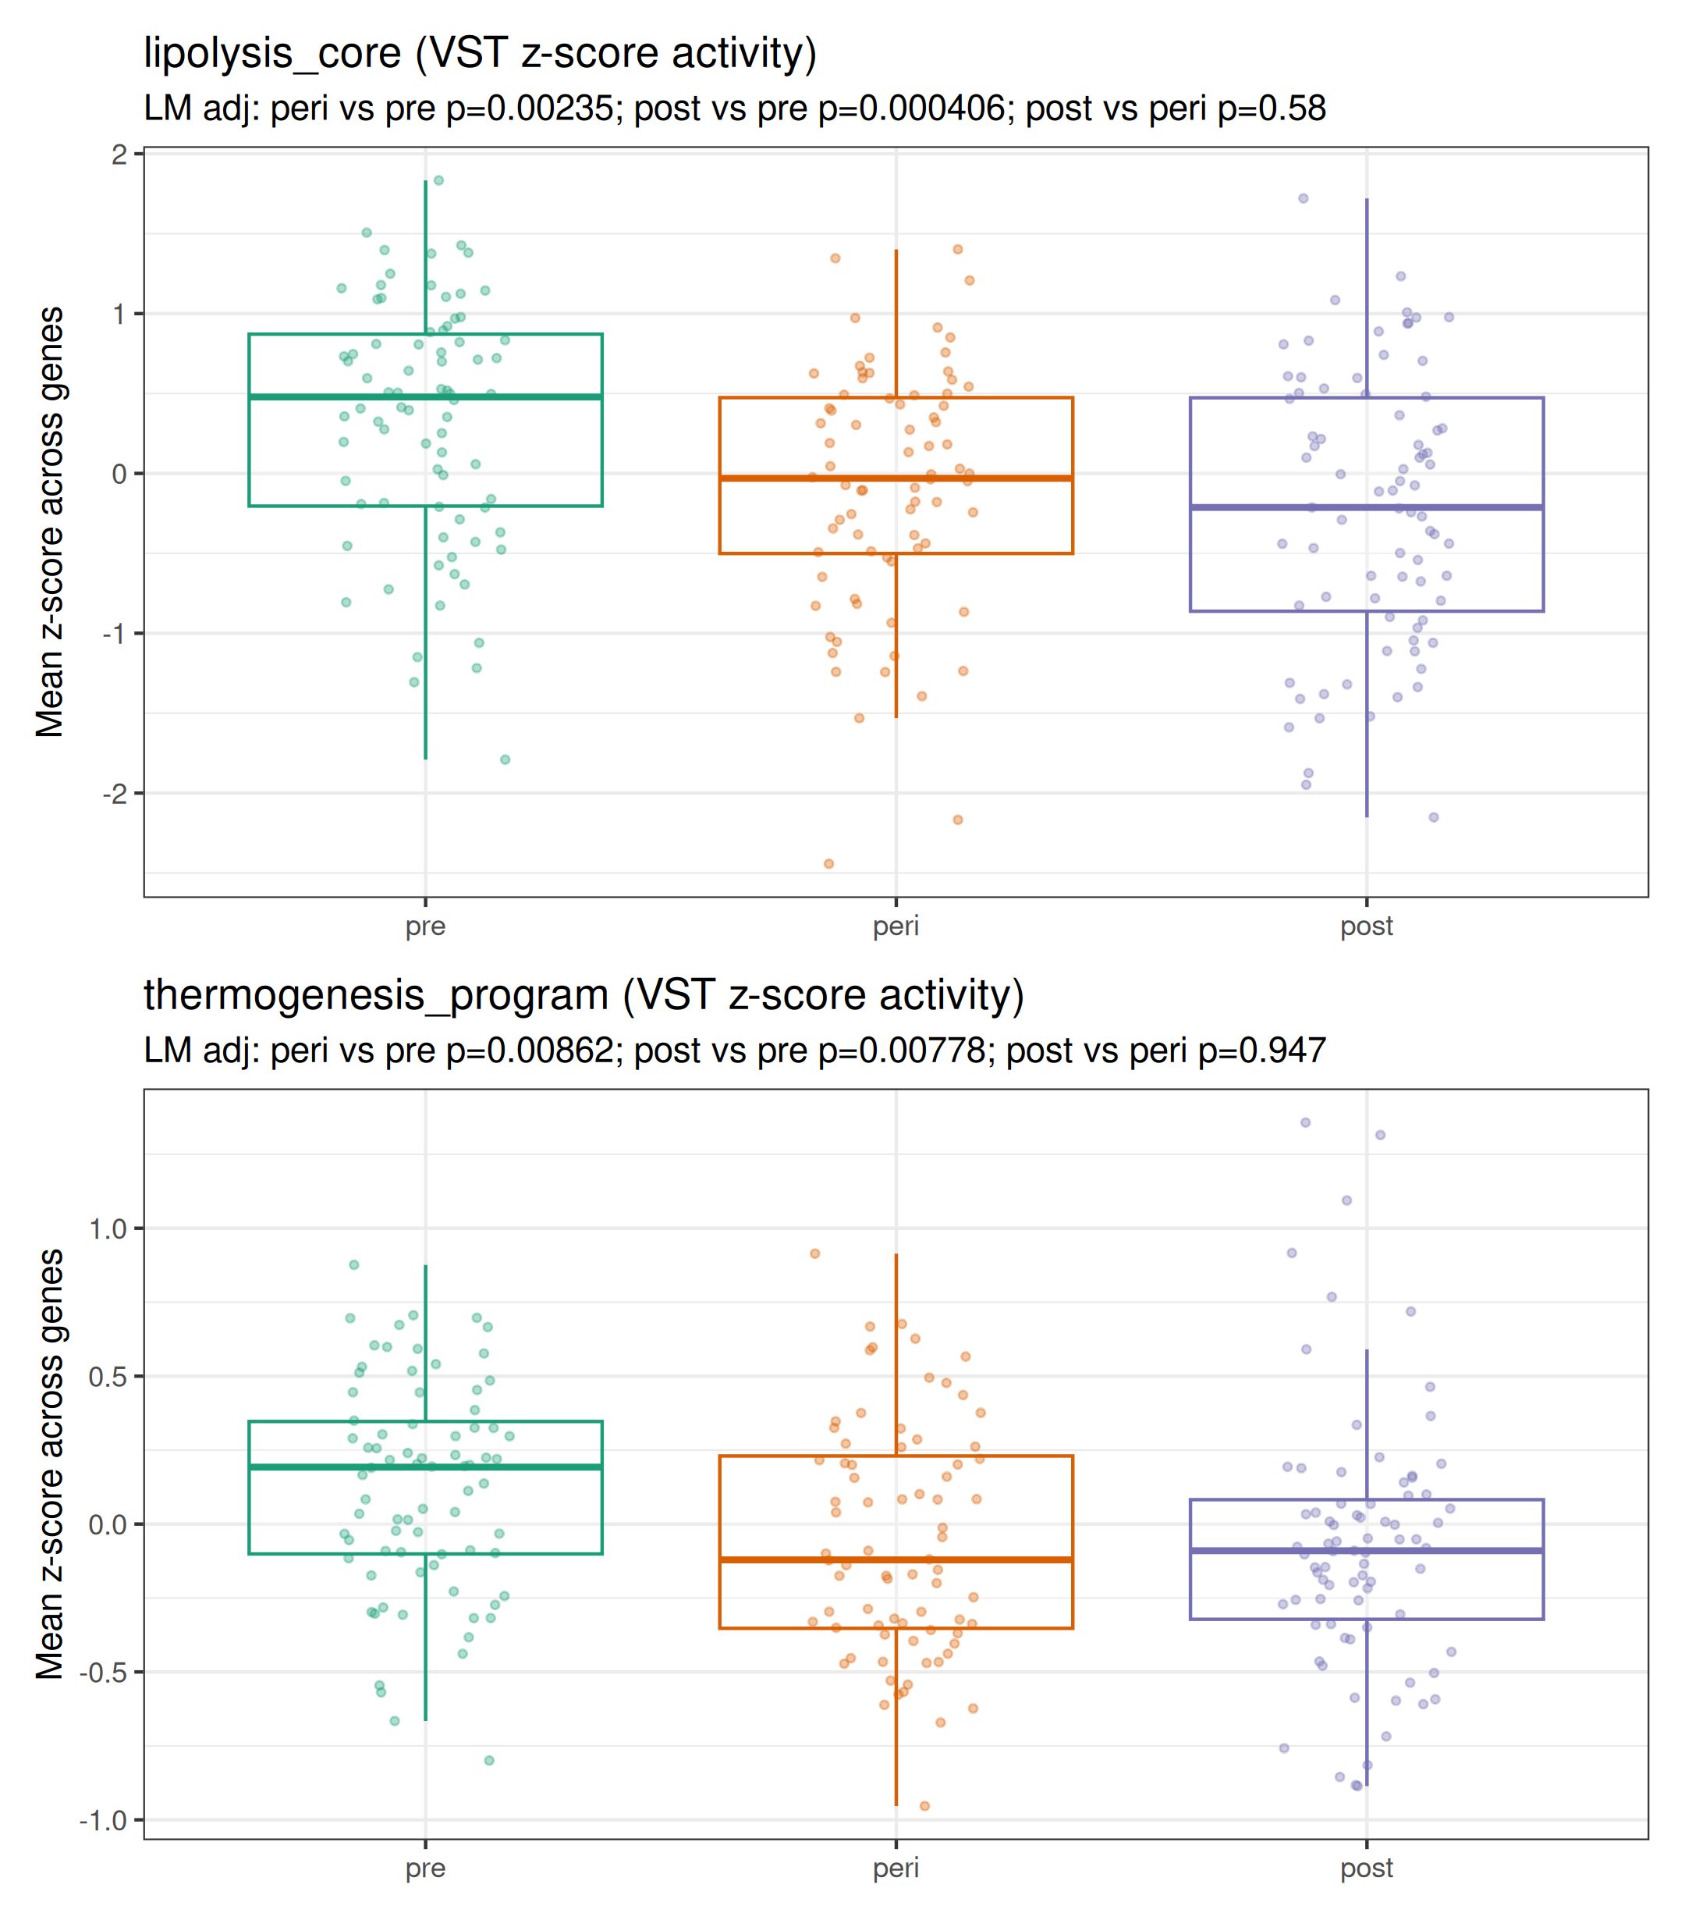
Kenichi panel — subcutaneous baseline gene-set activity

Slide 6
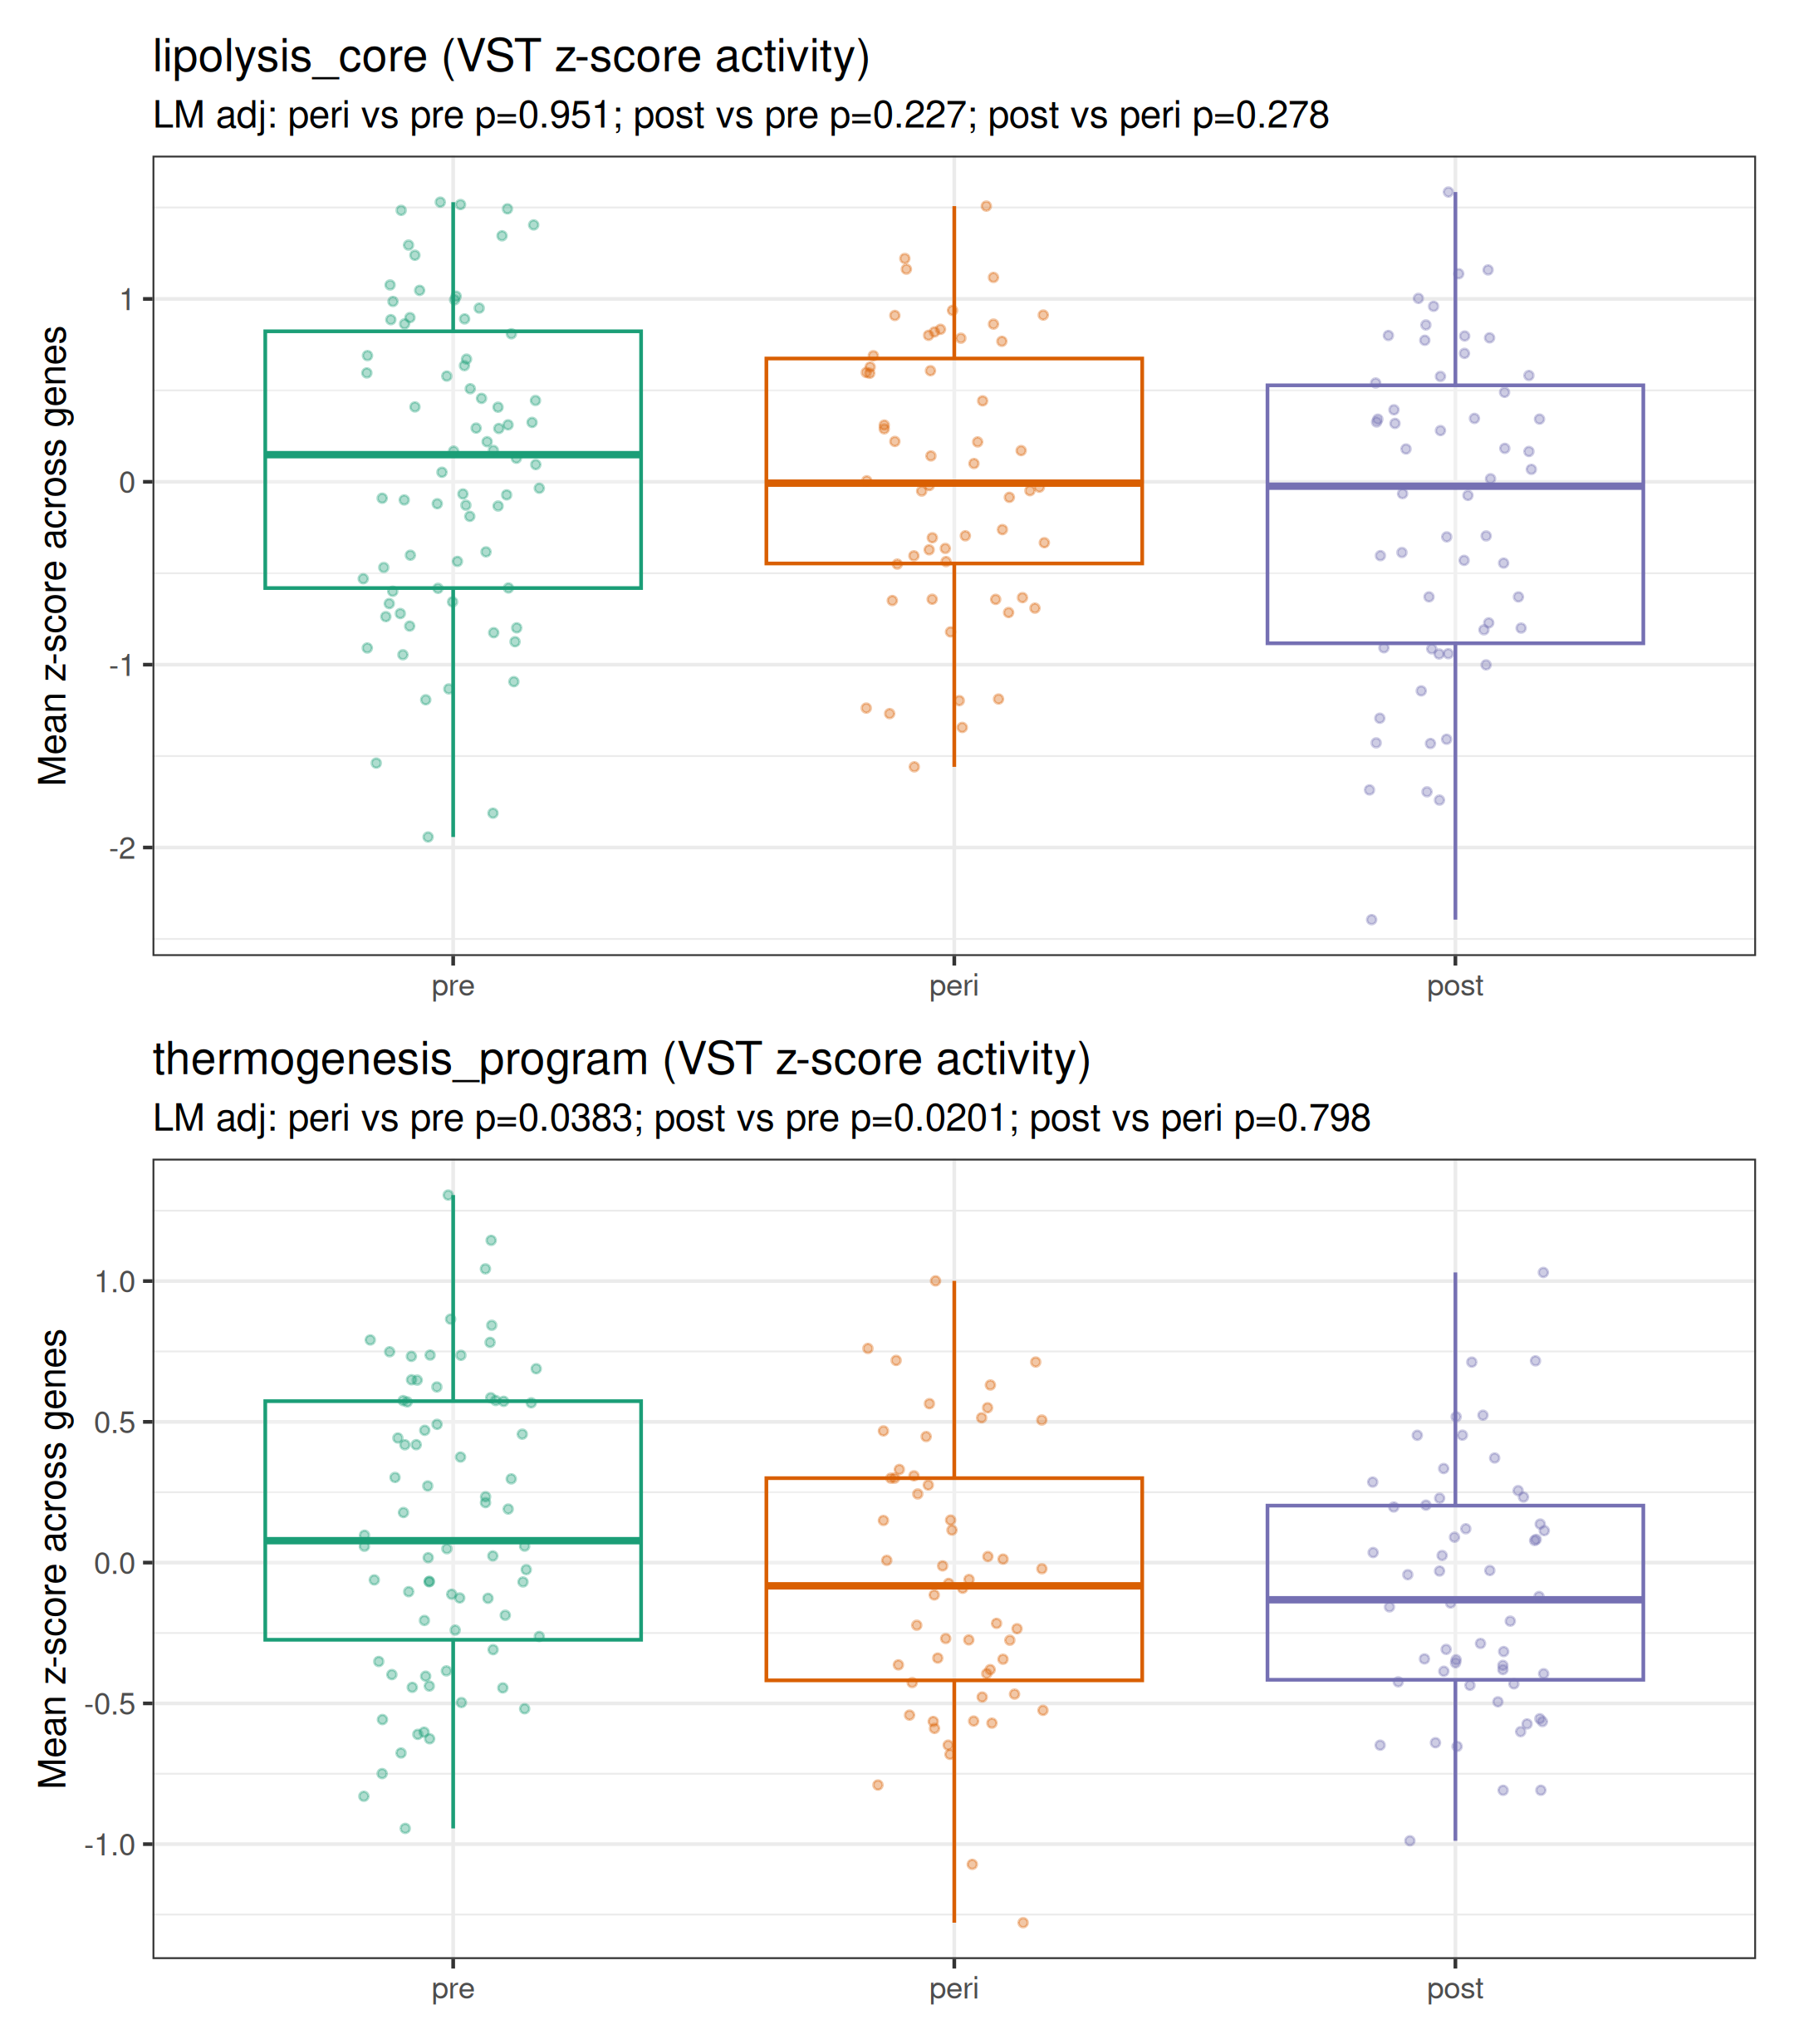
Kenichi panel — visceral baseline gene-set activity

Slide 7
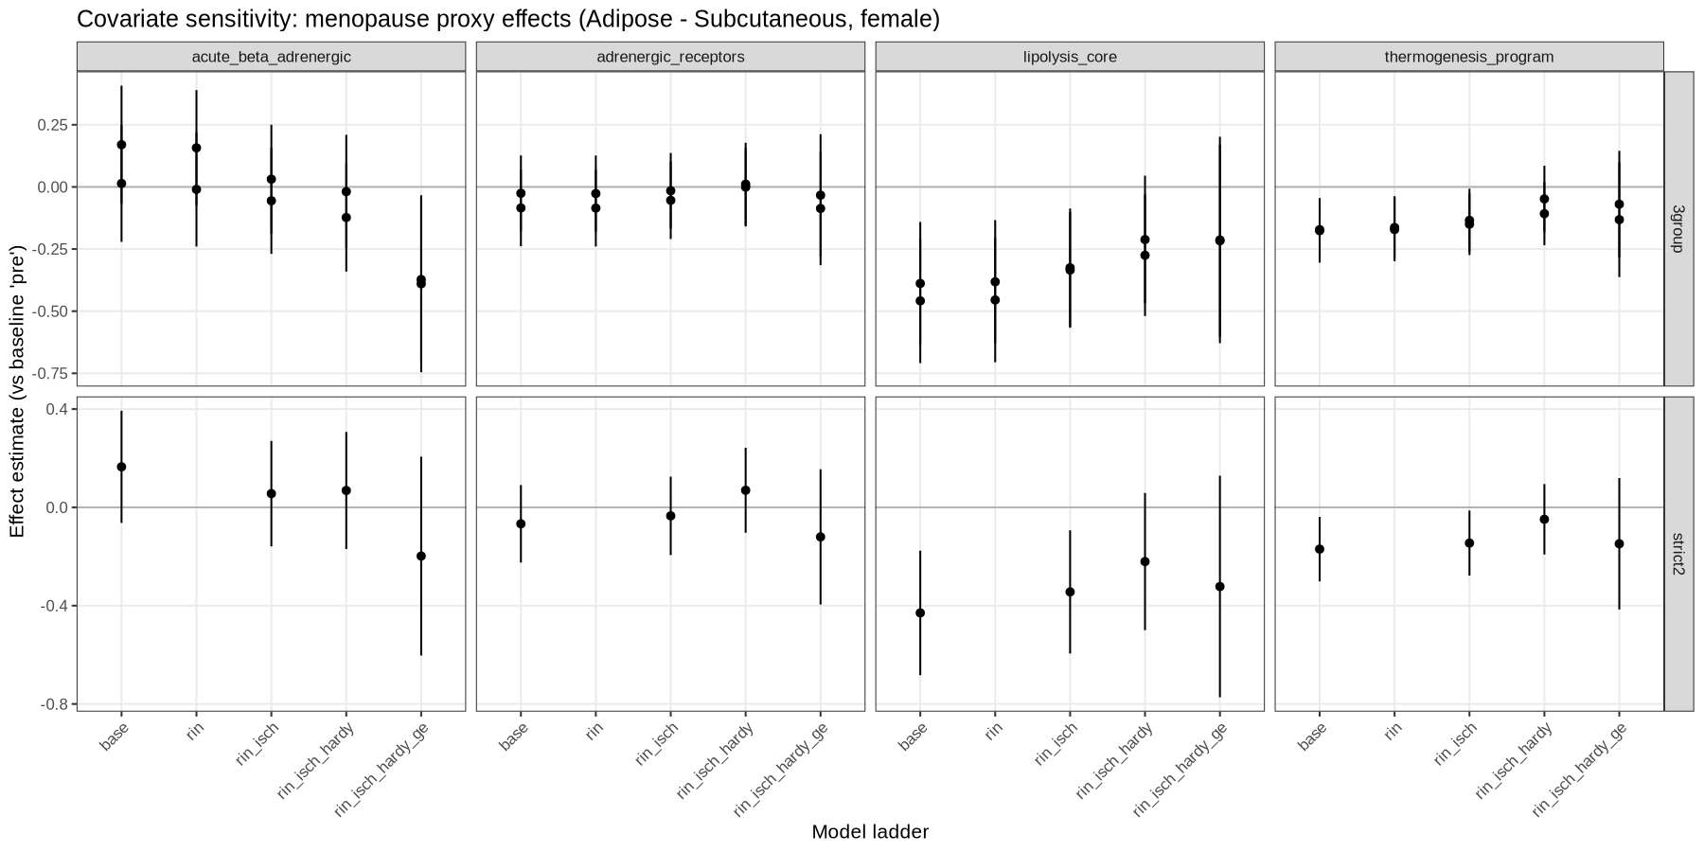
Technical confounding sensitivity (RIN / ischemic time / Hardy / batch)

Slide 8
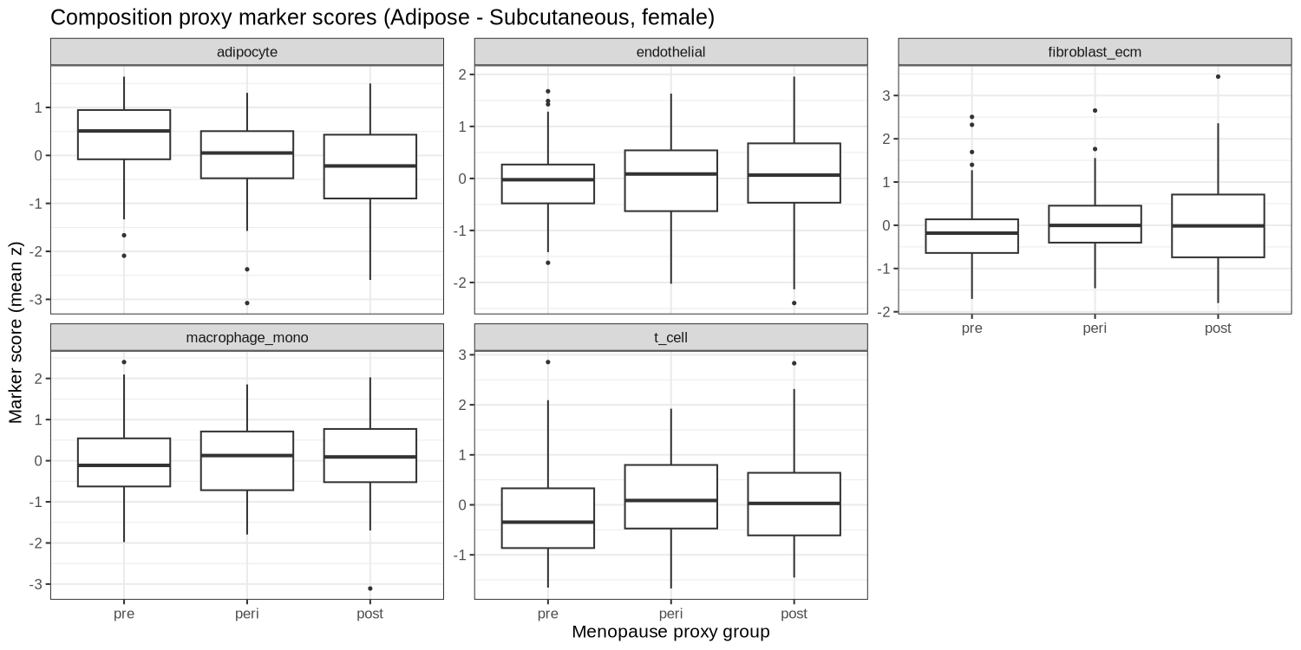
Bulk adipose composition proxies shift with menopause proxy

Slide 9
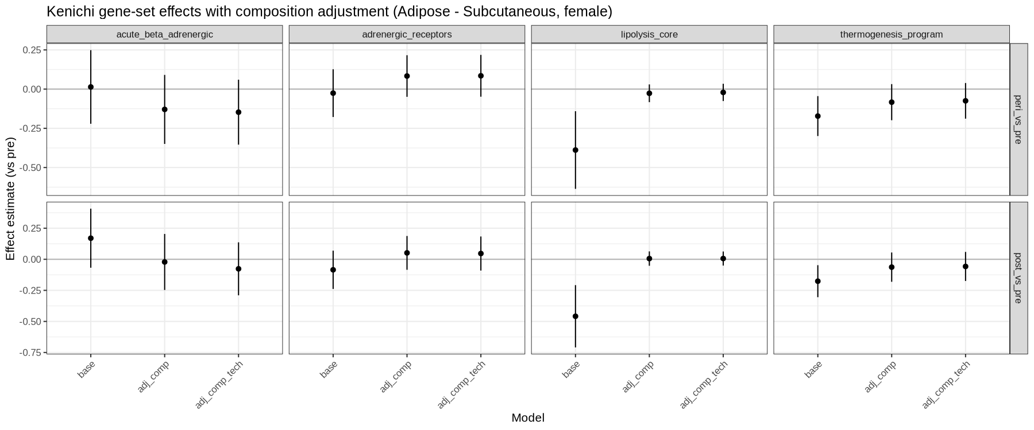
Subcutaneous: composition adjustment explains “lipolysis_core down”

Slide 10
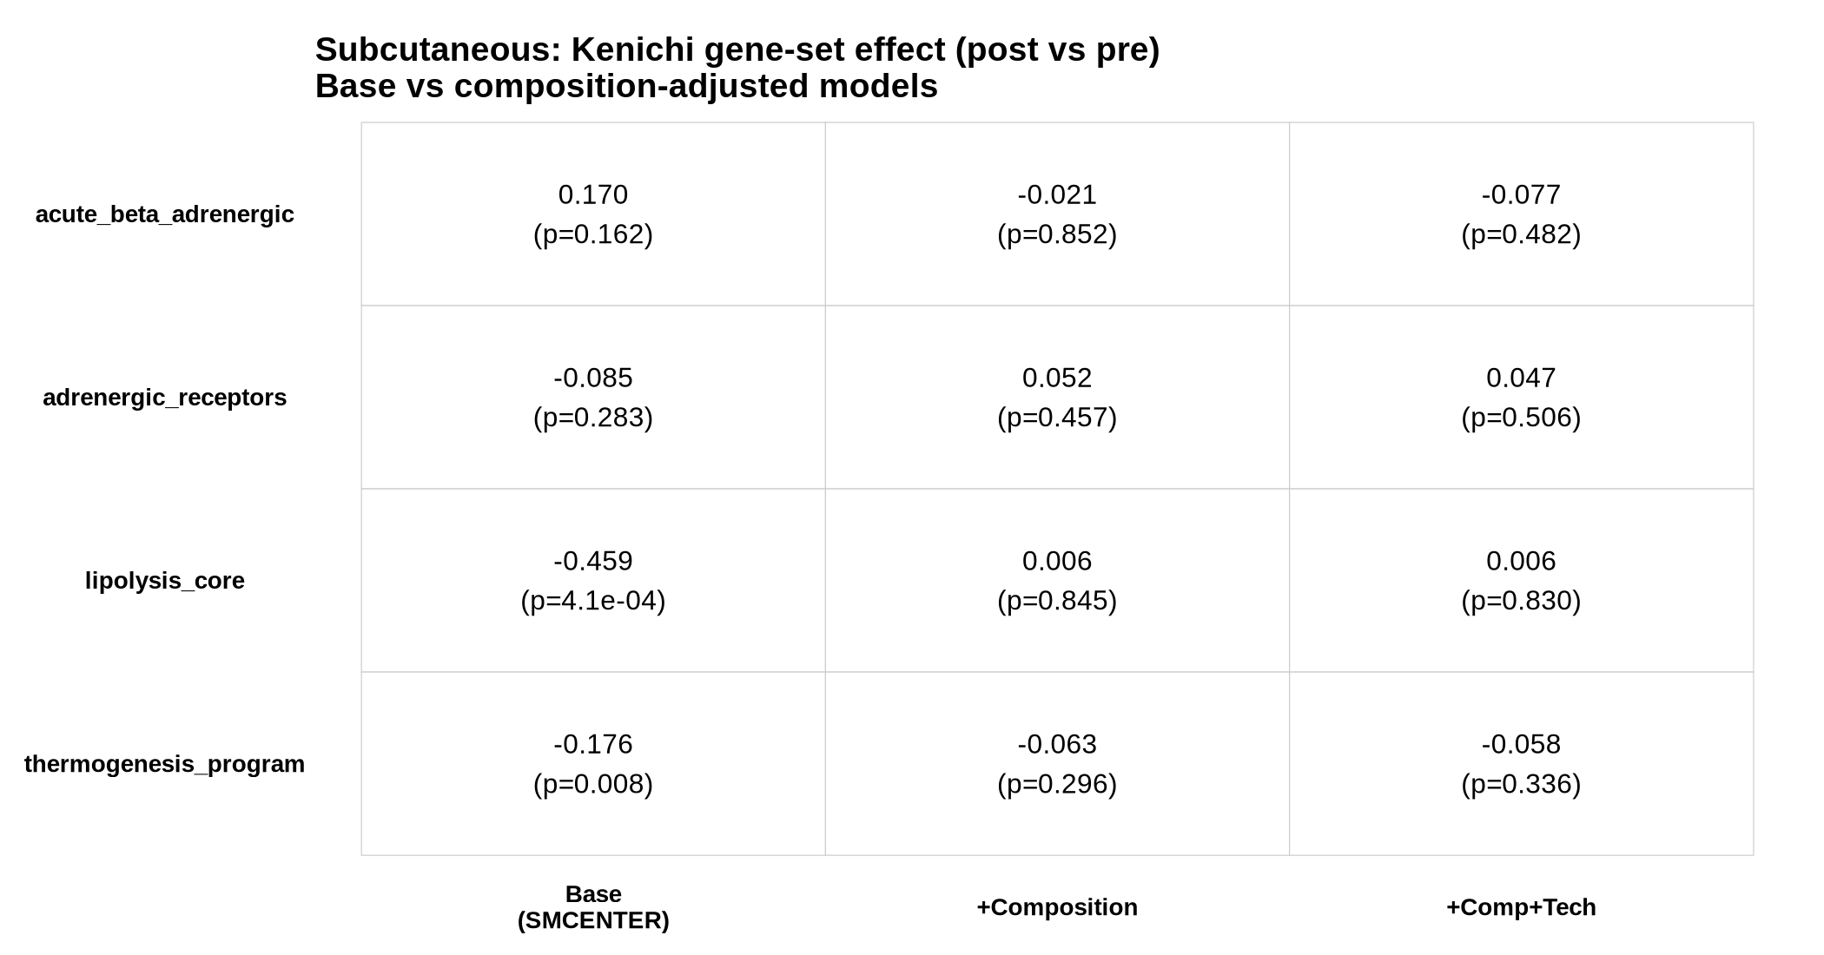
Subcutaneous: key table (post vs pre) — base vs composition-adjusted

Slide 11
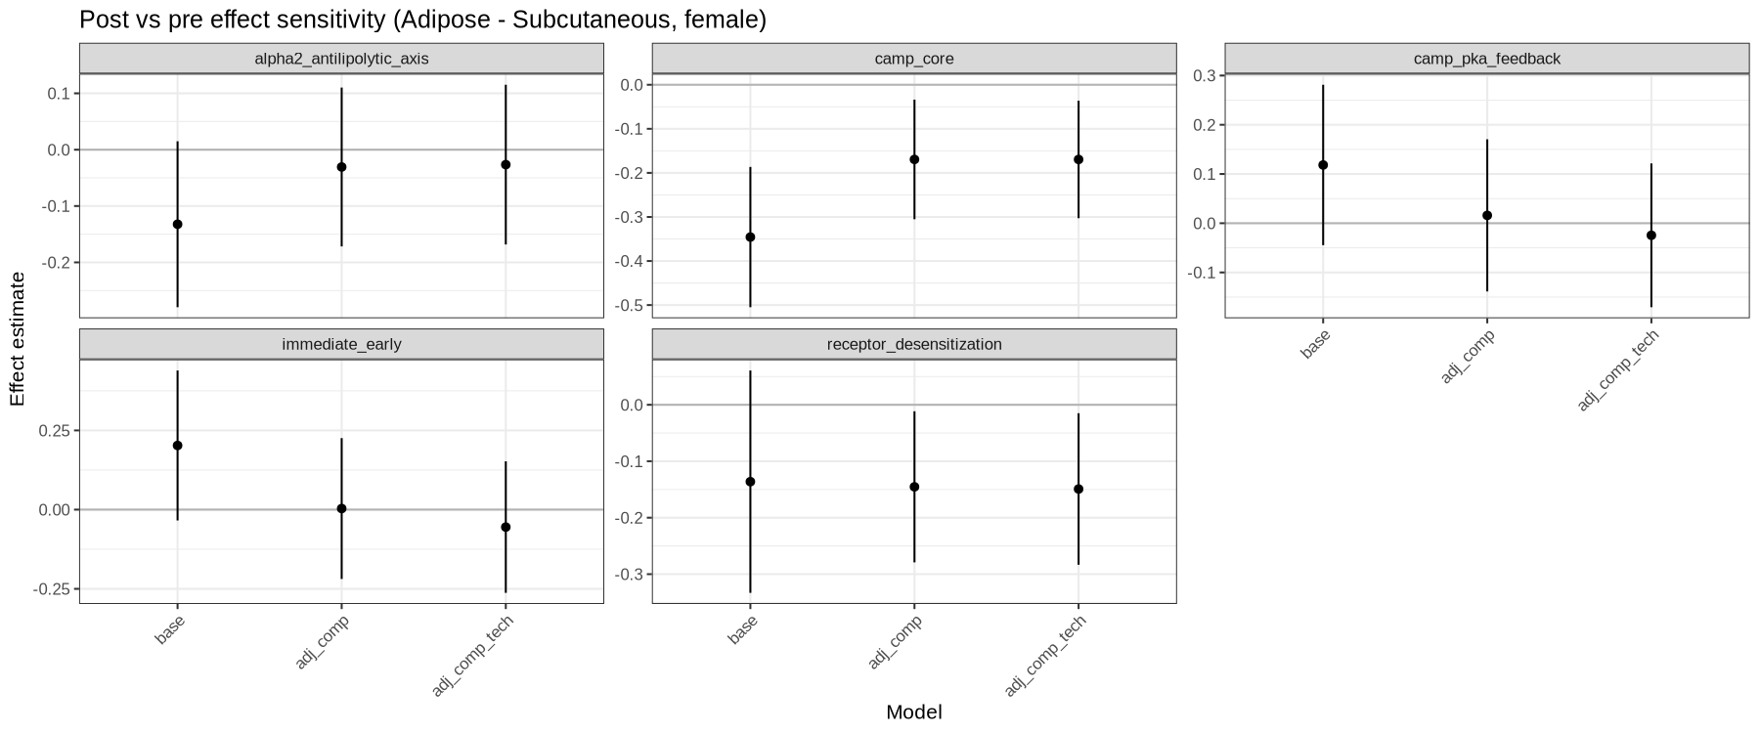
Adrenergic/cAMP/desensitization modules (subcutaneous)

Slide 12
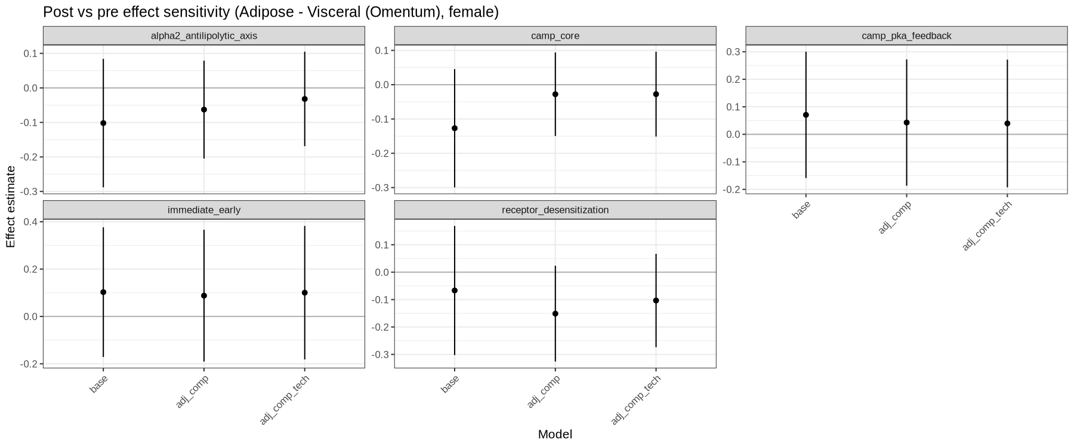
Adrenergic/cAMP/desensitization modules (visceral)

Slide 13
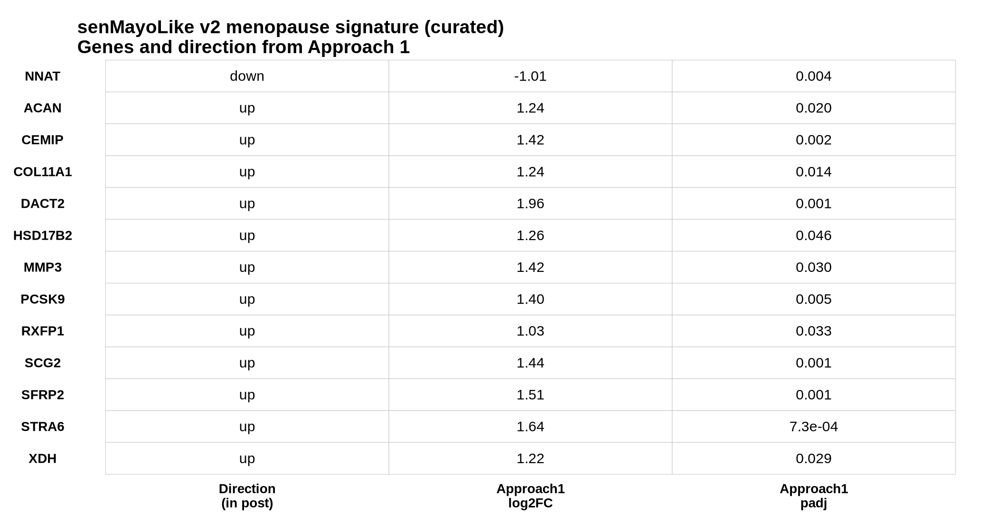
Menopause signature: senMayoLike v2 (curated, evidence-backed)

Slide 14
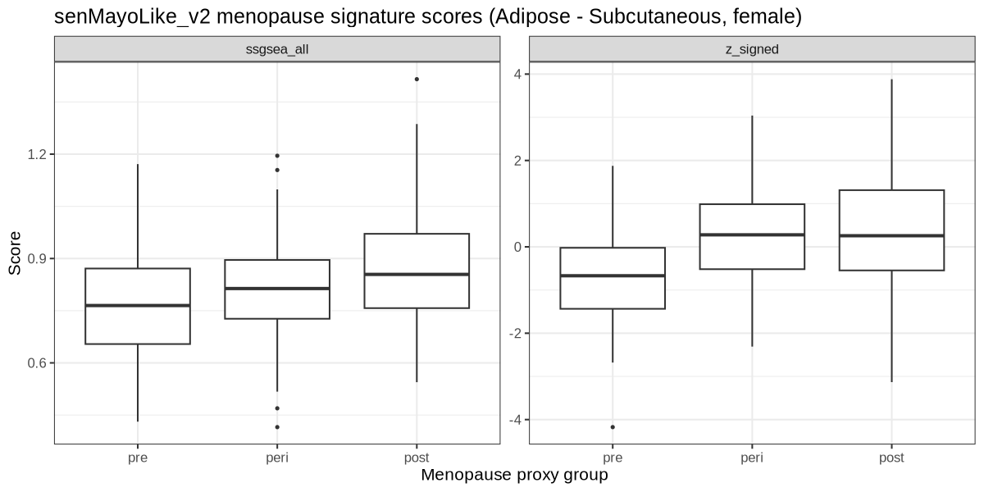
senMayoLike v2 score in GTEx (subcutaneous + visceral)

Slide 15
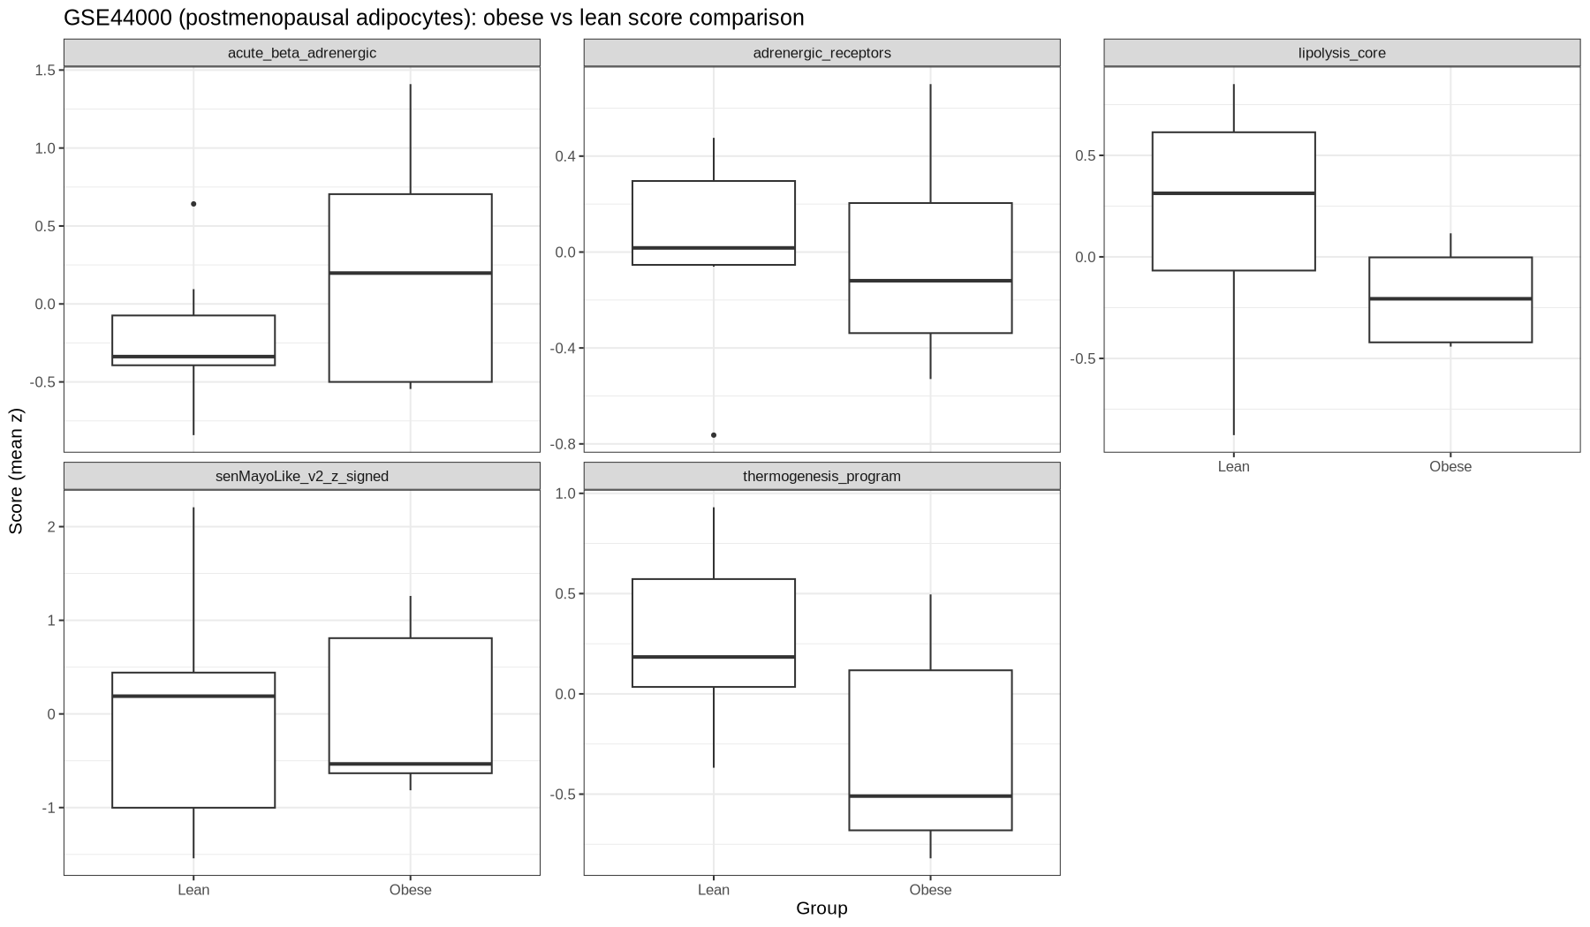
External context (not menopause-status): GSE44000 adipocytes (postmeno only)

Slide 16
Recommended manuscript framing (what we can claim)
Baseline GTEx adipose does not show strong acute SNS immediate-early activation across menopause proxy groups.
Bulk subcutaneous “lipolysis program down” is largely explained by adipocyte-content/composition proxies.
Patterns are compatible with chronic remodeling / altered adrenergic-cAMP responsiveness (possible catecholamine resistance).
senMayoLike v2 menopause signature separates menopause proxy groups (stronger in subcutaneous).

Slide 17
Files to share with collaborators
Master summary: docs/master_summary_menopause_sns_gtex_2026-02-01.md
Key figures:
GTEx_v10_AT_analysis_out/figs/kenichi_sns_panel/figure_candidate__lipolysis_thermogenesis.png
GTEx_v10_AT_analysis_out/figs/next_steps_2026-02-01_composition/kenichi_gene_set_effects_with_composition_adjustment.png
GTEx_v10_AT_analysis_out/figs/next_steps_2026-02-01_signature_refinement/senMayoLike_v2_scores_by_group.png
senMayoLike v2 signature + evidence:
references/menopause_signature_senMayoLike_v2.tsv
references/menopause_signature_senMayoLike_v2_evidence.tsv

