Slide 1
Menopause proxy + SNS/lipolysis in human adipose (GTEx v10)
2026-02-28

Slide 2
Goal + constraints
Goal: add human adipose transcriptomic evidence consistent with adrenergic/lipolysis differences in postmenopause.
Constraints:
GTEx is baseline/unstimulated tissue → acute SNS transcripts may be weak.
Chronic SNS can yield catecholamine resistance → directionality not straightforward.
Bulk adipose is mixed cell types → composition can dominate signals.
Definition here: ‘SNS activation’ = increased sympathetic/adrenergic drive to adipose; in RNA this is often proxied by immediate-early genes (NR4A/FOS/JUN/EGR1) and downstream cAMP/lipolysis programs, but baseline tissue may not capture acute responses.

Slide 3
Data + cohorts (what “pre / peri / post” mean here)
Dataset: GTEx v10 bulk adipose RNA-seq (counts), analyzed separately by depot.
Women-only samples:
Subcutaneous: n=233
Visceral (omentum): n=180
Menopause proxy by age-bin midpoint (GTEx provides age bins, not true menopause status):
pre: age_mid < 45
peri: 45 ≤ age_mid ≤ 55
post: age_mid > 55
Note (important for interpretation): GTEx age is 10-year bins; with this midpoint-based rule, groups map to pre=20–49, peri=50–59, post=60+.
“Strict pre vs post” analyses exclude peri (50–59) to focus on likely extremes.
? Is this acceptable?

Slide 4
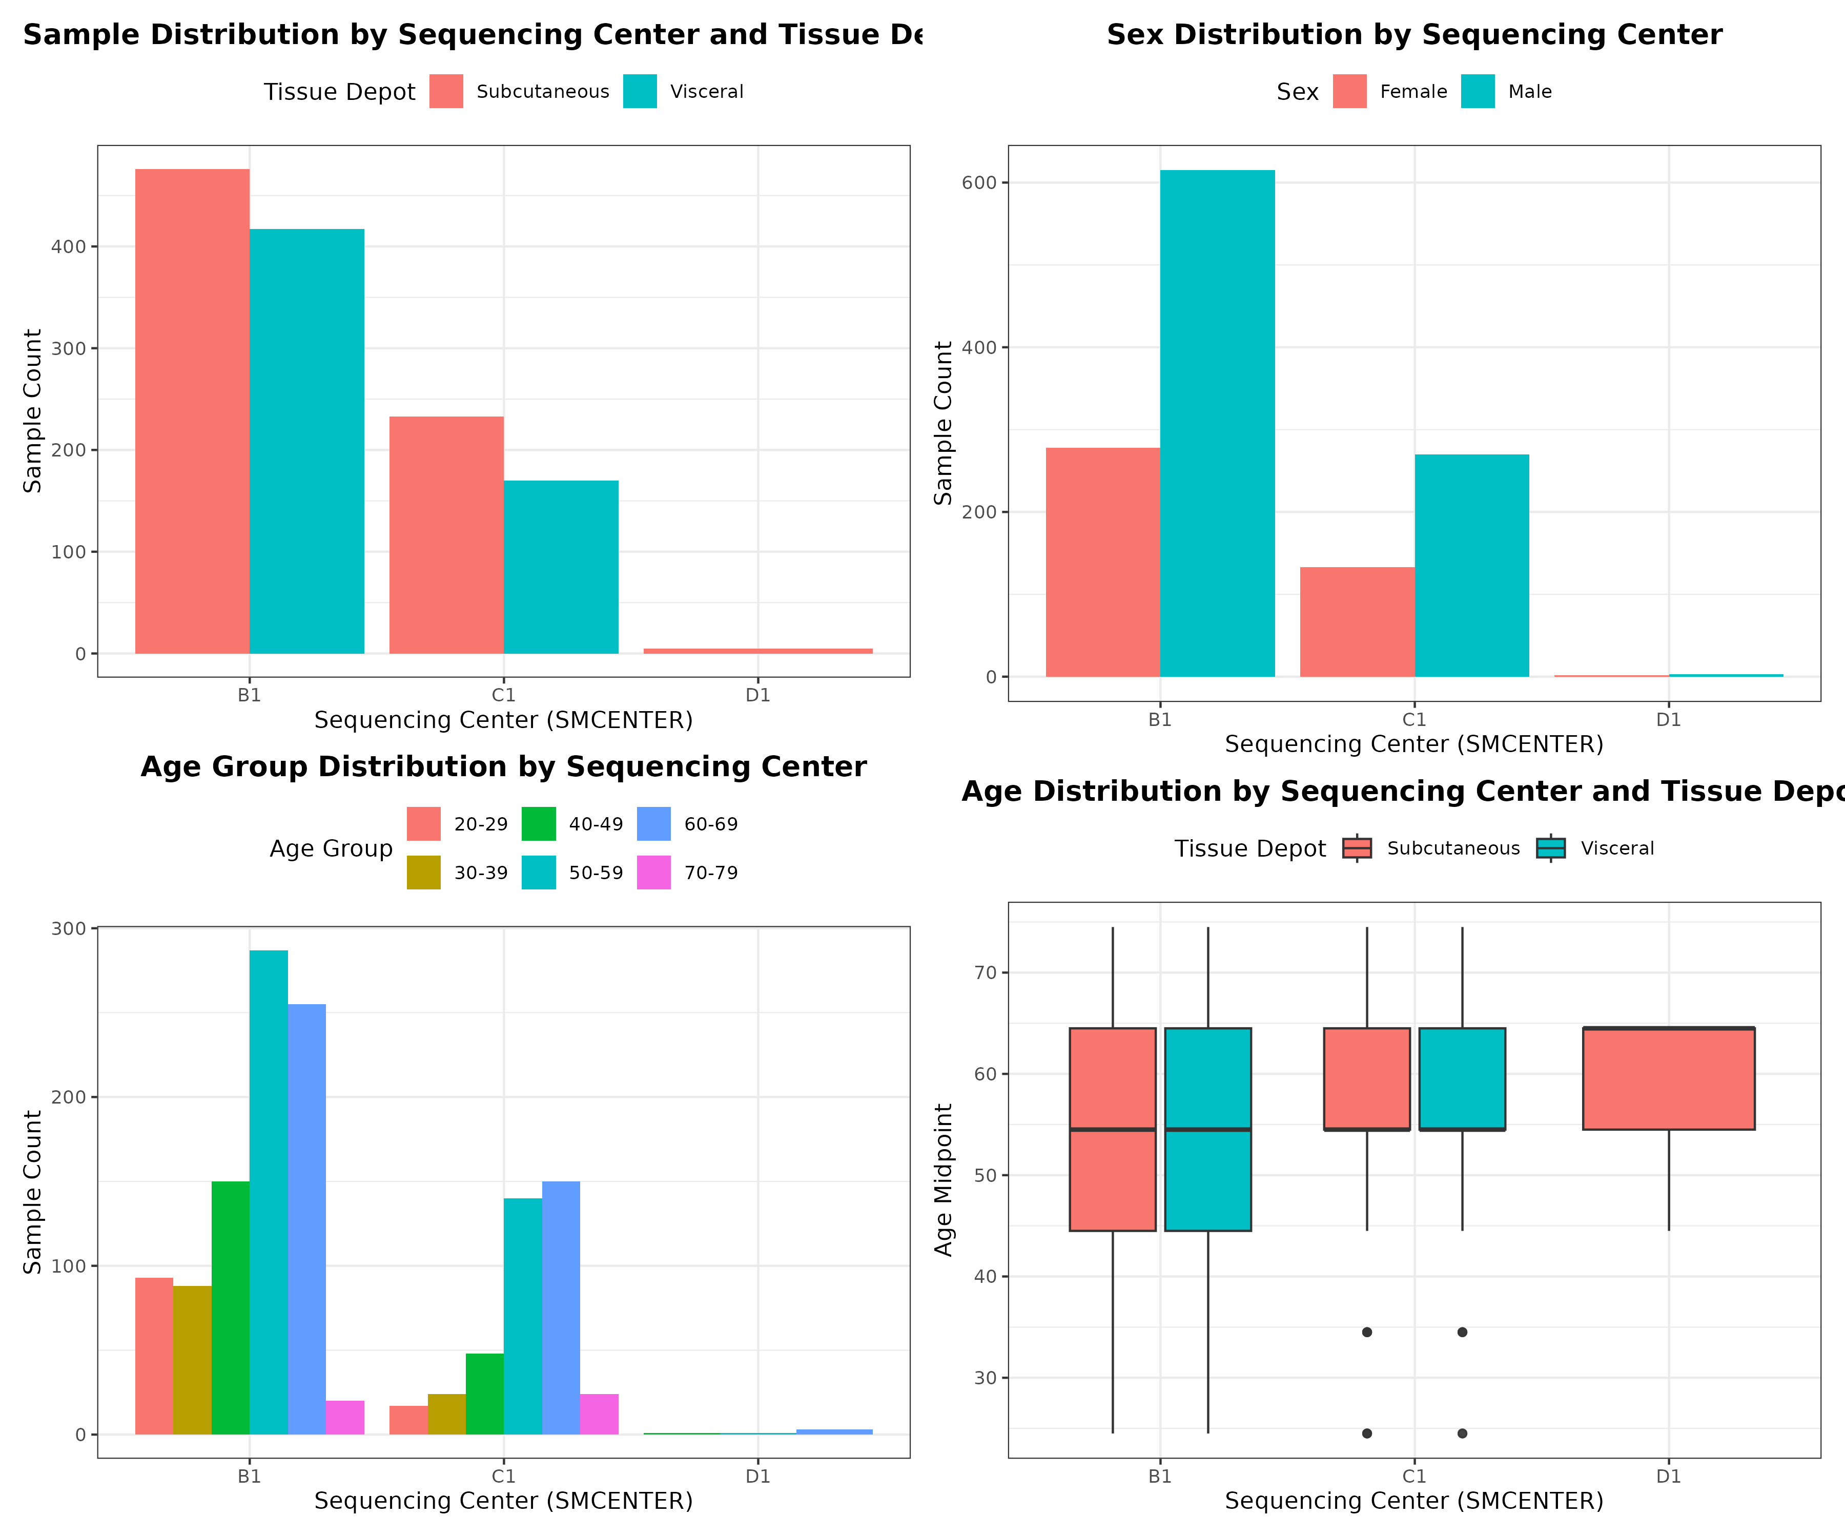
GTEx “batch” reality: sequencing center and batches are major covariates
In GTEx adipose, technical variables are not independent of biology:
SMCENTER (sequencing center) differs by depot, sex, and age-bin distribution.
“Batch correction” is not a single plug-and-play step because aggressive removal can also remove biology if batch is confounded with group.
Therefore in downstream models we:
Always include SMCENTER as a covariate.
Treat “gene-expression batch” (e.g., SMGEBTCH) as a sensitivity/robustness adjustment (not a single “best” model).

Slide 5
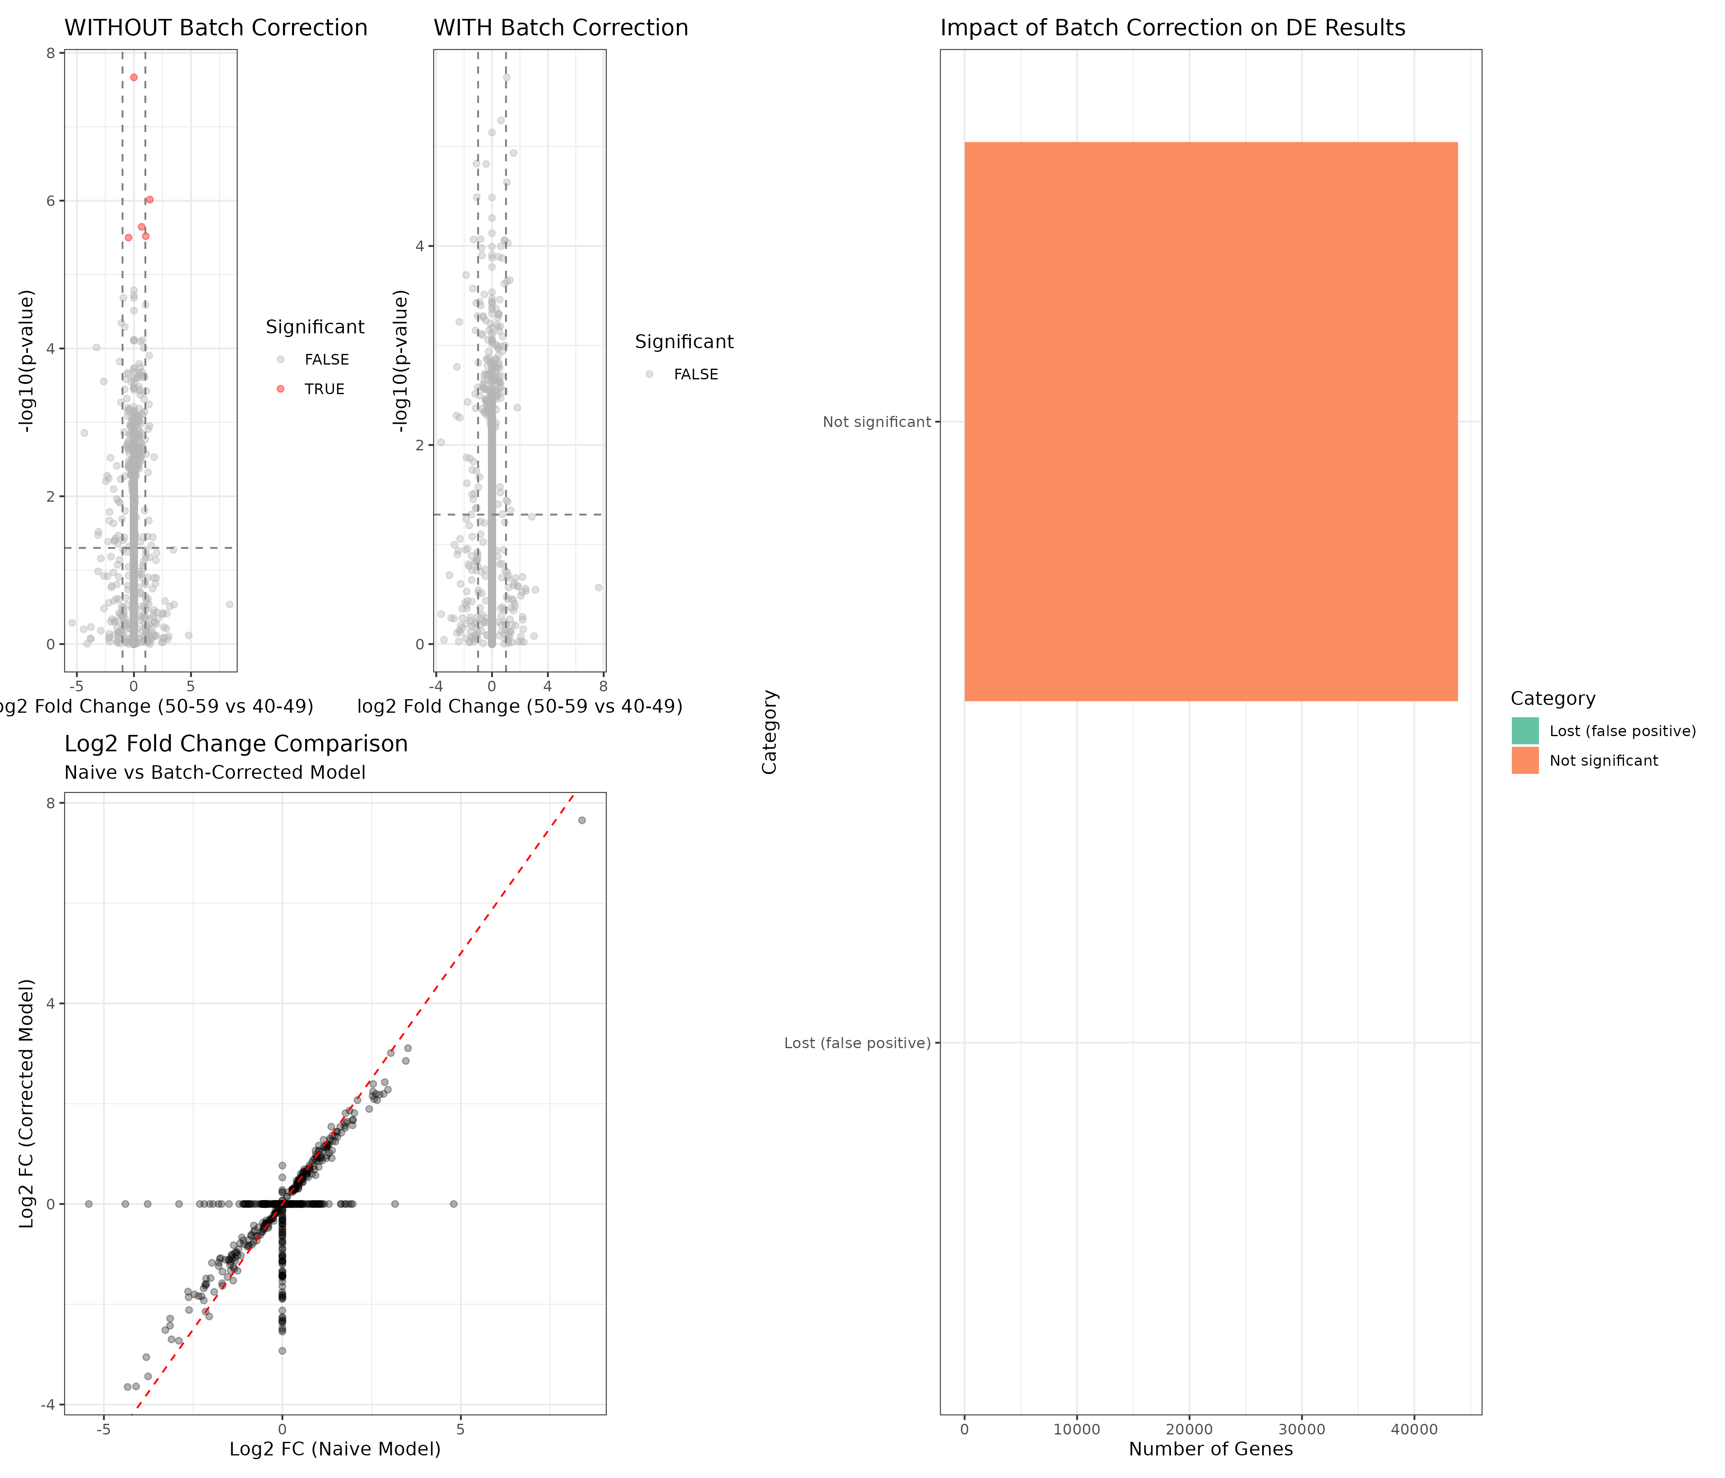
Why we don’t just “ComBat everything”: batch adjustment changes conclusions
Example (female subcutaneous; 40–49 vs 50–59): naive DE can yield “significant” genes that disappear after adding SMCENTER (likely false positives).
Visualization: left shows naive vs center-adjusted DE comparison; right shows PCA before/after ComBat (illustrates how strong center-related structure is).

Slide 6
How gene-set “z-scores” were computed (for Slides 4–6)
For each depot (women-only), using VST-normalized expression:
Step 1: DESeq2 VST on counts.
Step 2: map Ensembl → gene symbols; collapse duplicates by mean.
Step 3: for each gene in a gene set, compute per-sample z-score across samples: - z(gene, sample) = (expr − mean_over_samples) / sd_over_samples
Step 4: gene-set score per sample = mean of z(gene, sample) across genes in the set.
Interpretation: a higher score means higher relative expression of the genes in that set within that depot’s cohort (not an absolute activity measurement).
Kenichi panel gene sets (exact gene lists): references/kenichi_panel_gene_sets.tsv
Plot convention: each dot = one GTEx sample’s gene-set score (not one gene).

Slide 7
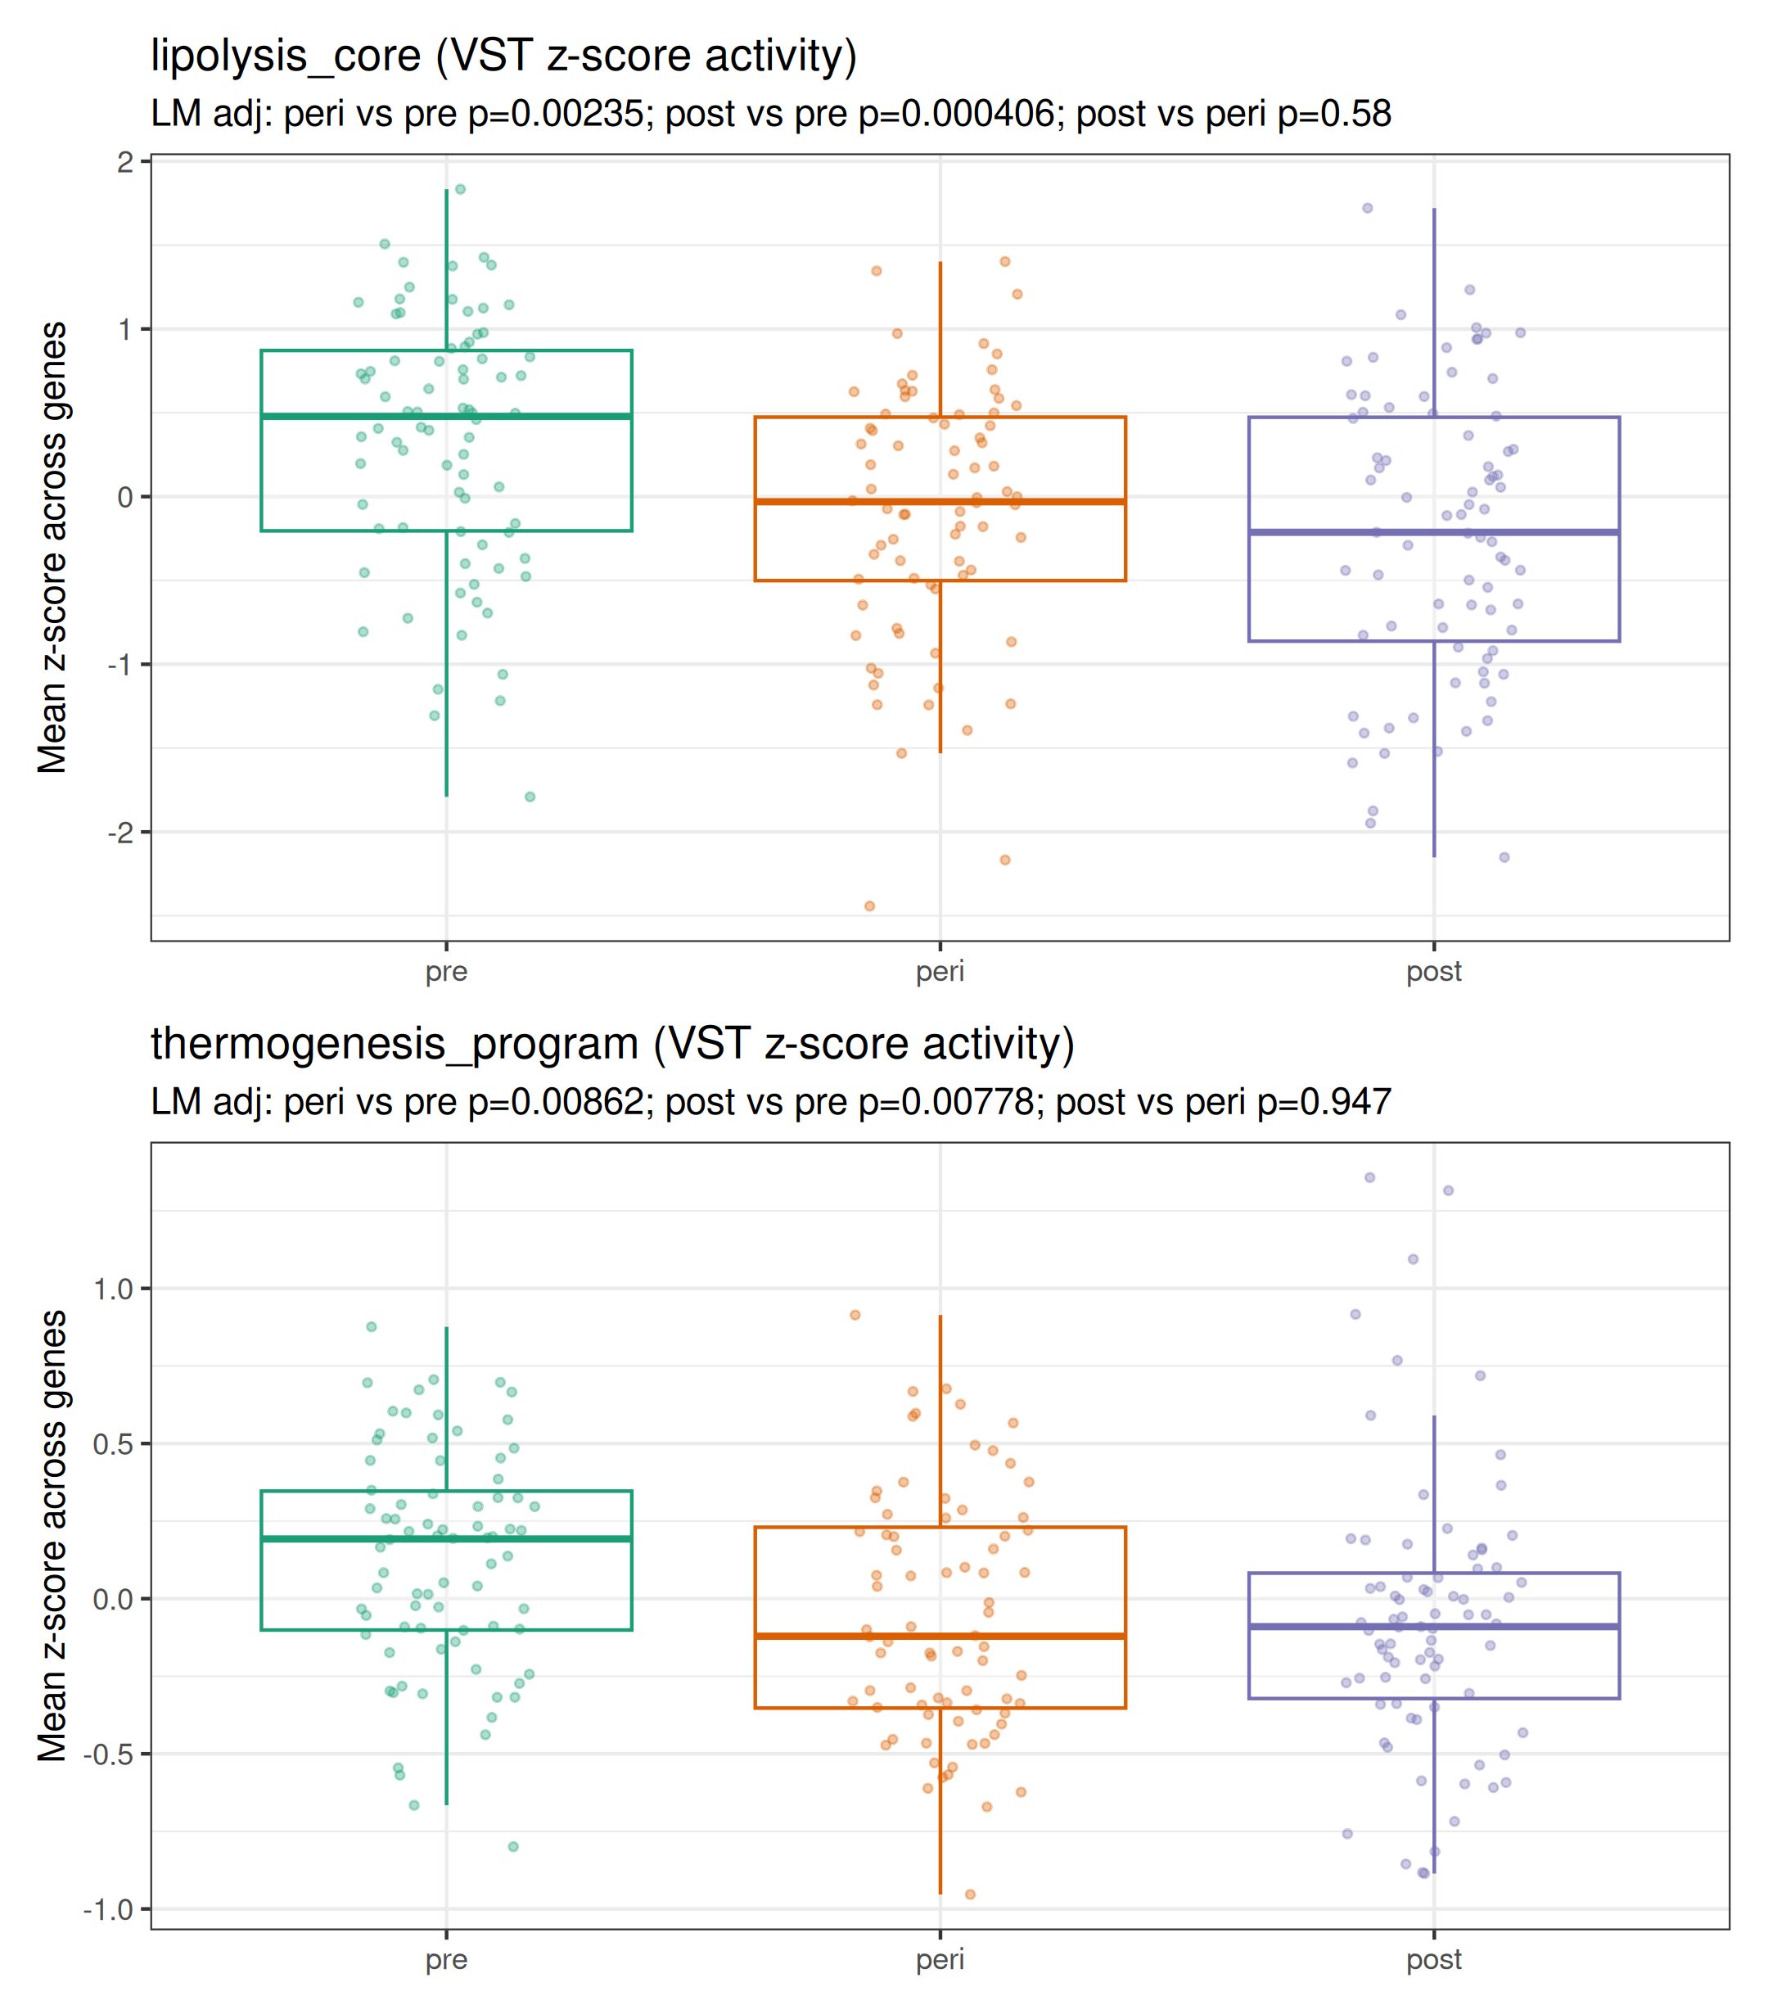
Kenichi panel — subcutaneous baseline gene-set activity
Conclusion (SMCENTER-adjusted):
Groups shown: pre=20–49, peri=50–59, post=60+ (age-bin proxy; not true menopause status).
Score shown: mean gene-wise z-score across the genes in each set (VST expression; z computed across women in this depot).
Kenichi panel includes multiple gene sets; this figure shows lipolysis_core and thermogenesis_program (program-level sets).
Each dot = one sample; per-sample score = mean(z) across the genes in the set.
Acute SNS immediate-early set: not robust at baseline
Lipolysis and thermogenesis programs: lower in peri/post vs pre (bulk signal; see composition adjustment later)

Slide 8
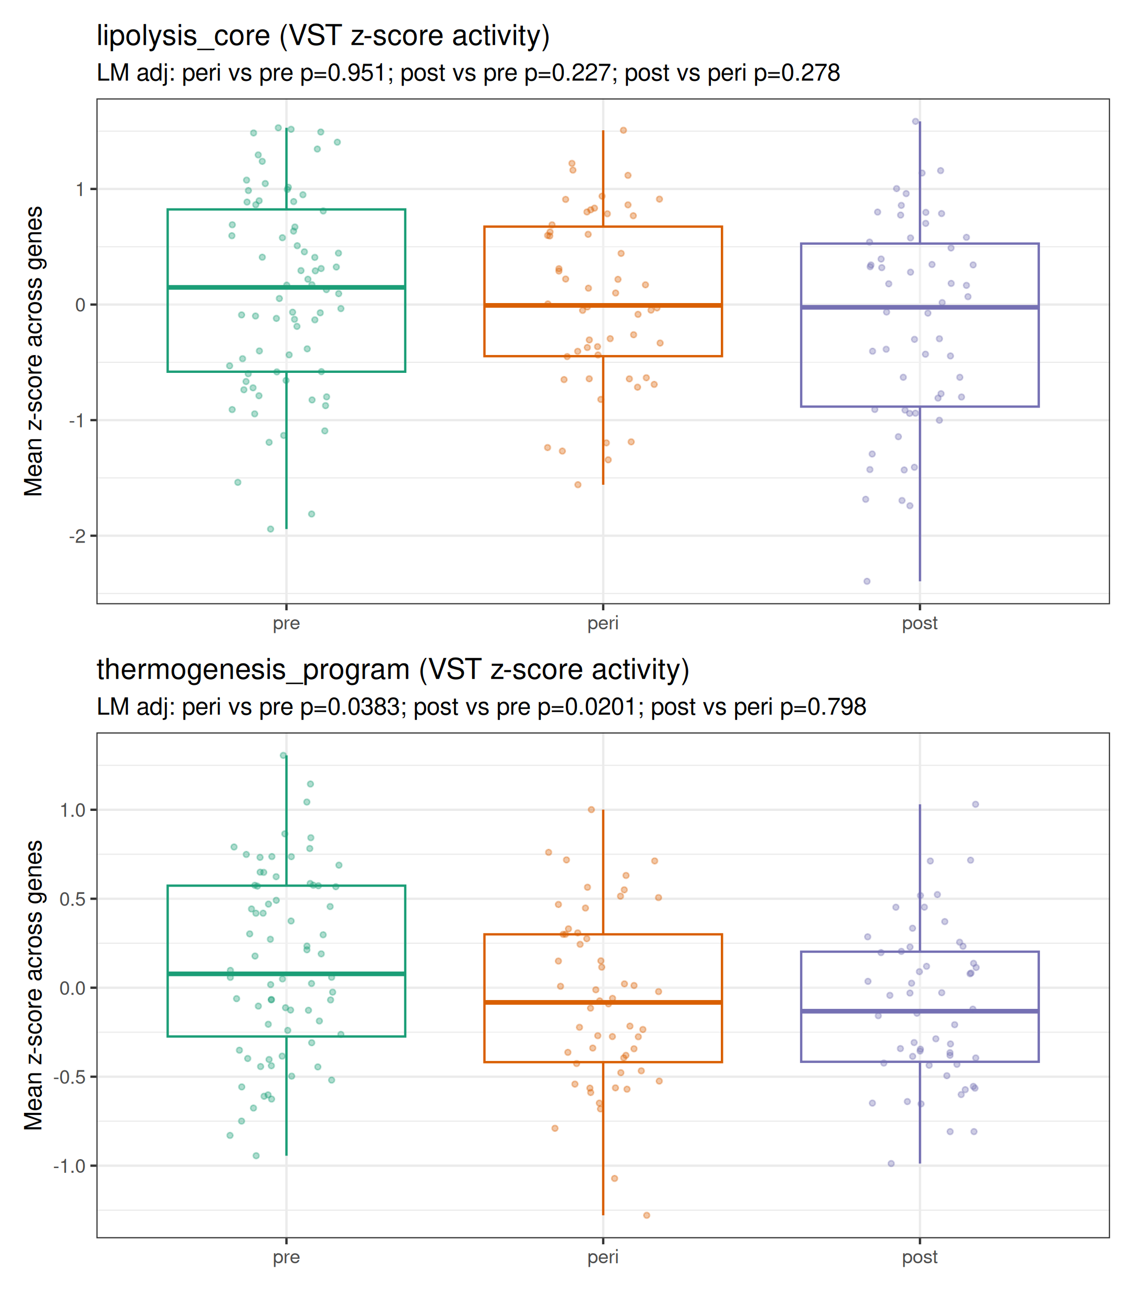
Kenichi panel — visceral baseline gene-set activity
Conclusion (SMCENTER-adjusted):
Groups shown: pre=20–49, peri=50–59, post=60+ (age-bin proxy; not true menopause status).
Score shown: mean gene-wise z-score across the genes in each set (VST expression; z computed across women in this depot).
Kenichi panel includes multiple gene sets; this figure shows lipolysis_core and thermogenesis_program (program-level sets).
Each dot = one sample; per-sample score = mean(z) across the genes in the set.
Acute SNS immediate-early set: not robust at baseline
Thermogenesis program: lower in peri/post vs pre - Lipolysis core: not robust in this depot

Slide 9
Confounding sensitivity analyses (what Slides 10–12 show)
These slides are NOT classical GSEA outputs.
We compute per-sample gene-set/module scores from VST expression (mean gene-wise z across set genes).
Then we fit linear models for group contrasts under a covariate ‘ladder’:
- base: SMCENTER + group
- add technical covariates: SMRIN (RIN), SMTSISCH (ischemic time), DTHHRDY, and optionally SMGEBTCH (gene-expression batch)
- add composition proxies: adipocyte / macrophage / fibroblast marker scores
Interpretation: if an effect disappears after adding composition proxies, the bulk-tissue signal is likely driven by cell-type proportion shifts (not necessarily per-adipocyte transcriptional change).

Slide 10
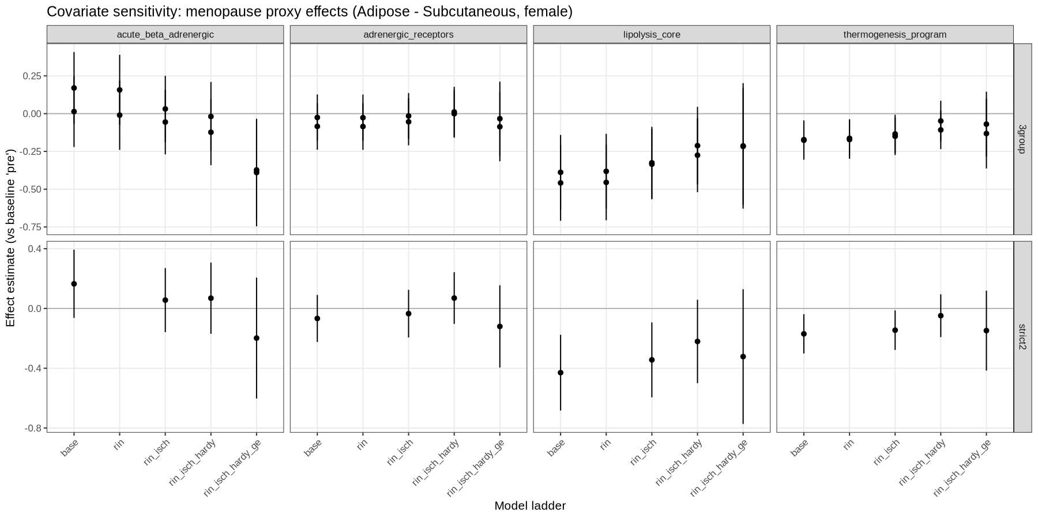
Technical confounding sensitivity (RIN / ischemic time / Hardy / batch)
Purpose: test whether menopause-proxy effects are stable when adding GTEx technical covariates.

Slide 11
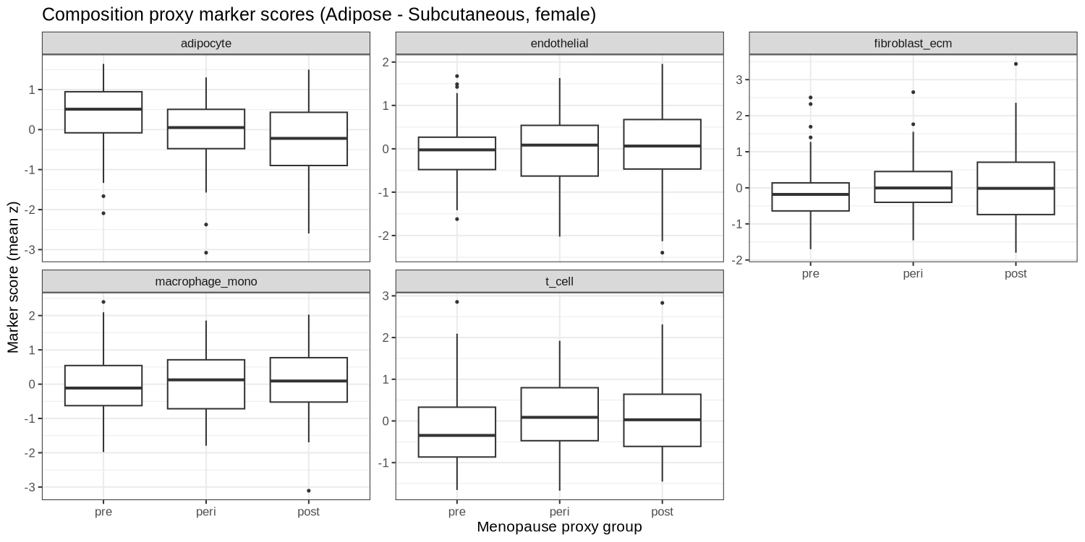
Bulk adipose composition proxies shift with menopause proxy
Key point: adipocyte-content proxy decreases in peri/post vs pre in subcutaneous bulk tissue.

Slide 12
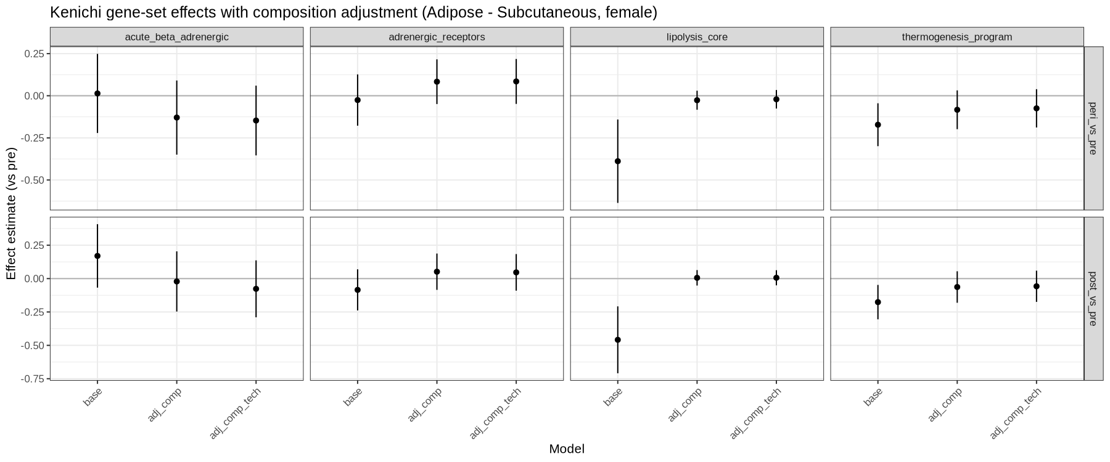
Subcutaneous: composition adjustment explains “lipolysis_core down”
Key point: the subcutaneous lipolysis_core “down” signal is strongly composition-sensitive.

Slide 13
Quick summary (confounding + composition): interpretation
Bulk adipose RNA is a mixture: bulk_expr ≈ p_adip·expr_adip + p_SVF·expr_SVF.
So if adipocyte fraction (p_adip) decreases, adipocyte-enriched genes/sets can look ‘down’ in bulk even when per-adipocyte expression is unchanged.
In subcutaneous GTEx, adipocyte proxy score decreases in peri/post vs pre.
After adding composition proxies as covariates, the residual post–pre difference for lipolysis_core is ~0 → we cannot claim strong per-adipocyte downregulation from bulk alone.
This does NOT prove there is no per-adipocyte dysregulation; it means bulk data cannot separate composition vs per-cell regulation without additional evidence (e.g., purified adipocytes or single-cell / deconvolution).

Slide 14
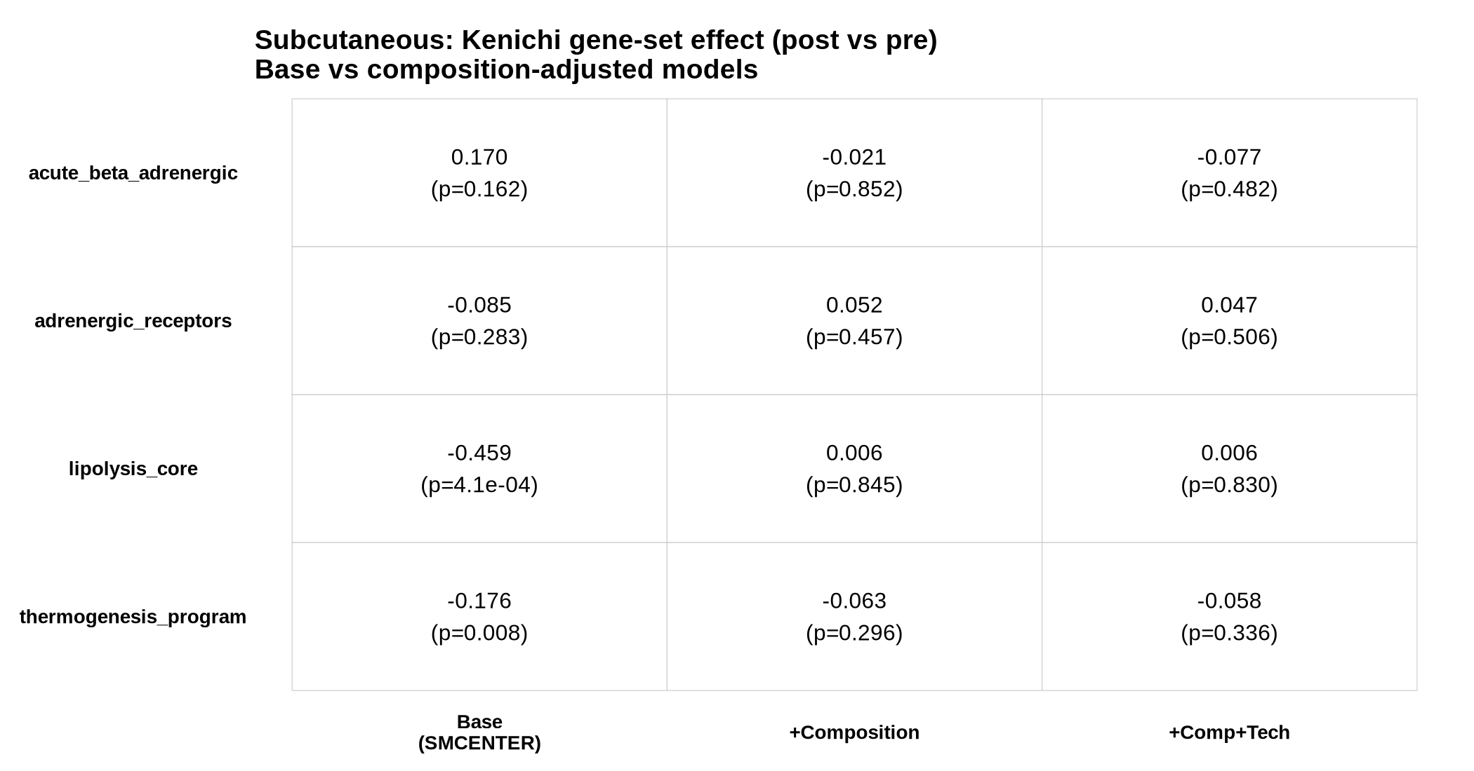
Subcutaneous: key table (post vs pre) — base vs composition-adjusted

Slide 15
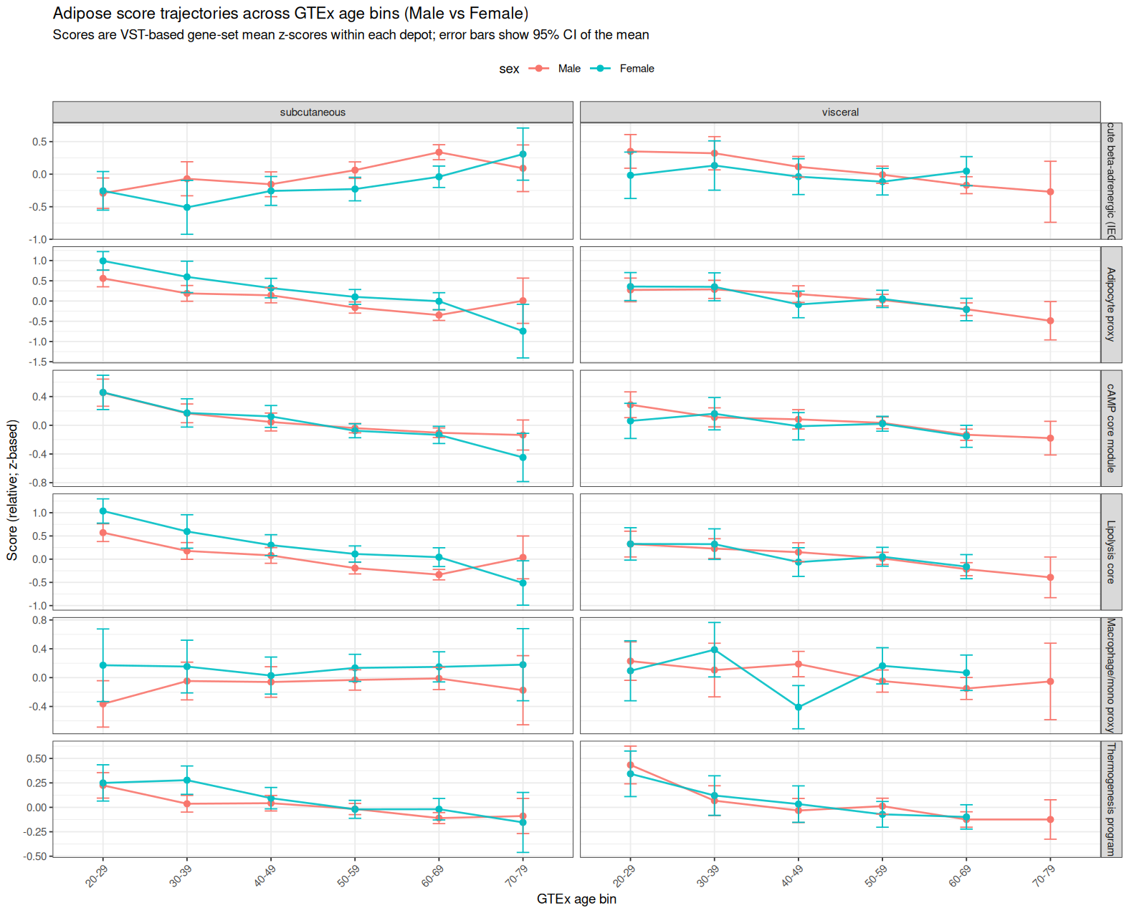
Male vs female context (Kenichi caveat) — trajectories across age bins
Kenichi note: male–female comparisons are not a perfect control (men also have hormonal aging + psychosocial confounds), but can provide context.
Here we plot key adipose scores across GTEx age bins in both sexes (separate depots).

Slide 16
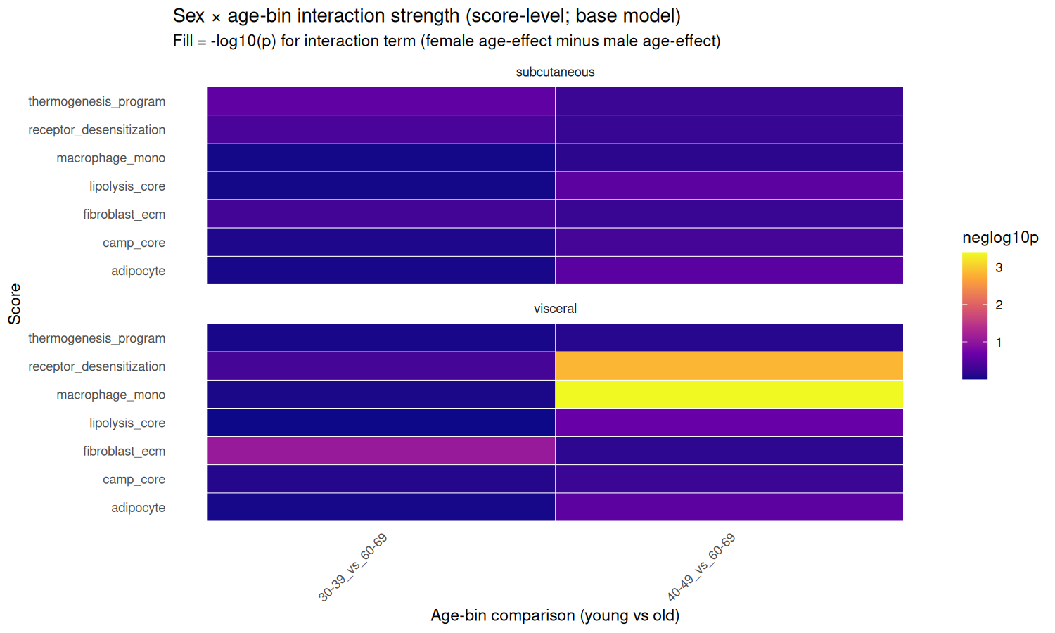
Male vs female context — sex×age interaction (score-level)
Model: score ~ SMCENTER + sex + age_group + sex:age_group (base); comparisons: 40–49 vs 60–69 and 30–39 vs 60–69.
Color = −log10(p) for interaction term (female aging effect minus male aging effect).
Interaction term = (Female_old − Female_young) − (Male_old − Male_young) = ‘female age-effect minus male age-effect’ (difference-in-differences).
Summary: several aging effects appear stronger in males (consistent with the “male aging may be larger” caveat); female-specific interaction is modest for most scores after composition-aware adjustment.

Slide 17
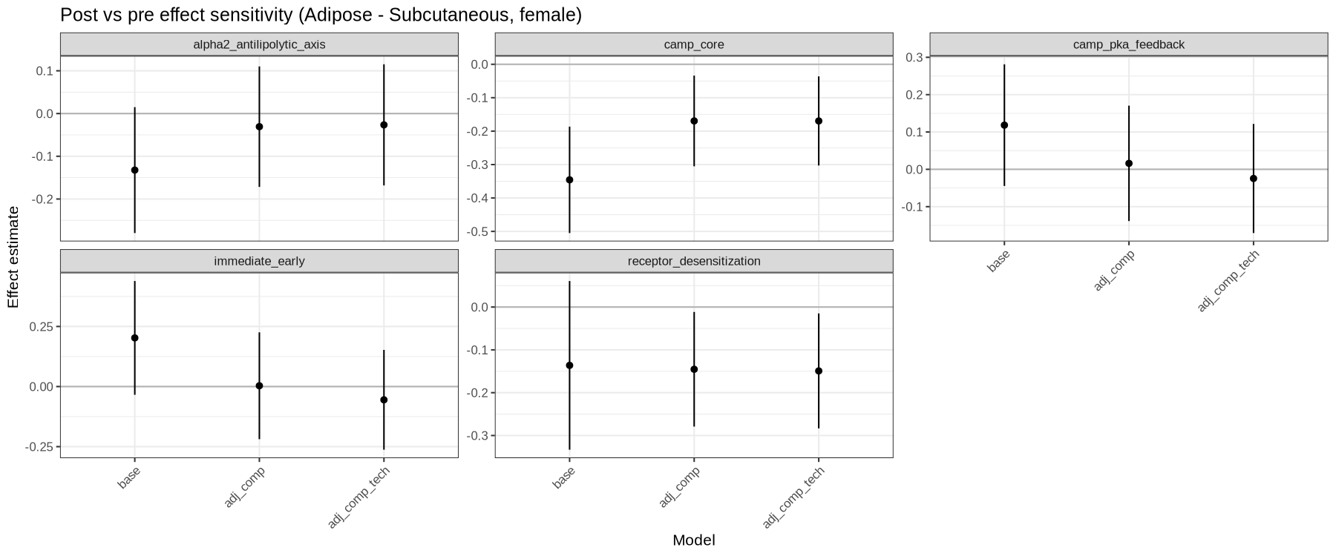
Adrenergic/cAMP/desensitization modules (subcutaneous)
Interpretation: more compatible with altered responsiveness/chronic adaptation than acute SNS activation at baseline.
Effect estimate = adjusted difference in module score (post − pre) from linear models.
Models shown: base = SMCENTER + group; adj_comp = base + (adipocyte/macrophage/fibroblast proxies); adj_comp_tech = adj_comp + (SMRIN + SMTSISCH).
Positive = higher in post; negative = lower in post (relative expression of genes in the module).

Slide 18
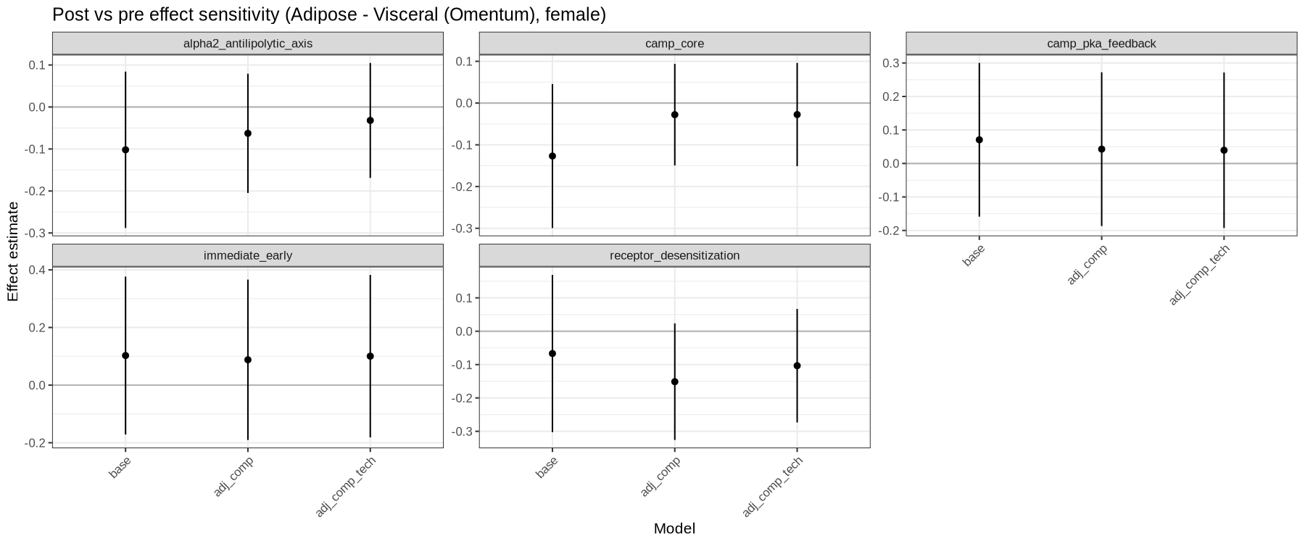
Adrenergic/cAMP/desensitization modules (visceral)

Slide 19
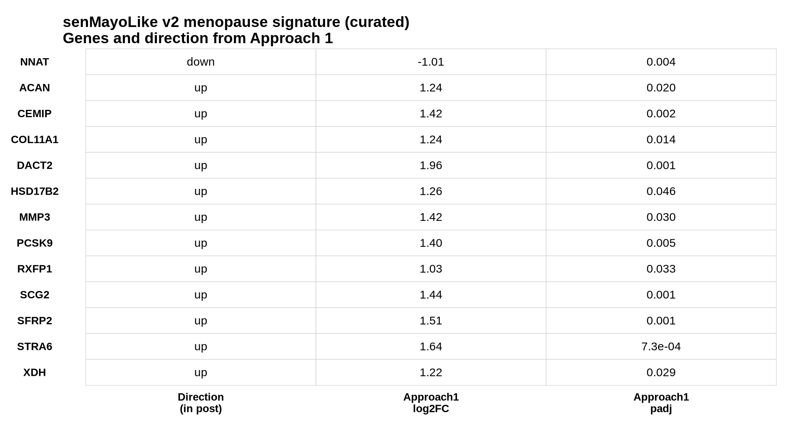
Menopause signature: senMayoLike v2 (curated, evidence-backed)
Signature size: 13 total genes (12 up in post, 1 down in post).
How selected (summary):
- Start: GTEx subcutaneous menopause-proxy discovery list (Approach 1; 81 genes).
- Remove lncRNA/pseudogene/keratin/blood-heavy markers; score robustness to composition + technical covariates.
- v1 = data-driven ‘robustness-screen’ subset (top genes in adj_comp_tech model).
- v2 (shown here) = curated, smaller, biology-interpretable subset anchored to Approach 1 direction + literature evidence (ECM/Wnt/remodeling + hormone/metabolic candidates).
Not the same as the Kenichi SNS panel: the SNS panel is hypothesis-driven adrenergic/lipolysis sets; this is a menopause-proxy signature.
Full per-gene evidence + sources: docs/senMayoLike_v2_signature_details_2026-02-02.xlsx (or CSV).

Slide 20
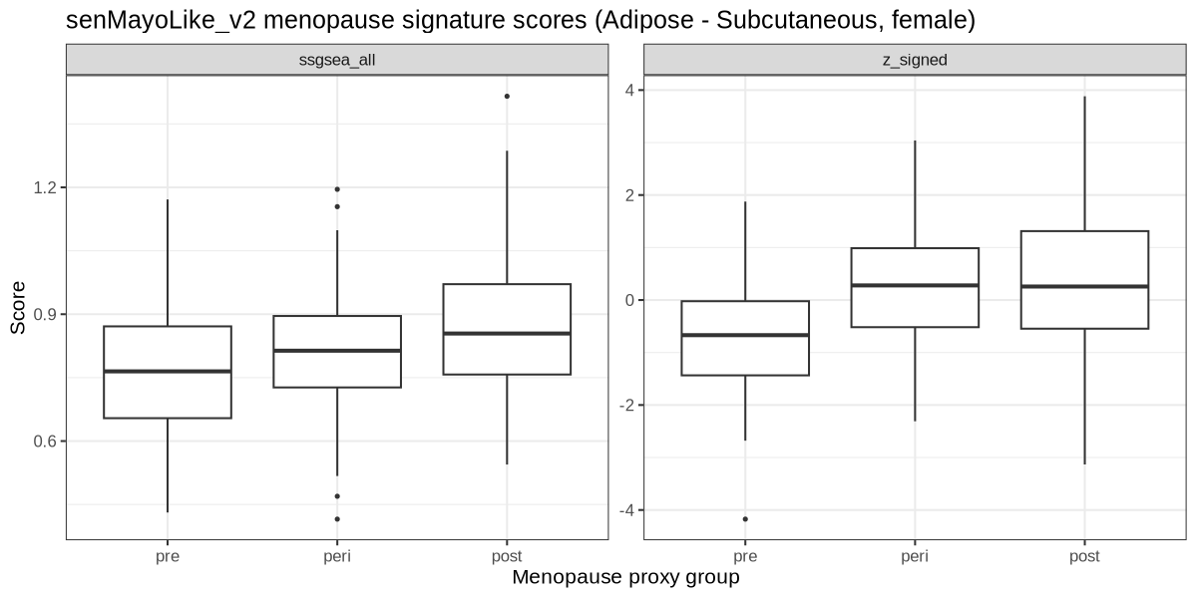
senMayoLike v2 score in GTEx (subcutaneous + visceral)
How the score is computed (Slide 13): - z_signed = mean(z of “up” genes) − mean(z of “down” genes), using the same per-gene z-scoring as earlier. - ssgsea_all = ssGSEA enrichment score (GSVA::ssgsea) using VST expression. - Conclusion: menopause-proxy groups separate most clearly in subcutaneous (post > pre); visceral is weaker/noisier.

Slide 21
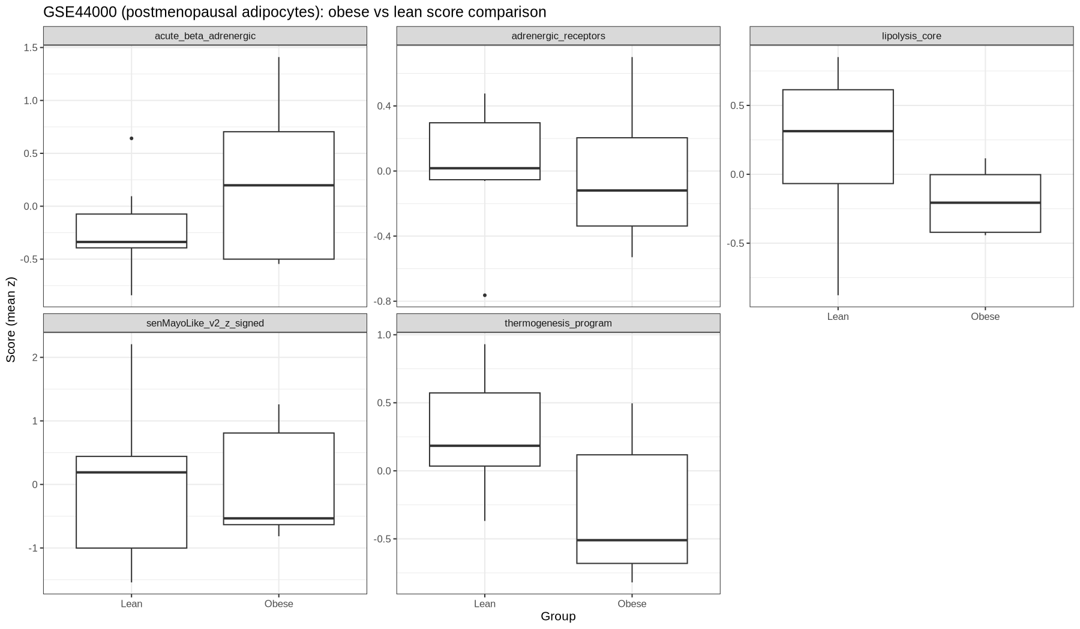
External context (not menopause-status): GSE44000 subcutaneous adipocytes
Dataset: GSE44000 (Agilent microarray)
Tissue/cell type: isolated human subcutaneous adipocytes
Subjects: postmenopausal women only (not a pre/post menopause dataset)
Contrast: obese vs lean (n=14 total)
Purpose here: adipocyte-enriched context to interpret programs without bulk composition confounding

Slide 22
Summary (what we can claim)
Baseline bulk GTEx adipose does not show robust ‘acute SNS activation’ immediate-early signatures across menopause-proxy groups (NR4A/FOS/JUN/EGR1 set is weak at baseline).
Across multiple stress-tests, we do observe shifts consistent with altered adrenergic signaling *responsiveness* (cAMP/feedback modules) and depot remodeling, which is compatible with a chronic SNS / catecholamine-resistance framework (but may not directly measure SNS outflow).
Subcutaneous bulk lipolysis_core differences are strongly composition-sensitive; after adipocyte/SVF proxy adjustment the residual post–pre difference is small → avoid per-adipocyte claims from bulk alone.
Visceral depot shows weaker/noisier signals overall, but thermogenesis-program shifts are more consistent than lipolysis-core shifts.
Positive finding: the evidence-backed senMayoLike v2 menopause signature (13 genes) separates menopause-proxy groups (stronger in subcutaneous).
Recommended wording: ‘Human baseline adipose transcriptomes support menopause-associated remodeling and altered adrenergic/cAMP program behavior; acute SNS activation signatures are not robustly observed in unstimulated tissue.’

Slide 23
Files to share with collaborators
Master summary: docs/master_summary_menopause_sns_gtex_2026-02-01.md
senMayoLike v2 (full details + evidence):
TSV: references/menopause_signature_senMayoLike_v2_evidence.tsv
CSV: docs/senMayoLike_v2_signature_details_2026-02-02.csv
Excel: docs/senMayoLike_v2_signature_details_2026-02-02.xlsx
Key figures:
GTEx_v10_AT_analysis_out/figs/kenichi_sns_panel/figure_candidate__lipolysis_thermogenesis.png
GTEx_v10_AT_analysis_out/figs/next_steps_2026-02-01_composition/kenichi_gene_set_effects_with_composition_adjustment.png
GTEx_v10_AT_analysis_out/figs/next_steps_2026-02-01_signature_refinement/senMayoLike_v2_scores_by_group.png

Slide 24
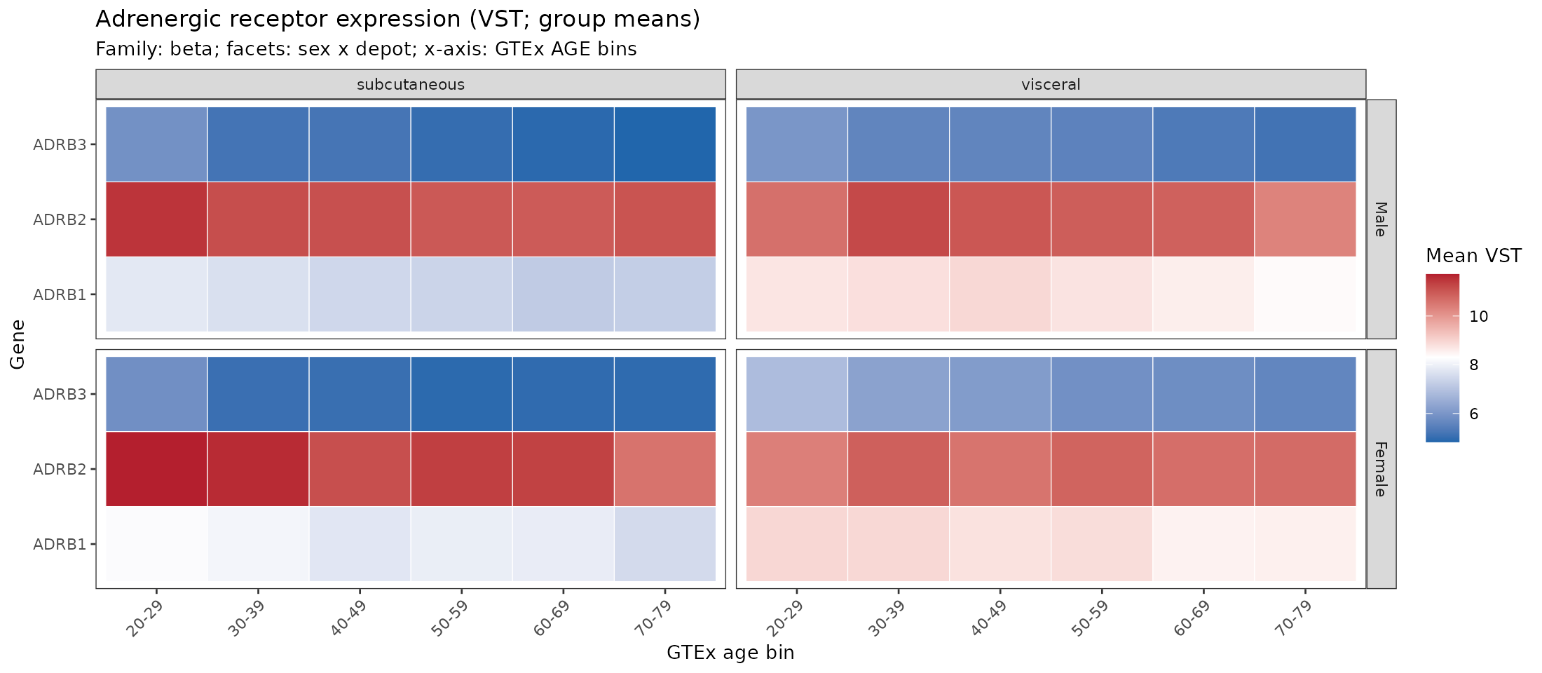
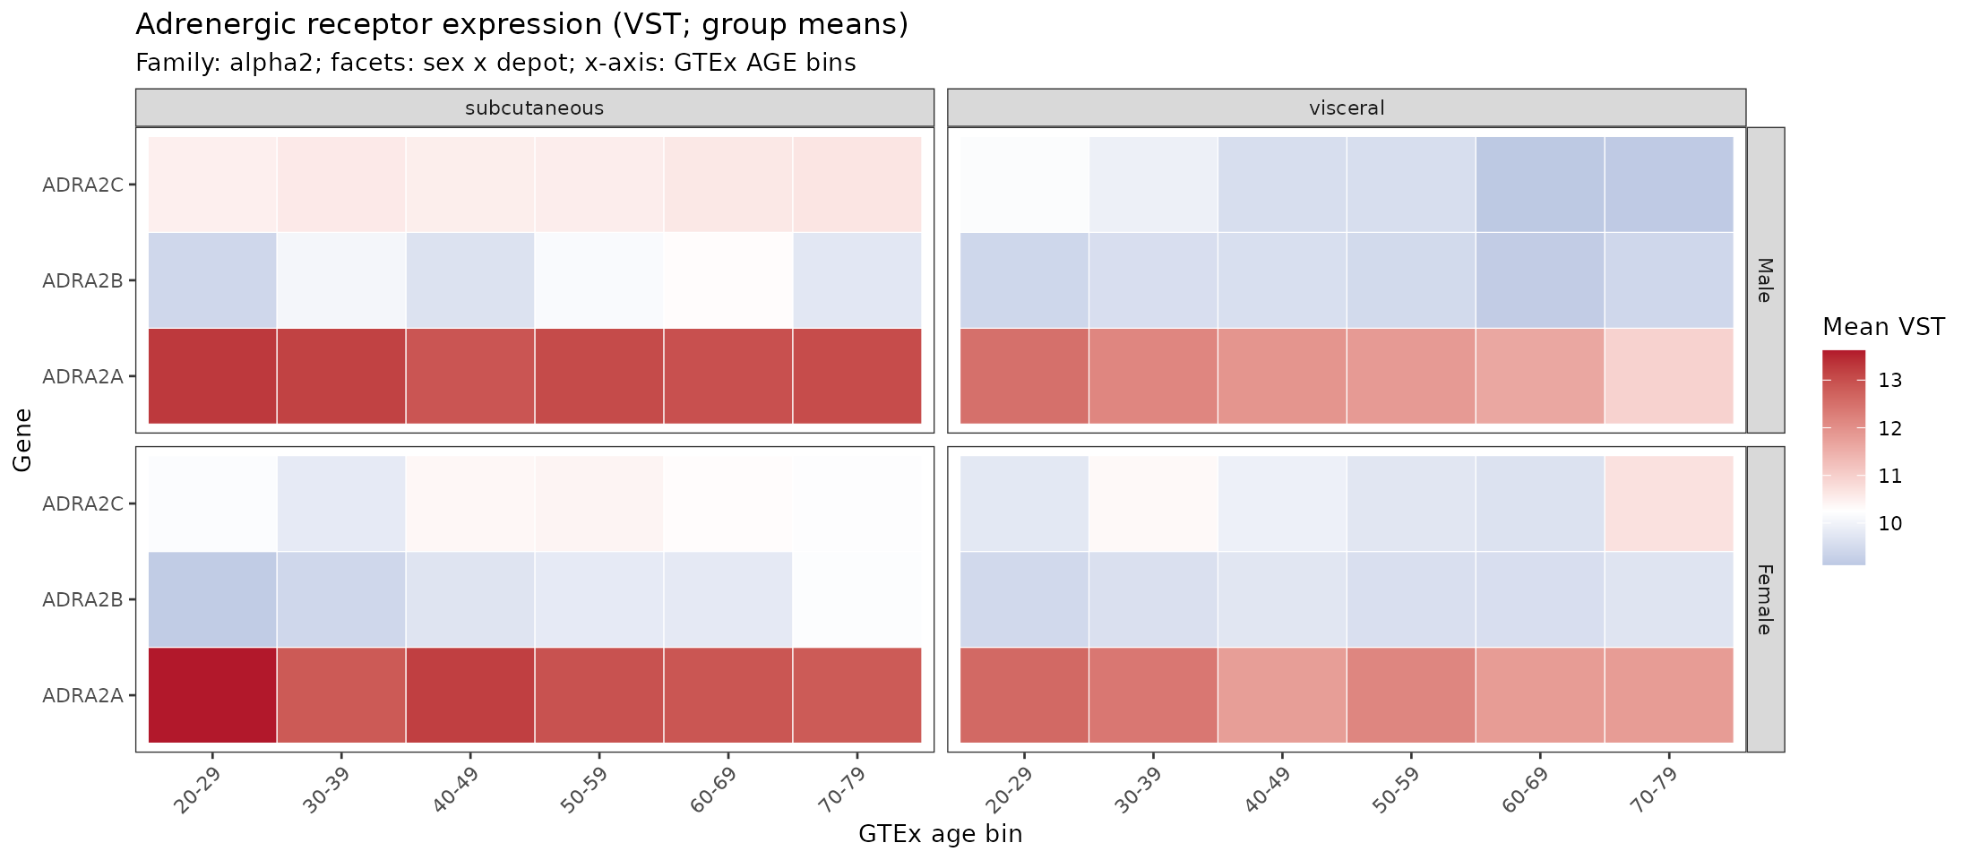
Update (2026-02-28): adrenergic receptor expression (depot/sex/age bins)
Heatmaps show mean VST per (depot × sex × age bin).

Slide 25
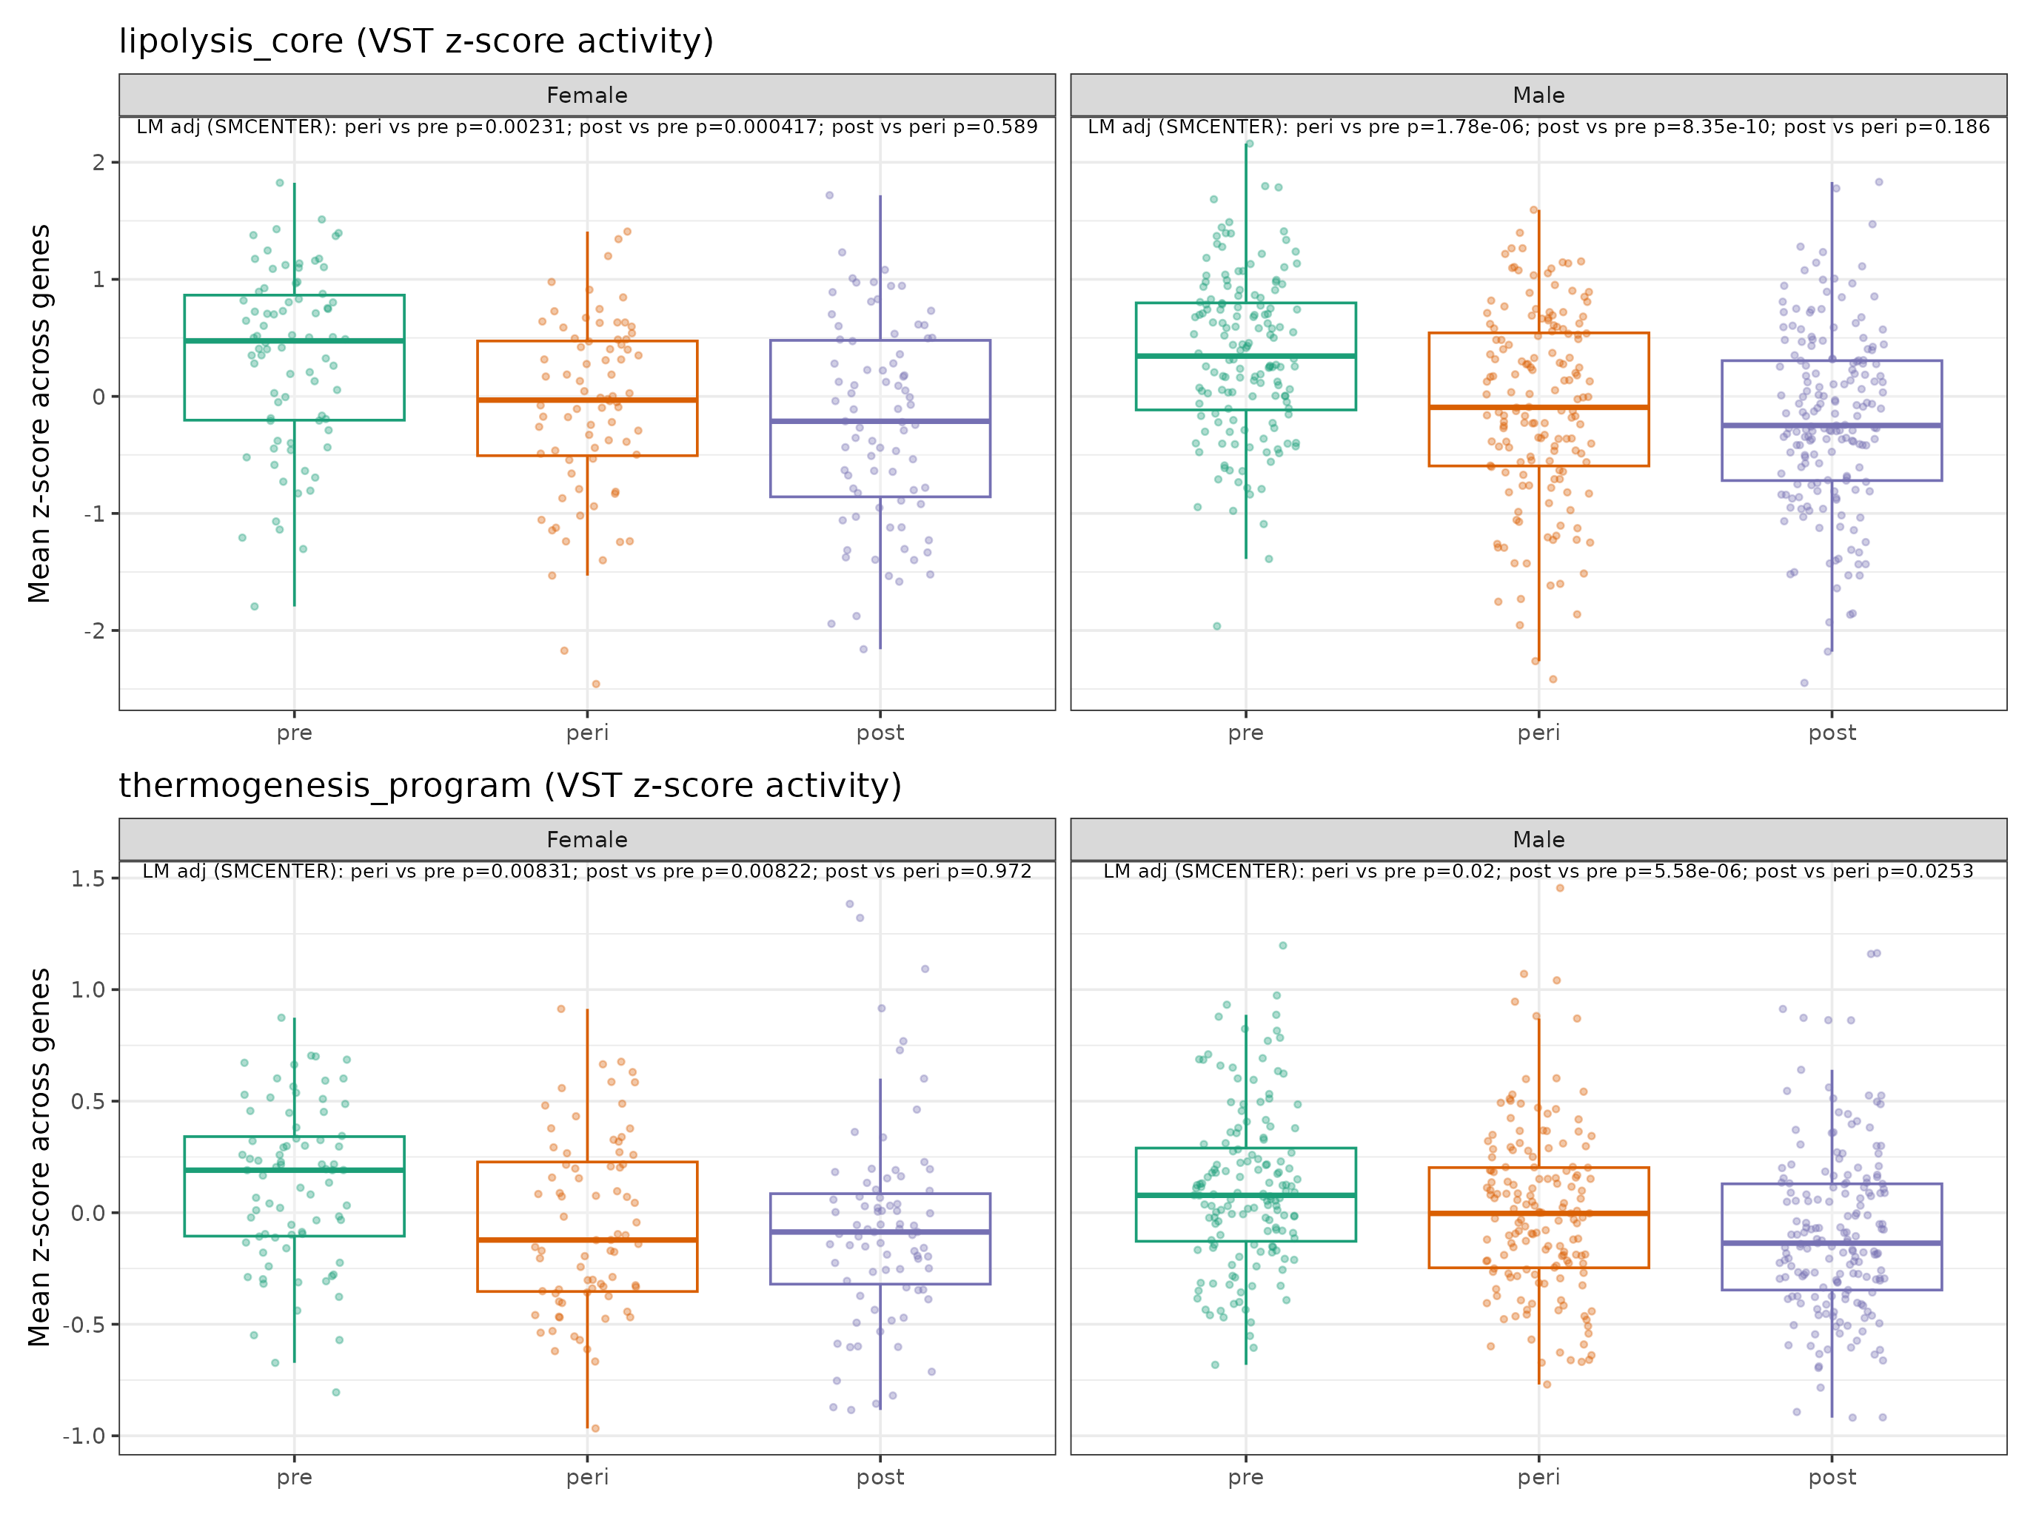
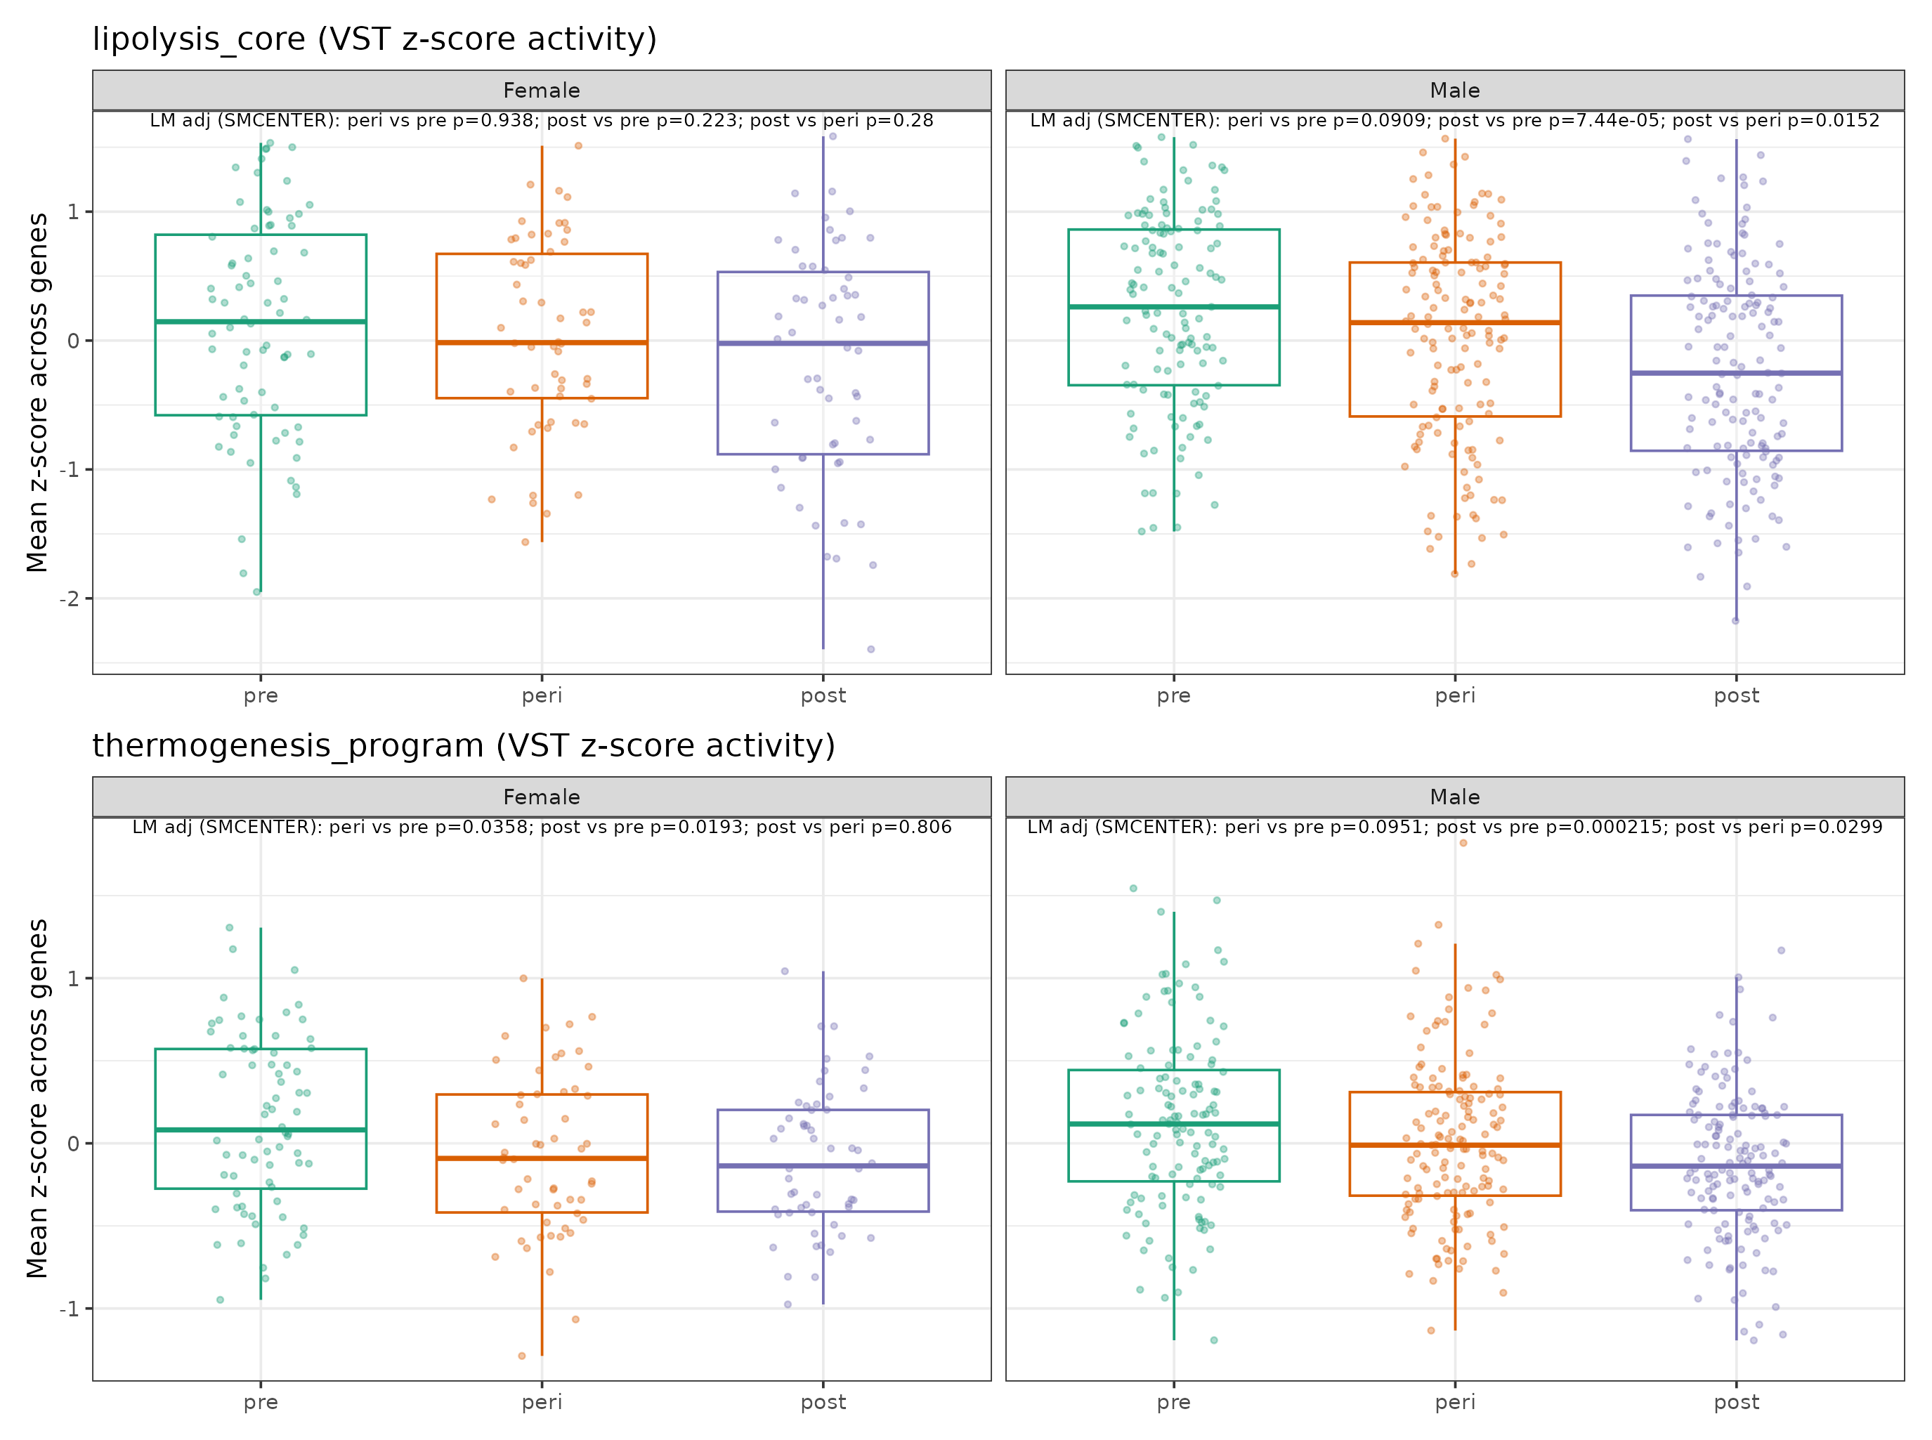
Update (2026-02-28): Kenichi panel (Slides 7–8 style), faceted by sex
Same scoring as Slides 7–8; plotted separately for male vs female.

Slide 26
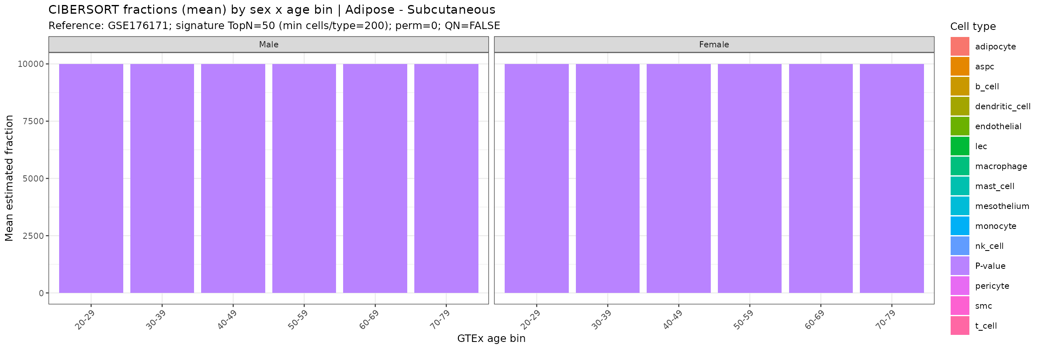
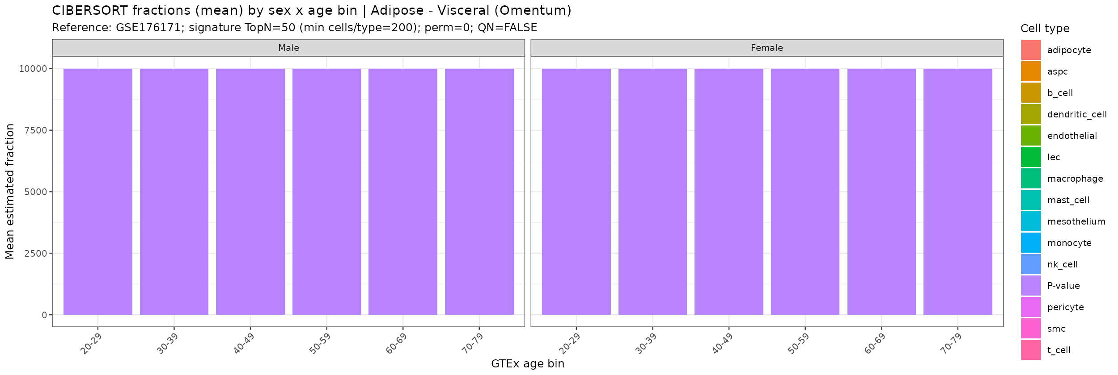
Update (2026-02-28): first-pass cell fractions (CIBERSORT; GSE176171 reference)
Fractions are mean by (sex × age bin); perm=0 first pass; TopN50 signature.

Slide 27
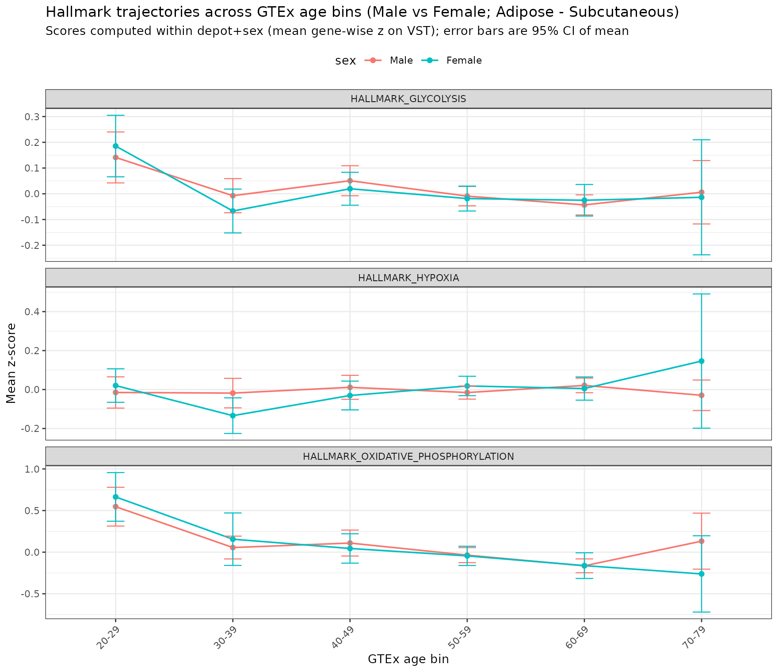
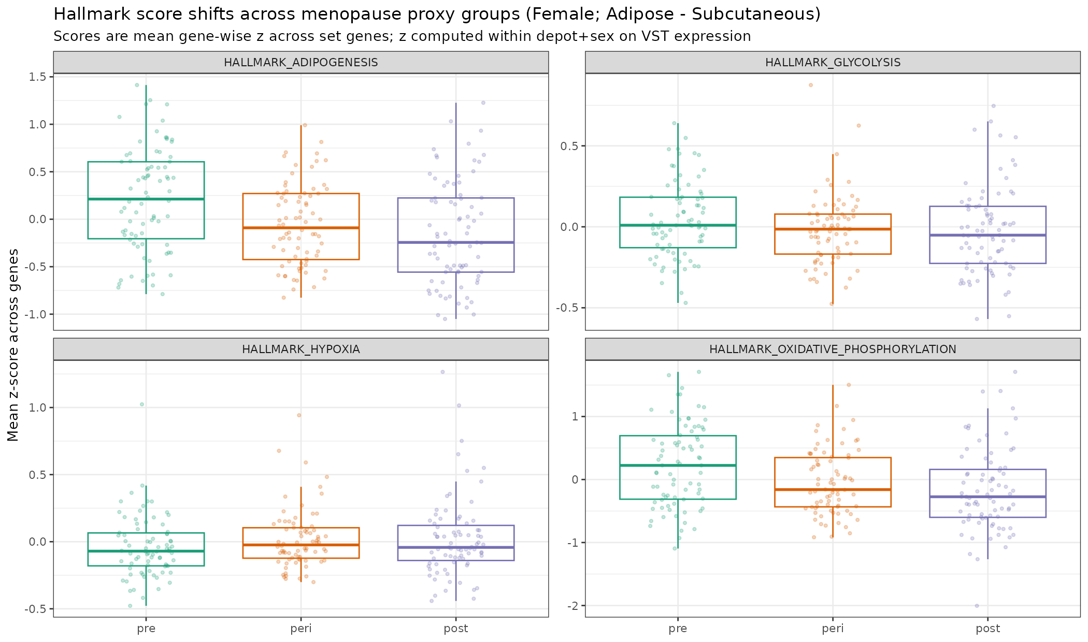
Update (2026-02-28): glycolysis and related hallmarks (baseline GTEx)
Key point: Hallmark Glycolysis shows no robust pre/peri/post shift; OXPHOS/inflammation/adipogenesis move.

Slide 28
Update (2026-02-28): new outputs added since v4.1.2
Adrenergic receptor heatmaps: figs/next_steps_2026-02-28_receptor_heatmaps/*.png
Sex-faceted Kenichi panels: figs/next_steps_2026-02-28_kenichi_panel_by_sex/*.png
CIBERSORT first-pass fractions: figs+tables/next_steps_2026-02-28_cibersort_fractions/*
Glycolysis/Hypoxia/OXPHOS hallmarks: figs+tables/next_steps_2026-02-28_glycolysis/*
Memo: docs/glycolysis_hypothesis_memo_2026-02-28.md

