Slide 1
Update (2026-04-12)
Kenichi Follow-Up | Glycolysis Gene-Node Modeling | CIBERSORTx Pipeline
v4.6.1 | 1

Slide 2
Kenichi Follow-Up: Overview
Addressing feedback from 2026-03-27 email
Point 1: Inflammation Depot Specificity
Point 2: Baseline Transcriptome Limitation
Is inflammation increased in subcutaneous but NOT visceral?
Opposite to OVX mouse model (visceral inflammation UP)
-> Formal depot x menopause interaction test
Cannot conclude SNS activity from baseline data alone
Patterns 'consistent with' chronic drive, not proof
-> CIBERSORTx HiRes in progress for cell-type resolution
Point 3: Aging vs Menopause Confound
Point 4: ADRB2 / Fibrosis / Adipocyte Correlations
Male and female trends parallel in some gene sets (v4.3.0 baseline)
-> Sex-interaction model: score ~ sex + age + sex:age
-> Formal test of female-specific beyond-male-aging effects
ADRB2 negatively correlated with inflammation/fibrosis
Consistent with catecholamine resistance model
-> Deep correlation analysis + human-mouse concordance
Key New Findings:
1. Inflammation: confirmed UP in subcutaneous-post, weaker/non-significant in visceral (depot-specific)
2. Senescence: significantly UP in both depots (subcutaneous p=0.0008, visceral p=0.005)
3. Aging vs menopause: some gene sets show female-specific effects beyond male aging
4. ADRB2 negatively correlated with inflammatory/fibrotic scores in both depots
5. Concordance with OVX mouse: 8/14 comparisons concordant; discordance mainly in visceral inflammation/fibrosis and ADRB2 direction
v4.6.1 | 2

Slide 3
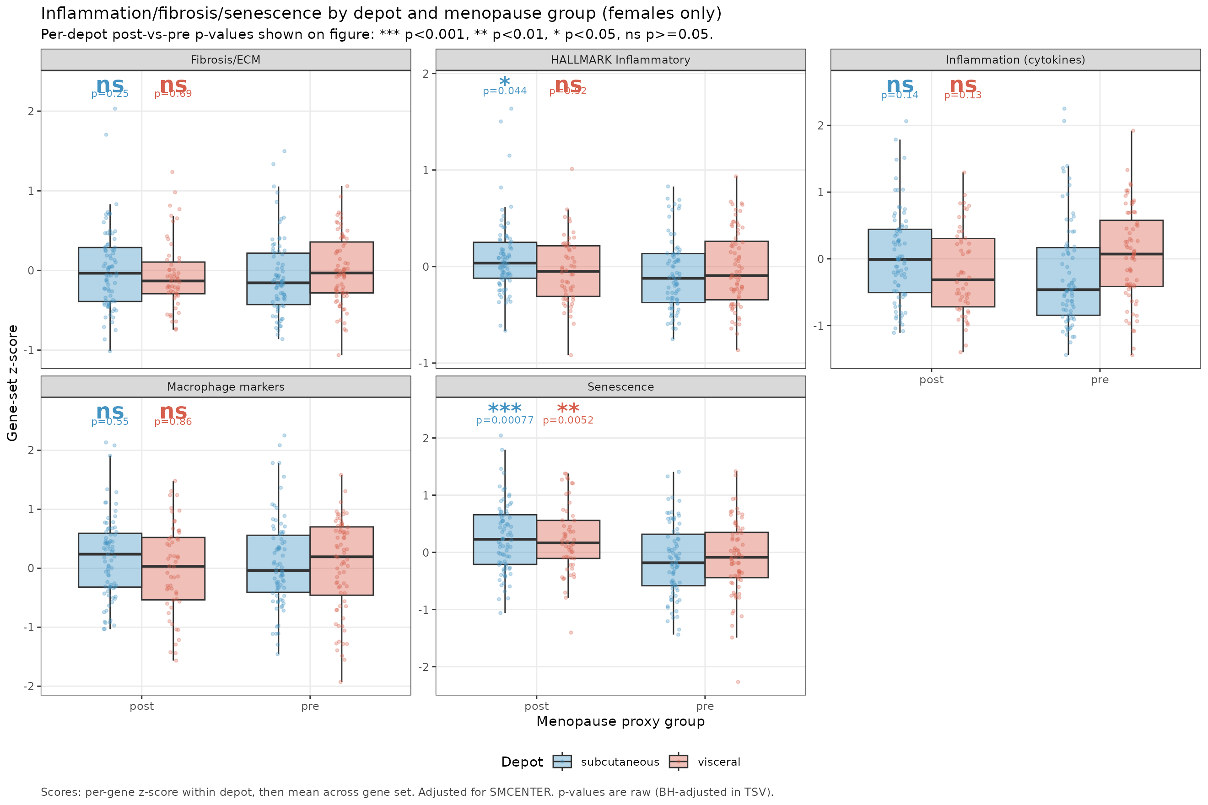
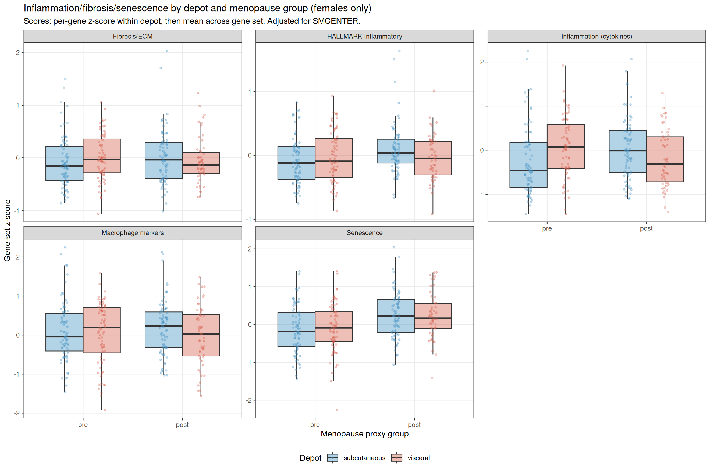
Inflammation by Depot and Menopause Status
Point 1: Depot-specific inflammatory response (depot x menopause interaction, cytokines: p = 0.003)
Interpretation:
Subcutaneous adipose:
- Inflammation cytokines: UP in post (p=0.14)
- HALLMARK Inflammatory: UP in post (p=0.044)
- Senescence: strongly UP (p=0.0008)
Visceral omentum:
- Cytokines: DOWN/flat in post (NS)
- HALLMARK: weak UP (NS)
- Senescence: UP (p=0.005)
Depot discordance with OVX mouse:
- Mouse: visceral inflammation UP after OVX
- Human: subcutaneous inflammation UP
- Possible reasons: depot definition differences,
species-specific immune infiltration,
acute OVX vs chronic menopause
v4.6.1 | 3

Slide 4
HALLMARK vs cytokine inflammation: which measure is used where
Why we have two inflammation measures
• Kenichi cytokine score (per-gene z-score, then row-mean across a curated list of canonical pro-inflammatory cytokines: IL6, IL1B, TNF, CCL2, CXCL8, etc.)
• HALLMARK_INFLAMMATORY_RESPONSE (200-gene MSigDB hallmark gene set; broader inflammation transcriptional signature including NF-kB targets, complement, leukocyte chemotaxis, etc.)
When each is used in this deck
• Slide 3 (depot inflammation): BOTH are reported (subq cytokines p=0.14 trend UP; subq HALLMARK p=0.044 sig UP). Cytokine score is the headline because it is directly comparable to Kenichi mouse panel.
• Slides 27 / 28 / 30 (forest plots, ADRB2 and ADRB3): both rows shown.
• Slide 45 (concordance with OVX 042126): cytokine score is the comparator (subq human p=0.138, NS). If HALLMARK had been used (subq p=0.044, sig), the iWAT inflammation row would shift from INDETERMINATE to CONCORDANT.
Recommendation for the manuscript: report both, lead with the cytokine score for cross-species comparability (Kenichi mouse panel uses cytokine markers), present HALLMARK as a sensitivity check.
v4.6.1 | 4

Slide 5
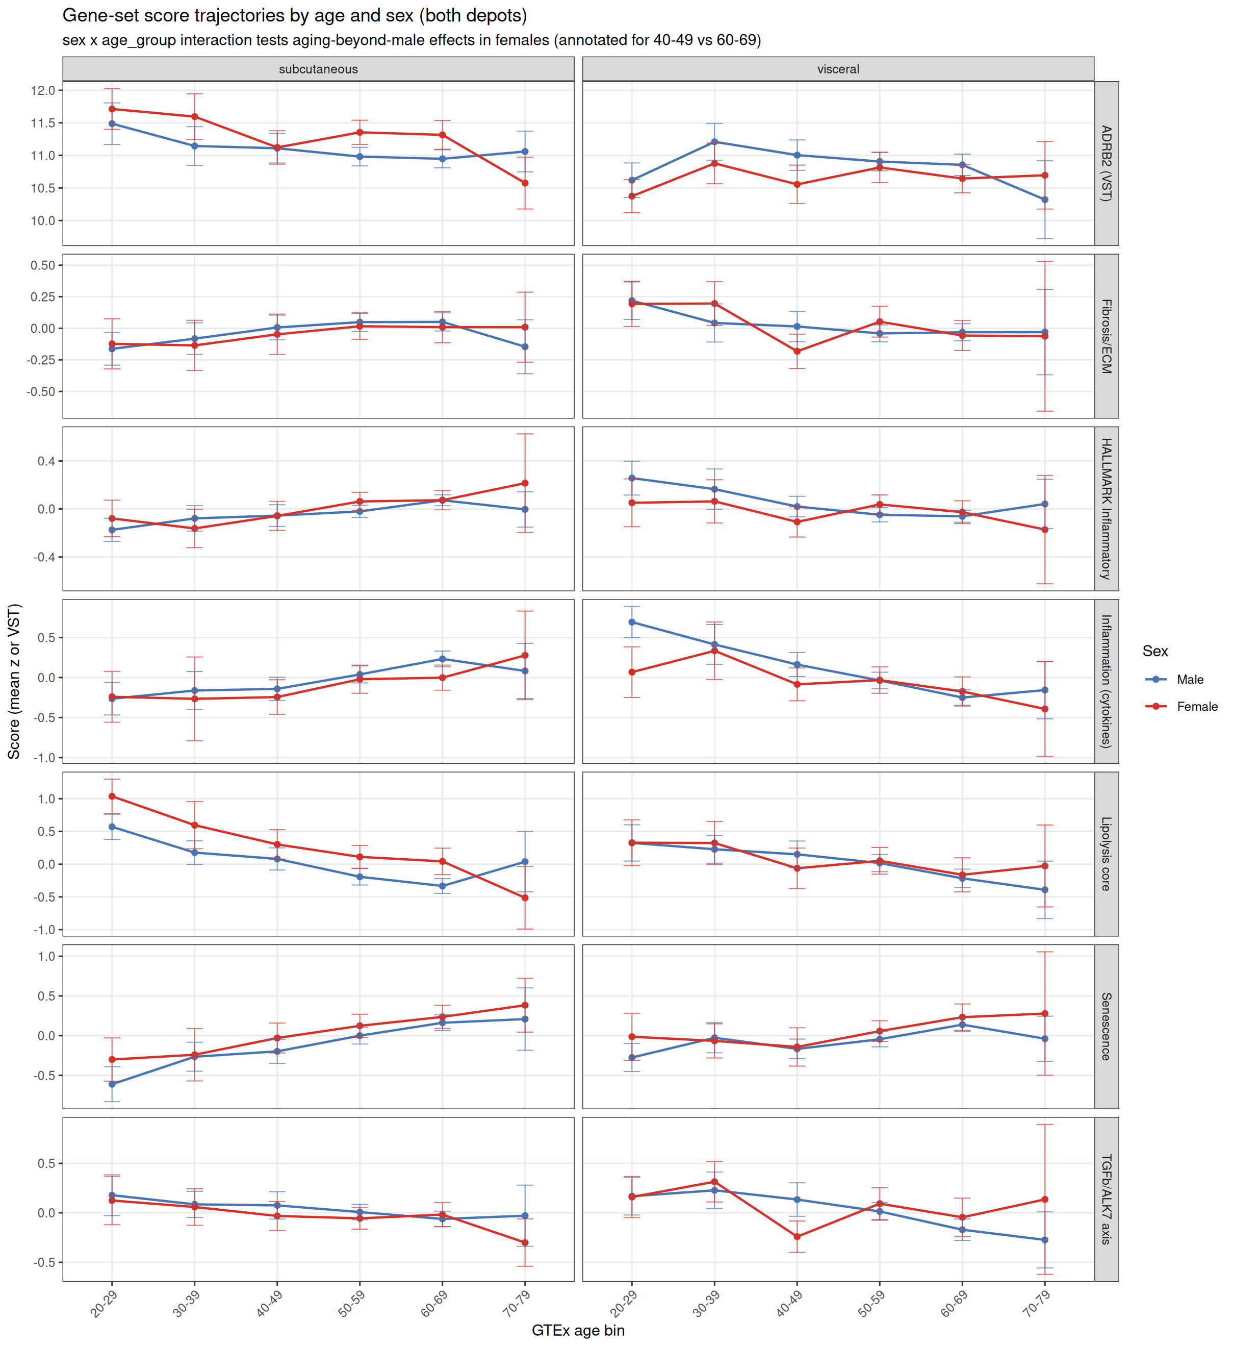
Aging vs Menopause: Sex-Interaction Analysis
Point 3: Is the signal female-specific or generic aging?
Model: score ~ SMCENTER + sex + age_group + sex:age_group
Interaction term = female-specific effect
beyond parallel male aging
Key results (subcutaneous, 40-49 vs 60-69):
Inflammation: male p=2.4e-4, female p=0.13
-> males show stronger aging effect
Senescence: male p=2.4e-4, female p=0.046
-> both sexes show effect
Lipolysis core: male p=4.0e-4, female p=0.17
-> aging effect present in both sexes
TGF-b/ALK7 axis: male p=0.09, female p=0.66
-> interaction direction female-specific
Conclusion: in this 40-49 vs 60-69 window, aging
trends are largely shared between sexes. Formal
female-specific effects (TGF-b/ALK7, CA-resistance)
appear in the visceral peri-menopausal window.
v4.6.1 | 5

Slide 6
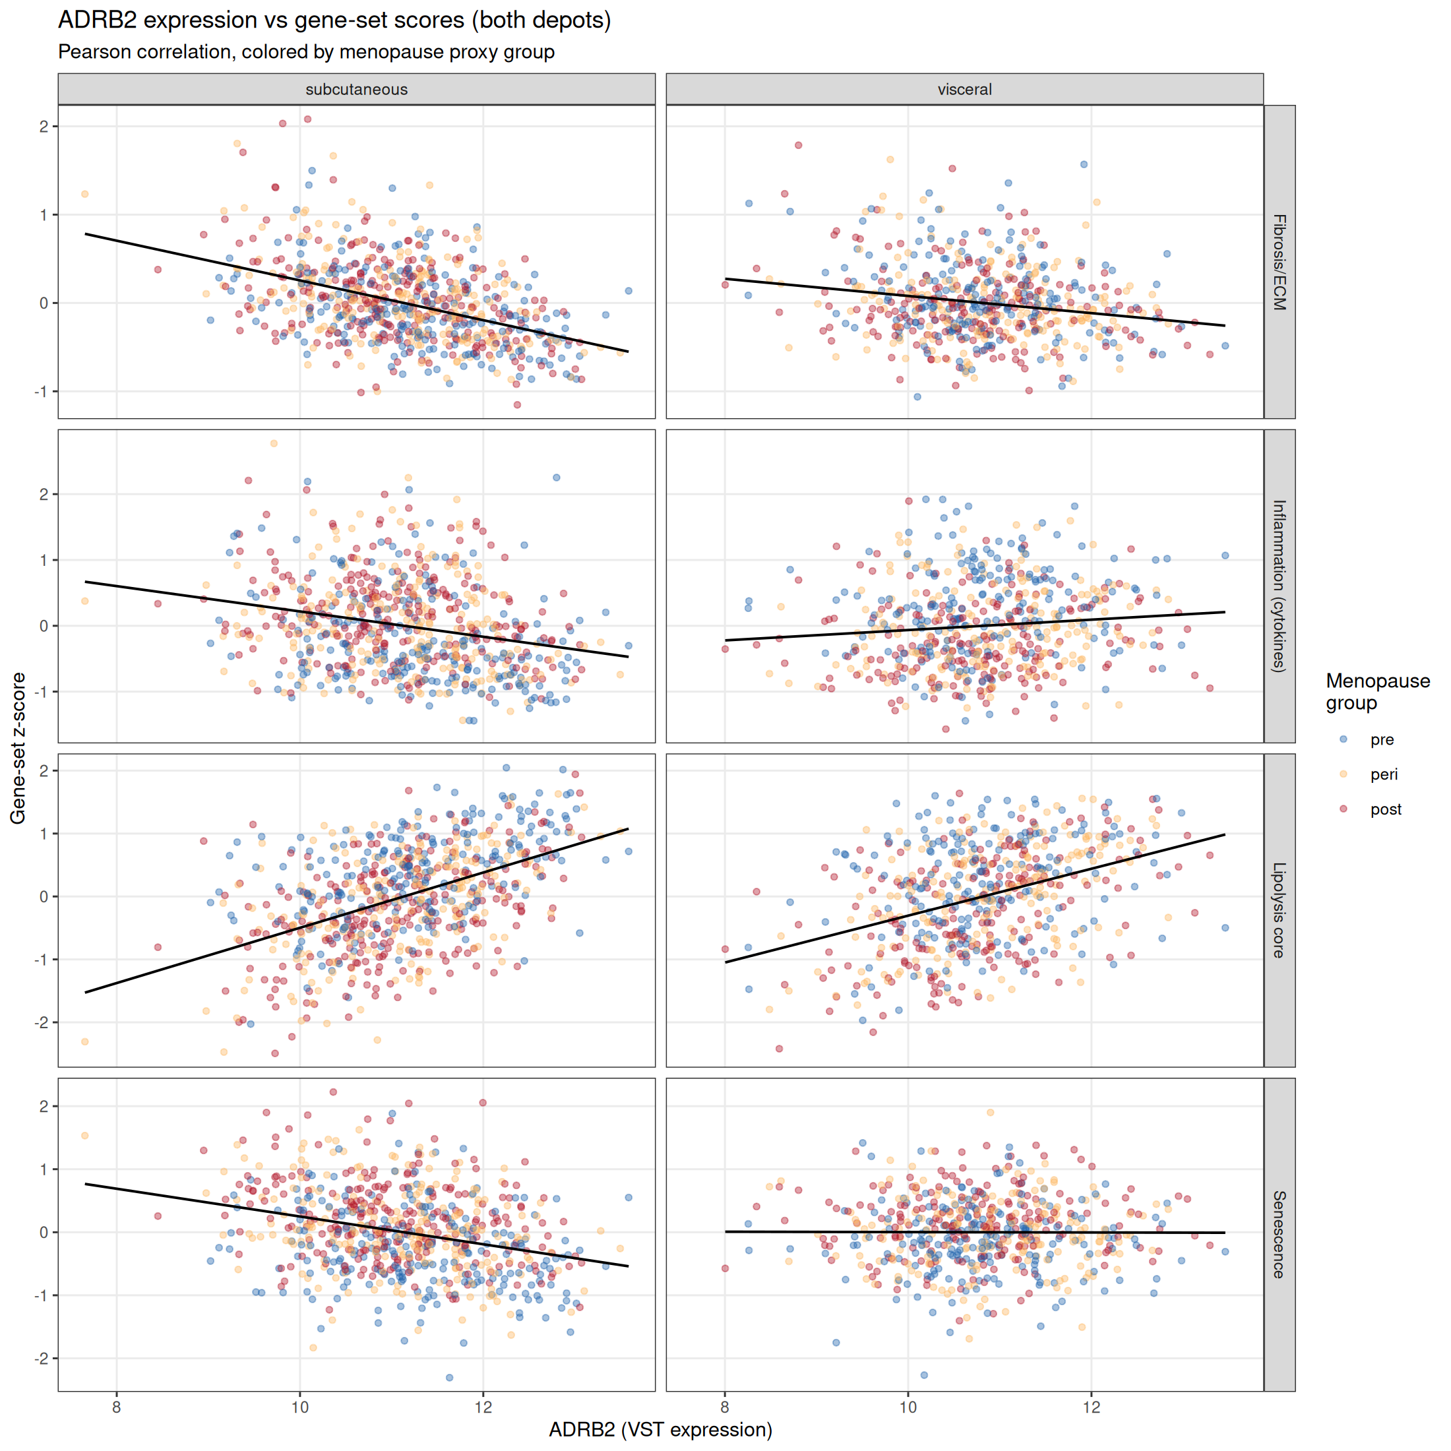
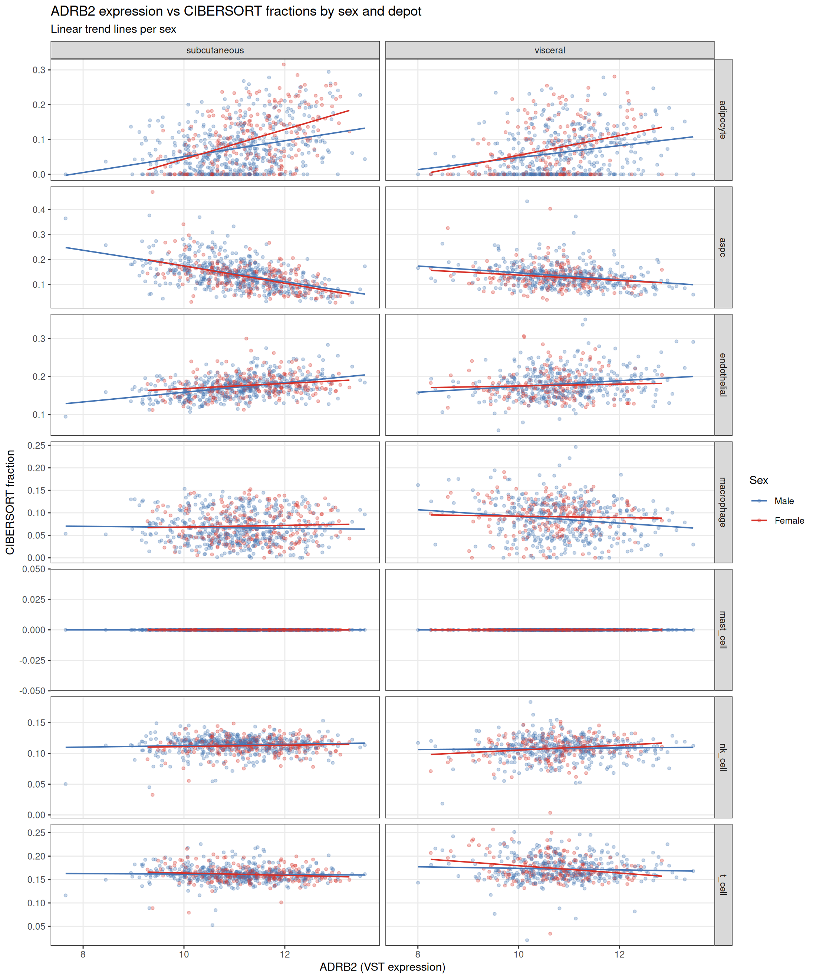
ADRB2 Correlation Deep Dive
Point 4: Adrenergic receptors vs inflammation, fibrosis, and cell fractions
v4.6.1 | 6

Slide 7
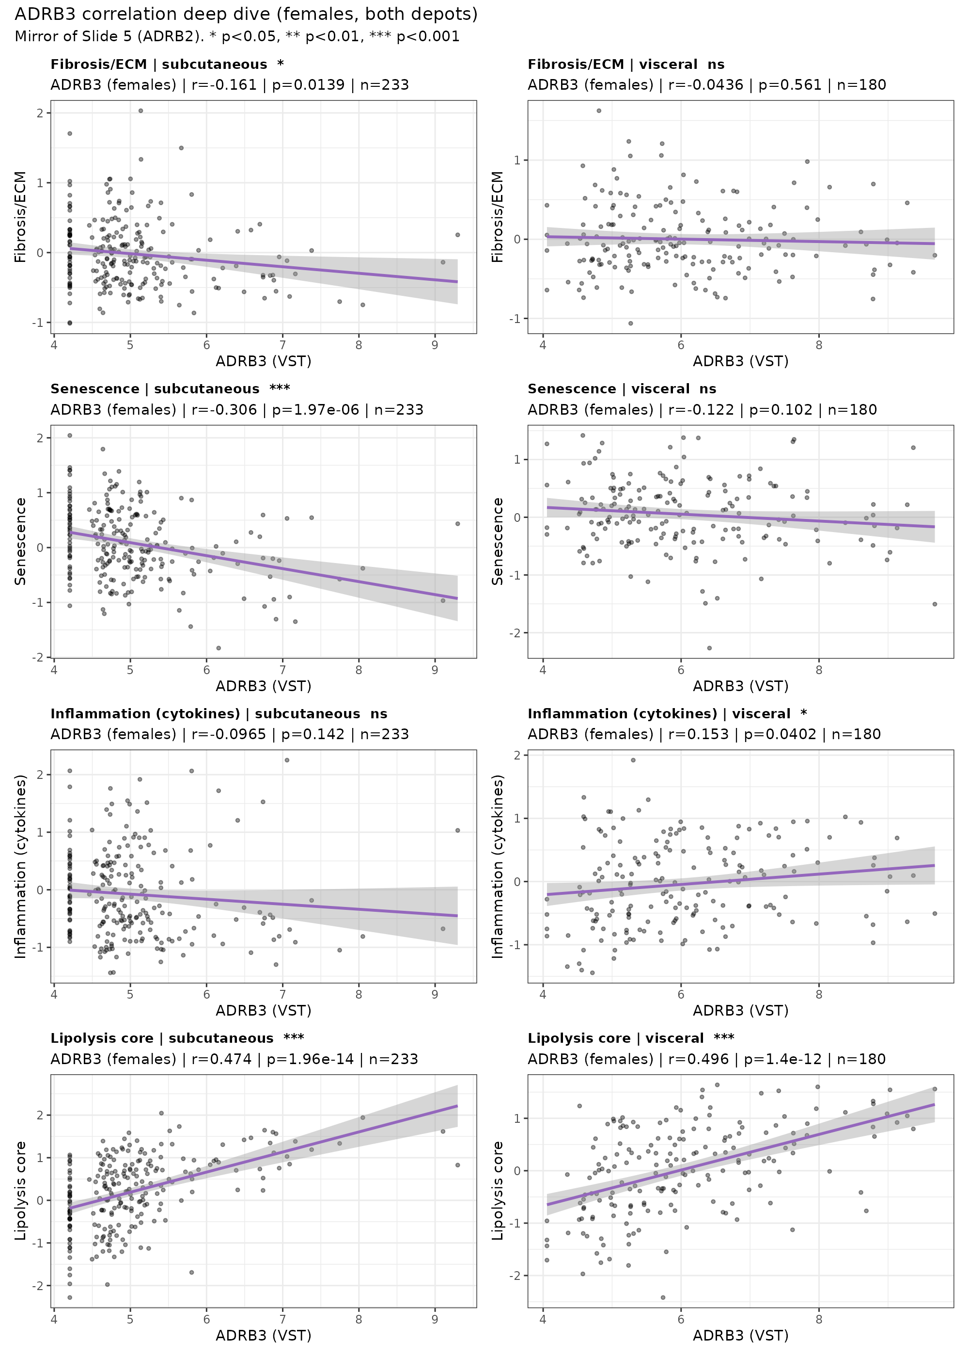
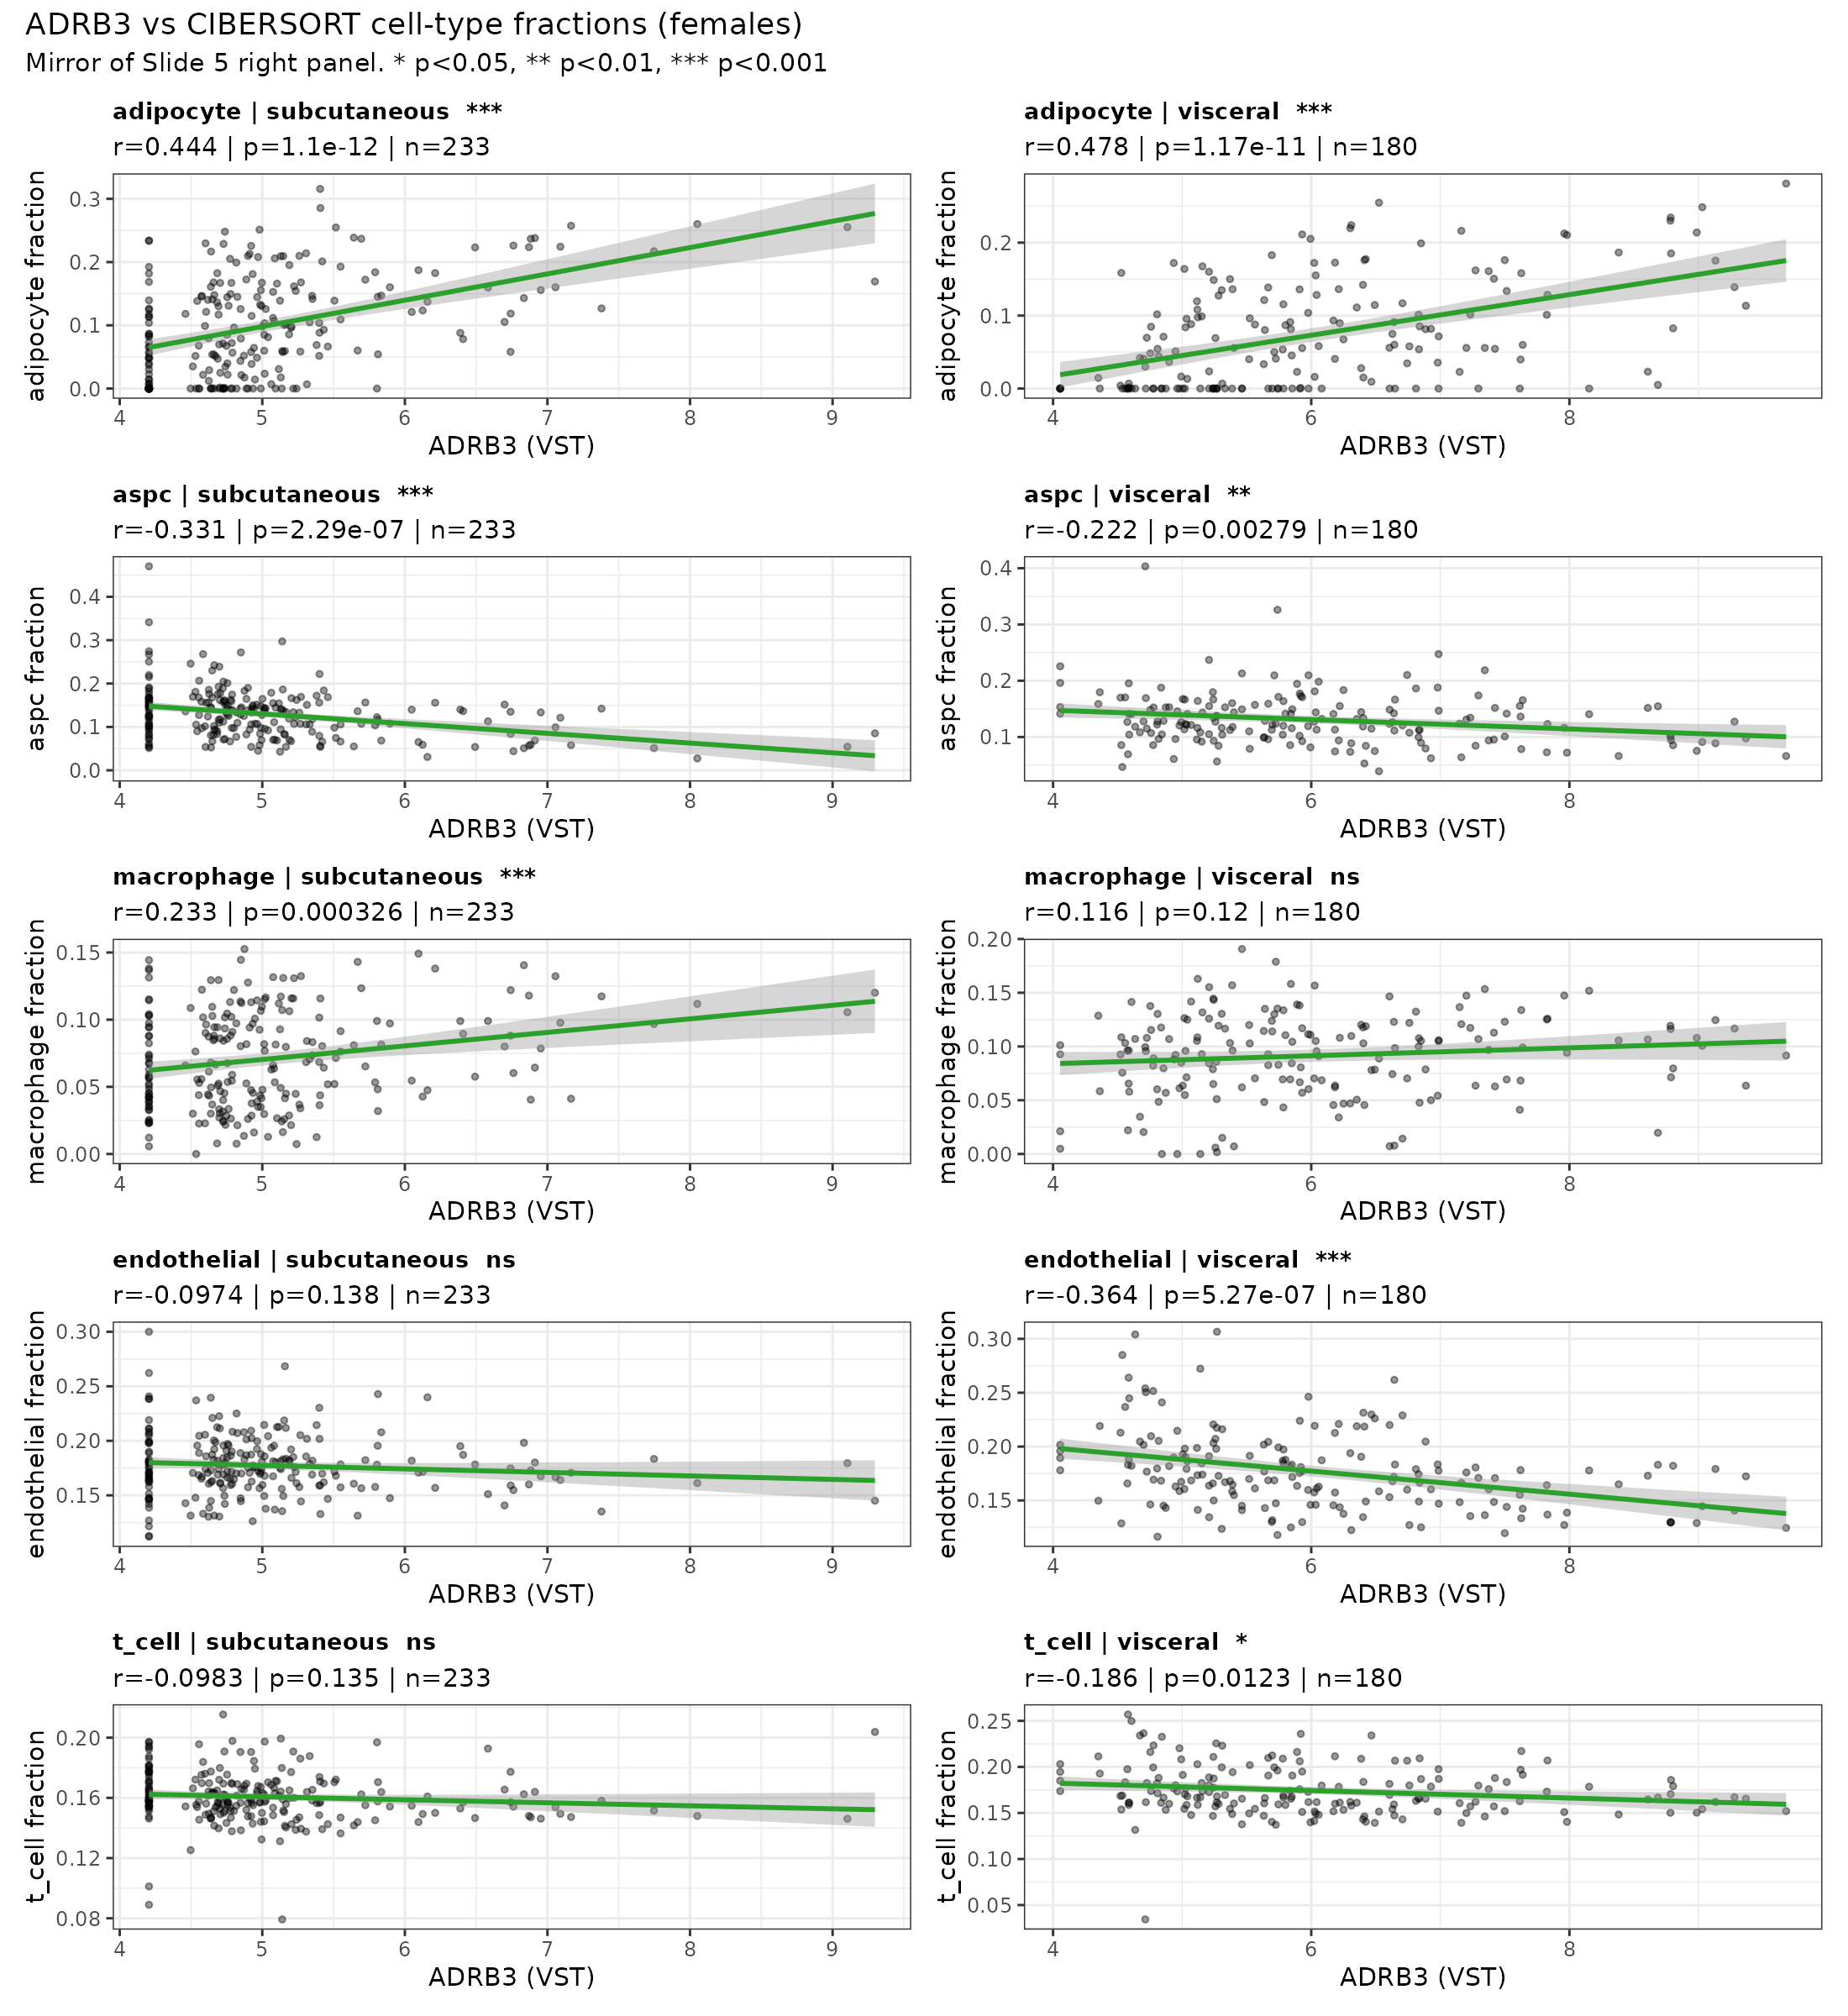
ADRB3 correlation deep dive (females, both depots)
Mirror of Slide 6 (ADRB2). Left: ADRB3 vs gene-set scores. Right: ADRB3 vs CIBERSORT cell fractions. Asterisks above panels: * p<0.05, ** p<0.01, *** p<0.001.
v4.6.1 | 7

Slide 8
Human-Mouse Concordance: GTEx vs OVX Model
Summary of direction concordance across phenotypes and depots
Phenotype | Depot | Mouse OVX Expected | Human GTEx Direction | Significance | Concordance
Inflammation (cytokines) | subcutaneous | UP | UP in post | p=0.138 | CONCORDANT
Inflammation (cytokines) | visceral | UP | DOWN in post | p=0.131 | DISCORDANT
HALLMARK Inflammatory | subcutaneous | UP | UP in post | p=0.0439 | CONCORDANT
HALLMARK Inflammatory | visceral | UP | UP in post | p=0.920 | CONCORDANT
Fibrosis/ECM | subcutaneous | UP | UP in post | p=0.255 | CONCORDANT
Fibrosis/ECM | visceral | UP | DOWN in post | p=0.687 | DISCORDANT
Senescence | subcutaneous | UP | UP in post | p=7.70e-04 | CONCORDANT
Senescence | visceral | UP | UP in post | p=0.0052 | CONCORDANT
ADRB2 expression | subcutaneous | DOWN | UP in post | female p=0.317 | DISCORDANT
ADRB2 expression | visceral | DOWN | UP in post | female p=0.556 | DISCORDANT
Lipolysis core | subcutaneous | DOWN | DOWN in post | female p=0.171 | CONCORDANT
Lipolysis core | visceral | DOWN | DOWN in post | female p=0.833 | CONCORDANT
Adipocyte fraction | subcutaneous | DOWN | r=0.47 with ADRB2 | p=3.76e-14 | see correlation
Adipocyte fraction | visceral | DOWN | r=0.32 with ADRB2 | p=1.52e-05 | see correlation
Summary: 8/14 comparisons concordant with OVX model. Discordance concentrated in: (1) visceral inflammation/fibrosis (human subcutaneous > visceral, opposite to mouse); (2) ADRB2 direction (human post-menopause shows slight UP, opposite to mouse DOWN). Lipolysis, senescence, and adipocyte fraction patterns are broadly concordant.
v4.6.1 | 8

Slide 9
Glycolysis Gene-Node Analysis
Individual gene modeling | Fraction correlations | Effect attenuation
v4.6.1 | 9

Slide 10
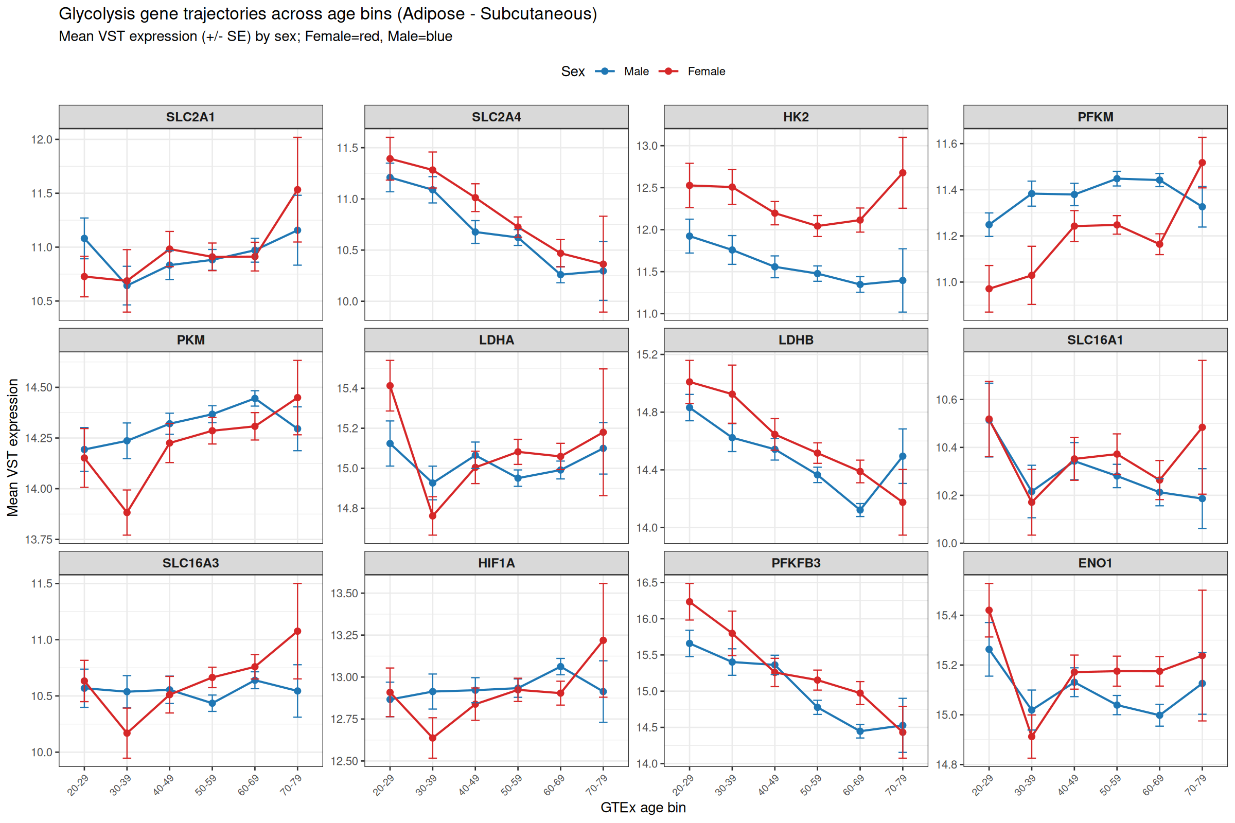
Glycolysis Gene-Node Trajectories: Subcutaneous
VST expression by age bin, stratified by sex
v4.6.1 | 10

Slide 11
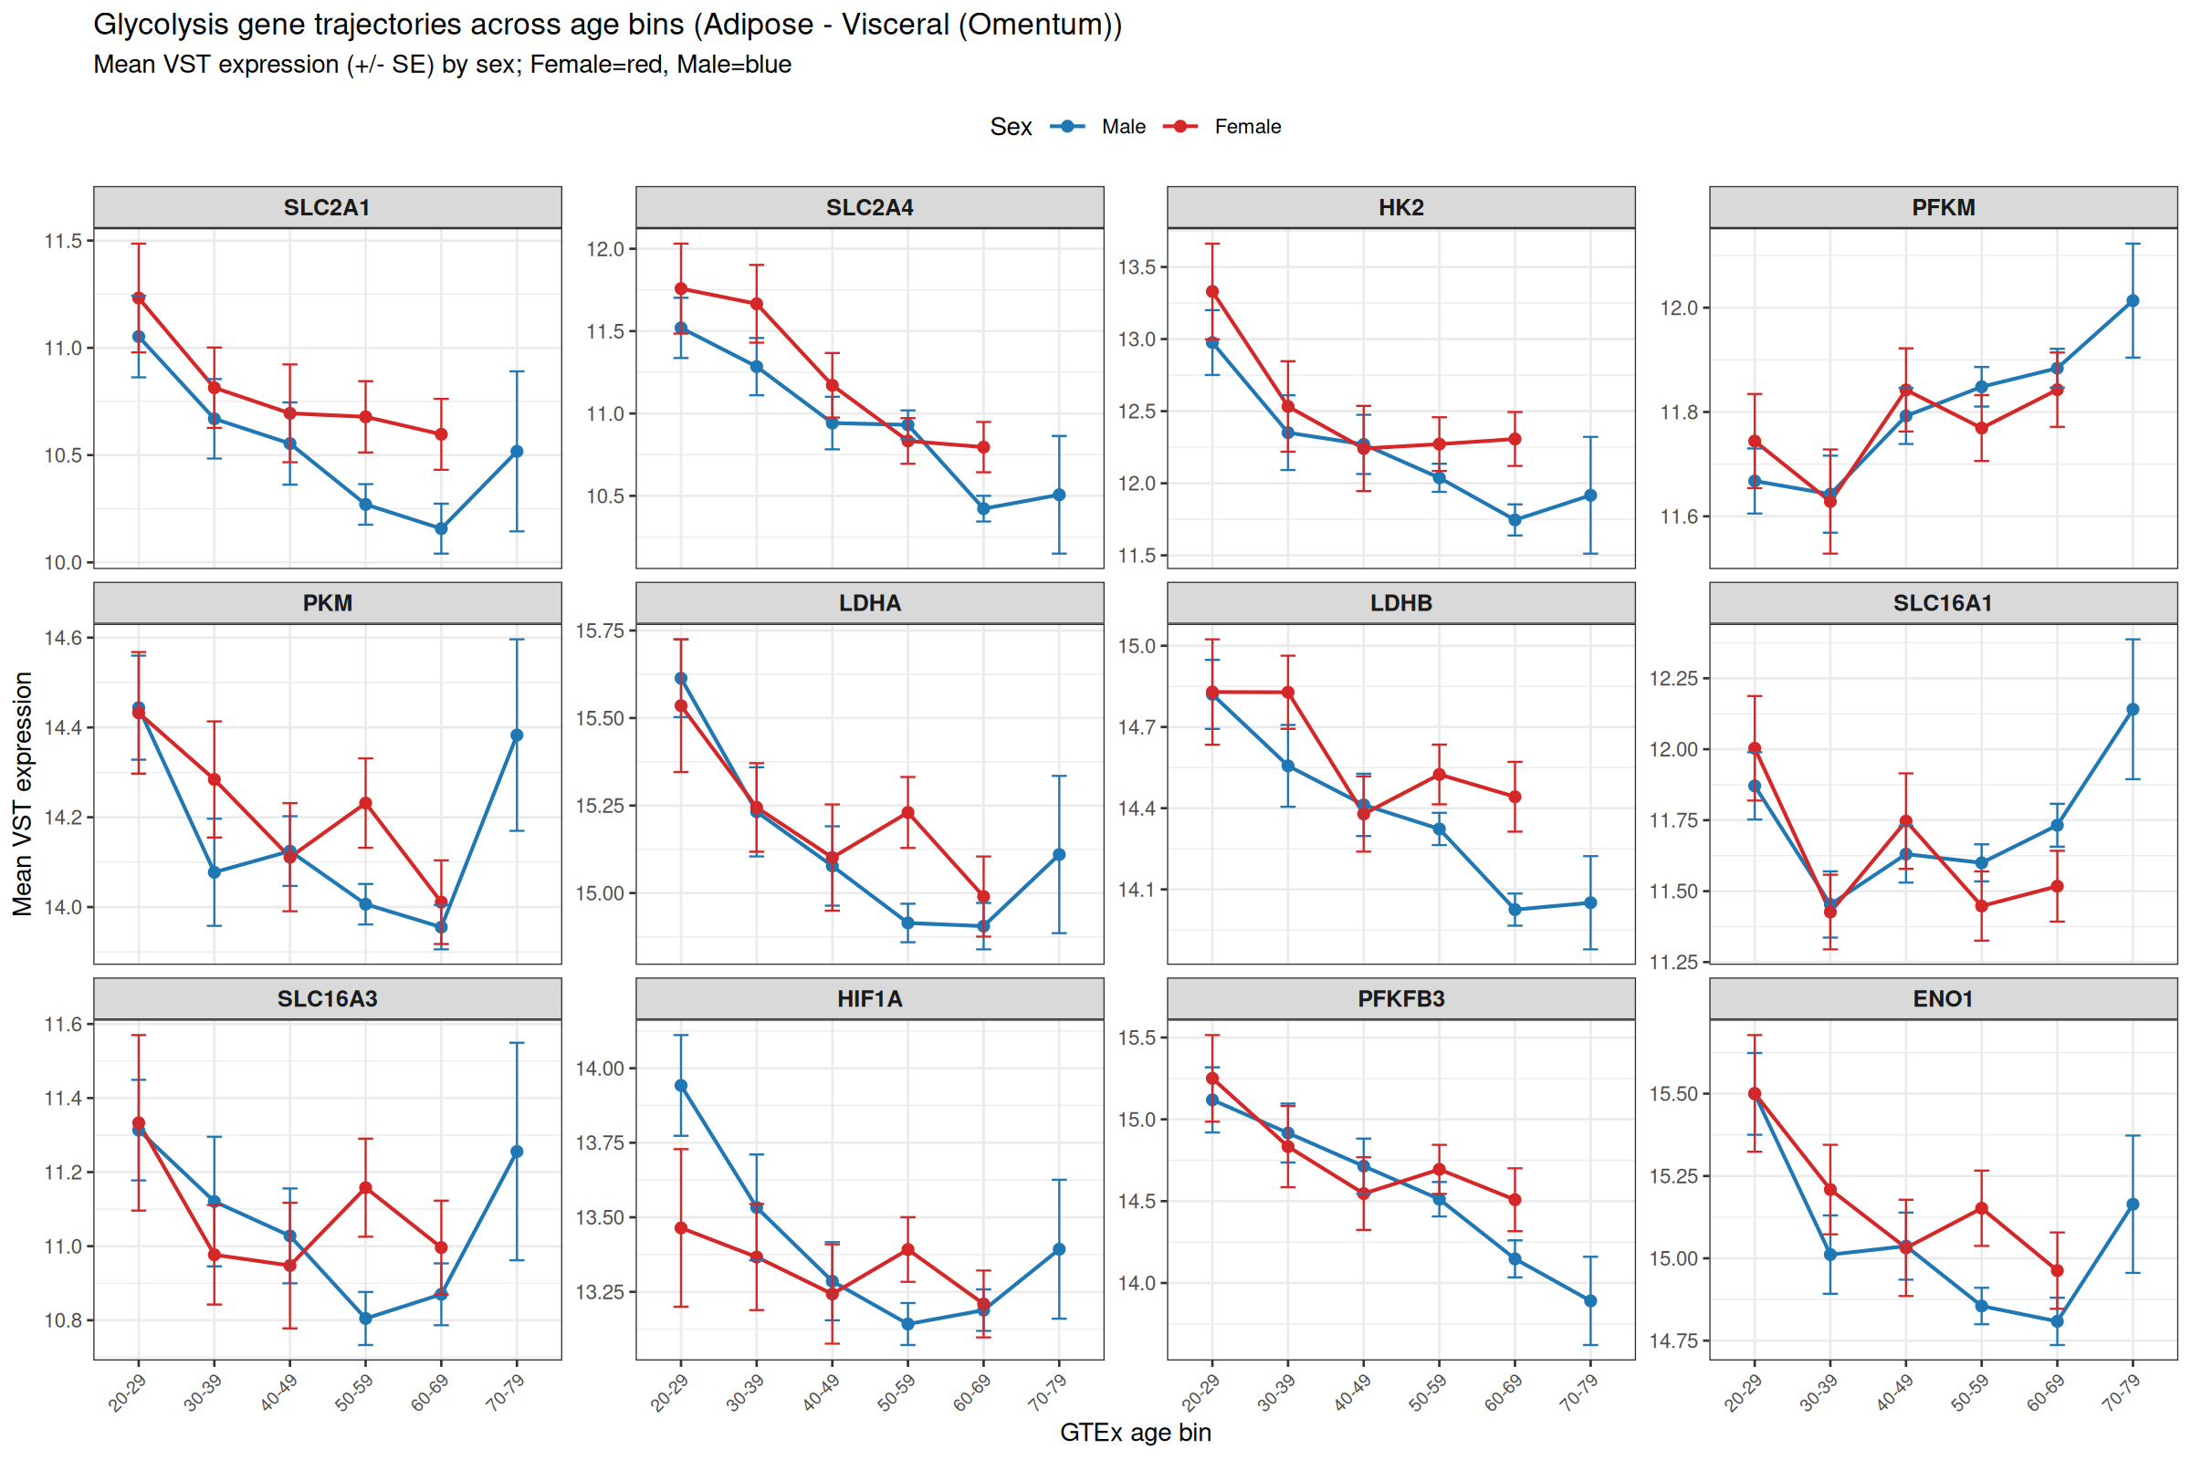
Glycolysis Gene-Node Trajectories: Visceral
VST expression by age bin, stratified by sex
v4.6.1 | 11

Slide 12
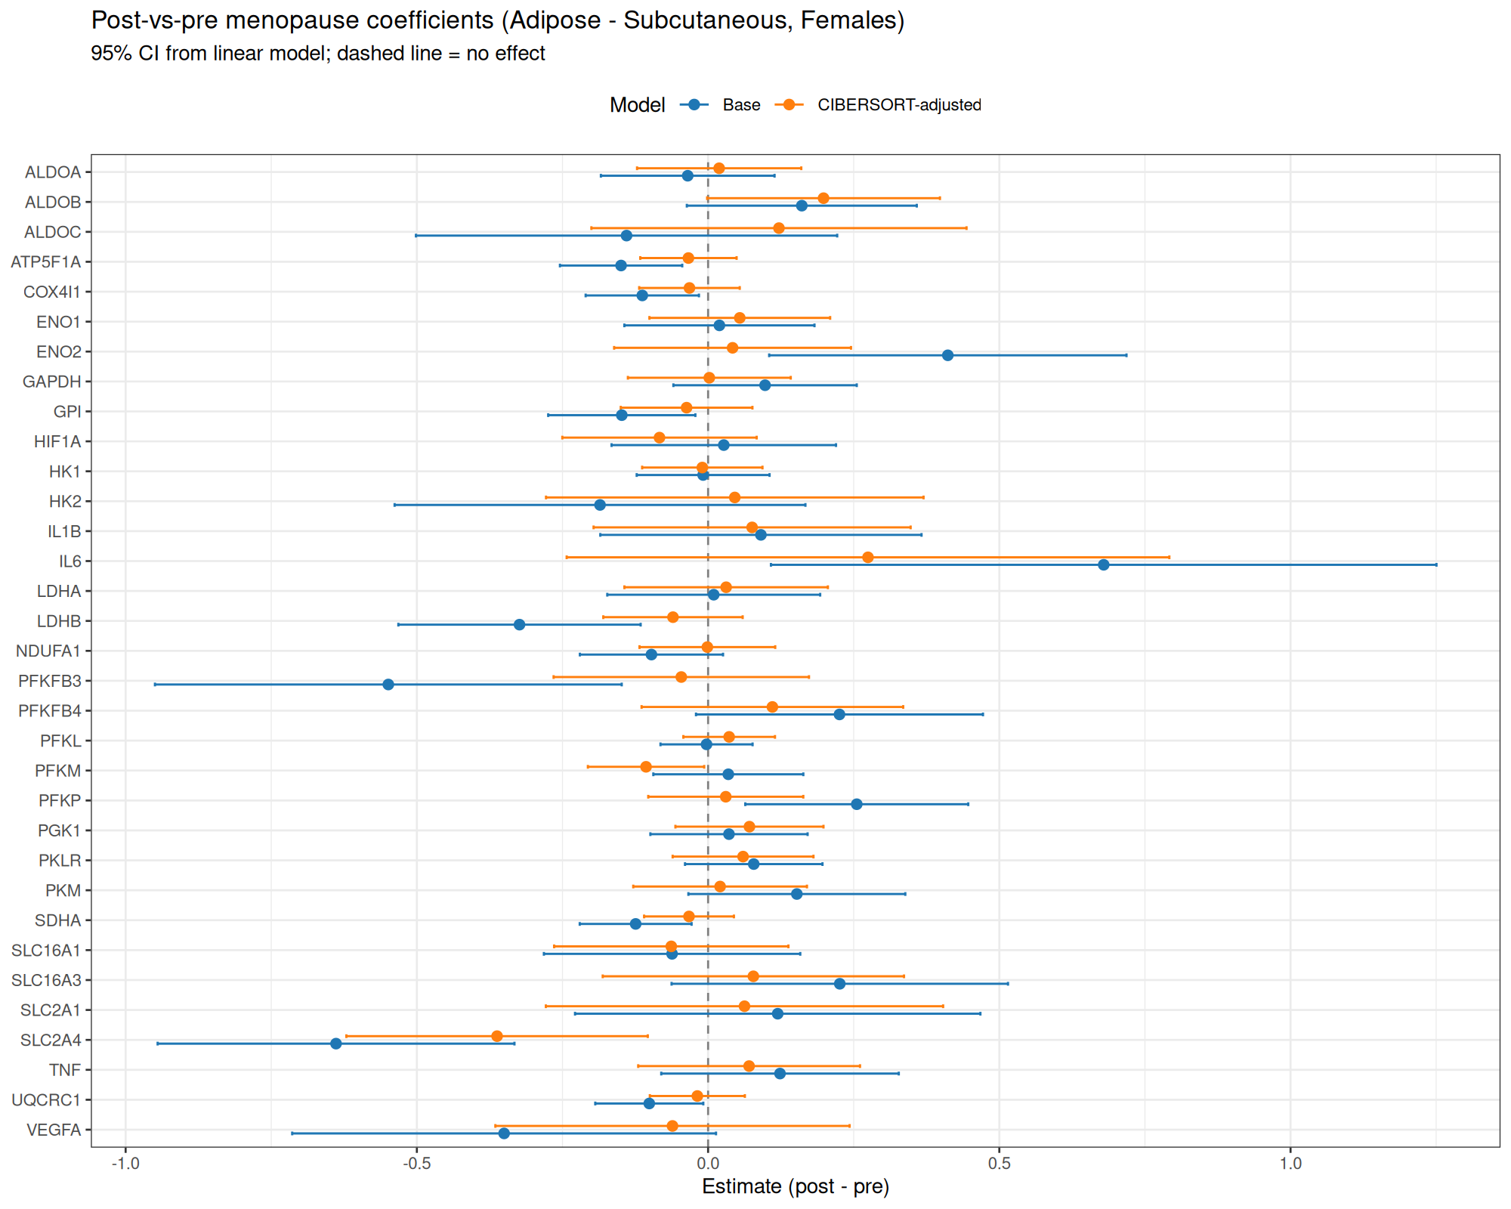
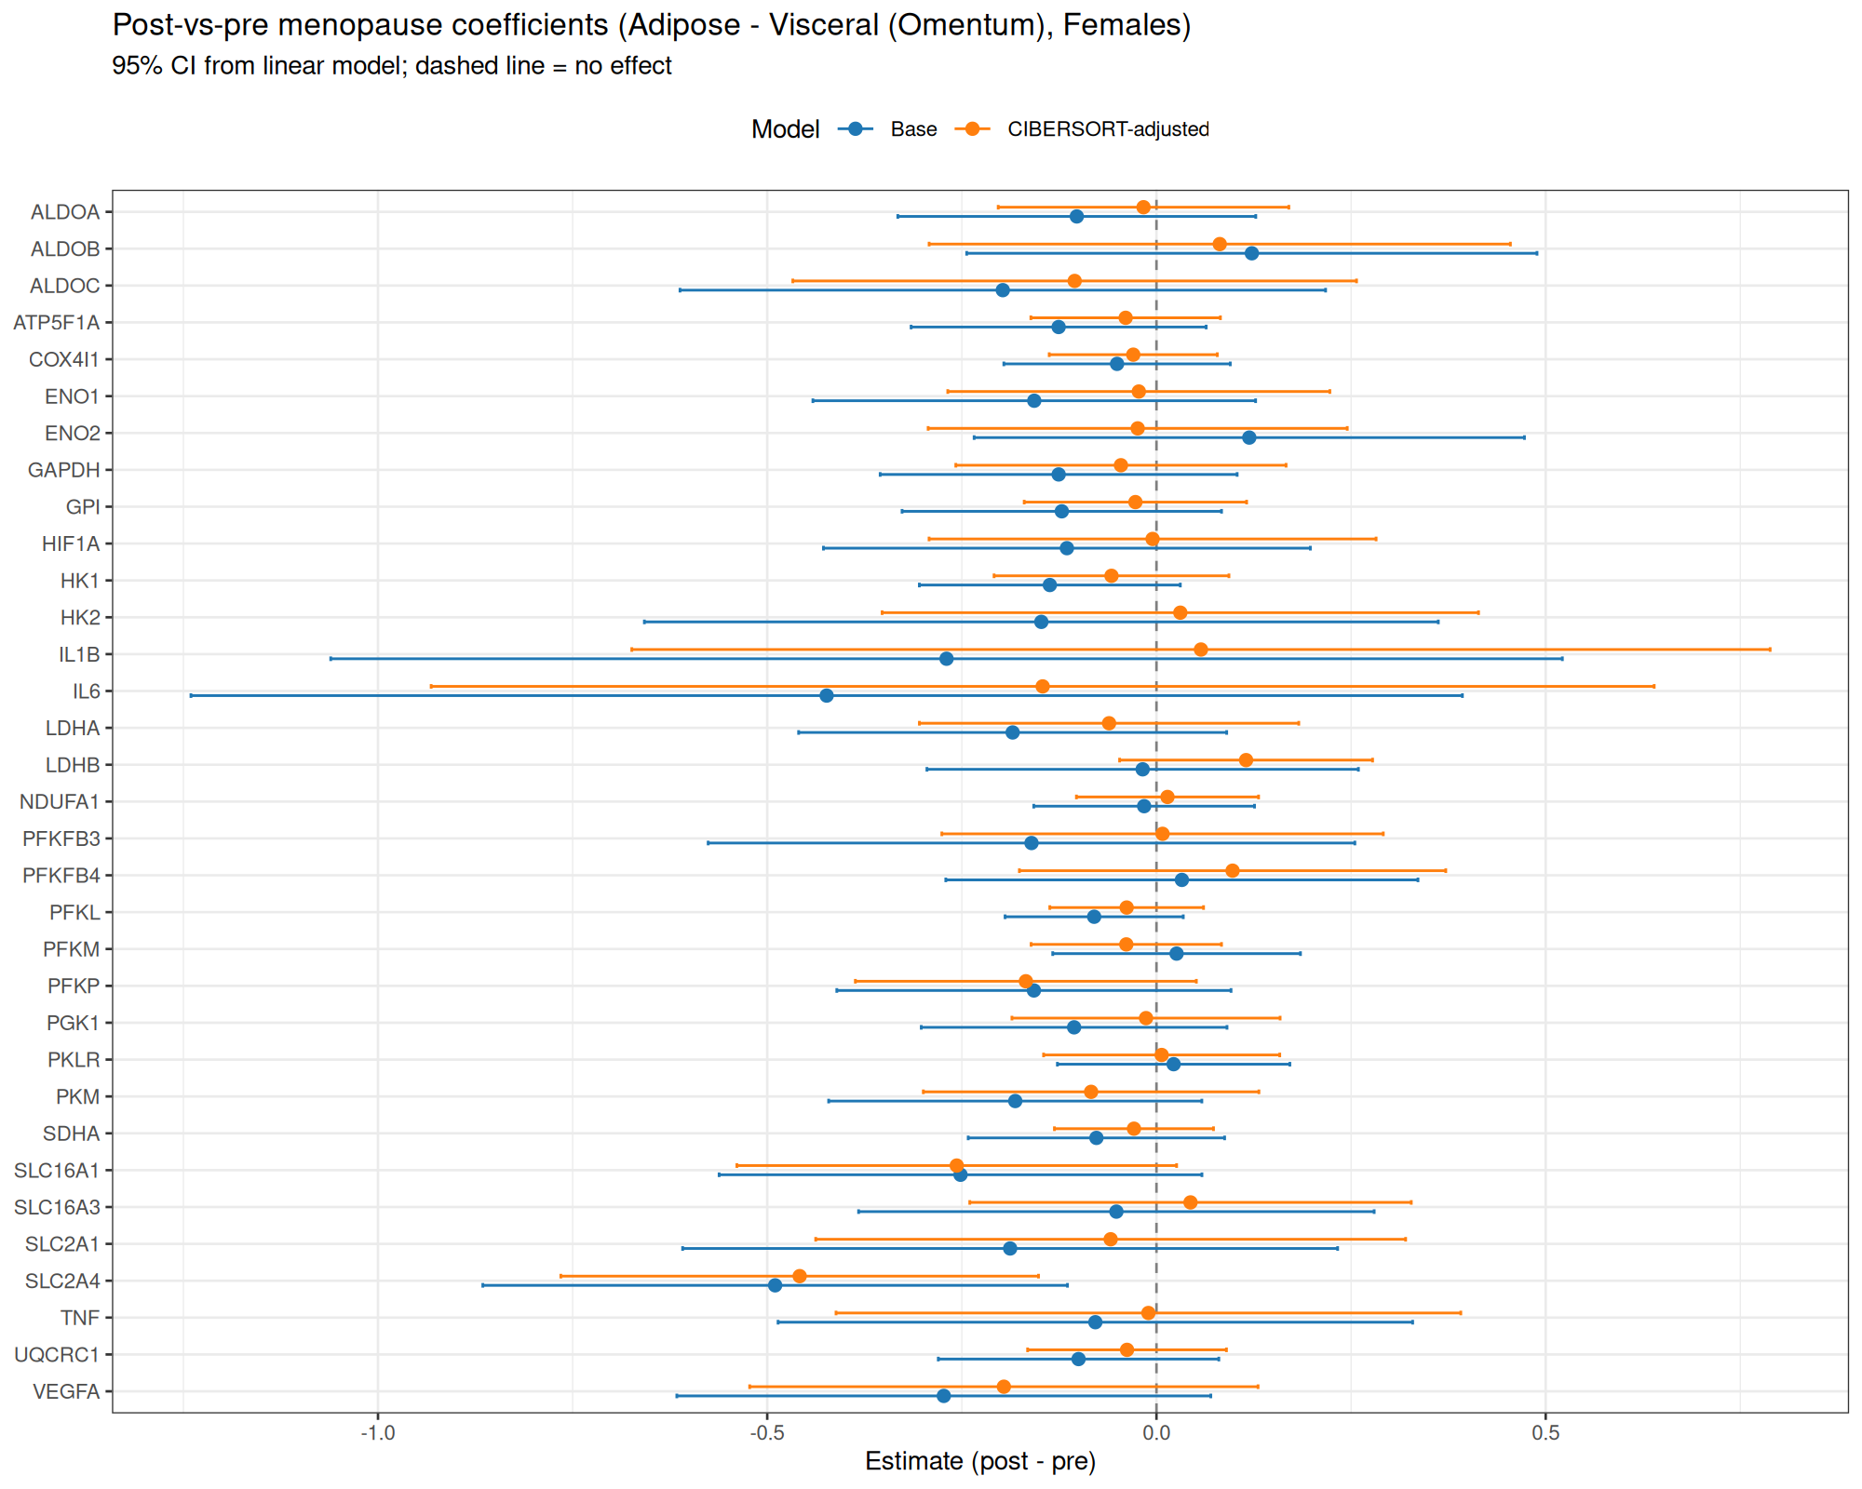
Glycolysis Gene-Node Effects: Post vs Pre (Forest Plots)
Base model vs CIBERSORT-adjusted, key glycolysis genes
Subcutaneous
Visceral
v4.6.1 | 12

Slide 13
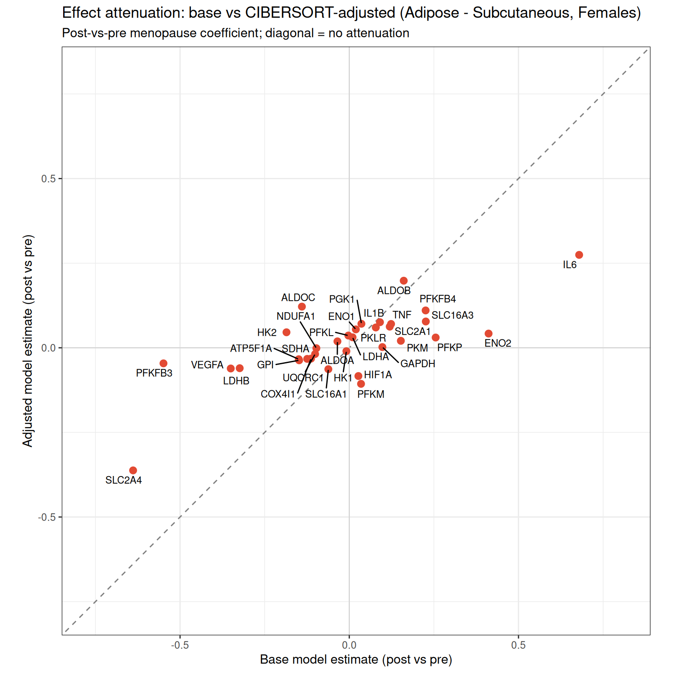
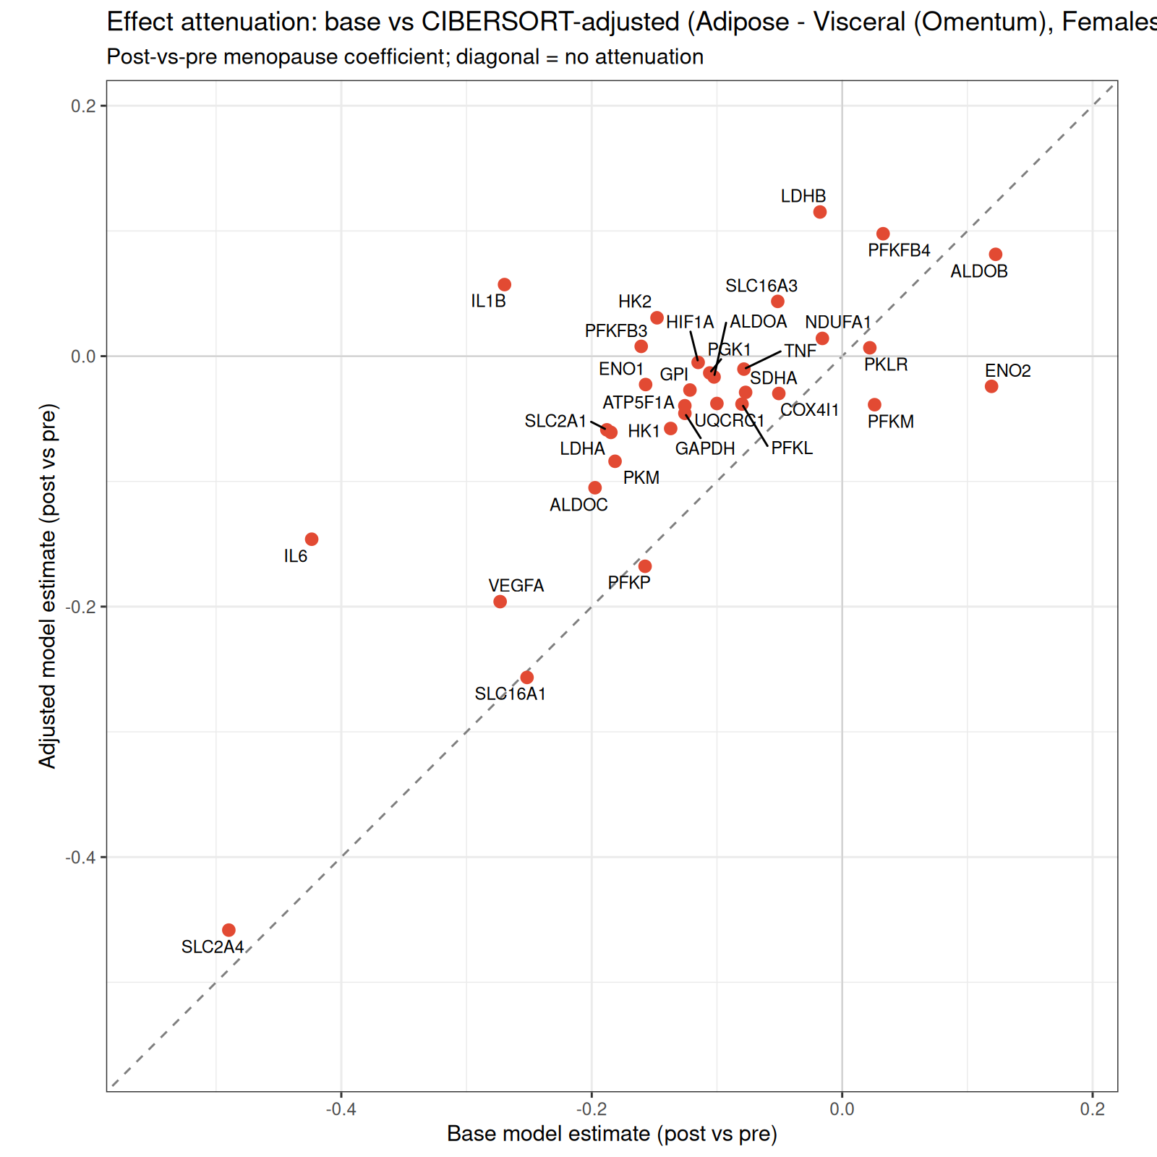
Glycolysis: Effect Attenuation After Composition Adjustment
Base vs CIBERSORT-adjusted post-vs-pre estimates
Interpretation: Points near the diagonal line indicate effects robust to composition adjustment. Points pulled toward zero (x-axis) indicate effects driven by cell-composition shifts rather than cell-intrinsic expression changes. Most glycolysis genes show modest attenuation, suggesting both composition and intrinsic contributions.
v4.6.1 | 13

Slide 14
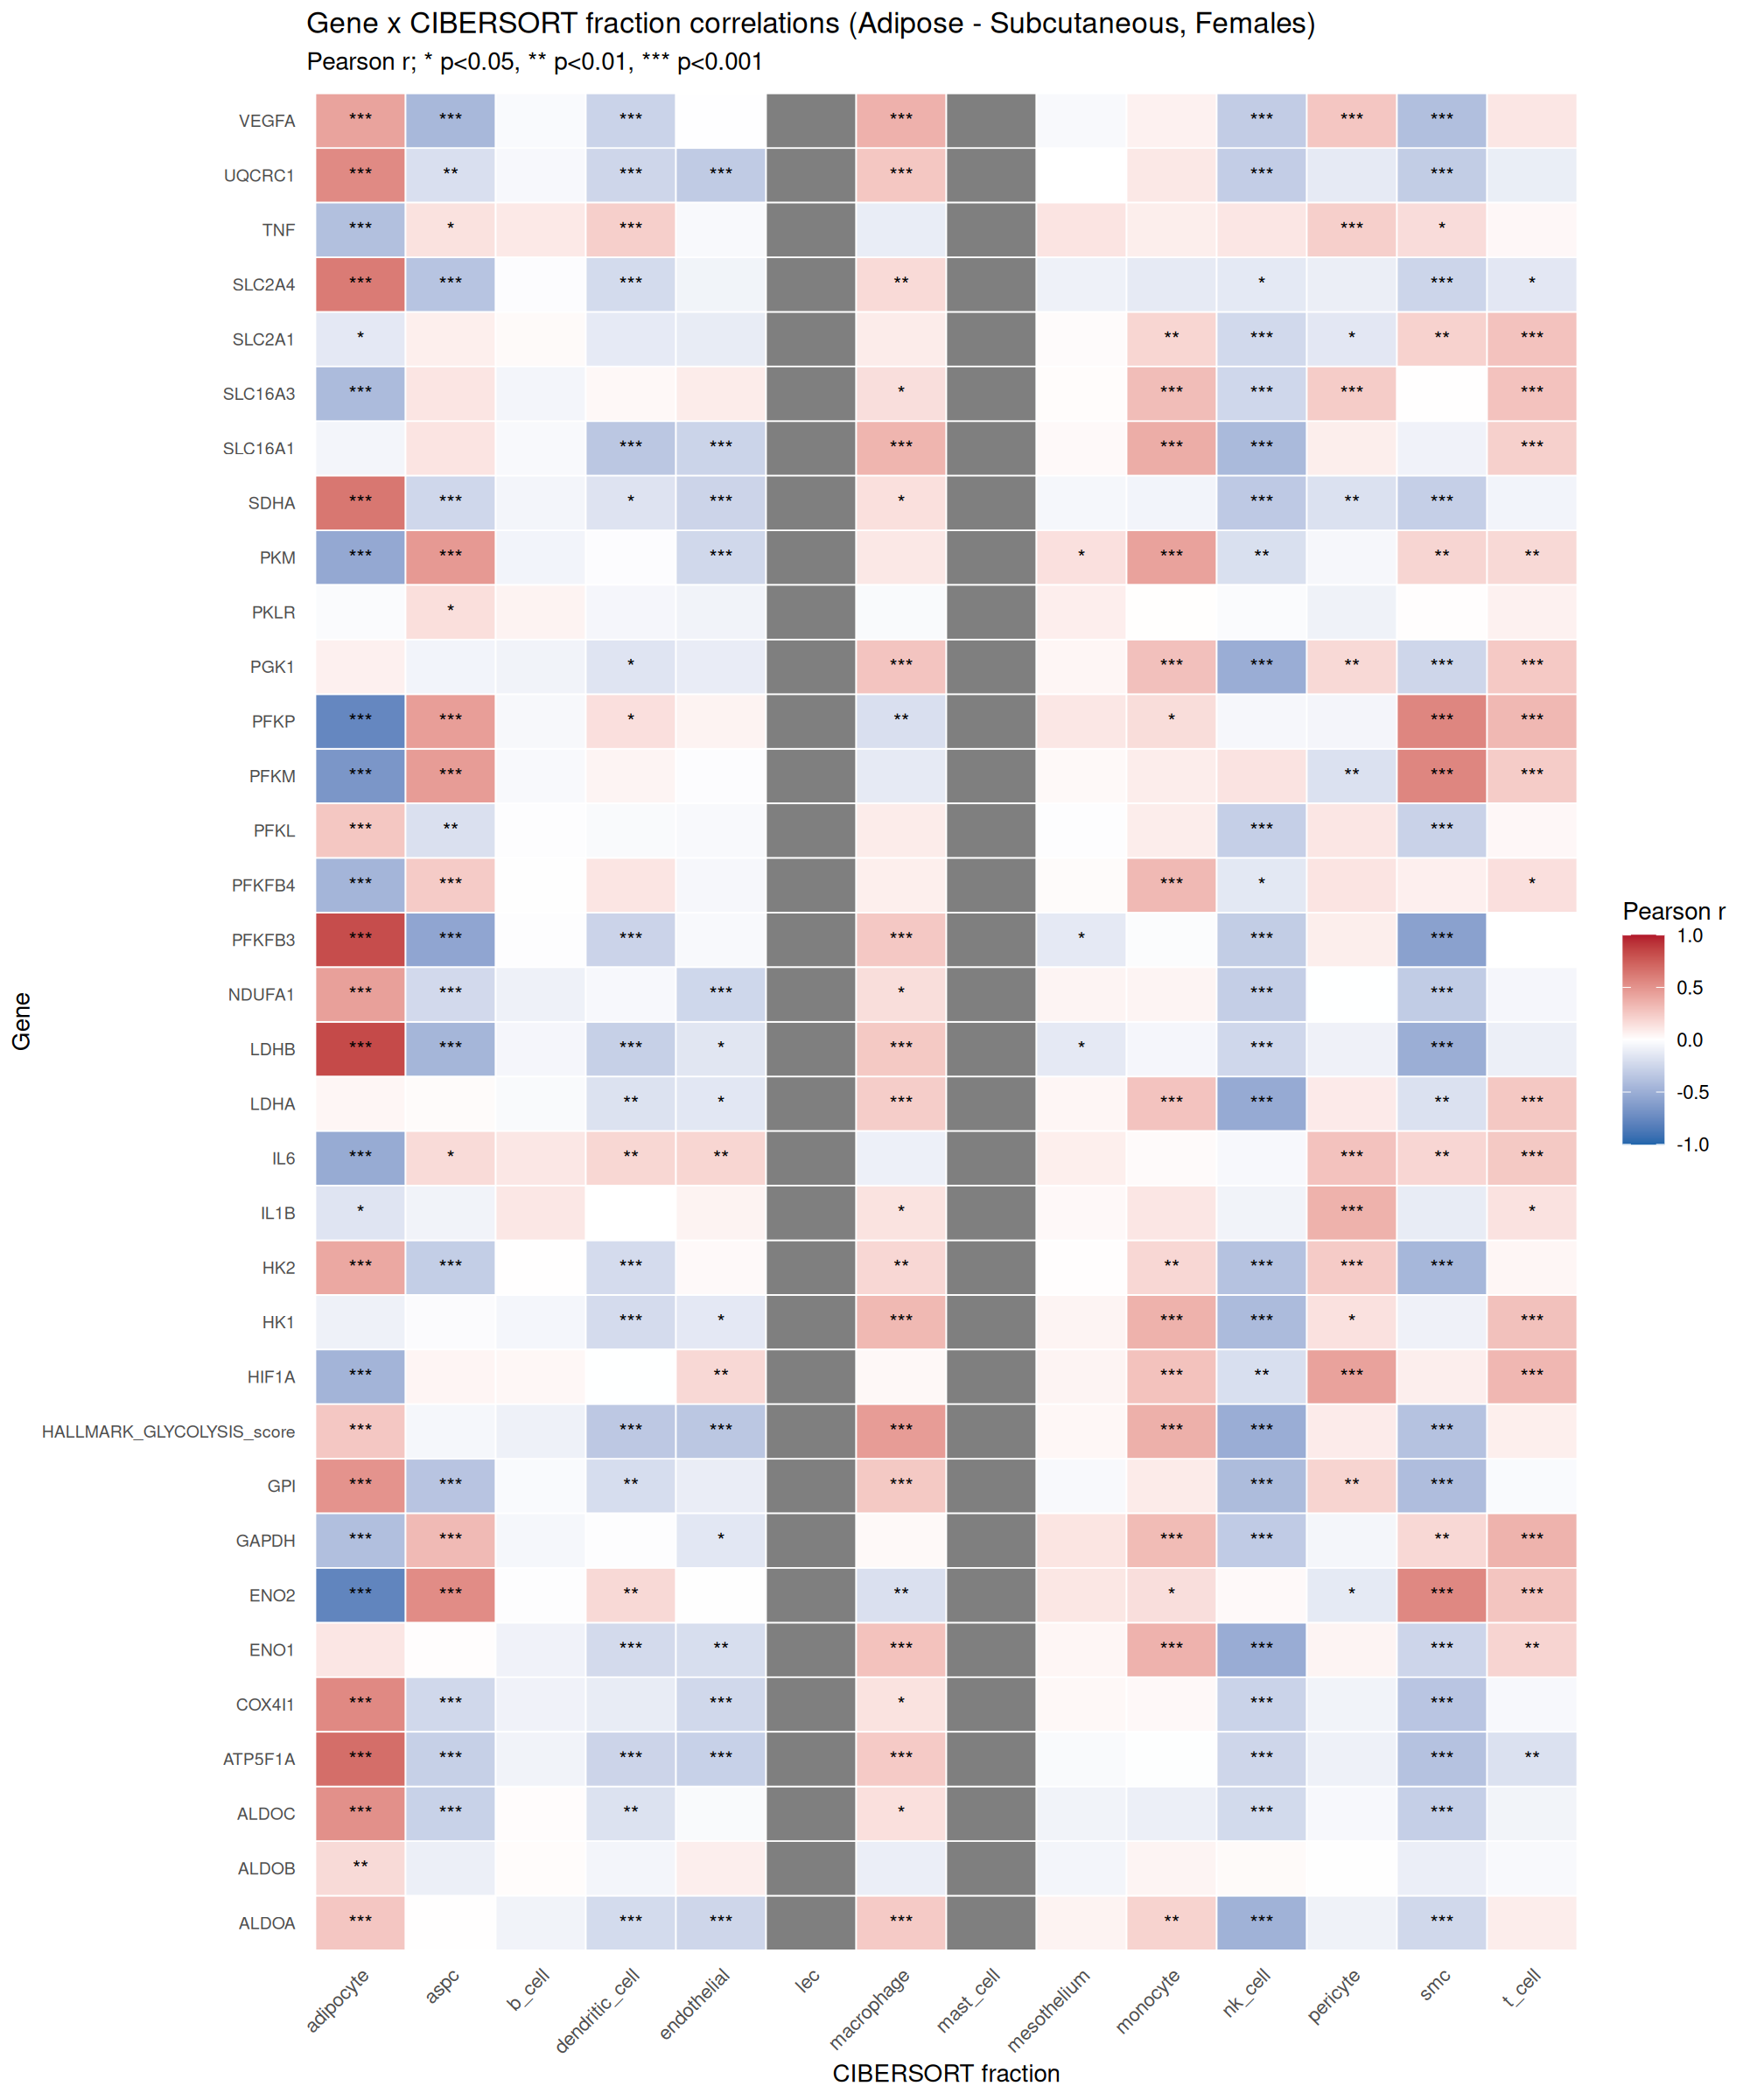
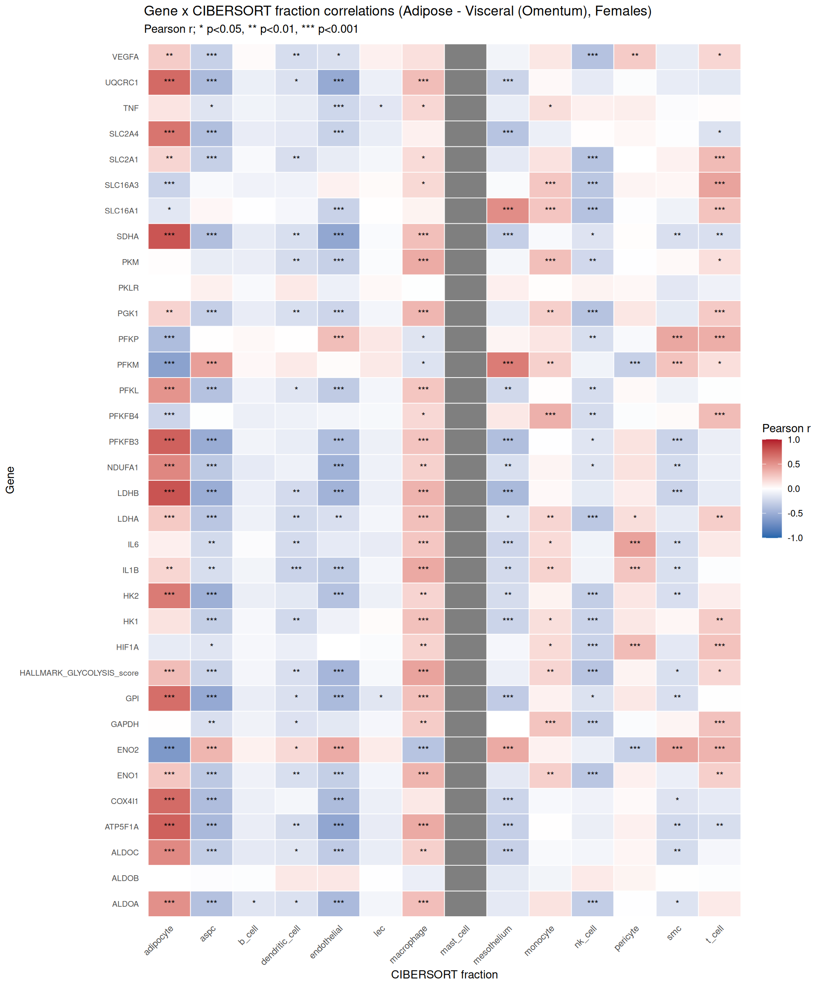
Glycolysis Genes vs CIBERSORT Fractions: Correlation Heatmaps
Which cell fractions drive glycolysis gene expression variance?
Subcutaneous
Visceral
v4.6.1 | 14

Slide 15
CIBERSORTx HiRes Pipeline: Status and Next Steps
CIBERSORTx Pipeline (In Progress)
Expected Outputs
Docker images: fractions, gep, hires (all installed)
Reference: GSE176171 sc adipose (human WAT)
Input preparation: COMPLETE
- Refsample: 2.3 GB (gene symbols x cells)
- Mixture subcutaneous: 412 MB (57,852 genes x 714 samples)
- Mixture visceral: 338 MB (57,852 genes x 587 samples)
Docker execution: PENDING (token regeneration needed)
1. CIBERSORTx Fractions: cell-type proportions (all cell types)
- With S-mode batch correction + 100 permutations
2. CIBERSORTx HiRes: per-sample, per-cell-type expression
- Cell-type-specific expression matrices for each sample
3. Downstream DE on imputed expression:
- Female menopause proxy (pre/peri/post) within each cell type
- Male comparison (hypothesis: males ~ pre-menopausal females)
Why CIBERSORTx HiRes Matters
Current approach: Bulk DE identifies net expression changes, but cannot distinguish:
(a) Changes in per-cell expression (cell-intrinsic) from
(b) Changes in cell composition (more/fewer of a cell type)
CIBERSORTx HiRes resolves this by imputing sample-level expression for each cell type.
This directly addresses Kenichi's question about 'unexpected directions' in bulk data:
- A bulk UP gene could be UP in macrophages but DOWN in adipocytes
- Composition adjustment partially addresses this, but HiRes provides the full picture
- Cell-type DE will reveal which cell types drive the observed menopause-associated changes
v4.6.1 | 15

Slide 16
2026-04-12 Update: New Outputs Summary
Kenichi Follow-Up Analyses
Glycolysis Gene-Node Analysis
R/next_steps_2026-04-12_kenichi_followup_targeted.R
Tables (6):
kenichi_inflammation_depot_comparison.tsv
kenichi_aging_vs_menopause_interaction.tsv
kenichi_aging_vs_menopause_interaction_40to60_window.tsv
kenichi_adrb2_correlations_detail.tsv
kenichi_adrb2_sex_difference_correlations.tsv
kenichi_human_mouse_concordance.tsv
Figures (4): inflammation depot, trajectories, ADRB2 panels
R/next_steps_2026-04-12_glycolysis_gene_nodes.R
Tables (6):
glycolysis_gene_node_lm_stats_{subq,visc,ALL}.tsv
glycolysis_fraction_correlations_{subq,visc,ALL}.tsv
Figures (8): trajectories, forest plots,
effect attenuation, fraction correlation heatmaps
(per depot)
CIBERSORTx Pipeline (Pending)
Email Draft
R/next_steps_2026-04-12_prepare_cibersortx_inputs.R
scripts/run_cibersortx_pipeline_2026-04-12.sh
R/next_steps_2026-04-12_cibersortx_hires_de_analysis.R
Inputs prepared (3.1 GB total)
Docker execution pending token refresh
DE analysis script ready for post-Docker execution
docs/reply_to_kenichi_2026-04-12.md
Addresses all 4 of Kenichi's points with
specific data references and analysis results
Ready for review and sending
Snapshot label at email draft time (2026-04-12): v4.4.0 partial
v4.6.1 | 16

Slide 17
CIBERSORTx HiRes: Cell-Type-Resolved Differential Expression
Subcutaneous + Visceral | 14 cell types | Female menopause proxy + Male comparison
v4.6.1 | 17

Slide 18
CIBERSORTx Pipeline: What Was Done
Reference
GSE176171 single-cell adipose (human WAT)
14 cell types annotated
Fractions
Signature matrix built from sc reference
S-mode batch correction, 100 permutations
HiRes Imputation
Sample-level cell-type expression
Window=20, 10 threads per job
Differential Expression
limma per cell type
Female: pre/peri/post menopause
Male comparison cohort
Subcutaneous
714 samples
18,359 genes, 14 cell types
Visceral
587 samples
18,359 genes, 14 cell types
Pipeline ran on GTEx v10 adipose tissue. HiRes resolves bulk RNA-seq into cell-type-specific expression profiles.
v4.6.1 | 18

Slide 19
CIBERSORTx HiRes DE: Subcutaneous (Post vs Pre, Females)
Cell Type | Genes Tested | UP | DOWN | Total Sig
Adipocyte | 9,697 | 79 | 142 | 221
ASPC | 10,487 | 112 | 40 | 152
Macrophage | 10,691 | 53 | 75 | 128
SMC | 11,558 | 64 | 74 | 138
Endothelial | 9,464 | 83 | 41 | 124
LEC | 9,531 | 81 | 34 | 115
T cell | 8,249 | 98 | 15 | 113
Monocyte | 5,234 | 70 | 24 | 94
Mesothelium | 6,514 | 39 | 40 | 79
NK cell | 5,487 | 36 | 28 | 64
Dendritic cell | 6,804 | 23 | 22 | 45
Mast cell | 2,383 | 24 | 1 | 25
B cell | 1,080 | 3 | 0 | 3
Pericyte | 4,604 | 0 | 0 | 0
Adipocyte shows asymmetric DOWN (142 vs 79 UP), suggesting cell-intrinsic downregulation after menopause. ASPC and T cell show strong UP bias.
v4.6.1 | 19

Slide 20
CIBERSORTx HiRes DE: Visceral (Post vs Pre, Females)
Cell Type | Genes Tested | UP | DOWN | Total Sig
Endothelial | 11,337 | 84 | 57 | 141
Macrophage | 10,663 | 82 | 48 | 130
Adipocyte | 9,726 | 76 | 39 | 115
Mesothelium | 12,361 | 71 | 43 | 114
T cell | 8,842 | 84 | 25 | 109
SMC | 10,761 | 46 | 35 | 81
ASPC | 10,100 | 63 | 15 | 78
LEC | 8,807 | 39 | 24 | 63
Monocyte | 3,712 | 13 | 26 | 39
Mast cell | 1,898 | 3 | 26 | 29
NK cell | 3,581 | 10 | 18 | 28
Pericyte | 2,911 | 10 | 14 | 24
Dendritic cell | 1,846 | 9 | 9 | 18
B cell | 4,505 | 10 | 3 | 13
Endothelial becomes the top DE cell type in visceral. Macrophage consistent across depots. Mast cell shows striking DOWN-only pattern (3 up, 26 down).
v4.6.1 | 20

Slide 21
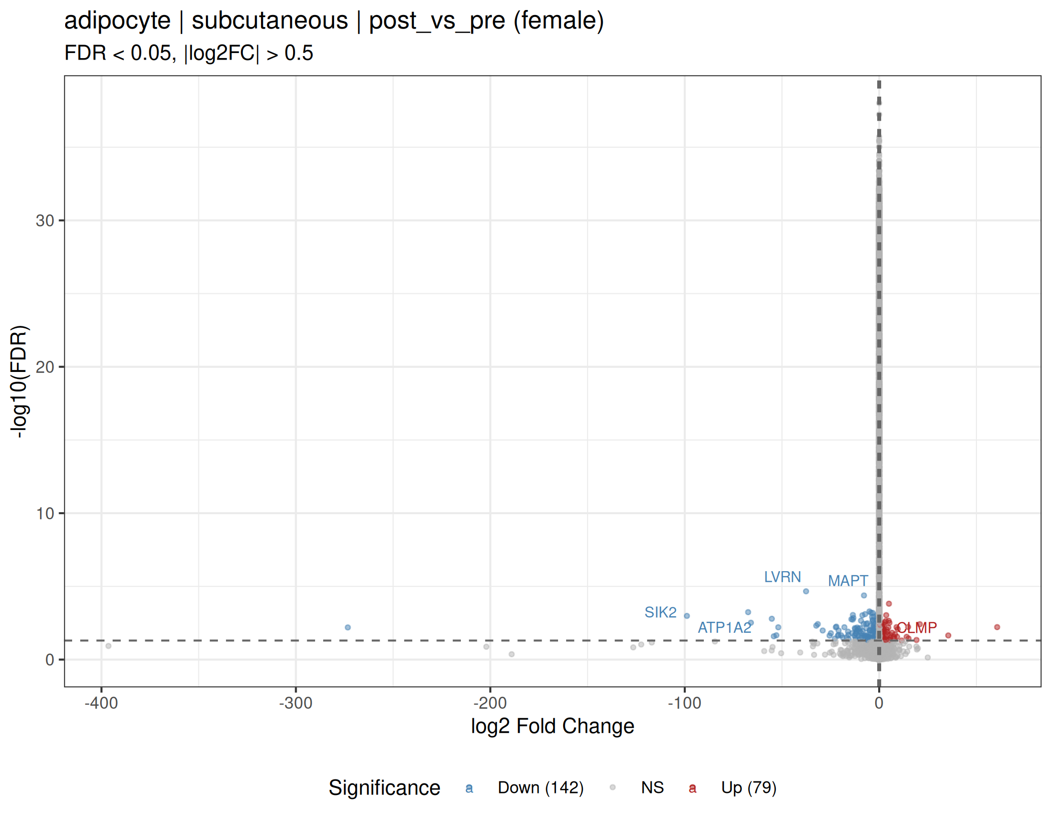
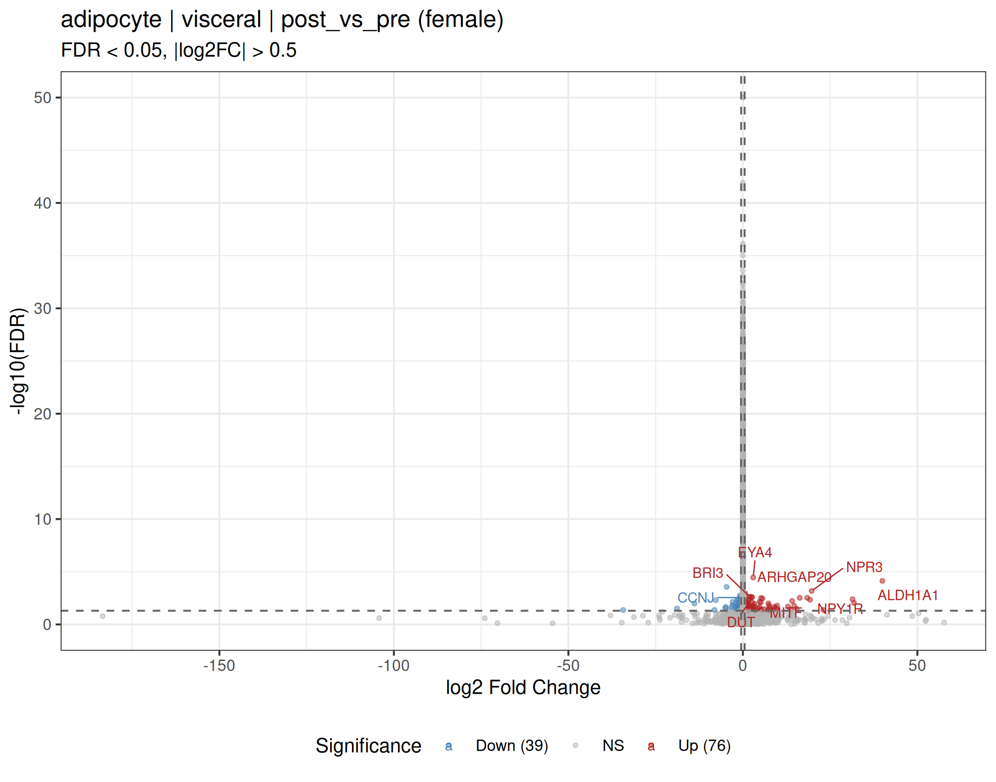
Adipocyte: Post vs Pre Menopause (HiRes-Resolved)
Subcutaneous
Visceral
v4.6.1 | 21

Slide 22
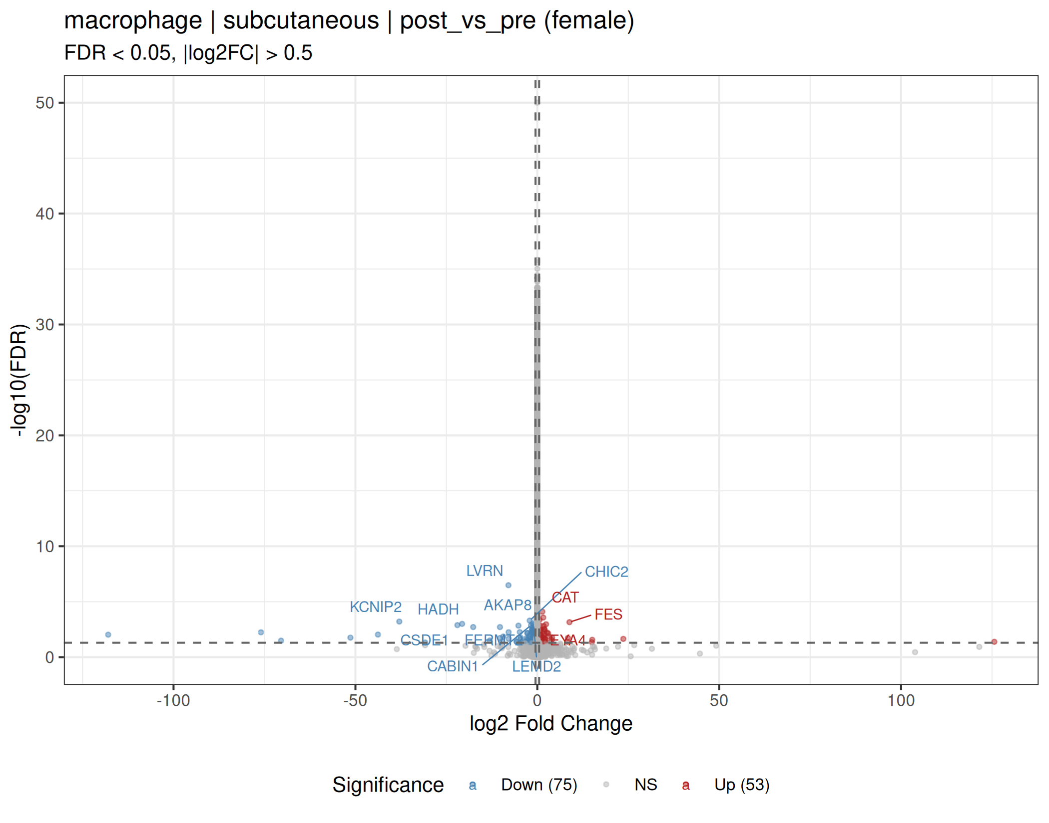
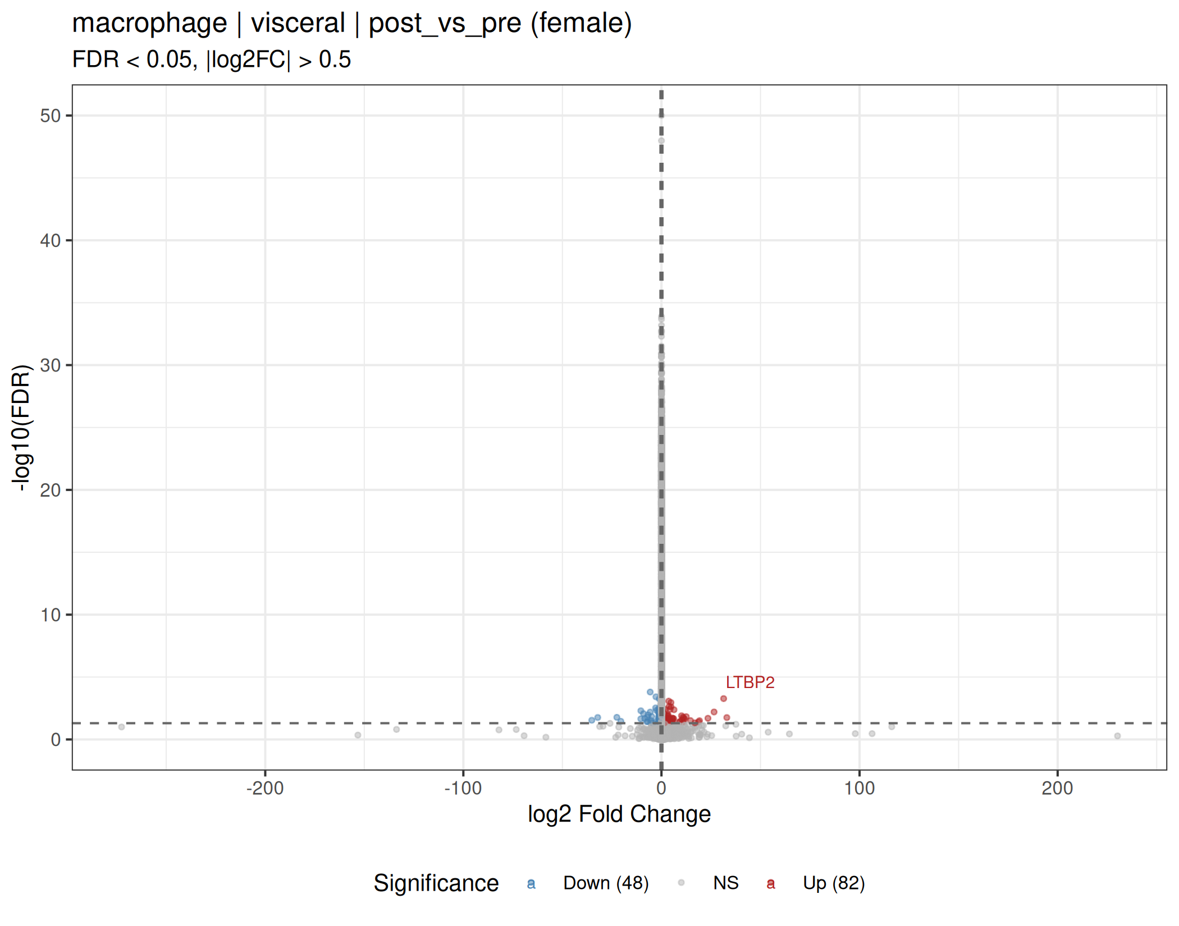
Macrophage: Post vs Pre Menopause (HiRes-Resolved)
Subcutaneous
Visceral
v4.6.1 | 22

Slide 23
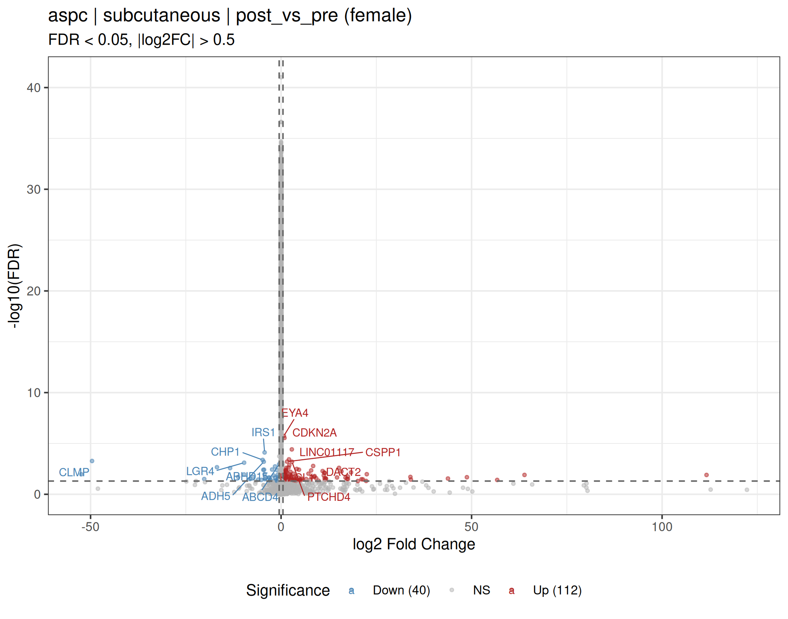
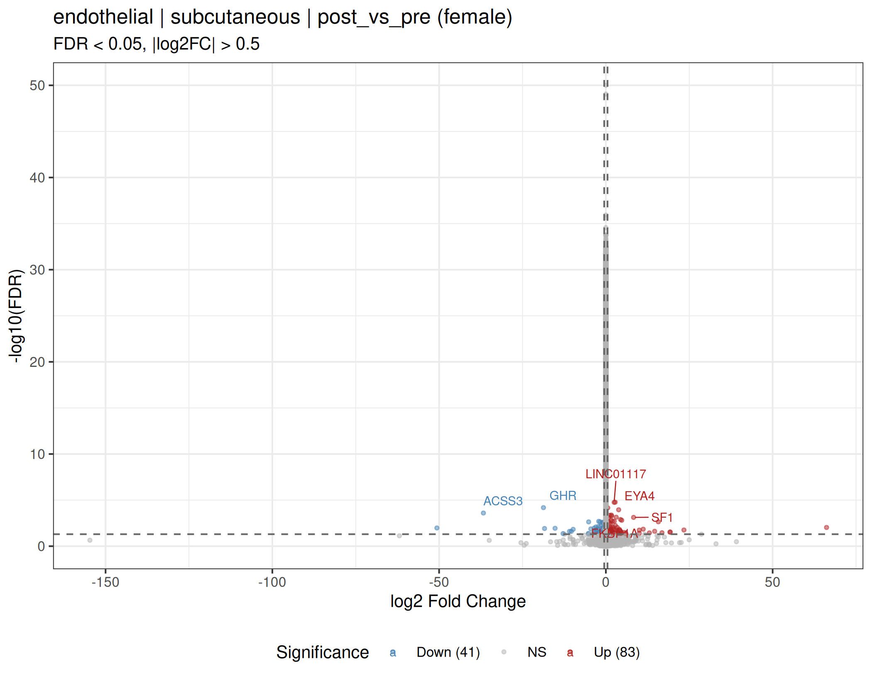
ASPC & Endothelial: Post vs Pre (Subcutaneous, HiRes)
ASPC
Endothelial
v4.6.1 | 23

Slide 24
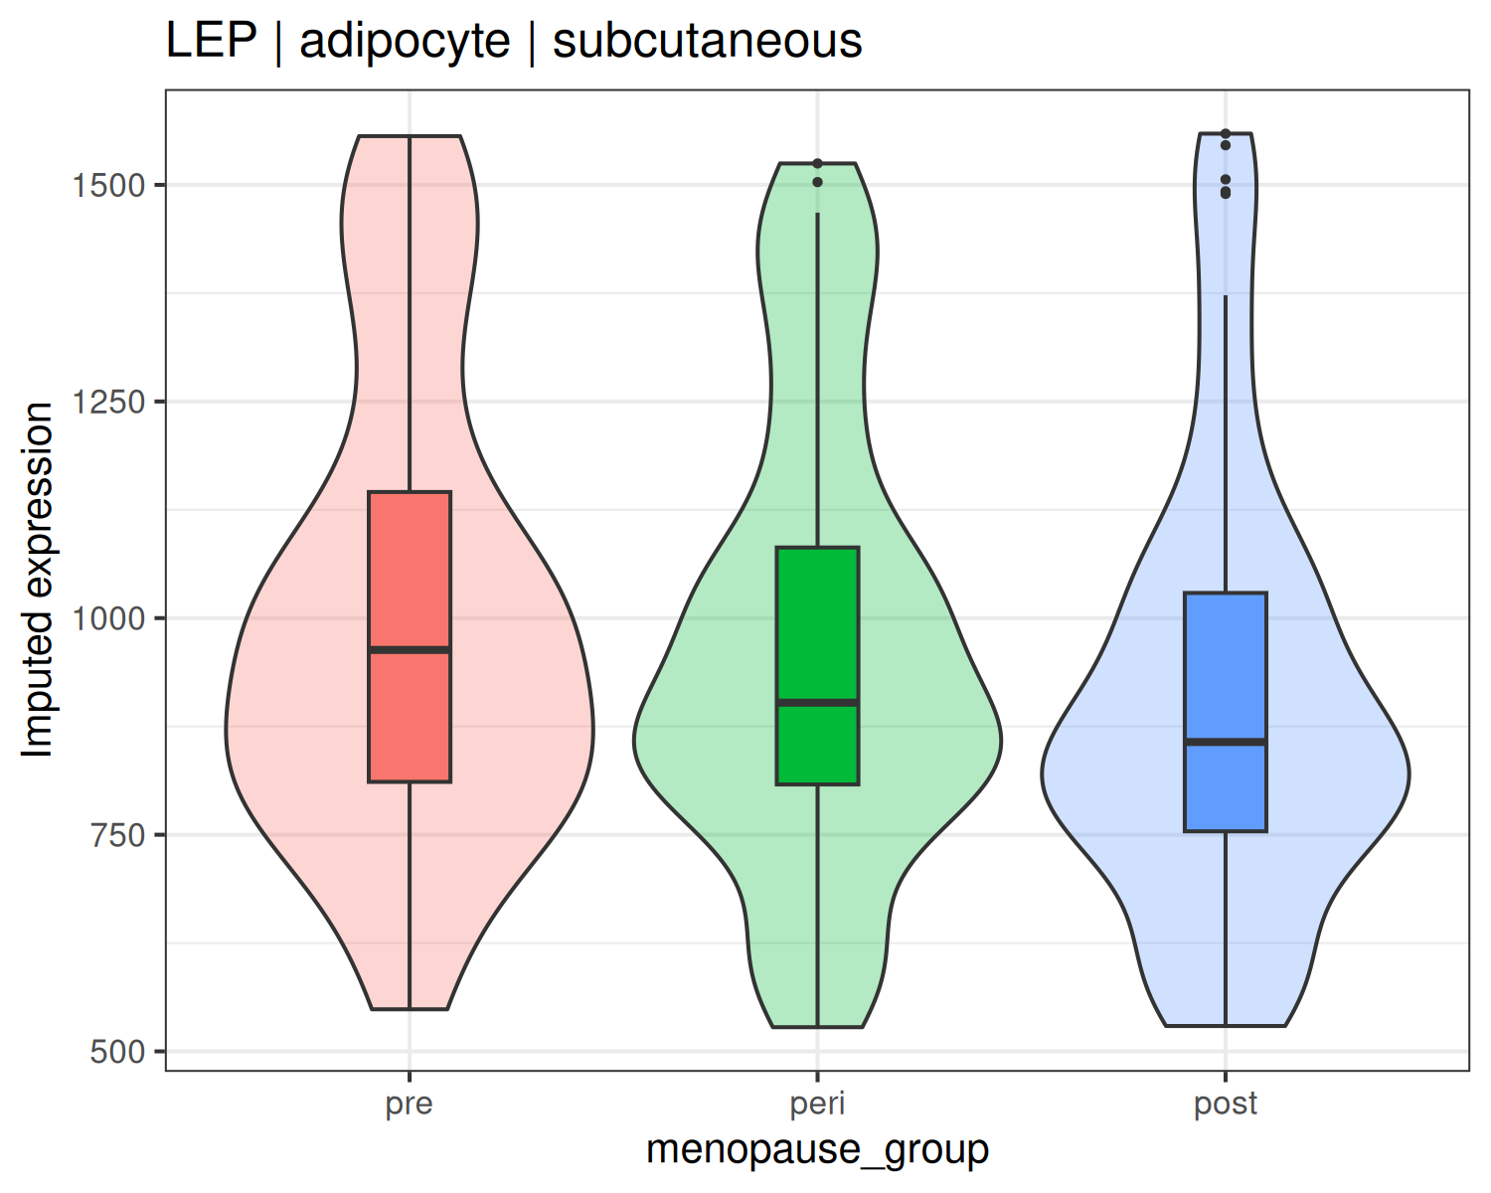
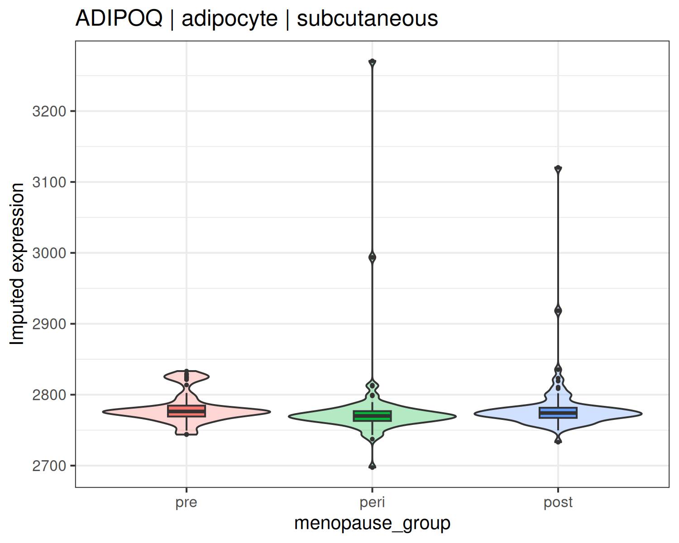
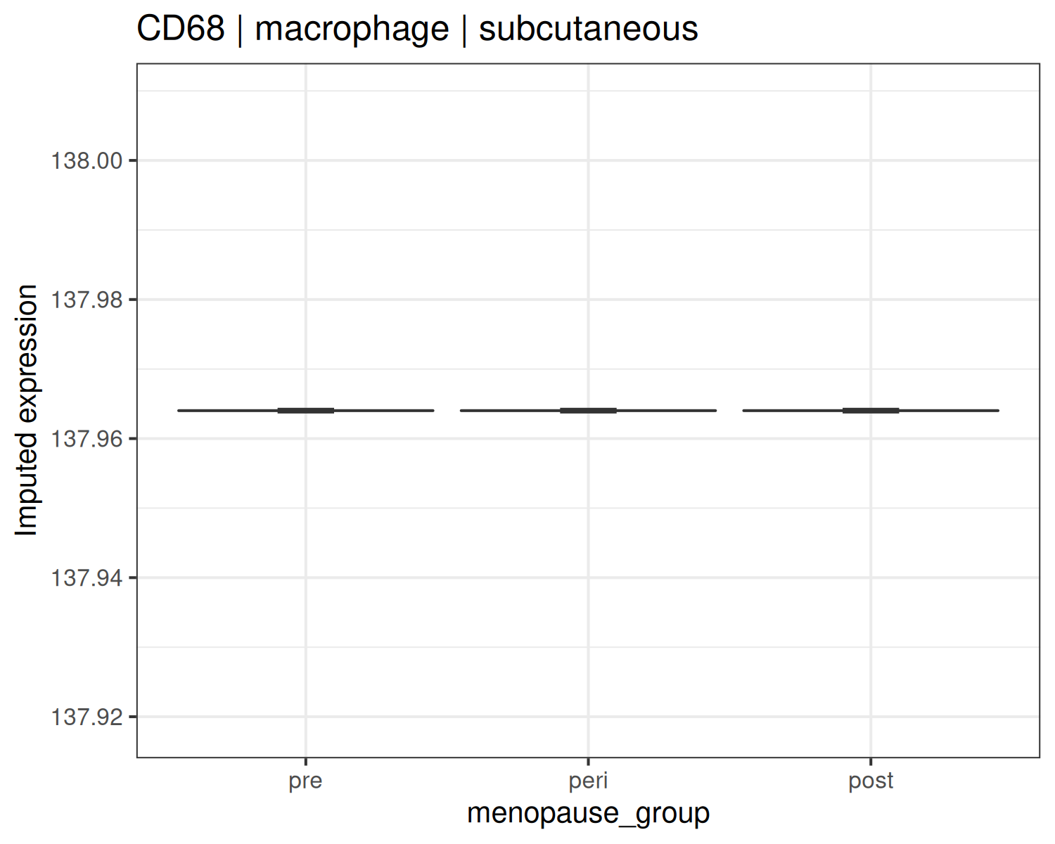
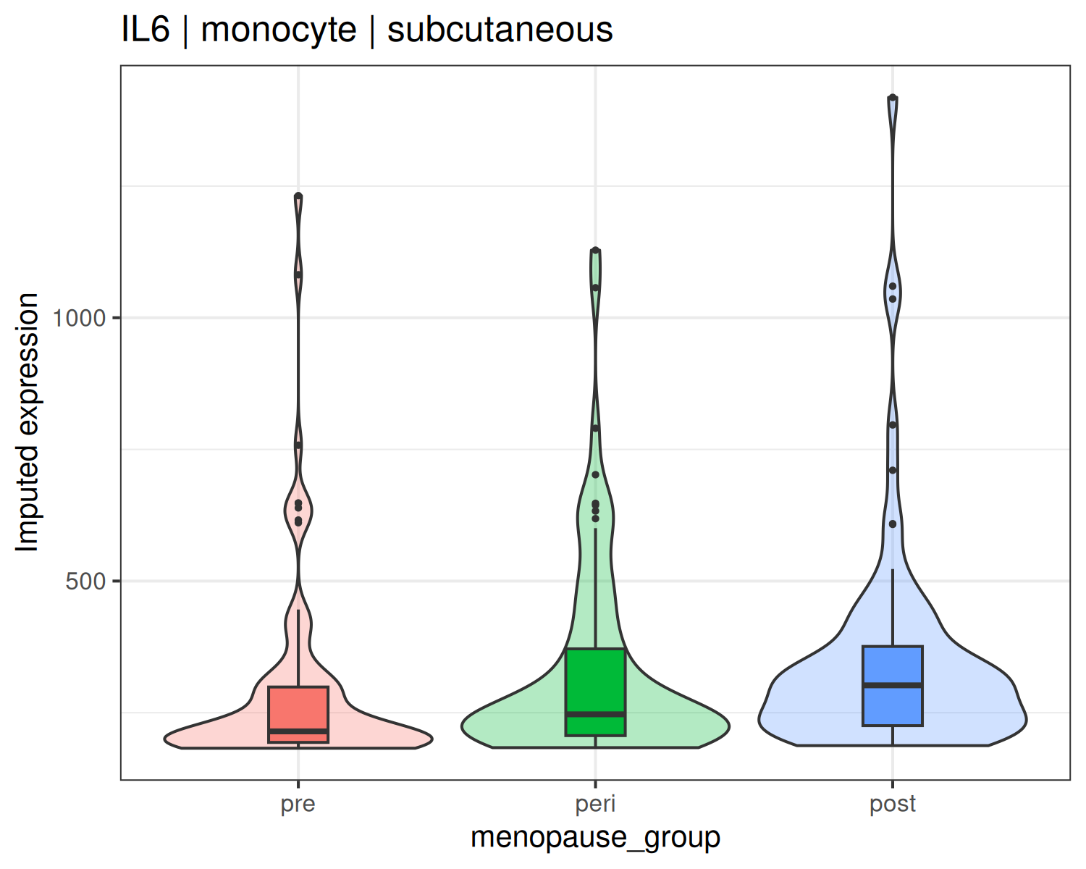
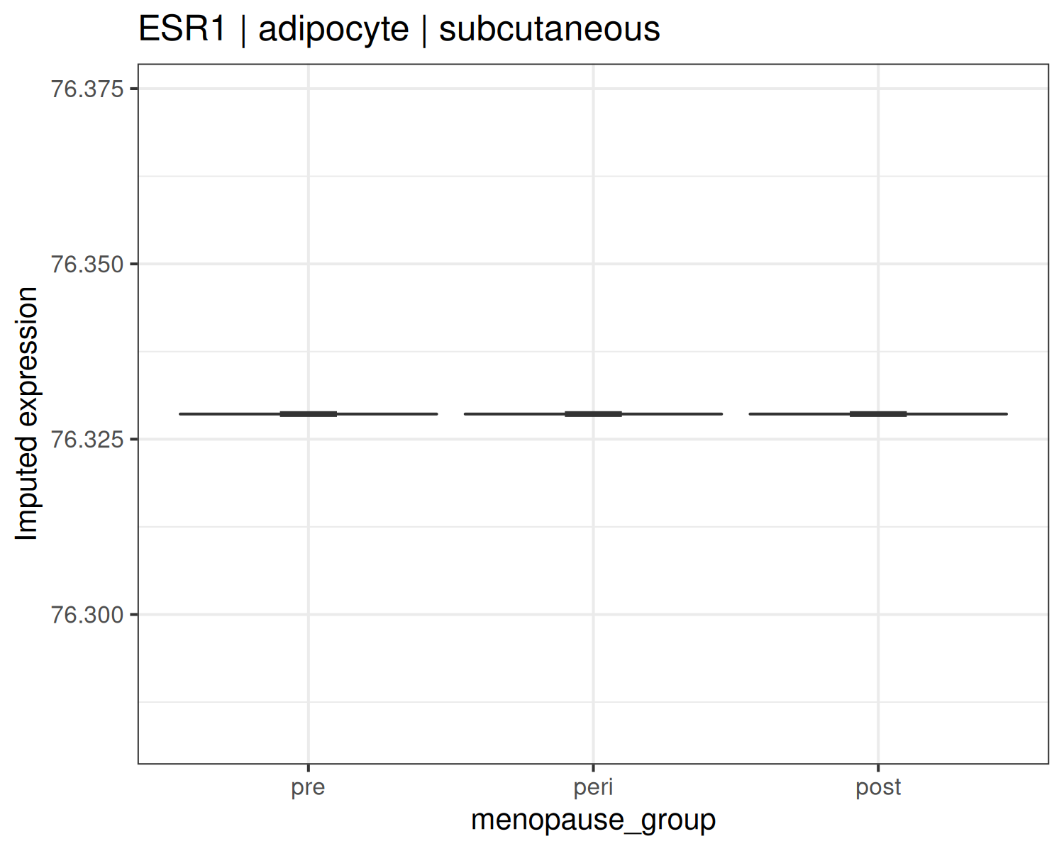
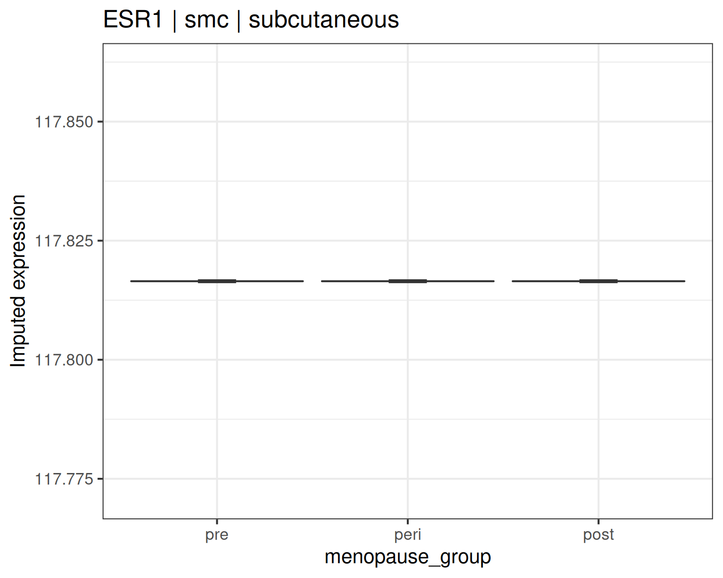
Cell-Type-Specific Expression of Key Genes (Subcutaneous)
v4.6.1 | 24

Slide 25
Follow-up on Kenichi’s catecholamine results (2026-04-21)
Catecholamine resistance in OVX - age-stratified ADRB2 analyses, sex-specific decline, Saltiel Fig 8-style panels, and cross-species concordance
v4.6.1 | 25

Slide 26
Recap: your OVX 042126 findings
What you showed and why it matters for our human GTEx analysis
• Slide 1: Adrb3 is DOWN in both pWAT (visceral) and iWAT (subcutaneous); Adrb1 also DOWN in iWAT (visible in figure panels; gene name not in Slide 1 text labels).
• The reduction is MORE PRONOUNCED in iWAT.
• Slide 2: inflammation, fibrosis, senescence markers are UP in OVX pWAT (similar in iWAT, not shown).
• Hypothesis: estrogen deficiency -> chronic SNS activity -> catecholamine resistance (reduced beta-AR signaling).
• Context: Prog Lipid Res 2009 - in human adipose, ADRB1 AND ADRB2 (not ADRB3) are the primary lipolytic beta-AR subtypes.
• Therefore, for the human translational comparison, ADRB1 and ADRB2 are the most physiologically relevant targets.
Your four questions
• Q1 - Is ADRB2 - inflammation/fibrosis/senescence negative correlation STRONGER in older women vs younger women?
• Q2 - Is ADRB2 reduced in subcutaneous older women, and is the reduction more pronounced in women than men?
• Q3 - Reproduce Saltiel Fig 8-style scatter: ADRB2 vs age, CCL2, fibrosis, senescence in women.
• Q4 - Suggest best visualization.
v4.6.1 | 26

Slide 27
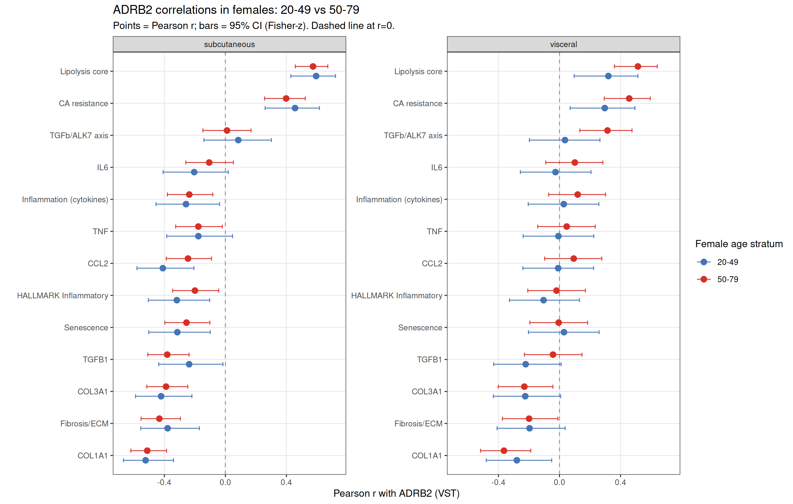
Q1: ADRB2 correlations in females - 20-49 vs 50-79 (forest plot)
Points = Pearson r, bars = 95% CI (Fisher-z). Dashed line at r=0. Fisher-z tests for young vs older female correlation magnitudes are all non-significant at a=0.05 (min p=0.062 for visceral TGFb/ALK7 axis, where older females show a STRONGER POSITIVE correlation - opposite direction to catecholamine-resistance hypothesis).
v4.6.1 | 27

Slide 28
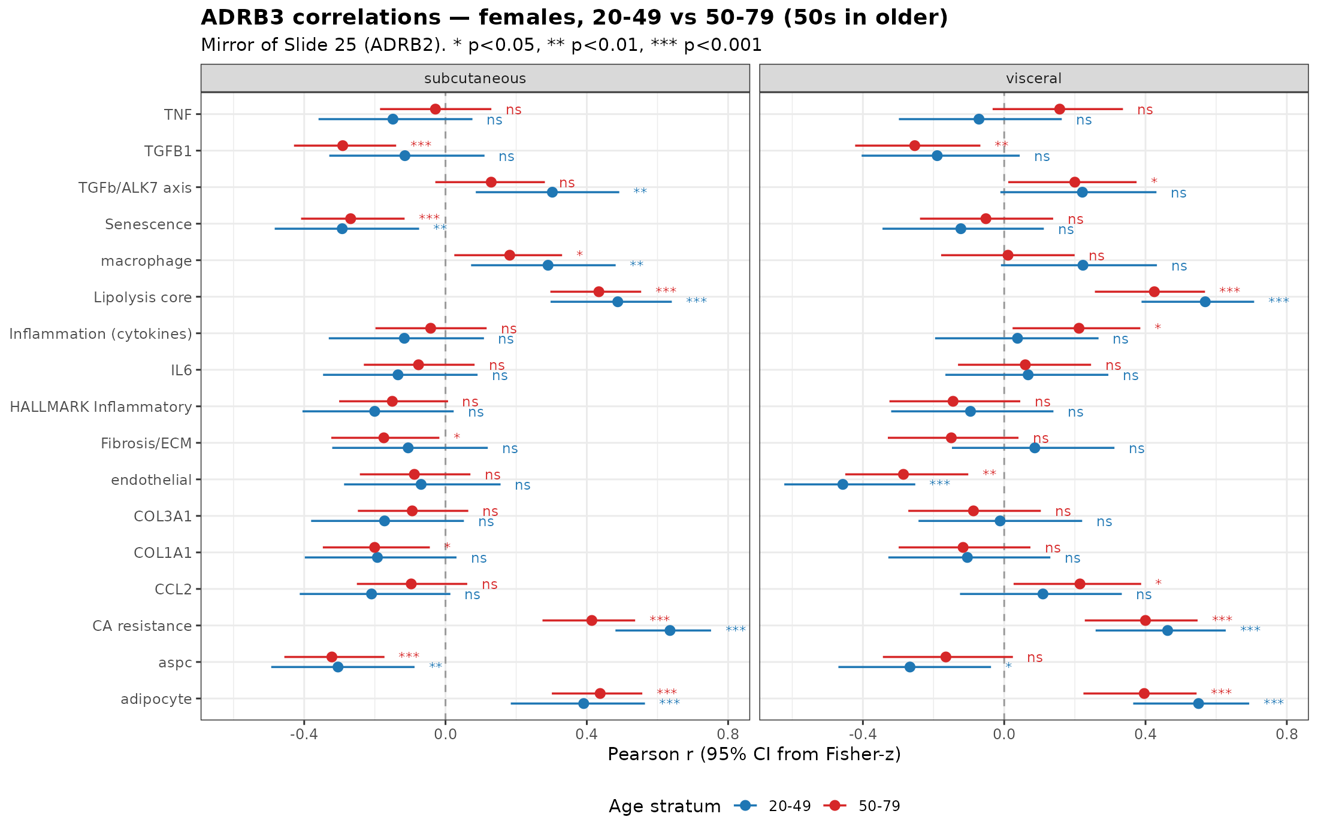
Q1 mirror: ADRB3 correlations in females (20-49 vs 50-79)
Forest plot mirroring Slide 27 (ADRB2). Asterisks indicate within-group correlation significance (* p<0.05, ** p<0.01, *** p<0.001). Compare to ADRB2 forest in Slide 27.
v4.6.1 | 28

Slide 29
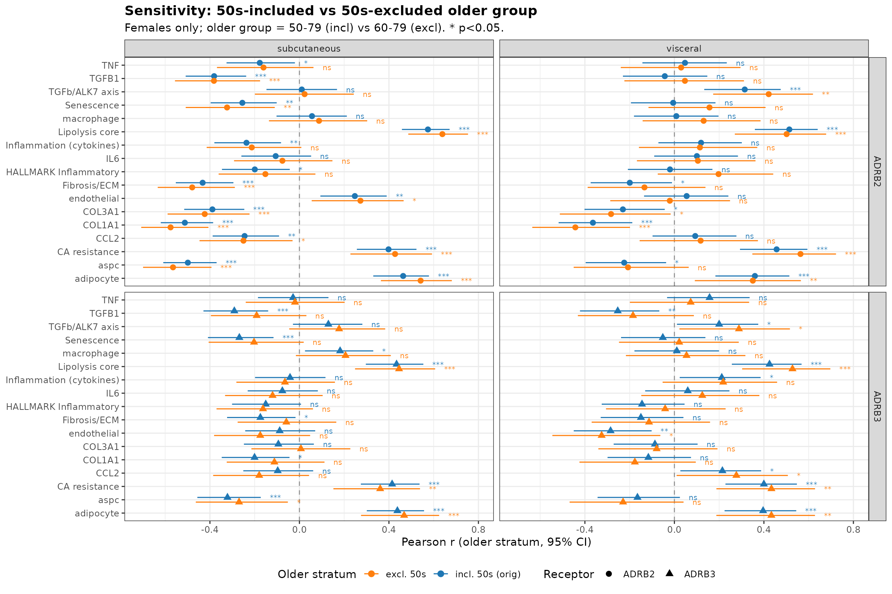
Sensitivity: 50s-included vs 50s-excluded older group
Older group definition changes: 50-79 (incl) vs 60-79 (excl). Headline: excluding the 50s STRENGTHENS the ADRB2-fibrosis correlation in older subq women (-0.43 -> -0.48); ADRB3-fibrosis attenuates (-0.17 -> -0.06; Fisher-z p=0.43, NS).
v4.6.1 | 29

Slide 30
Q1: Fisher-z comparison (older vs younger females) - top gene sets
Depot | Target | n young | r young | n older | r older | Delta r | Fisher p | Older more -
subcutaneous | inflammation cytokines | 78 | -0.258 | 155 | -0.237 | +0.021 | 0.871 | no
subcutaneous | fibrosis | 78 | -0.379 | 155 | -0.433 | -0.054 | 0.647 | YES
subcutaneous | senescence | 78 | -0.315 | 155 | -0.255 | +0.060 | 0.644 | no
subcutaneous | lipolysis core | 78 | +0.595 | 155 | +0.574 | -0.020 | 0.827 | YES
subcutaneous | CCL2 | 78 | -0.410 | 155 | -0.245 | +0.165 | 0.189 | no
subcutaneous | IL6 | 78 | -0.204 | 155 | -0.106 | +0.098 | 0.475 | no
subcutaneous | TNF | 78 | -0.177 | 155 | -0.177 | -0.000 | 0.999 | YES
subcutaneous | COL1A1 | 78 | -0.523 | 155 | -0.512 | +0.011 | 0.917 | no
subcutaneous | TGFB1 | 78 | -0.237 | 155 | -0.381 | -0.144 | 0.258 | YES
visceral | inflammation cytokines | 72 | +0.028 | 108 | +0.119 | +0.091 | 0.554 | no
visceral | fibrosis | 72 | -0.196 | 108 | -0.199 | -0.003 | 0.983 | YES
visceral | senescence | 72 | +0.029 | 108 | -0.006 | -0.035 | 0.822 | YES
visceral | lipolysis core | 72 | +0.320 | 108 | +0.514 | +0.193 | 0.128 | no
visceral | CCL2 | 72 | -0.009 | 108 | +0.093 | +0.102 | 0.51 | no
visceral | IL6 | 72 | -0.026 | 108 | +0.100 | +0.127 | 0.412 | no
visceral | TNF | 72 | -0.007 | 108 | +0.047 | +0.055 | 0.725 | no
visceral | COL1A1 | 72 | -0.279 | 108 | -0.364 | -0.085 | 0.542 | YES
visceral | TGFB1 | 72 | -0.222 | 108 | -0.043 | +0.179 | 0.239 | no
Net result: no formal evidence that the ADRB2-inflammation/fibrosis negative correlation is STRONGER in older women vs younger women. In subcutaneous, fibrosis shows slight strengthening with age (Delta r = -0.05, NS); CCL2 shows the opposite (Delta r = +0.16, NS).
v4.6.1 | 30

Slide 31
Q1 mirror: Fisher-z young-vs-older for ADRB3 (3 stratifications)
Three stratifications compared (females only)
• broad_young_vs_older = 20-49 vs 50-79 (50s in older) — original Slide 28 cutoff
• peri_menopause_window = 40-49 vs 50-59 — narrow peri window
• broad_50s_excluded = 20-49 vs 60-79 (50s dropped) — sensitivity
ADRB3 fibrosis (subcutaneous, females)
• broad: r_young=-0.106 (n=78), r_older=-0.175 (n=155), delta=-0.069
• peri 40-49 vs 50-59: r_young=-0.016 (n=43), r_older=-0.357 (n=76), delta=-0.342 **
• broad-50s-excluded: r_young=-0.106 (n=78), r_older=-0.059 (n=79), delta=+0.047 (NS)
ADRB2 fibrosis (subcutaneous, females) — for comparison
• broad: r_older=-0.43 (n=155); peri 50-59: r=-0.37 (n=76); broad-excl-50s: r=-0.48 (n=79)
Interpretation
• ADRB2 effect on fibrosis is robust across age slices and STRENGTHENS once 50s are removed.
• ADRB3 effect on fibrosis is concentrated in the 50s (peri window r=-0.357), not in 60-79.
Full table: tables/next_steps_2026-05-03_v4.5.4/adrb3_age_correlation_young_vs_older_fisherz.tsv
v4.6.1 | 31

Slide 32
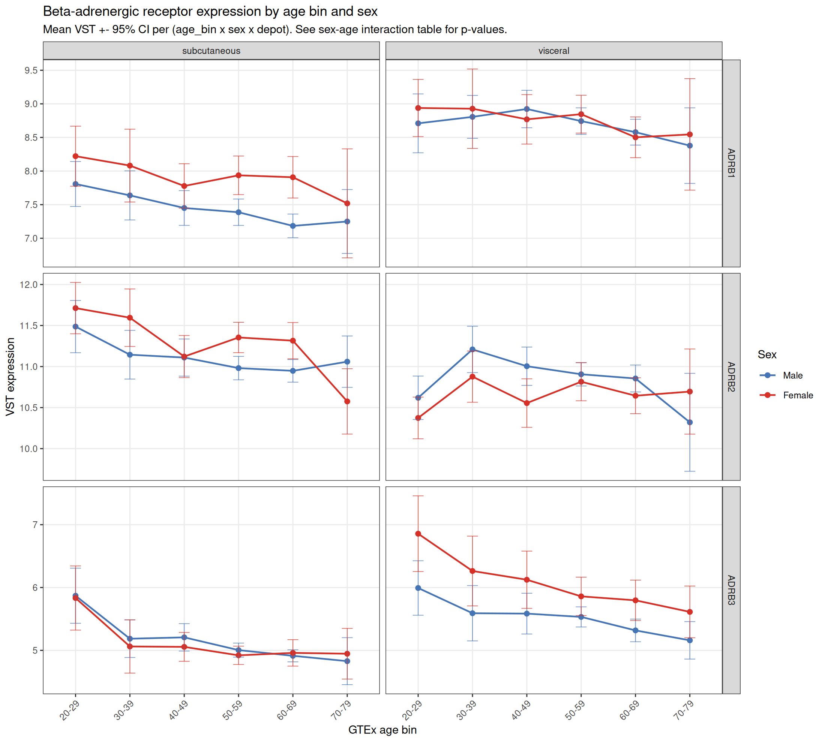
Q2: Beta-AR expression by age and sex (both depots)
Mean VST +/- 95% CI per (age bin x sex x depot). All three receptors decline with age in subcutaneous; ADRB3 declines in both depots.
v4.6.1 | 32

Slide 33
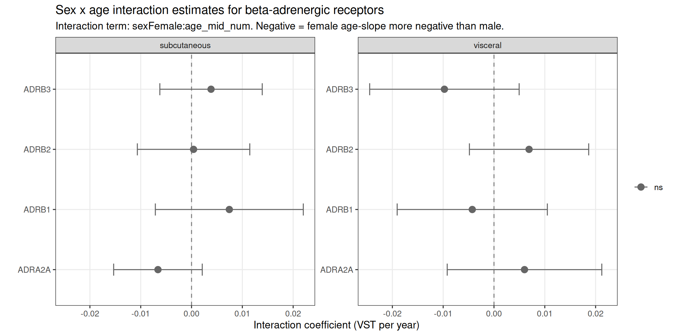
Q2: Sex x age interaction - is female decline larger than male?
Depot | Rcpt | S | Slope/yr | p
subq | ADRA2A | F | -0.0102 | 0.00805
subq | ADRA2A | M | -0.0048 | 0.0598
subq | ADRB1 | F | -0.0078 | 0.228
subq | ADRB1 | M | -0.0144 | 0.000624
subq | ADRB2 | F | -0.0084 | 0.064
subq | ADRB2 | M | -0.0103 | 0.002
subq | ADRB3 | F | -0.0134 | 0.00226
subq | ADRB3 | M | -0.0173 | 7.5e-09
visc | ADRA2A | F | -0.0100 | 0.122
visc | ADRA2A | M | -0.0189 | 2.2e-05
visc | ADRB1 | F | -0.0070 | 0.246
visc | ADRB1 | M | -0.0040 | 0.366
visc | ADRB2 | F | +0.0048 | 0.304
visc | ADRB2 | M | -0.0016 | 0.647
visc | ADRB3 | F | -0.0208 | 0.00276
visc | ADRB3 | M | -0.0109 | 0.00799
ADRB2 subcutaneous: male slope = -0.0103 (p=0.002), female slope = -0.0084 (p=0.064, borderline within-female); pooled sex*age interaction p = 0.94 - NO significant sex difference in ADRB2 decline. ADRB3 visceral: female -0.0208 vs male -0.0109, interaction p = 0.19 (directionally matches OVX pWAT but NS).
v4.6.1 | 33

Slide 34
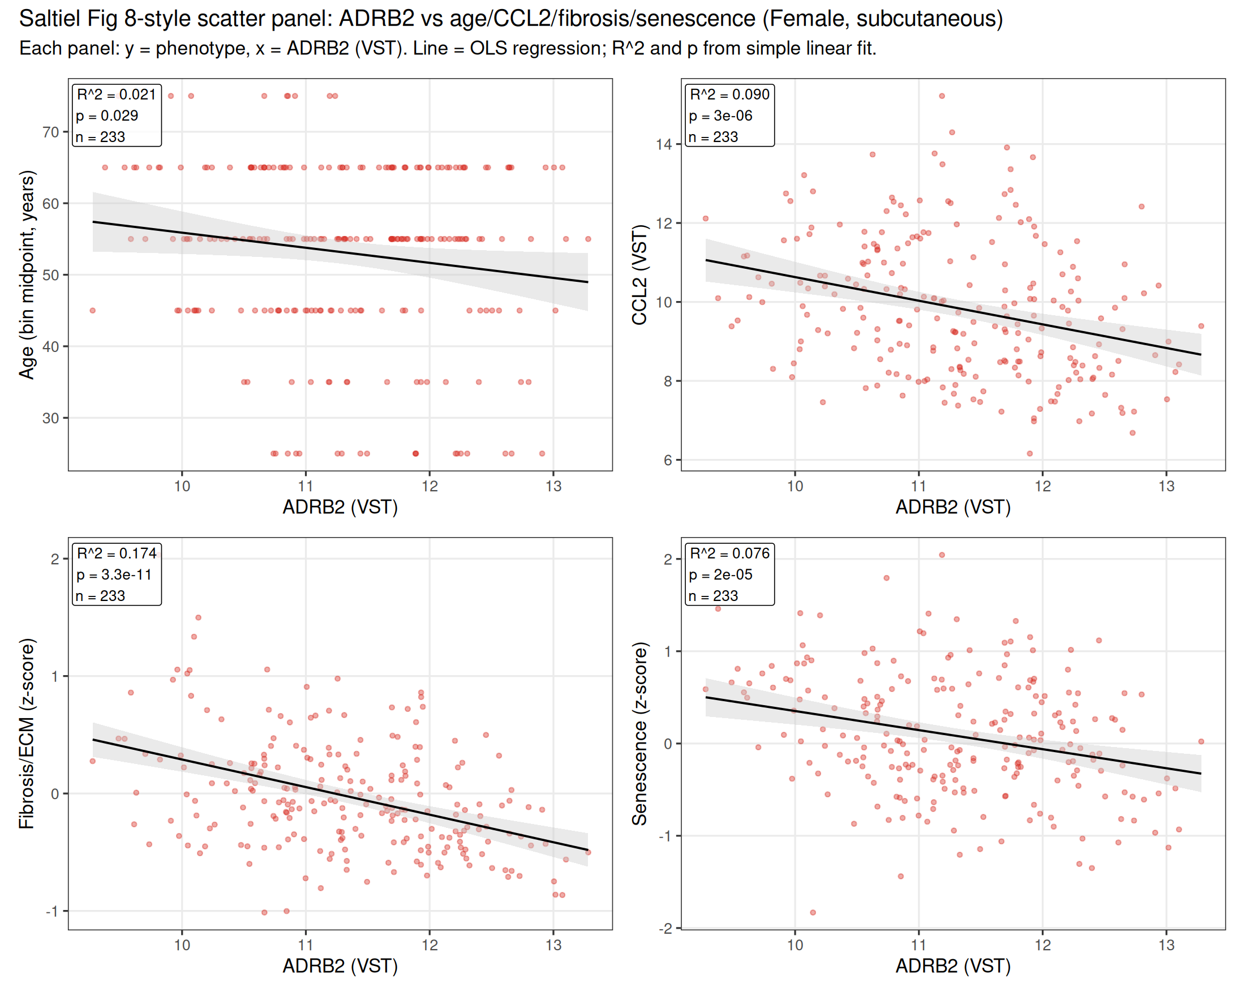
Q3: Saltiel Fig 8-style panel - FEMALE, subcutaneous (primary)
ADRB2 vs fibrosis: R^2 = 0.17, p = 3.3e-11 (strongest panel). ADRB2 vs CCL2: R^2 = 0.09, p = 3.0e-6. ADRB2 vs senescence: R^2 = 0.076, p = 2.0e-5. ADRB2 vs age: R^2 = 0.021, p = 0.029 (weak but significant).
v4.6.1 | 34

Slide 35
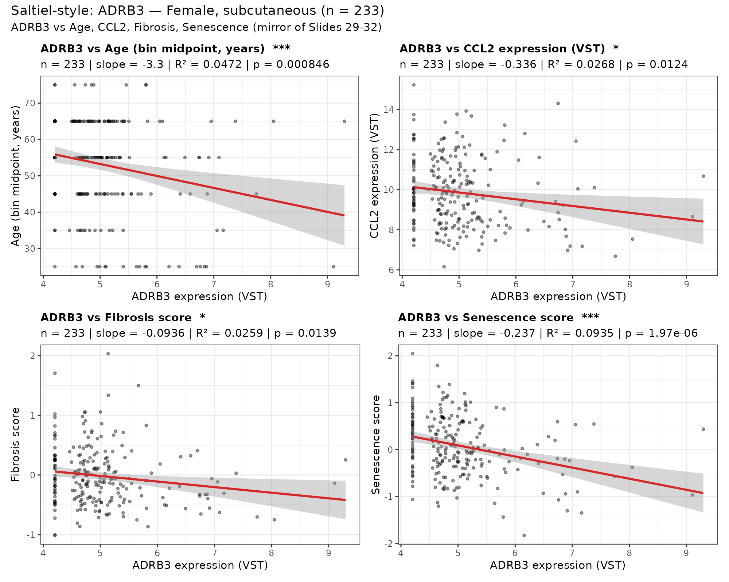
Q3 mirror: Saltiel-style — ADRB3 — FEMALE, subcutaneous (n=233)
Mirror of Slide 34 (ADRB2). Headline: ADRB3 vs senescence is the strongest panel. Asterisks in panel titles: * p<0.05, ** p<0.01, *** p<0.001.
v4.6.1 | 35

Slide 36
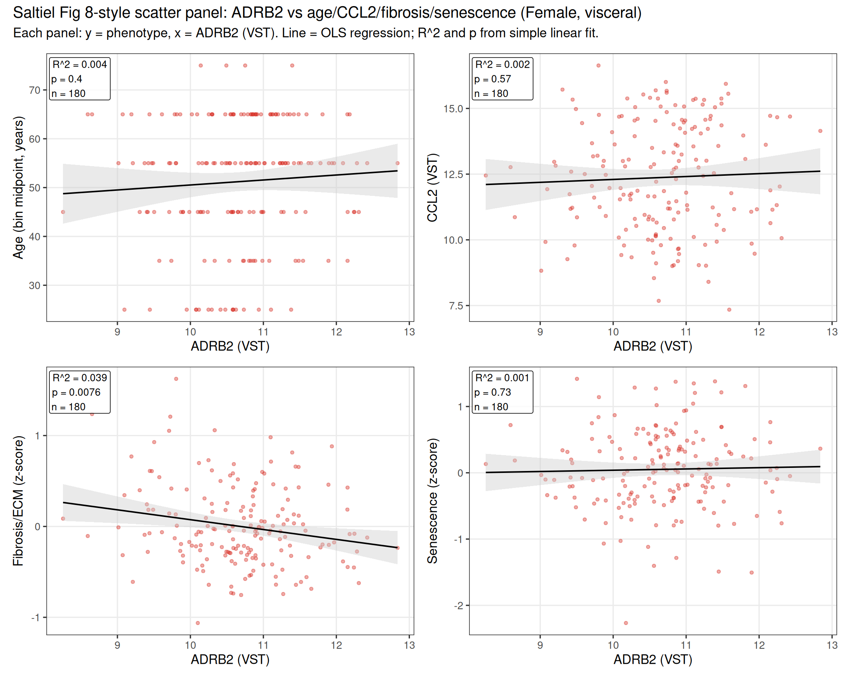
Q3: Saltiel-style panel - FEMALE, visceral (supplementary)
Female visceral: weaker ADRB2 relationships overall. Only fibrosis reaches significance (R^2 = 0.04, p = 7.6e-3). Depot-specific attenuation consistent with 2026-04-12 analysis.
v4.6.1 | 36

Slide 37
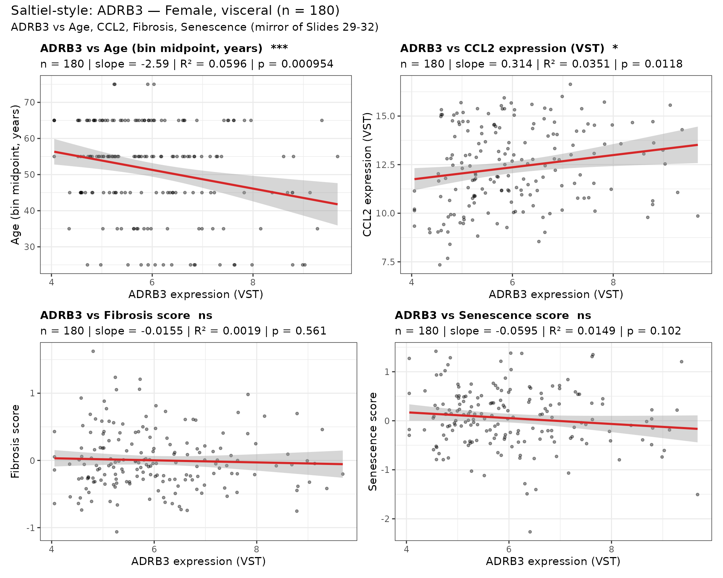
Q3 mirror: Saltiel-style — ADRB3 — FEMALE, visceral (n=180)
Mirror of Slide 36 (ADRB2). Asterisks in panel titles: * p<0.05, ** p<0.01, *** p<0.001.
v4.6.1 | 37

Slide 38
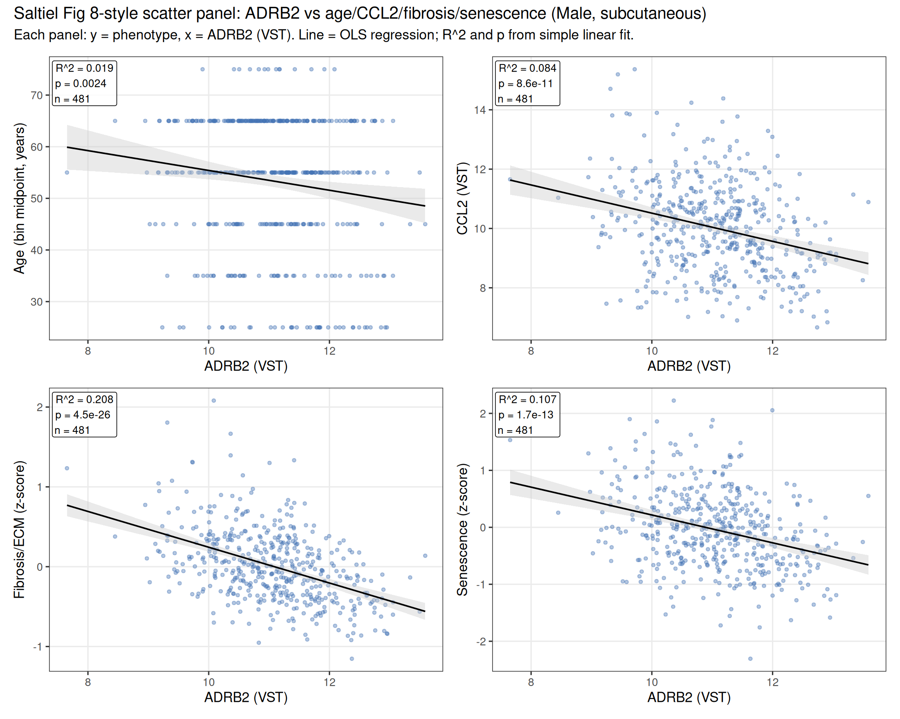
Q3: Saltiel-style panel - MALE, subcutaneous (sex-comparison)
Male subcutaneous (n=481) shows the same directional relationships as females, with higher power. ADRB2 vs fibrosis: R^2 = 0.21, p = 4.5e-26. Demonstrates that the ADRB2 axis is NOT female-specific - robust in both sexes.
v4.6.1 | 38

Slide 39
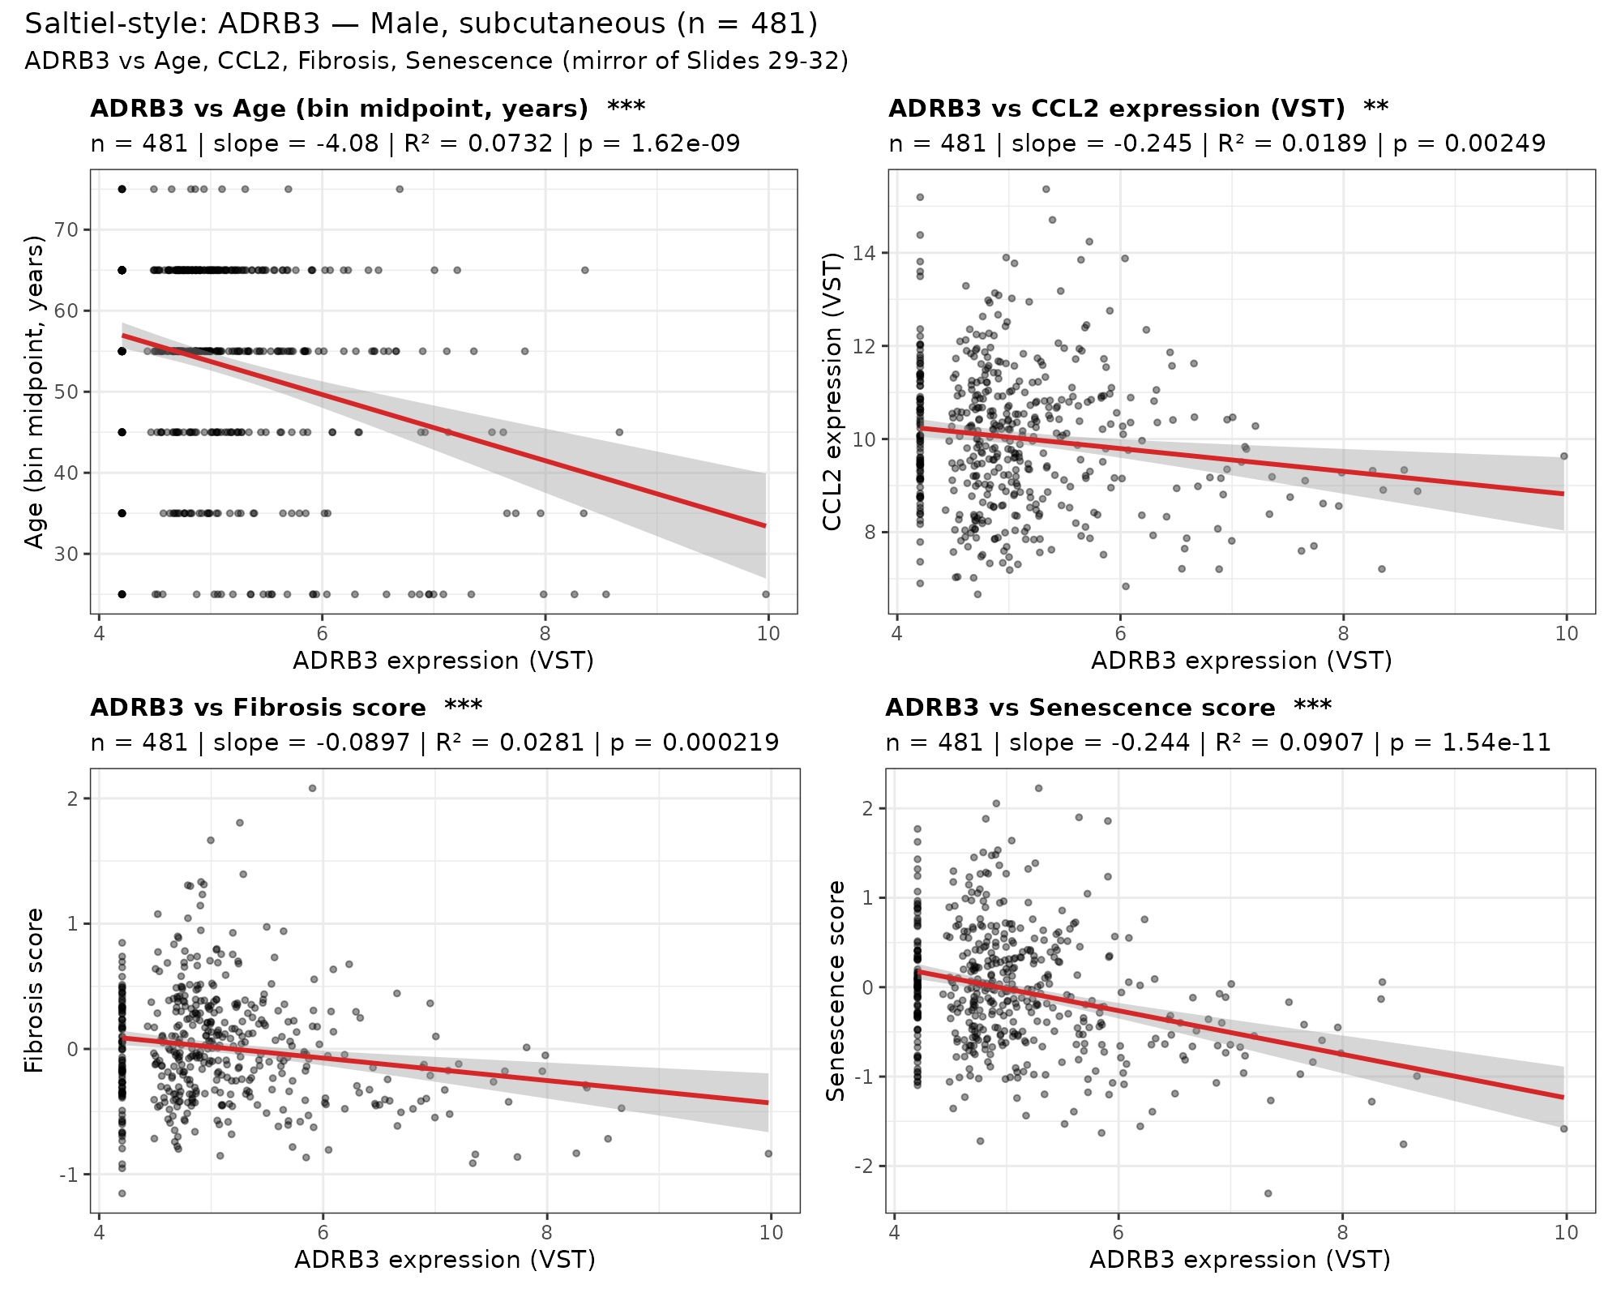
Q3 mirror: Saltiel-style — ADRB3 — MALE, subcutaneous (n=481)
Mirror of Slide 38 (ADRB2). Sex-comparison panel. Asterisks in panel titles: * p<0.05, ** p<0.01, *** p<0.001.
v4.6.1 | 39

Slide 40
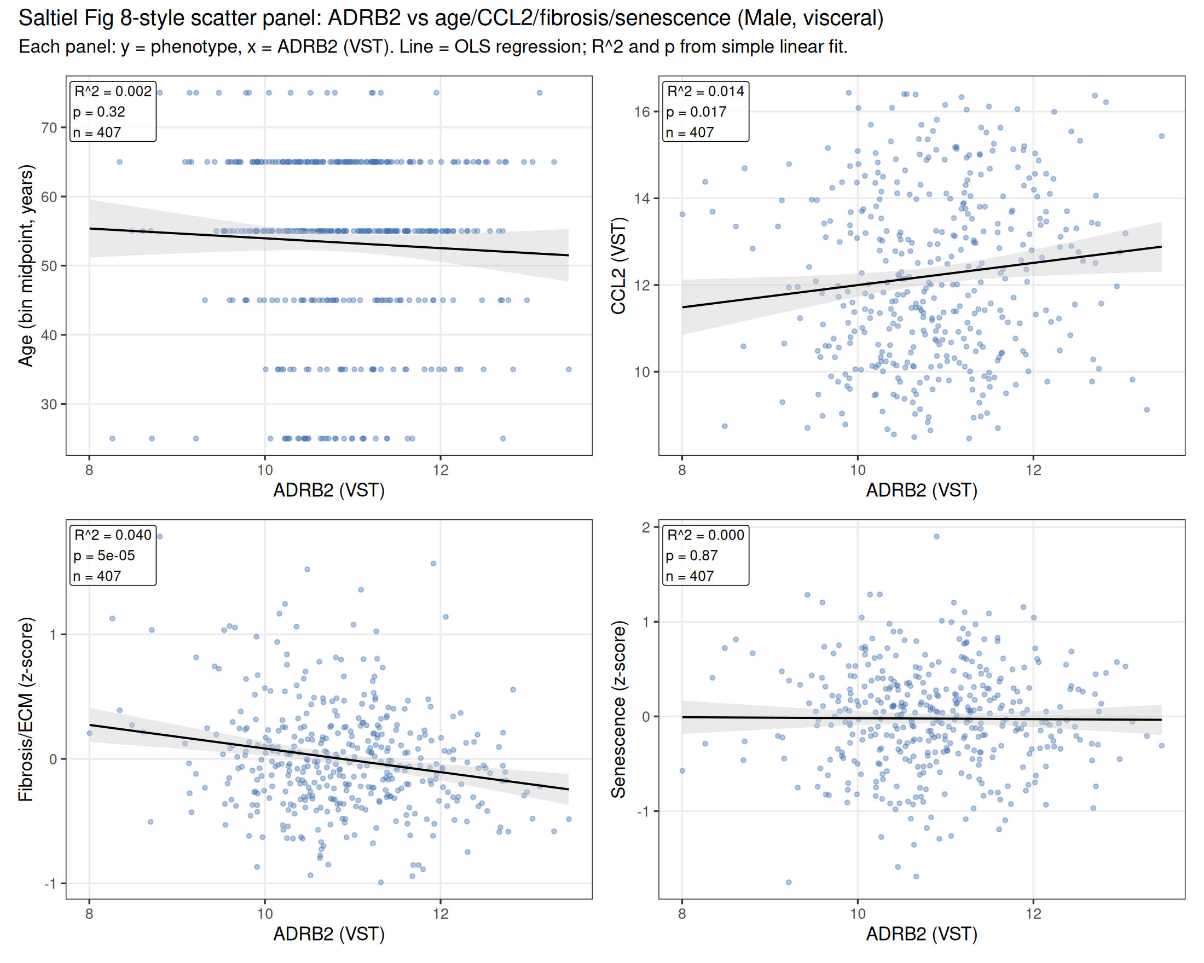
Q3: Saltiel-style panel - MALE, visceral (sex-comparison)
Male visceral: fibrosis relationship holds (R^2 = 0.04, p = 5.0e-5). CCL2 shows a weak POSITIVE relationship (R^2 = 0.014, p = 0.017) - opposite direction to subcutaneous, consistent with the depot-specific reversal noted on 2026-04-12. Age and senescence are not significant.
v4.6.1 | 40

Slide 41
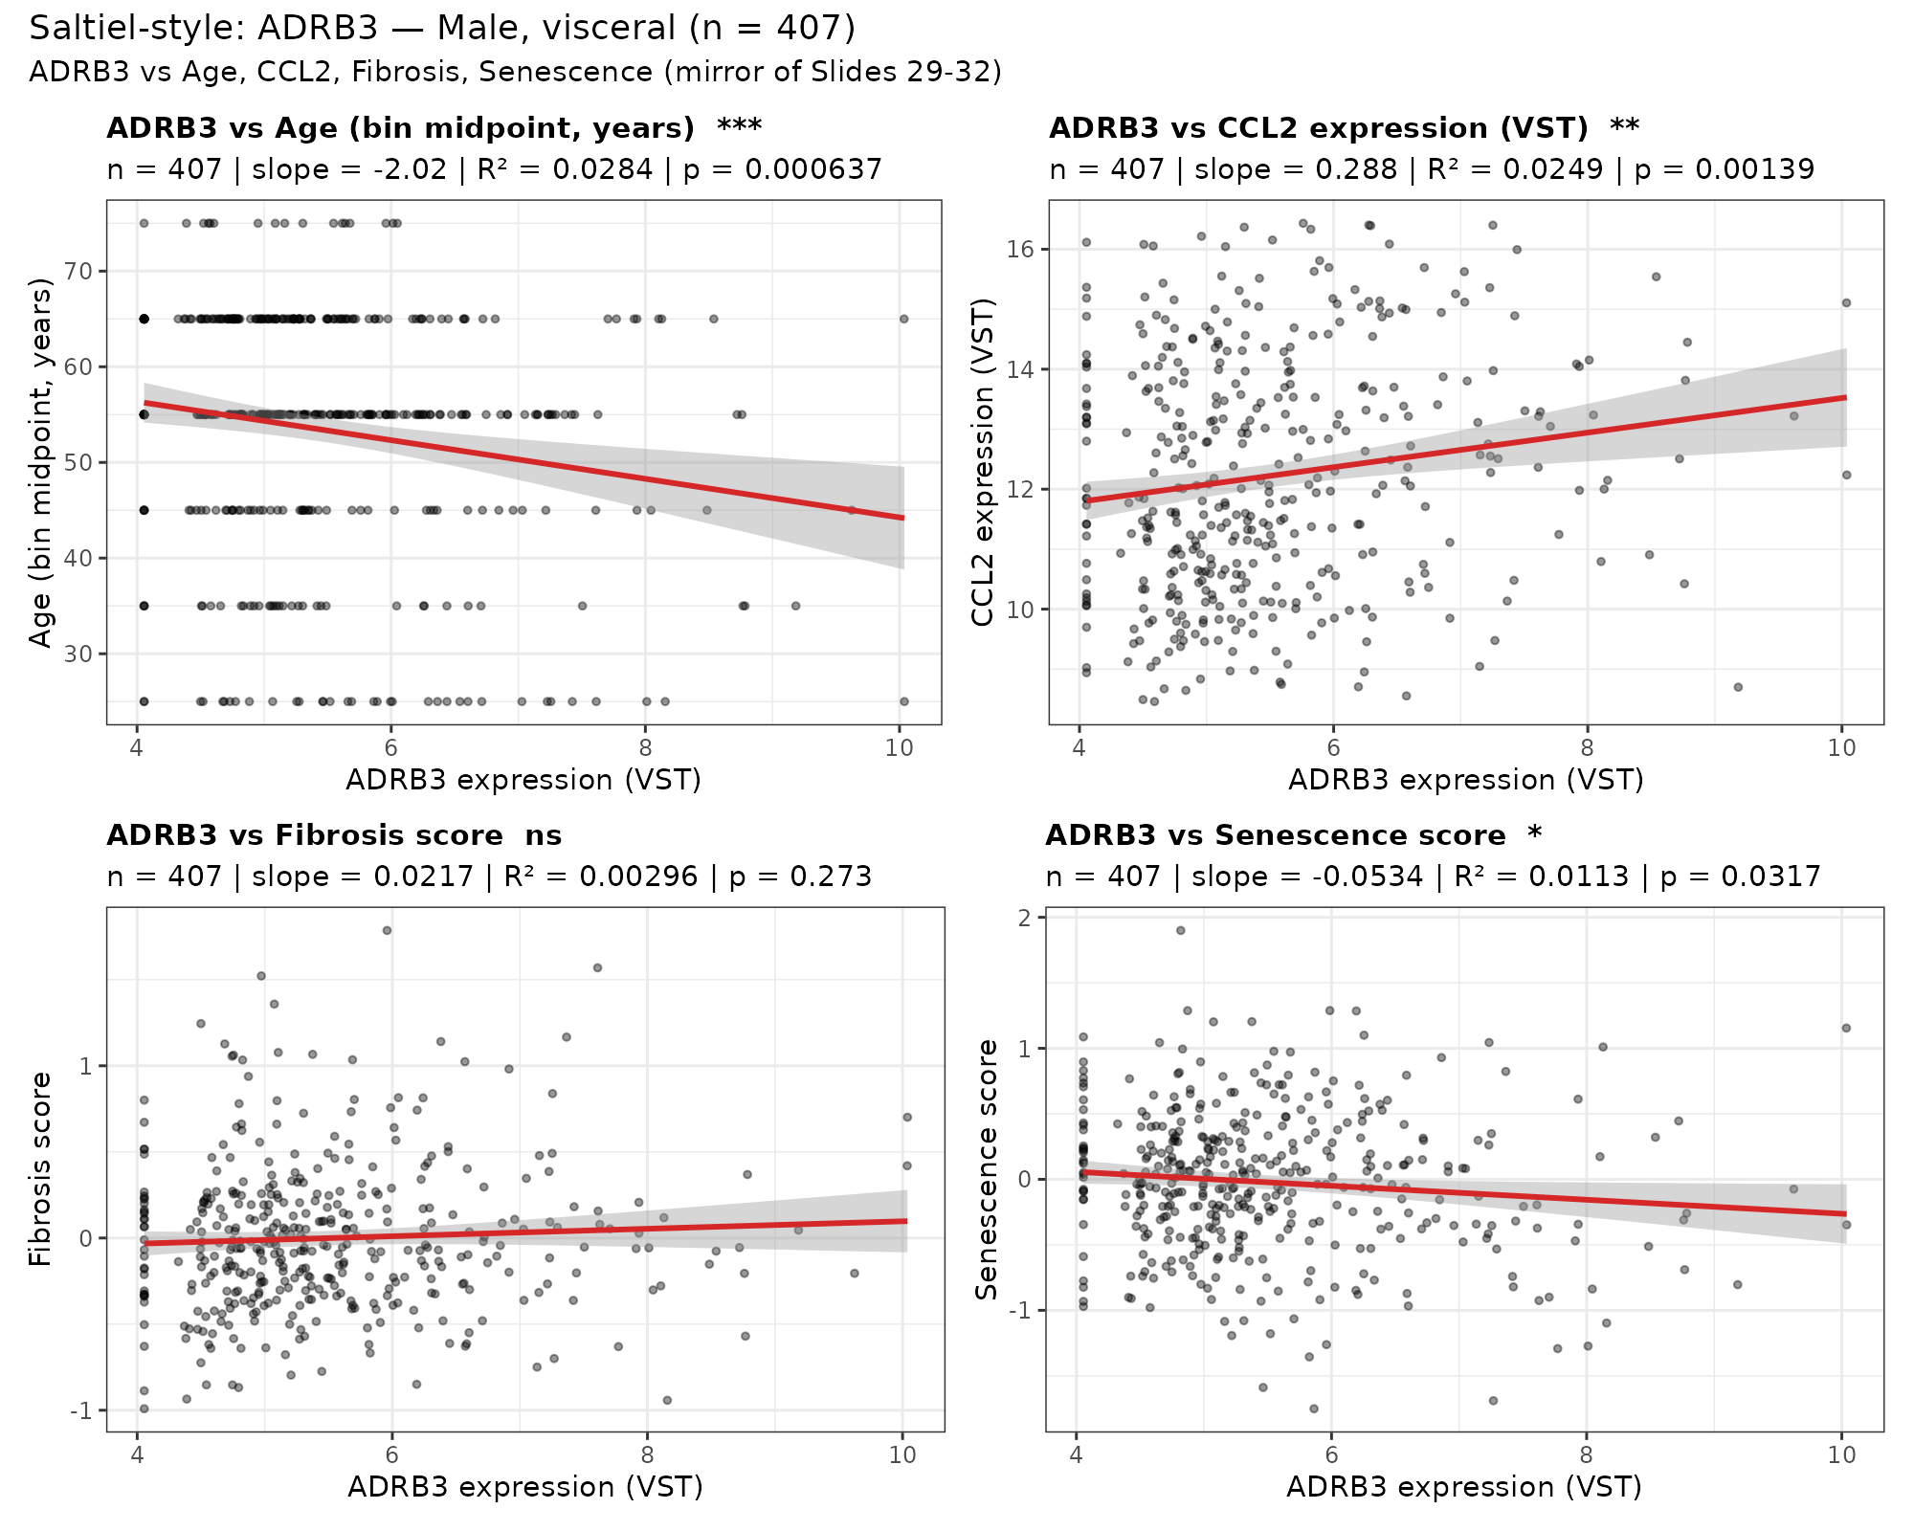
Q3 mirror: Saltiel-style — ADRB3 — MALE, visceral (n=407)
Mirror of Slide 40 (ADRB2). Asterisks in panel titles: * p<0.05, ** p<0.01, *** p<0.001.
v4.6.1 | 41

Slide 42
Q3: Saltiel-style regression stats - all panels
Sex | Depot | Phenotype (y) | n | Slope vs ADRB2 | R^2 | p-value
Female | subcutaneous | age_mid_num | 233 | -2.107 | 0.021 | 0.0288
Female | subcutaneous | CCL2 | 233 | -0.599 | 0.090 | 3.0e-06
Female | subcutaneous | kenichi__fibrosis | 233 | -0.235 | 0.174 | 3.3e-11
Female | subcutaneous | kenichi__senescence | 233 | -0.207 | 0.076 | 2.0e-05
Female | visceral | age_mid_num | 180 | +1.021 | 0.004 | 0.403
Female | visceral | CCL2 | 180 | +0.110 | 0.002 | 0.568
Female | visceral | kenichi__fibrosis | 180 | -0.108 | 0.039 | 0.00762
Female | visceral | kenichi__senescence | 180 | +0.019 | 0.001 | 0.732
Male | subcutaneous | age_mid_num | 481 | -1.918 | 0.019 | 0.00236
Male | subcutaneous | CCL2 | 481 | -0.475 | 0.084 | 8.6e-11
Male | subcutaneous | kenichi__fibrosis | 481 | -0.224 | 0.208 | 4.5e-26
Male | subcutaneous | kenichi__senescence | 481 | -0.244 | 0.107 | 1.7e-13
Male | visceral | age_mid_num | 407 | -0.709 | 0.002 | 0.317
Male | visceral | CCL2 | 407 | +0.256 | 0.014 | 0.0175
Male | visceral | kenichi__fibrosis | 407 | -0.095 | 0.040 | 5.0e-05
Male | visceral | kenichi__senescence | 407 | -0.005 | 0.000 | 0.866
Strongest effects: ADRB2 vs fibrosis in MALE subcutaneous (R^2=0.21) and FEMALE subcutaneous (R^2=0.17). Visceral relationships consistently weaker in both sexes.
v4.6.1 | 42

Slide 43
Q3 mirror: Saltiel-style regression stats — ADRB3 (16-row summary)
Strongest ADRB3 effects (mirror of Slide 42 for ADRB2)
• FEMALE subq, ADRB3 vs senescence: R²=0.093, p=2e-6 ***
• FEMALE subq, ADRB3 vs age: R²=0.047, p=8e-4 ***
• FEMALE subq, ADRB3 vs CCL2: R²=0.027, p=0.012 *
• FEMALE subq, ADRB3 vs fibrosis: R²=0.026, p=0.014 * (weaker than ADRB2 R²=0.174)
• MALE subq, ADRB3 vs senescence and CCL2: significant, generally weaker than ADRB2 panel
• Visceral panels (both sexes): mostly weak / NS
ADRB2 vs ADRB3 head-to-head (FEMALE subq, R²)
• Fibrosis: ADRB2 0.174 vs ADRB3 0.026 — Williams t=-3.54, p=0.0004 *** (only sig diff)
• Senescence: ADRB2 0.076 vs ADRB3 0.093 — directional only, not statistically significant (p>0.6)
• Age: ADRB2 0.021 vs ADRB3 0.047 — directional only, not statistically significant (p~0.34)
• CCL2: ADRB2 0.090 vs ADRB3 0.027 — directional only, not statistically significant (p~0.07)
Bottom line: ADRB2's dominance on the fibrosis axis is statistically significant (Williams t=-3.54 for dependent correlations, p=0.0004). The other three apparent specializations (Age, CCL2, Senescence) are directionally consistent but not statistically distinguishable at n=233. Larger cohort needed to formally establish receptor specialization on those axes.
Full table: tables/next_steps_2026-05-03_v4.5.4/saltiel_style_regression_stats_adrb3.tsv
v4.6.1 | 43

Slide 44
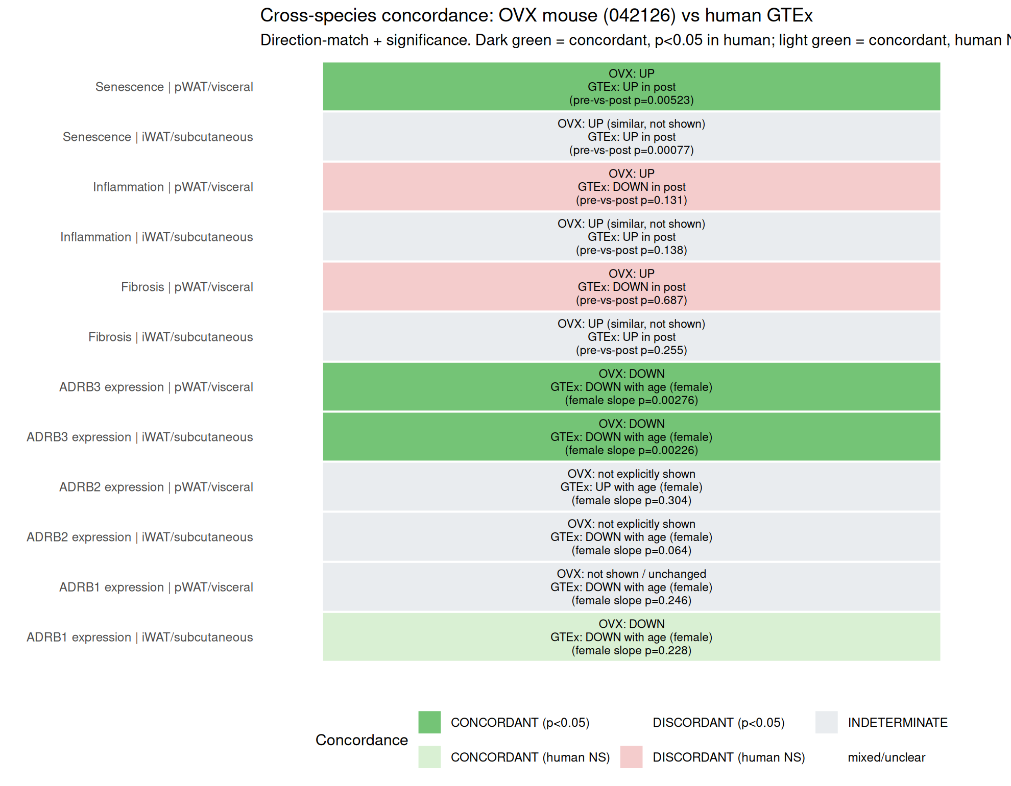
Cross-species concordance: OVX 042126 vs human GTEx
Concordant (human p<0.05): ADRB3 DOWN in both pWAT/iWAT (both species); Senescence UP in pWAT/visceral. Concordant (human NS): ADRB1 iWAT (direction match, p=0.228). Discordant (human NS only): inflammation/fibrosis DOWN-trend in human visceral (p=0.13, p=0.69) vs UP in OVX pWAT. Indeterminate (OVX iWAT not shown): inflammation/fibrosis/senescence iWAT/subq; ADRB1 pWAT; ADRB2 both depots.
v4.6.1 | 44

Slide 45
Concordance table - OVX 042126 observations vs human GTEx
Phenotype | Mouse depot | Human depot | OVX direction | Human direction | Human stat | Concordance
ADRB3 expression | pWAT | visceral | DOWN | DOWN with age (female) | female slope p=0.00276 | CONCORDANT
ADRB3 expression | iWAT | subcutaneous | DOWN | DOWN with age (female) | female slope p=0.00226 | CONCORDANT
ADRB1 expression | iWAT | subcutaneous | DOWN | DOWN with age (female) | female slope p=0.228 | CONCORDANT (NS)
ADRB1 expression | pWAT | visceral | not shown / unchanged | DOWN with age (female) | female slope p=0.246 | INDETERMINATE
ADRB2 expression | pWAT | visceral | not explicitly shown | UP with age (female) | female slope p=0.304 | INDETERMINATE
ADRB2 expression | iWAT | subcutaneous | not explicitly shown | DOWN with age (female) | female slope p=0.064 | INDETERMINATE
Inflammation | pWAT | visceral | UP | DOWN in post | pre-vs-post p=0.131 | DISCORDANT (NS)
Inflammation | iWAT | subcutaneous | UP (similar, not shown) | UP in post | pre-vs-post p=0.138 | INDETERMINATE
Fibrosis | pWAT | visceral | UP | DOWN in post | pre-vs-post p=0.687 | DISCORDANT (NS)
Fibrosis | iWAT | subcutaneous | UP (similar, not shown) | UP in post | pre-vs-post p=0.255 | INDETERMINATE
Senescence | pWAT | visceral | UP | UP in post | pre-vs-post p=0.00523 | CONCORDANT
Senescence | iWAT | subcutaneous | UP (similar, not shown) | UP in post | pre-vs-post p=0.00077 | INDETERMINATE
v4.6.1 | 45

Slide 46
Interpretation and manuscript framing
What we can conclude
• ADRB3 declines with age in both depots in women AND men (p<0.05 in both sexes; CONCORDANT with OVX). Not female-specific.
• OVX 'iWAT>pWAT' asymmetry reproduces in HUMAN MALES (ADRB3 subq -0.017 vs visc -0.011) but REVERSES in FEMALES (subq -0.013 vs visc -0.021).
• ADRB2 declines with age in subcutaneous (males p=0.002; females p=0.064, borderline NS); pooled sex*age interaction NS (p=0.94). Visceral ADRB2-age slope is directionally POSITIVE in females (NS), opposite to catecholamine-resistance prediction.
• ADRB2 x fibrosis correlation robust in subcutaneous (female R^2=0.17; male R^2=0.21). Weak in visceral.
• Prog Lipid Res 2009: ADRB1 and ADRB2 (not ADRB3) are the primary lipolytic beta-ARs in human adipose - the translational analog of OVX Adrb3 in humans is ADRB1 + ADRB2 combined.
• Visceral inflammation/fibrosis 'discordance' is direction-only (both human p>0.13); should NOT be framed as genuine cross-species divergence.
• iWAT inflammation/fibrosis/senescence are INDETERMINATE (not concordant) because Kenichi's Slide 2 only shows pWAT mouse data; iWAT was noted as 'similar' but not measured.
Visualization recommendations (Q4)
• PRIMARY figure for manuscript: female subcutaneous Saltiel-style panel (R^2 up to 0.17).
• COMPANION: male subcutaneous Saltiel-style panel to show sex-agnostic robustness.
• RECEPTOR-DECLINE figure: beta-AR age trend by sex (Q2 figure).
• CONCORDANCE figure: heatmap for discussion section.
• Depot-comparison figure (from 2026-04-12): retain to document visceral/subcutaneous divergence.
v4.6.1 | 46

Slide 47
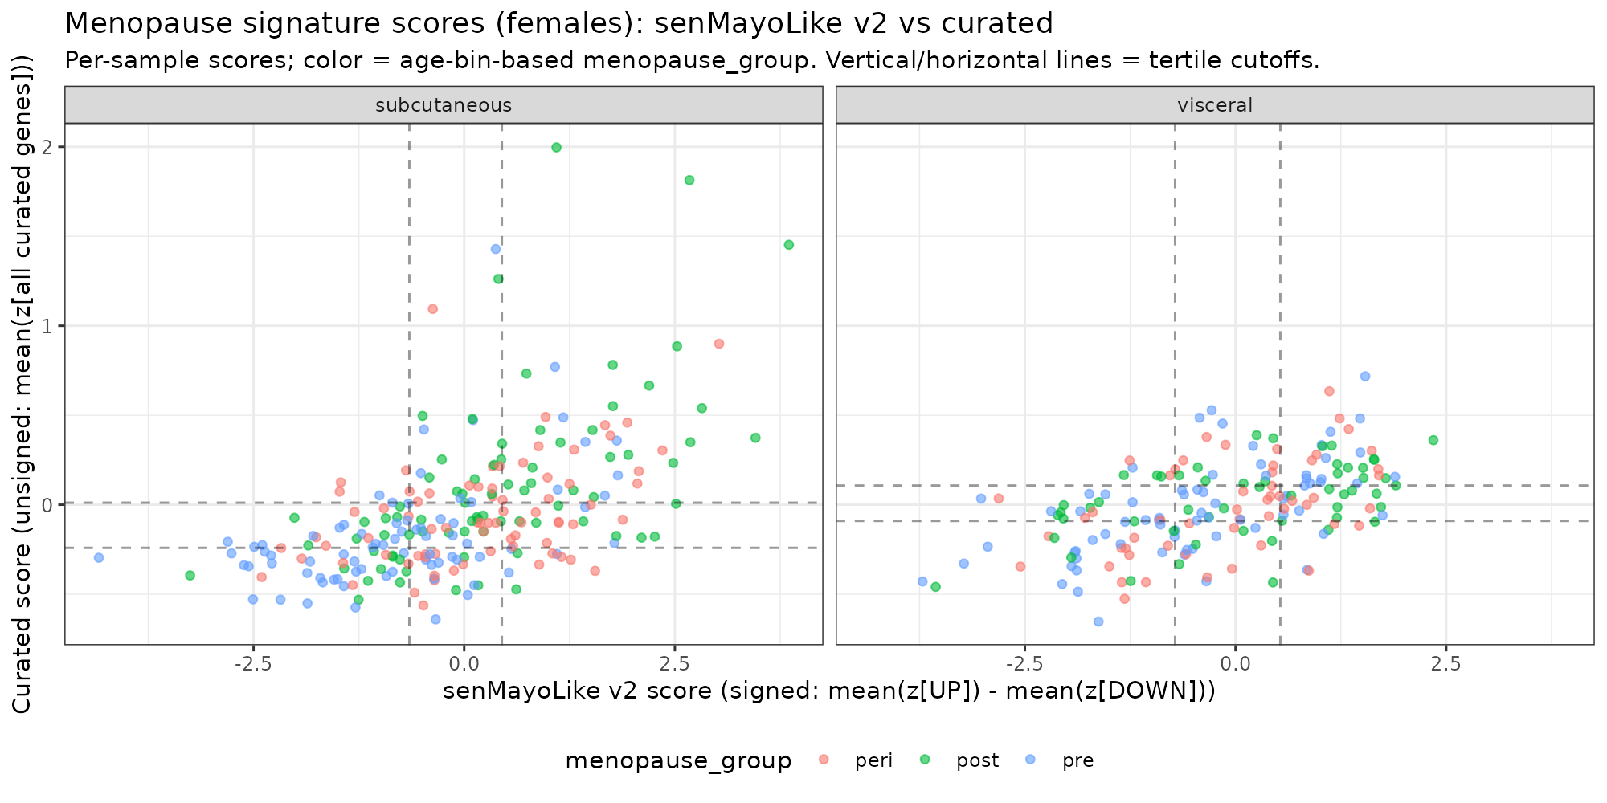
Section 4: Menopause signature score stratification — score distributions
Two signatures: senMayoLike v2 (13 genes) and curated v1 (72 genes). Dashed lines = tertile cutoffs per signature. Concordance with age-bin grouping is slight (Cohen's kappa 0.10-0.17).
v4.6.1 | 47

Slide 48
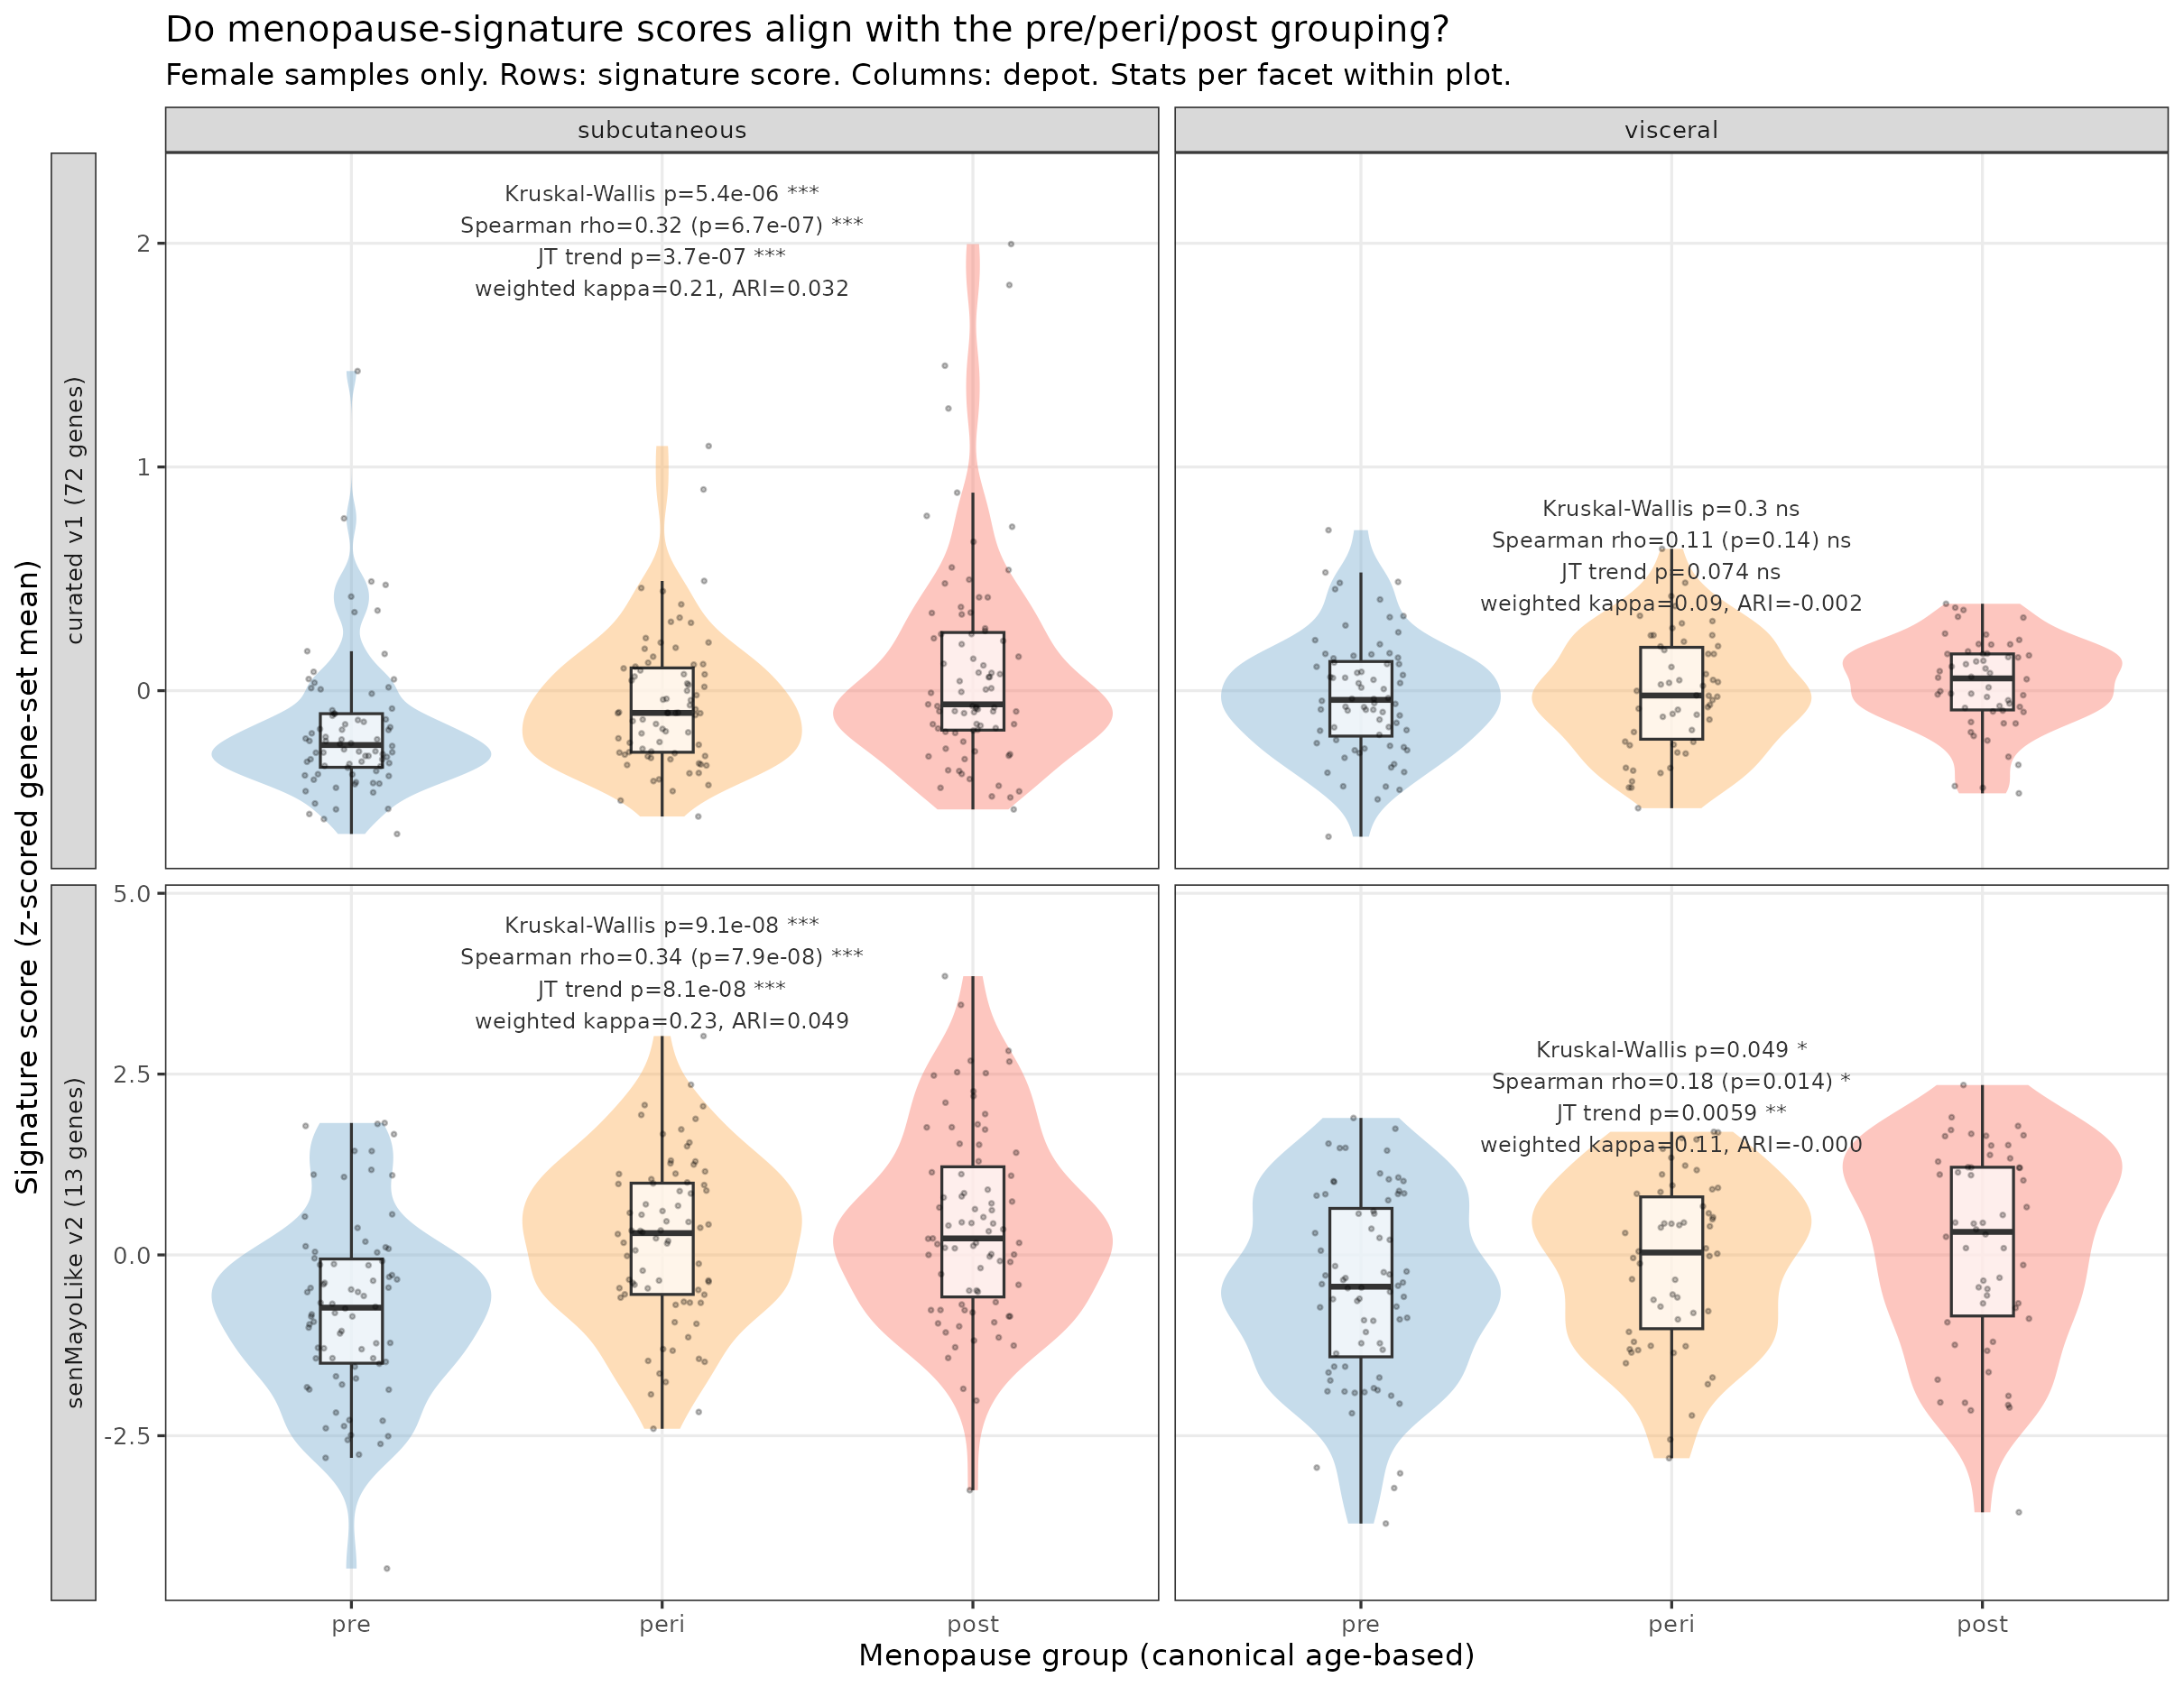
Do menopause-signature scores align with pre/peri/post?
Female samples; n=233 subq, n=180 visc. Both scores increase pre->peri->post in subcutaneous (Spearman rho=0.32-0.34, JT trend p<1e-6) but the signal is essentially 'pre vs not-pre' (peri vs post not significant after BH correction). In visceral, alignment is weak (senMayo rho=0.18, curated NS).
v4.6.1 | 48

Slide 49
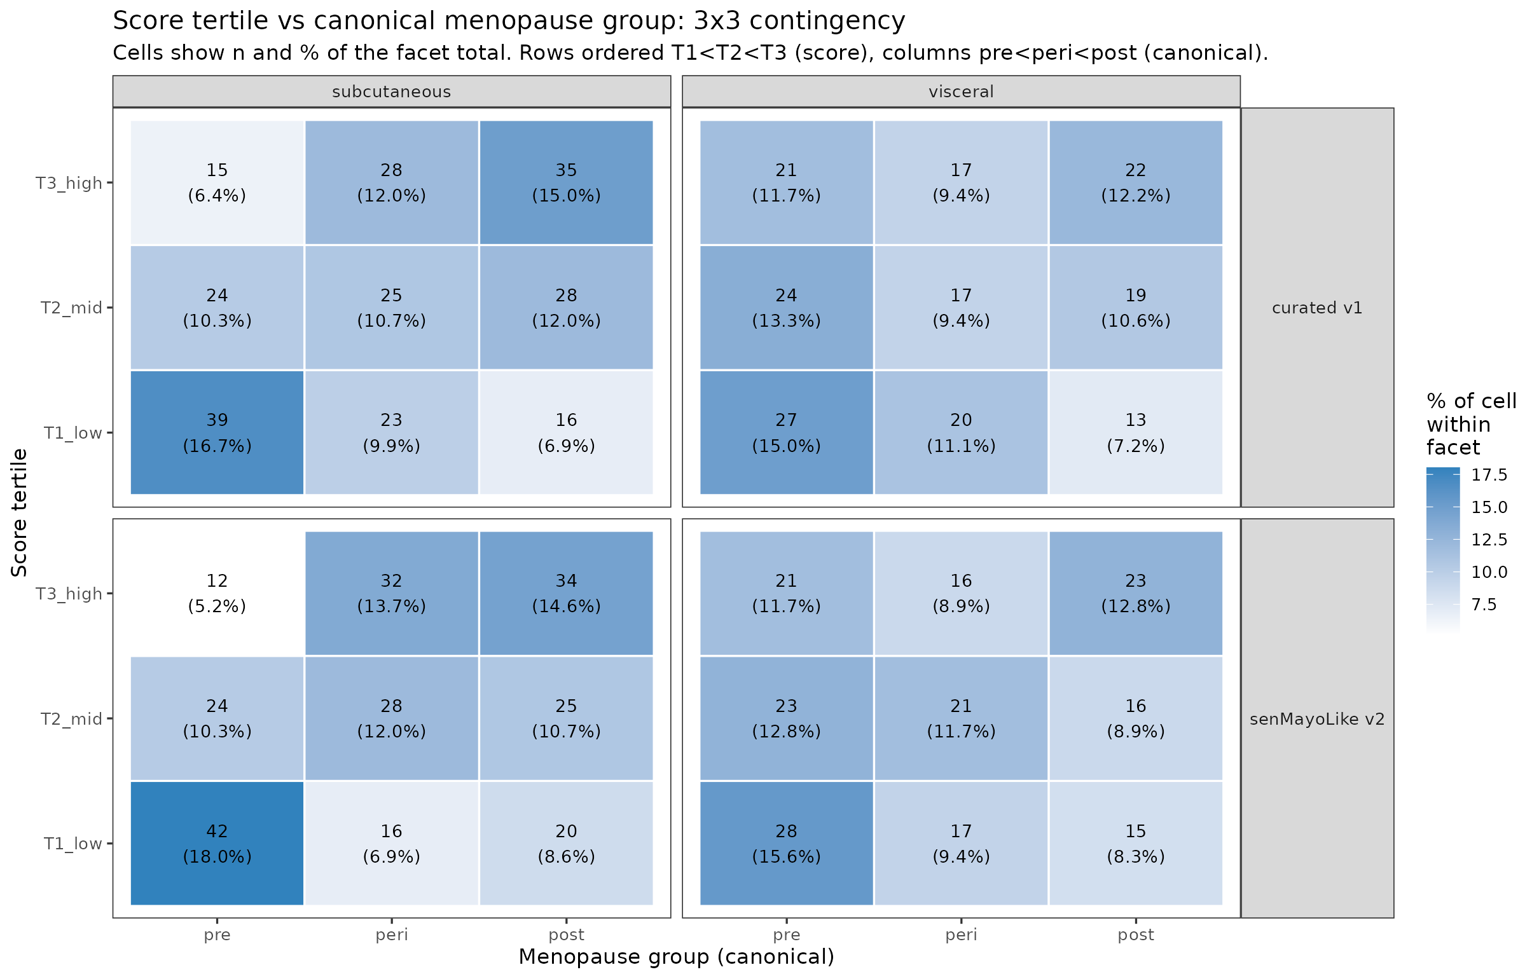
Score tertile vs canonical menopause group: 3x3 contingency
Weighted Cohen's kappa is 0.21-0.23 in subq (fair) and 0.09-0.11 in visc (poor). Adjusted Rand Index ~0.03-0.05 in subq, ~0 in visc. Score-tertile boundaries do not align cleanly with the pre/peri/post boundaries; this is why the Slide 47 kappa BETWEEN the two scores' tertiles was only 0.10-0.17 -- each score itself only weakly tracks the canonical grouping.
v4.6.1 | 49

Slide 50
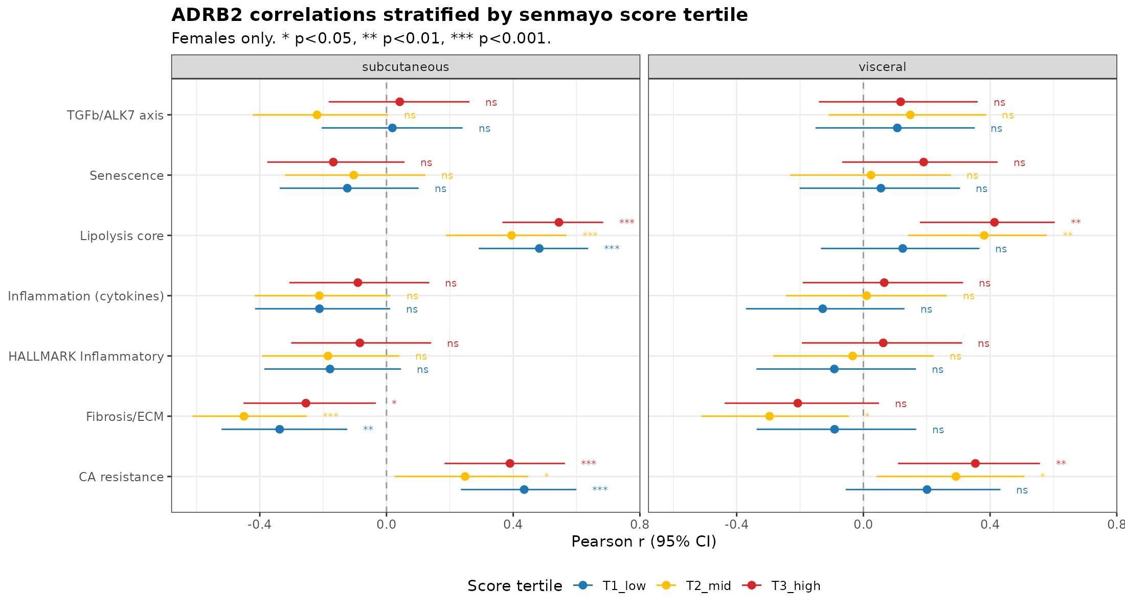
ADRB2 correlations stratified by menopause score tertile (senMayoLike v2)
Female samples partitioned into three tertiles by senMayoLike score. Curated-signature counterpart in score_tertile_correlations_adrb2_curated.png; results consistent.
v4.6.1 | 50

Slide 51
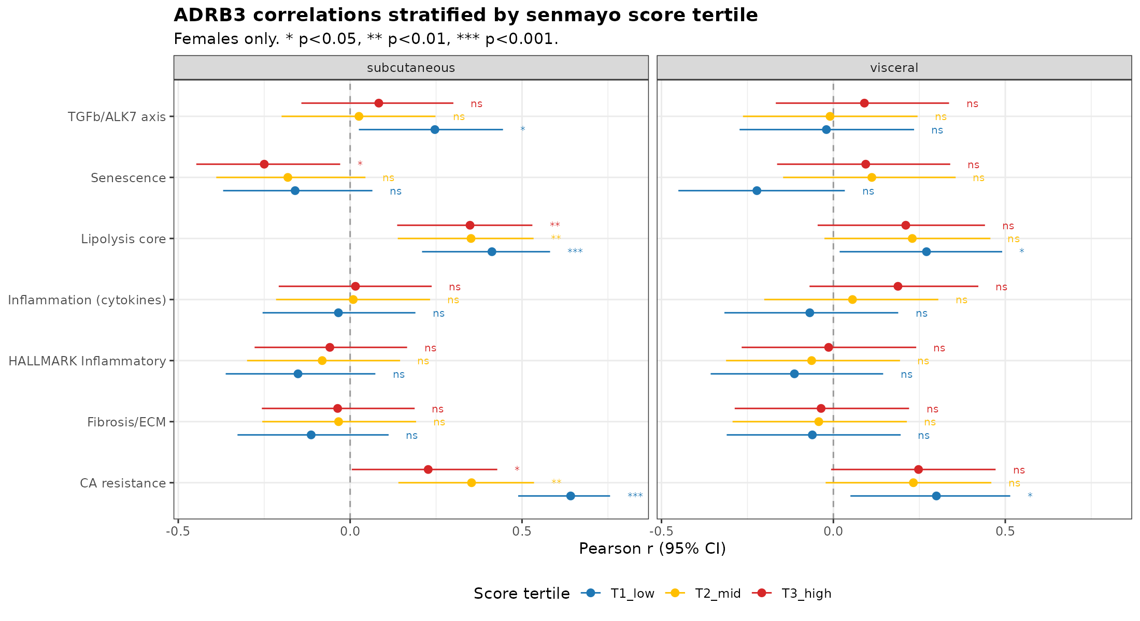
ADRB3 correlations stratified by menopause score tertile (senMayoLike v2)
Female samples partitioned into three tertiles by senMayoLike score. Curated-signature counterpart in score_tertile_correlations_adrb3_curated.png; results consistent.
v4.6.1 | 51

Slide 52
Caveats and proposed next steps
Caveats
• GTEx age is binned (10-yr increments); using bin midpoints attenuates absolute slope estimates (p-values remain valid).
• Female sample sizes in narrow age windows are modest (e.g., subq 40-49: n=43; 50-59: n=76; visc peri 40-49/50-59: n=36/n=54).
• Baseline GTEx does not capture acute hormonal withdrawal - steady-state may differ from acute OVX.
• CIBERSORTx HiRes (14 cell types) from 2026-04-12 not yet applied to ADRB2 correlations - next step.
• OVX 042126 does not show ADRB2 - adding it would complete the translational bridge.
Proposed next steps
• Finalize figures with Female SubQ Saltiel-style as primary.
• Cell-type-resolved ADRB2 analysis using CIBERSORTx HiRes (adipocyte-specific expression).
• Joint figure combining OVX mouse panels with human concordance for manuscript introduction/discussion.
• Add mouse ADRB2 if available to resolve Indeterminate rows in concordance table.
v4.6.1 | 52

