Slide 1
Caterpillars Count!
Prairie Ridge Ecostation Summer 2015 Results

Slide 2
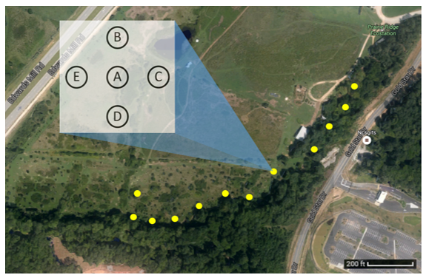
Figure 1. Map of Prairie Ridge Ecostation including survey circle locations. Each yellow dot represents a 5-tree survey circle, with the schematic magnifying the layout of a single survey circle.

Slide 3
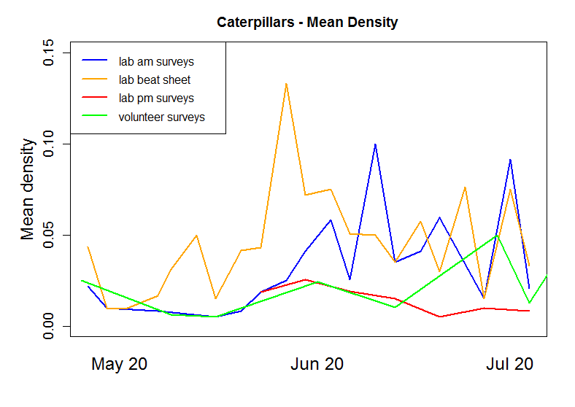
Figure 2. Mean density is the total number of caterpillars counted (with a minimum length of 5) divided by the number of surveys. Mean density was calculated for each survey day.

Slide 4
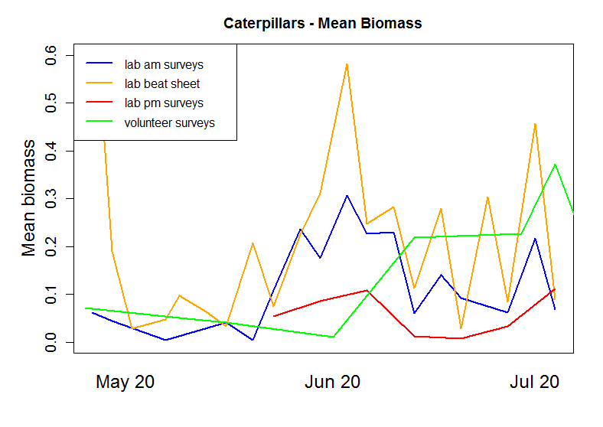
Figure 3. Mean biomass is the total biomass of caterpillars counted (with a minimum length of 5) divided by the number of surveys. Mean biomass was calculated for each survey day.

Slide 5
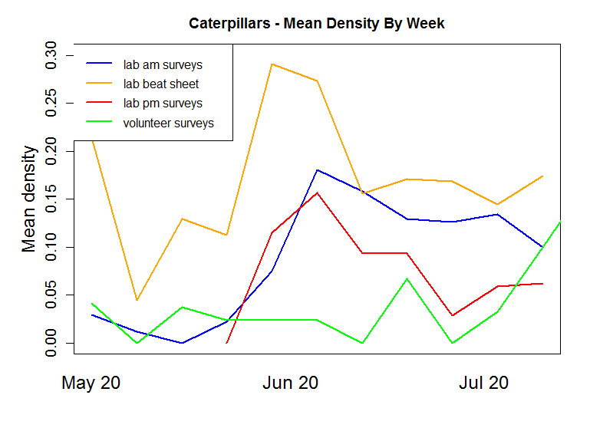
Figure 4. Mean density is the total number of caterpillars counted (with a minimum length of 5) divided by the number of surveys. Mean density was calculated for each survey week.

Slide 6
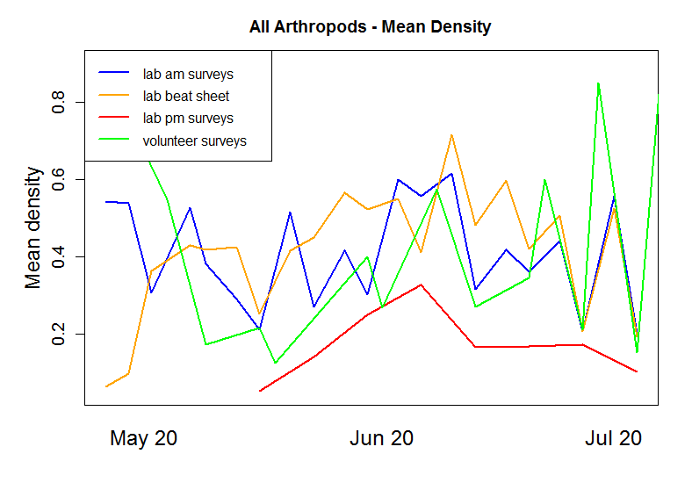
Figure 5. Mean density is the total number of arthropods counted (with a minimum length of 5) divided by the number of surveys.

Slide 7
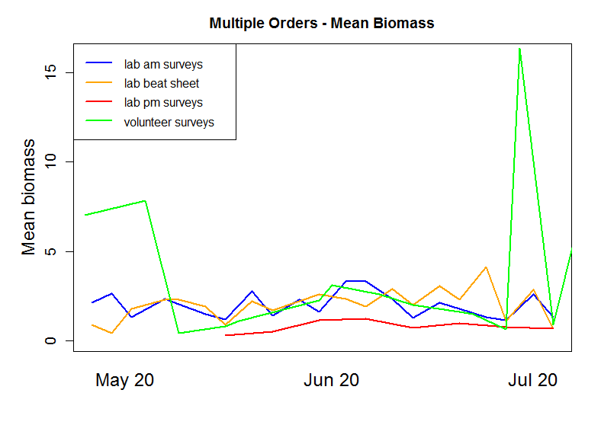
Figure 6. Mean biomass is the total biomass of selected orders with regression data (with a minimum length of 5) divided by the number of surveys. Orders included that had regression data used for calculating biomass from length: ARAN, AUCH, COLE, DIPT, LEPL, OPIL, and ORTH. (See Figure 8 for arthropod codes).

Slide 8
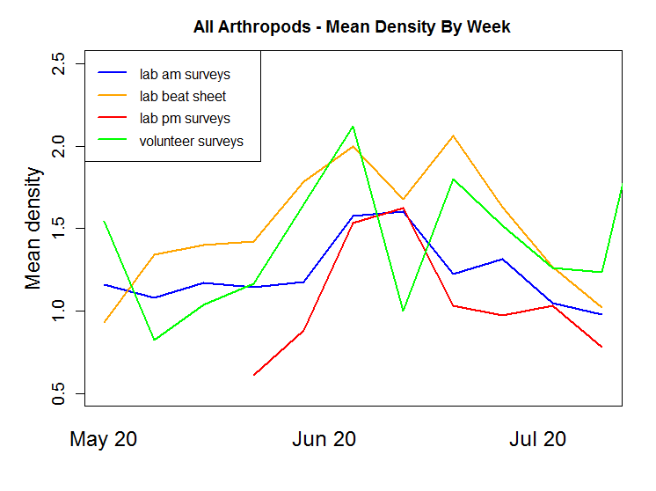

Slide 9
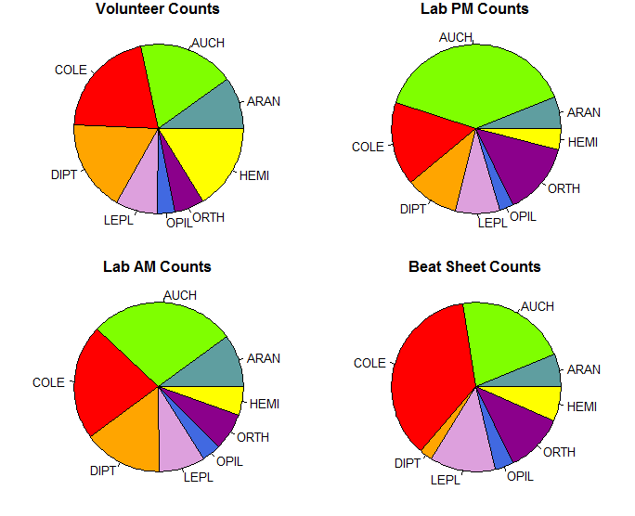

Arthropod Code | Order/Suborder
LEPL | Lepidoptera larvae (caterpillars)
ORTH | Orthoptera (grasshoppers, crickets)
AUCH | Auchenorrhyncha (leafhoppers)
ARAN | Araneae (spiders)
COLE | Coleoptera (beetles)
HEMI | Hemiptera (true bugs)
OPIL | Opiliones (daddy longlegs)
DIPT | Diptera (flies)

Slide 10
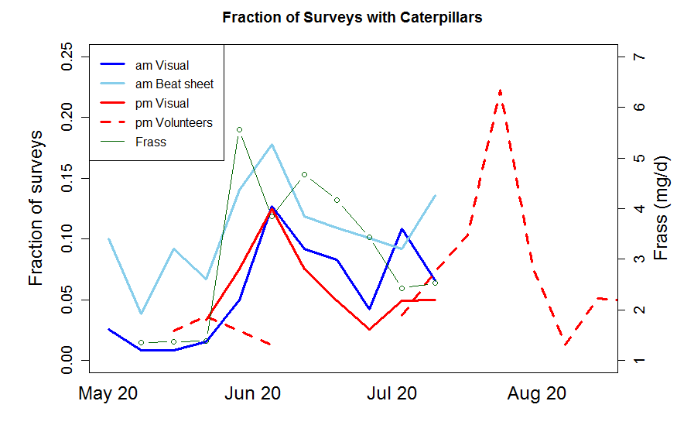

Slide 11
Caterpillars – Mean Density By Day
Caterpillars – Mean Biomass By Day

Slide 12
All Orders – Mean Density
Selected Orders – Mean Biomass

Slide 13
Caterpillars – Mean Density By Week
All Orders – Mean Density By Week

Slide 14
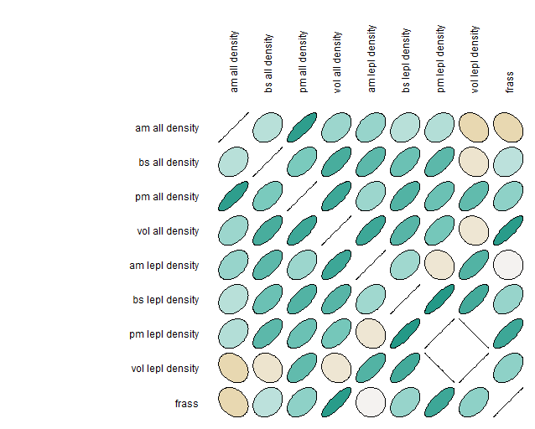
By Day Mean Density Correlation Plot

Slide 15
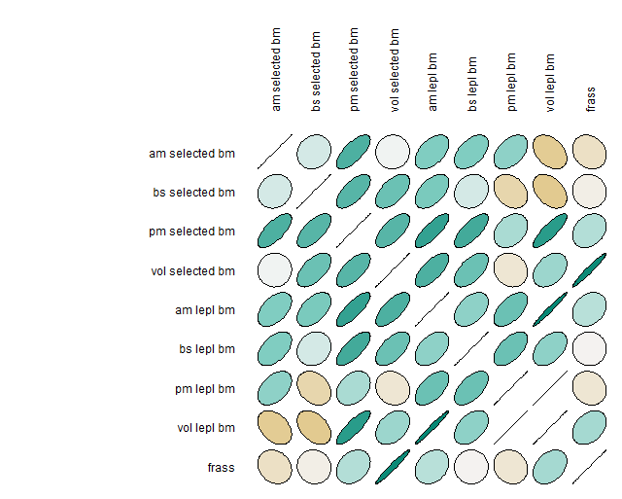
By Day Mean Biomass Correlation Plot

Slide 16
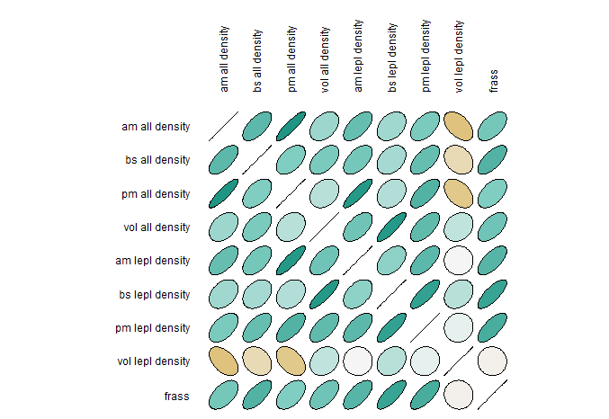
By Week Mean Density Correlation Plot

