Slide 1
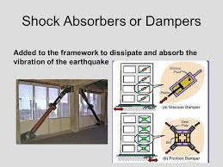
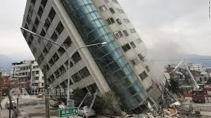
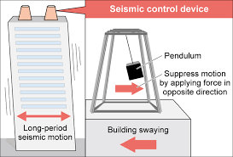
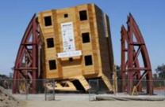
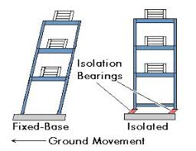
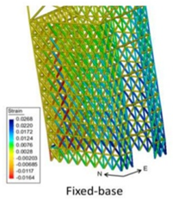
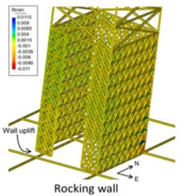
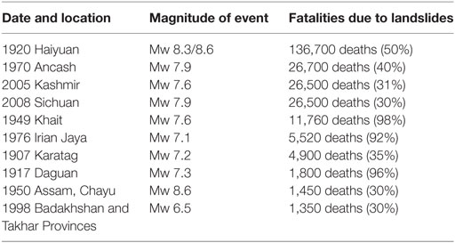
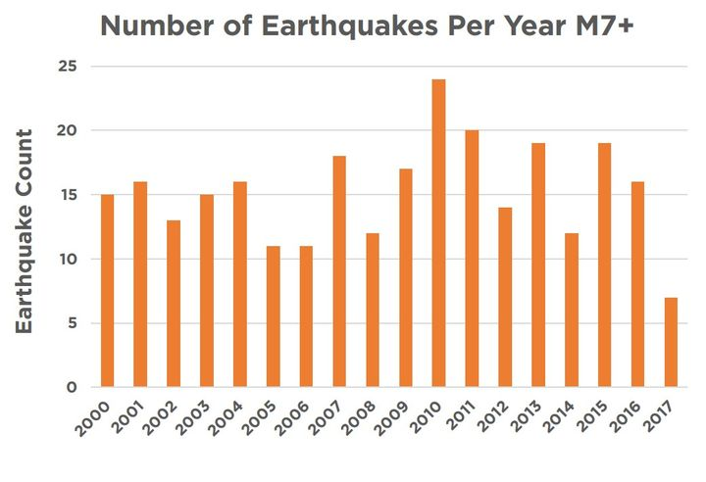

TREMBLER ABSORBERS
HUMA SHAFIQUE, SUMBAL NOREEN, AYESHA BUTT,SONIA NAAZ,KHADIJA TUL KUBRA
LAHORE GARRISON UNIVERSITY,PAKISTAN
INTRODUCTION
Devices that control unwanted spring motion are as follows:
Shock absorbers
Pendulum power technique
Seismic invisibility cloak
Rocking core walls
HEALTON SAYING
“When I look at structures that people think are beautiful , open airy things full of windows, I just see crushed human bodies waiting to happen”.
RECONSTRUCTION OF BUILDING TO INCREASE SEISMIC POWER AT LOWER COST
In many modern high rise buildings, engineers use core wall construction to increase seismic power performance at lower cost. In this design, a reinforced concrete core runs through the heart of structure, surrounding the elevator banks. For extremely tall buildings, the core wall can be quite substantial at least 30 feet in each plan direction and 18 to 30 inches thick. While core wall construction helps buildings stand up to earthquakes , its not a perfect technology. Researchers have found that fixed based buildings with core walls can still experience significant inelastic deformations , large shear forces and damaging floor acceleration. One possible solution is to involve base isolation floating. This design reduces floor accelerations and shear forces.
MOTIVATION
We prefer all of you to use these advanced methods for your infrastructure in order to save your lives because they are cheap , an effective ,easily available and really simple to use.
BETTER SOLUTION
A better solution for structures in earthquake zones calls for a rocking core wall combined with base isolation. A rocking core wall rocks at the ground level to prevent the concrete in the wall from being permanently reformed. To accomplish this , engineers reinforce the lower two levels of the building with steel and incorporate post tensioning along the entire height . In post tensioning systems, steel tendons are threaded through the core wall . The tendons act like rubber bands , which can be tightly stretched by hydraulic jacks to increase the tensile strength of the core wall
AIMS AND OBJECTIVES:
To keep our buildings in contact with the surface to save human lives as much as possible.
POSTER PRESENTATION IN 1ST NATIONAL SYMPOSIUM ON TREMBLER ABSORBERS
DEPATRMENT OF PHYSICS, LAHORE GARRISON UNIVERSITY, LAHORE, PAKISTAN
CONCLUSION
Modern and updated infrastructures are designed using these techniques to withstand major earthquakes.

