Slide 1



SMART INDIA HACKATHON 2026
TITLE PAGE
Retina
Your WhatsApp media, searchable and conversational.
Problem Statement ID
SIH260150
Problem Statement Title
Online integrated platform for projects taken up by
the students of various universities and colleges
Smart Education
TEAM REYNA
Theme
Yash Vardhan Dixit
PS Category
Software
Harsh Narayan
Team ID
Fill in from the SIH portal
Aditya Rai
Chinmayi M.
Team Name (Registered on portal)
Reyna
Gopi Thankur
Prasanjeet Kumar

Slide 2
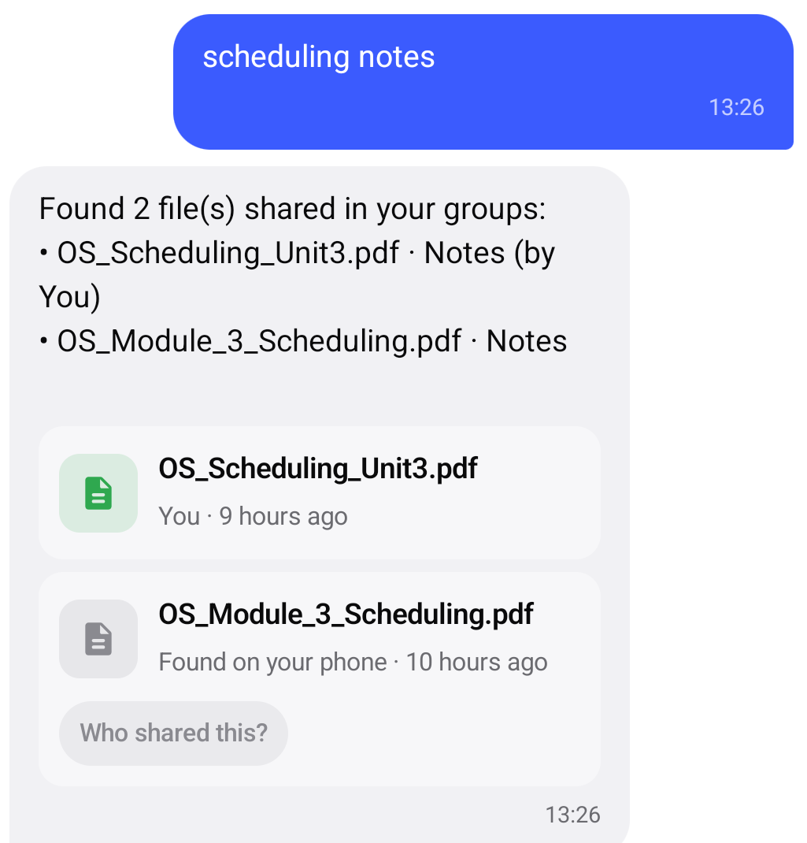
RETINA · THE SECOND BRAIN FOR WHATSAPP MEDIA
Core concept · background ingestion · sender-aware context
Incoming images and PDFs become searchable knowledge—without a manual upload step.
BACKGROUND LISTENER
SMART SENDER PARSING
ZERO-TOUCH KNOWLEDGE PIPELINE
• WhatsAppListenerService.kt runs as an Android NotificationListenerService.
• It monitors incoming WhatsApp notifications in the background.
• It targets notifications that carry a Photo or Document attachment.
• Direct chats: captures the sender.
• Group chats: captures both the group and the individual sender.
• Example: “Nidhi in SIH'26 : Selected teams”.
1 Detect
2 Read
3 Embed
4 Retrieve
The listener triggers extraction, AI understanding, local storage and retrieval—silently in the background.

Slide 3
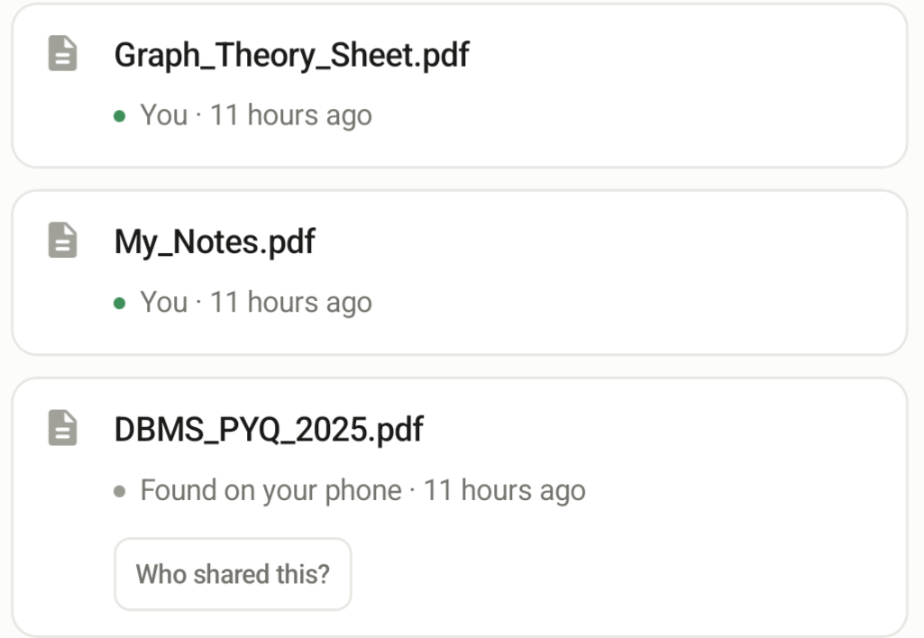
TECHNICAL APPROACH
Android ingestion · OCR and parsing · Gemini embeddings · local retrieval
1
2
3
4
5
6
Listen
WhatsApp
notification
Identify
Photo or
Document
Extract
ML Kit or
PdfRenderer
Embed
Gemini
VectorEngine
Store
Local JSON
database
Ask
Retrieve and
answer
EXTRACT
UNDERSTAND & STORE
SEARCH & ANSWER
Images
Google ML Kit OCR scans the image and returns readable text.
PDFs / documents
Android PdfRenderer processes document pages for text extraction.
VectorEngine.kt bundles extracted text + filename + sender.
Gemini converts that context into a semantic embedding.
FileStorage.kt saves metadata, text and vectors in a local JSON database.
The query becomes an embedding. Retina ranks every file using cosine similarity, then boosts explicit sender matches.
The top 3 files, question and chat history go to Gemini Chat for a grounded response.

Slide 4
PERSISTENCE & RELIABILITY
Local file memory · thread-safe writes · durable chat history
FILE DATABASE
SAFE BACKGROUND WRITES
CONVERSATION MEMORY
FileStorage.kt keeps each file's metadata, extracted text and embedding in a local JSON database on the device.
WhatsApp files can arrive rapidly. @Synchronized locks serialize database access and protect the JSON file from overlapping writes and corruption.
ChatStorage.kt saves conversations locally. When the app restarts, earlier interactions remain available as context for the next answer.
Local metadata + extracted text + embeddings + chat history = a persistent second brain on the device.

Slide 5
INTELLIGENT SEARCH & CHAT
Semantic retrieval · sender-aware ranking · fetch-aware interface
MEANING
SENDER
TOP 3
FETCH
query embedding + cosine similarity
keyword boost for by/from [Name]
highest-ranked files become context
shows matching files as chips
HYBRID RETRIEVAL
CONTEXTUAL ANSWERING
1. Embed the user's query.
2. Compare it with every stored file using cosine similarity.
3. Detect explicit sender phrases such as “by Nidhi” or “from Nidhi”.
4. Apply a strong sender boost and rank the results.
• With “fetch”: surface the top 3 files as interactive chips.
• Without “fetch”: retrieve silently and keep the chat uncluttered.
• Send the top 3 files + question + chat history to Gemini Chat.
• Generate an answer grounded in the exact file contents.
Example: “Fetch the image from Nidhi about isometric projection.”

Slide 6
END-TO-END ARCHITECTURE
Named components and the data passed between them
ANDROID INGESTION & EXTRACTION
AI, STORAGE & MEMORY
WhatsAppListenerService.kt
Notification interception + attachment and sender parsing
Google ML Kit OCR
Text extraction from images
Android PdfRenderer
Document-page processing
VectorEngine.kt
Gemini embeddings for files and queries
FileStorage.kt
Local JSON metadata, text and vectors
ChatStorage.kt
Persistent local conversation history
HOW ONE FILE BECOMES AN ANSWER
WhatsApp notification → attachment + sender → OCR/PDF text → Gemini embedding → local JSON → hybrid Top-3 retrieval → Gemini Chat answer

