Slide 1
TourFirm
Modern technologies
Nadia Hurska,
Olya Bilynska,
Diana Kuzmenko

Slide 2
Plan:
Analysis of similar projects
Describe advantages and disadvantages of similar projects
SMART model
Goals of our app
General requirements to our project
Main functionality
Users, their needs and how our app helm them

Slide 3
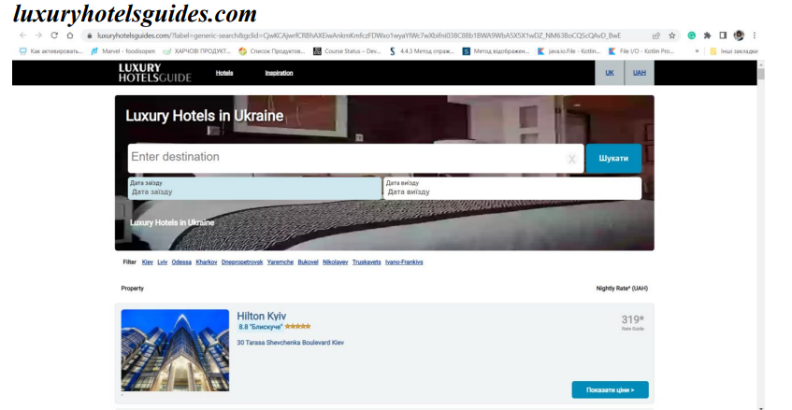
Competitors

Slide 4
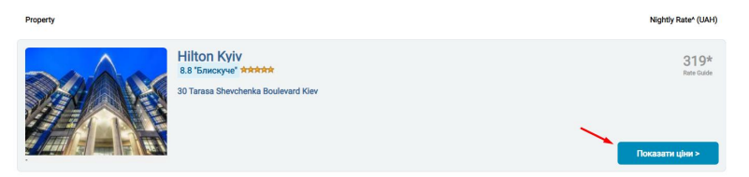
Competitors
Advantages:
It has friendly minimalistic and calm interface
There are photos with hotels on the main page
When you just open a website you can choose date and time and start the search
Disadvantages:
After click on the button “Показати ціни” user can see other site - “Booking.com”, as opposed to the fact that the site could include a price comparison feature on its own site
Notes:
Переваги:
Має мінімалістичний та спокійний інтерфейс
На головній сторінці вказані фото готелів при відкритті сайті зразу можна обрати дату та час і почати пошук
Недоліки:
при переході на “Показати ціни” юзеру відкривається інший сайт “Booking.com”, на противагу тому, що сайт міг би включати функцію порівняння цін на власному сайті

Slide 5
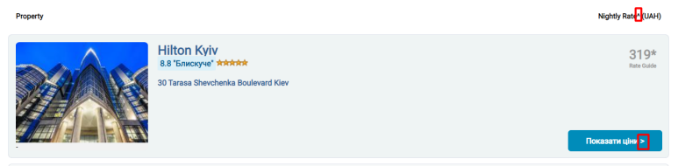
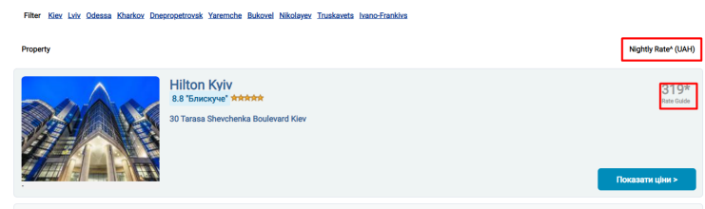
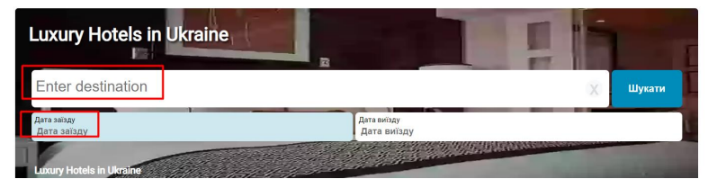
Competitors
the design of the page is not fully thought out, and you can see that the titles are added characters that do not fit very well into the overall picture
duplicated names which are not needed
different languages on the same page

Slide 6
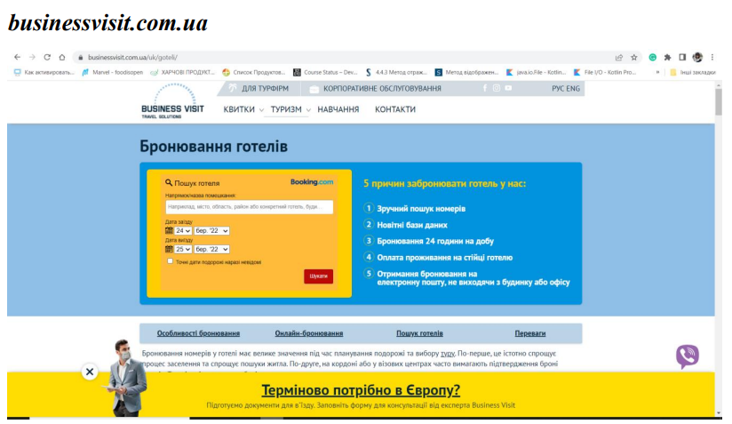
Competitors

Slide 7
Competitors
Advantages:
it has bright and patriotic interface
communication with support via viber is available
there is detailed information on how to use the site
you can choose date on the home page and search
Disadvantages:
contains many pop-ups
at the first open site (advertising, viber, location)
hotel search is carried out using the third-party site "Booking.com"

Slide 8

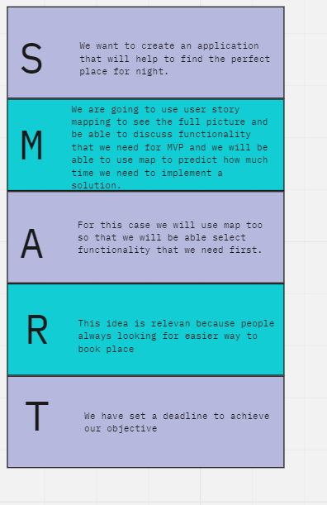
Goals of our app:
Notes:
🍐 This is a Pear Deck Multiple Choice Slide. Your current options are:
🍐 To edit the type of question or choices, go back to the "Ask Students a Question" in the Pear Deck sidebar.

Slide 9
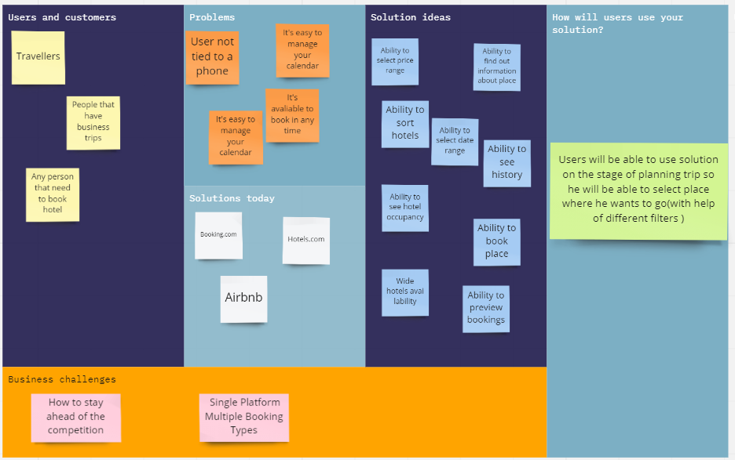

Slide 10
General requirements
how the system will function the technology used to develop the project, and Overall Description
Safety Requirements
Databases should use sharding to be redundant to prevent loss of data.
Security Requirements
Any keys used for the project should be stored securely.
Only the Java should be able to connect to the databases.
Databases should be behind a firewall.

Slide 11
General requirements
how the system will function the technology used to develop the project, and Overall Description
Customers
The customers will be users, who plan to travel abroad.
System Features Functional Requirements
Users should be able to sort hotels.
Users should be able to book a hotel.
Users should be choose start and end date for booking.
Users should be able to choose price from/to
Users should be able to view own booking
Users should be able to see all available hotels

Slide 12
General requirements
how the system will function the technology used to develop the project, and Overall Description
User Interfaces Software:
Java
Database software: MySQL
Hardware Interfaces
Both Mac and Windows operating systems through their default web browser
Performance Requirements
The application should load and be usable within 6 seconds
The application should update the interface on interaction within 5 seconds
The database should be normalized to prevent redundant data and improve performance
The database should be distributed to prevent outages

Slide 13
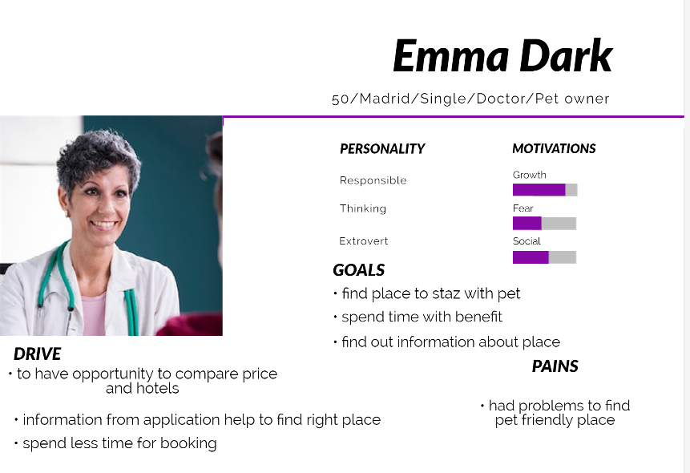
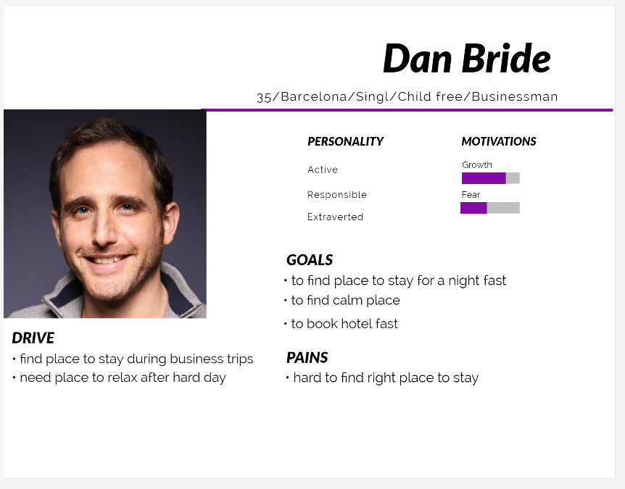
Users:

Slide 14
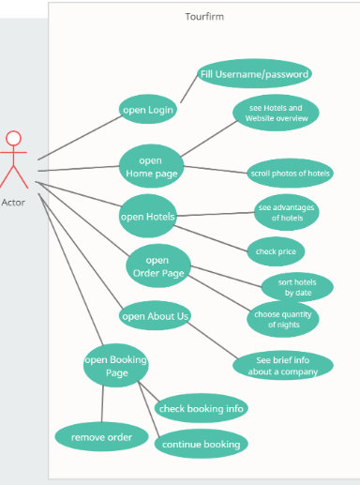

Slide 15
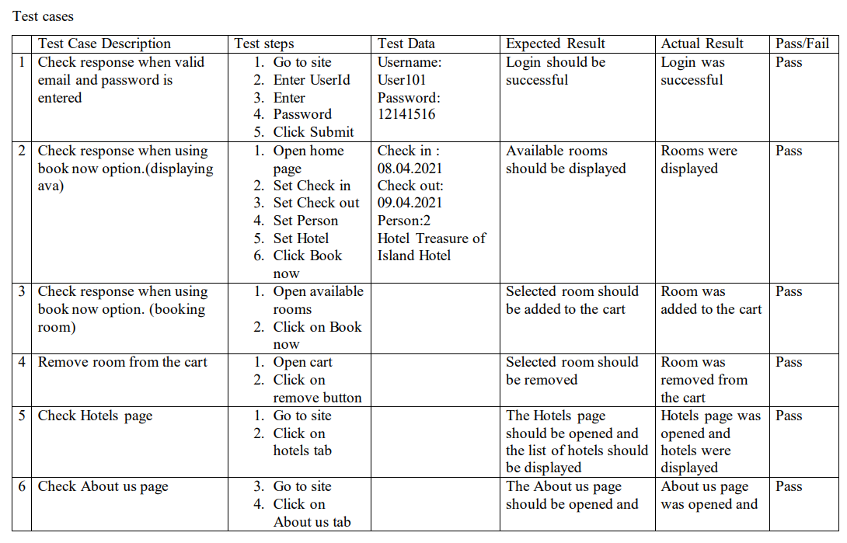

Slide 16
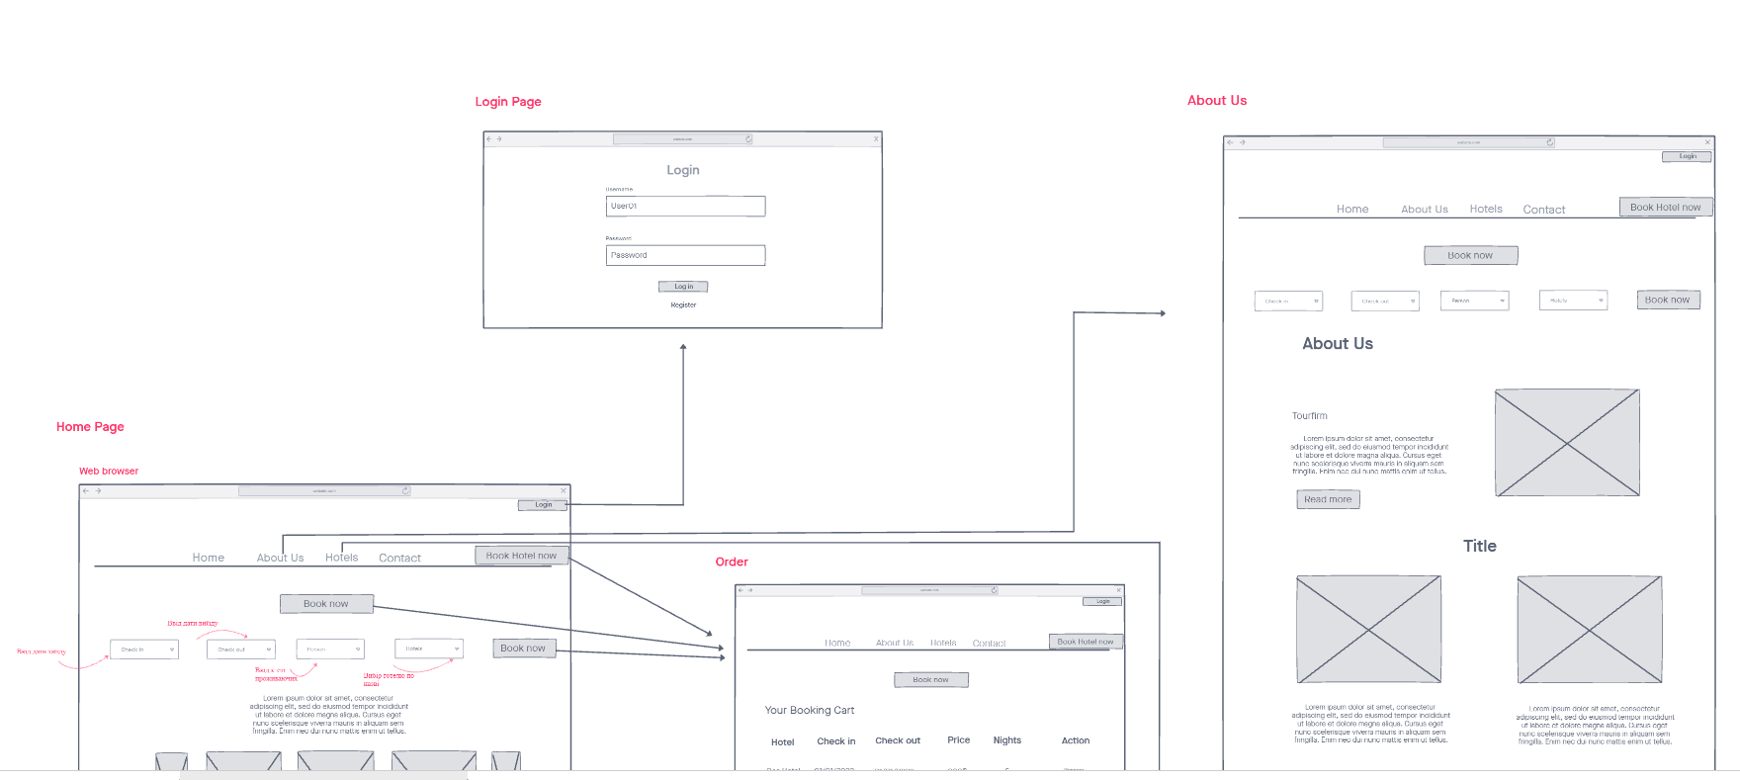
Wireframe:
https://projects.invisionapp.com/freehand/document/KGMOweeWr

Slide 17
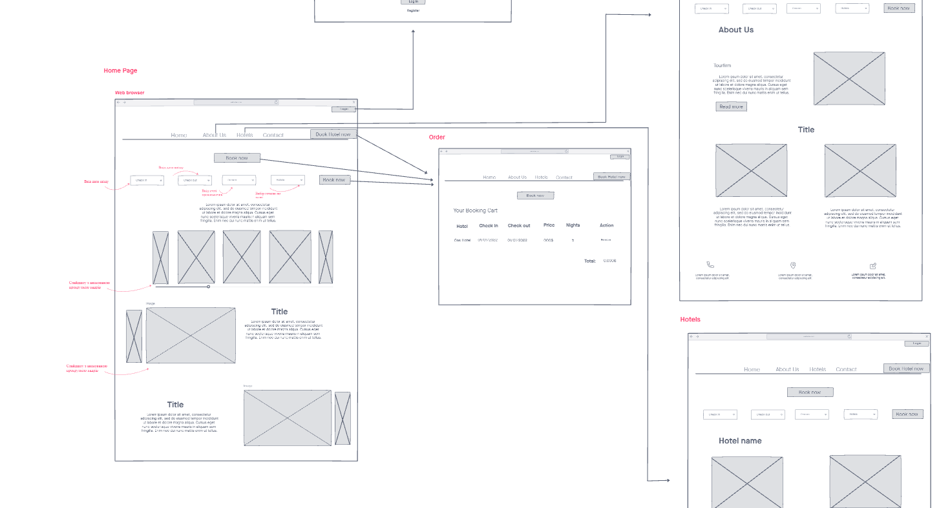

Slide 18
Thanks for your attention!

