Slide 1
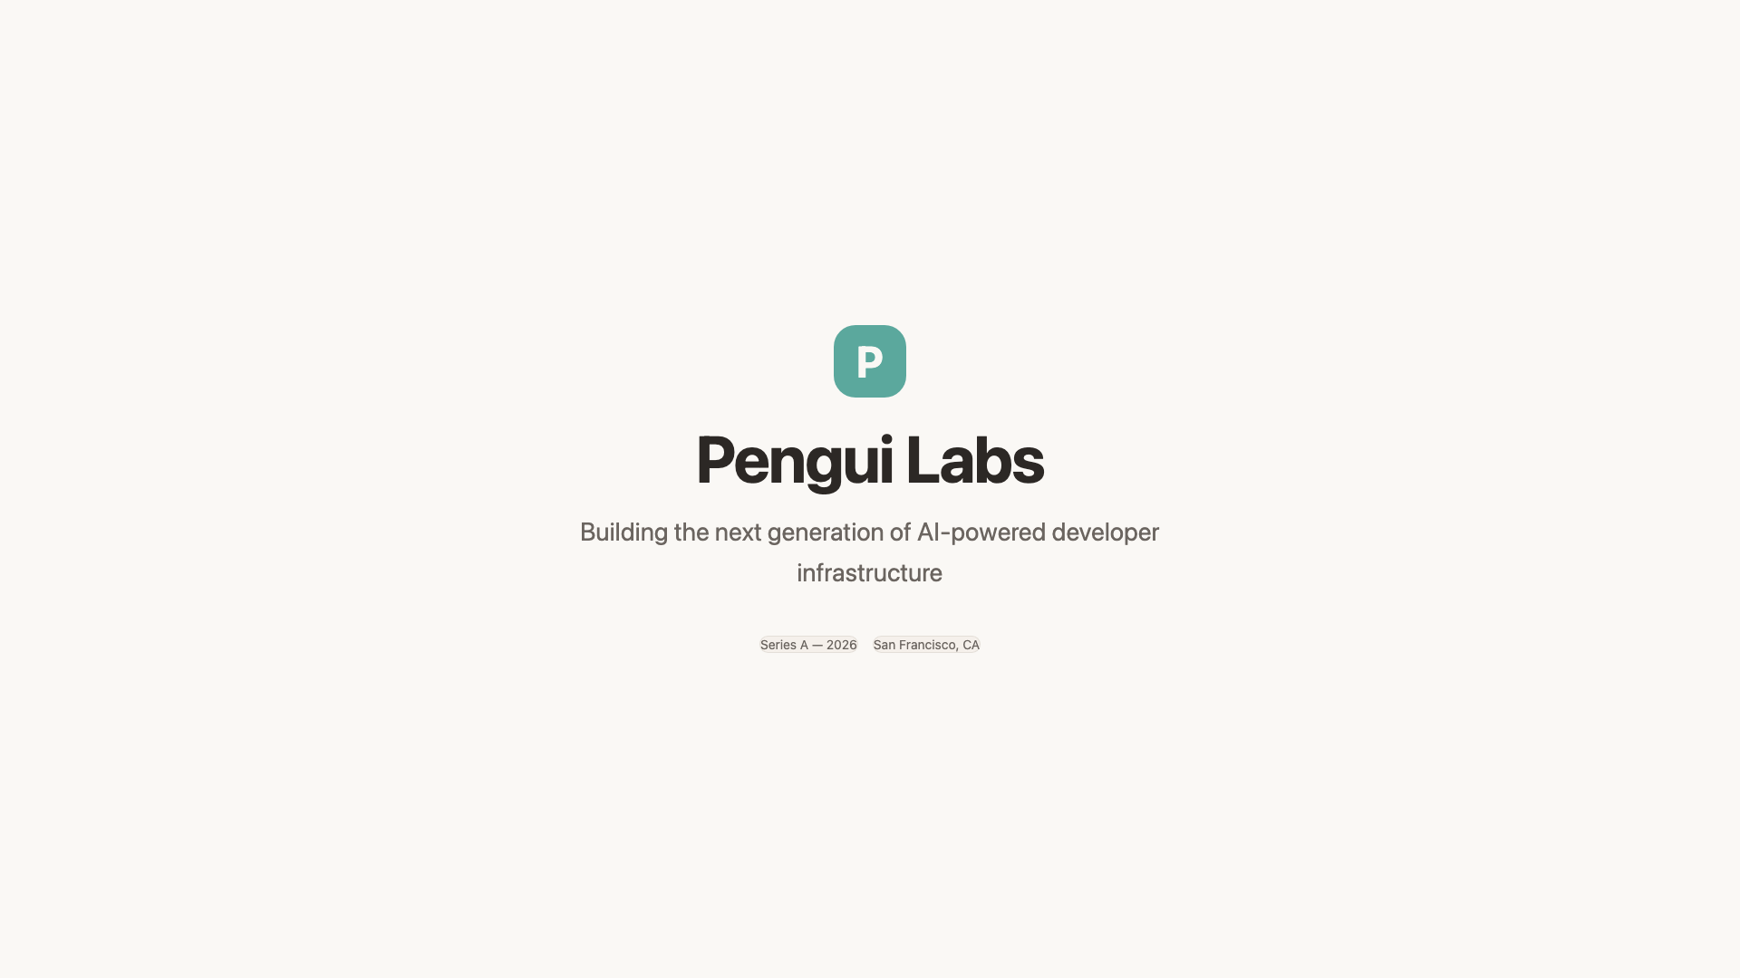
Notes:
# Pengui Labs Opening title slide introducing Pengui Labs, a next-generation AI infrastructure company building intelligent tools for developers. ## Key Points - AI Infrastructure - Developer Tools - Next Generation

Slide 2
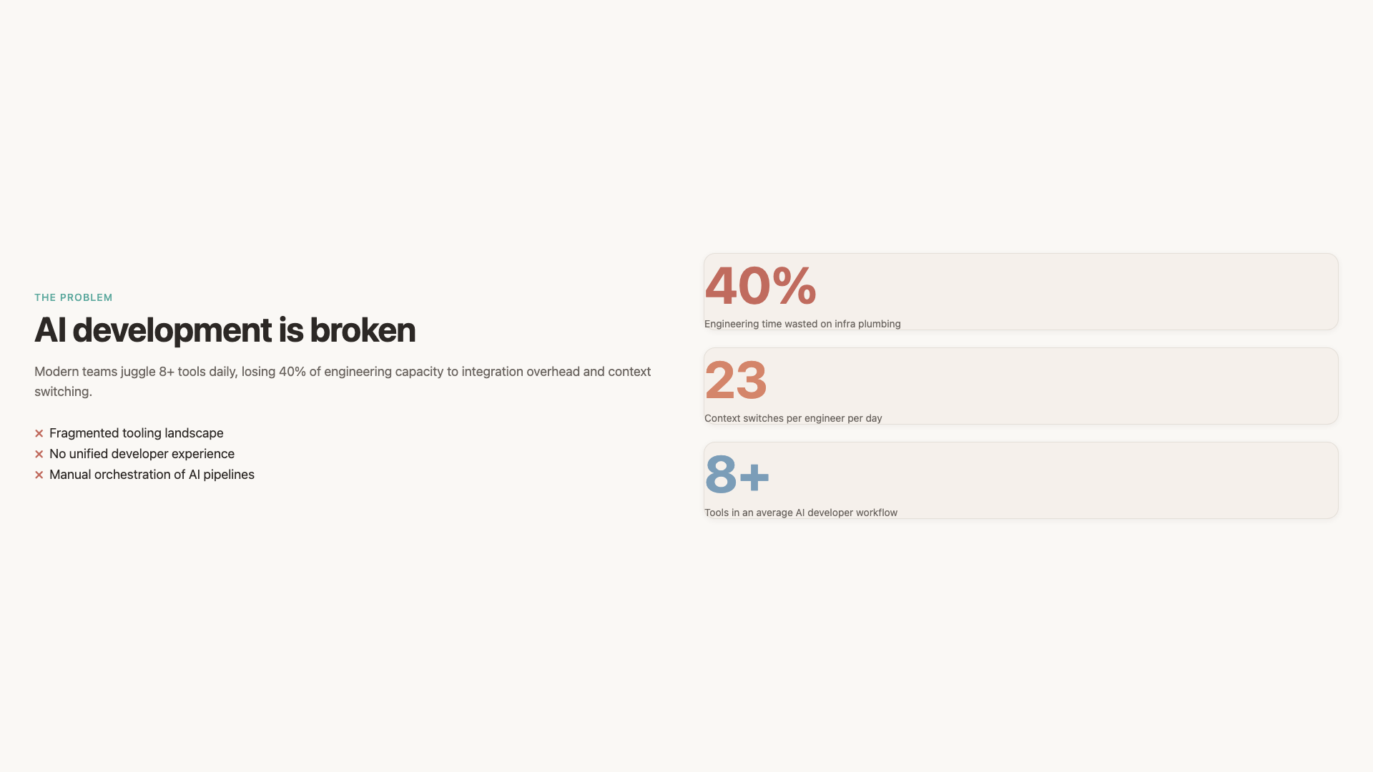
Notes:
# The Problem We Solve Modern AI development is fragmented. Teams waste 40% of engineering time on infrastructure plumbing instead of building products. ## Key Points - Fragmented tooling landscape - Engineers spend 40% on infra plumbing - Context switching between 8+ tools daily - No unified developer experience ## Data - Time wasted on infra: 40 % - Average tools per workflow: 8 - Context switches per day: 23

Slide 3
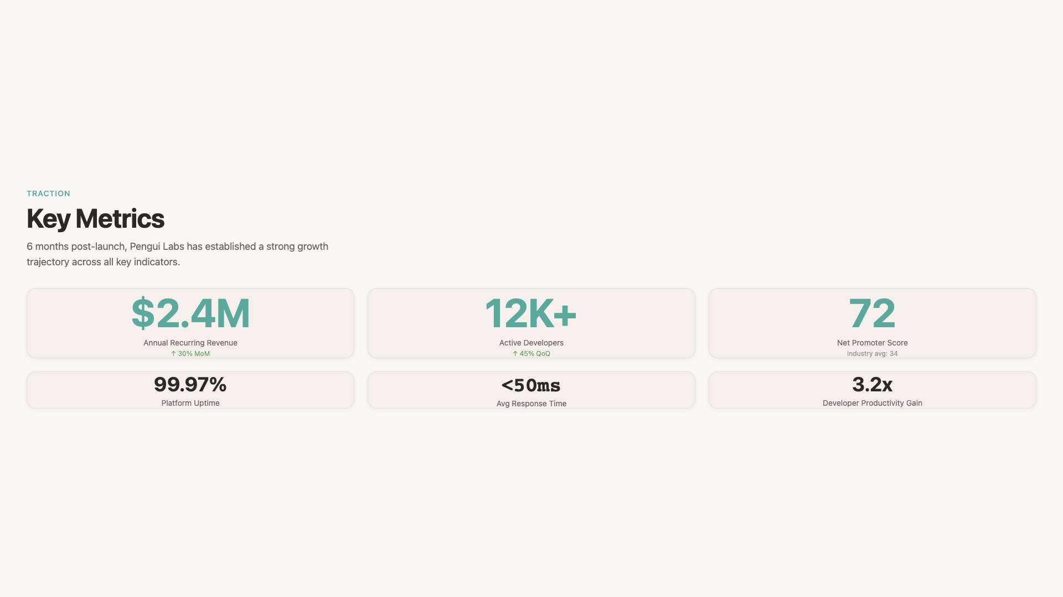
Notes:
# Key Metrics Pengui Labs has achieved strong traction since launching 6 months ago, with rapid growth in both revenue and developer adoption. ## Key Points - $2.4M ARR growing 30% MoM - 12,000+ developers on platform - 99.97% uptime SLA - NPS of 72 ## Data - Annual Recurring Revenue: $2.4M - Monthly Growth Rate: 30 % - Active Developers: 12,000+ - Net Promoter Score: 72 - Platform Uptime: 99.97 % - Average Response Time: <50ms

Slide 4
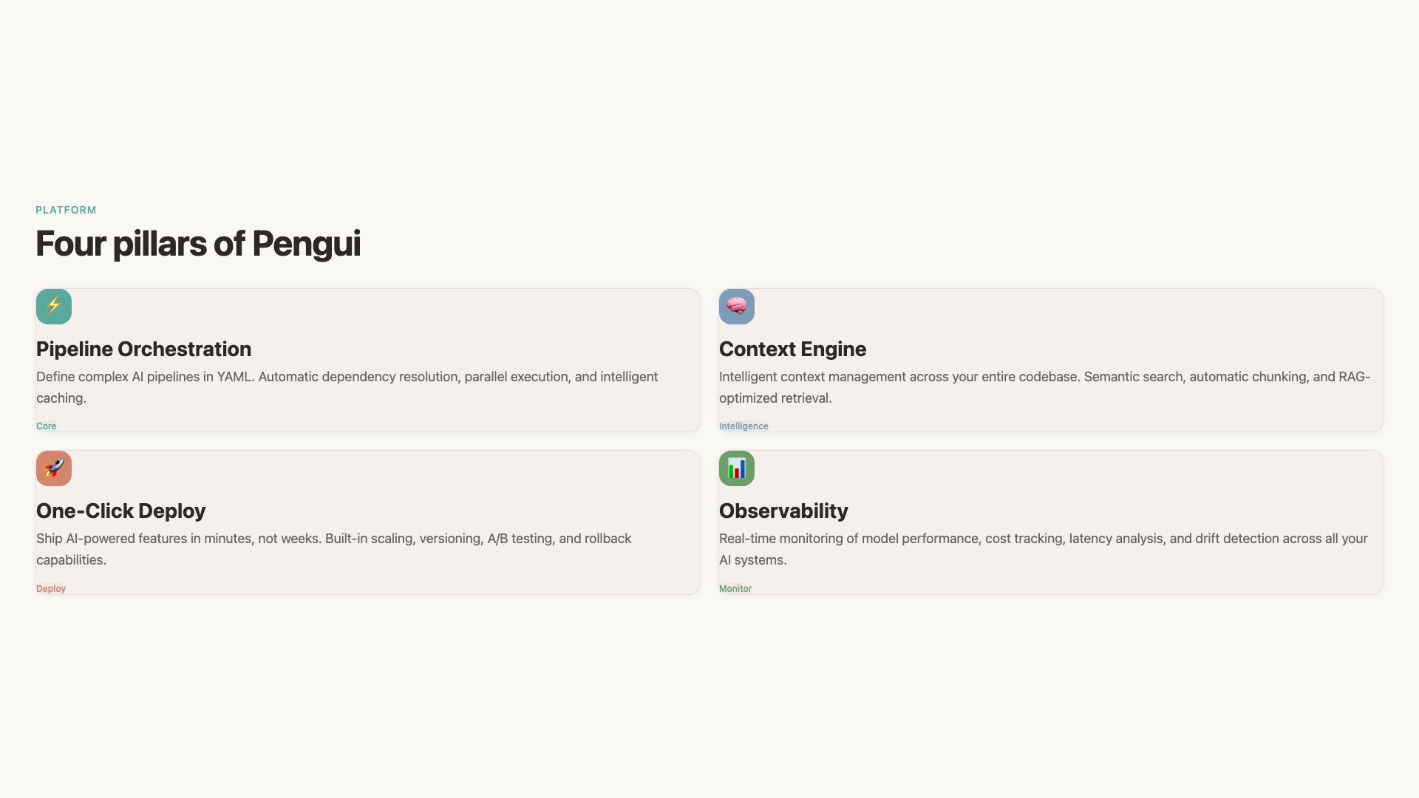
Notes:
# Product Platform The Pengui platform provides four core capabilities that work together to eliminate infrastructure overhead for AI development teams. ## Key Points - Unified Pipeline Orchestration - Intelligent Context Engine - One-Click Deployment - Real-time Observability

Slide 5
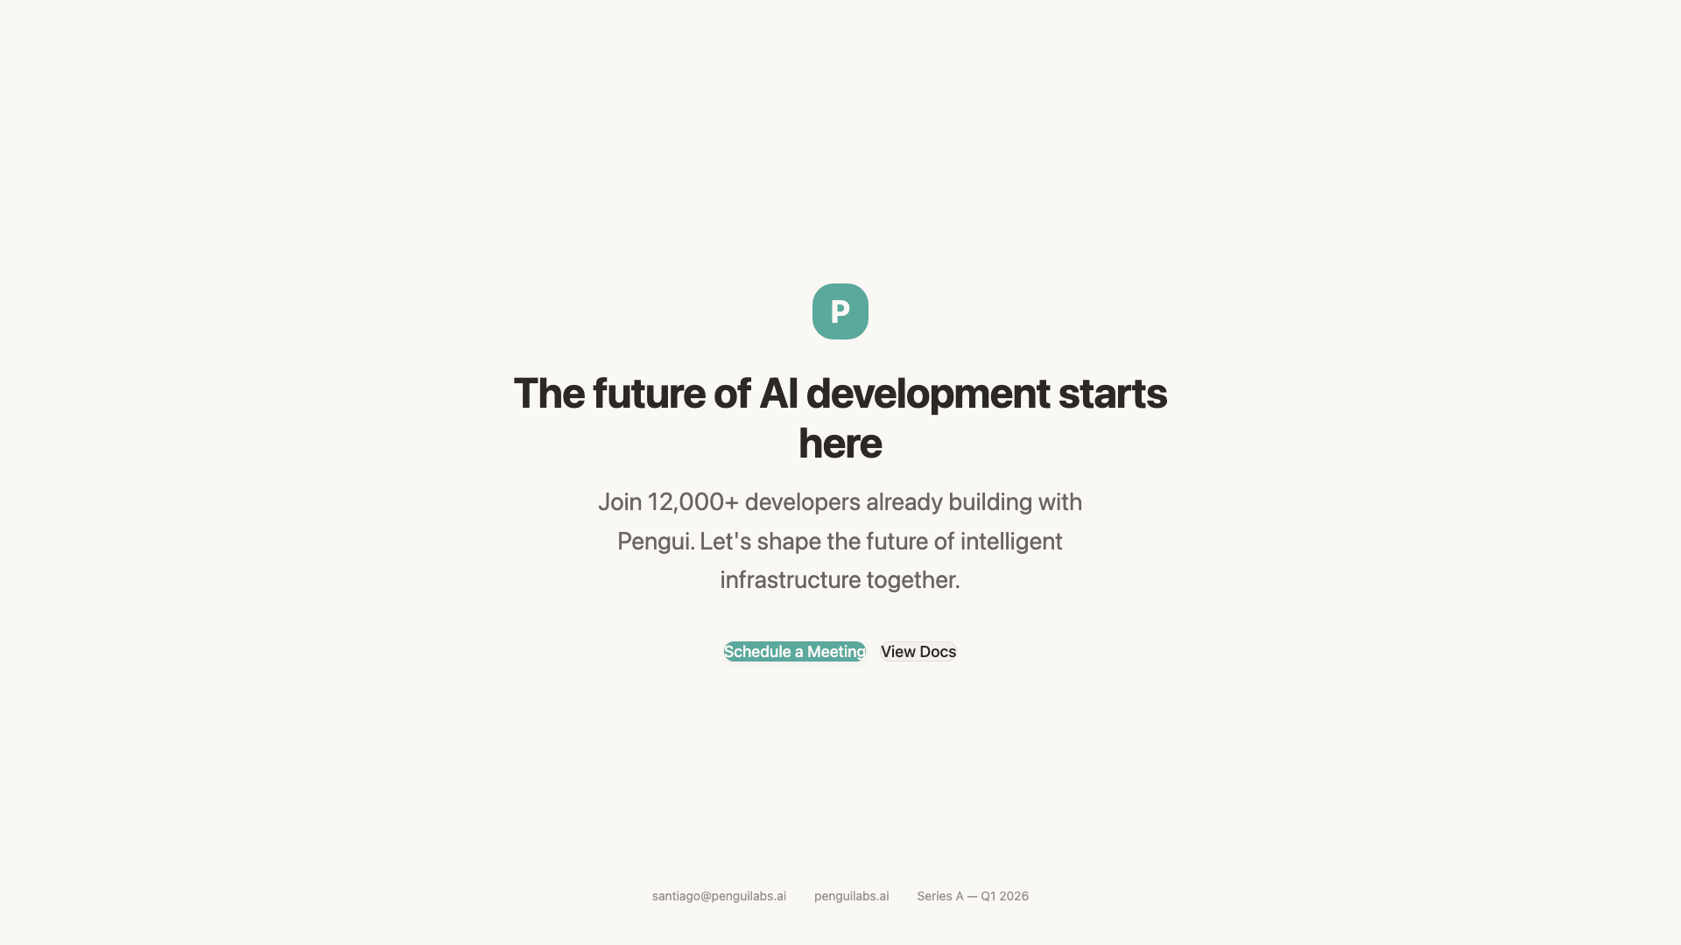
Notes:
# Join the Revolution Closing call-to-action inviting investors to join Pengui Labs Series A round and help shape the future of AI developer tooling. ## Key Points - Series A: $15M target - Led by top-tier VCs - Join 12K+ developers already building with Pengui

