Slide 2
Student Feedback
Packback is an Instructional AI supported online writing and discussion platform for developing critical thinking, curiosity, and writing skills.
Spring 2024 Student Feedback Survey
“The writing and discussion features in Packback facilitate the development of my unique voice by providing me with opportunities for expression, interaction with diverse perspectives, and critical thinking. Through engaging discussions and feedback, I can refine my opinions and articulate my thoughts confidently and authentically.”

Slide 3
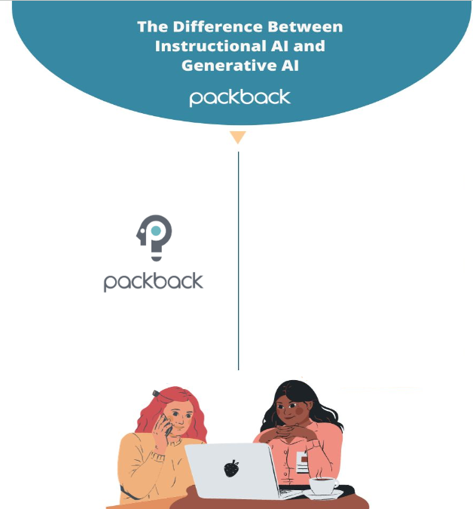
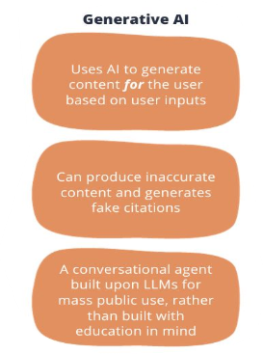
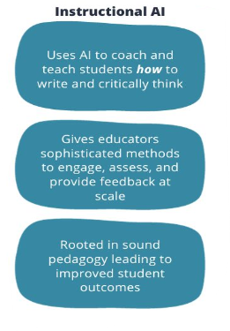

Slide 4
Critical questioning and writing skills are essential to college and post-grad life:
In asking effective questions while interviewing to select the right job after graduation.
In identifying opportunities for innovation, when starting a business, or working within a team.
In communicating effectively, with colleagues or clients through written communication.
In clearly and successfully expressing your thoughts or research, in projects and written assignments.
In learning new skills independently after graduation, to keep adapting to a changing world!

Slide 5
Our specific Packback course objectives
In this class we’re using Packback to:
To utilize discussions in a way students ask questions about research and learn from each other
Incorporate more in class discussions
Develop better writing skills with the microbiome project

Slide 6





Metagenomics Competency
Knowledge
Skills
Assignment
Number
Total % grade
Assignment
Number
Total % grade
Discussions
6
18%
Project Homework
20
20%
Journal Club
8
24%
Project Deep Dives
6
24%
JC Presentation
1
14%
Total 56%
Total 44%

Slide 7
Packback is worth
Discussions (18%) Journal Club (24%) Microbiome Project (24%) of your final grade!
These are important assignments, please take them seriously as it will affect your final grade.

Slide 8
Discussion Board

Slide 9



Participation requirements (Class Discussions)
6 Discussions due
Sundays at 11:59 PM at the end of the module.
Questions are due Sundays at 11:59 PM the week they are assigned
What to Post per deadline period
Post 1 Question
Post 2 Responses (Your choice of a Response, Counterpoint, or Supporting point)
Other Expectations
Posts must have a minimum Curiosity Score of 70
Partial Credit (1/2) for less than 70 Curiosity Score.

Slide 10
Participation requirements (Journal Club)
8 Journal Club Discussions due
Sundays at 11:59 PM the week of journal club.
Questions are due Tuesdays at 12:30 PM the day of journal club.
What to Post per deadline period
Post 1 Question
Post 2 Responses (Your choice of a Response, Counterpoint, or Supporting point)
Other Expectations
Posts must have a minimum Curiosity Score of 70
Partial Credit (1/2) for less than 70 Curiosity Score.

Slide 11
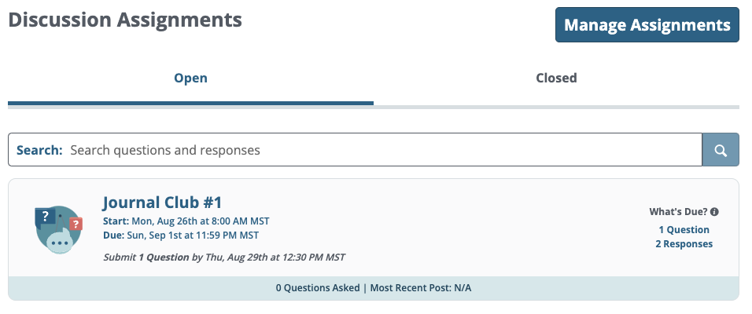
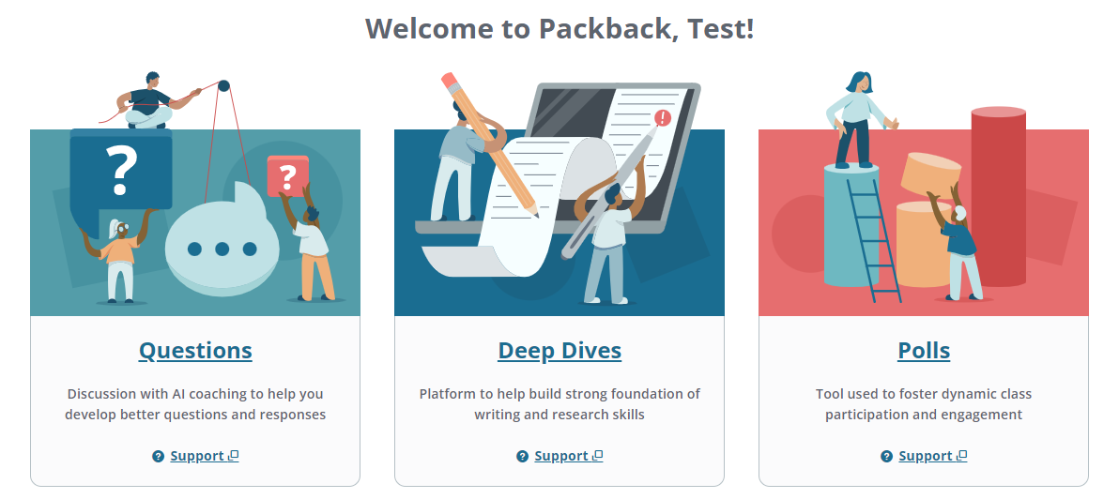


How to use Packback Questions
Go to the discussion assignment(s) under the open assignments tab.
Ask open ended, curious questions to elicit interesting, in depth discussions.
Respond to your professor/peers’ questions and dive into conversations that go beyond the textbook/lecture notes.
Pay attention to what is due and your current grade progress!
Click this red button to ask a question - remember it has to be open ended! Avoid “what is” questioning as those questions tend to have a close ended answer.
Click this blue button to respond to a professor/peer’s question. You can also receive points by replying to a peer’s response to your initial question.

Slide 12
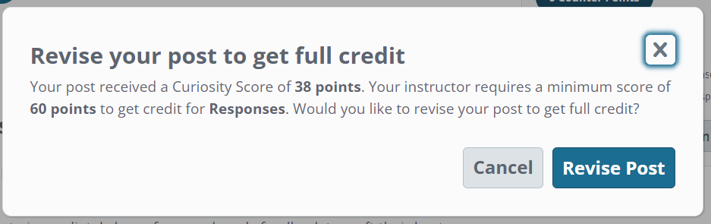
Packback uses AI to assign a curiosity score
to each question and response.
Curiosity scores (CPs) are based on:
Depth: be thoughtful in your response!
Credibility: cite a high quality source; unsupported opinions don’t make for good answers!
Presentation: use our Text Editor to format the answers & insert interesting images / videos to elevate the answer quality.
You will receive live AI feedback as you write on the right side of your screen. Follow the feedback to get to the curiosity score level required by your course. You can go back and edit your posts to increase your curiosity score as needed!
If you receive this warning, revise your post for full points!

Slide 13

Posts on Packback are reviewed by AI
Packback’s AI
Packback’s AI “flags” posts that may be violating community guidelines.
Posts are then reviewed by Packback moderators.
Offending posts are moderated and no longer count for credit until they are re-published.
Packback’s AI flags for:
Plagiarism
AI-Generated Responses
Closed Ended Questions (e.g. “What is the definition of mitosis?”)
Class Logistics Posts (e.g. “When is the next test?”)
Low Effort/Low Detail Posts

Slide 14


What happens if your post is moderated?
Post is “Flagged”
If your post is “Flagged”, you have not yet lost points!
At this time, your post is still published and still counts for credit.
Post is “Moderated”
If your post is moderated, it is unpublished and no longer counts for credit.
If your post is “Moderated”, you receive an email notifying you.
Post is “Republished”
From the email, you can “edit & re-publish” the post.
Doing so will earn back your points for the post without penalty, so long as you edit before grades are entered.

Slide 15
Packback Deep Dives Writing Assignments

Slide 16

Packback Deep Dives will support you during your writing assignments so you can be an effective researcher and written communicator, and so you can submit your best work possible.
Notes:
The most meaningful quote, I think, from the earlier set of quotes we saw is:
“For students who are really struggling, I have to choose what to give feedback on. I can’t overwhelm them with a thousand comments, so I have to choose; do I give feedback on foundational writing mechanics, or do I push them on their ideas and content?”
When every student can have strong foundational writing skills, they are able to be evaluated equitably on the content of their ideas.

Slide 17
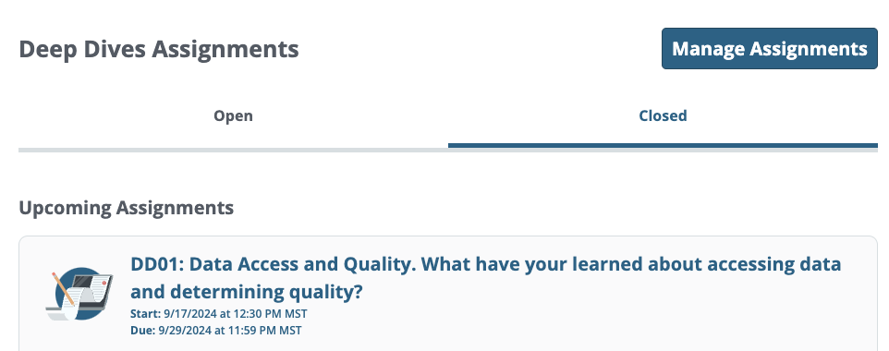


Packback Deep Dives
We will have 6 writing assignments in Deep Dives for this course. Please see the course syllabus for information and dates. Follow the prompt and rubric for each assignment.
Go to the open assignments tab and click into the assignment you wish to work on.
After reading through the Overview and Rubric tabs to best understand your assignment, click the “Start My Deep Dive” Button!

Slide 18
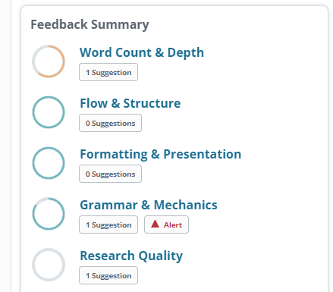
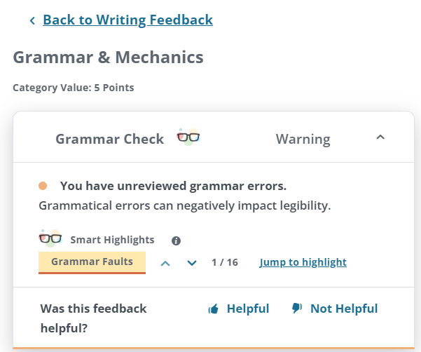
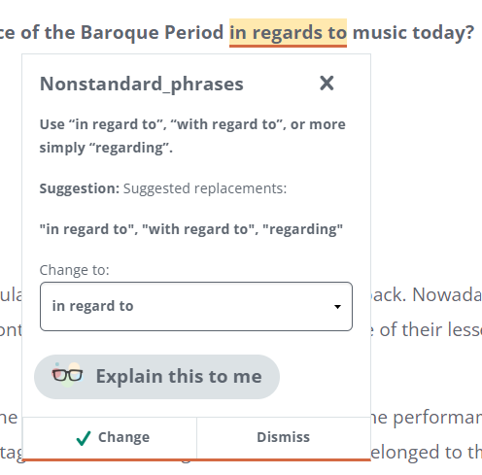
How to Use Deep Dives Feedback Summary:
Click into the categories that have suggestion(s) /Alerts to see your feedback
The best way to become a better writer is to learn from your mistakes. Therefore, Deep Dives does not provide auto-corrections.
Your goal as a student, is to ensure that your Feedback Summary circles are fully blue with zero suggestions remaining.
Once that is completed, you know you have a well written and cohesive paper to submit!
Read your suggestion and click “change”. If you need more help, click “Explain this to me” to chat with our AI bot for more help!

Slide 19
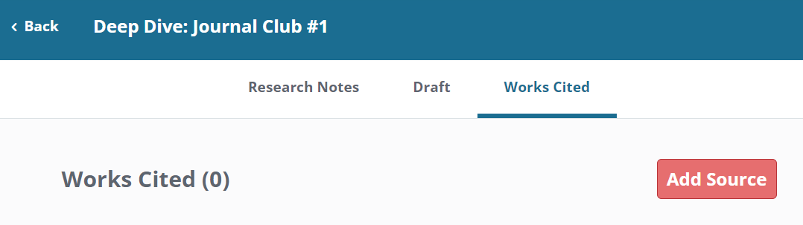
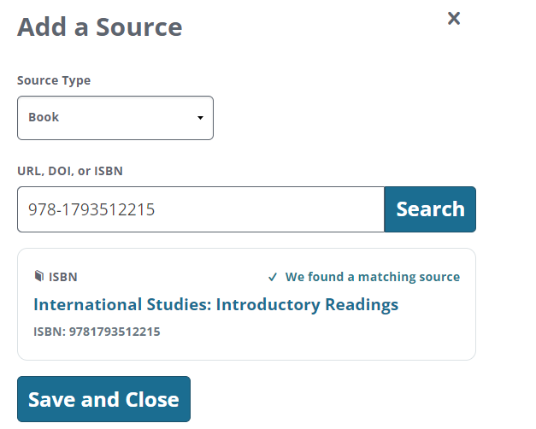
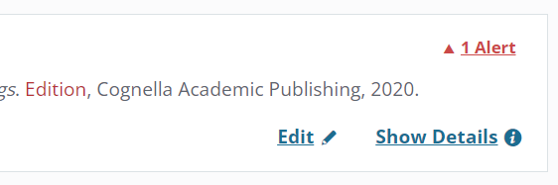
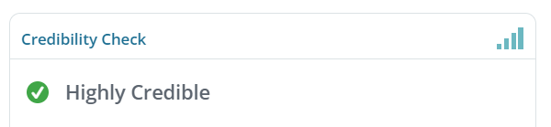
How to Add a Source:
Packback’s AI will grade you on the sources you insert under the Work Cited Tab.
Listing your sources at the bottom of your paper will not be counted and will interfere with your Grammar & Mechanics and Formatting & Presentation grades!
Input the source type and identifying information then click “Search” - our system should find a matching source!
Packback’s AI will grade you on the number of sources you use as the credibility of those sources.
“Credible” and “Highly Credible” will help you receive full credit for your Research Quality grade!
As a note: Your professor is the final decision maker on your grade as they are the content expert!
Check for any alerts (missing info) and edit the red text.
Check the Credibility of your source!

Slide 20
Submissions on Packback are reviewed by AI
Packback’s Originality Report:
Packback’s AI “flags” submissions that violate the originality report guidelines.
Offending posts are moderated and Packback informs your professor directly upon submission.
Packback’s AI flags for:
Plagiarism
(copied from sources)
AI-Generated Responses
(ChatGPT, etc)
Side-by-Side Comparison
(matches other Packback submissions)

Slide 21
How to Check Grades & Sync Them to the Gradebook

Slide 22
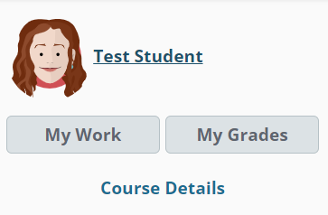
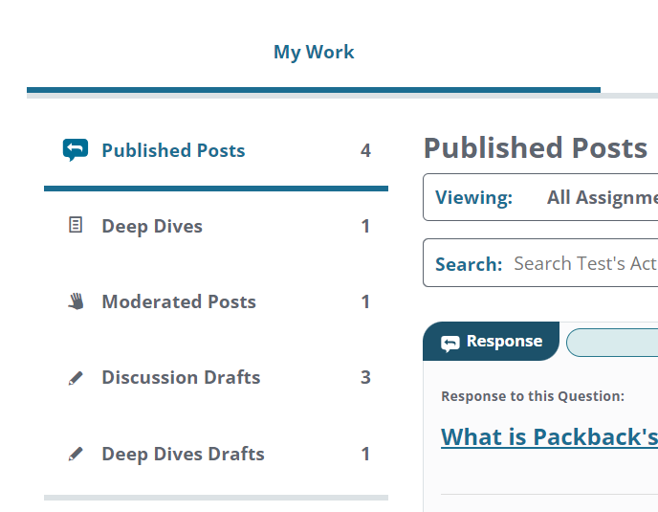

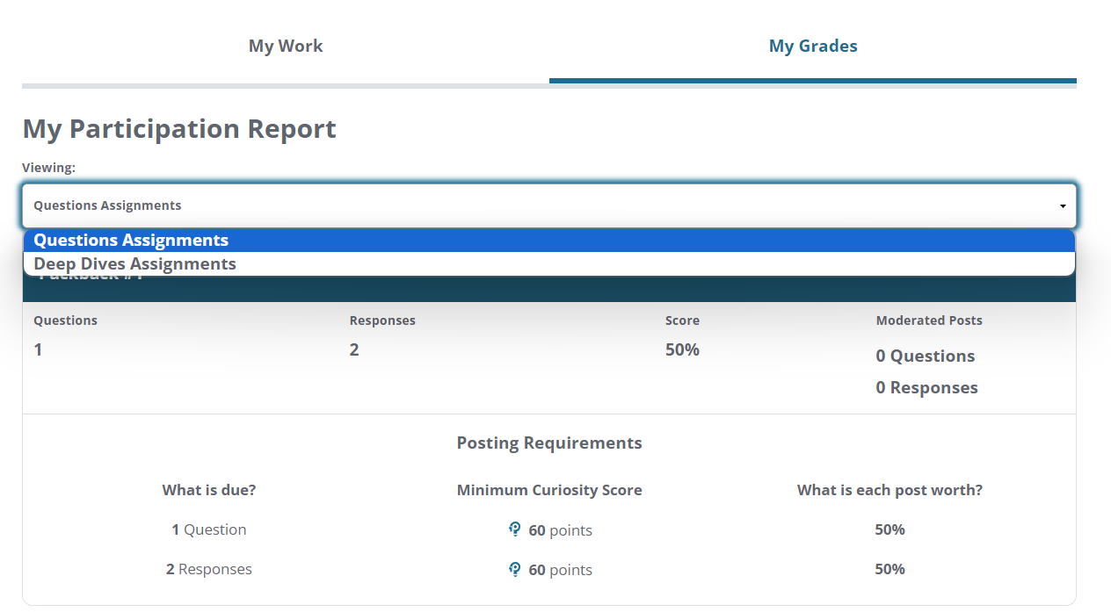
Track your participation
Your Name
Find your name and avatar in the top left corner - if you do not see this, click this icon to expand the menu:
Under “My Work” you can see all of your posted assignments, drafts, and your moderated posts.
Under “My Grades” you can see your grades for all of your assignments.
Note: If you completed the required amount of posts and do not have a 100%, this would indicate that you need to raise your curiosity score for one or more of your posts! (as seen in the example to the left)

Slide 23
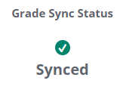
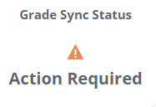
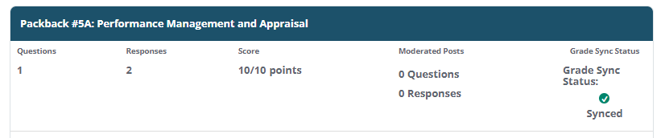
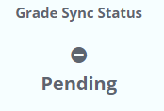
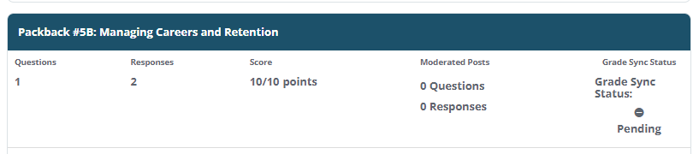
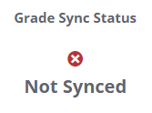
You are responsible for your gradebook sync!
What do the “Grade Sync Status” symbols mean?
Under the “My Grades” tab you can check your sync status for your assignments.
Your grade has successfully synced! No further action required.
You have not yet synced your gradebook. Please click the correlating assignment in your LMS
Your grade has successfully synced! It will update when the next deadline falls.
Email help@packback.co for assistance
Note: This student has a 10/10 so they are done with this assignment. They are waiting for the deadline to end for their grade to send over to their gradebook (pending)!

Slide 24
How to send my Packback grade to the Blackboard gradebook?
Only access Packback via D2L to activate the grade transfer process:
Go to your course on D2L
2. Click the link for a Packback assignment you want to sync.
3. Allow Packback to load so you see the community feed.
For your grade to transfer from Packback to Blackboard you must do this for ONE assignment. You can still activate the assignment if the deadline is passed.
Questions?
If you have any issues getting your grade to transfer to Blackboard, please email help@packback.co

Slide 25
Getting Registered
& Getting Help

Slide 26
Registering for Packback
Register via D2L
Go to your course on D2L
Select the first Packback Assignment
Follow the instructions on your screen to finish your registration.
If you have any questions or concerns about Packback throughout the semester, please read their FAQ at help.packback.co
Questions?
If you have any questions or concerns about getting registered on Packback, please email help@packback.co

Slide 27
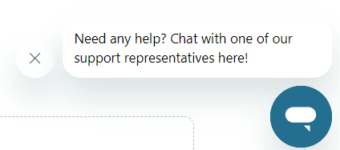
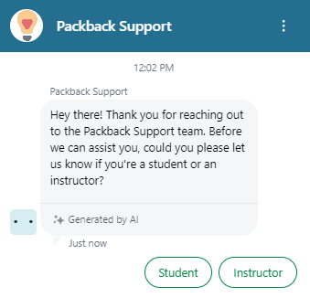
Need Help?
Do NOT email your professor with Packback issues; the Packback help team will be able to assist you faster!
Option 2: Chat with the AI Generated Support
Click the blue message icon on the bottom right hand side of your PB page.
Option 1: Email help@packback.co to chat with a real person!
Packback’s support team is available 7 days a week via email, and will help you will all technical issues.
You will hear back from a Packback member within 48 hours
Note: Response time is dependent on the issue reported and the time needed to be invested into the problem.
Choose student, answer the first few prompted questions, then you’ll be directed to the corresponding help articles!

